Slide 1
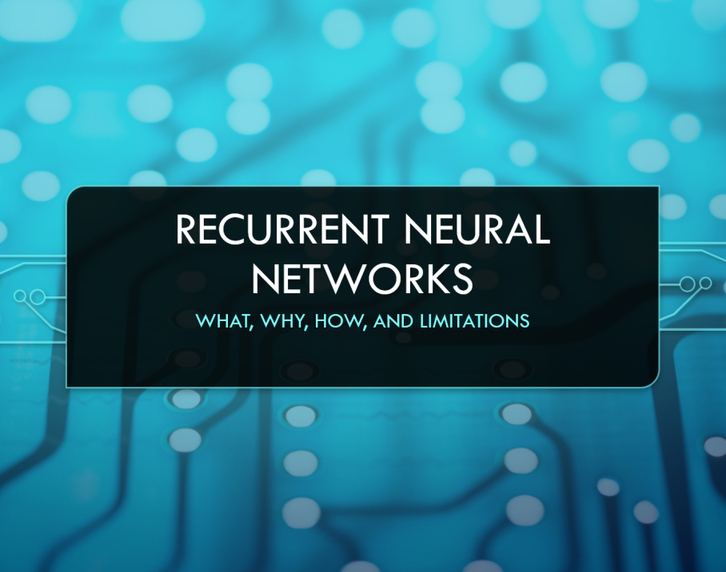

Topic: Recurrent Neural Networks (RNN & LSTM)
Present Date: 2023/11/08
Presenter: 何哲平 (Ho, Che-Ping)
Student ID: 111C71008
Class: 人工智慧科技學位學程碩士班

Slide 2
Outline
RNN (Recurrent Neural Networks)
Why do we need RNN?
What the function of RNN?
The limitation of RNN?
LSTM (Long Short-Term Memory )
Why do we need LSTM?
What the function of LSTM?
The limitation of LSTM?

Slide 3
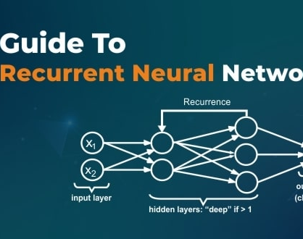
RNN (Recurrent Neural Networks)
Why do we need RNN?
What the function of RNN?
The limitation of RNN?

Slide 4
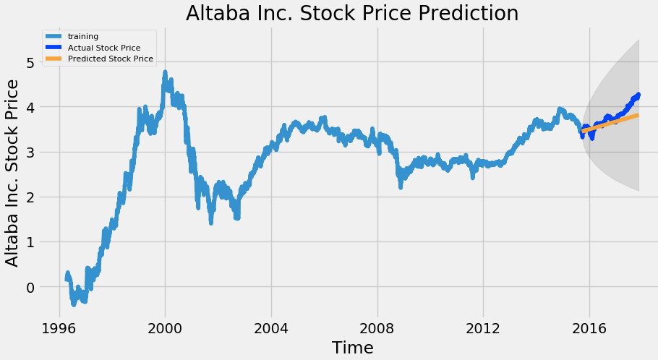
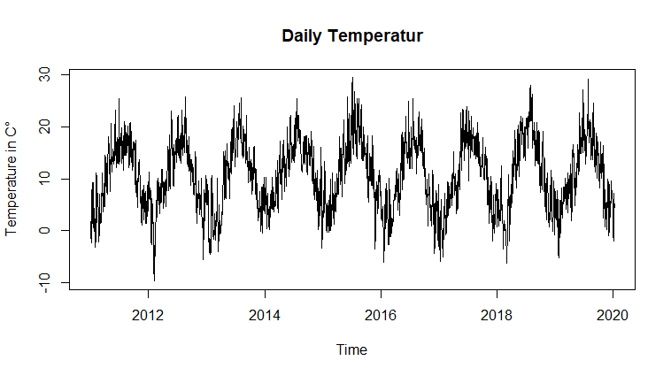
RNN (Recurrent Neural Networks)
Temperature Series Data
〔Think〕
Why do need RNN?
To solve or process time series data problem.
How is about other neural networks, such as MLP?
The Feed Forward Networks, such as convolutional neural networks, does not consider the temporal states
What is time series data?
A sequence of data points indexed in time order.
Example: Temperature, Speech, or Stock Price.
Stock Price Series Data
Notes:
In other words, feed forward networks does not consider the relationship between current sample and the previous samples.
For some kind of data, especially time series data, the relationship between current and previous symbols is very important.
EX. For stock-price data, we need to use the previous price to predict next price.

Slide 5
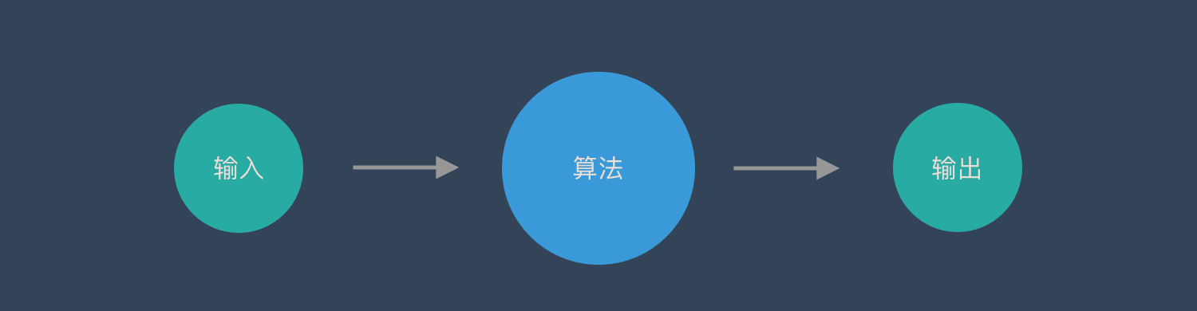

RNN (Recurrent Neural Networks)
Illustration of traditional neural network, such as feed forward network.
Feed Forward Network
Model
Input
Output
Prediction:
Dog
One input corresponds to one output.
Notes:
卷積神經網路– CNN和普通的演算法大部分都是輸入和輸出的一一對應，也就是一個輸入得到一個輸出。不同的輸入之間是沒有關聯的。

Slide 6
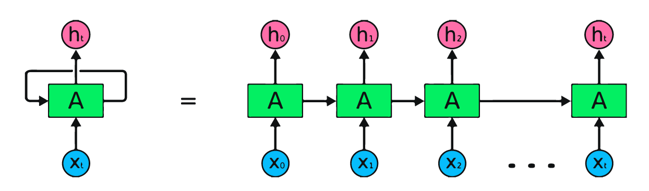
RNN (Recurrent Neural Networks)
Illustration of the Structure of RNN:
Use a loop, called Recurrent Connection resending the output back to itself, to memorize the previous information.
When the next output comes in, RNN will calculate the new output based on current input and the previous output.
Output
Recurrent
Connection
RNN
Input

Slide 7
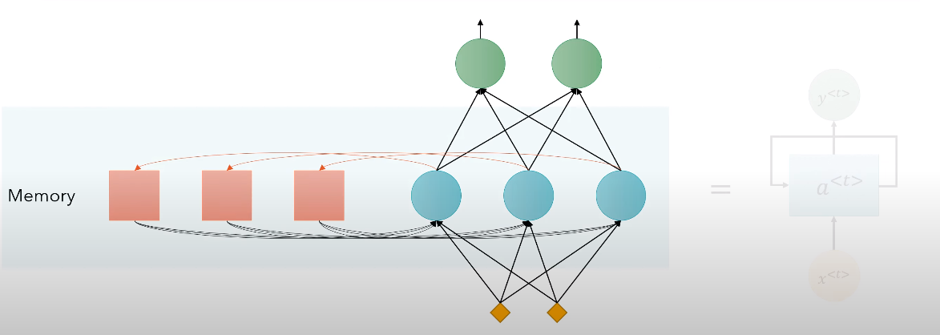
RNN (Recurrent Neural Networks)
To make it simple, RNN is an artificial neural network with memory.
Output
Hidden Layer
Memory:
Remember the previous output, so recurrent neural networks can memorize previous data in the previous state.
Input

Slide 8
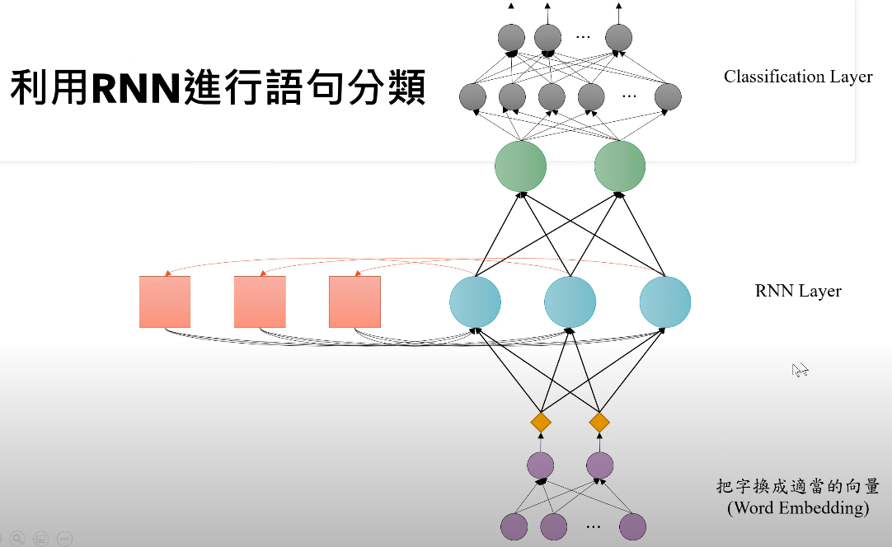
RNN (Recurrent Neural Networks)
Effective for speech recognition, language modeling, translation
〔Example：Classification〕
Classification Layer
Output
Positive or Negative review
RNN Layer
Code Tutorial:
https://youtu.be/ubDtr6dh0c8?si=_oF5MRoCfC1ReKf2
Word Embedding
Input
EX. "customer reviews"
Notes:
customer reviews: https://raw.githubusercontent.com/SophonPlus/ChineseNlpCorpus/master/datasets/waimai_10k/waimai_10k.csv

Slide 9

RNN (Recurrent Neural Networks)
However, RNN faces problem while encountering long series data.
For example: If we ask the time “ What time is it?”
We put the vocabulary as input in order.
Long-Term
Short-Term
The impact on short-term memory is greater,
but the impact on long-term memory is very small.

Slide 10

RNN (Recurrent Neural Networks)
What if we ask the cloze test like this,
I grew up in France and as a result, I speak fluent __________.
Of course, we know the answer is (D)French, because
we can integrate the entire text to fill in a certain sentence.
〔Options〕
A.) Chinese
B.) Mandarin
C.) Indonesian
D.) French
However, if the network (RNN) only knows a few nearby words, it may know that a language needs to be filled in here.
But which language should be filled in? It needs to find more information further back.
When the length of sentence increases, the ability of RNN to connect related information becomes weaker.

Slide 11
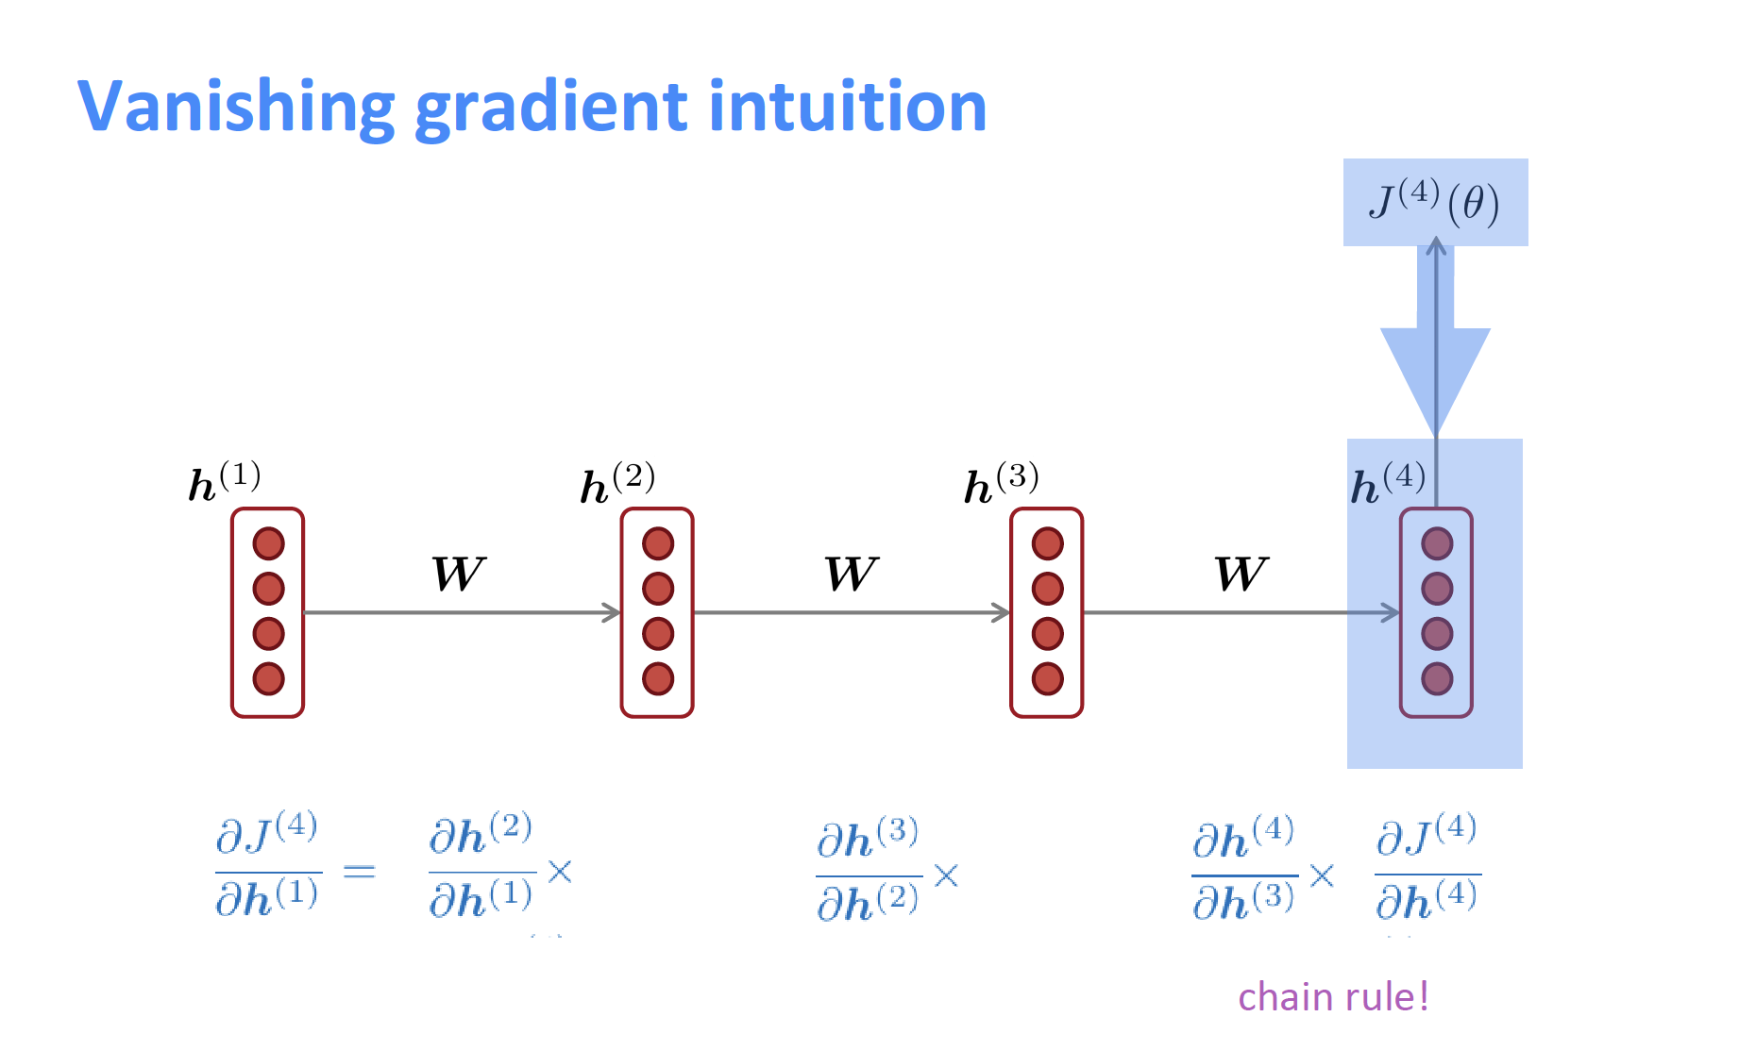
RNN (Recurrent Neural Networks)
Limitation of RNN
Performs not well at long-term memory.
Moreover
Easy to learn, however, Hard to train. (Hidden states tend to exponentially explode or vanish.)
Vanishing / Exploding Gradient Problems
If we unroll RNN in the time domain, the weight matrix, the back propagation through time (BPTT), still needs to go back to multiple layers, like deep neural network.
Through multiple partial differentiation (偏微分) will cause the gradient to disappear, which makes it difficult for us to find the relationship between vocabularies in long sequences.
*What is Vanishing Gradient Problem? When we try to update parameters, the gradient will decrease with the number of layers passed, making the parameters of the model updated very slowly, even difficult to continue training.

Slide 12

RNN (Recurrent Neural Networks)
Application of RNN
NLP (Natural Language Processing)
Chatbot
Speech Recognition
Language Translation
Image Captioning

Slide 13
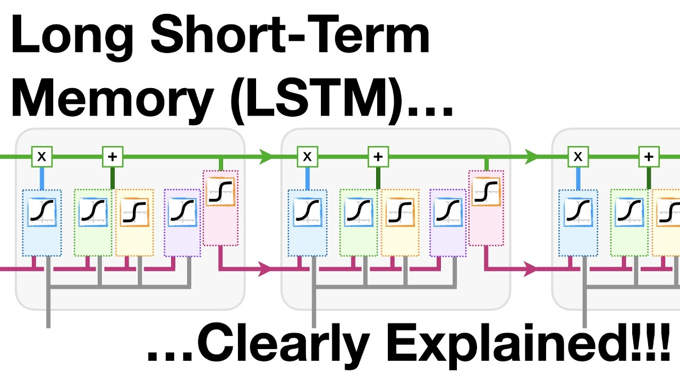
LSTM (Long Short-Term Memory )
Why do we need LSTM?
What the function of LSTM?
The limitation of LSTM?

Slide 14
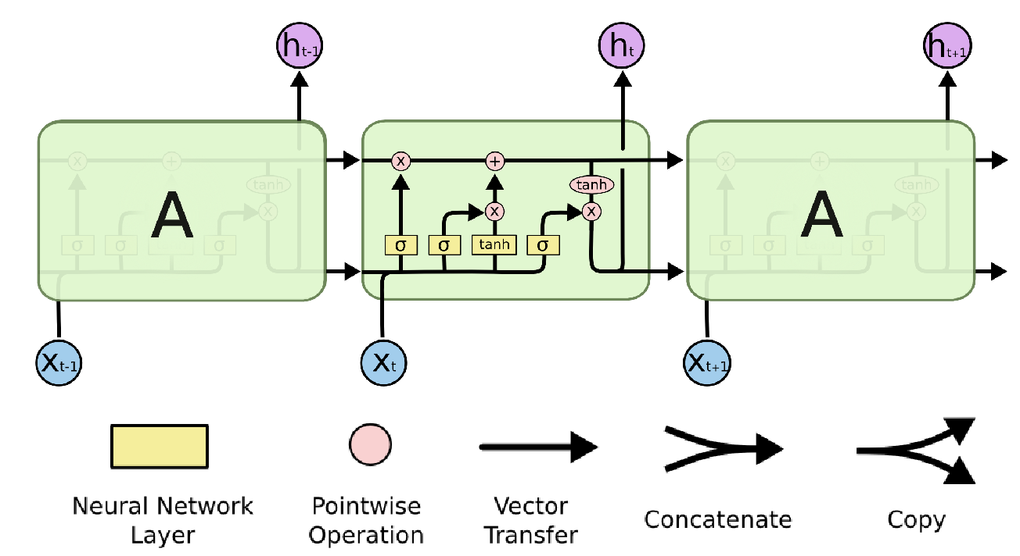
LSTM (Long Short-Term Memory)
〔Think〕 How to solve the memory problem of RNN?
LSTM modify the hidden layer and add three gates:
Input Gate: Control when to let new input in.
Forget Gate: Delete the trivial information.
Output Gate: Let the info impact the output at the current time step.
The paper of LSTM was published in 1997 by Hochreiter & Schmidhuber.

Slide 15
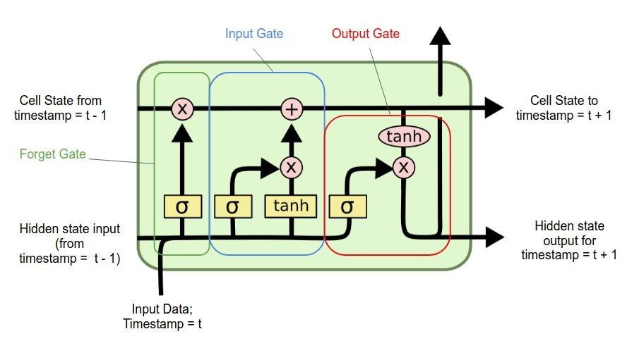
LSTM (Long Short-Term Memory)
Other Part of the network
Illustration of the Structure of LSTM:
Output Gate
Try to make it simple.
Forget Gate
Memory Cell
I draw like this
Input Gate
A little bit complicated.
Other Part of the network

Slide 16
LSTM (Long Short-Term Memory)
Step-by-Step Explanation:

Slide 17
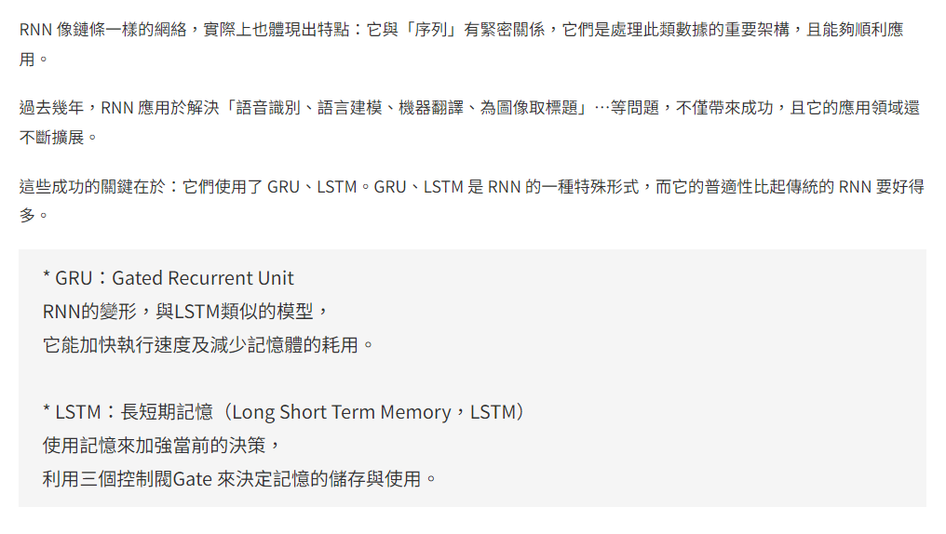
Note

Slide 18

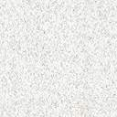
Reference
RNN
LSTM
GRU

Slide 19
Reference
〔RNN〕
recurrent neural network RNN in python https://www.youtube.com/watch?v=Dj7Bkhf3ccw
什麼是循環神經網路 Recurrent Neural Networks, RNN？ https://blog.tibame.com/?p=19075

