Slide 1
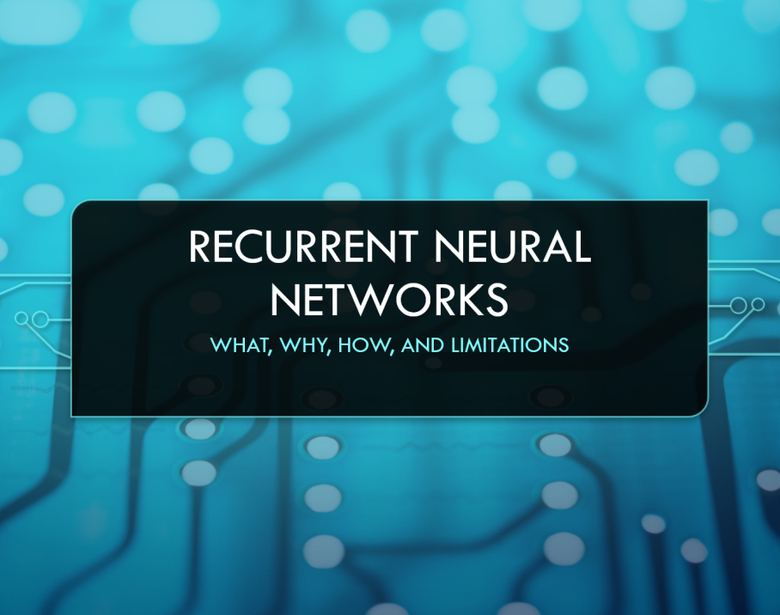

Topic: Recurrent Neural Networks (RNN & LSTM)
Present Date: 2023/11/08
Presenter: 何哲平 (Ho, Che-Ping)
Student ID: 111C71008
Class: 人工智慧科技學位學程碩士班

Slide 2
Outline
RNN (Recurrent Neural Networks)
Why do we need RNN?
What the function of RNN?
The limitation of RNN?
LSTM (Long Short-Term Memory )
Why do we need LSTM?
What the function of LSTM?
The limitation of LSTM?

Slide 3
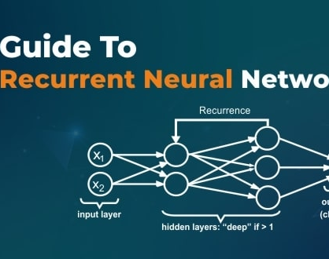
RNN (Recurrent Neural Networks)
Why do we need RNN?
What the function of RNN?
The limitation of RNN?

Slide 4
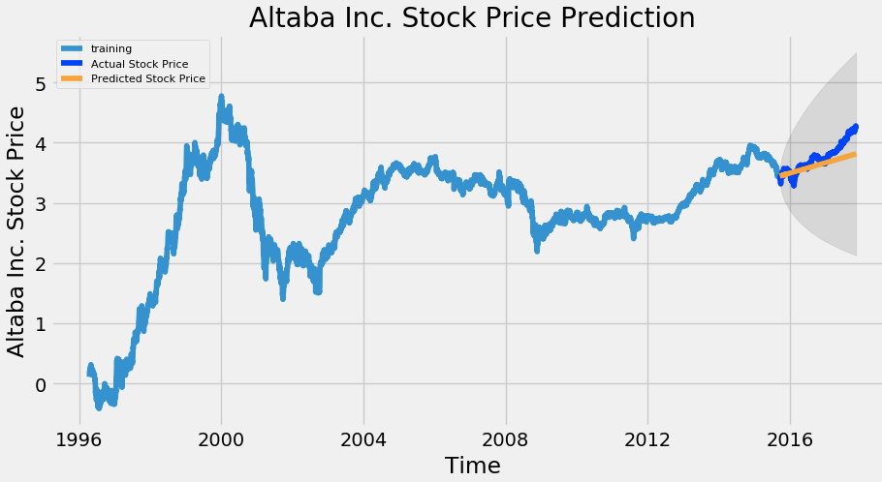
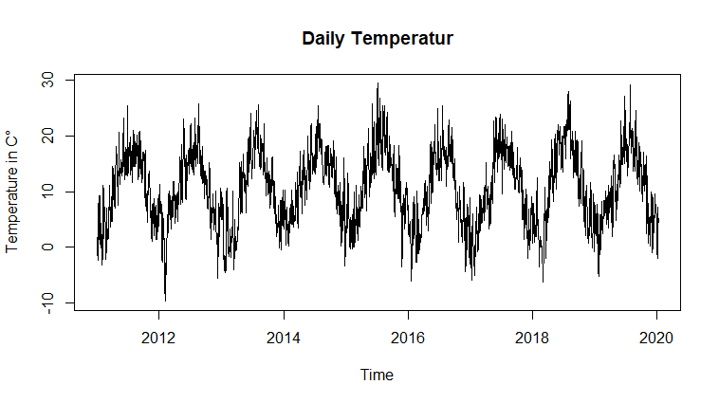
RNN (Recurrent Neural Networks)
Temperature Series Data
〔Think〕
Why do need RNN?
To solve or process time series data problem.
How is about other neural networks, such as MLP?
The Feed Forward Networks, such as convolutional neural networks, does not consider the temporal states
What is time series data?
A sequence of data points indexed in time order.
Example: Temperature, Speech, or Stock Price.
Stock Price Series Data
Notes:
In other words, feed forward networks does not consider the relationship between current sample and the previous samples.
For some kind of data, especially time series data, the relationship between current and previous symbols is very important.
EX. For stock-price data, we need to use the previous price to predict next price.

Slide 5
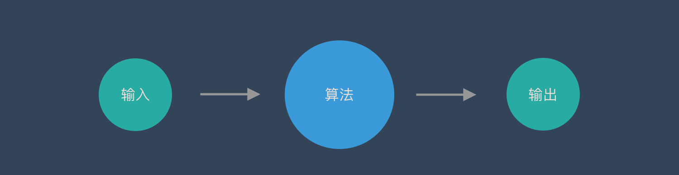

RNN (Recurrent Neural Networks)
Illustration of traditional neural network, such as feed forward network.
Feed Forward Network
Model
Input
Output
Prediction:
Dog
One input corresponds to one output.
Notes:
卷積神經網路– CNN和普通的演算法大部分都是輸入和輸出的一一對應，也就是一個輸入得到一個輸出。不同的輸入之間是沒有關聯的。

Slide 6
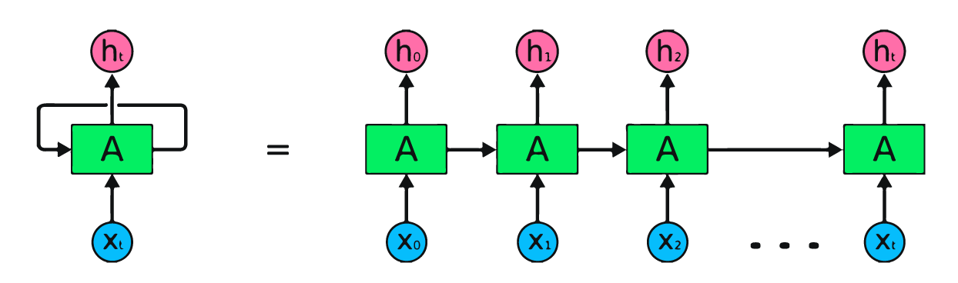
RNN (Recurrent Neural Networks)
Illustration of the Structure of RNN:
Use a loop, called Recurrent Connection resending the output back to itself, to memorize the previous information.
When the next output comes in, RNN will calculate the new output based on current input and the previous output.
Output
Recurrent
Connection
RNN
Input

Slide 7
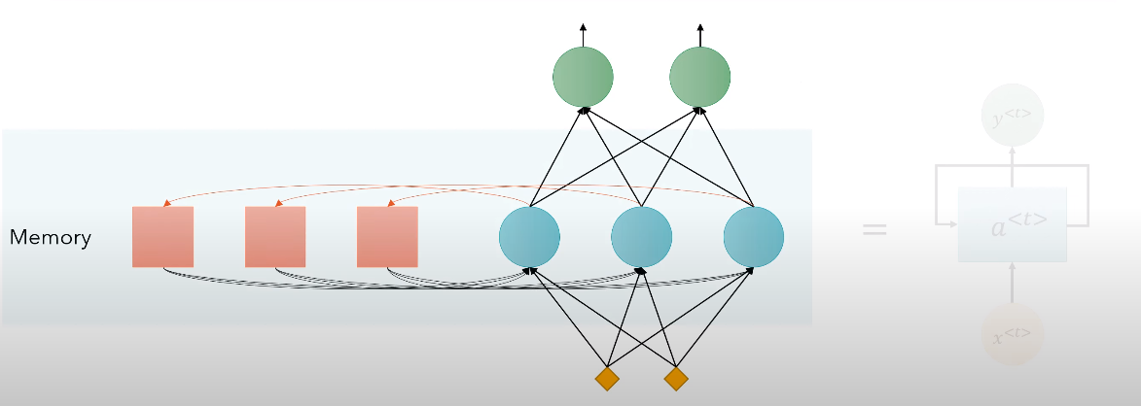
RNN (Recurrent Neural Networks)
To make it simple, RNN is an artificial neural network with memory.
Output
Hidden Layer
Memory:
Remember the previous output, so recurrent neural networks can memorize previous data in the previous state.
Input

Slide 8
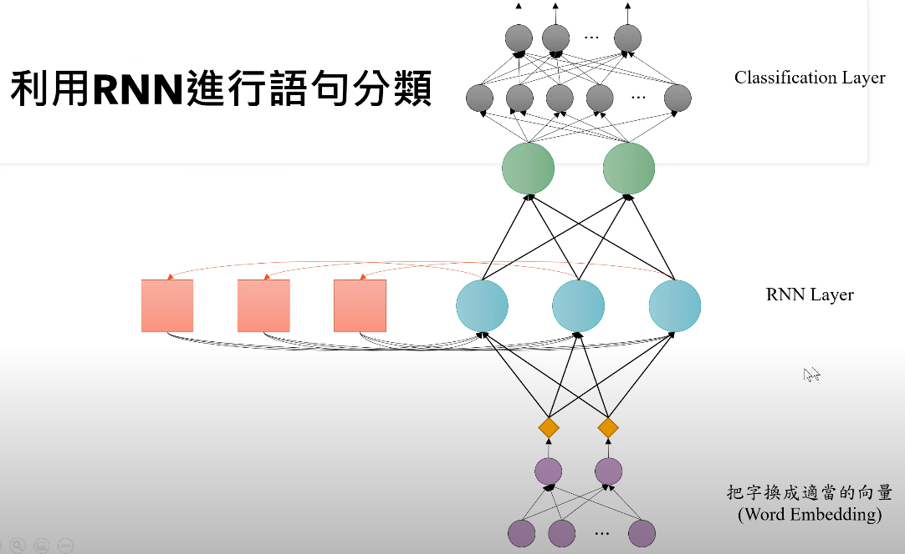
RNN (Recurrent Neural Networks)
Effective for speech recognition, language modeling, translation
〔Example：Classification
Many-to-One Problem〕
Classification Layer
Output
Positive or Negative review
RNN Layer
Code Tutorial:
https://youtu.be/ubDtr6dh0c8?si=_oF5MRoCfC1ReKf2
Word Embedding
Input
EX. "customer reviews"
Notes:
customer reviews: https://raw.githubusercontent.com/SophonPlus/ChineseNlpCorpus/master/datasets/waimai_10k/waimai_10k.csv

Slide 9
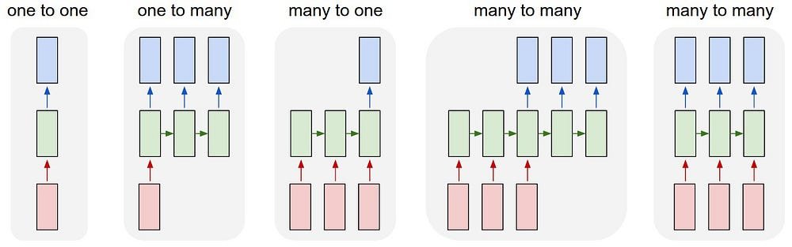
RNN (Recurrent Neural Networks)
The strength of RNN is that it allows the input and output data to be not just a single set of vectors, but a sequence of multiple sets of vectors.
Type | Example
One-to-One | Classification
One-to-Many | Image Captioning
Many-to-One | Sentiment Analysis Text Classification
Many-to-Many | Translation Video Classification
Notes:
淺談遞歸神經網路 (RNN) 與長短期記憶模型 (LSTM) https://tengyuanchang.medium.com/%E6%B7%BA%E8%AB%87%E9%81%9E%E6%AD%B8%E7%A5%9E%E7%B6%93%E7%B6%B2%E8%B7%AF-rnn-%E8%88%87%E9%95%B7%E7%9F%AD%E6%9C%9F%E8%A8%98%E6%86%B6%E6%A8%A1%E5%9E%8B-lstm-300cbe5efcc3
LSTM RNN in Keras: Examples of One-to-Many, Many-to-One & Many-to-Many https://wandb.ai/ayush-thakur/dl-question-bank/reports/LSTM-RNN-in-Keras-Examples-of-One-to-Many-Many-to-One-Many-to-Many---VmlldzoyMDIzOTM
RNN 與 LSTM 的強大效果以及應用方向
遞歸神經網路強大的地方在於它允許輸入與輸出的資料不只是單一組向量，而是多組向量組成的序列。當只能一組固定大小的向量輸入，且只允許一組向量輸出時時，可以處理分類問題。但一組輸入多組輸出時，就可以處理將圖片自動標上文字的問題。多組輸入一組輸出則可以處理文本的情感理解，比如說從一段文章中知道是正面或反面的結果。而當可以處理多組輸入，多組輸出時，就可以處理自動翻譯，或是影片分類的問題。

Slide 10

RNN (Recurrent Neural Networks)
However, RNN faces problem while encountering long series data.
For example: If we ask the time “ What time is it?”
We put the vocabulary as input in order.
Long-Term
Short-Term
The impact on short-term memory is greater,
but the impact on long-term memory is very small.

Slide 11

RNN (Recurrent Neural Networks)
What if we ask the cloze test like this,
I grew up in France and as a result, I speak fluent __________.
Of course, we know the answer is (D)French, because
we can integrate the entire text to fill in a certain sentence.
〔Options〕
A.) Chinese
B.) Mandarin
C.) Indonesian
D.) French
However, if the network (RNN) only knows a few nearby words, it may know that a language needs to be filled in here.
But which language should be filled in? It needs to find more information further back.
Unfortunately, as that gap grows, RNNs become unable to learn to connect the information.

Slide 12
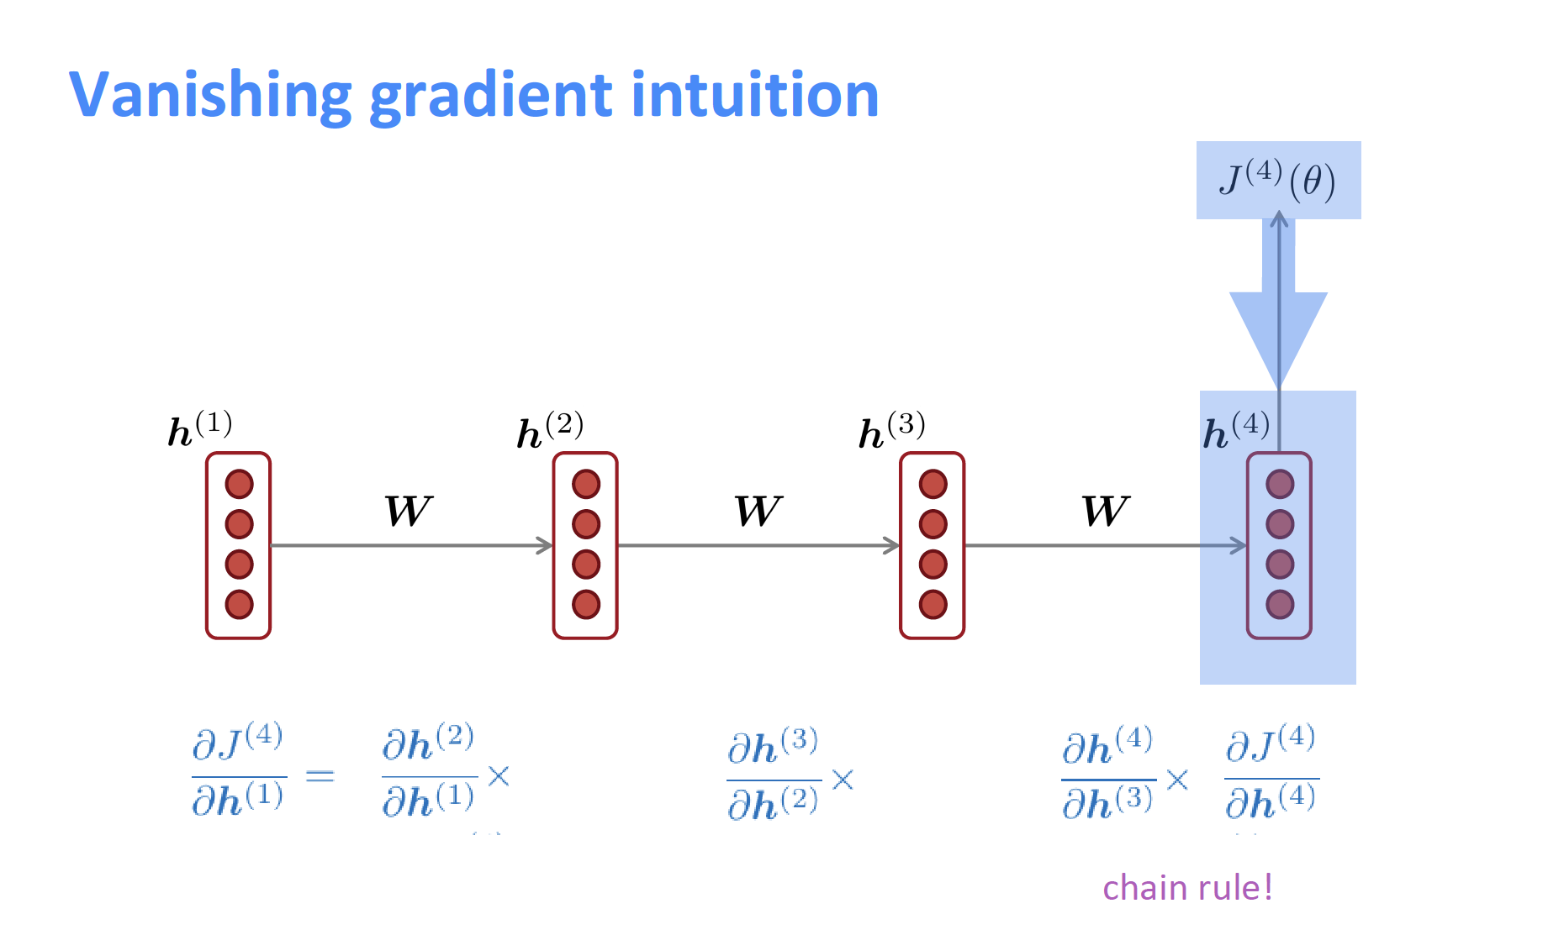
RNN (Recurrent Neural Networks)
Limitation of RNN
Performs not well at long-term memory. (The later the input, the greater the impact, and the earlier the input, the smaller the impact.)
Moreover
Easy to learn, however, Hard to train. (Hidden states tend to exponentially explode or vanish.)
Vanishing / Exploding Gradient Problems
If we unroll RNN in the time domain, the weight matrix, the back propagation through time (BPTT), still needs to go back to multiple layers, like deep neural network.
Through multiple partial differentiation (偏微分) will cause the gradient to disappear, which makes it difficult for us to find the relationship between vocabularies in long sequences.
*What is Vanishing Gradient Problem? When we try to update parameters, the gradient will decrease with the number of layers passed, making the parameters of the model updated very slowly, even difficult to continue training.

Slide 13

RNN (Recurrent Neural Networks)
Application of RNN
NLP (Natural Language Processing)
Chatbot
Speech Recognition
Language Translation
Image Captioning

Slide 14
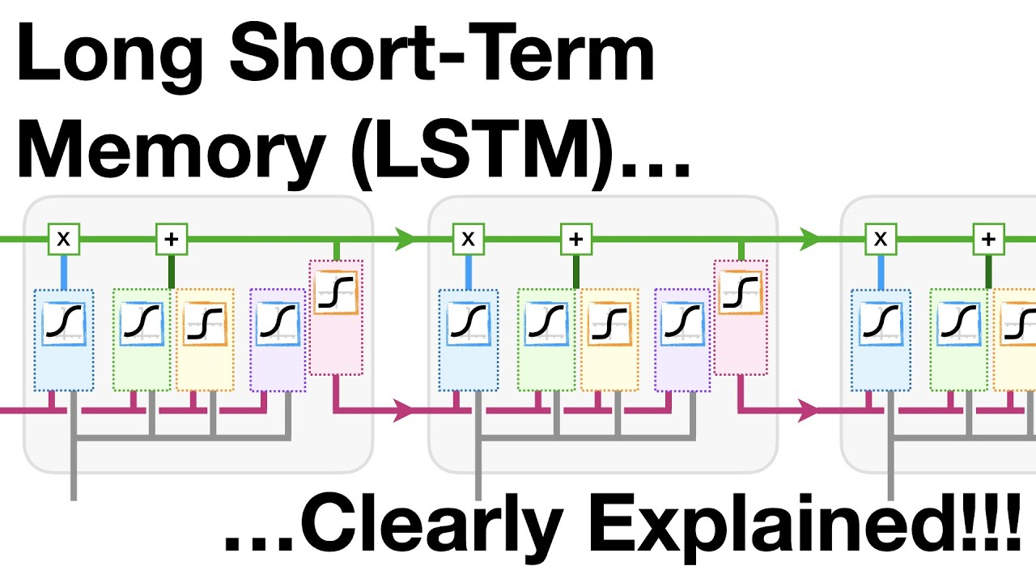
LSTM (Long Short-Term Memory )
Why do we need LSTM?
What the function of LSTM?
The limitation of LSTM?

Slide 15
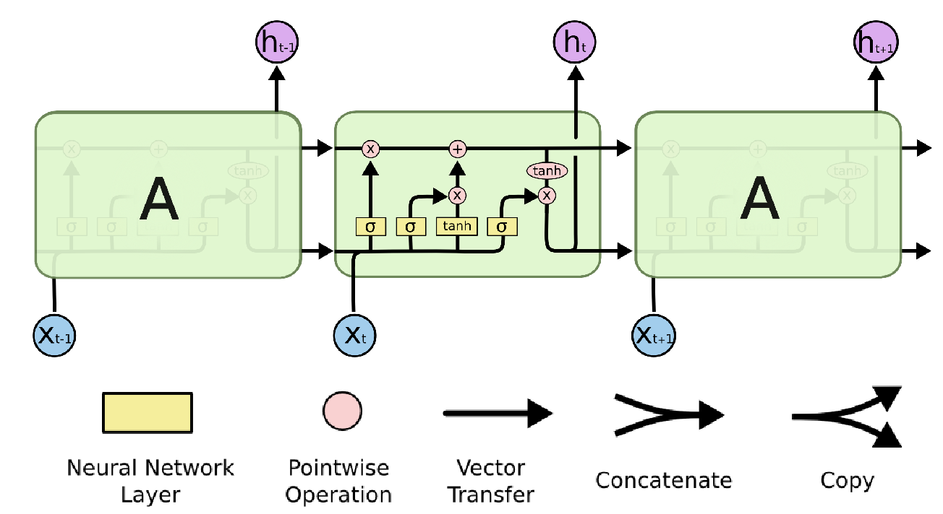
LSTM (Long Short-Term Memory)
LSTM :
Introduced by Hochreiter & Schmidhuber in 1997.
Explicitly designed to avoid the long-term dependency problem.
Instead of having a single neural network layer, there are four, interacting in a very special way.
Furthermore, add multiple gates (input gate, forget gate, and output gate).
(Result) Work tremendously well on a large variety of problems, and now widely used.

Slide 16
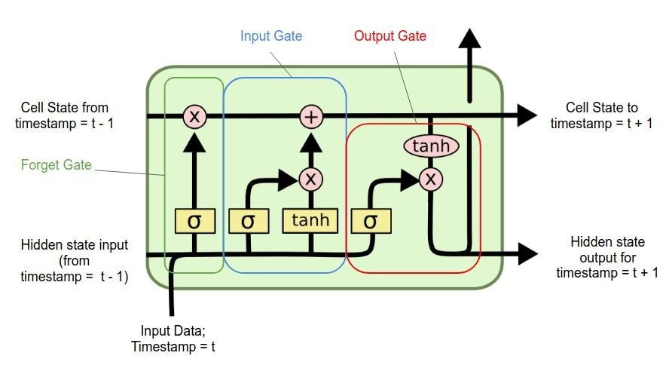
LSTM (Long Short-Term Memory)
Three important gates in LSTM Model:
Function:
Keep important information in longer sequence data and ignore unimportant information, solving the problem of RNN short-term memory.
Input Gate: Control when to let new input in or ignore, how much input information to pass into the cell state.
Output Gate: Let the information impact the output at the current time step or not. Control how much information to pass to the next stage.
Forget Gate: Delete the trivial information, simulating the ability of human that we usually forget some trivial things .
Other Part of the network
Output Gate
Memory Cell
Forget Gate
Input Gate
Other Part of the network

Slide 17
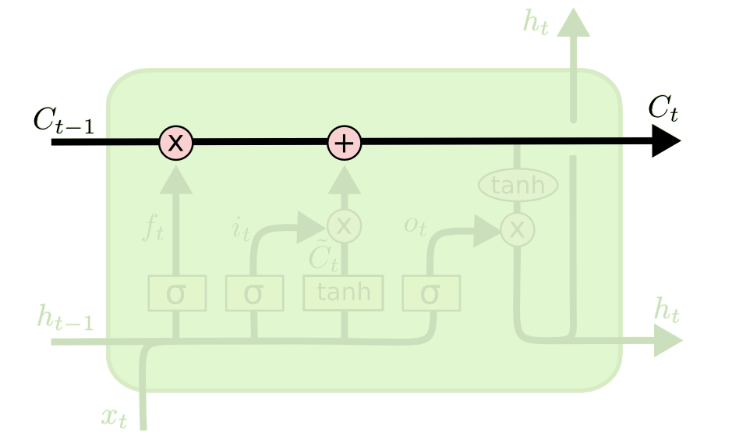
LSTM (Long Short-Term Memory)
Step-by-Step Explanation of LSTM Structure
Cell State:
The Core Idea Behind LSTMs.
Horizontal line running through the top of the diagram.
Like conveyor belt, runs straight down the entire chain, with only some minor linear interactions.
Save the state information, easy and allow information to just flow along it without any change.

Slide 18
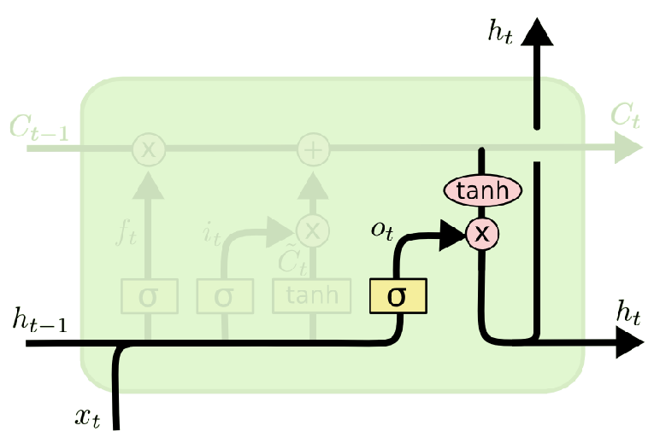
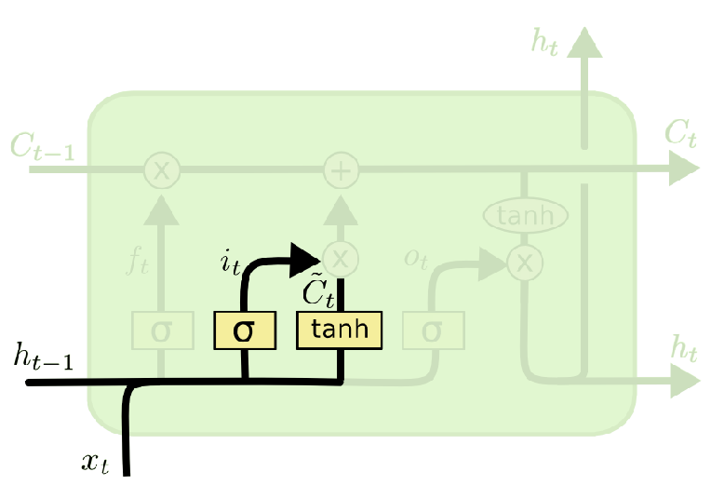
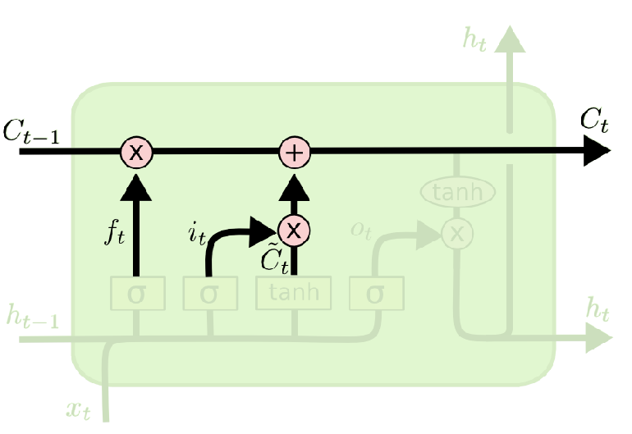
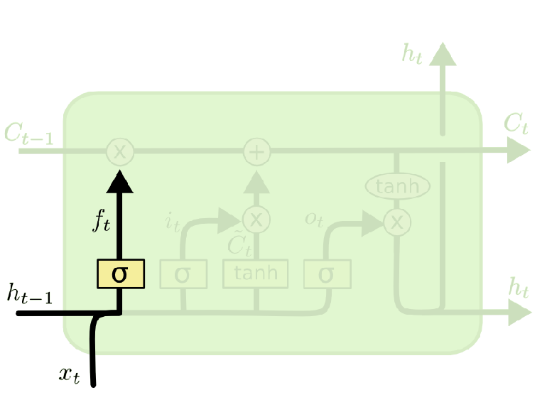
LSTM (Long Short-Term Memory)
Step-by-Step Explanation of LSTM Structure
1st Step: Decide what information to throw away.
This layer called “Forget Gate” made by sigmoid layer, which outputs numbers between zero and one.
One represents “completely keep this”, while zero represents “completely get rid of this.”
2nd Step: Decide what new information to store.
This layer called “Input Gate” made by sigmoid layer decides which values to update.
3rd Step: Update the old cell state into the new cell state.
4th Step: Decide what to output.

Slide 19
RNN (Recurrent Neural Networks)
Limitation of RNN
Performs not well at long-term memory. (The later the input, the greater the impact, and the earlier the input, the smaller the impact.)
Moreover
Easy to learn, however, Hard to train. (Hidden states tend to exponentially explode or vanish.)
Vanishing / Exploding Gradient Problems
If we unroll RNN in the time domain, the weight matrix, the back propagation through time (BPTT), still needs to go back to multiple layers, like deep neural network.
Through multiple partial differentiation (偏微分) will cause the gradient to disappear, which makes it difficult for us to find the relationship between vocabularies in long sequences.
*What is Vanishing Gradient Problem? When we try to update parameters, the gradient will decrease with the number of layers passed, making the parameters of the model updated very slowly, even difficult to continue training.

Slide 20
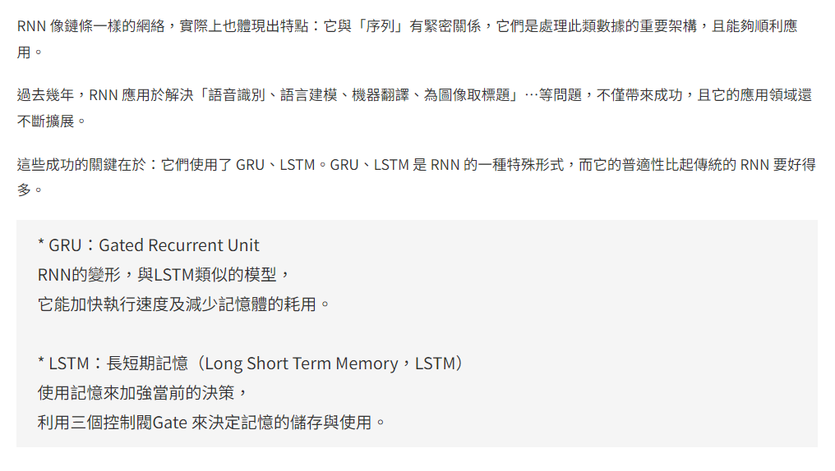
Note

Slide 21


Reference
RNN
LSTM
GRU

Slide 22
Reference
〔RNN〕
recurrent neural network RNN in python https://www.youtube.com/watch?v=Dj7Bkhf3ccw
什麼是循環神經網路 Recurrent Neural Networks, RNN？ https://blog.tibame.com/?p=19075

Slide 23
Reference
〔LSTM〕
淺談遞歸神經網路 (RNN) 與長短期記憶模型 (LSTM) https://tengyuanchang.medium.com/%E6%B7%BA%E8%AB%87%E9%81%9E%E6%AD%B8%E7%A5%9E%E7%B6%93%E7%B6%B2%E8%B7%AF-rnn-%E8%88%87%E9%95%B7%E7%9F%AD%E6%9C%9F%E8%A8%98%E6%86%B6%E6%A8%A1%E5%9E%8B-lstm-300cbe5efcc3

