Slide 1
Code Blocks

Slide 2
What Are Custom Blocks?
Custom blocks are our own special commands.
They make code easier to read and reuse.
Instead of repeating code, we just call the block!

Slide 3
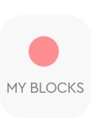
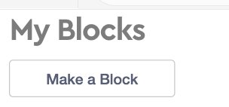
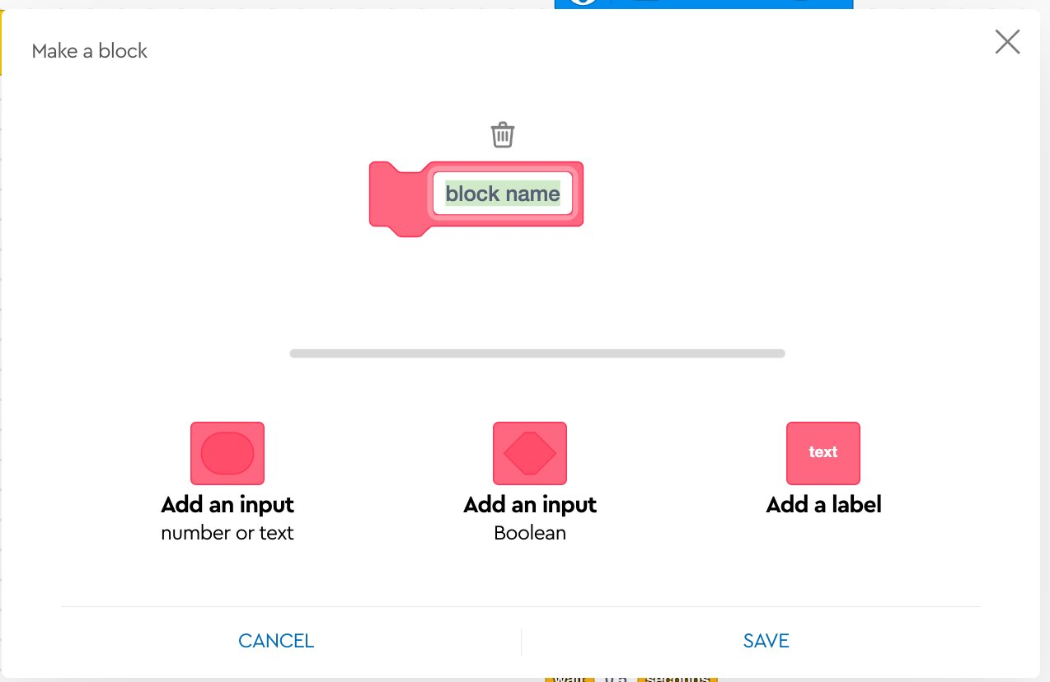
How to create a block!
Press on my block
Select make block
Name your block press save

Slide 4
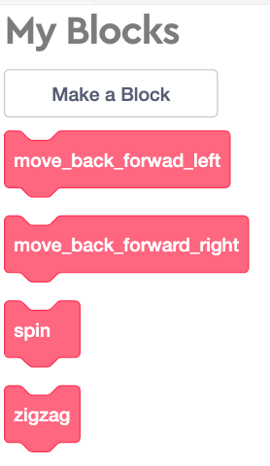
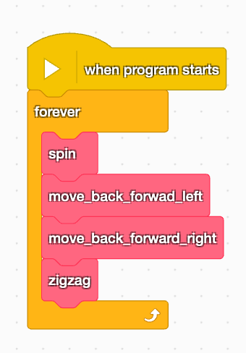
Use you code!

Slide 5

Dancing robot

Slide 6
We will create some custom blocks to make our robot dance!

Slide 7
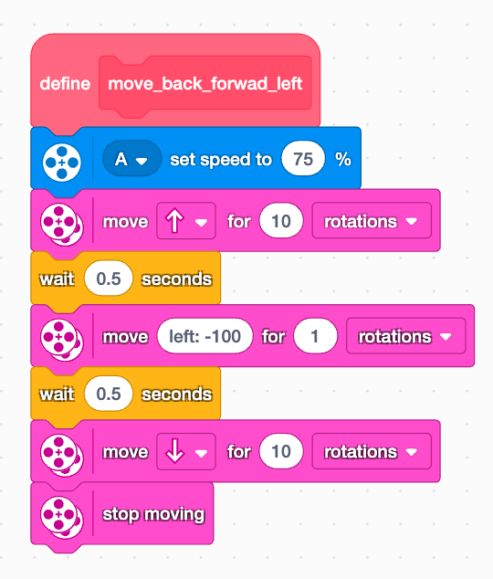
Back forward left

Slide 8
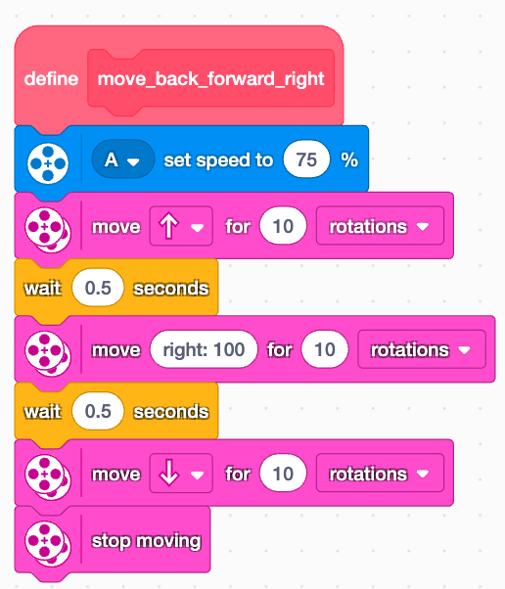
Back forward right

Slide 9
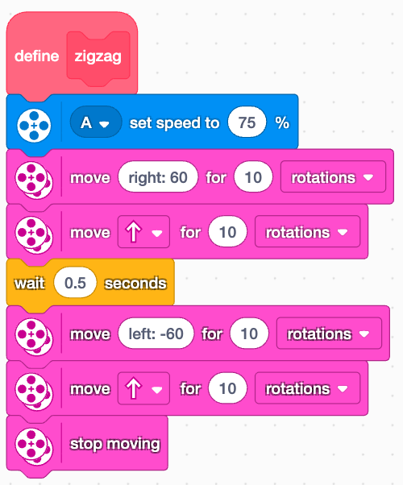
ZigZag

Slide 10
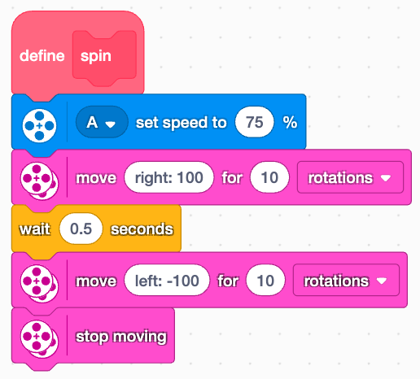
Spin

Slide 11
What ather moviments can you came up with?

