Slide 1
Ekthelius's Prototyping Trading Evidence: 04/12/2026~10/31/2026
The year's live fills, the average price drawn from them, and the market they ran in.
Every asset is labelled A01 to A40 and named nowhere.
9,052 fills on 40 bases, 12 Apr to 31 Oct
tools/build_product_manual.py, in write_evidence_deck

Slide 2
What the record holds
The fill record is the operator's own venue export. No row of it is reproduced here. Every figure is an aggregate over that record.
Reading | The newest export
Physical rows | 9,109
Body rows | 9,105
Fills on a charted base | 9,052
Charted bases | 40
First fill | 12 Apr
Last fill | 31 Oct
Rows carrying no fill | 53
Drops by cause | Deposit 15; Reward Income 24; Withdrawal 1; quote cash leg 13
tools/build_product_manual.py, in export_reading

Slide 3
How the average is drawn
A running sum of price times quantity over a running sum of quantity. The price is the export's Price at Transaction column.
A fee is a transaction cost and not a price, so the fee column stays out.
1 unit at $10 and 3 at $20 average 17.50, weighted by quantity. The unweighted mean of the two prices is 15.00, so a lost weighting would show as a gap of 2.50.
tools/build_product_manual.py, in trajectory

Slide 4
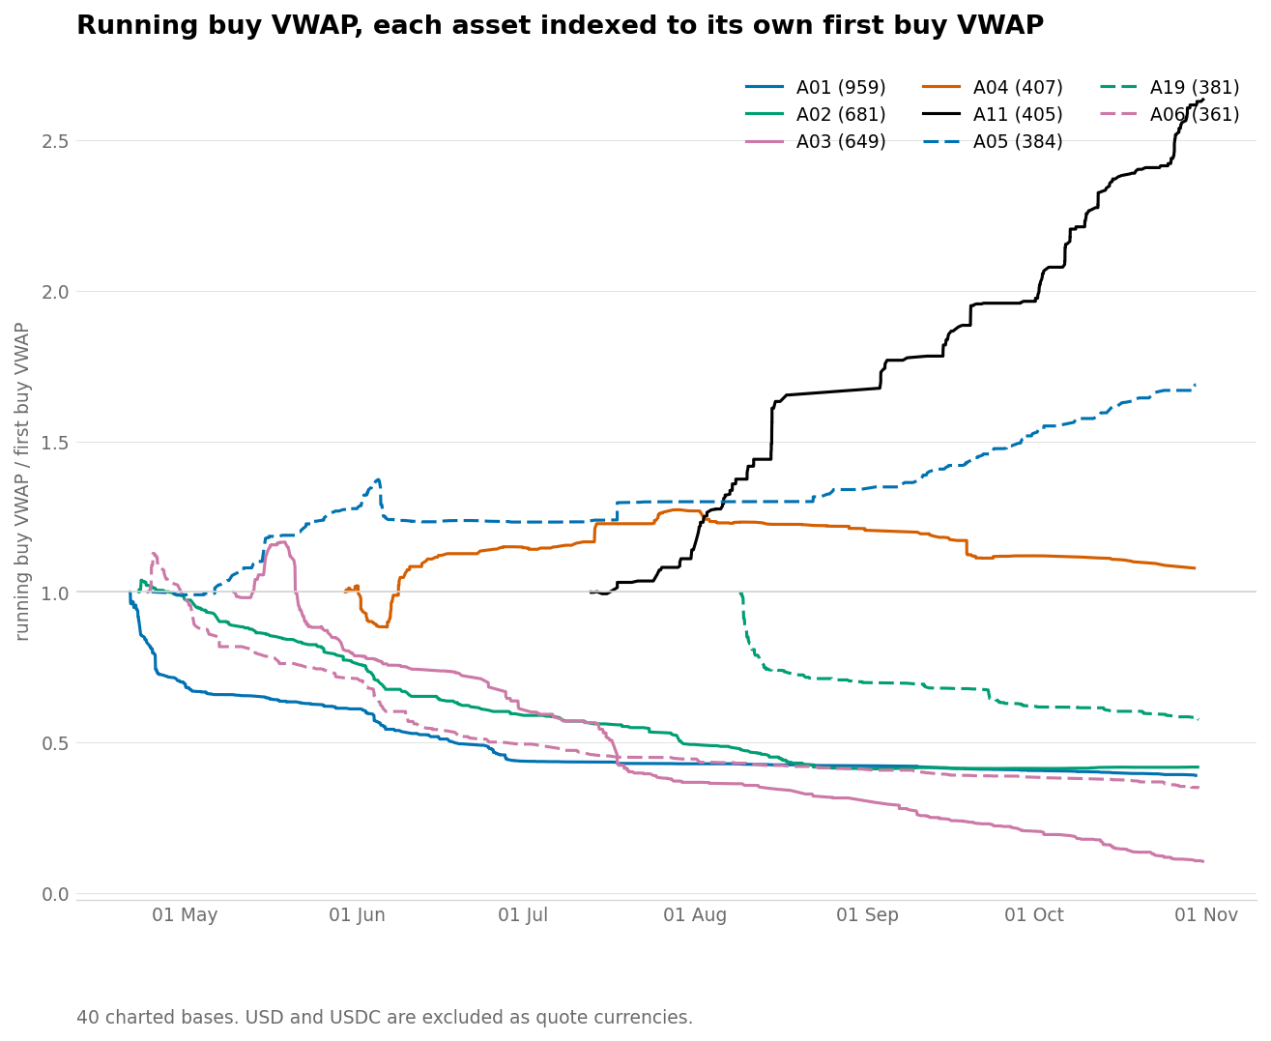
The eight most-traded bases on one scale
Each line is that base's running buy average divided by its own first value, so a base priced in cents and one priced in thousands share one axis.
figures/vwap_combined.png

Slide 5
Where the eight lines end
A falling line says the average cost of the units now held fell. It is not profit, and the index carries no sale in it at all.
Asset | Fills | First buy VWAP | Final buy VWAP | Final index
A01 | 959 | 1.5915 | 0.621713 | 0.391
A02 | 681 | 0.10842 | 0.0453699 | 0.418
A03 | 649 | 0.11868 | 0.0125314 | 0.106
A04 | 407 | 0.2478 | 0.267397 | 1.079
A11 | 405 | 0.01722 | 0.0453765 | 2.635
A05 | 384 | 359.67 | 606.914 | 1.687
A19 | 381 | 0.00395 | 0.00228008 | 0.577
A06 | 361 | 0.01581 | 0.00552588 | 0.350
tools/build_product_manual.py, in base_rows

Slide 6
Two readings, and neither stands in for the other
The trajectory
What the units now held cost on average. It keeps moving while the position is open, counts every buy, and carries no sale at all.
It says nothing about whether a sale ever cleared its cost.
The sell-over-buy ratio
Whether the trades already closed sold above what they cost. One settled figure per base across the whole record.
It counts only what completed on both sides, so it says nothing about the units still held.
tools/build_product_manual.py, in trajectory and sell_over_buy

Slide 7
The average sale against the average cost
Above 1.000 the average sale price beat the average buy price. The figure reads how the closed trades performed, and nothing else.
Reading | Value
Bases with four fills a side or more | 40
Finishing above 1.000 | 33
Finishing below 1.000 | 7
Landing exactly on 1.000 | 0
Highest | A29 at 1.212
Lowest | A20 at 0.909
Carrying no ratio | none
A base with three fills or fewer on a side carries no ratio, because a mean over so few fills moves with any one of them.
tools/build_product_manual.py, in sell_over_buy

Slide 8
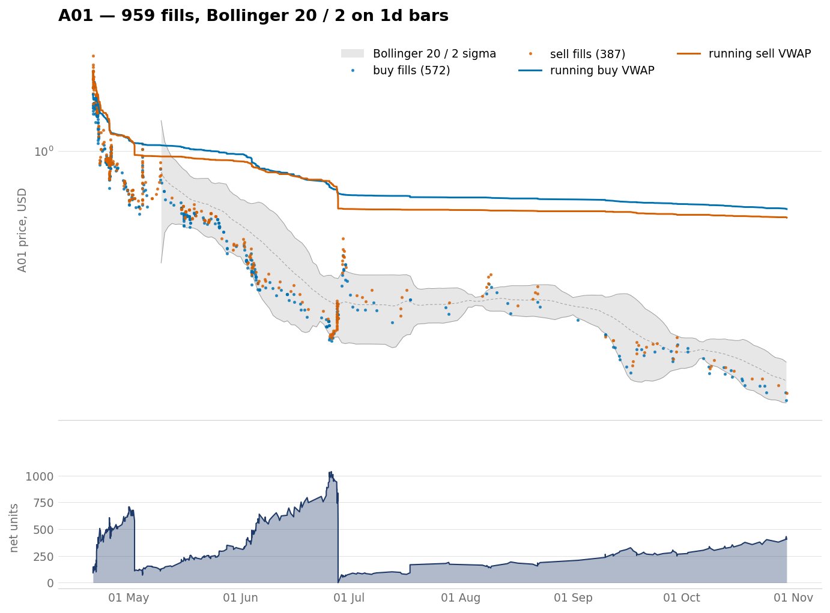
A01 — 959 fills, 572 buys, 387 sells
Buy VWAP from 1.5915 to 0.621713, index 0.391; sell over buy 0.932; 21 Apr to 30 Oct.
figures/vwap_a01.png

Slide 9
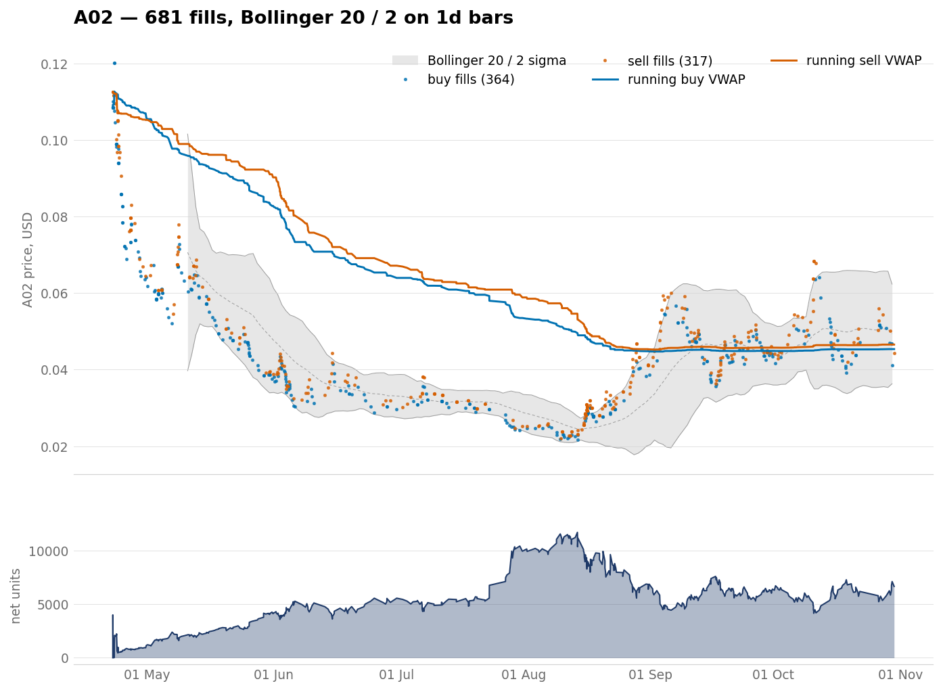
A02 — 681 fills, 364 buys, 317 sells
Buy VWAP from 0.10842 to 0.0453699, index 0.418; sell over buy 1.026; 22 Apr to 30 Oct.
figures/vwap_a02.png

Slide 10
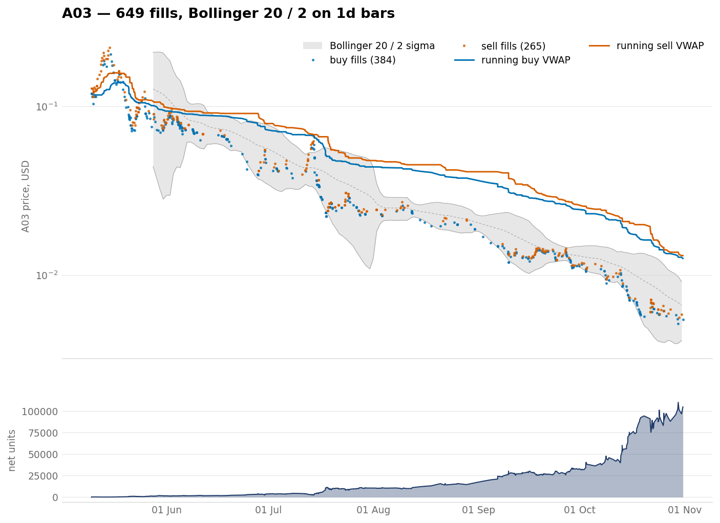
A03 — 649 fills, 384 buys, 265 sells
Buy VWAP from 0.11868 to 0.0125314, index 0.106; sell over buy 1.040; 9 May to 31 Oct.
figures/vwap_a03.png

Slide 11
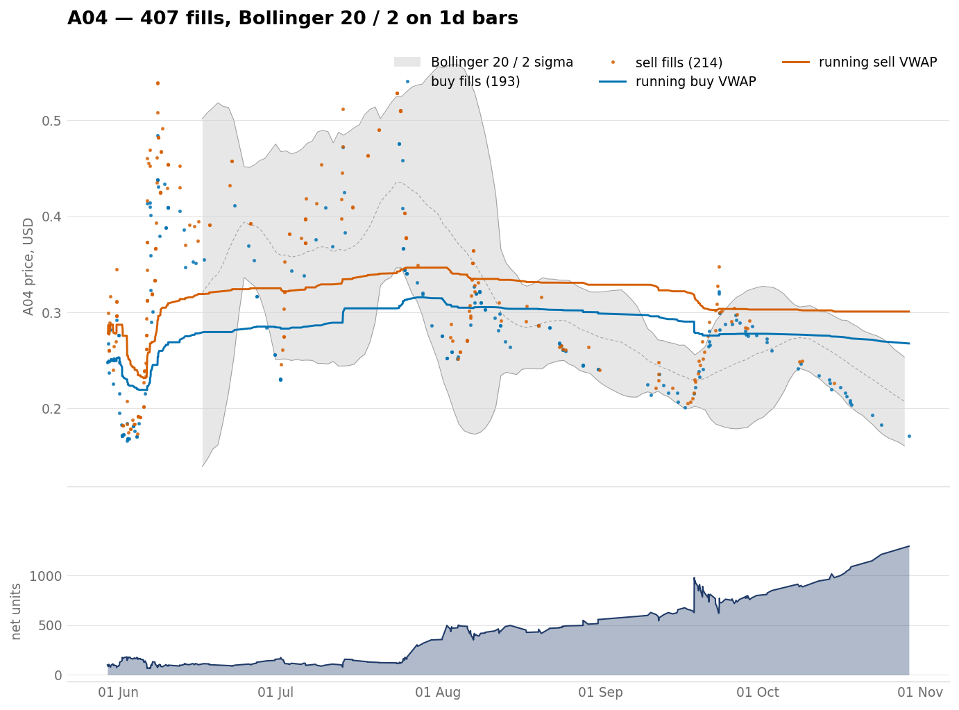
A04 — 407 fills, 193 buys, 214 sells
Buy VWAP from 0.2478 to 0.267397, index 1.079; sell over buy 1.124; 29 May to 29 Oct.
figures/vwap_a04.png

Slide 12
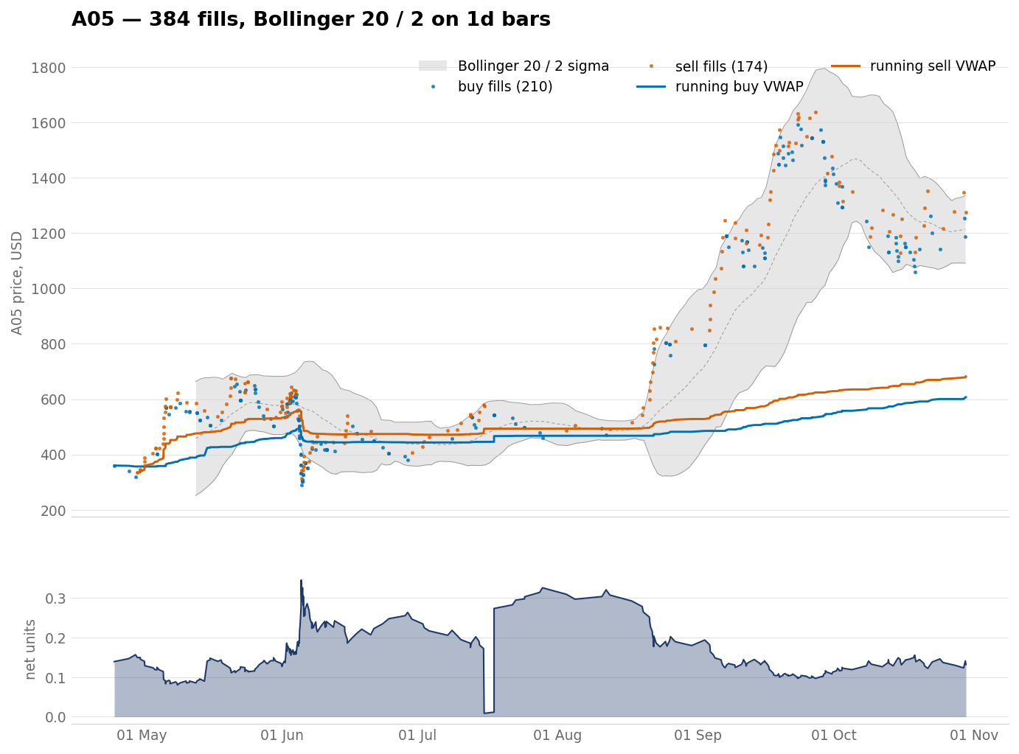
A05 — 384 fills, 210 buys, 174 sells
Buy VWAP from 359.67 to 606.914, index 1.687; sell over buy 1.124; 24 Apr to 30 Oct.
figures/vwap_a05.png

Slide 13
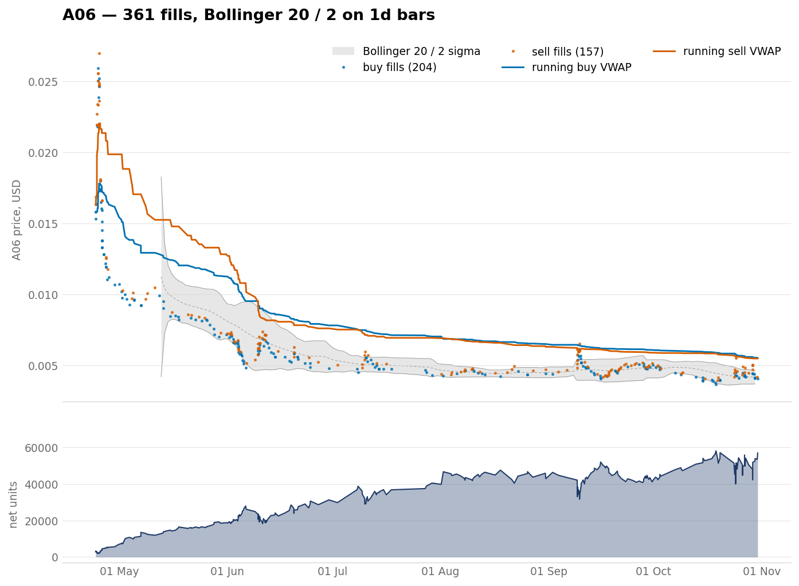
A06 — 361 fills, 204 buys, 157 sells
Buy VWAP from 0.01581 to 0.00552588, index 0.350; sell over buy 0.993; 24 Apr to 30 Oct.
figures/vwap_a06.png

Slide 14
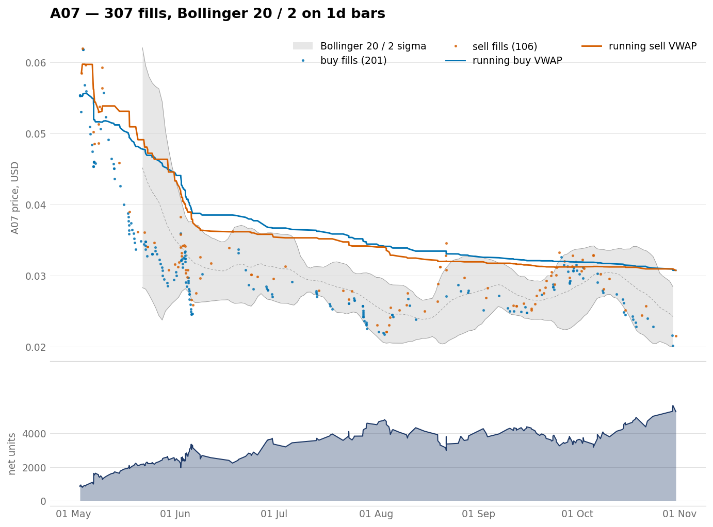
A07 — 307 fills, 201 buys, 106 sells
Buy VWAP from 0.05537 to 0.0307559, index 0.555; sell over buy 0.999; 3 May to 30 Oct.
figures/vwap_a07.png

Slide 15
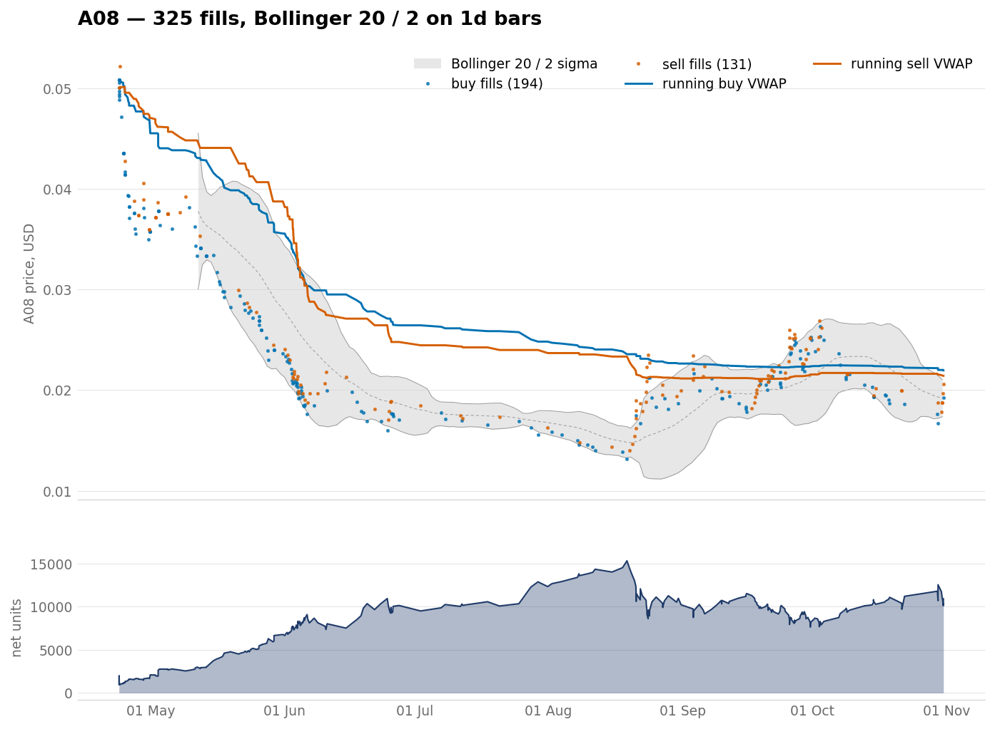
A08 — 325 fills, 194 buys, 131 sells
Buy VWAP from 0.0508 to 0.0219571, index 0.432; sell over buy 0.975; 23 Apr to 31 Oct.
figures/vwap_a08.png

Slide 16
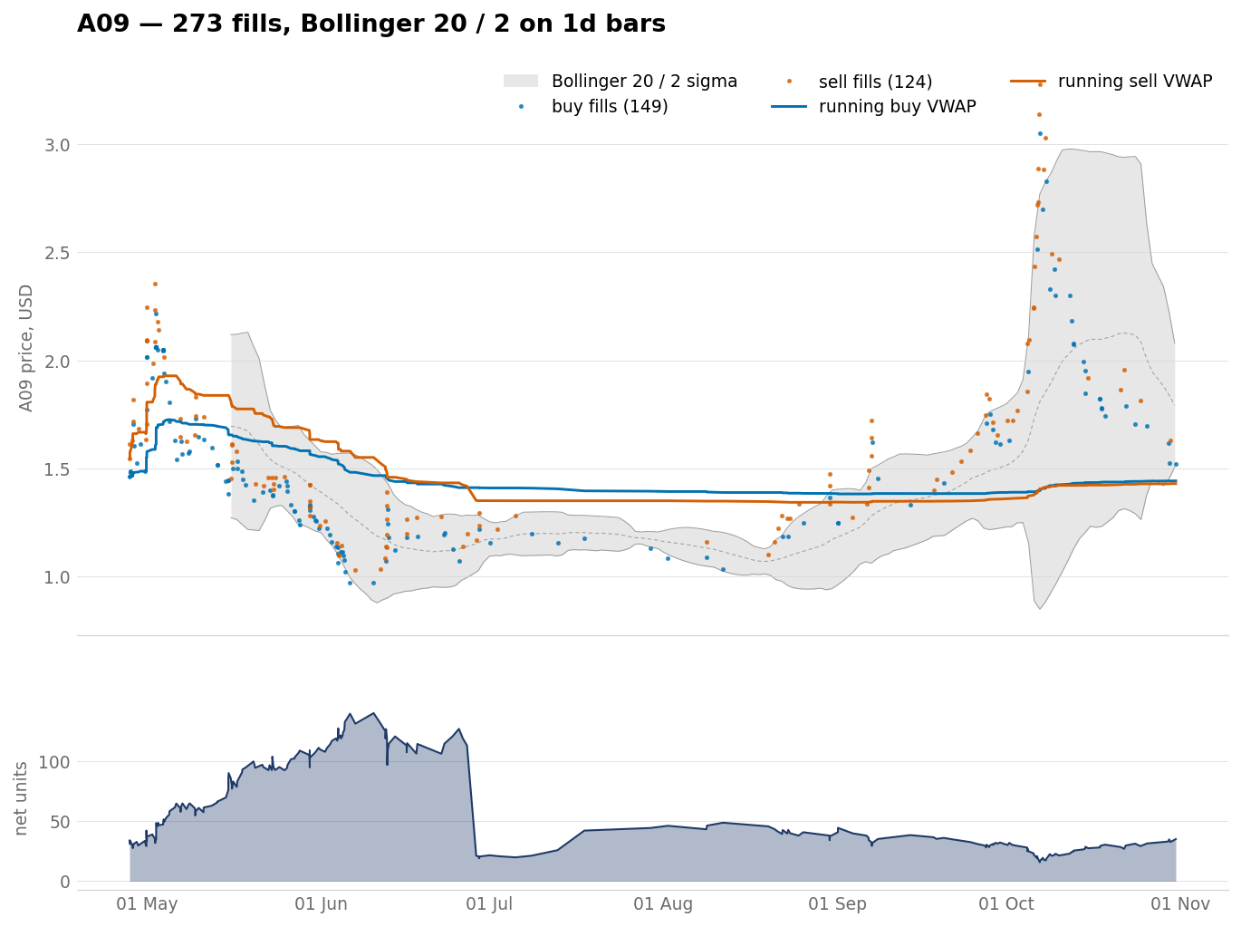
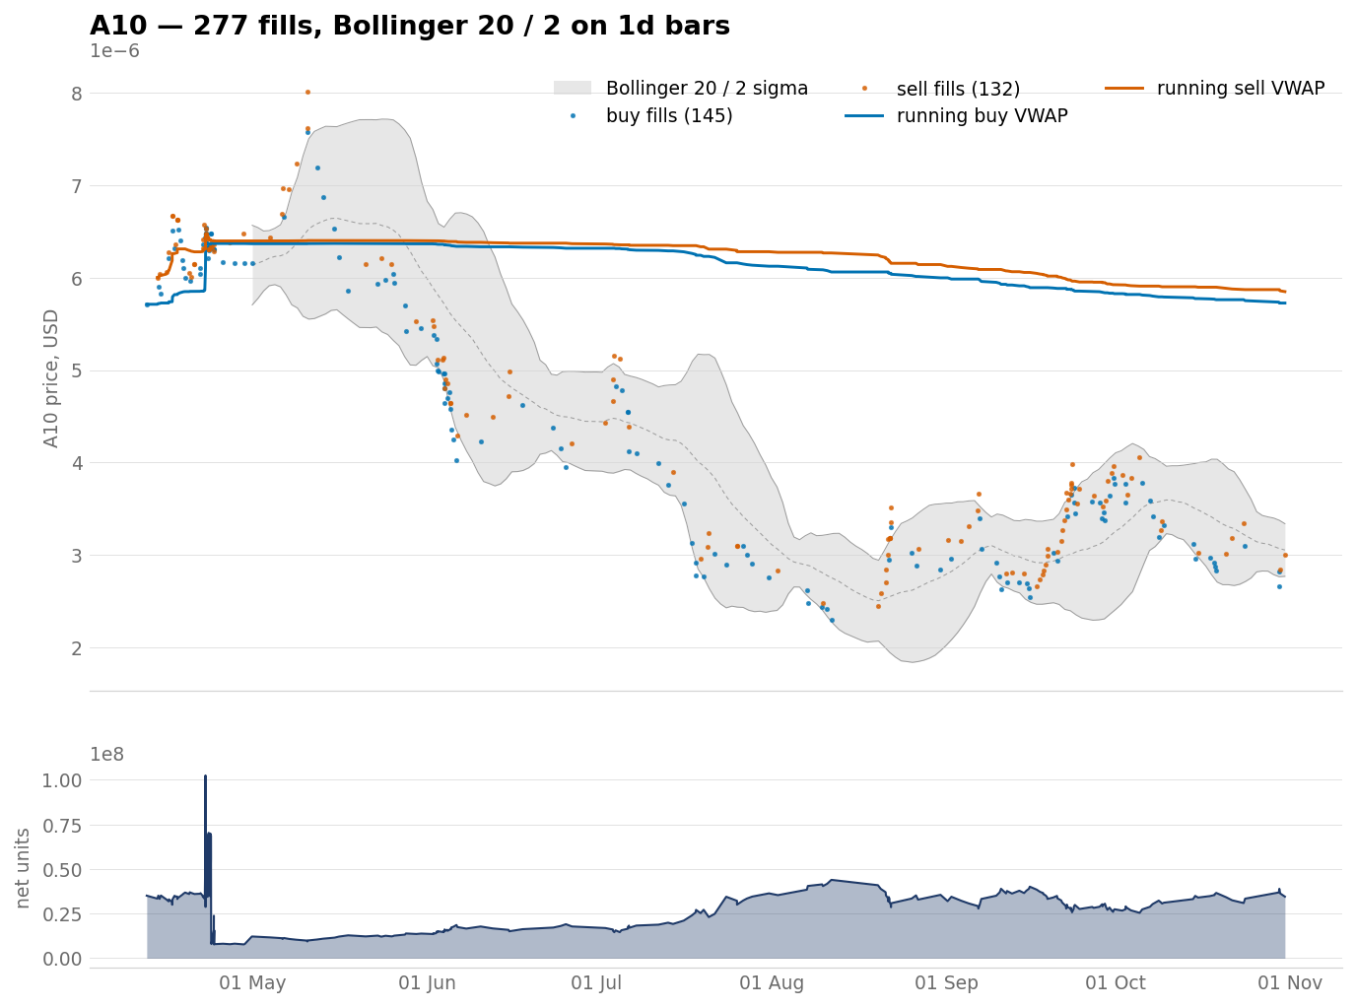
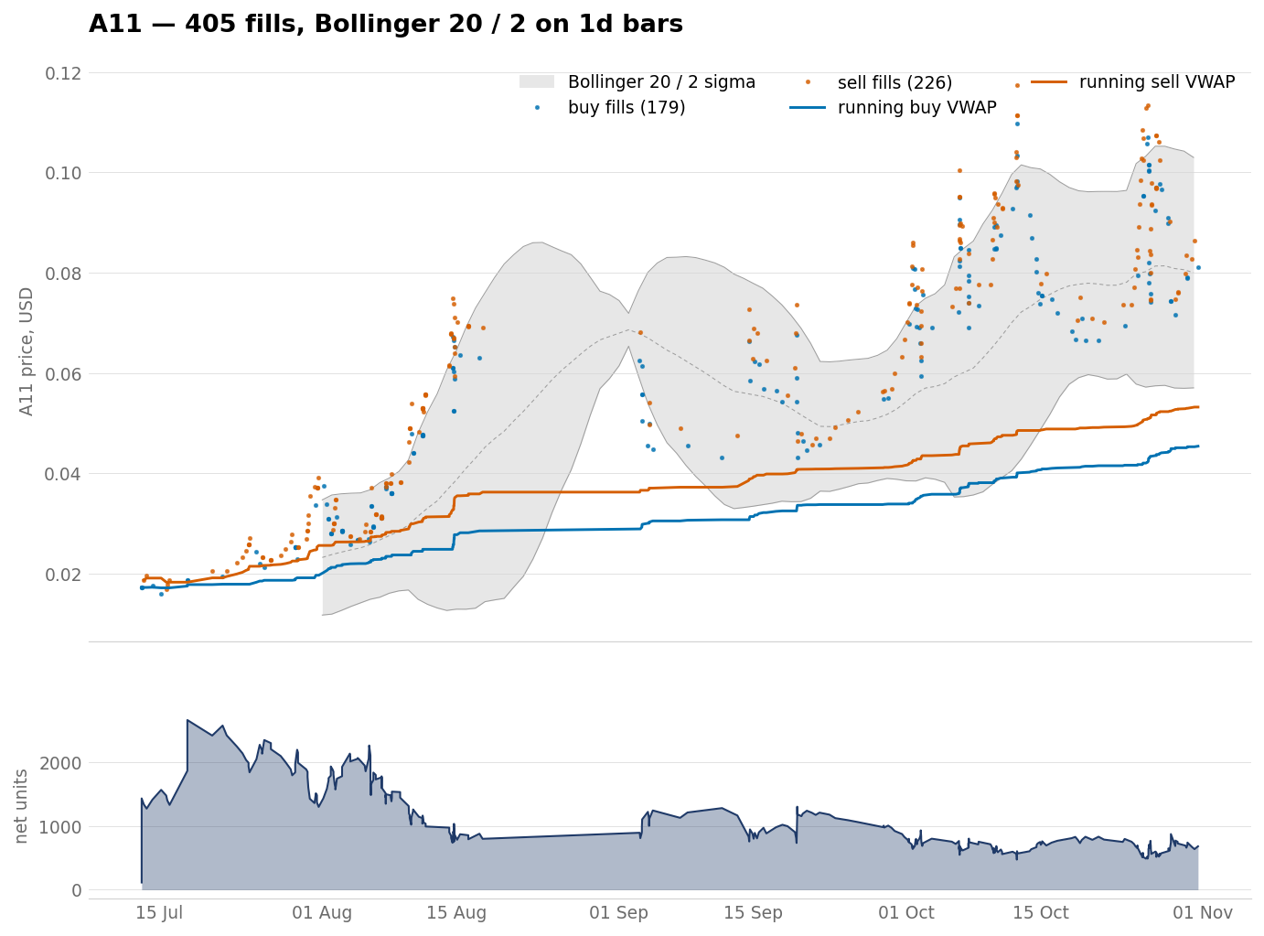
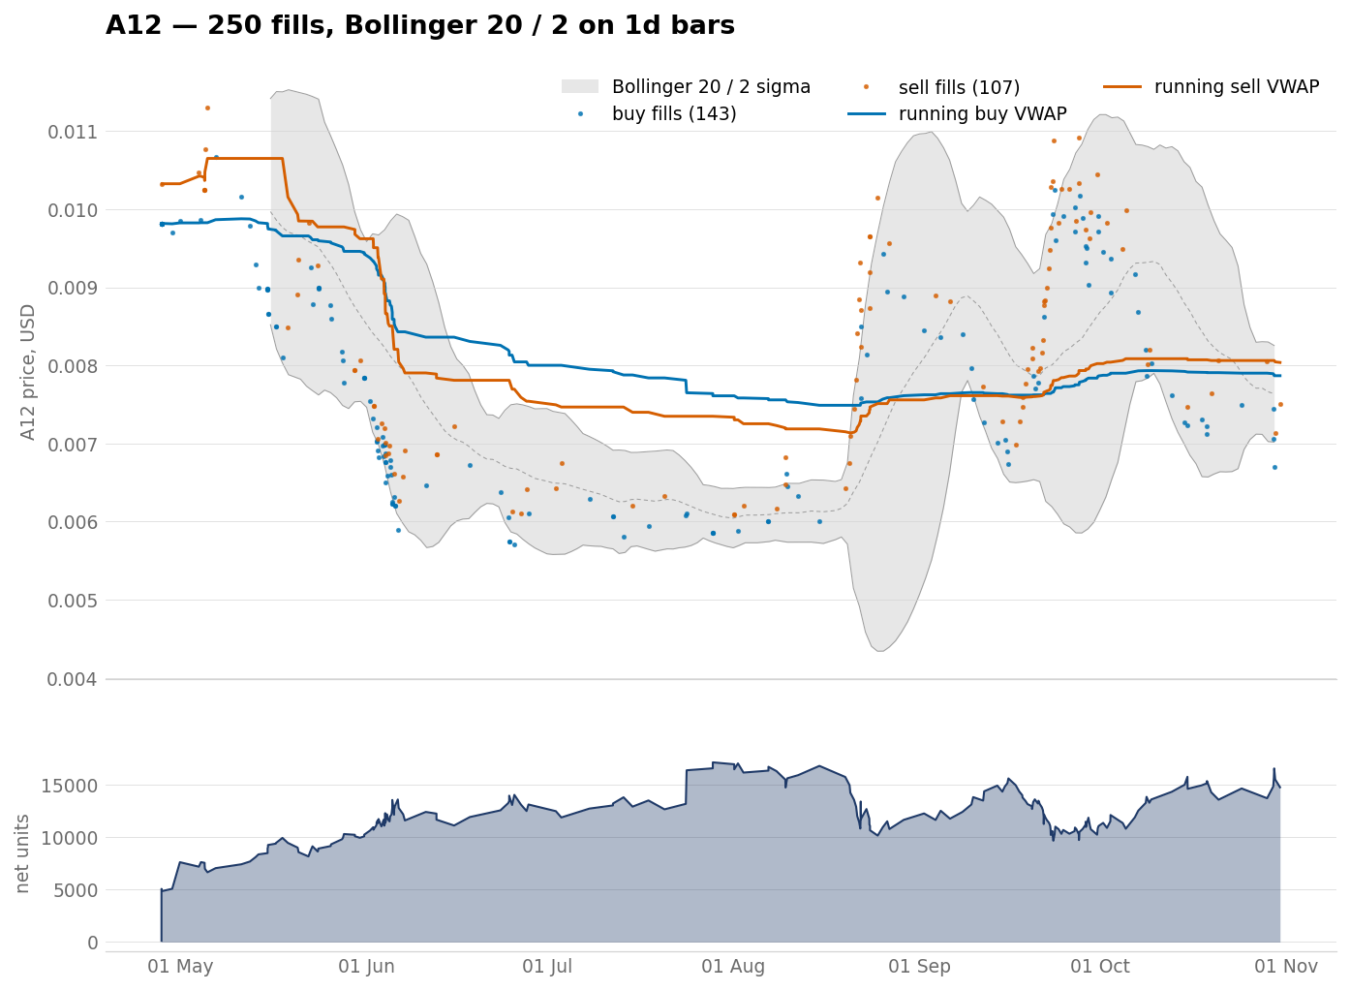
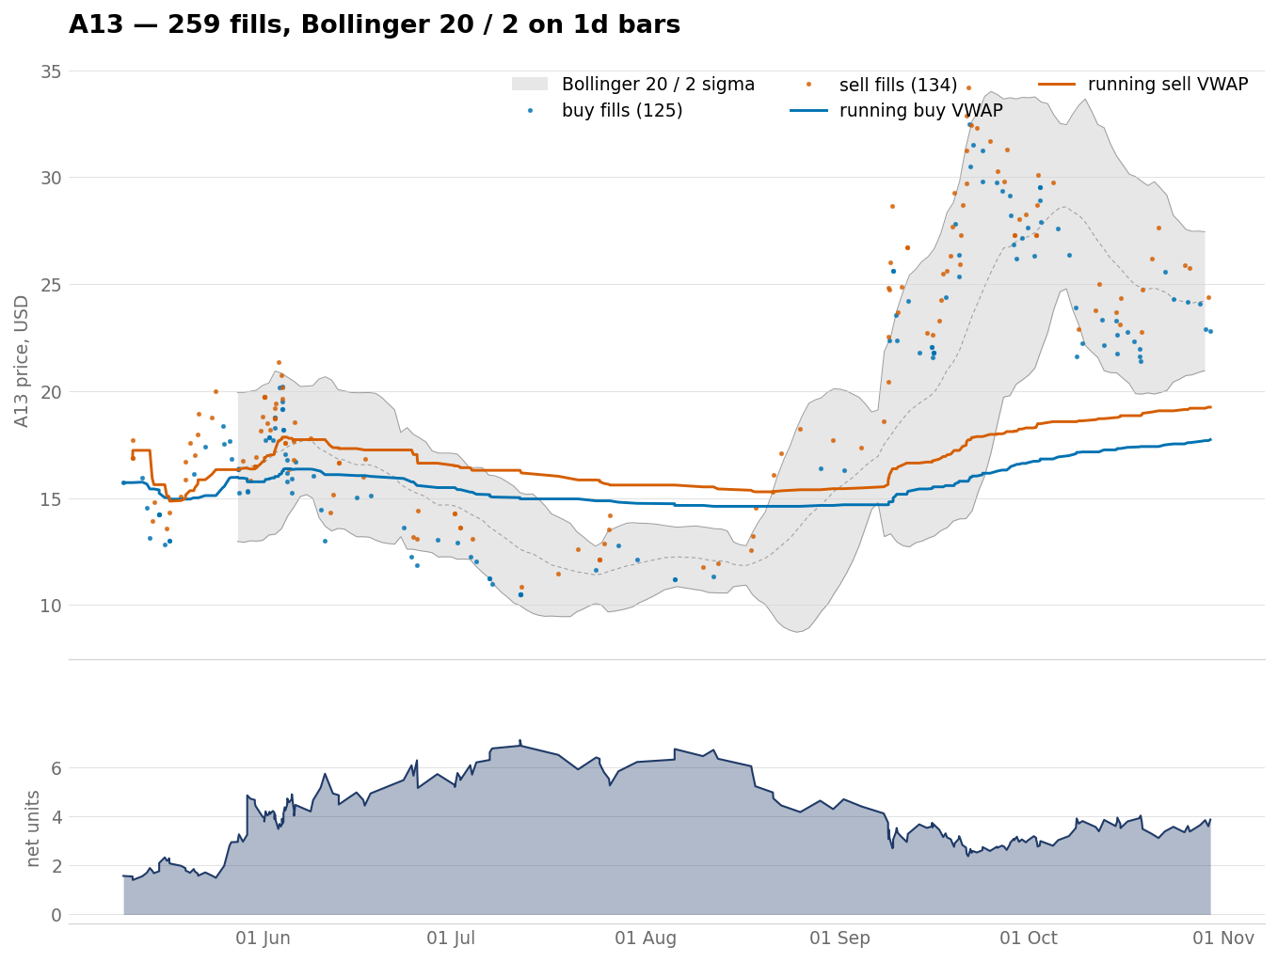
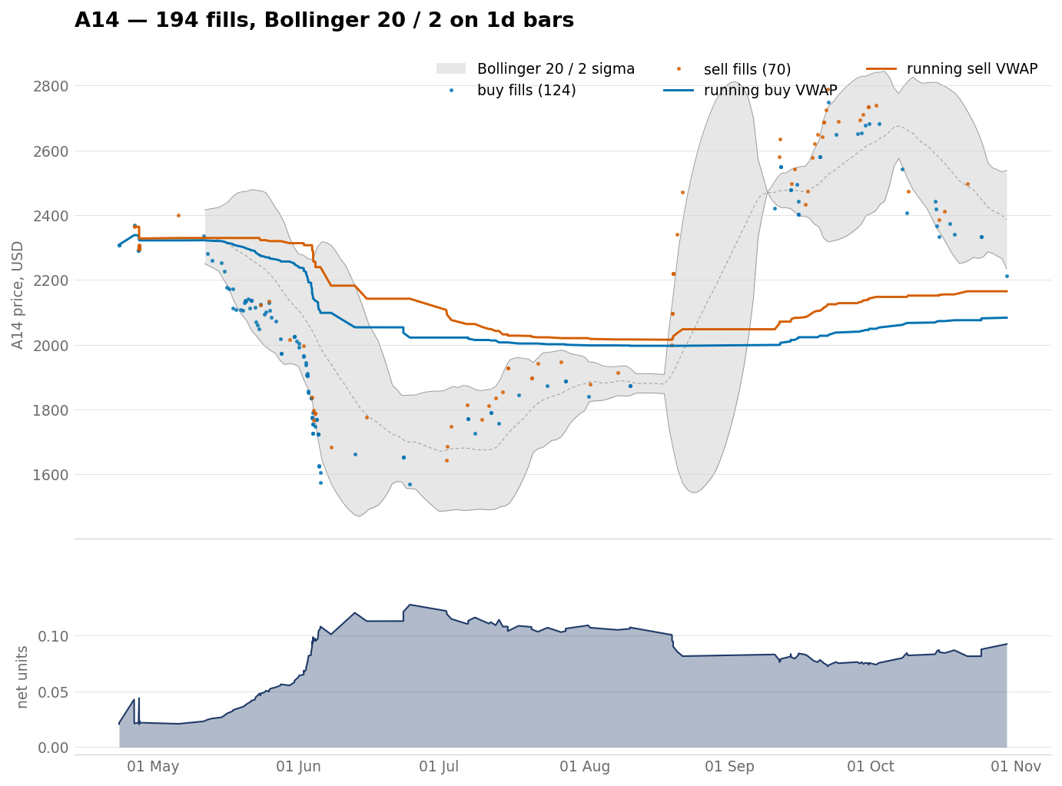
The remaining bases, A09 to A14
Six charts to a slide. Each one carries the same two lines and the same net-units panel as the eight above.
A09 273 fills index 0.986
A10 277 fills index 1.002
A11 405 fills index 2.635
A12 250 fills index 0.802
A13 259 fills index 1.128
A14 194 fills index 0.902
figures/vwap_a<NN>.png

Slide 17
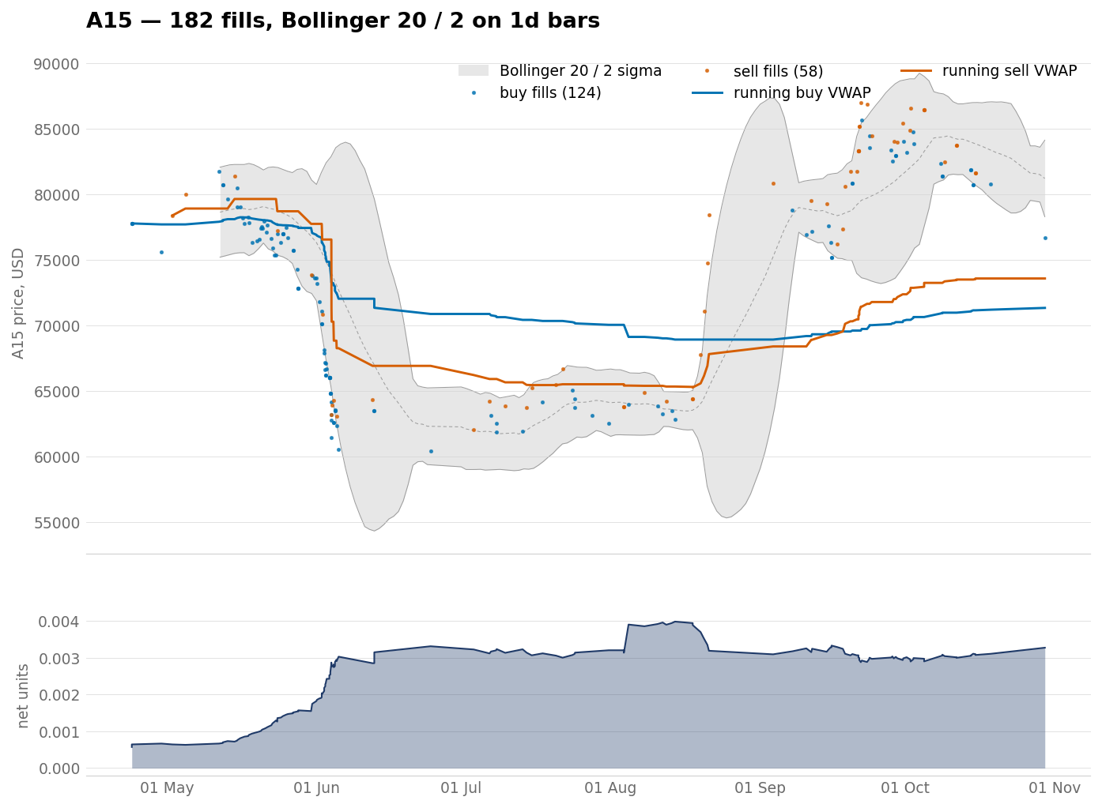
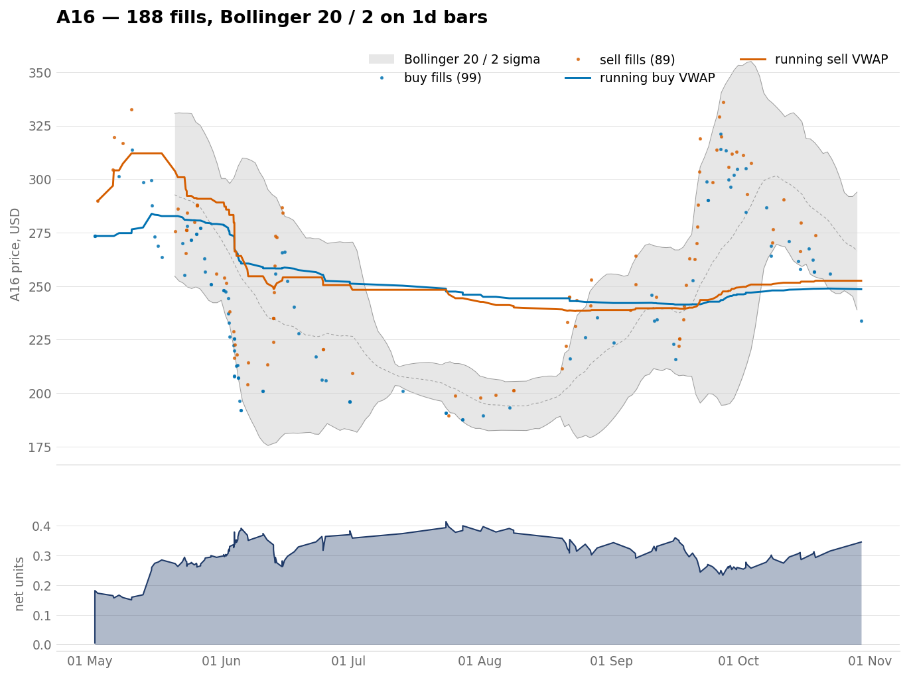
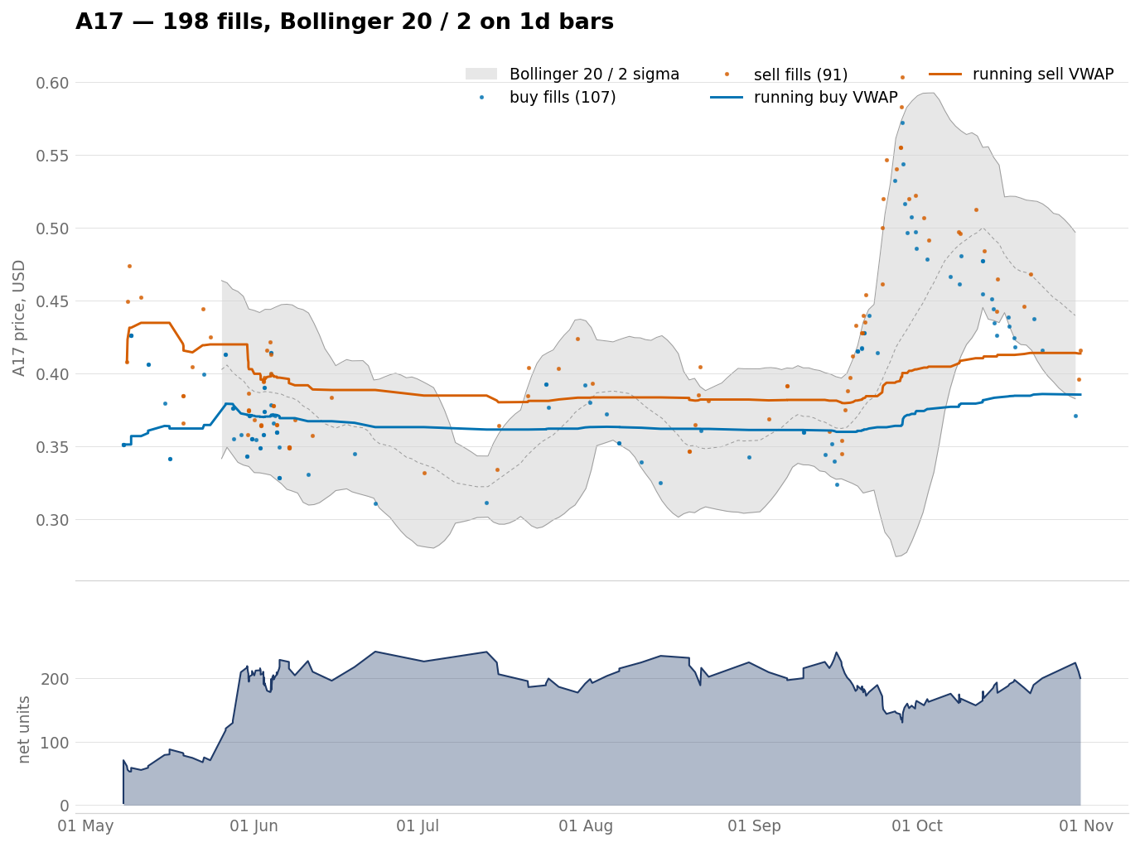
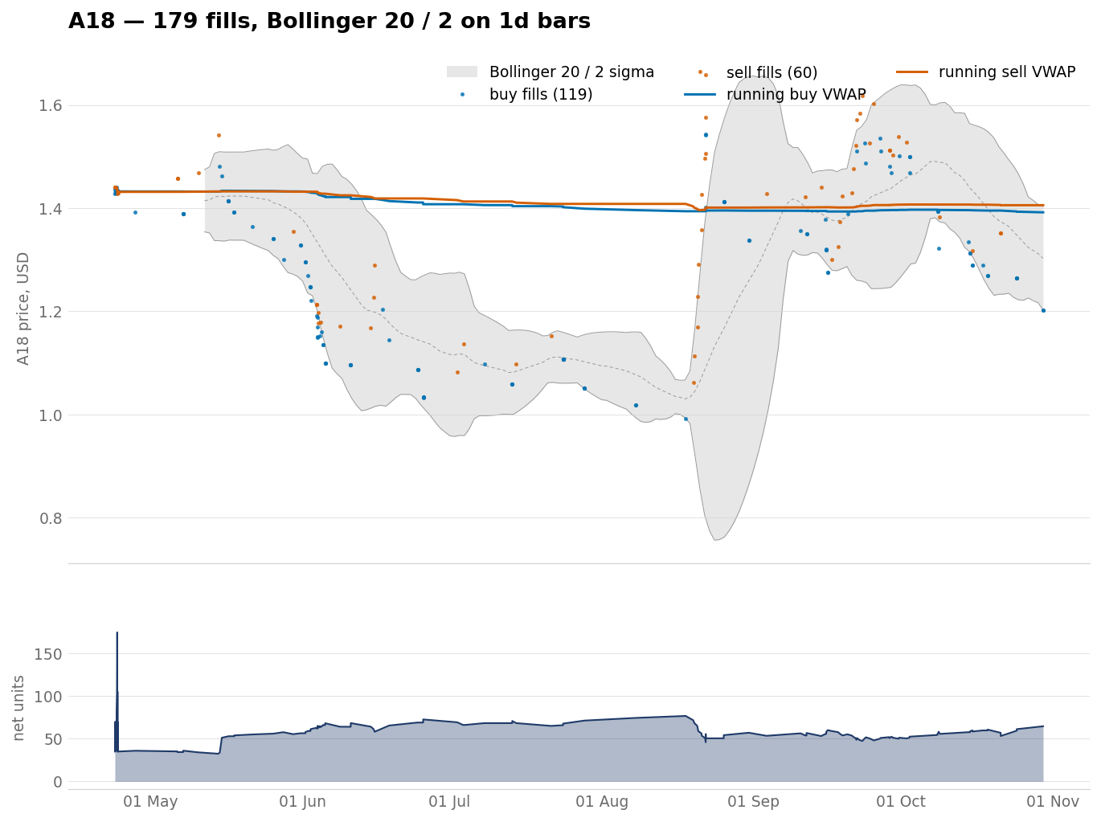
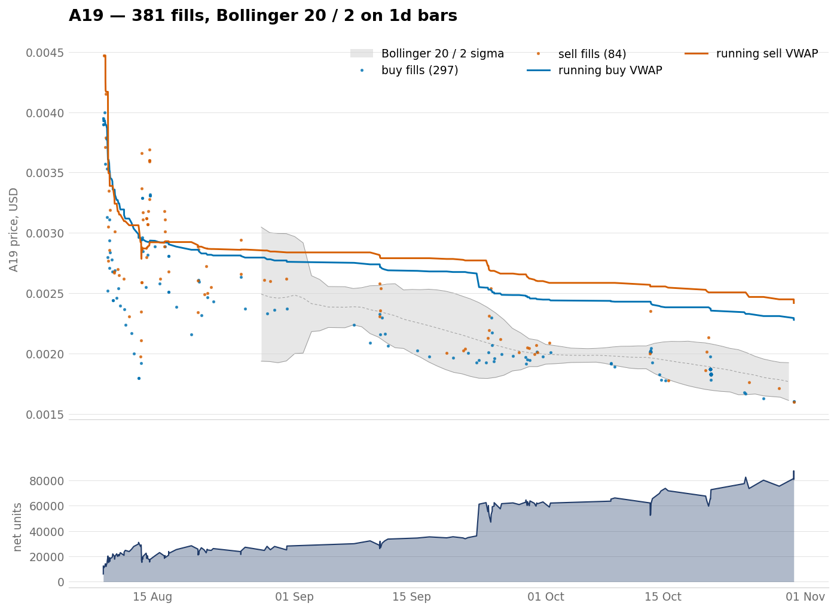
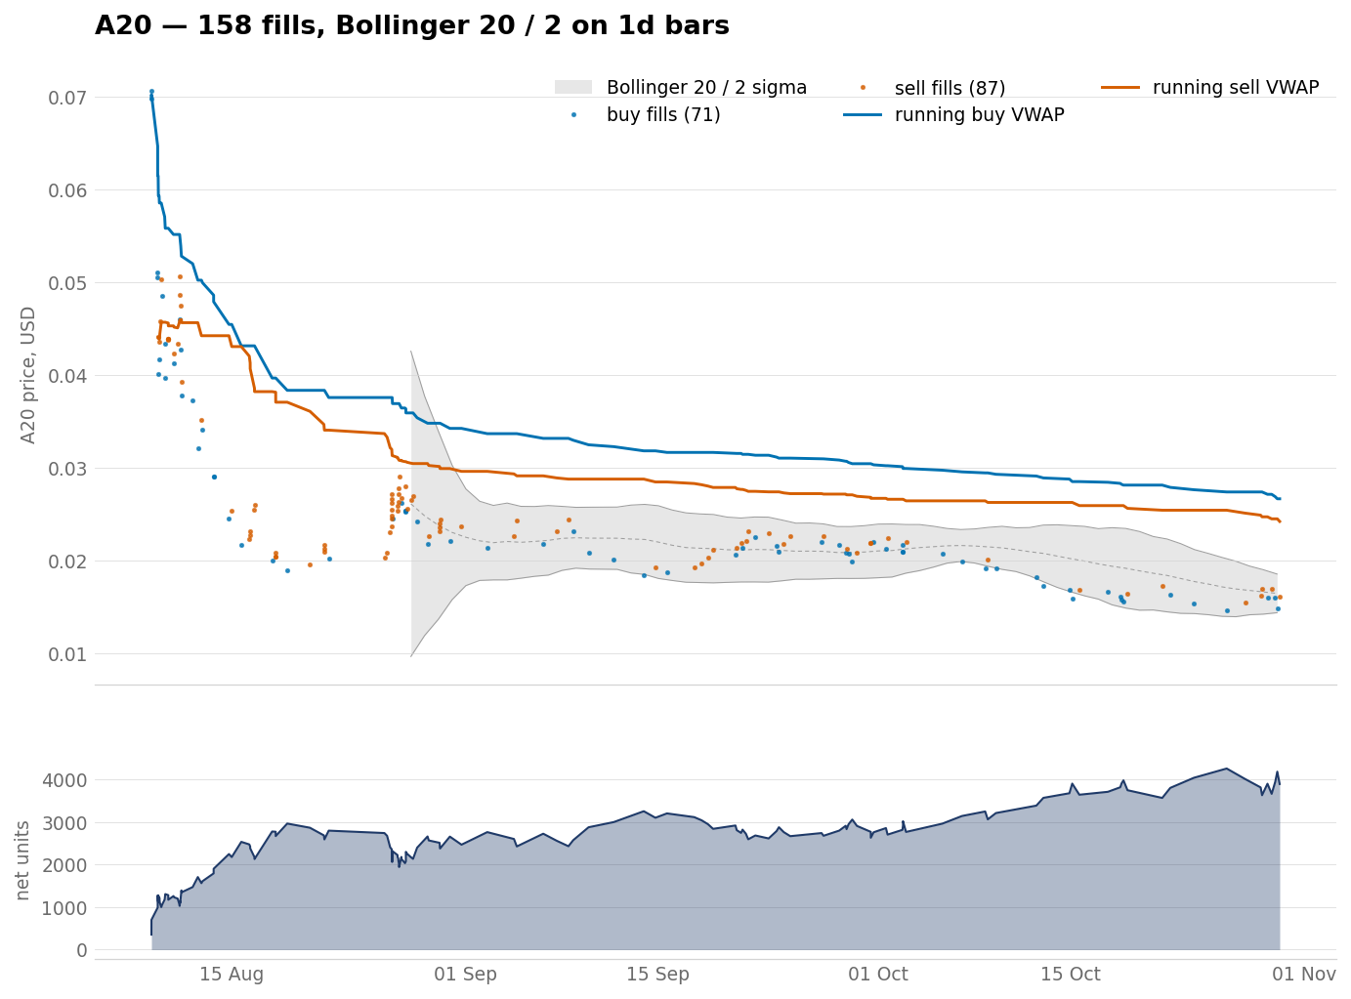
The remaining bases, A15 to A20
Six charts to a slide. Each one carries the same two lines and the same net-units panel as the eight above.
A15 182 fills index 0.917
A16 188 fills index 0.909
A17 198 fills index 1.097
A18 179 fills index 0.975
A19 381 fills index 0.577
A20 158 fills index 0.382
figures/vwap_a<NN>.png

Slide 18
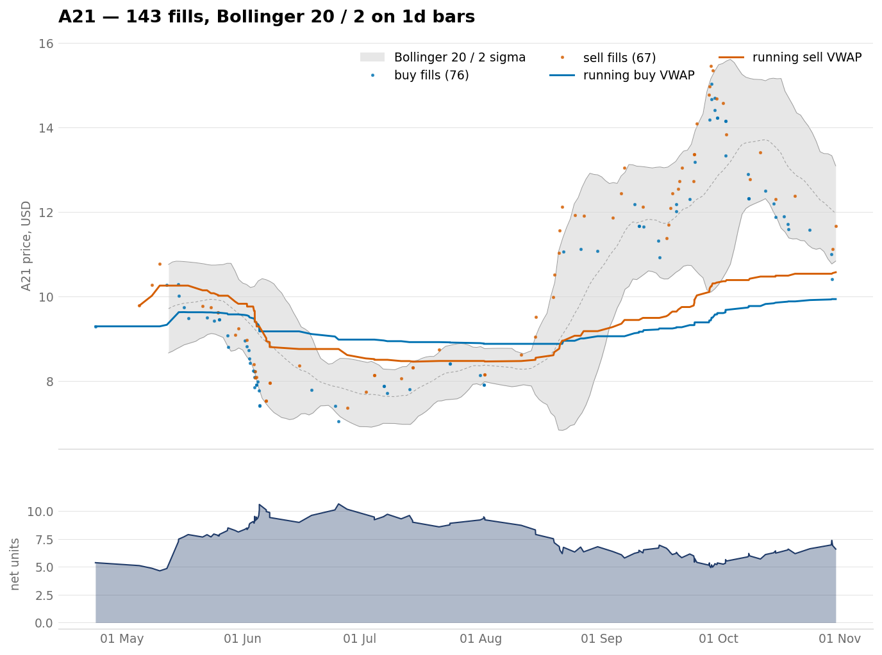
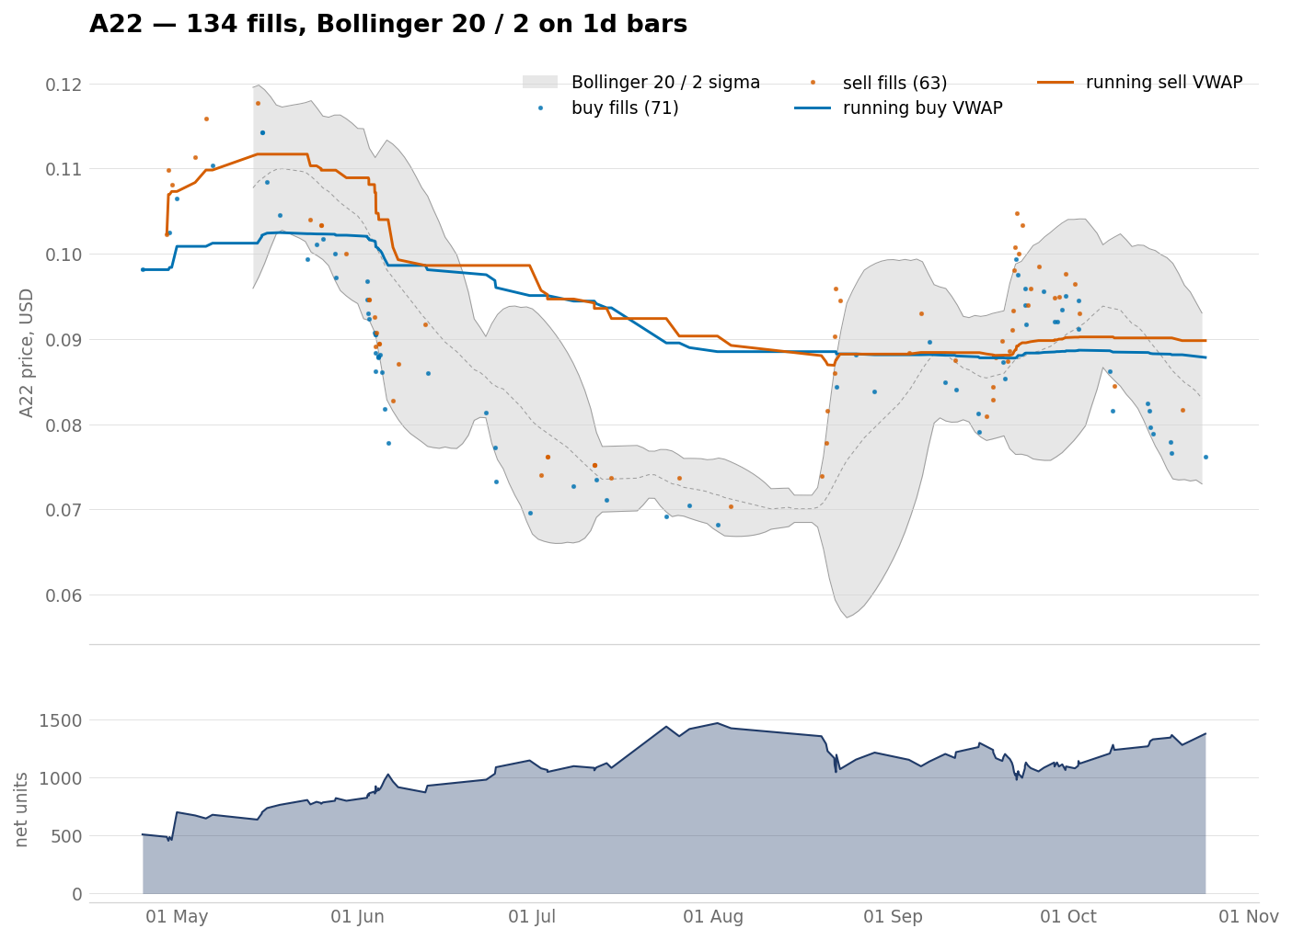
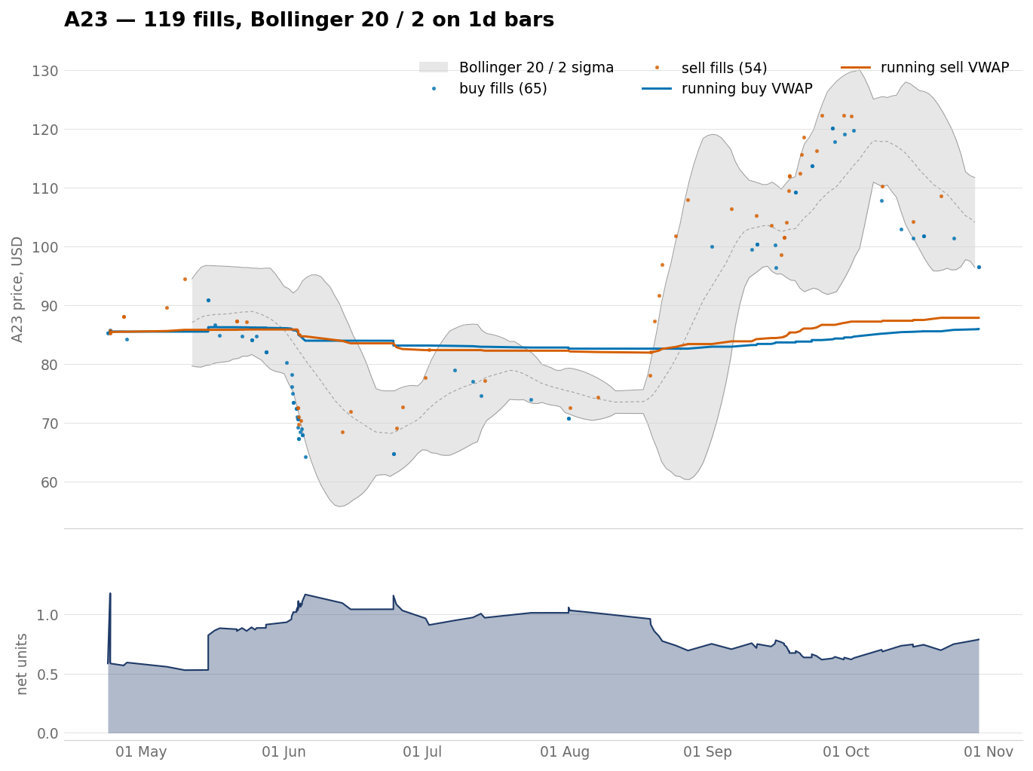
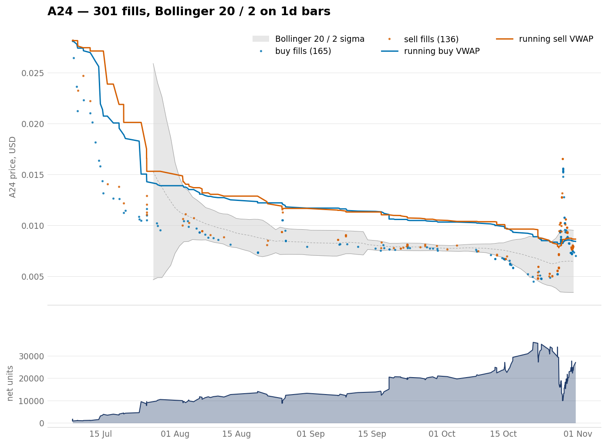
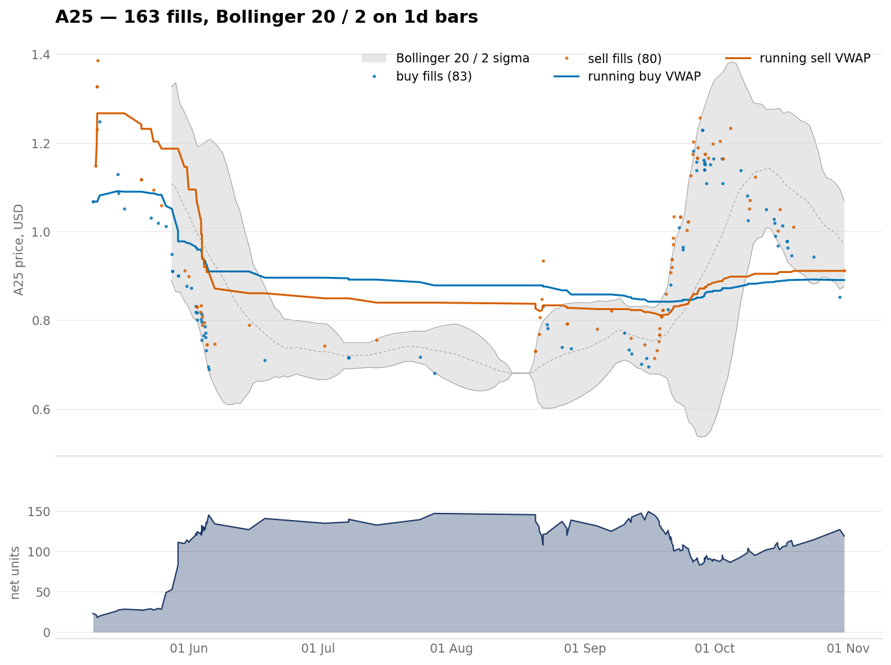
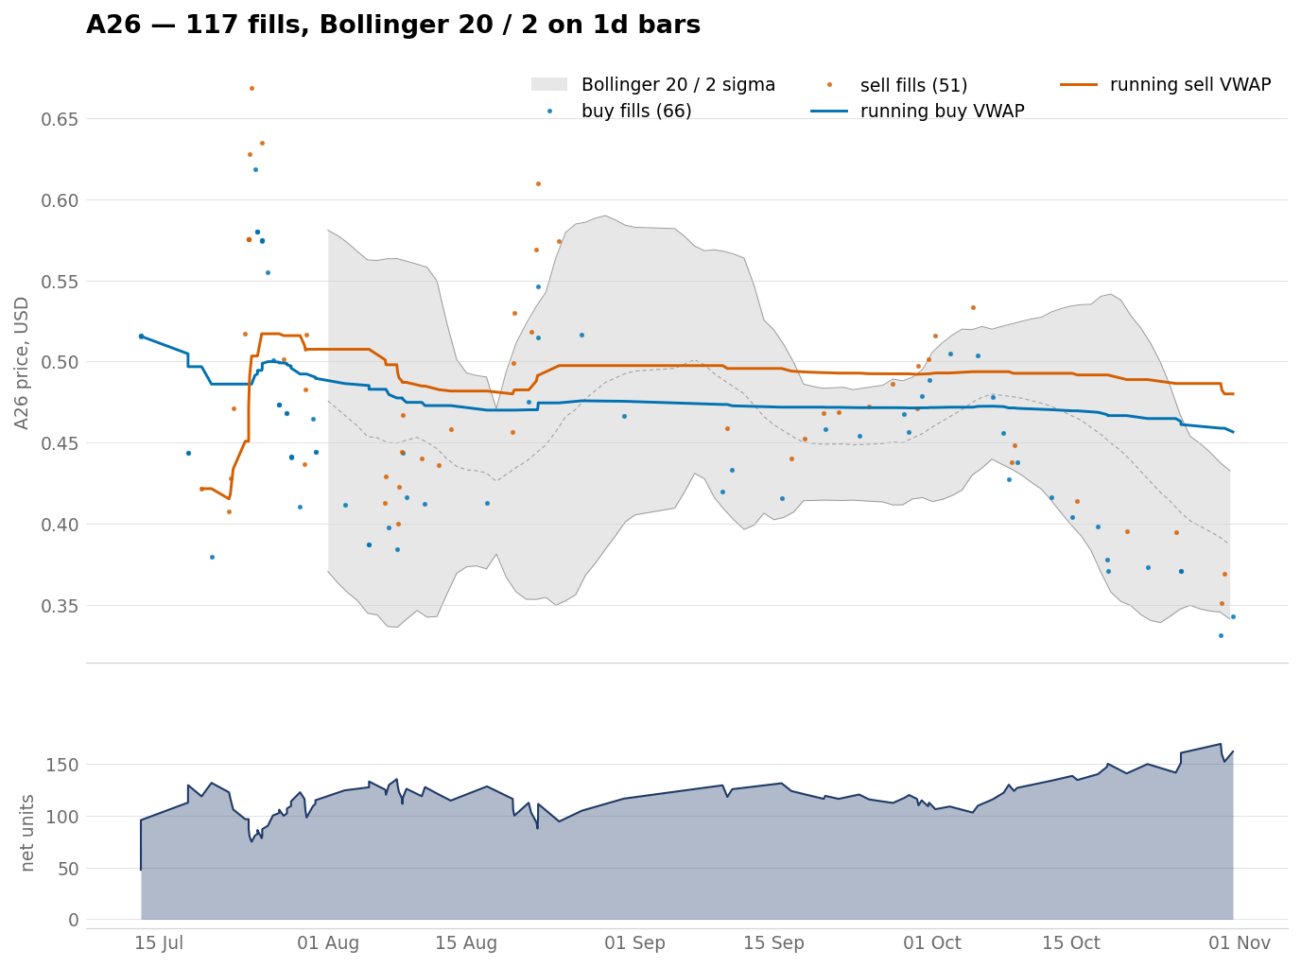
The remaining bases, A21 to A26
Six charts to a slide. Each one carries the same two lines and the same net-units panel as the eight above.
A21 143 fills index 1.069
A22 134 fills index 0.895
A23 119 fills index 1.007
A24 301 fills index 0.300
A25 163 fills index 0.834
A26 117 fills index 0.886
figures/vwap_a<NN>.png

Slide 19
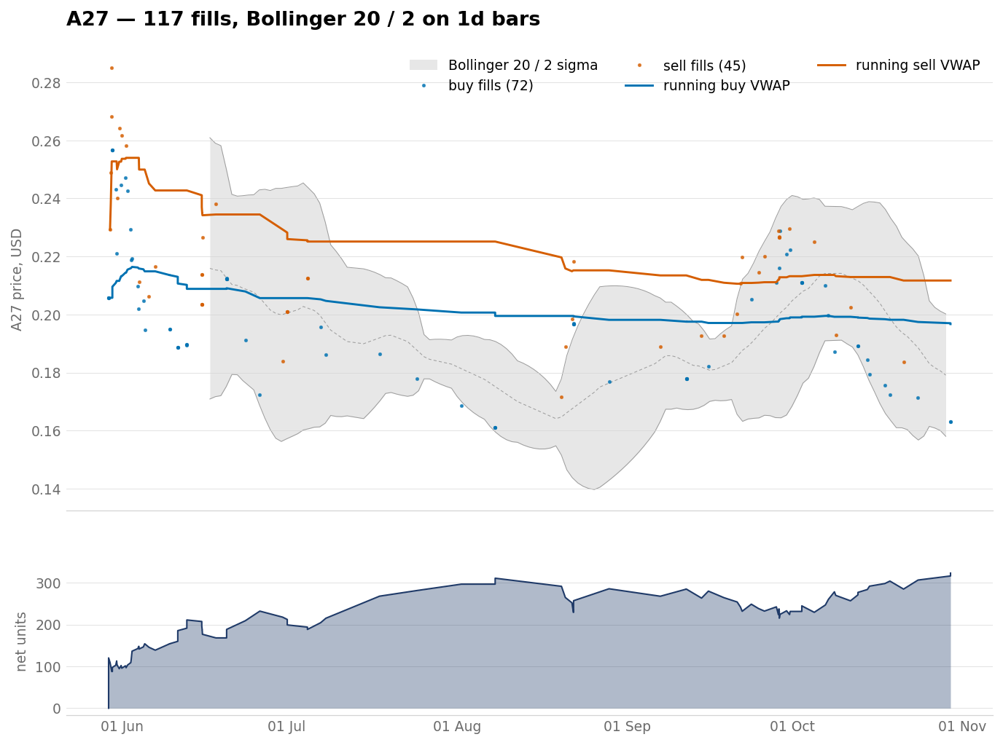
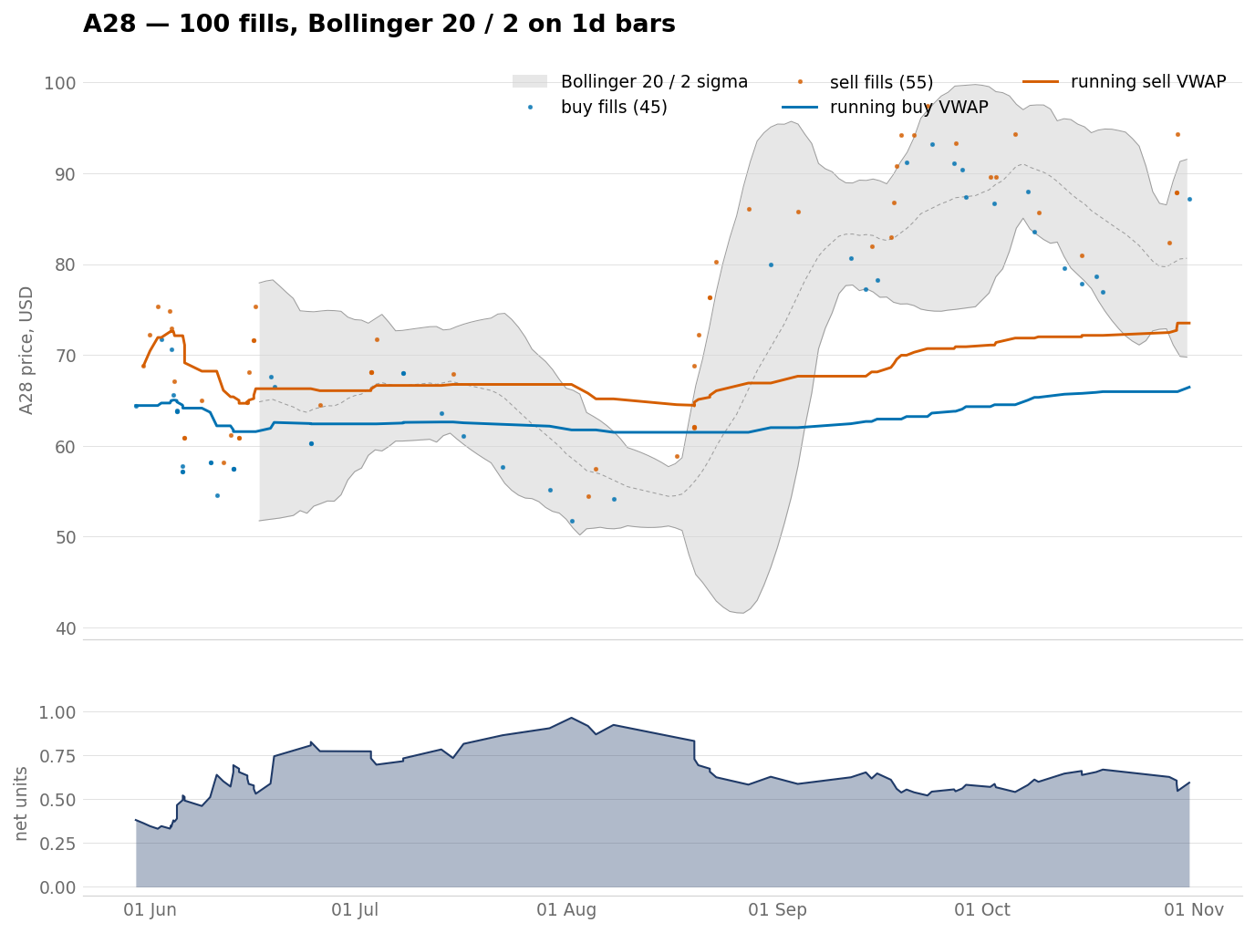
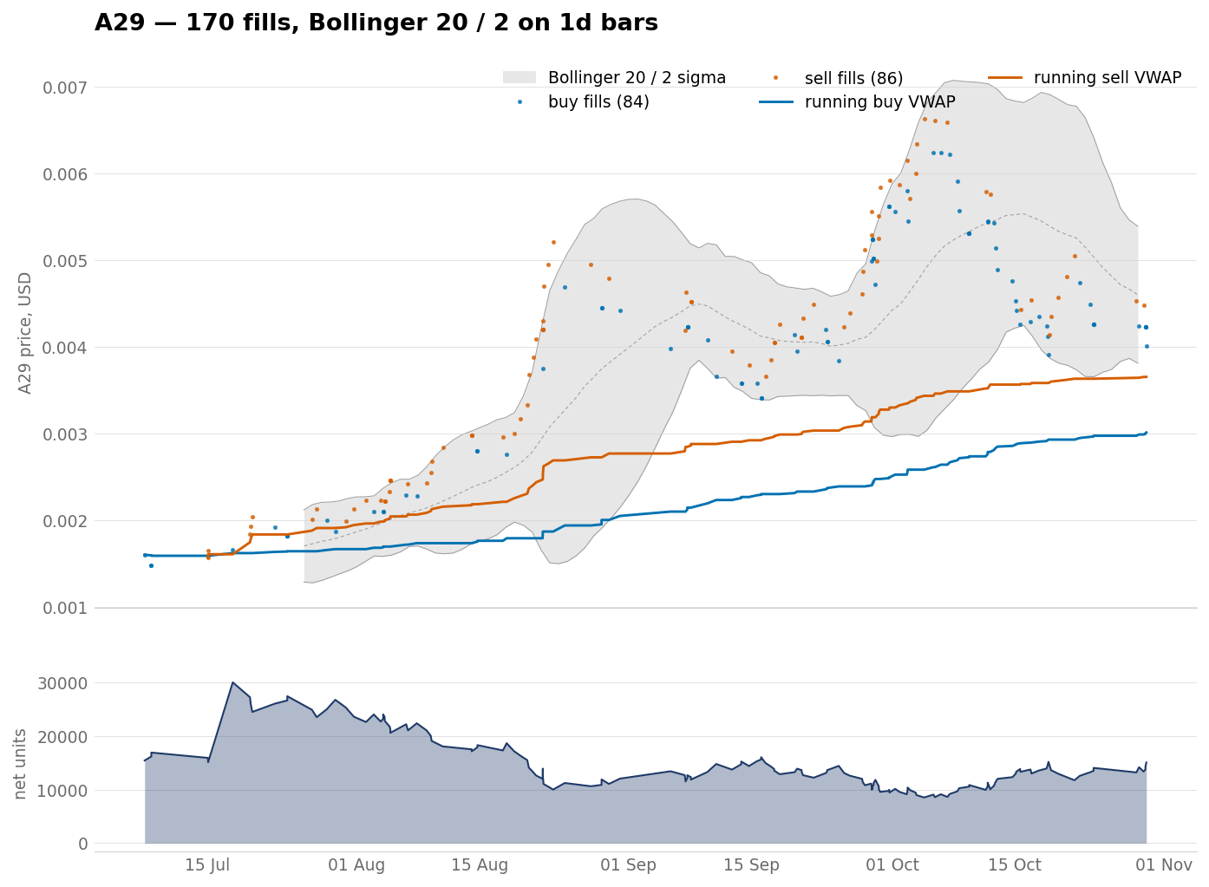
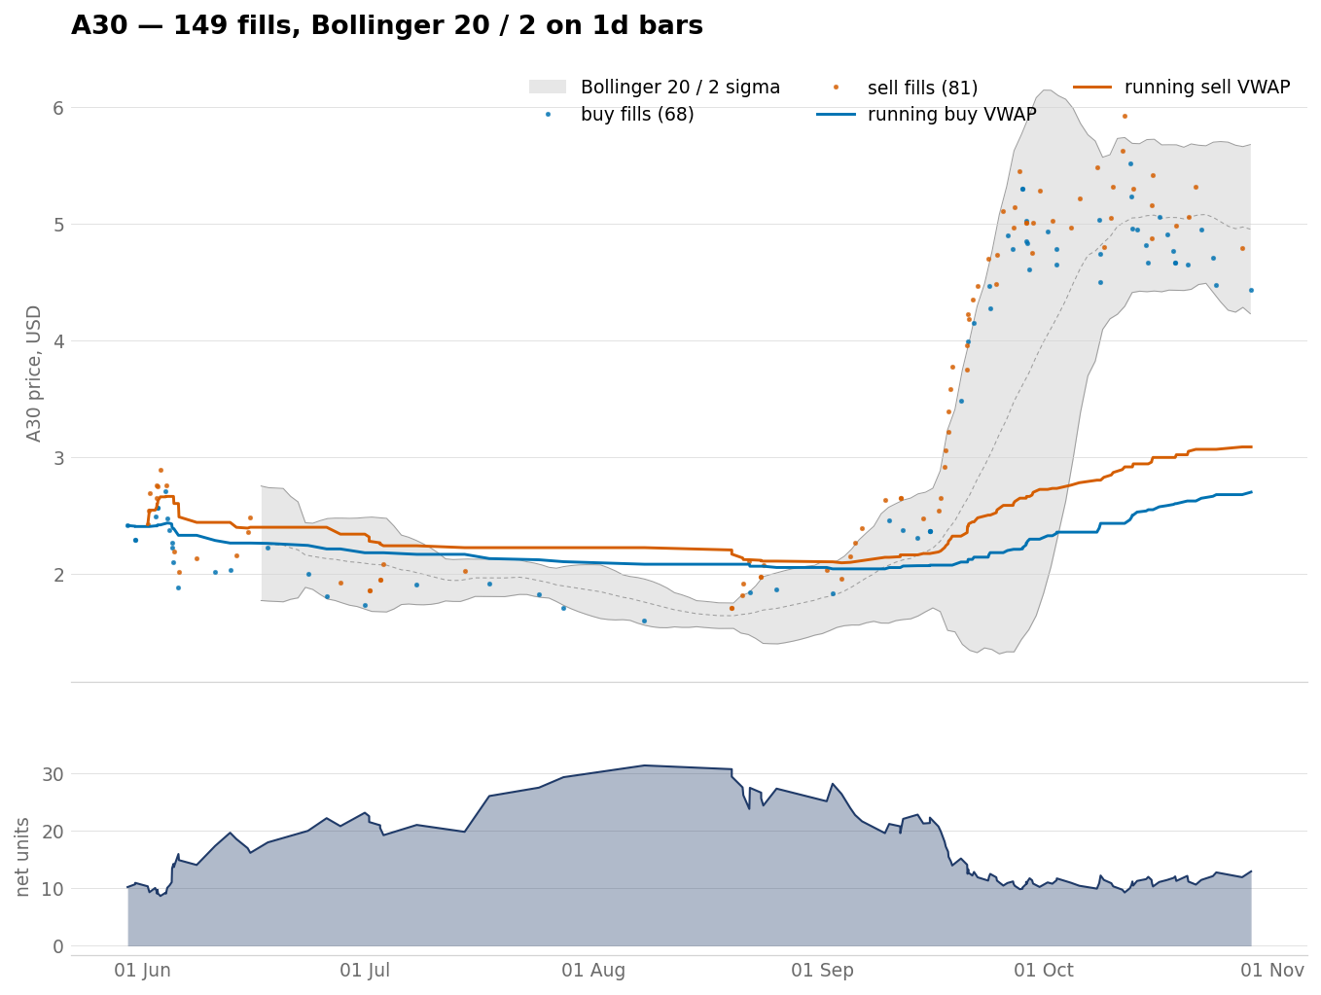
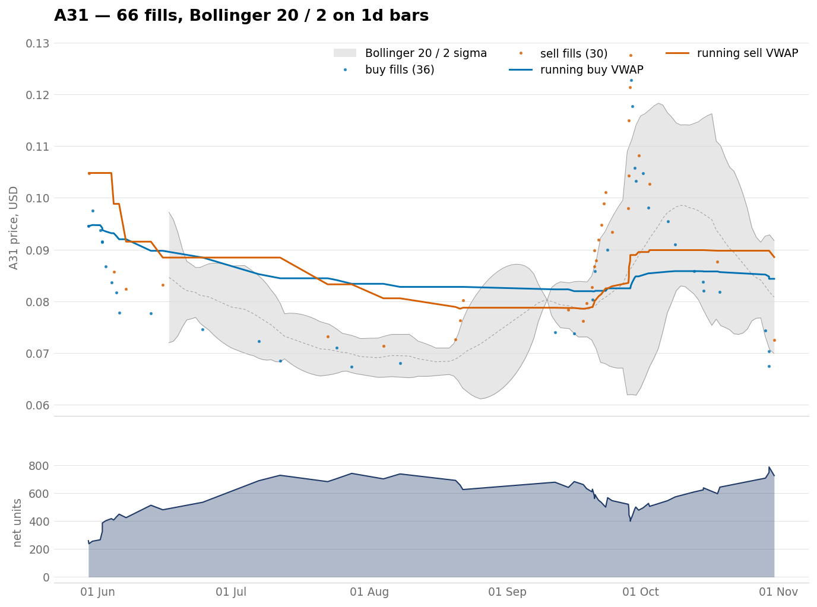
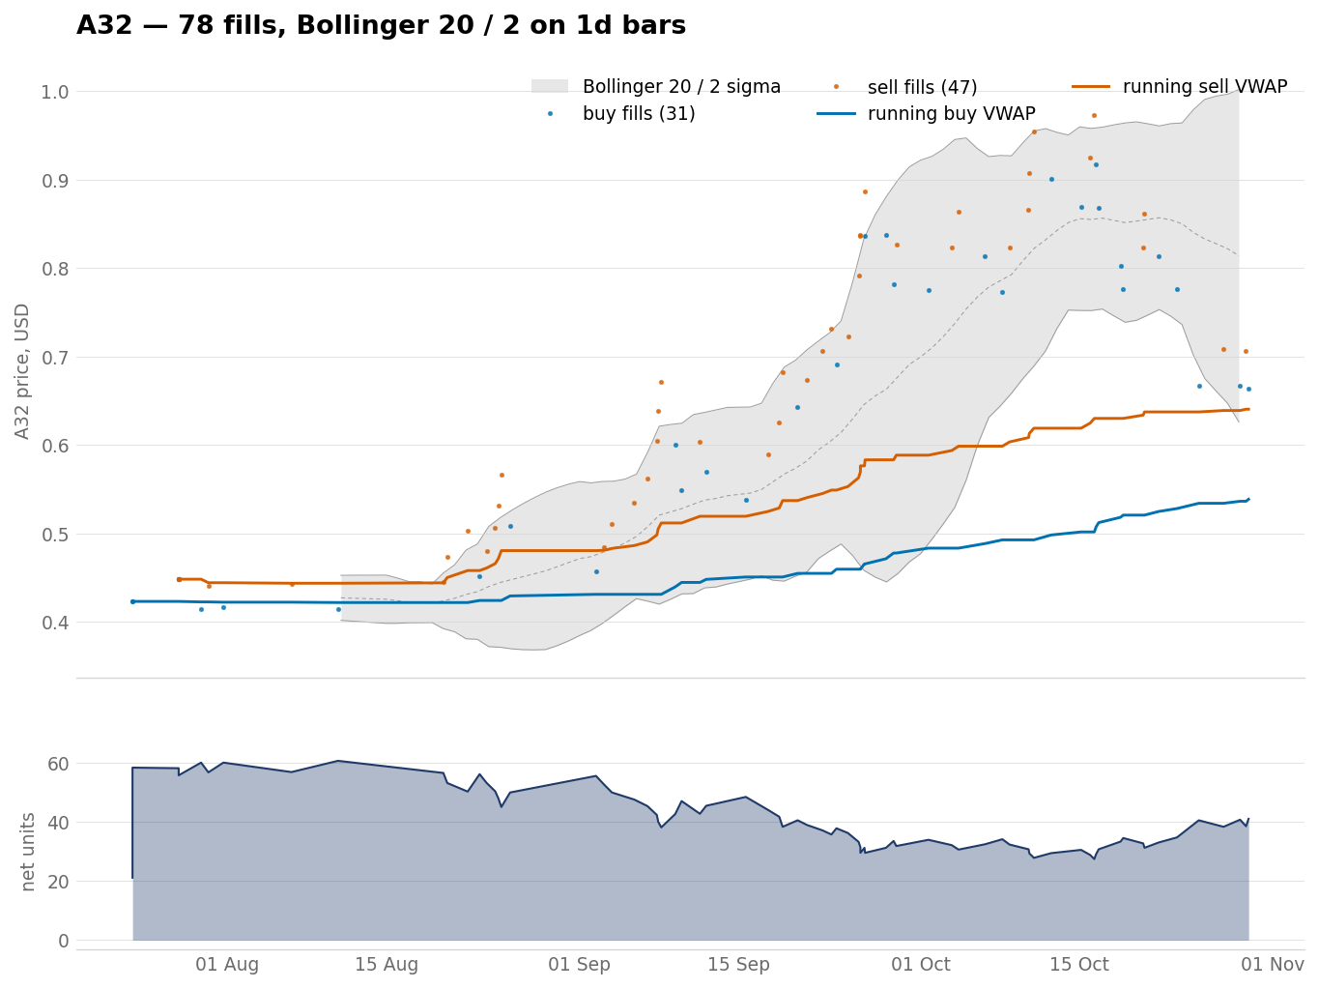
The remaining bases, A27 to A32
Six charts to a slide. Each one carries the same two lines and the same net-units panel as the eight above.
A27 117 fills index 0.956
A28 100 fills index 1.031
A29 170 fills index 1.879
A30 149 fills index 1.119
A31 66 fills index 0.892
A32 78 fills index 1.273
figures/vwap_a<NN>.png

Slide 20
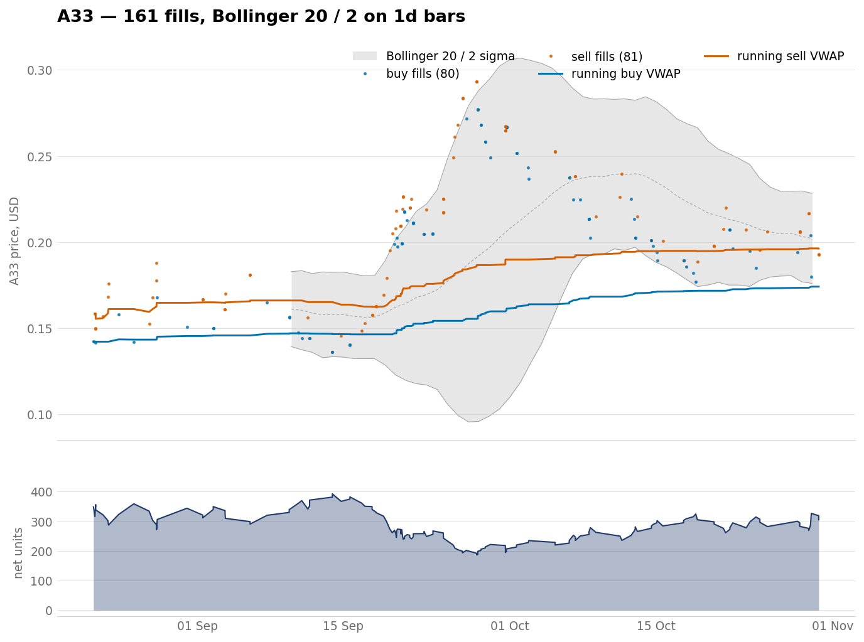
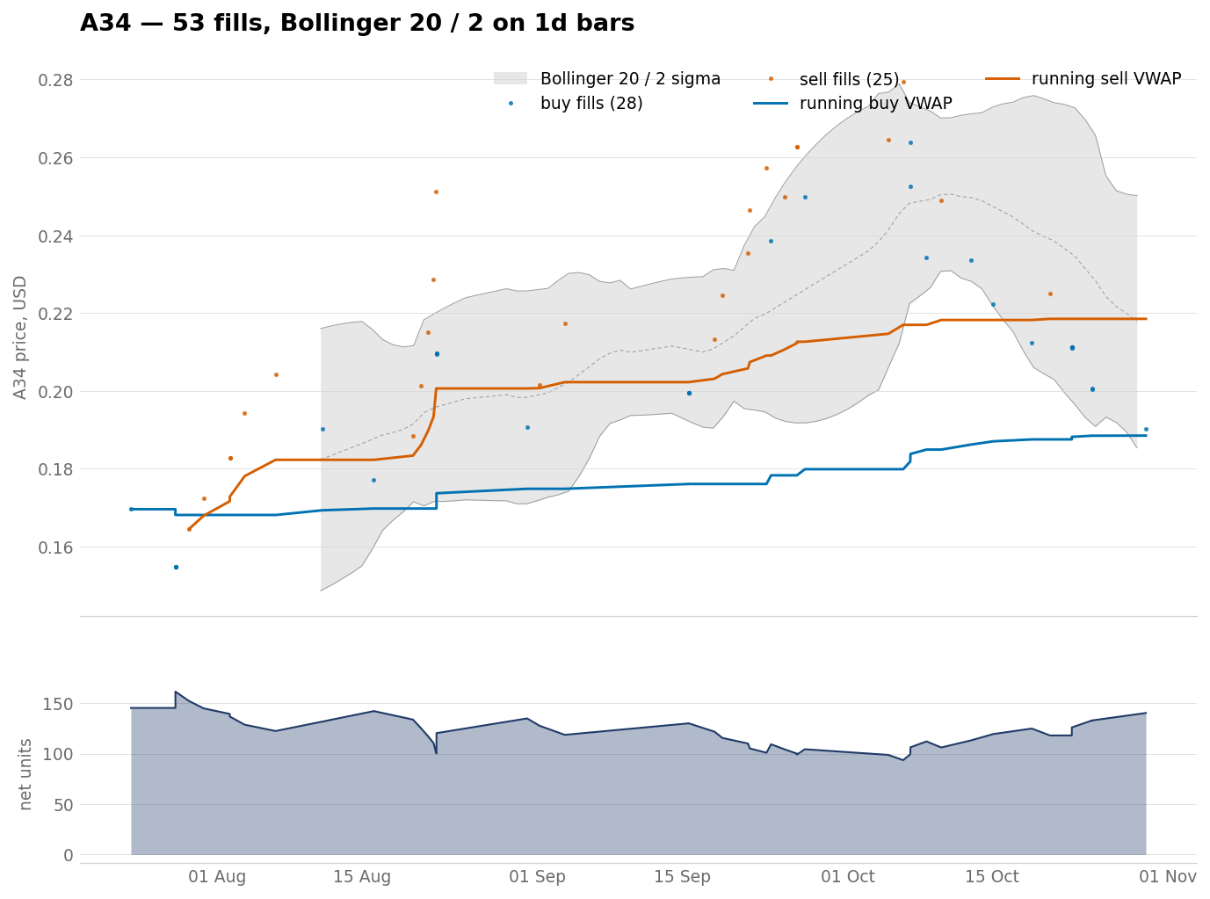
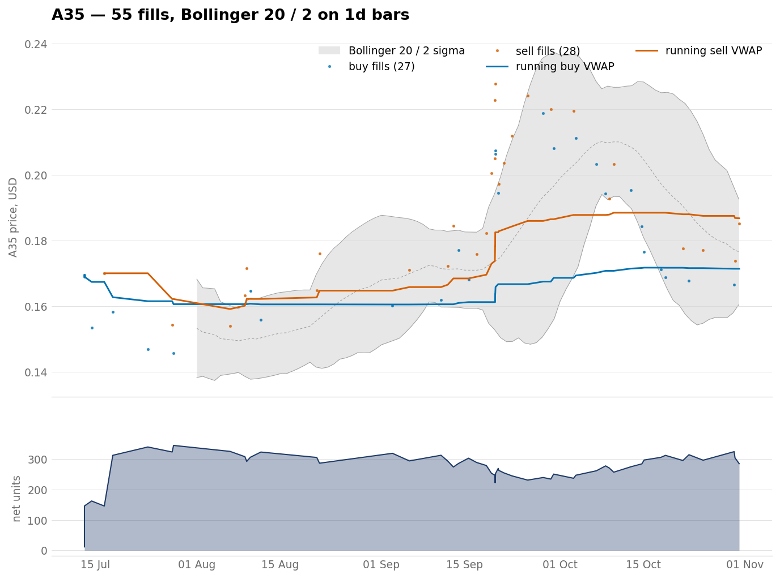
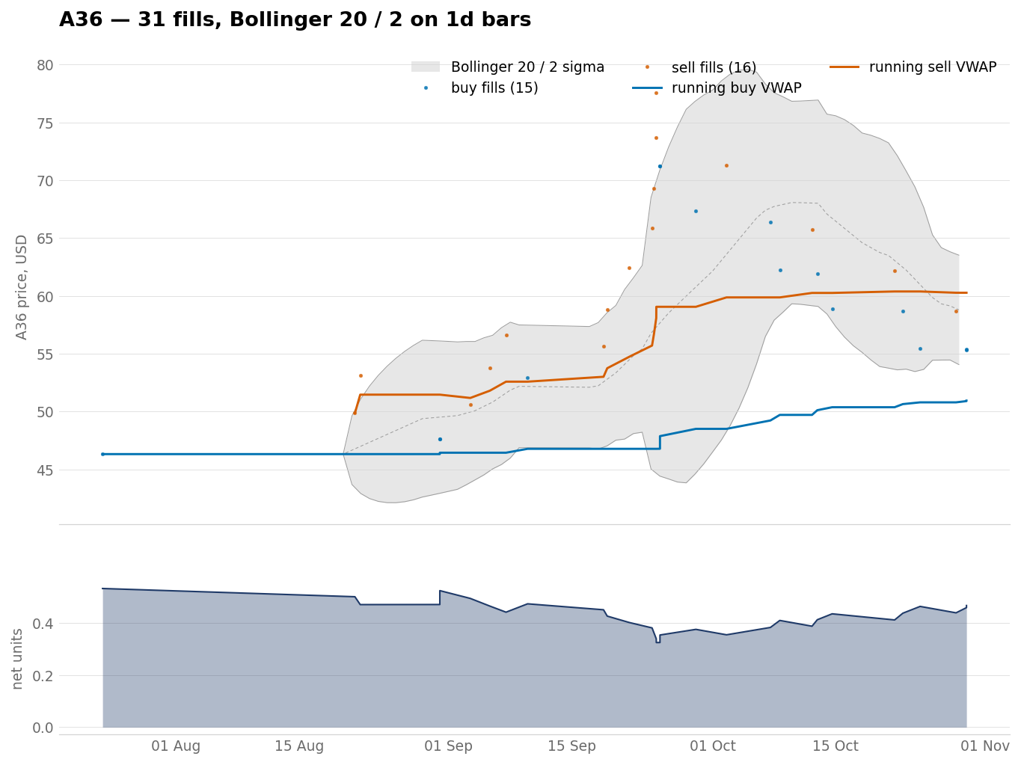
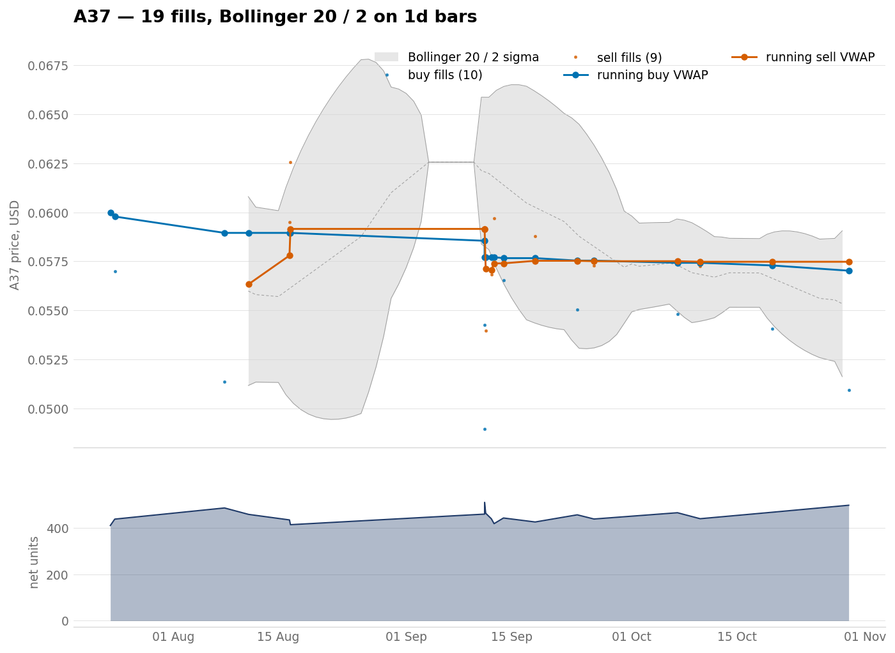
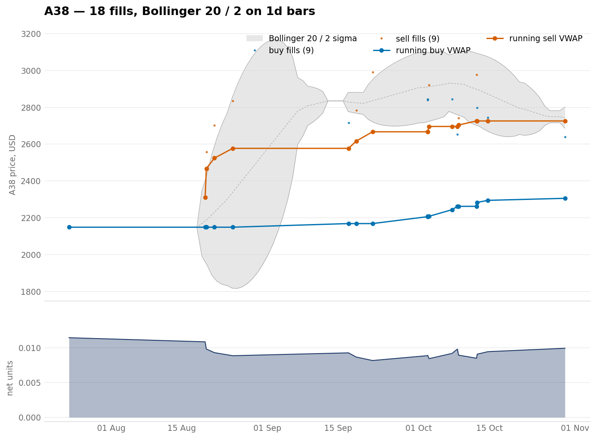
The remaining bases, A33 to A38
Six charts to a slide. Each one carries the same two lines and the same net-units panel as the eight above.
A33 161 fills index 1.224
A34 53 fills index 1.112
A35 55 fills index 1.011
A36 31 fills index 1.100
A37 19 fills index 0.951
A38 18 fills index 1.073
figures/vwap_a<NN>.png

Slide 21
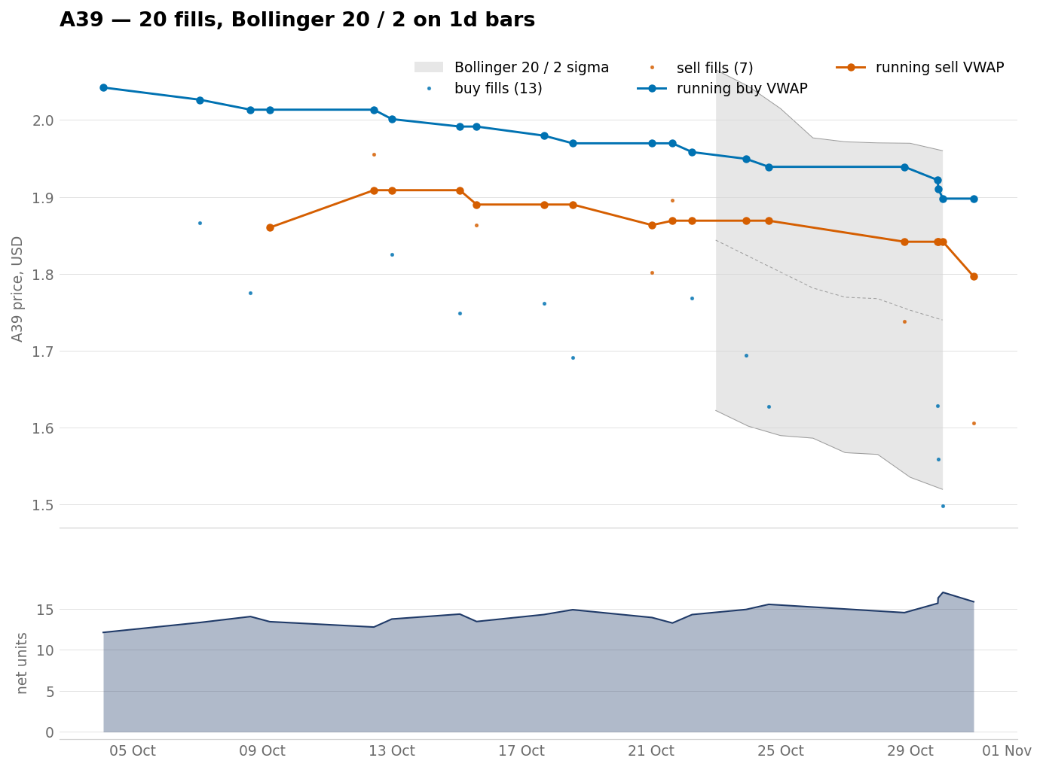
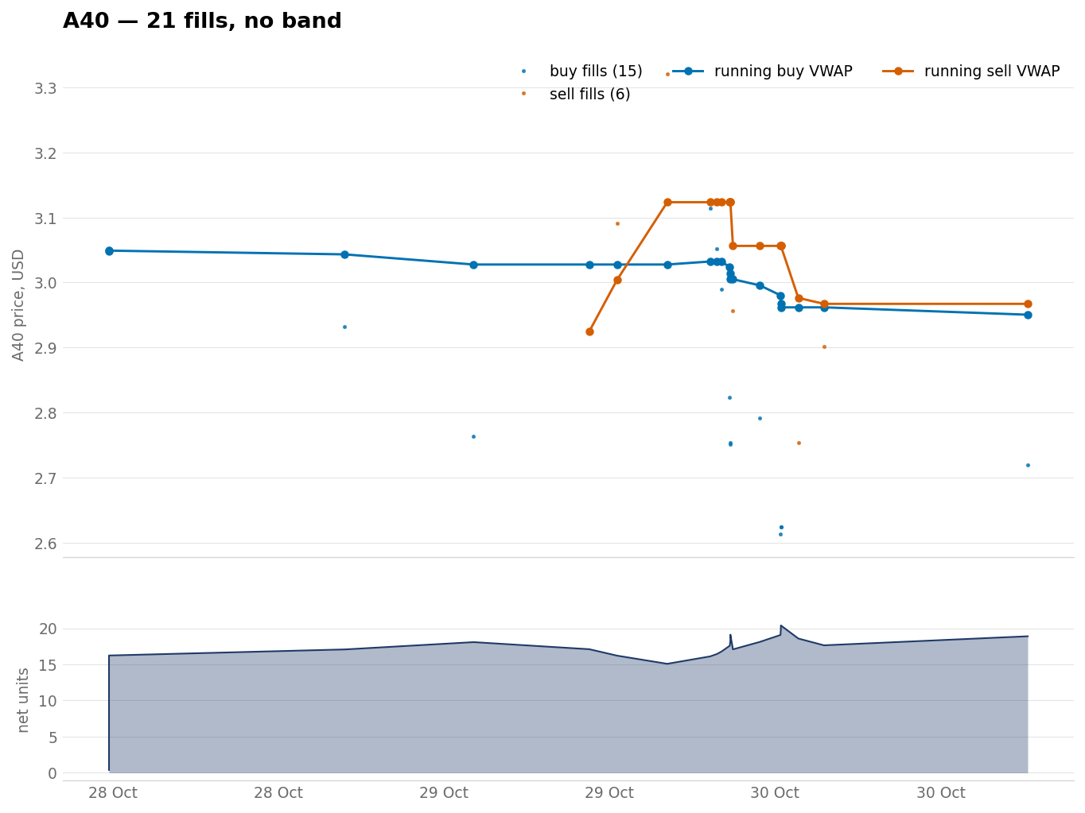
The remaining bases, A39 to A40
Six charts to a slide. Each one carries the same two lines and the same net-units panel as the eight above.
A39 20 fills index 0.929
A40 21 fills index 0.968
figures/vwap_a<NN>.png

Slide 22
Why the band's bar is a day long
The grey channel behind the fills is a Bollinger band at period 20 and width 2. It puts a trade at a volatility extreme on the picture.
Bar length | Bands drawn | Zero width | Share | Fills in a banded bar
5 minutes | 1,668,377 | 1,553,229 | 93.1% | 8,920
15 minutes | 555,647 | 458,049 | 82.4% | 8,894
1 hour | 138,370 | 74,966 | 54.2% | 8,753
4 hours | 34,060 | 6,506 | 19.1% | 8,313
1 day | 5,093 | 36 | 0.7% | 6,996
At 5 minutes, 93.1% of the channel has no width, so the band traces the price line and shows no extreme. At 1 day, 0.7% has no width. The charts use bars of 1 day, and 20 of them must close before the first band appears.
tools/build_product_manual.py, in band_tally

Slide 23
Where the fills landed against the band
The upper line is 2 standard deviations above the recent average price, so a sell on it is a sale made at the top of that base's range.
Reading | Value
Fills at or above the upper band, 40 bases | 829
Fills at or below the lower band, 40 bases | 624
Sells at or above the upper band, most often | A11 at 73, A02 at 61
Buys at or below the lower band, most often | A03 at 54, A15 at 39
Nothing about a fill at a band edge says it was profitable. It says where in the recent price distribution the trade landed. A dot inside the channel is an ordinary trade.
tools/build_product_manual.py, in band_tally

Slide 24
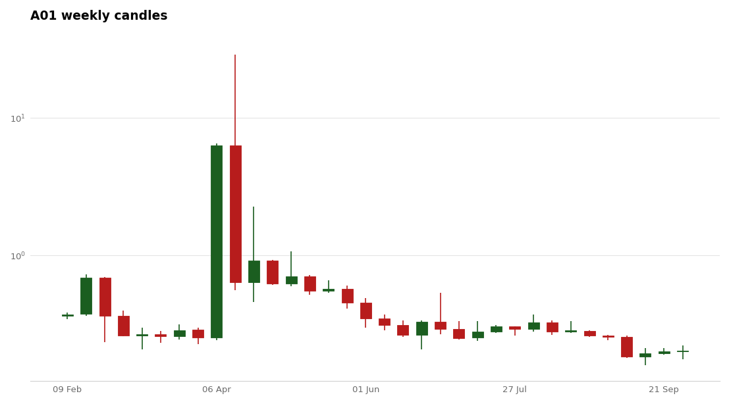
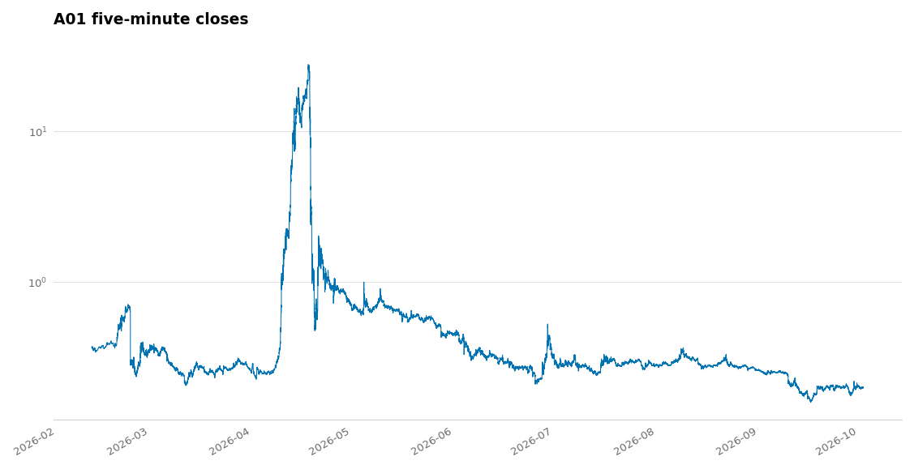
The market A01's fills ran in
A weekly bar hides what happens inside its week, and inside the week is where the cycle works. The trace plots every five-minute close.
A01 weekly chart, 34 weekly candles built from 50,380 five-minute rows.
A01 price trace, 50,380 five-minute closes across the recorded window.
figures/weekly_a<NN>.png and trace_a<NN>.png

Slide 25
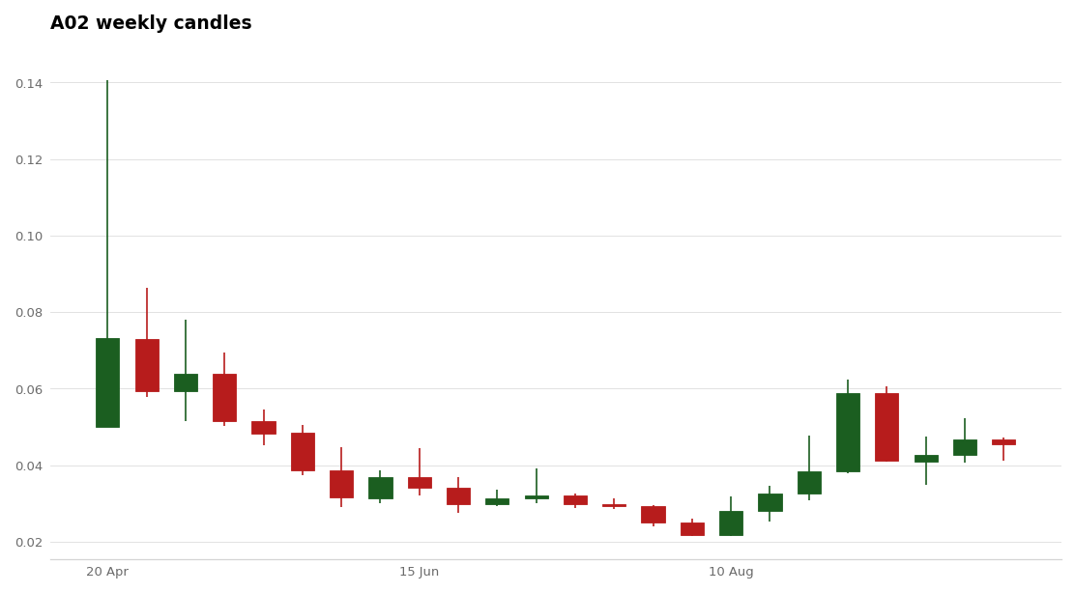
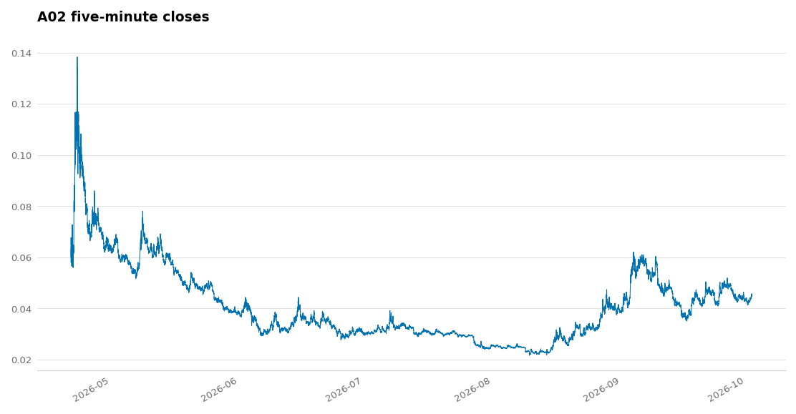
The market A02's fills ran in
A weekly bar hides what happens inside its week, and inside the week is where the cycle works. The trace plots every five-minute close.
A02 weekly chart, 24 weekly candles built from 38,463 five-minute rows.
A02 price trace, 38,463 five-minute closes across the recorded window.
figures/weekly_a<NN>.png and trace_a<NN>.png

Slide 26
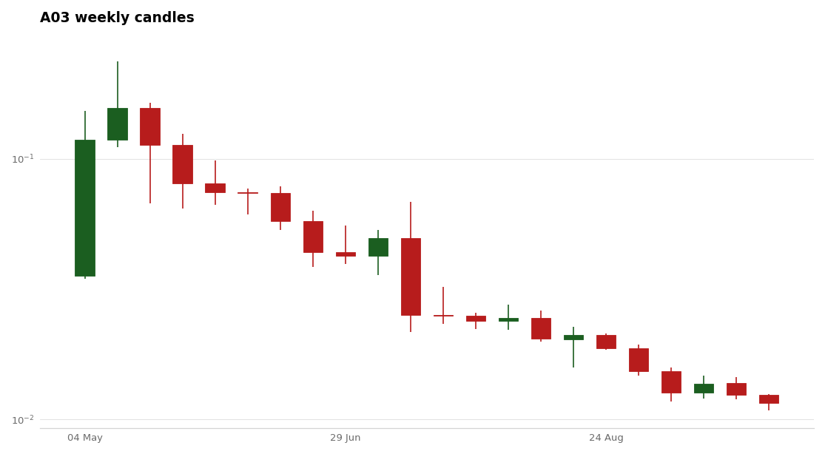
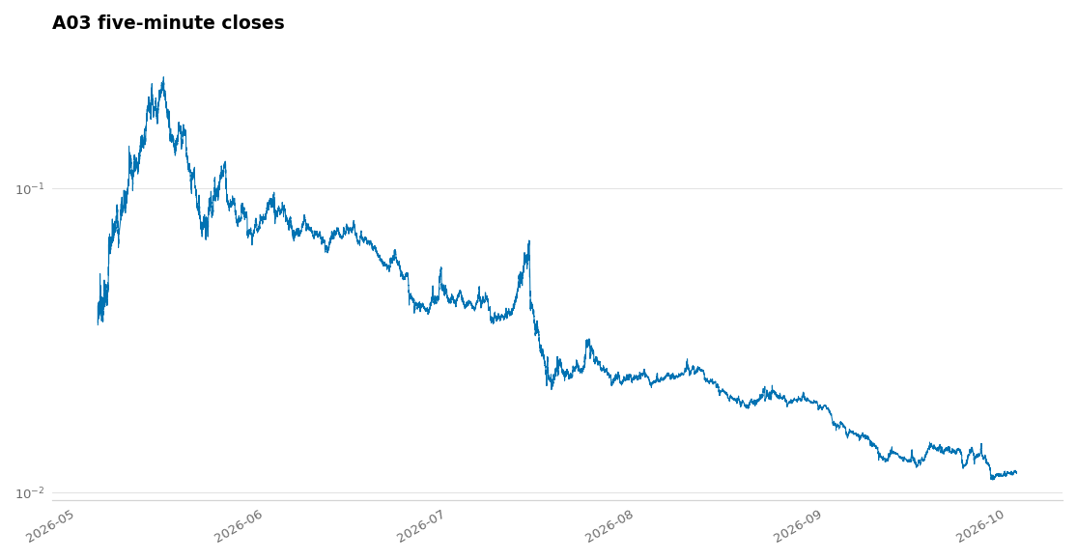
The market A03's fills ran in
A weekly bar hides what happens inside its week, and inside the week is where the cycle works. The trace plots every five-minute close.
A03 weekly chart, 22 weekly candles built from 39,186 five-minute rows.
A03 price trace, 39,186 five-minute closes across the recorded window.
figures/weekly_a<NN>.png and trace_a<NN>.png

Slide 27
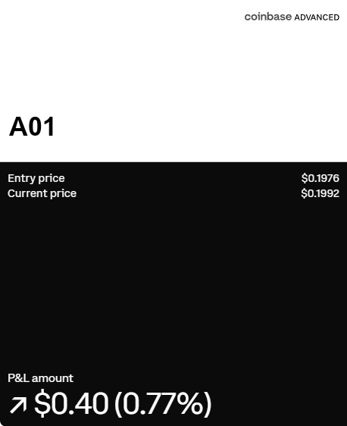
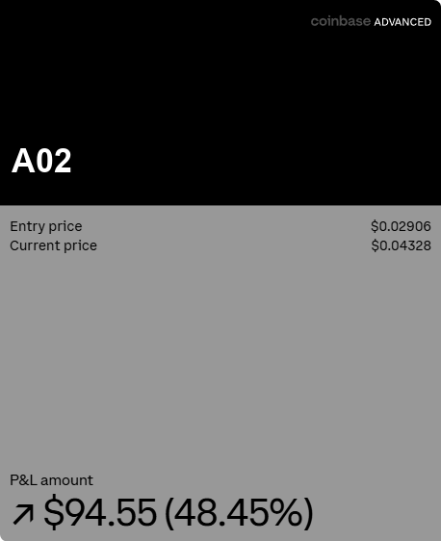
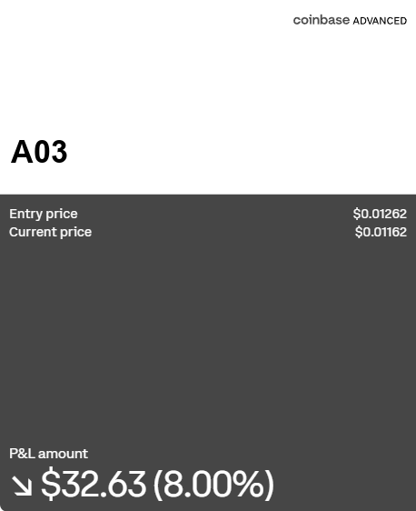







The venue's own position cards, A01 to A10
Each card carries the entry price the venue holds for the open position, the current price, and the gain or loss. The figures are the venue's own.
A01
A02
A03
A04
A05
A06
A07
A08
A09
A10
figures/card_a<NN>.png

Slide 28










The venue's own position cards, A11 to A20
Each card carries the entry price the venue holds for the open position, the current price, and the gain or loss. The figures are the venue's own.
A11
A12
A13
A14
A15
A16
A17
A18
A19
A20
figures/card_a<NN>.png

Slide 29










The venue's own position cards, A21 to A30
Each card carries the entry price the venue holds for the open position, the current price, and the gain or loss. The figures are the venue's own.
A21
A22
A23
A24
A25
A26
A27
A28
A29
A30
figures/card_a<NN>.png

Slide 30







The venue's own position cards, A31 to A40
Each card carries the entry price the venue holds for the open position, the current price, and the gain or loss. The figures are the venue's own.
A31
A32
A33, no card
A34
A35
A36
A37
A38
A39, no card
A40, no card
figures/card_a<NN>.png

Slide 31
What the platform's own grader scores
Four axes and no more. The overall figure is the unweighted mean of the axes that scored, and 0.5 when none of them could.
execution | timing | strategic | outcome
scored | scored | scored | scored
A+ | A | B | C | D | F
0.93 | 0.85 | 0.70 | 0.55 | 0.40 | under 0.40
An axis whose price inputs are absent is left out. The market regime rides beside the grade rather than inside it, and carries no score of its own.
src/trading/trade_grader.py, in grade_trade

Slide 32
What this deck does not claim
A falling average cost is not profit. It does not become profit until units are sold, and no sale enters that line.
A ratio above 1.000 reads the trades already closed. It says nothing about the units still held.
Every base carries a ratio, because every base has four fills or more on each side.
A card's entry price is not the buy line above it. The card follows the open position only and resets to zero on a full close. The buy line counts every buy in the record and never resets.
tools/build_product_manual.py, in sell_over_buy

Slide 33
Where every figure came from
Reading | Value
The builder | tools/build_product_manual.py
The figures | docs/manual/figures/
Figures on these slides | 84
Absences stated rather than drawn | card_a33.png, card_a39.png, card_a40.png
The export these slides read | 9,052 fills on 40 bases, 12 Apr to 31 Oct
Exports in the input folder | 16
The one command | python -m tools.build_product_manual --evidence-dir <folder>
The deck is a build output. The command above draws the figures, these slides and the manual from one export, so nobody edits a slide by hand.
tools/build_product_manual.py, in write_evidence_deck

