Slide 1
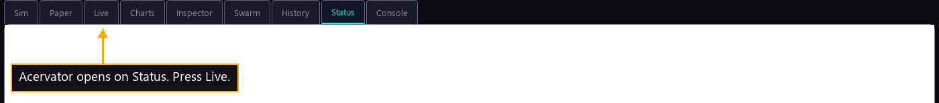
Step 1 — The window opens
Acervator opens on Status. Press Live.

Slide 2
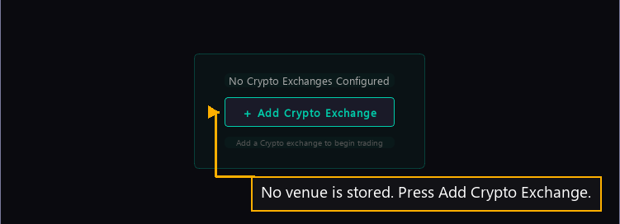
Step 2 — Live has no venue
No venue is stored. Press Add Crypto Exchange.

Slide 3
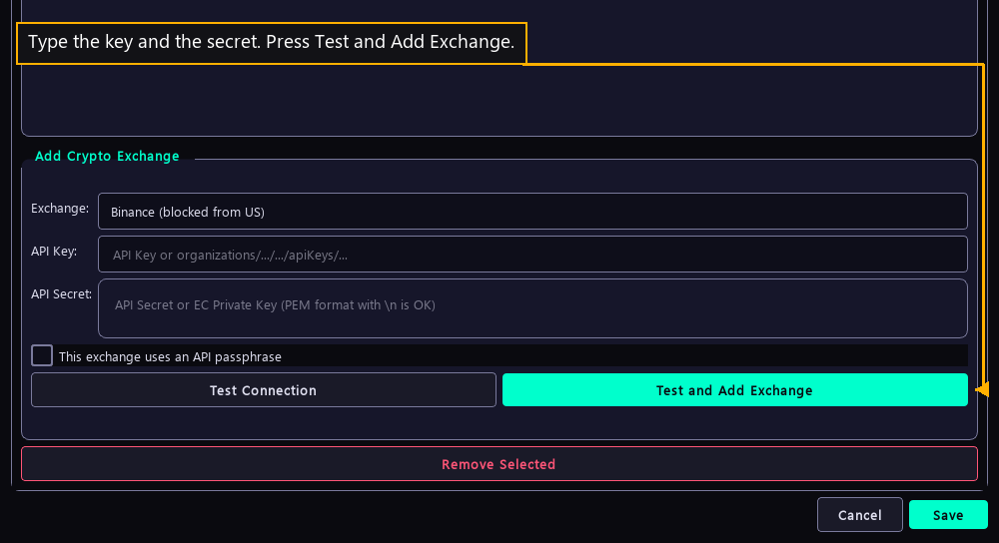
Step 3 — Enter the venue keys
Type the key and the secret. Press Test and Add Exchange.

Slide 4
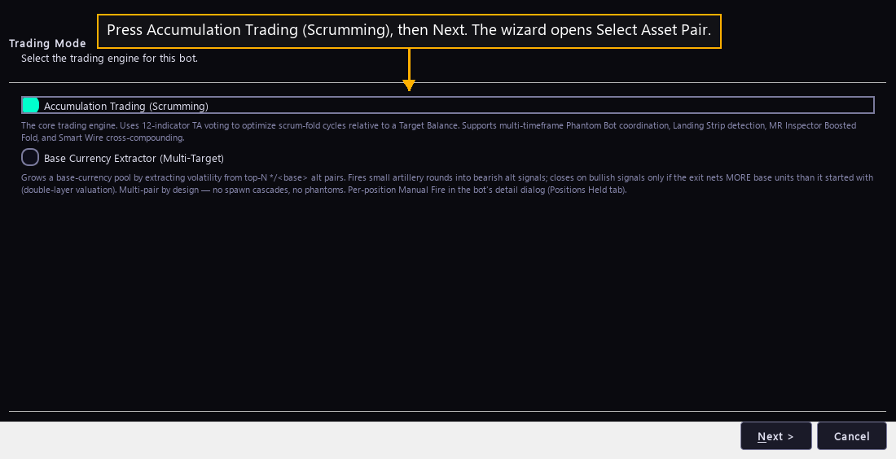
Step 4 — Choose the engine
Press Accumulation Trading (Scrumming), then Next.

Slide 5
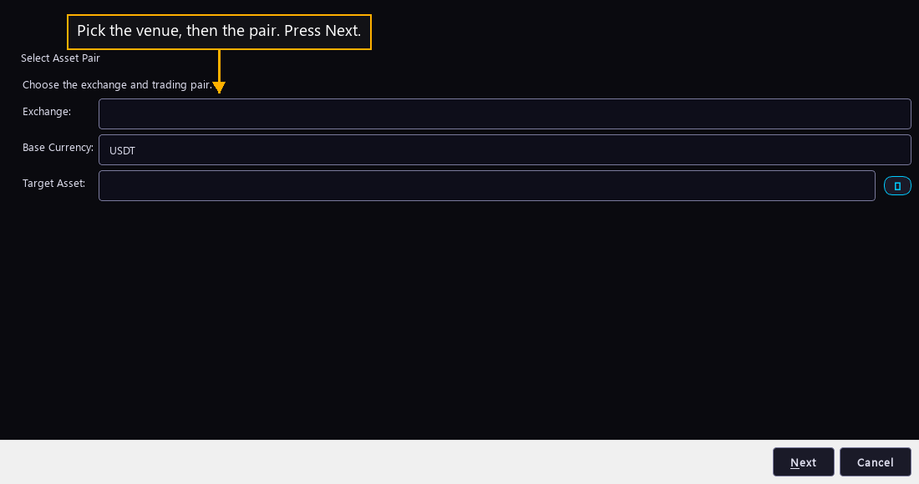
Step 5 — Name what it trades
Pick the venue, then the pair. Press Next.

Slide 6
Step 6 — Make the fleet
This step carries no picture. Driving it creates bots.
Open Inspector and scan. Press Preview on a topology proposal, then Adopt.
Adopt is the only control on that screen that creates anything. It opens the wizard once for each new bot.

Slide 7
Step 7 — Start the fleet
This step carries no picture. A started bot places real orders on a real venue.
Start each bot from the bot list under Live.
The fleet is running.

