Slide 1
RESTAURANT-DATABASE
Student name:
Group #:
Database I
Section:
Instructor:

Slide 2
Talking Points:
Introduction:
group members
short project overview
tools and techniques
Detailed project description:
project assumptions
requirements, including examples
entities, relationships, fields and data-types
ERD, including project’s history
SQL queries (5 examples).
Summary and lessons learned
Q&A

Slide 3
INTRODUCTION

Slide 4
Group members:
# | Role | Name | Email
1 | Project Manager (Instructor)
2 | Project Coordinator/Member (Student)

Slide 5
Project overview (part 1):
The “Restaurant Database” project aims to store information regarding average restaurant activities and resources such as orders, items, quantities, prices, categories, suppliers, phone numbers, and addresses.

Slide 6
Project overview (part 2):
The database design would provide flexibilities in terms of adding and disabling of a single item and whole categories as well. The database design would also provide an efficient data system in terms of CRUD capabilities.

Slide 7
Software Utilities and Tools:
# | Vendor | Product | Version | Comments
1 | Romain Bourdon | WAMP Server | 3.0.6 (64 bit) | Windows web development environment
2 | Apache Software Foundation | Apache | 2.4.23 | Web server
3 | PHP open source Community | PHP | 5.6.25 | Script Engine
4 | Oracle | MySQL | 5.7.14 | DB engine
5 | Oracle | MySQL Workbench | 6.3.8 (64 bit) | DB visualization tool
6 | CodeLobster | CodeLobster PHP Edition | 5.11.4 | Scripting tool
7 | GitHub Inc. | GitHub.com | n/a | Online file repository (https://github.com/ikostan/RESTAURANT-DATABASE)
8 | Git open source community | Git GUI client | 0.20.GITGUI | GUI client for distributed version control system
9 | Git open source community | Git client | 2.9.2.windows.1 | Distributed version control system
10 | © 2017 Mockaroo, LLC. | mockaroo.com | n/a | URL: https://mockaroo.com

Slide 8
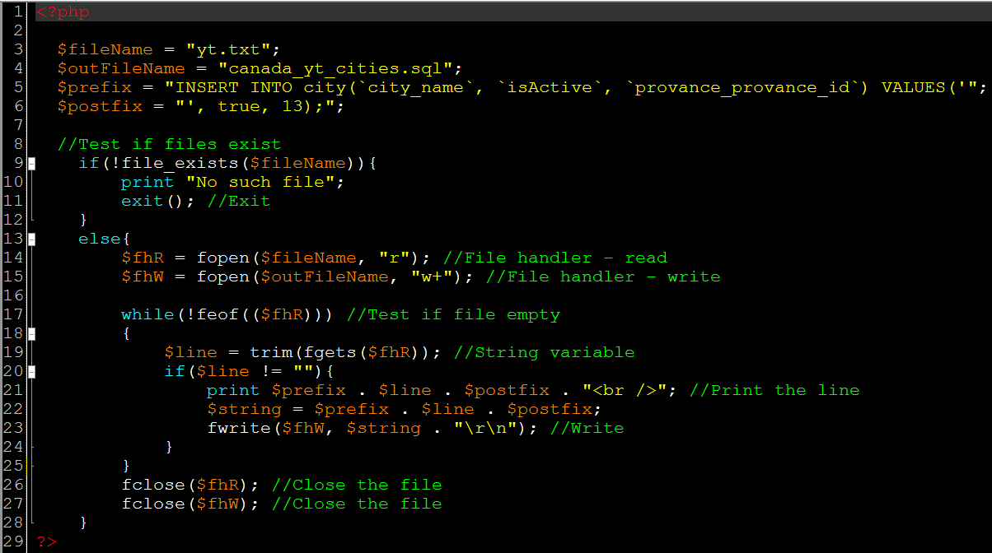
Software Utilities and Tools:

Slide 9
DETALIED PROJECT DESCRIPTION

Slide 10
Assumptions (part 1):
Addresses history will not be preserved.
One supplier may provide multiple brands.
Each supplier may have one and only one address
Each supplier may have multiple telephone numbers.
Suppliers may be from different cities.
There is a track of prices history per item.

Slide 11
Assumptions (part 2):
No updates allowed for customers’ feedbacks.
One order may have no more than one feedback.
Item type may have multiple subtypes.
Each item subtype may have multiple related items.
Each item must have weight unit.
Each item may be related to only one brand.
No tracks of customers’ data.

Slide 12
Requirements (part 1):
There were 25 requirements in total.
Only 4 were not implemented in the final version.
Only 6 were partially implemented.
Priorities:
High: 16 (14 implemented, 3 partially)
Medium: 7 (3 partially implemented)
Low: 2 (0 implemented…???)
Team members are committed to the requirement implementation of high and medium priorities only.

Slide 13
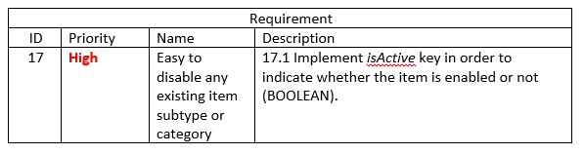
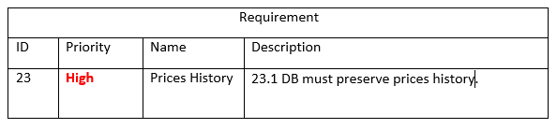
Requirements (part 2):
Examples - High priority requirements:

Slide 14
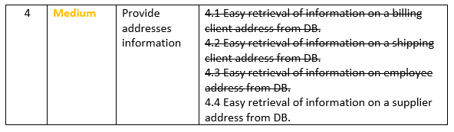
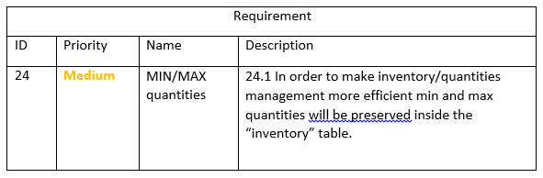
Requirements (part 3):
Examples - Medium priority requirements:

Slide 15
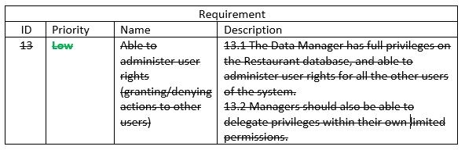
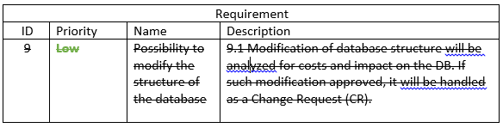
Requirements (part 4):
Examples - Low priority requirements:

Slide 16
Relationships:
Relationship | Example
One-to-One (1:1) | Supplier > address, order > feedback, ordered item > price
One-to-Many (1:n) | Province > city, city > zip code, area code > phone number, item > price
Many-to-Many (n:m) | price > order-has-item < order

Slide 17
Entities:
18 entities in total.
6 strong entities: province, street, supplier, order, item-type, weight-unit.
12 weak entities:
One ID-dependent: order-has-item.
11 non-ID-dependent: area-code, city, phone-number, zip-code, price, address, brand, item, inventory, feedback, item-subtype.

Slide 18
Keys and data-types (part 1):
All primary keys (except one weak entity table) are non-composite surrogate type keys (good for 2NF).
Data-type | Default value | Examples (keys)
TINYINT |  | area_code_id, province_province_id
BOOLEAN |  | isActive
SMALLINT(3) |  | area_code
DATETIME | CURRENT_TIMESTAMP | date_created
 | CURRENT_TIMESTAMP ON UPDATE CURRENT_TIMESTAMP | date_updated

Slide 19
Keys and data-types (part 2):
Data-type | Default value | Examples (keys)
INT |  | phone_number_id, city_id
VARCHAR(45) |  | province_name, city_name
BIGINT |  | zip_code_id
DECIMAL |  | price_tag
MEDIUMINT |  | brand_brand_id

Slide 20
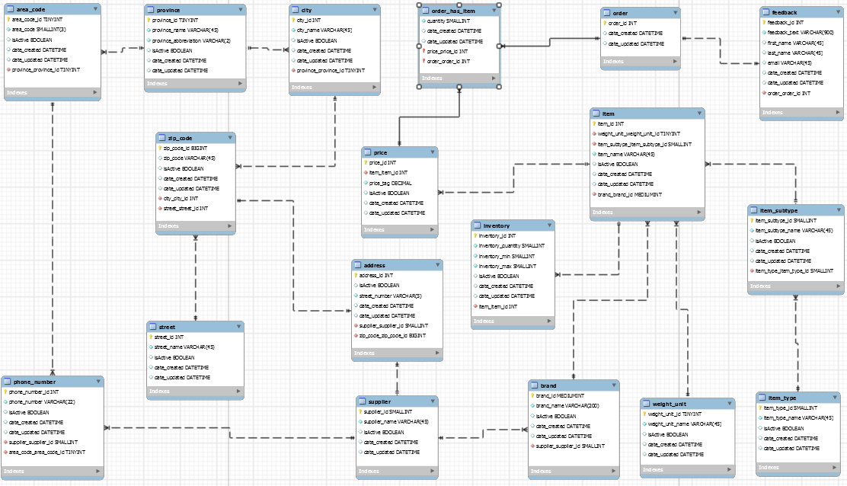
ERD (final version):

Slide 21
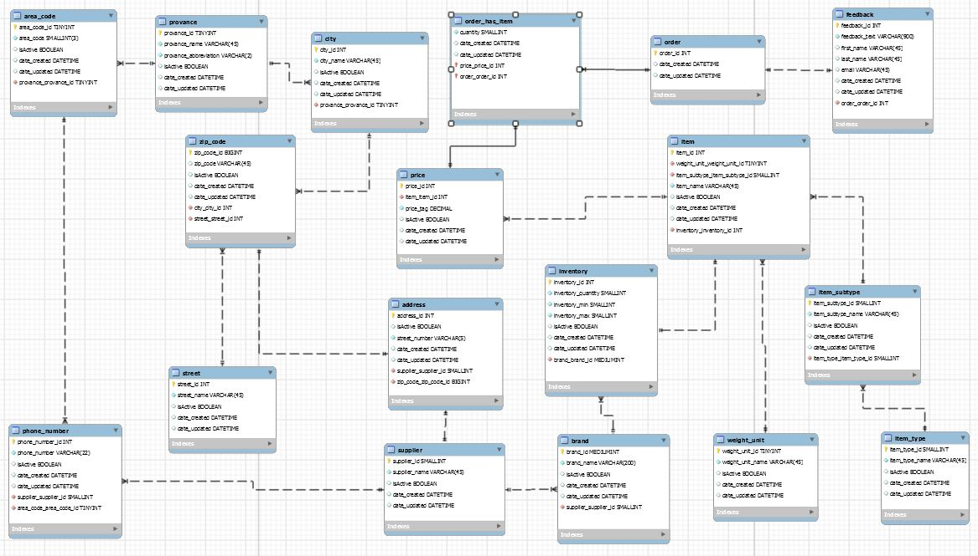
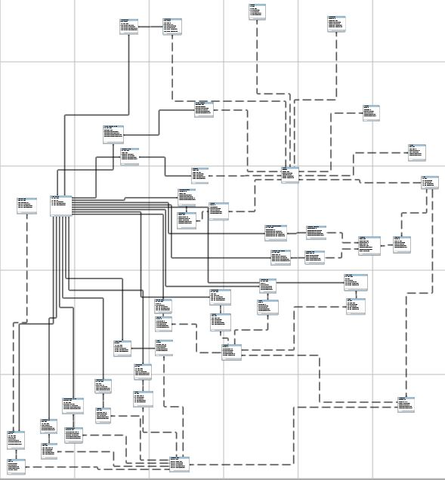
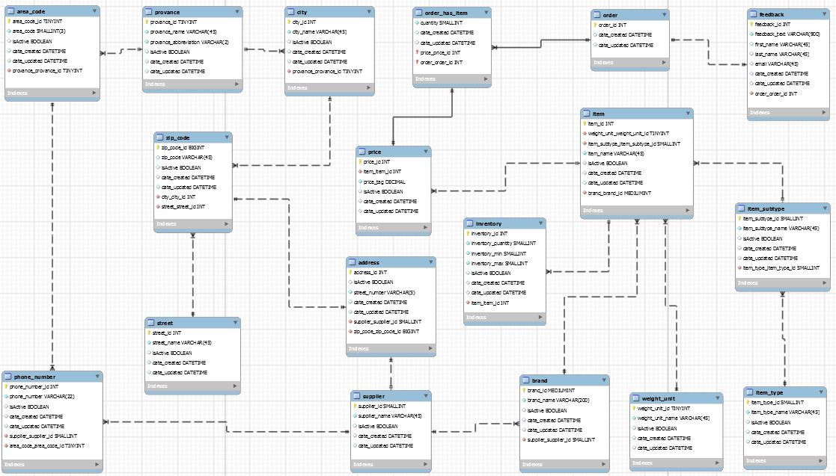
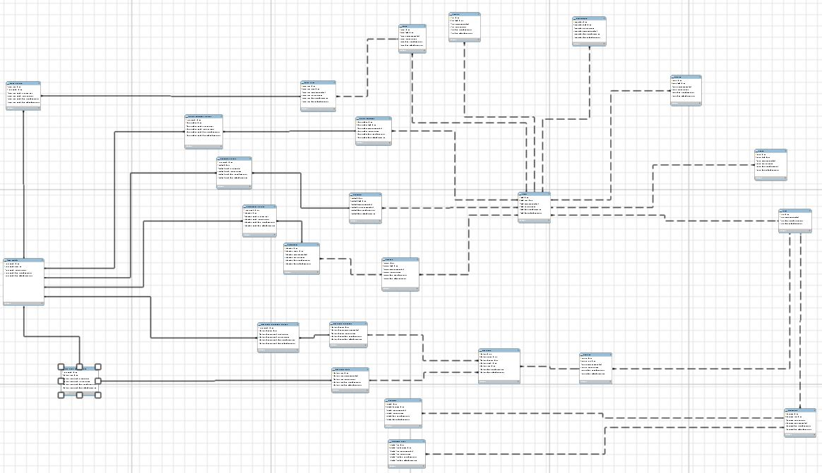
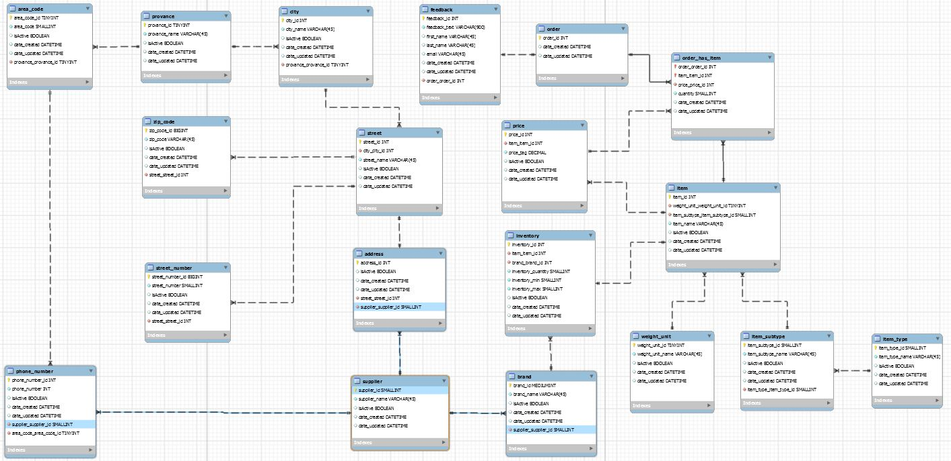
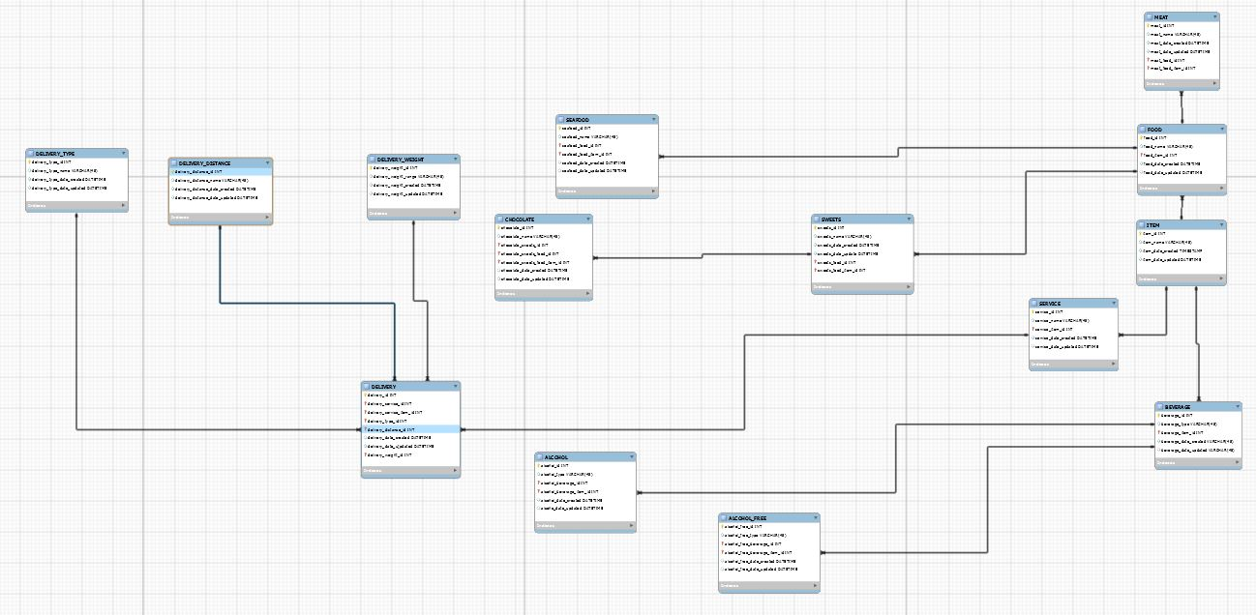
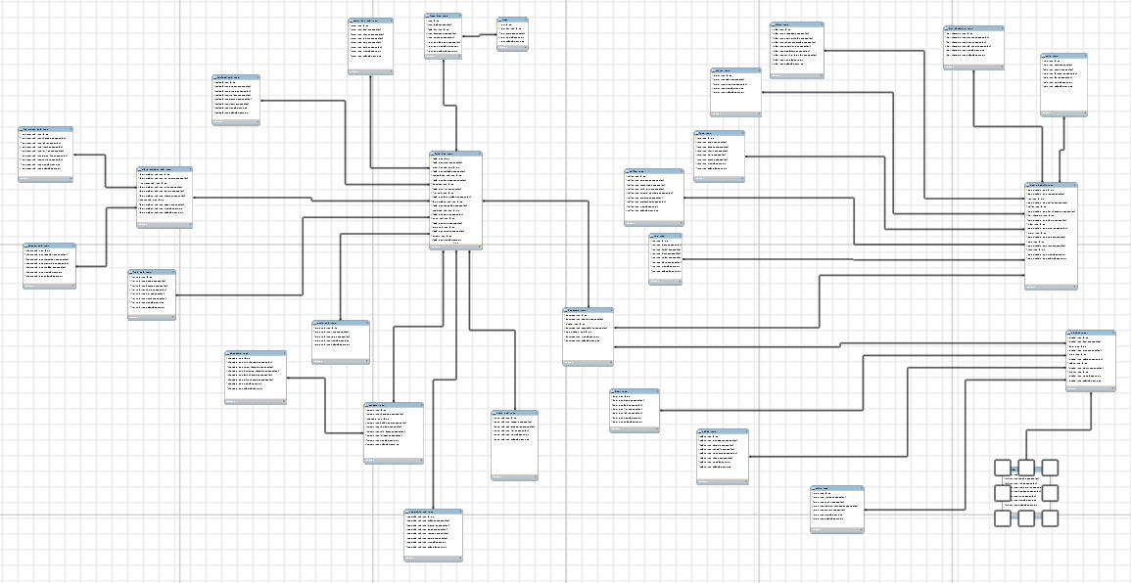
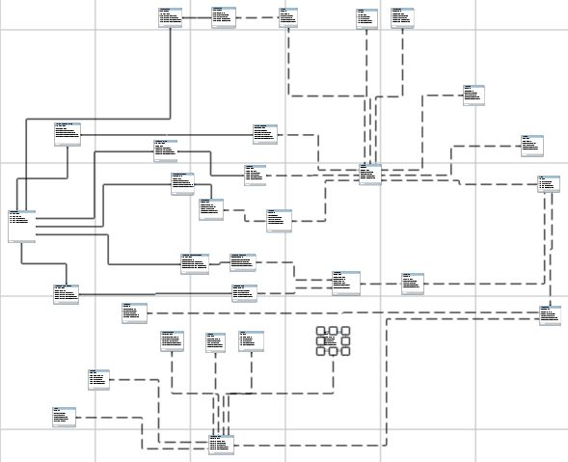
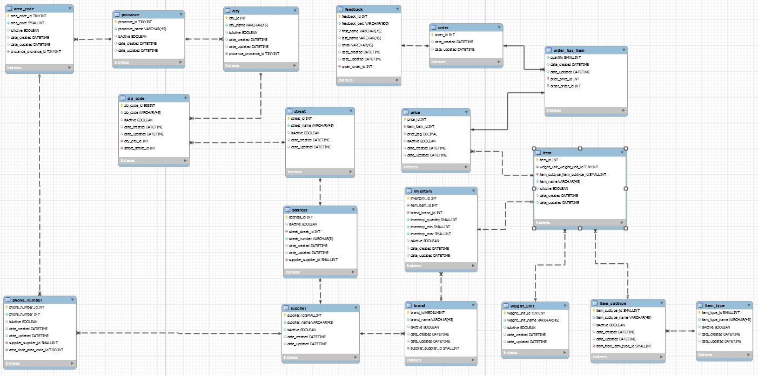
ERD (history):

Slide 22
SQL QUERIES

Slide 23
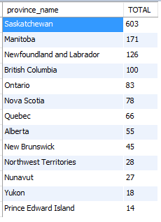
SQL query #1:
Simple join with 2 tables - get total number of cities per province and display the numbers in descending order:
SELECT P.province_name, COUNT(C.city_name) AS TOTAL FROM grp24.province AS P
INNER JOIN city AS C
ON C.province_province_id = P.province_id
GROUP BY P.province_name
ORDER BY TOTAL DESC;

Slide 24
SQL query #2:
Complex join with multiple tables - get full address of specific brand supplier (brand id 11):
SELECT B.brand_name, S.supplier_name, ST.street_name, A.street_number, Z.zip_code, CT.city_name, PRV.province_name
FROM grp24.brand AS B
INNER JOIN grp24.supplier AS S
ON S.supplier_id = B.supplier_supplier_id
INNER JOIN grp24.address AS A
ON A.supplier_supplier_id = S.supplier_id
INNER JOIN grp24.zip_code AS Z
ON Z.zip_code_id = A.zip_code_zip_code_id
INNER JOIN grp24.street AS ST
ON Z.street_street_id = ST.street_id
INNER JOIN grp24.city AS CT
ON Z.city_city_id = CT.city_id
INNER JOIN grp24.province AS PRV
ON PRV.province_id = CT.province_province_id
WHERE brand_id = 11;

Slide 25

SQL query #3:
Complex join with multiple tables and calculation - find the most dramatic item price change (provide min and max price, item name):
SELECT DTABLE.item_item_id, DTABLE.item_name, MAX(DTABLE.price_tag), MIN(DTABLE.price_tag), (MAX(DTABLE.price_tag) - MIN(DTABLE.price_tag)) AS DIF FROM (
SELECT P.price_id, P.item_item_id, P.price_tag, I.item_id, I.item_name
FROM grp24.price AS P
INNER JOIN grp24.item AS I
ON I.item_id = P.item_item_id
ORDER BY P.item_item_id
) AS DTABLE GROUP BY DTABLE.item_item_id
ORDER BY DIF DESC LIMIT 0,1;

Slide 26

SQL query #4:
Complex join with multiple tables, including aggregation and filtering - find the most selling brand (use active brands only):
SELECT total_table.brand_id, total_table.brand_name, SUM(TOTAL_ORDER) AS TOTAL FROM (
SELECT B.brand_id, B.brand_name, I.item_name, I.item_id, P.price_id, P.price_tag, O.quantity, O.price_price_id, (P.price_tag * O.quantity) AS TOTAL_ORDER
FROM grp24.brand AS B
INNER JOIN grp24.item AS I
INNER JOIN grp24.price AS P
INNER JOIN grp24.order_has_item AS O
WHERE O.price_price_id = P.price_id AND P.item_item_id = I.item_id AND B.brand_id = I.brand_brand_id AND B.isActive = TRUE
) AS total_table GROUP BY total_table.brand_id ORDER BY TOTAL DESC LIMIT 0,1;

Slide 27

SQL query #5:
Complex join with multiple tables, including aggregation and filtering - what item is the most selling ever (including item-type and sub-type):
SELECT TOTAL.item_id, TOTAL.item_name, TOTAL.item_subtype_name, TOTAL.item_type_name, SUM(TOTAL.quantity) AS QUANTITY, SUM(TOTAL_ITEM) AS TOTAL_SOLD FROM (
SELECT I.item_id, I.item_name, ISB.item_subtype_id, ISB.item_subtype_name, IT.item_type_id, IT.item_type_name, P.price_id, P.price_tag, O.order_order_id, O.quantity,
O.price_price_id, (P.price_tag * O.quantity) AS TOTAL_ITEM
FROM grp24.item AS I
INNER JOIN grp24.item_subtype AS ISB
INNER JOIN grp24.item_type AS IT
INNER JOIN grp24.price AS P
INNER JOIN grp24.order_has_item AS O
WHERE O.price_price_id = P.price_id AND P.item_item_id = I.item_id AND IT.item_type_id = ISB.item_type_item_type_id AND I.item_subtype_item_subtype_id = ISB.item_subtype_id
ORDER BY O.order_order_id
) AS TOTAL GROUP BY TOTAL.item_id ORDER BY TOTAL_SOLD DESC LIMIT 0,1;

Slide 28
SUMMARY

Slide 29
Summary and lessons learned:
POSITIVE | NEGATIVE
Vast majority of the requirements were implemented in the final version | There was no formal QA process during the project (a lot of bugs)
Early ERD implementation allowed further design changes and improvements | Some of the features were not implemented because of small number of the group members
The whole project built by using open source or free tools only (good for budget) | Luck of design/documentation review (lead to multiple changes)
To be in touch with the project manager is always a good idea | There were a lot of DB design changes, including late stages of the project
The project accomplished on time | The original design was too complicated due to lack of knowledge (at least in the early stages of the design process)

Slide 30
THANKS

Slide 31
Q&A

