Slide 1
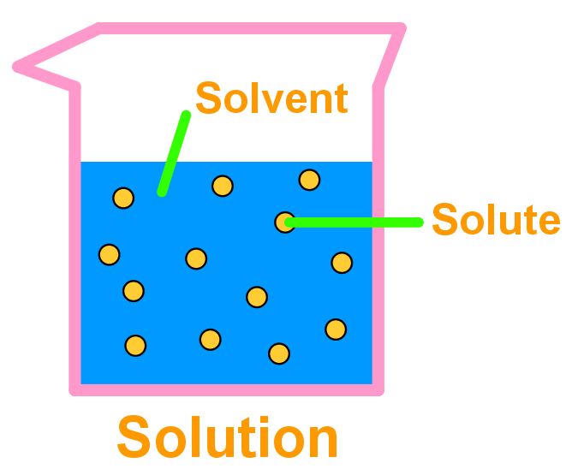
Water - Solutions - Solubility
Victory Ogaga

Slide 2
What are solutions ?
What are solvents ?
What are solutes ?
what is solubility ?
What solubility curve ?
What are saturated and unsaturated solutions ?

Slide 3
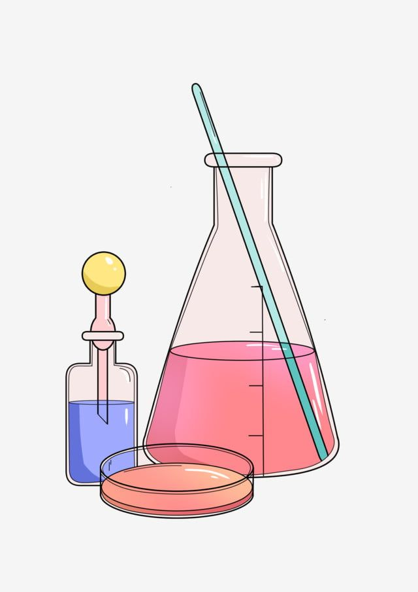
Key Concepts:
Solute: The substance being dissolved (e.g., salt).
Solvent: The substance that dissolves the solute (e.g., water).
Solution: A uniform mixture of solute and solvent.
Solubility: Ability of a solute to dissolve in a solvent.

Slide 4
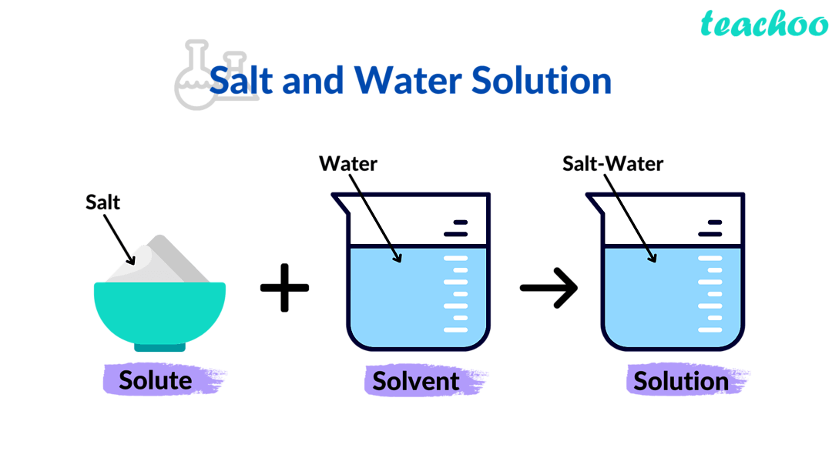

Slide 5
PTS/WAEC/JAMB Question
Why is water often referred to as the "universal solvent"?
A
Water is the most abundant substance on Earth
B
Water is essential for all living organisms.
C
Water is involved in many chemical reactions
D
Water can dissolve a wide variety of substances due to its polar nature

Slide 6
Factors affecting Solubility
Nature of solute
Temperature
Pressure
Nature of solvent

Slide 7
On which of the following is the solubility of a gaseous substance dependent (i) nature of solvent (ii) nature of solute (iii) temperature (iv) pressure
A i ii iii and iv
B i and ii only
C. ii only
D i iii and iv only

Slide 8
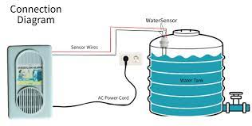
Water & Treatment:
Common source: Rainwater 🌧️
Chlorination: Adding chlorine to kill germs 🦠
Industrial Treatment:
Potassium Alum [KAl(SO4)2]: Causes coagulation — impurities clump together.
Sodium Alum III [NaAlO2]: Enhances purification by settling impurities.

Slide 9
Hardness of Water:
Hard water: Doesn’t form lather easily with soap 🧼
Caused by dissolved salts:
Calcium salts (CaSO4)
Magnesium salts (MgSO4)
Origin of Hardness:
CaSO4•2H2O (Gypsum)
CaCO3 (Limestone)
Reaction: CaCO3 + CO2 + H2O → Ca(HCO3)2 (Soluble)

Slide 10

Types of Hard Water:
Temporary Hardness:
Removed by boiling 🔥
Ca(HCO3)2 → CaCO3 + H2O + CO2
Example: Fur in kettles ☕

Slide 11
PTS/JAMB/WAEC Question
Which of the following methods can be used to remove temporary hardness from water?
A
Boiling
B
Filtration
C
Distillation
D
Chlorination

Slide 12

Permanent Hardness:
Removed by adding chemicals:
Washing soda (Na2CO3):
Na2CO3 + CaSO4 → CaCO3 + Na2SO4
Na2CO3 + MgSO4 → MgCO3 + Na2SO4
Caustic soda (NaOH):
2NaOH + CaSO4 → Ca(OH)2 + Na2SO4
2NaOH + MgSO4 → Mg(OH)2 + Na2SO4

Slide 13
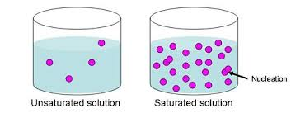
Saturated & Unsaturated Solutions:
Saturated: Maximum amount of solute dissolved
Unsaturated: More solute can still dissolve

Slide 14
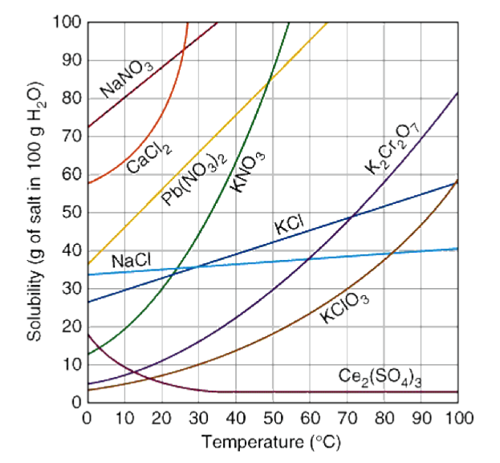
Solubility Curve: 📈 Visual representation of how solubility changes with temperature

Slide 15
The solubility curve shows the variation of a solute concentration with
A volume
B vapour density
C pressure
D temperature

Slide 16
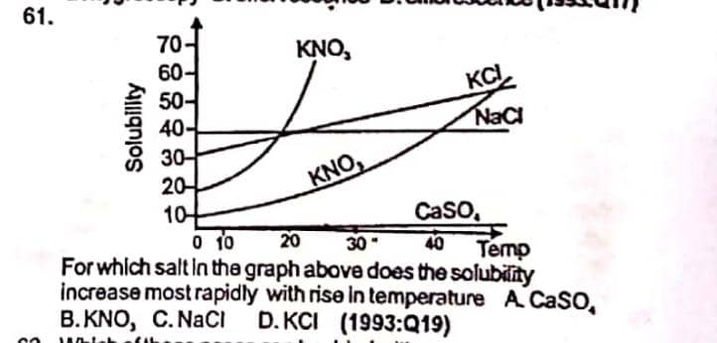

Slide 17
CALCULATIONS

Slide 18
Solubility Calculations:
Formula: S = (g/v ÷ m.m) x 1000

Slide 19
PTS/JAMB/WAEC Question
If 10.5g of lead(ii) trioxonitrate (v) Pb(NO₃)₂ is dissolved at 20cm3 in distilled water at 18⁰C. The solubility of the solute in mol/dm3 is
A. 1.6
B. 5.52
C. 16
D. 525
[ Pb = 207, N=14 ,O =16]

Slide 20
step 1: Molar mass of Pb(NO₃)₂ =
207 + 2x14 + 6 x16
= 207 + 28 + 96
= 207 + 124
= 207 + 124
= 331 g/mol
Step 2:
S =(g/v ÷ m.m) x 1000
10.5 / 20 = 0.525
0.525 / 331 = 0.00158
0.00158 x 1000
1.58 = 1.56
Pb + 2N + 6O

Slide 21
The solubility in mole per dm³ of 20g of CuSO₄ dissolved 100 cm³ of water at 180⁰C is
A. 0.13
B. 0.25
C. 1.24
D. 2.0
[Cu=63.5 , S= 32, O= 16]

Slide 22
STEP 1: 1 Molar mass of CuSO₄
Cu + S + 4O
64 + 32 + 64
160
STEP 2:
g/v ÷ m.m
20/100 = 0.2
0.2/160 = 0.00125
0.00125 x 1000
=1.25

Slide 23
Try
9.8g of solid potassium chlorate was added to 40cm3 water, and heated to dissolve all the acid. As the solution cools ,crystals of KCLO3 started forming at 66⁰C. The solubility of KClO3 at 66⁰C is therefore
A. 24.5 mol/dm3
B. 0.2 mol/dm3
C. 10 mol/dm3
D. 20 mol/dm3
E. 2 mol/dm3
K = 39, Cl = 35.5, O = 16

