Slide 1
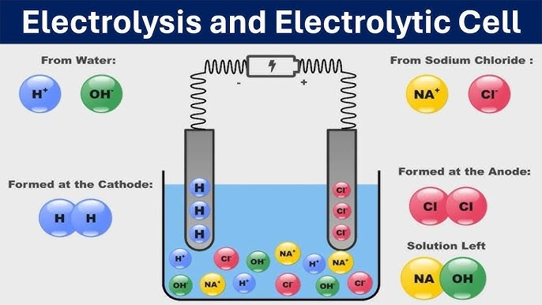

Slide 2
What is electrochemistry ?
Electrochemistry is the relationship between chemicals and electricity e.g NaCl is a compound that dissociate to give charges Na⁺ and Cl⁻ this ion can conduct electrolysis

Slide 3

What is electricity?
Electricity is the continous flow of charges Current electricity: A steady flow of electric charge through a conductor, which powers devices and systems.

Slide 4
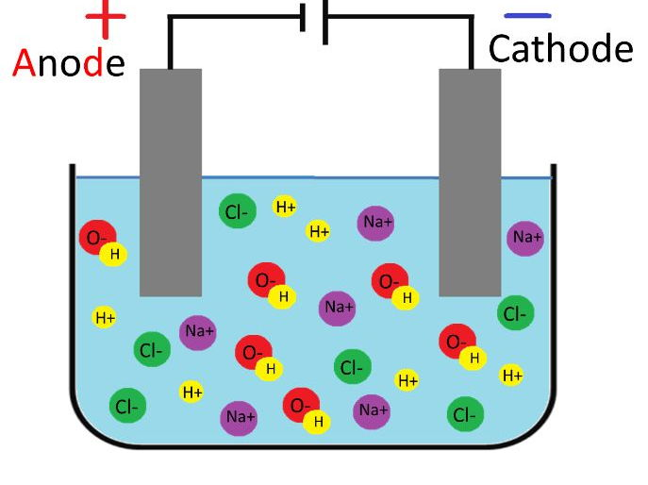
What is electrolysis?
Electrolysis can be defined as the chemical decomposition of a compound in a molten or fused state after the passage of electric current through it.

Slide 5
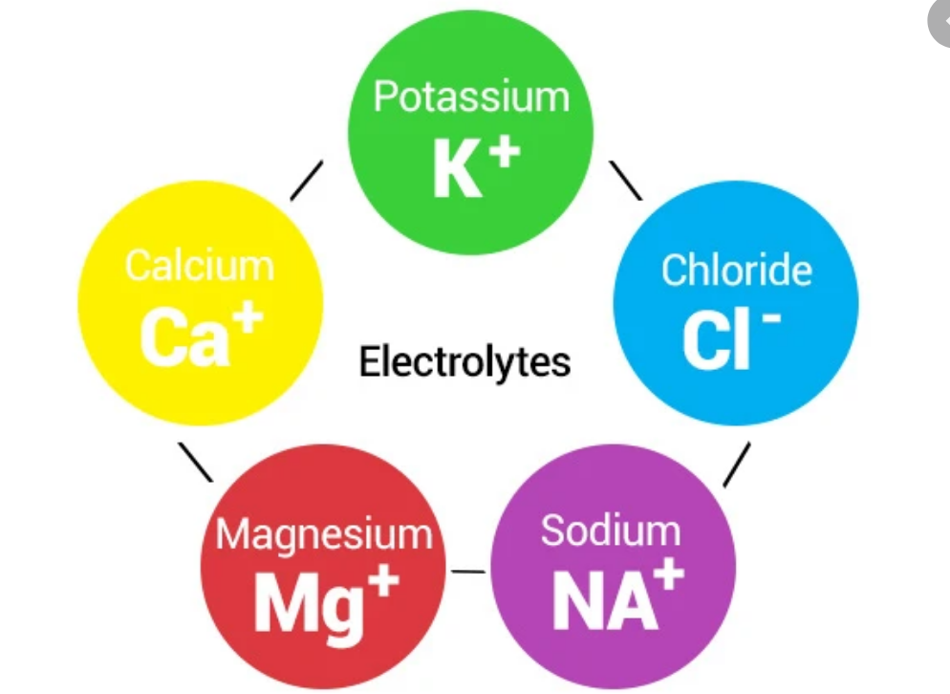
What is an electrolyte?
An electrolyte is a chemical compound which in aqueous solution will conduct electricity or electric current.
E.g: NaCl, KOH, H₂SO₄.

Slide 6
Strong electrolytes?
These are compounds that ionize completely in aqueous solution.
Eg: H₂SO₄, HCl, HNO₃, NaOH, KOH, NaCl, NH₄Cl, K₂SO₄

Slide 7
Weak electrolytes
Weak electrolytes:A weak electrolyte is a substance that only partially ionizes in solution, producing a small number of ions alongside many un-ionized molecules
Eg: Acetic acid(CH₃COOH)
Ammonium hydroxide(NH4OH)
Carbonic acid(H₂CO₃)

Slide 8
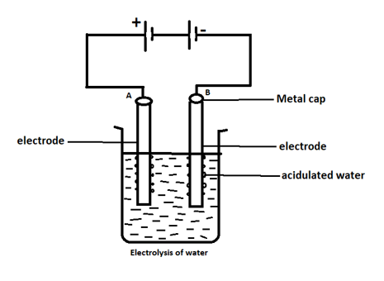
What are electrodes?
Electrodes are metal plates or conductors in the forms of wires or rods through which and electric current enters or leaves the electrolytes.
They are either anode (+ve) or cathode(-ve)

Slide 9
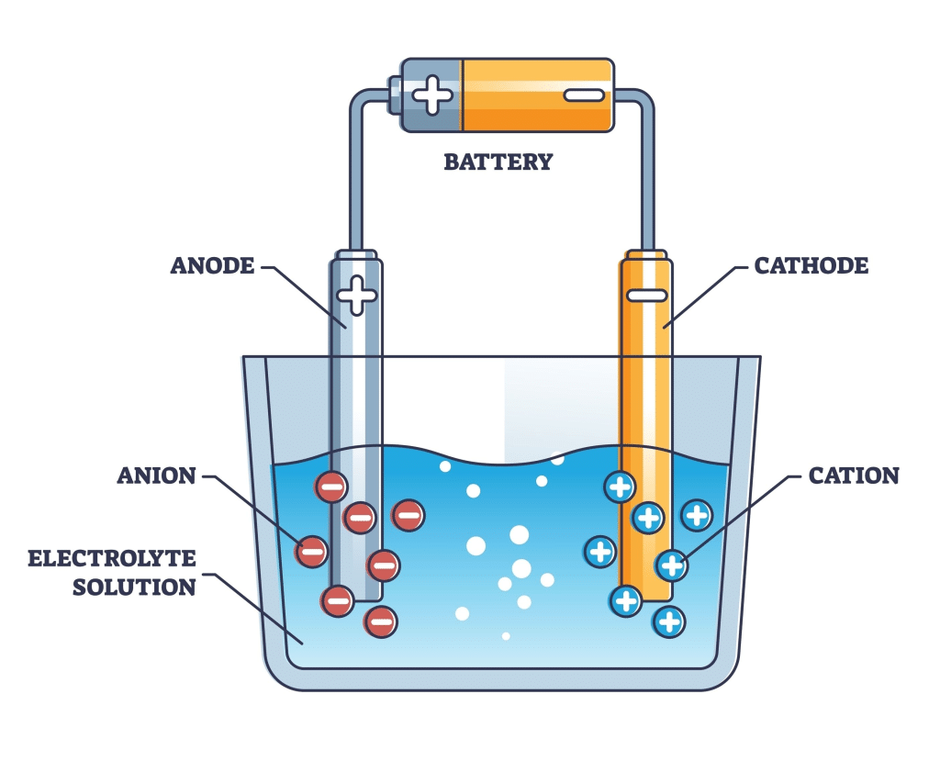
What is an anode?
An anode is the positive electrode through which current enters the electrolytes or electrons leaves an electrolyte.

Slide 10
What is a cathode?
Cathode is the negative electrode through which current leaves the electrolytes or electrons enters an electrolyte.

Slide 11
Calculations

Slide 12
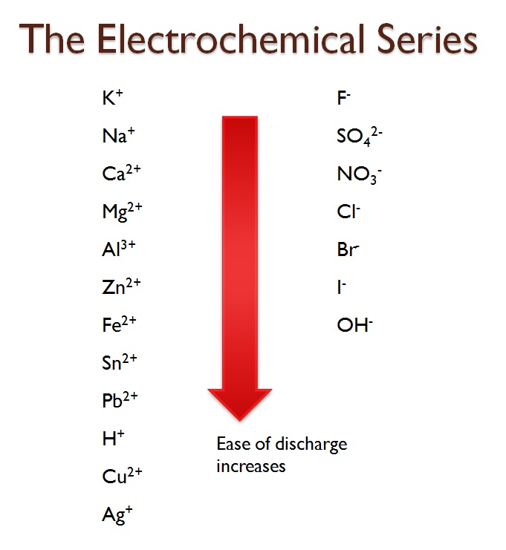

Slide 13
TIME CONVERSION
60seconds → 1minute
60minutes → 1hour
To convert minutes to seconds, multiply by 60
To conver hours to seconds, multilply by 60 x 60
e.g convert 30minutes to seconds
30 x 60 = 1800seconds
e.g convert 2 hours to secdonds
2 x 60 x 60 = 7200seconds

Slide 14
Try 1
convert 45minutes to seconds
45 X 60 = 2700

Slide 15
Try 2
convert 24 hours to seconds
24 X 60 X 60 = 86400s

Slide 16
Try 3
convert 1 hour 45minutes to seconds
1 x 60 x 60 + 45 x 60 = 6300s

Slide 17
Convert hour to seconds first
1 x 60 x 60 = 3600
Convert minutes to seconds next
45 x 60 = 2700
add everything togther
3600 + 2700 = 6300seconds

Slide 18
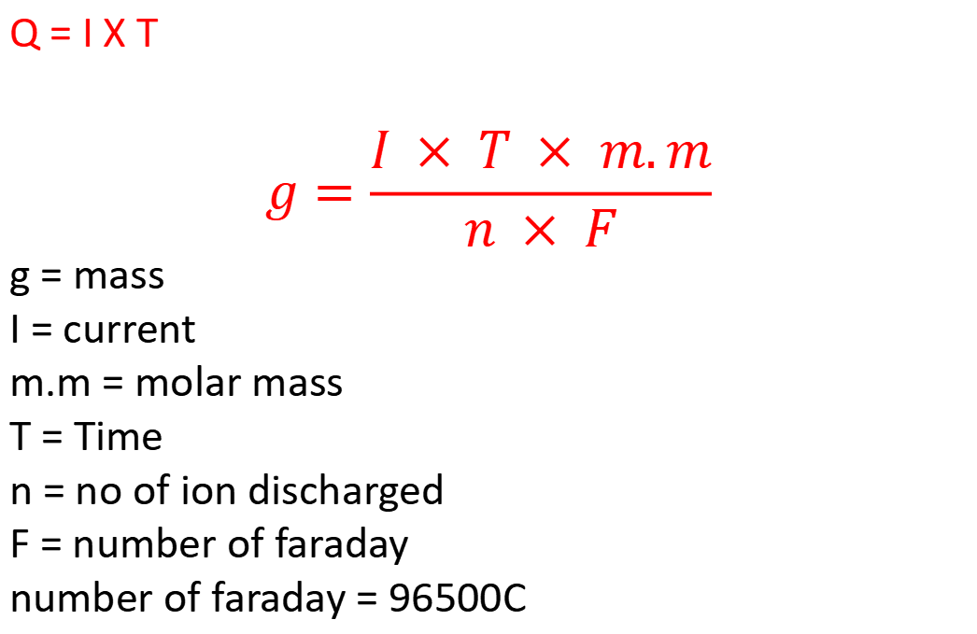
Q = I X T
$$g=\frac{I × T × m.m}{n × F}$$
g = mass
I = current
m.m = molar mass
T = Time
n = no of ion discharged
F = number of faraday
number of faraday = 96500C

Slide 19
PTS/JAMB/WAEC QUESTION
During the electrolysis of copper(II) sulfate solution using copper electrodes, a current of 2.5 A was passed for 1800seconds. Calculate the mass of copper deposited on the cathode. (Faraday’s constant = 96500 C/mol, Molar mass of copper = 63.5 g/mol)
A) 0.49 g
B) 1.58 g
C) 2.46 g
D) 3.18 g

Slide 20
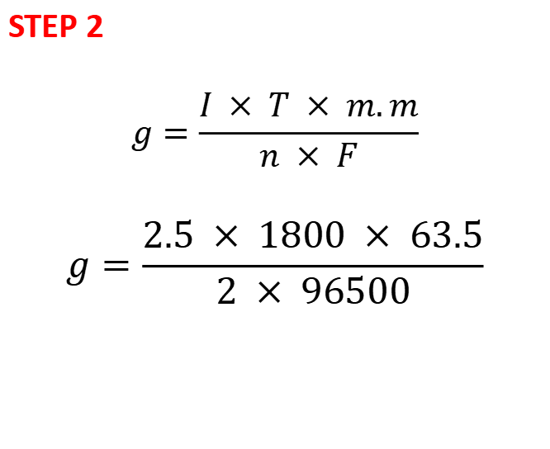
STEP 1
g = ?
m.m =63.5
T = 1800
I = 2.5
f = 96500
n = 2
STEP 2
$$g=\frac{I × T × m.m}{n × F}$$
$$g=\frac{2.5 × 1800 × 63.5}{2 × 96500}$$
1.48 g

Slide 21
PTS/JAMB/WAEC Question
A current of 3 A is passed through a solution of silver nitrate (AgNO₃) for 50 minutes. Calculate the mass of silver deposited at the cathode. (Faraday’s constant = 96500 C/mol, Molar mass of silver = 108 g/mol)
A) 4.2 g
B) 5.0 g
C) 10.1 g
D) 8.4 g

Slide 22
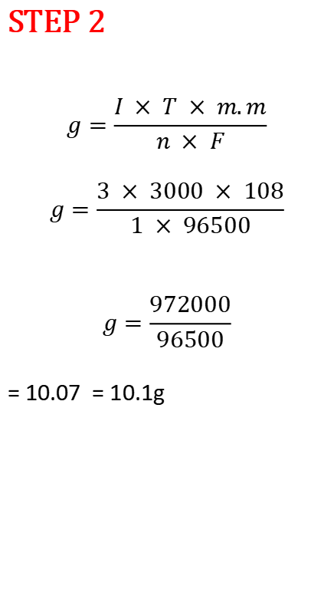
STEP 1
I = 3A
T = 50 X 60 = 3000seconds
M.M = 108
F = 96500
n = 1
STEP 2
$$g=\frac{I × T × m.m}{n × F}$$
$$g=\frac{3 × 3000 × 108}{1 × 96500}$$
$$g=\frac{972000}{96500}$$
= 10.07 = 10.1g

Slide 23
TRY
When Titanum chloride was electrolysed by passing 0.12A current through the solution for 500seconds, 0.015g of Titanum was deposited. What is the charge on Tinanum ion(F = 96500C, Ti = 48.0)
A. 60
B. 2
C. 30
D. 1.05

Slide 24

STEP 2
$$g=\frac{I × T × m.m}{n × F}$$
$$0.015=\frac{0.12 × 500 × 48}{n × 96500}$$
$$0.015=\frac{2880}{96500n}$$
= 1.99 = 2
STEP 1
I = 0.12A
T = 500seconds
M.M = 48
F = 96500
n = ?

Slide 25
TRY
How many columbs of electricity would liberate 1.08g of Ag from a solution of silver salt (Ag = 108.0, F = 96500C)
A. 96500c
B. 9650C
C. 965C
D. 9.65C

Slide 26

STEP 2
$$g=\frac{I × T × m.m}{n × F}$$
$$g=\frac{Q × m.m}{n × F}$$
$$1.08=\frac{Q × 108}{1 × 96500}$$
$$1.08=\frac{108Q}{96500}$$
108Q = 1.08 x 96500
Q = 104220 / 108
Q = 965C
STEP 1
Q = I x T
Q = ?
g = 1.08
M.M = 108
F = 96500
n = 1

Slide 27
TRY
What is the mass of Silver deposited when 24125C of electricity is passed through a solution of silver salt (Ag = 108, F = 96500C)
Parameters
Q= 24125C
F = 96500
M.M = 108
g = ?

Slide 28


