Slide 1
INTRODUCTION TO PROGRAMMING IN C LANGUAGE
BABCOCK UNIVERSITY
COMPUTER SCIENCE DEPARTMENT
Bola Akande

Slide 2
Why COSC101?
Write out what you want to gain from this course.
Write out your plan to achieve this.

Slide 3
Special Notice
Attendance is very important
The first mid-semester test will take place in the fourth week of resumption
The second mid-semester test will take place in the eighth week of resumption
A mini project will be given at the sixth week of resumption, to be submitted on the ninth week of resumption. The project will be openly defended.

Slide 4
How to survive this course
Work consistently: do not leave your assignment undone till the last moment, do it the same day you are given, this will get you prepared for the next class.
Ask: when you don’t understand something ask for it becomes hard to work when you don’t understand something.

Slide 5
How to survive this course
For students to do well in programming you must:
Attend practical classes as well as lectures and
organized tutorials
Start practical assignment as soon as you are given
Do the tutorial exercises
Seek help when things get difficult

Slide 6
Help…..
If you get help from your friends or tutors on assignment, make sure you understand it.
You can also search the internet to get resources on learning C programming.
You may mail me at adexbukene@gmail.com if you still don’t understand what I taught and you have asked your colleague whom you think understands.
You can also meet me at schedule time for interaction.

Slide 7
Things to do
Register your name, phone number, and e-mail address with the class Representative.

Slide 8
DEFINING A COMPUTER
A computer acts based on instructions.
A computer is not intelligent, because it cannot analyze a problem on its own.
It needs a human expert to analyze a problem and develop a program (a set of instruction) for the computer.
The computer can only carry out the instructions given to it.

Slide 9
Computers Are Electronic Data-Processing Devices
A computer’s four major functions:
Accepts data
Processes data into information
Outputs data or information
Stores data and information
Thus data is the raw fact which computer uses. Data can be in form of diagram, numbers, alphabets, words, video etc.

Slide 10
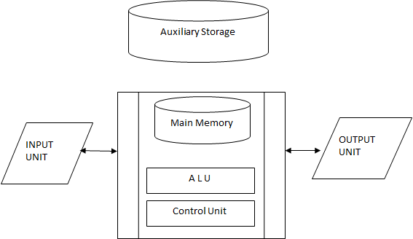
Three Basic Units of a Computer

Slide 11

Defining Computer Science
Computer Science is about building abstract models of real-world objects or phenomena, with the aim of using the model to solve problems by automating the models through the use of algorithm, and implementing the algorithm in form of instructions which the computer can understand.

Slide 12
Why Computer?
Computers are used for implementation of codes because they are amazingly fast at executing algorithms on data.
Note that we could even use pencil and paper to work our algorithm but this will take a longer time and will easily attract error.

Slide 13

Computer Scientist
Thus Computer Science is about solving problem.
Therefore Computer Scientists are thinkers, they think on how problems should be solved.
Thus abstraction starts from the mind.

Slide 14
Computer Scientist
As you think, you have a picture of how a problem should be solved in your mind (i.e. an abstraction). Thinking then leads to modeling, this means you now make the picture of the solution in your mind into a model.

Slide 15
Computer Scientist
A computer scientist then automates the model through the use of algorithm.

Slide 16
PROBLEM SOLVING PROCESS
Problem solving is an act of finding a solution to a challenging question.
problem solving is a natural way of providing solution to a problem.
E.g. Cook Rice. How?
There are things to do (most times one step follows another to get such problem solved)
Wash rice
Put in pot
Start gas
Put rice on fire
Add some measured quantity of salt
Add little onion(if you want)
Leave it on fire for a timed period
Test if done ; if yes, remove from fire; If no, leave it a little longer

Slide 17
Problem Solving Process
There are different ways of solving a problem, e.g. use of well defined mathematical principles will help to solve a mathematical problem, using of tractor on hectares of land will help to plough the land etc.
In computing we are interested in solving problems through the use of computers.
Thus we ask questions that can be solved using computer.
These are questions that do not involve physical activity or emotions this is because a computer only acts on instructions given to it, thus it is not intelligent i.e. garbage in garbage out.

Slide 18
Problem Solving Process
Advantage of using computer to solve a problem is that once the instruction is written for the computer, the computer can repeat the solution very quickly and consistently, again and again, for different situations or data.
This means, a computer program for computation of CGPA of students can do it accurately for as many students as possible.

Slide 19
Steps in Problem Solving Process
Understanding and analysis of the problem (breaking it down into simpler manageable units)
Development of algorithm i.e. devising a plan
Coding and implementation (writing programs)
Deployment and Maintenance
Note: At each stage there should be testing and proper documentation.

Slide 20
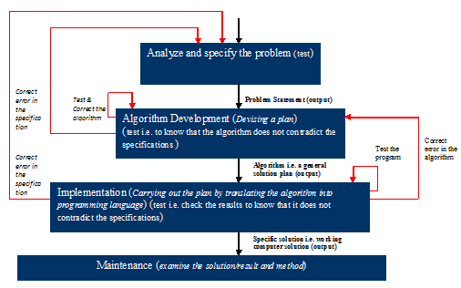
Diagrammatic representation of Problem Solving Process

Slide 21
Understanding and analysis of the problem
To have a proper understanding of the problem, some analytical questions must be asked and answered, for example:
What input data/information is available or needed?
What does it represent?
What format is it in?
Is anything missing?
Do I have everything that I need?
What output information am I trying to produce?
What do I want the result to look like i.e. result format e.g. text, picture, a graph …?
What am I going to have to compute ?

Slide 22
Understanding and analysis of the problem
These questions will help in:
Identifying the input data
Identifying the output requirement (results)
Describe the processing requirements (e.g. the square of a number n is n multiply by itself; nxn)
Determine whether computer is require to solve the problem

Slide 23

Understanding and analysis of the problem (Problem decomposition)
Knowing the input, process and output requirement will help to break the problem down into smaller sub- problems.
Each sub problem has data that can be computed in order to process the data.
Note: Analysis means breaking a problem down into solvable units or sub-problems

Slide 24
Lab I: Understanding and Analyzing the Problem (Example 1)
Note that the first thing is the problem statement, for example, if we have a problem statement as given below:
Example 1
Calculate the average grade for all students in a class.

Slide 25
Lab I: Understanding and Analyzing the Problem (Example 1)
a. Determine the input data:
What input data/information is available/required? (score, total number of students)
What format is it in? (integer? float? string? video? picture?)
Is anything missing ? (is there any missing score?)
b. Determine the processing requirement.
Do I have everything that I need ? (sum, total number of students)
c. What output information am I trying to produce ?
What do I want the result to look like … text,
a picture, a graph … ?

Slide 26
Lab I
Identify (stage 1):
Output requirement and respective formats
Input requirement and respective formats
Processing requirement
Stage 2:
Identify the sub-problems

Slide 27
Lab I: Understanding and Analyzing the Problem (Example 1)
Output requirement:
Expected Result: Average grade
Format: floating-point or double(numeric)
Input data:
Total number of students (format: integer)
Score per student (format: floating-point)
Total score: (format: floating-point)
Processing requirement:
Average grade= total score/total number of student
Format: digit

Slide 28
Problem Decomposition (Example 1)
In the problem at hand there are data like scores, sum of scores, and number of student in the class. These data are used in calculating average grade.
Thus the sub problems are:
Total score: problem of adding all the students scores together.
Total number of students: problem of counting the number of all students.
Average grade: problem of finding the average score per student.
Average=sum of scores/total no of students
If no mathematical expression is available you can formulate one if necessary.

Slide 29
Lab I: Understanding and Analyzing the Problem (Example 2)
Example 2:
The personnel office of Babcock University is assigned the task of computing the monthly emolument of all category of employees of the institution. The employee taxation is based on the following constraints:

Slide 30
Lab I: Understanding and Analyzing the Problem (Example 2)
If basic salary is less than or equal to N5000, 5% of basic salary is deducted as tax otherwise 8% deducted.
Also 10% of the employee gross pay should be deducted as part of pension scheme.
It is require that each employee pay slip should contain employee number, name, total allowance, tax, basic salary, gross pay and Net pay

Slide 31
Lab I: Understanding and Analyzing the Problem (Example 2)
Analyse the above problem and identify the output, input and processing requirements
Solution:
Output requirements:
Employee Number
Employee Name
Total allowance
Tax
Contributory Pension
Basic salary
Gross pay
Net pay
Notes:
Trick: when you know the output requirement then you will be able to identify the input requirement/data

Slide 32
Lab I: Understanding and Analyzing the Problem (Example 2)
Input data:
Employee Number
Employee Name
Basic salary
Housing allowance
Transport allowance
Meal subsidy

Slide 33
Lab I: Understanding and Analyzing the Problem (Example 2)
Processing requirements:
If Basic salary is <=5000, Tax = 5% of Basic salary
Else Tax = 8% of basic salary.
Total allowances = Housing + Transport + meal subsidy
Gross Pay = Basic salary + Total allowances
Contributory pension= 10% of Gross Pay
Net pay = Gross pay – (Tax + contributory pension)

Slide 34
Classwork: Problem Decomposition (class/lab work)
Identify the sub problems in Example 2
The volume of a cylinder is given by:
V = π r²h
Analyse the above problem and identify:
the input, output and processing requirements
And the sub problems
The area of a circle is given by the formula
Area = πr²
Analyse the above and identify the output, input and processing requirements. And identify the sub problems.

Slide 35
Class Comment/Interactive Session
In what way(s) do you think step 1 of problem decomposition is needful or helpful?

Slide 36
Assignment
Think about a computable problem and generate the following:
Problem Statement - (i.e. What is the problem?)
Output, Input, and Processing requirements
Sub-problems

Slide 37
Self Assessment
Is the concepts of Computer Science, Computer Scientist, abstraction, modelling, clear?
How exactly do Computer Scientists solve problem?
How can I understand and analyse a problem?

