Slide 1
Introduction to Programming with C++
Computer Science Department
Babcock University
Ilisan
Bola Akande and Omotunde

Slide 2
Language Overview

Slide 3
Brief History of C++
C++ is an extension of C programing language.
It was developed in the year 1979 by Bjarne Stroustrup of Bell’s laboratory.
The ANSI-C++ specific standard was published in the year 1998.
Its one of the preferred languages to develop professional applications on all platform.

Slide 4
C++ as an extension of C
C++ extends C by adding these to the features of C
Object-oriented feature
Safety feature
New standard library features

Slide 5
Characteristics of C++
It is an object oriented language
Portability i.e. it can be compiled and executed on almost all type of computers and operating system without making any changes.
Brevity: it is very short compared to other programming languages.
Modular programming: application created with C++ can comprise of several source code which are compiled separately and linked together.
C compatible: Codes written in C can be easily included in C++ without making any change.
Speed: due to its duality as both an high level and low level, and to its short size, C++ is very efficient.

Slide 6
Characteristics of C++
C++ can be used to write both console and graphical programs.
C++ like C is case sensitive

Slide 7
Creating a C++ Program(A flowchart)
Check page 7 of CPP workbook

Slide 8
Tokens
A token is a string of one or more character which is significant or meaningful to the compiler.
There are different types of tokens, they are
Keywords:
Identifier
Literals
Operators
Punctuation/Separators
White space

Slide 9
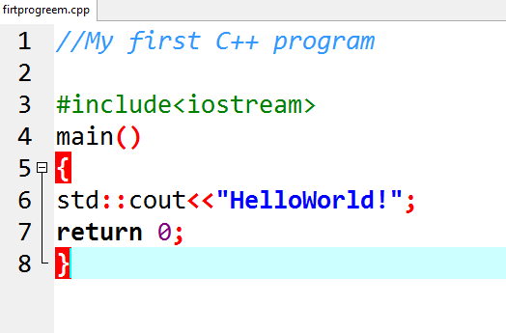
My First C++ Program Example I

Slide 10
Explanation
cout << is the syntax for outputing text to the screen.
return 0; indicates that the program should tell the computer that it has ended successfully.
std:: is the scope resolutor. Its informing the compiler to look for an identifier inside a namespace.
Thus to access an identifier in a namespace we either use the following syntax
std:: cout << “output statement”;
or insert
using namespace std; after the preprocessor definitions.

Slide 11
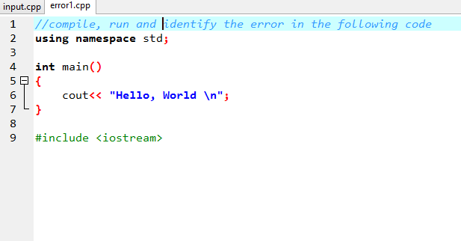
Classwork

Slide 12
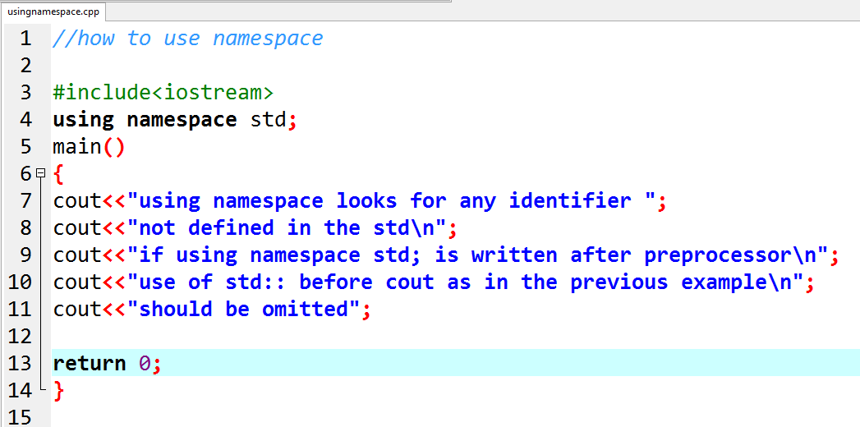
Example II

Slide 13
Explaining the line of Code (QUIZ)
Explain what the following lines in ExampleII mean based on your knowledge of C language
Line 1
# in line 3
Line 3
Where does execution begin?
The curly brackets in main() indicates ……….. .

Slide 14
QUIZ contd:
What escape sequence do we have in example II?
List five other escape sequences and the characters each represent.
What is a string?
Identify five strings in example II.

Slide 15
Basic Language Features
Statements, Values, and Expression:
Statement is a basic building block of a program, it is the smallest unit that does something
An expression is a statement that has value.
Note that not every statement is an expression.

Slide 16
Basic Language Features
Operators are used for performing mathematical operations.
Operators acts on operands e.g. 4, 2 etc.
An operator that acts on one operand is a unary operator e.g. !(NOT) which is a logical operator
Operator that acts on two operands is a binary operator e.g. Arithmetic operators.
Operator that acts on three operands is a tenary operator e.g. conditional operator.

Slide 17
Basic language Features
Types of operators are:
Arithmetic operators: +,-,/,*,%
Logical operators: &&-logical AND, ||-logical OR, !-NOT
Relational operators: ==, !=, <, >, <=, >=
Assignment operator: =
Compound Assignment operators: +=, -=, *=, /=

Slide 18
Basic language Features
Increment and Decrement operator:
increment:++ (++variable (pre-increment) or variable++(post-increment)).
decrement: --(--variable (pre-decrement) or variable—(post-decrement) ) . Note that the variable is an integer variable.
Conditional operator: it’s a tenary operator because it operates on three operands.
Syntax:
condition expression ? expression 1:expression 2
If the conditional expression evaluates to be true expression 1 is executed, if false expression 2 is executed

Slide 19
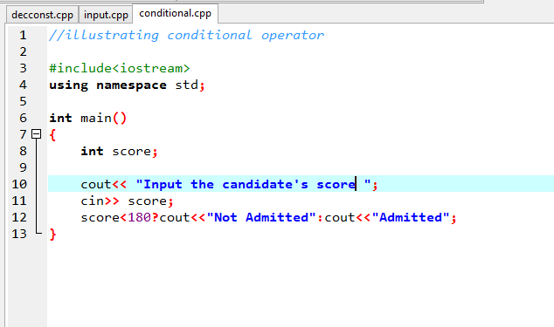
Conditional Operator

Slide 20
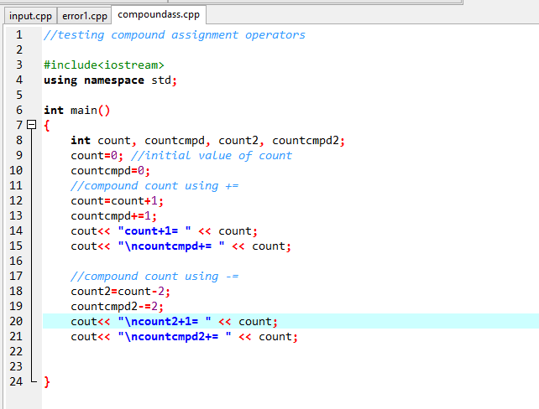
Example on Compound Assignment Operators

Slide 21
Classwork
Extend the precious program with the followings compound assignment operators
*=
/=

Slide 22
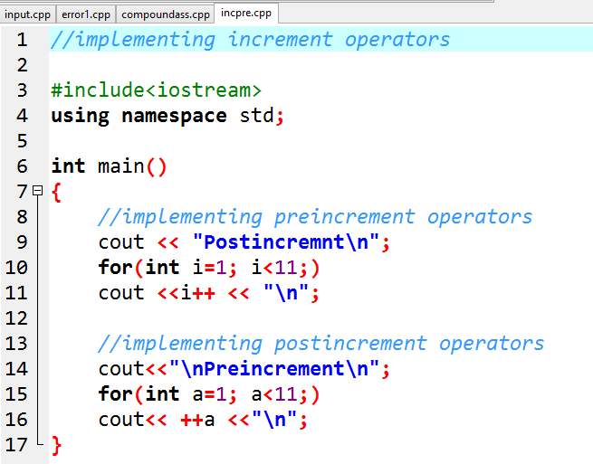
Example on Increment operators

Slide 23
Class/Labwork
Extend the previous program with decrements operators.

Slide 24
Operators Precedence
This refers to the set of order in which operators are evaluated.

Slide 25
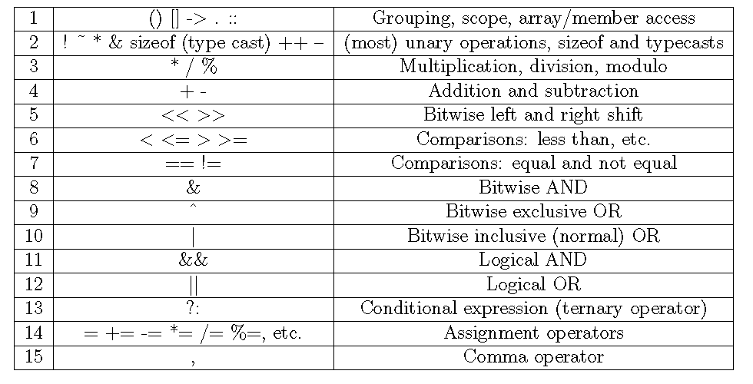
Table of Operators Precedence

Slide 26
Basic Language Features
Data Types:
It is a formal description of data a value is.
It indicates the set of value for a particular variable and the type of operation that can be performed on a value.

Slide 27
Basic Language Features
Constant: A constant is an expression with a fixed value.
There are three types of constants they are
Literal constant
Defined constant
Declared constant

Slide 28
Literal constant
Literal constant is for expressing particular values.
Literal constant can be
An integer (1,2,-3, -78)
Floating point (3.142, 0.89765)
Characters (“s”, “ ”, “\n”)
Strings (“hello world”, “a”)
Boolean (true, false)

Slide 29
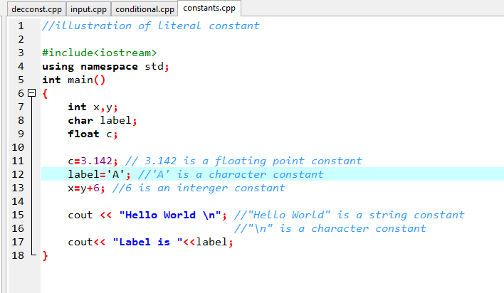
Literal Constant

Slide 30
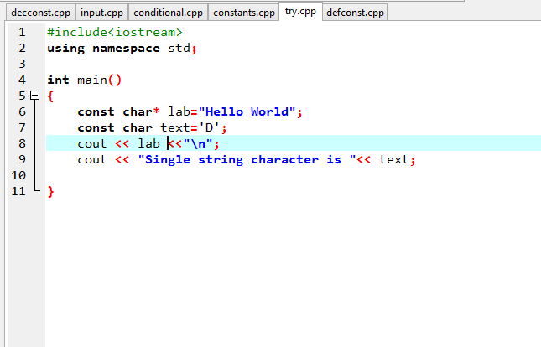
Literal Constant

Slide 31
Defined constant
Defined constant is a user-defined named constant which does not use up the memory like variables.
Syntax: #define <identifier> <value>
The preprocessor replaces every subsequent occurrences of the identifier with the constant value.

Slide 32
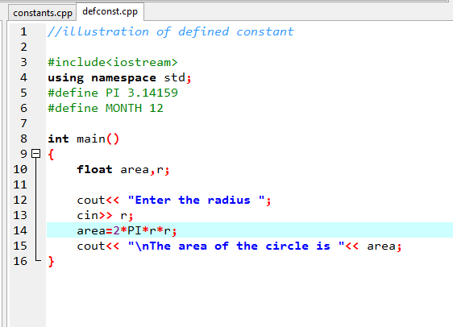
Defined Constant

Slide 33
Declared Constant
Its also a user-defined constant.
The value of a declared constant cannot be modified.
Syntax:
const <identifier> <value> ;

Slide 34
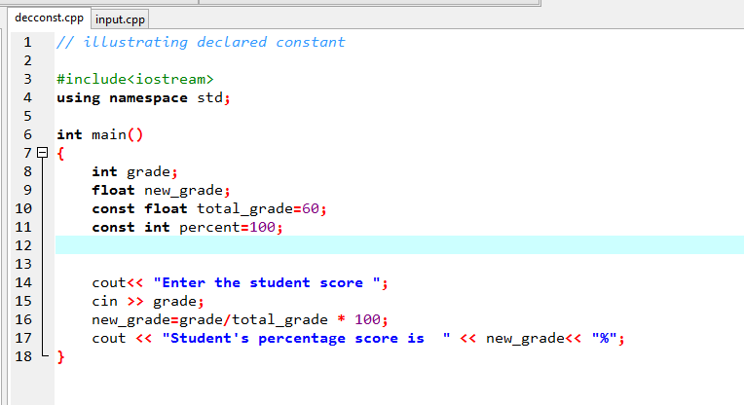
Example

Slide 35
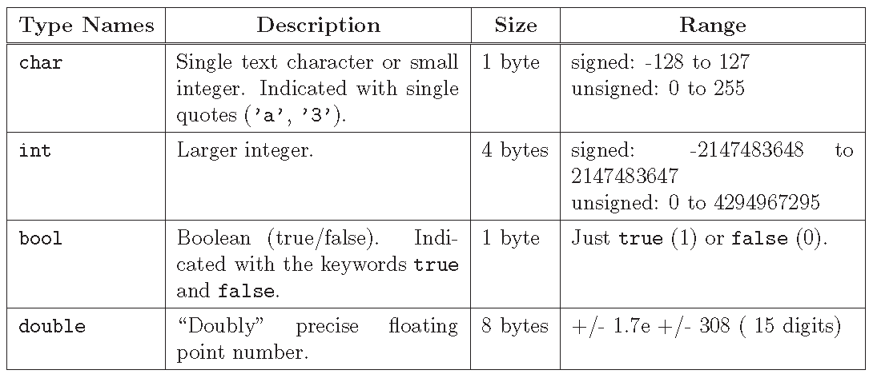
Table Showing the built in data type in C++

Slide 36
Lab Work
Write a program where you
Use statements to declare five variables
assign values to each statement.
Write a full commented program that uses the following operators:
%, /, +=,*=, ++variable, variable--, !=, ==, =
Write a program that uses conditional operator.

Slide 37
Variables
A variable is a named memory location which can be given to a value, or an expression.
Note that variable names are also tokens of a program.
An identifier refers to a variable name.
For example:
Given a name to value 6
int a=6;
Given a name to an expression (4+2)
int b=4+2;

Slide 38
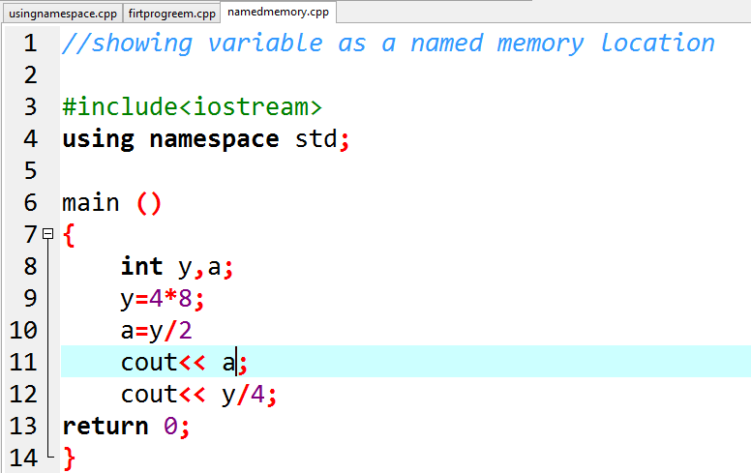
Variables

Slide 39
QUIZ
What does line 8 indicates?
Write a statement that initialize a variable with 10.
Re-write lines 8, 9 and 10 with two statements.

Slide 40
Input
Just like in C there is a syntax for accepting integer values for a variable from the keyboard as follows:
cin >> variable-name
To accept char use the followings:
To accept string use the followings:

Slide 41
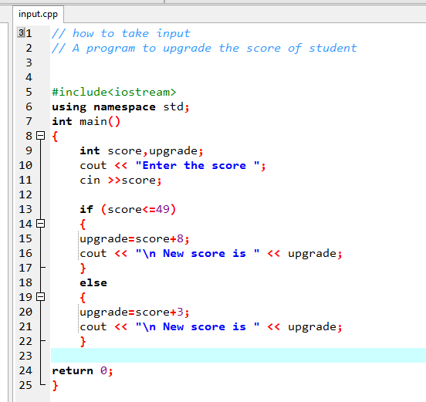
Example

Slide 42
Syntax of a Programming Language
The uniqueness of one programming language to another is it syntax and semantics.
Syntax: this are the grammatical rules of a particular programming language. As a natural language has its grammatical rule for construction of a correct sentence, so also programming languages has grammatical rules for the construction of a correct statement.

Slide 43
Semantic of a Programing language
Semantics: this is the intended interpretation of programming statement. It implies that meanings are attached to each programming statement e.g. assigning a floating point i.e. decimal to a memory location that has been declared as integer will cause a semantic error.

Slide 44
PROGRAMMING ERRORS
Violations to the syntax and semantics of a programming language leads to error.
Errors in programming are also known as bugs.
Removal of errors is what we know as debugging.

Slide 45
Programming Errors
There are 3 basic types of program errors
Syntax error
Semantic error
Logic error

Slide 46
PROGRAMMING ERRORS……
These errors can occur either during compilation time or during running time, thus depending on when the error occur we can categorized the errors into compile-time error and run-time error.

Slide 47
Programming Errors . . .
Compile - time error
Error that violate the rules (syntax) of a programming language. This category of error are reported during compilation. Errors reported at that time are syntax error and semantic error.
Examples of syntax errors are
Typographical mistakes
Omitted semicolon
References to undeclared variables
Wrong type of values assigned to a variable
Wrong number or type of arguments passed to a function

Slide 48
Programming Errors . . .
Run-time error
An error that does not prevent your program from compiling, but causes it to fail when you try to run it. This refers to errors reported during execution, this can be a semantic error or it can be a logic error. Note that its more tricky to debug a run-time error.
Example includes:
trying to divide by zero
trying to open a file that does not exist

Slide 49
Programming Errors . . .
Logic error
An error in design or implementation that does not prevent your program from compiling but causes it to not do what you intended.
Difficult to track.
Examples are:
an incorrect formula
incorrect sequence of statements

