Slide 1
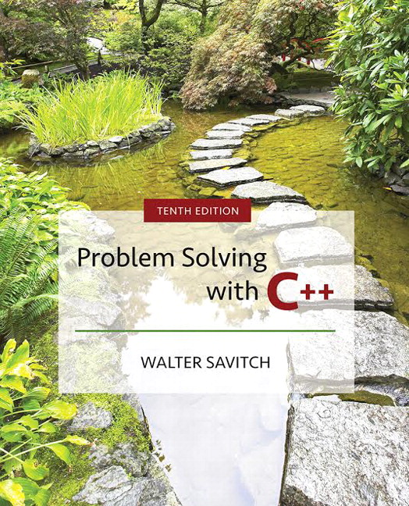

Slide 2
Week 4:Functions
Procedural Abstraction and Functions That Return a Value

Slide 3
Overview
4.1 Top-Down Design
4.2 Predefined Functions
4.3 Programmer-Defined Functions
4.4 Procedural Abstraction
4.5 Local Variables
4.6 Overloading Function Names
Slide 4- <number>

Slide 4
4.1
Top-Down Design

Slide 5
Top Down Design
To write a program
  Develop the algorithm that the program will use
  Translate the algorithm into the programming
  language
Top Down Design
(also called stepwise refinement)
  Break the algorithm into subtasks
  Break each subtask into smaller subtasks
  Eventually the smaller subtasks are trivial to
  implement in the programming language
Slide 4- <number>

Slide 6
Benefits of Top Down Design
Subtasks, or functions in C++, make programs
  Easier to understand
  Easier to change
  Easier to write
  Easier to test
  Easier to debug
  Easier for teams to develop
Slide 4- <number>

Slide 7
4.2
Predefined Functions

Slide 8
Predefined Functions
C++ comes with libraries of predefined
functions
Example: sqrt function
  theRoot = sqrt(9.0);
  returns, or computes, the square root
  of a number
  The number, 9, is called the argument
  theRoot will contain 3.0
Slide 4- <number>

Slide 9
Function Calls
sqrt(9.0) is a function call
  It invokes, or sets in action, the sqrt function
  The argument (9), can also be a variable or an
  expression
A function call can be used like any expression
  bonus = sqrt(sales) / 10;
  Cout << “The side of a square with area “ << area
  << “ is “
  << sqrt(area);
Display 4.1
Slide 4- <number>

Slide 10
Function Call Syntax
Function_name (Argument_List)
  Argument_List is a comma separated list:
  (Argument_1, Argument_2, … , Argument_Last)
Example:
  side = sqrt(area);
  cout << “2.5 to the power 3.0 is “
  << pow(2.5, 3.0);
Slide 4- <number>

Slide 11
Function Libraries
Predefined functions are found in libraries
The library must be “included” in a program
to make the functions available
An include directive tells the compiler which
library header file to include.
To include the math library containing sqrt():
#include <cmath>
Newer standard libraries, such as cmath, also require
the directive
using namespace std;
Slide 4- <number>

Slide 12
Other Predefined Functions
abs(x) --- int value = abs(-8);
  Returns absolute value of argument x
  Return value is of type int
  Argument is of type x
  Found in the library cstdlib
fabs(x) --- double value = fabs(-8.0);
  Returns the absolute value of argument x
  Return value is of type double
  Argument is of type double
  Found in the library cmath
Display 4.2
Slide 4- <number>

Slide 13
Random Number Generation
Really pseudo-random numbers
1. Seed the random number generator only once
#include <cstdlib>
#include <ctime>
srand(time(0));
2. The rand() function returns a random integer that is greater than or equal to 0 and less than RAND_MAX
rand();
Slide 4- <number>

Slide 14
Random Numbers
Use % and + to scale to the number range you want
For example to get a random number from 1-6 to simulate rolling a six-sided die:
int die = (rand() % 6) + 1;
Can you simulate rolling two dice?
Generating a random number x where 10 < x < 21?
Slide 4- <number>

Slide 15
Type Casting
Recall the problem with integer division:
int totalCandy = 9, numberOfPeople = 4;
double candyPerPerson;
candyPerPerson = totalCandy / numberOfPeople;
  candyPerPerson = 2, not 2.25!
A Type Cast produces a value of one type
from another type
  static_cast<double>(totalCandy) produces a double
  representing the integer value of totalCandy
Slide 4- <number>

Slide 16
Type Cast Example
int totalCandy = 9, numberOfPeople = 4;
double candyPerPerson;
candyPerPerson = static_cast<double>(totalCandy)
/ numberOfPeople;
  candyPerPerson now is 2.25!
  This would also work:
  candyPerPerson = totalCandy /
  static_cast<double>( numberOfPeople);
  This would not!
  candyPerPerson = static_cast<double>( totalCandy /
  numberOfPeople);
Integer division occurs before type cast
Slide 4- <number>

Slide 17
Old Style Type Cast
C++ is an evolving language
This older method of type casting may be
discontinued in future versions of C++
candyPerPerson = double(totalCandy)/numberOfPeople;
candyPerPerson = (double) totalCandy /numberOfPeople;
Slide 4- <number>

Slide 18
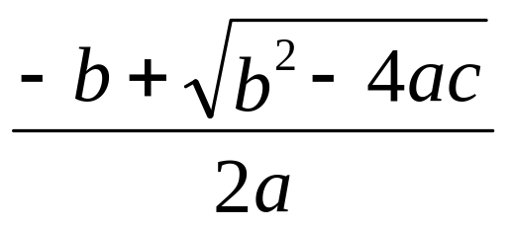
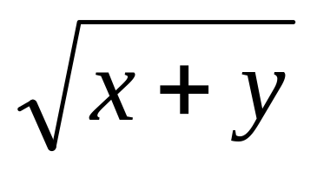
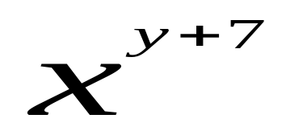
Section 4.2 Conclusion
Can you
  Determine the value of d?
  double d = 11 / 2;
  Determine the value of
  pow(2,3) fabs(-3.5) sqrt(pow(3,2))
  7 / abs(-2) ceil(5.8) floor(5.8)
  Convert the following to C++
Slide 4- <number>

Slide 19
4.3
Programmer-Defined Functions

Slide 20
Programmer-Defined Functions
Two components of a function definition
  Function declaration (or function prototype)
    Shows how the function is called
    Must appear in the code before the function can be called
    Syntax:
    Type_returned Function_Name(Parameter_List);
    //Comment describing what function does
  Function definition
    Describes how the function does its task
    Can appear before or after the function is called
    Syntax:
    Type_returned Function_Name(Parameter_List)
    {
    //code to make the function work
    }
;
Slide 4- <number>

Slide 21
Function Declaration
Tells the return type
Tells the name of the function
Tells how many arguments are needed
Tells the types of the arguments
Tells the formal parameter names
  Formal parameters are like placeholders for the actual
  arguments used when the function is called
  Formal parameter names can be any valid identifier
Example:
double totalCost(int numberPar, double pricePar);
// Compute total cost including 5% sales tax on
// numberPar items at cost of pricePar each
Slide 4- <number>

Slide 22
Function Definition
Provides the same information as the declaration
Describes how the function does its task
Example:
double totalCost(int numberPar, double pricePar)
{
const double TAX_RATE = 0.05; //5% tax
double subtotal;
subtotal = pricePar * numberPar;
return (subtotal + subtotal * TAX_RATE);
}
function header
function body
Slide 4- <number>

Slide 23
The Return Statement
Ends the function call
Returns the value calculated by the function
Syntax:
return expression;
  expression performs the calculation
  or
  expression is a variable containing the
  calculated value
Example:
return subtotal + subtotal * TAX_RATE;
Slide 4- <number>

Slide 24
The Function Call
Tells the name of the function to use
Lists the arguments
Is used in a statement where the returned value
makes sense
Example:
double bill = totalCost(number, price);
Display 4.3
Slide 4- <number>

Slide 25
Function Call Details
The values of the arguments are plugged into
the formal parameters (Call-by-value mechanism
with call-by-value parameters)
  The first argument is used for the first formal
  parameter, the second argument for the second
  formal parameter, and so forth.
  The value plugged into the formal parameter is used
  in all instances of the formal parameter in the
  function body
Display 4.4
Slide 4- <number>

Slide 26
Alternate Declarations
Two forms for function declarations
  List formal parameter names
  List types of formal parmeters, but not names
  First aids description of the function in comments
Examples:
double totalCost(int numberPar, double pricePar);
double totalCost(int, double);
Function headers must always list formal
parameter names!
Slide 4- <number>

Slide 27
Order of Arguments
Compiler checks that the types of the arguments
are correct and in the correct sequence.
Compiler cannot check that arguments are in the
correct logical order
Example: Given the function declaration:
char grade(int received_par, int minScore_par);
int received = 95, minScore = 60;
cout << grade( minScore, received);
  Produces a faulty result because the arguments are not in
  the correct logical order. The compiler will not catch this!
Display 4.5 (1)
Display 4.5 (2)
Slide 4- <number>

Slide 28
Function Definition Syntax
Within a function definition
  Variables must be declared before they are used
  Variables are typically declared before the
  executable statements begin
  At least one return statement must end the function
    Each branch of an if-else statement might have its
    own return statement
Display 4.6
Slide 4- <number>

Slide 29
Placing Definitions
A function call must be preceded by either
  The function’s declaration
  or
  The function’s definition
    If the function’s definition precedes the call, a
    declaration is not needed
Placing the function declaration prior to the
main function and the function definition
after the main function leads naturally to
building your own libraries in the future.
Slide 4- <number>

Slide 30
bool Return Values
A function can return a bool value
  Such a function can be used where a boolean
  expression is expected
    Makes programs easier to read
if (((rate >=10) && ( rate < 20)) || (rate == 0))
is easier to read as
if (appropriate (rate))
  If function appropriate returns a bool value based
  on the the expression above
Slide 4- <number>

Slide 31
Function appropriate
To use function appropriate in the if-statement
if (appropriate (rate))
{ … }
appropriate could be defined as
bool appropriate(int rate)
{
return (((rate >=10) && ( rate < 20)) || (rate == 0));
}
Slide 4- <number>

Slide 32
Section 4.3 Conclusion
Can you
  Write a function declaration and a function definition
  for a function that takes three arguments, all of type
  int, and that returns the sum of its three arguments?
  Describe the call-by-value parameter mechanism?
  Write a function declaration and a function definition
  for a function that takes one argument of type int and
  one argument of type double, and that returns a value
  of type double that is the average of the two
  arguments?
Slide 4- <number>

Slide 33
4.4
Procedural Abstraction

Slide 34
Procedural Abstraction
The Black Box Analogy
  A black box refers to something that we know how
  to use, but the method of operation is unknown
  A person using a program does not need to know
  how it is coded
  A person using a program needs to know what the
  program does, not how it does it
Functions and the Black Box Analogy
  A programmer who uses a function needs to know
  what the function does, not how it does it
  A programmer needs to know what will be produced if the proper arguments are put into the box
Slide 4- <number>

Slide 35
Information Hiding
Designing functions as black boxes is an
example of information hiding
  The function can be used without knowing how
  it is coded
  The function body can be “hidden from view”
Slide 4- <number>

Slide 36
Function Implementations and The Black Box
Designing with the black box in mind allows us
  To change or improve a function definition without
  forcing programmers using the function to change
  what they have done
  To know how to use a function simply by reading the
  function declaration and its comment
Display 4.7
Slide 4- <number>

Slide 37
Procedural Abstraction and C++
Procedural Abstraction is writing and using
functions as if they were black boxes
  Procedure is a general term meaning a “function like”
  set of instructions
  Abstraction implies that when you use a function as
  a black box, you abstract away the details of the
  code in the function body
Slide 4- <number>

Slide 38
Procedural Abstraction and Functions
Write functions so the declaration and comment
is all a programmer needs to use the function
  Function comment should tell all conditions
  required of arguments to the function
  Function comment should describe the returned
  value
  Variables used in the function, other than the
  formal parameters, should be declared in the
  function body
Slide 4- <number>

Slide 39
Formal Parameter Names
Functions are designed as self-contained modules
Different programmers may write each function
Programmers choose meaningful names for
formal parameters
  Formal parameter names may or may not match
  variable names used in the main part of the program
  It does not matter if formal parameter names
  match other variable names in the program
  Remember that only the value of the argument is
  plugged into the formal parameter
Display 4.8
Slide 4- <number>

Slide 40
Case Study Buying Pizza
What size pizza is the best buy?
  Which size gives the lowest cost per square inch?
  Pizza sizes given in diameter
  Quantity of pizza is based on the area which
  is proportional to the square of the radius
Slide 4- <number>

Slide 41
Buying Pizza Problem Definition
Input:
  Diameter of two sizes of pizza
  Cost of the same two sizes of pizza
Output:
  Cost per square inch for each size of pizza
  Which size is the best buy
    Based on lowest price per square inch
    If cost per square inch is the same, the smaller size
    will be the better buy
Slide 4- <number>

Slide 42
Buying Pizza Problem Analysis
Subtask 1
  Get the input data for each size of pizza
Subtask 2
  Compute price per inch for smaller pizza
Subtask 3
  Compute price per inch for larger pizza
Subtask 4
  Determine which size is the better buy
Subtask 5
  Output the results
Slide 4- <number>

Slide 43
Buying Pizza Function Analysis
Subtask 2 and subtask 3 should be implemented
as a single function because
  Subtask 2 and subtask 3 are identical tasks
    The calculation for subtask 3 is the same as the
    calculation for subtask 2 with different arguments
  Subtask 2 and subtask 3 each return a single
  value
Choose an appropriate name for the function
  We’ll use unitprice
Slide 4- <number>

Slide 44
Buying Pizza unitprice Declaration
double unitprice(int diameter, int double price);
//Returns the price per square inch of a pizza
//The formal parameter named diameter is the
//diameter of the pizza in inches. The formal
// parameter named price is the price of the
// pizza.
Slide 4- <number>

Slide 45
Buying Pizza Algorithm Design
Subtask 1
  Ask for the input values and store them in variables
    diameterSmall diameterLarge
    priceSmall priceLarge
Subtask 4
  Compare cost per square inch of the two pizzas using
  the less than operator
Subtask 5
  Standard output of the results
Slide 4- <number>

Slide 46
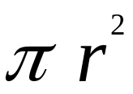
Buying Pizza unitprice Algorithm
Subtasks 2 and 3 are implemented as calls to
function unitprice
unitprice algorithm
  Compute the radius of the pizza
  Computer the area of the pizza using
  Return the value of (price / area)
Slide 4- <number>

Slide 47
Buying Pizza unitprice Pseudocode
Pseudocode
  Mixture of C++ and english
  Allows us to make the algorithm more precise without worrying about the details of C++ syntax
unitprice pseudocode
  radius = one half of diameter;
  area = π * radius * radius
  return (price / area)
Slide 4- <number>

Slide 48
Buying Pizza The Calls of unitprice
Main part of the program implements calls
of unitprice as
  double unitPriceSmall, unitPriceLarge;
  unitPriceSmall = unitprice(diameterSmall, priceSmall);
  unitPriceLarge = unitprice(diameterLarge, priceLarge);
Slide 4- <number>

Slide 49
Buying Pizza First try at unitprice
double unitprice (int diameter, double price)
{
const double PI = 3.14159;
double radius, area;
radius = diameter / 2;
area = PI * radius * radius;
return (price / area);
}
  Oops! Radius should include the fractional part
Slide 4- <number>

Slide 50
Buying Pizza Second try at unitprice
double unitprice (int diameter, double price)
{
const double PI = 3.14159;
double radius, area;
radius = diameter / static_cast<double>(2) ;
area = PI * radius * radius;
return (price / area);
}
  Now radius will include fractional parts
    radius = diameter / 2.0 ; // This would also work
Display 4.10 (1)
Display 4.10 (2)
Slide 4- <number>

Slide 51
Program Testing
Programs that compile and run can still
produce errors
Testing increases confidence that the program
works correctly
  Run the program with data that has known output
    You may have determined this output with pencil and paper
    or a calculator
  Run the program on several different sets of data
    Your first set of data may produce correct results in
    spite of a logical error in the code
      Remember the integer division problem? If there is no fractional
      remainder, integer division will give apparently correct results
Slide 4- <number>

Slide 52
Use Pseudocode
Pseudocode is a mixture of English and the
programming language in use
Pseudocode simplifies algorithm design by
allowing you to ignore the specific syntax of
the programming language as you work out
the details of the algorithm
  If the step is obvious, use C++
  If the step is difficult to express in C++, use English
Slide 4- <number>

Slide 53
Section 4.4 Conclusion
Can you
  Describe the purpose of the comment that
  accompanies a function declaration?
  Describe what it means to say a programmer should be able to treat a function as a black box?
  Describe what it means for two functions to be
  black box equivalent?
Slide 4- <number>

Slide 54
4.5
Local Variables

Slide 55
Local Variables
Variables declared in a function:
  Are local to that function, they cannot be used
  from outside the function
  Have the function as their scope
Variables declared in the main part of a
program:
  Are local to the main part of the program, they
  cannot be used from outside the main part
  Have the main part as their scope
Display 4.11 (1)
Display 4.11 (2)
Slide 4- <number>

Slide 56
Global Constants
Global Named Constant
  Available to more than one function as well as the
  main part of the program
  Declared outside any function body
  Declared outside the main function body
  Declared before any function that uses it
Example: const double PI = 3.14159;
double volume(double);
int main()
{…}
  PI is available to the main function
  and to function volume
Display 4.12 (1)
Display 4.12 (2)
Slide 4- <number>

Slide 57
Global Variables
Global Variable -- rarely used when more
than one function must use a common
variable
  Declared just like a global constant except const is not used
  Generally make programs more difficult to
  understand and maintain
Slide 4- <number>

Slide 58
Formal Parameters are Local Variables
Formal Parameters are actually variables that are
local to the function definition
  They are used just as if they were declared in the
  function body
  Do NOT re-declare the formal parameters in the
  function body, they are declared in the function
  declaration
The call-by-value mechanism
  When a function is called the formal parameters
  are initialized to the values of the
  arguments in the function call
Display 4.13 (1)
Display 4.13 (2)
Slide 4- <number>

Slide 59
Block Scope
Local and global variables conform to the rules of Block Scope
  The code block (generally defined by the { }) where an identifier like a variable is declared determines the scope of the identifier
  Blocks can be nested
Display 4.14
Slide 4- <number>

Slide 60
Namespaces Revisited
The start of a file is not always the best place
for
using namespace std;
Different functions may use different namespaces
  Placing using namespace std; inside the starting
  brace of a function
    Allows the use of different namespaces in different
    functions
    Makes the “using” directive local to
    the function
Display 4.15 (1)
Display 4.15 (2)
Slide 4- <number>

Slide 61
Example: Factorial
n! Represents the factorial function
n! = 1 x 2 x 3 x … x n
The C++ version of the factorial function
found in Display 3.14
  Requires one argument of type int, n
  Returns a value of type int
  Uses a local variable to store the current product
  Decrements n each time it
  does another multiplication
  n * n-1 * n-2 * … * 1
Display 4.16
Slide 4- <number>

Slide 62
4.6
Overloading Function Names

Slide 63
Overloading Function Names
C++ allows more than one definition for the
same function name
  Very convenient for situations in which the “same”
  function is needed for different numbers or types
  of arguments
Overloading a function name means providing
more than one declaration and definition using
the same function name
Slide 4- <number>

Slide 64
Overloading Examples
double ave(double n1, double n2)
{
return ((n1 + n2) / 2);
}
double ave(double n1, double n2, double n3)
{
return (( n1 + n2 + n3) / 3);
}
  Compiler checks the number and types of arguments
  in the function call to decide which function to use
  cout << ave( 10, 20, 30);
  uses the second definition
Slide 4- <number>

Slide 65
Overloading Details
Overloaded functions
  Must have different numbers of formal parameters
  AND / OR
  Must have at least one different type of parameter
  Must return a value of the same type
Display 4.17
Slide 4- <number>

Slide 66
Overloading Example
Revising the Pizza Buying program
  Rectangular pizzas are now offered!
  Change the input and add a function to compute
  the unit price of a rectangular pizza
  The new function could be named unitprice_rectangular
  Or, the new function could be a new (overloaded) version of the
  unitprice function that is already used
    Example:
    double unitprice(int length, int width, double price)
    {
    double area = length * width;
    return (price / area);
    }
Display 4.18 (1 – 3)
Slide 4- <number>

Slide 67
Automatic Type Conversion
Given the definition
double mpg(double miles, double gallons)
{
return (miles / gallons);
}
what will happen if mpg is called in this way?
cout << mpg(45, 2) << “ miles per gallon”;
The values of the arguments will automatically be
converted to type double (45.0 and 2.0)
Slide 4- <number>

Slide 68
Type Conversion Problem
Given the previous mpg definition and the
following definition in the same program
int mpg(int goals, int misses)
// returns the Measure of Perfect Goals
{
return (goals – misses);
}
what happens if mpg is called this way now?
cout << mpg(45, 2) << “ miles per gallon”;
  The compiler chooses the function that matches parameter
  types so the Measure of Perfect Goals will be calculated
Do not use the same function name for unrelated functions
Slide 4- <number>

Slide 69
Section 4.6 Conclusion
Can you
  Describe Top-Down Design?
  Describe the types of tasks we have seen so far
  that could be implemented as C++ functions?
  Describe the principles of
    The black box
    Procedural abstraction
    Information hiding
  Define “local variable”?
  Overload a function name?
Slide 4- <number>

Slide 70
Chapter 4 -- End
Slide 4- <number>

Slide 71
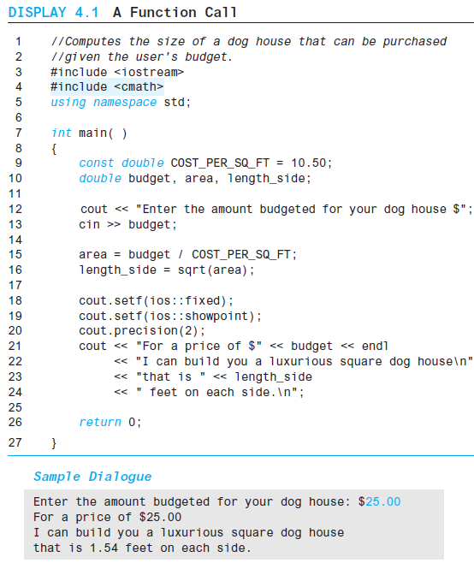
Display 4.1
Back
Next
Slide 4- <number>

Slide 72
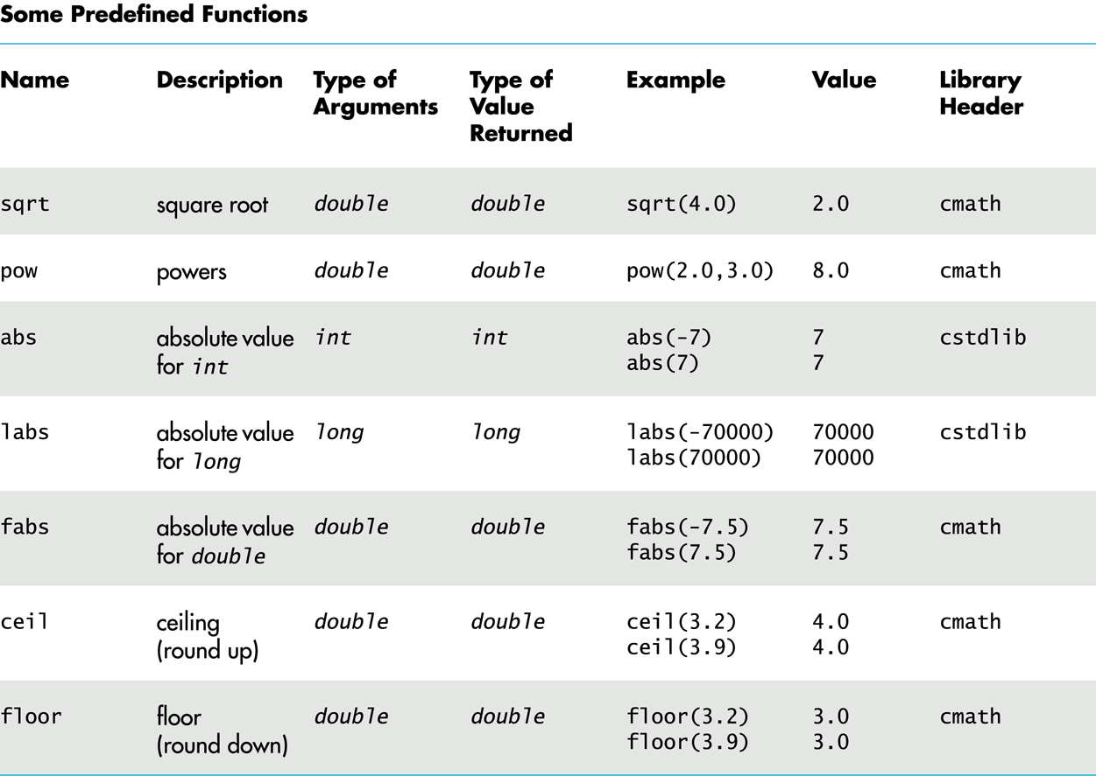
Display 4.2
Back
Next
Slide 4- <number>

Slide 73
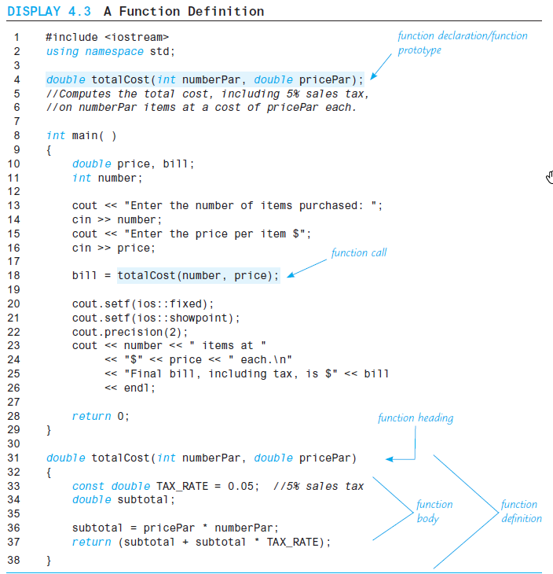
Display 4.3 (1/2)
Back
Next
Slide 4- <number>

Slide 74
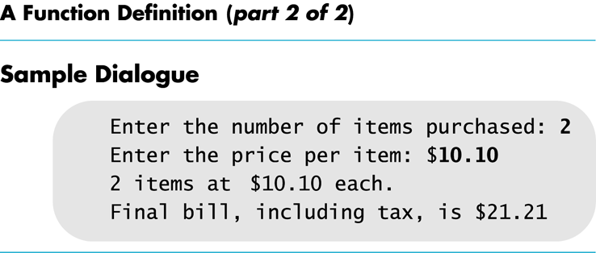
Display 4.3
(2/2)
Back
Next
Slide 4- <number>

Slide 75
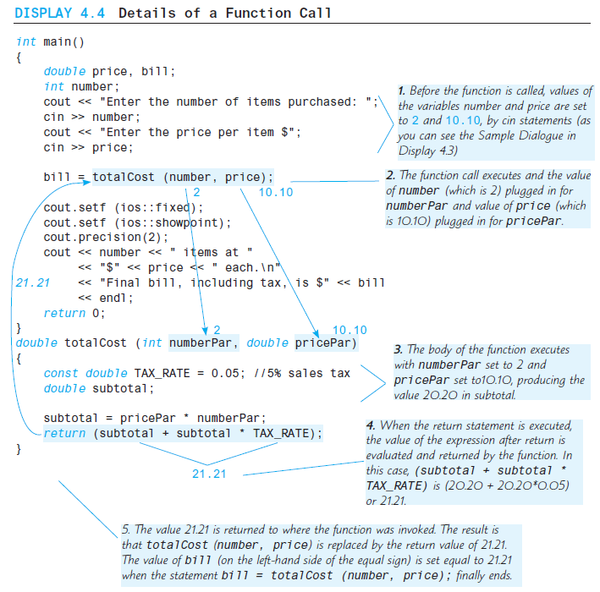
Display 4.4
Back
Next
Slide 4- <number>

Slide 76
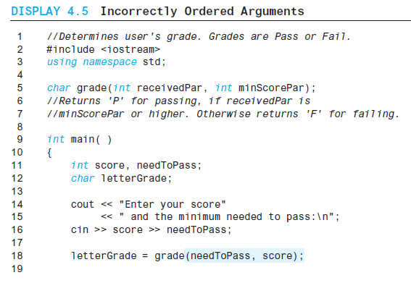
Display 4.5 (1/2)
Back
Next
Slide 4- <number>

Slide 77
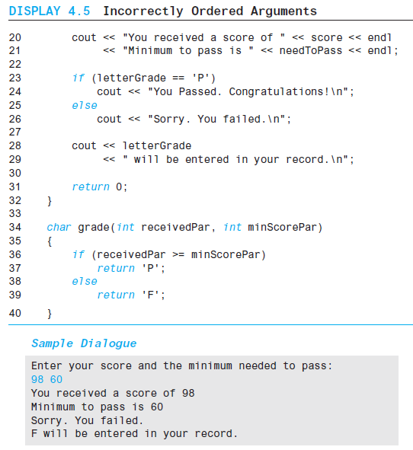
Display 4.5 (2/2)
Back
Next
Slide 4- <number>

Slide 78
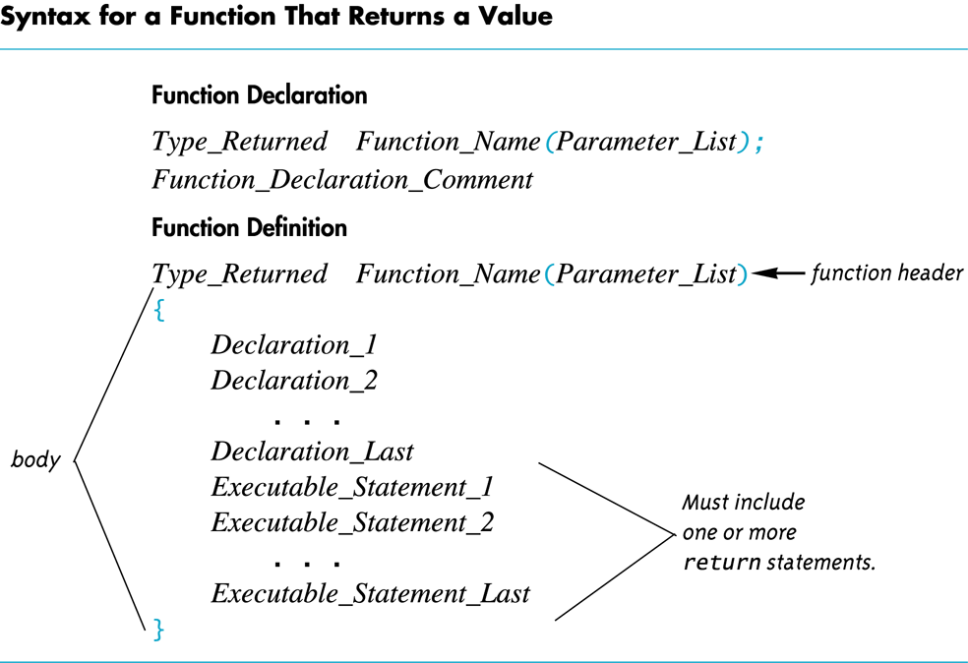
Display 4.6
Back
Next
Slide 4- <number>

Slide 79
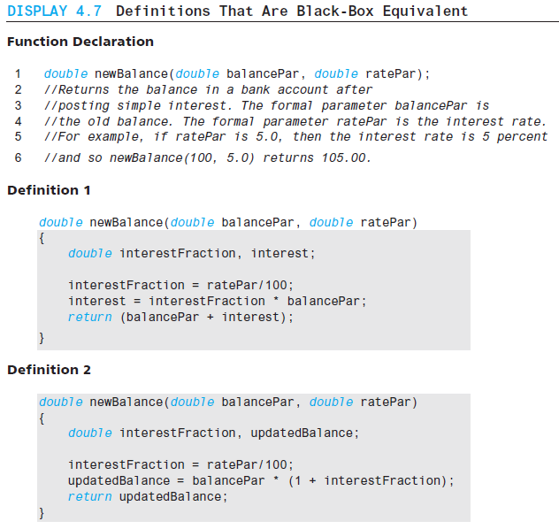
Display 4.7
Back
Next
Slide 4- <number>

Slide 80
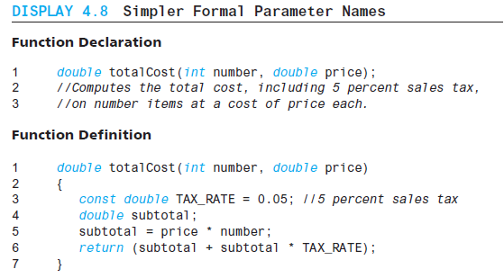
Display 4.8
Back
Next
Slide 4- <number>

Slide 81
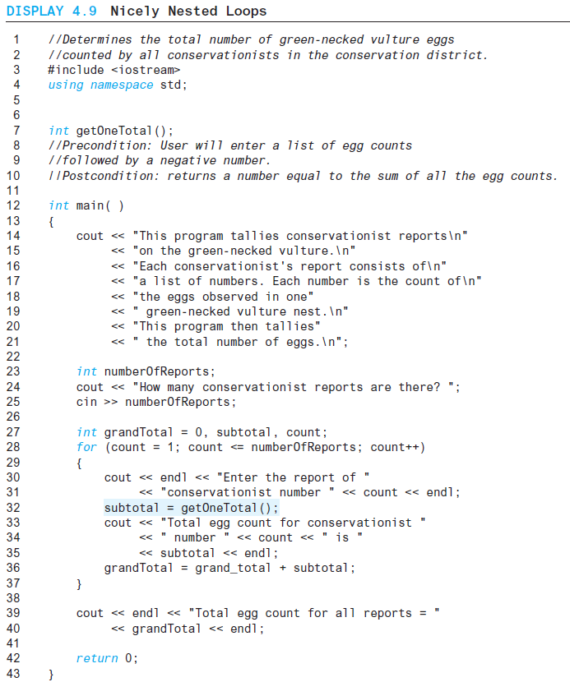
Display 4.9 (1/3)
Back
Next
Slide 4- <number>

Slide 82
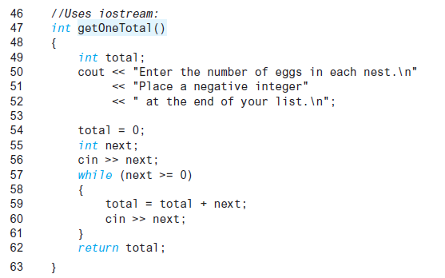
Display 4.9
(2/3)
Back
Next
Slide 4- <number>

Slide 83
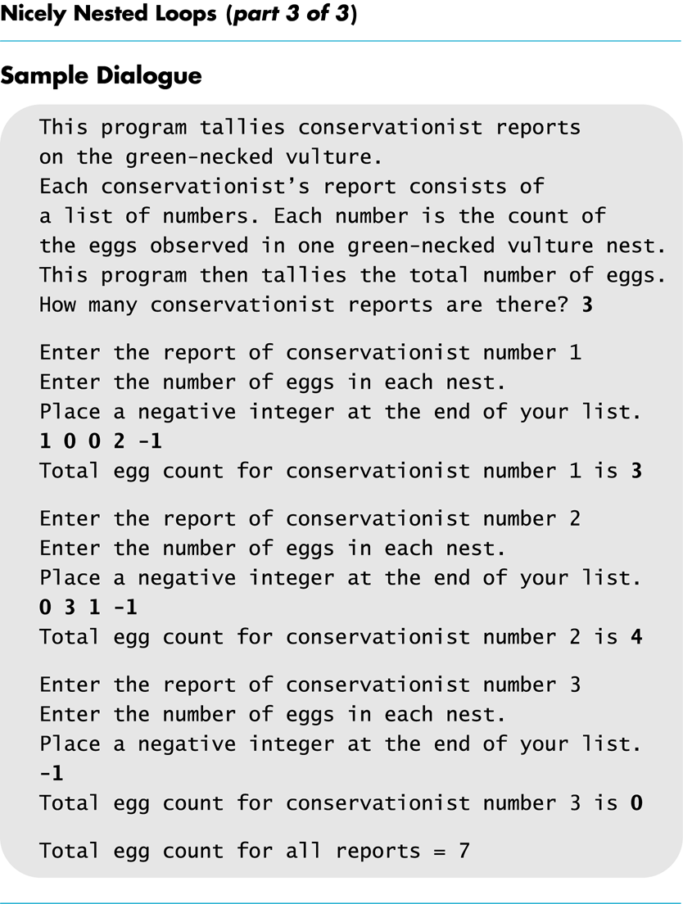
Display 4.9
(3/3)
Back
Next
Slide 4- <number>

Slide 84
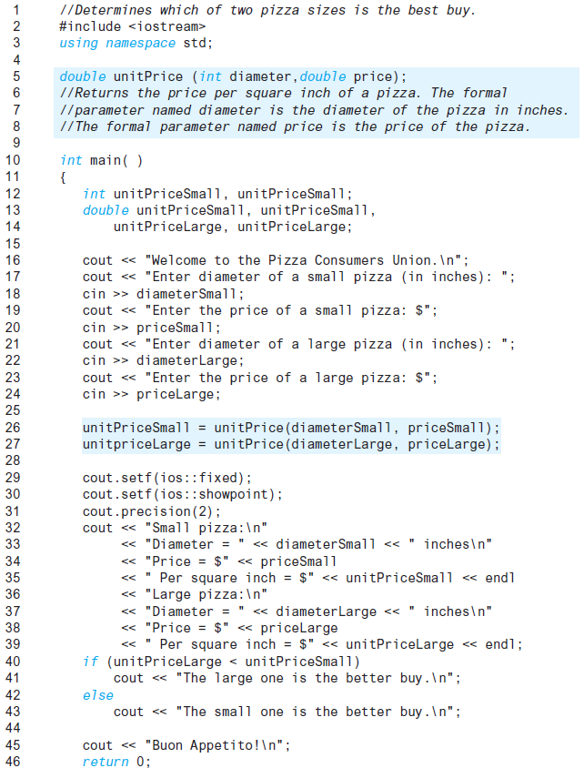
Display 4.10 (1/2)
Back
Next
Slide 4- <number>

Slide 85
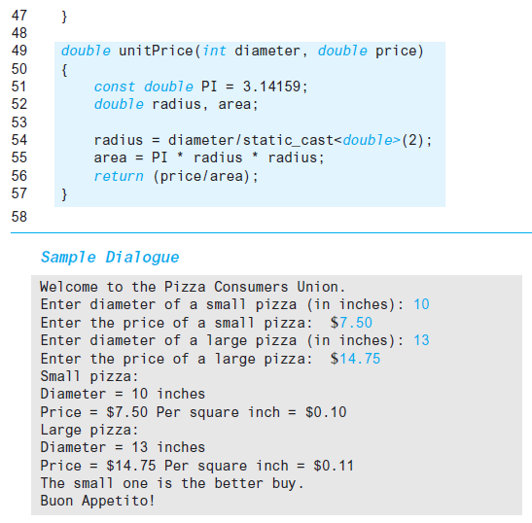
Display 4.10 (2/2)
Back
Next
Slide 4- <number>

Slide 86
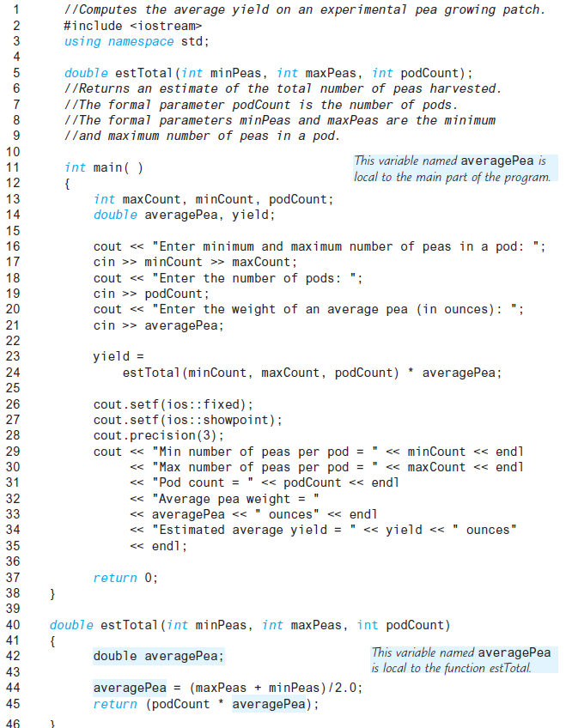
Display 4.11 (1/2)
Back
Next
Slide 4- <number>

Slide 87
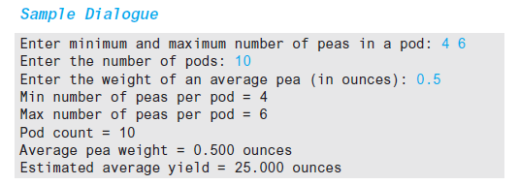
Display 4.11
(2/2)
Back
Next
Slide 4- <number>

Slide 88
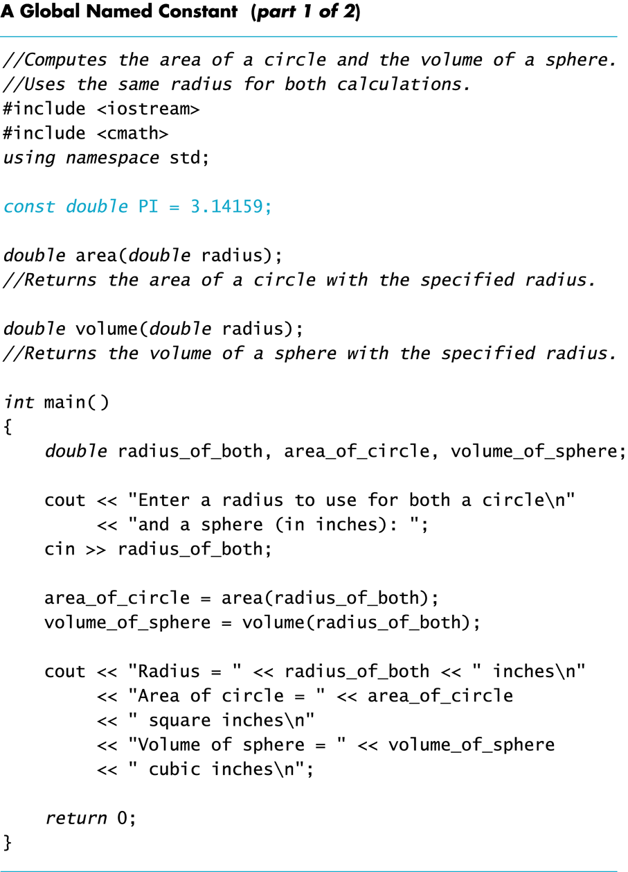
Display 4.12 (1/2)
Back
Next
Slide 4- <number>

Slide 89
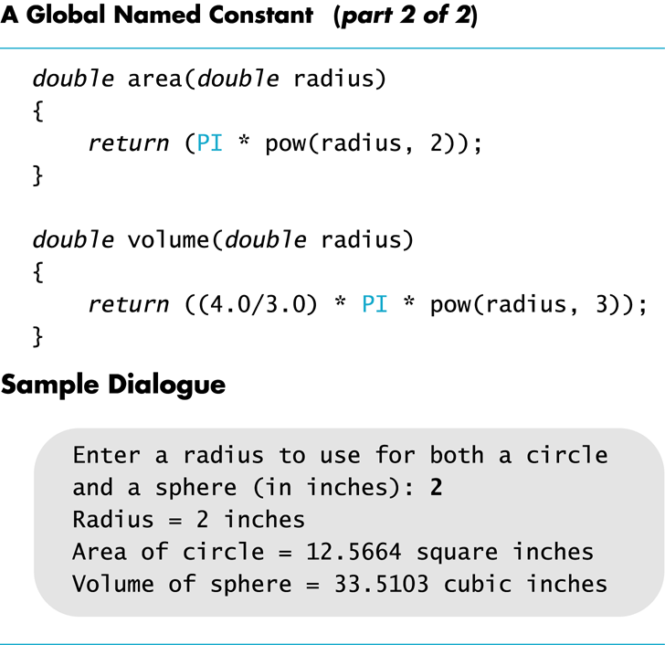
Display 4.12
(2/2)
Back
Next
Slide 4- <number>

Slide 90
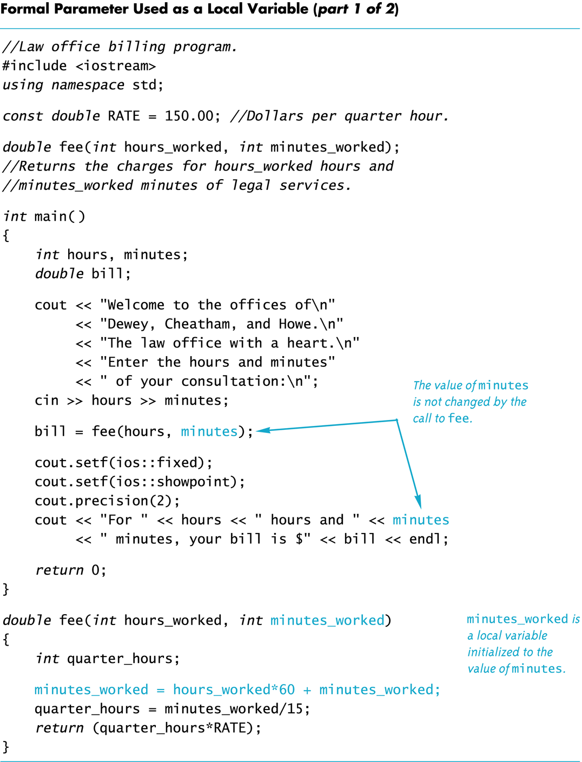
Display 4.13 (1/2)
Back
Next
Slide 4- <number>

Slide 91
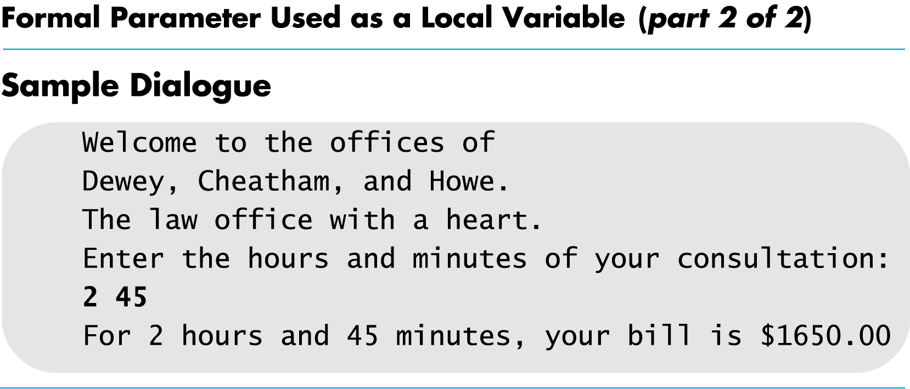
Display 4.13
(2/2)
Back
Next
Slide 4- <number>

Slide 92
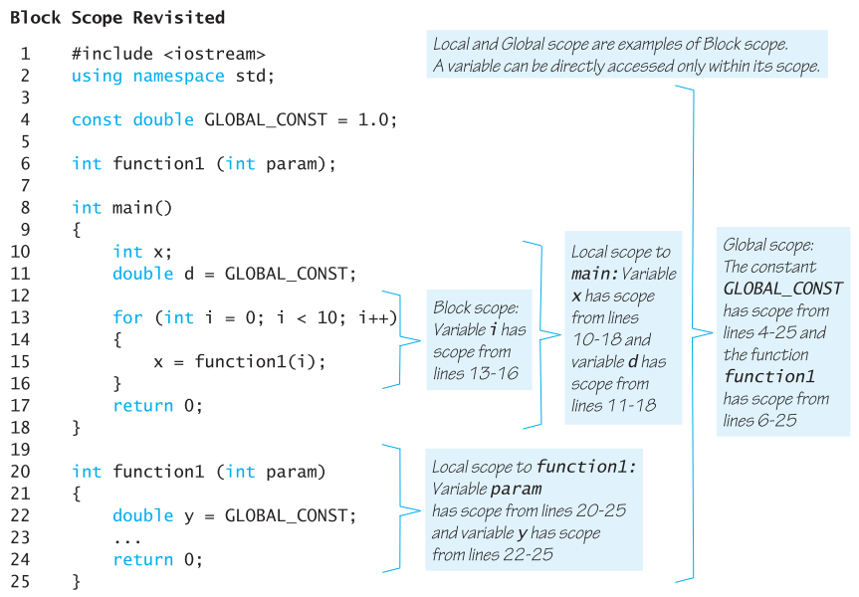
Display 4.14
Back
Next
Slide 4- <number>

Slide 93
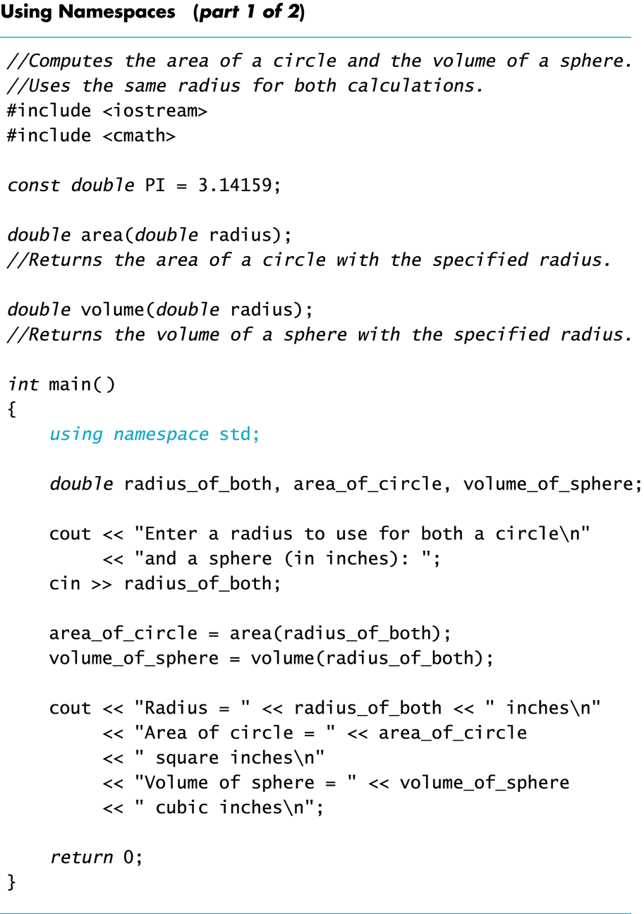
Display 4.15 (1/2)
Back
Next
Slide 4- <number>

Slide 94
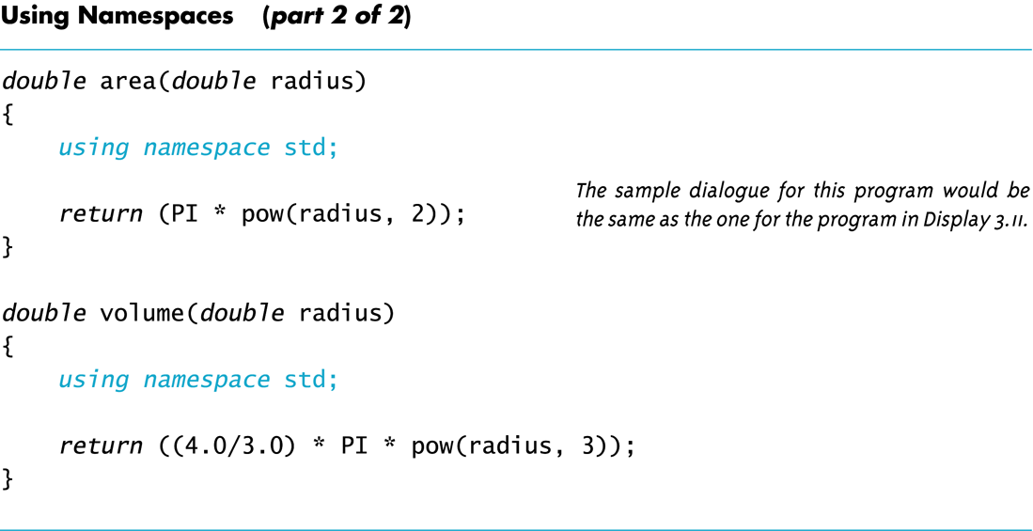
Display 4.15
(2/2)
Back
Next
Slide 4- <number>

Slide 95
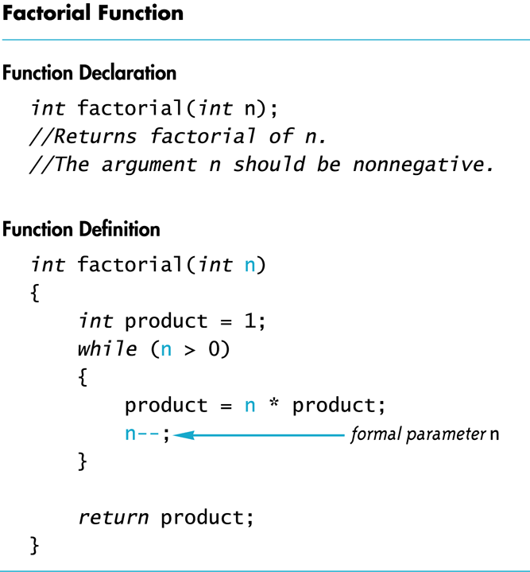
Display 4.16
Back
Next
Slide 4- <number>

Slide 96
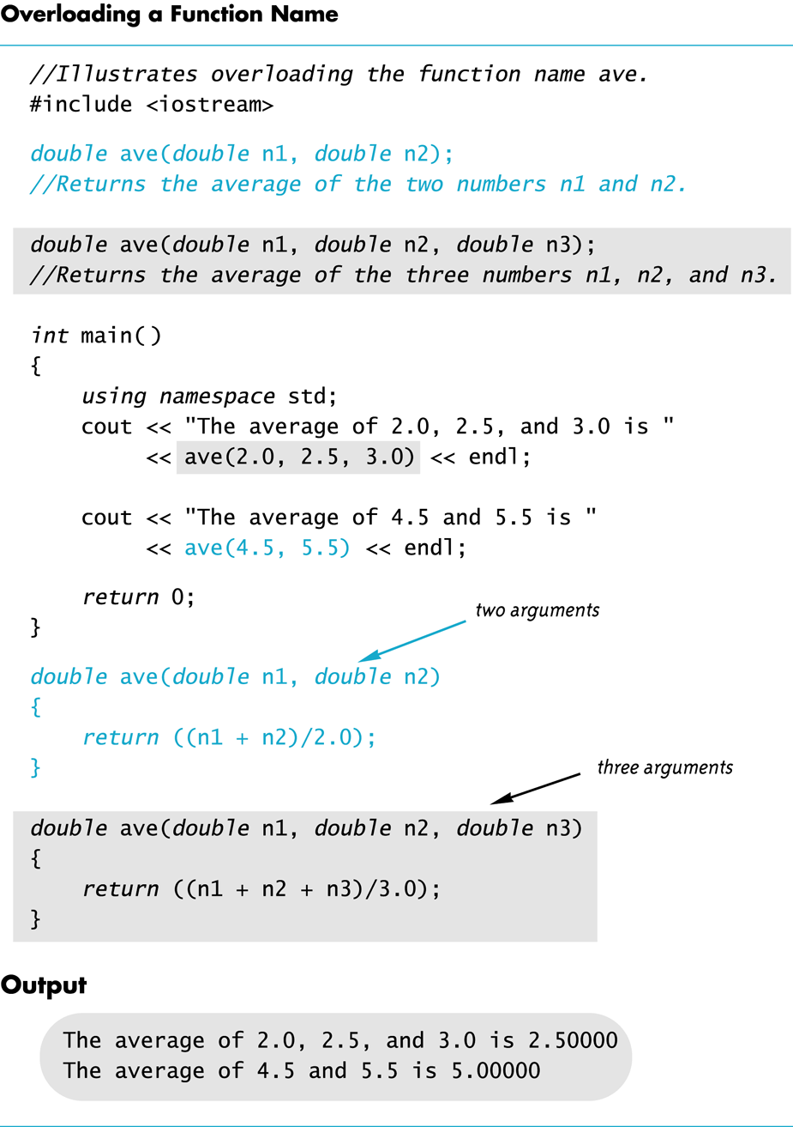
Display 4.17
Back
Next
Slide 4- <number>

Slide 97
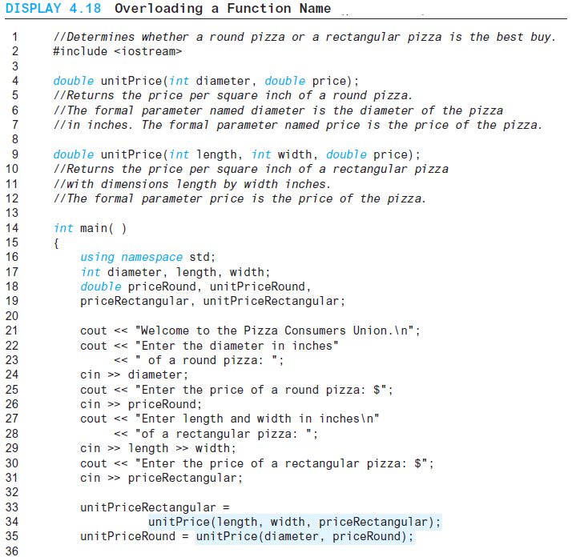
Display 4.18 (1/3)
Back
Next
Slide 4- <number>

Slide 98
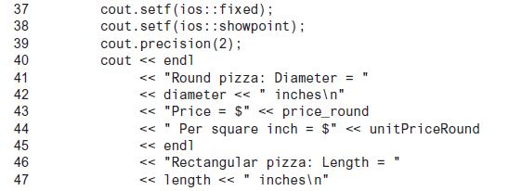
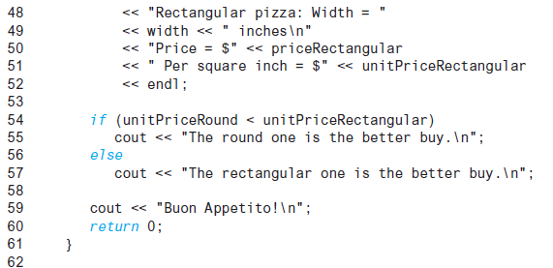
Display 4.18 (2/3)
Back
Next
Slide 4- <number>

Slide 99
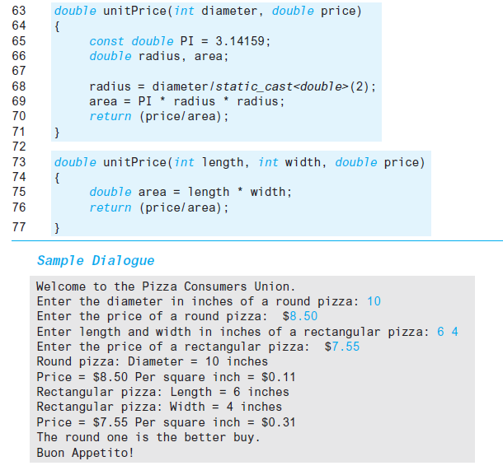
Display 4.18
(3/3)
Back
Next
Slide 4- <number>

