Slide 1
Introduction to Programming
Creating a C program

Slide 2
WRITING/EDITING C PROGRAM II
Advance Structure of a .c file
/* Begins with comments about file contents */
Insert #include statements and preprocessor definitions
Function prototypes and variable declarations
Define main() function
{
Function body
}
Define other function i.e. function definition
{
Function body
}

Slide 3
COMMENT
Comment is used to explain line of codes.
Its actually a way of documenting your source code.
It is completely ignored by the compiler
And it can appear anywhere in the program.
There are two commenting styles:
Single line comment
Multiple line comment

Slide 4
Single line comment
Single line comment is used for commenting every single line of comment.
Its inserted at the beginning of every line.
Examples:
For comment on a line
//………………….
//This is my first program
For comment on multiple lines
To use single line comment when the comment is more than a line, ‘//’ will be inserted at the beginning of each line.
// This Application is to perform application,
//and registration

Slide 5
Multiple line comment
/*……*/ this is multiple line commenting style,
For examples
For comment on a line
/* This is a registration application*/
For comment on multiple line
/*This Application is to perform application, and registration */

Slide 6
Where to use comment
At the beginning of your code, explaining what the program is all about.
You can comment a line or a segment of your code to explaining what the line or segment is doing.
You can also use comment on sections of the code so to see what the output is really like if the section is not written.

Slide 7
WARNING
To use multiple line for comment do not forget to close the comment with the */ or else the codes entered after will also be taken as comment by the compiler.
For a single line comment, do not forget to add the comment sign “//” at the beginning of every line or else the comments will be seen as code by the compiler. This will results into error during compilation.

Slide 8
GOOD PROGRAMMING STYLE
Always start you coding with comment, the comment here can be used for giving title to the code or explain what the code want to accomplish or its all about.

Slide 9
Lab Work
Write a comment on multiple lines using multiple line comment style, but do not close the comment. Continue coding after writing the comment and then compile your work.
Write a comment on multiple line using single line comment style, but do not add comment sign “//” before the last line of the comment. Then, continue coding after writing the comment and then compile your work.

Slide 10
Preprocessors Definitions
Preprocessor is a separate step of compilation. One of its uses is to allow C to make use of facilities which are not originally in C language. Any line in the source code stating with # sign is a preprocessor definition. There are different categories of C:
File Inclusion
Macro-substitution

Slide 11
File Inclusion
File inclusion makes it easy to;
access library functions in an header file
handle collection of #define and decalaration statements.
The most popular preprocessor for file inclusion is #include
#include is a preprocessor directory that tells the compiler to put code from the headers such as stdio.h into our program before actually creating the executable.
Typically you will use the preprocessor to define constants, perform conditional code inclusion, include header files or to create shortcuts
The C preprocessor permits you to define simple macros that are evaluated and expanded prior to compilation.

Slide 12
File Inclusion
To access library functions in an header file the most popular preprocessor to use is #include.
#include is a preprocessor directory that tells the compiler to put code from the headers such as stdio.h into our program before actually creating the executable.
Syntax:
#include <headerfile>
For example:
#include <stdio.h>
Note that extension .h is added to make the standard input and output library an header file.

Slide 13
File Inclusion
Header files contain definitions of variables and functions inside standard C libraries.
Such declarations of variables and functions (function prototype) are necessary for the functioning of a program. Examples of such functions are printf, scanf, getchar etc. which are part of standard input and output library, i.e. stdio.
stdio.h provides support for keyboard input and for displaying output.

Slide 14
Libraries in C standard library
< stdio.h> -> defining input and output routines
< ctype.h> -> defining character manipulation routines
< string.h> -> defining string manipulation routines
< math.h> -> defining mathematical routines
< stdlib.h> -> defining number conversion, storage allocation and similar tasks
< stdarg.h> -> defining libraries to handle routines with variable numbers of arguments
< time.h> -> defining time-manipulation routines
< assert.h> -> defining diagnostic routines
< setjmp.h> -> defining non-local function calls
< signal.h> -> defining signal handlers
< limits.h> -> defining constants of the int type
< float.h> -> defining constants of the float type

Slide 15
File Inclusion
#include preprocessor directory also handles collection of #define and declaration statements which are defined by the user-written.
Syntax:
#include “filename”
For example:
#include “fileA.c”

Slide 16
Common C headers in include preprocessor.
Standard Headers you should know about:
stdio.h – file and console (also a file) IO: perror, printf, open, close, read, write, scanf, etc.
stdlib.h - common utility functions: malloc, calloc, strtol, atoi, etc
string.h - string and byte manipulation: strlen, strcpy, strcat, memcpy, memset, etc.
ctype.h – character types: isalnum, isprint, isupport, tolower, etc.
errno.h – defines errno used for reporting system errors
math.h – math functions: ceil, exp, floor, sqrt, etc.
signal.h – signal handling facility: raise, signal, etc
stdint.h – standard integer: intN_t, uintN_t, etc
time.h – time related facility: asctime, clock, time_t, etc.

Slide 17
Macro-substitution
Macro-substitution implies that any subsequent occurrence of the token name will be replaced by the replacement text.
The most popular preprocessor used is #define
The C preprocessor permits you to define simple macros that are evaluated and expanded prior to compilation.

Slide 18
Macro-substitution
Syntax:
#define token-name replacement text
#define can be used for symbolic constant e.g.
#define PIE 3.142
This means subsequence occurrence of PIE will be replaced by 3.142

Slide 19
Function Prototype and variable declarations
Function prototypes and variable declarations is the third step in creating a C file.
Function prototypes are also known as function declarations.
Declaration refers to where the nature of a variable is stated but no storage is allocated.
At this stage user-defined function are declared. Also any variable declared here are called external variable.
External variable is a variable which is not declared within any function and can be accessed by any function.

Slide 20
Function
Function is simply a collection of commands that does something.
Function breaks large computing task into smaller ones.
It makes a program reusable i.e. enable people to build on what others have done instead of building another one from scratch.
It also hides the detail of operation from parts of the program that do not need to know about them.

Slide 21
Function Prototype/declaration
The syntax for declaring a function is:
return-type function-name (argument or argument-list);
For example: the following function add is an integer and takes in three parameters x, y, and z.
int add (int x, int y, int z);
int factorial (int n);
Note that if the return-type is not there C uses int by default.
Also the return value must match the return-type.
If a function will not return any value use the following syntax;
void function-name (argument or argument lists);
Void means no return value (when in the position of return-type), or no return arguments when in the position of argument.

Slide 22
Function Prototype/declaration
Arguments: are local variables i.e. values passed from caller.
Return value: single value returned to caller function.

Slide 23
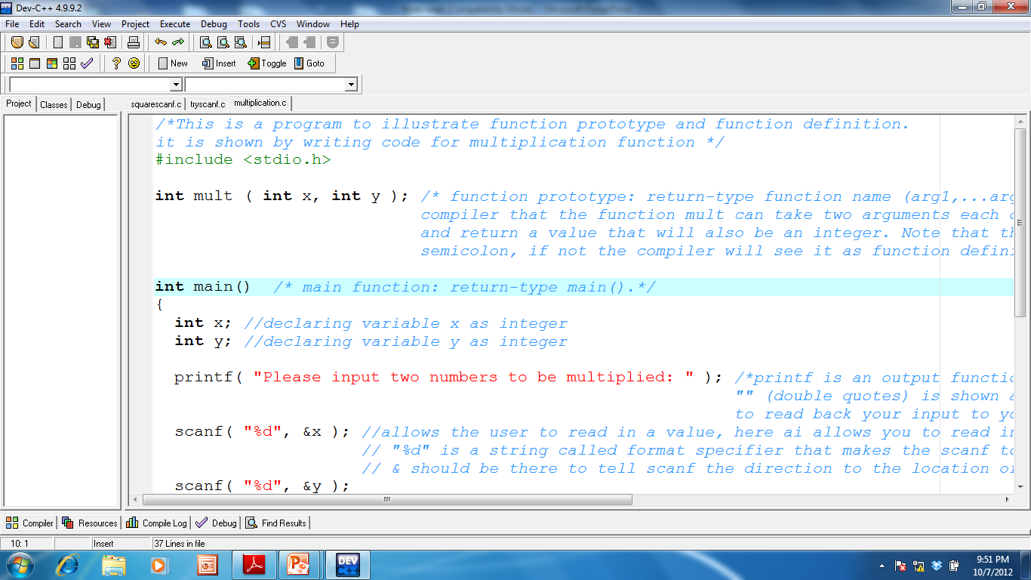
First argument: the argument type is integer
Function name
Return type

Slide 24
main function
main function is a special function which every c program must have.
Execution always start from the main function.
It is a function which expects no arguments; this is indicated by an empty list ().
Main function always call other functions like printf, scanf, getchar.
Syntax:
return type main ()

Slide 25
main function
The function body is enclosed within the left and right braces {…}.
{ This opening brace marks the start of the statements that make up the function body.
And must be ended with a closing brace }.
This pair of braces and the portion of the program between the braces is called a block

Slide 26
main function
Main function like every other function can communicate with another function by calling the function.
Syntax for function call:
function_name(argument);
For example:
printf(“Hello-World”);
printf(“the sum of two integers are %d”, sum(a,b));

Slide 27
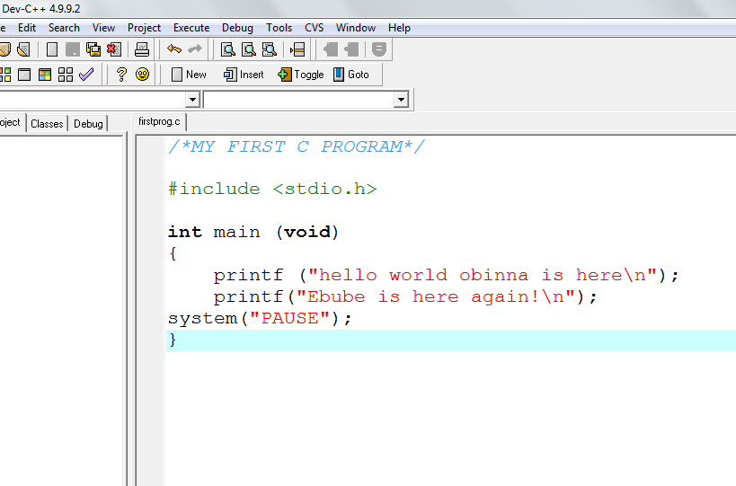
Declare the main function
1.Begin with comment
Define the library
# indicates
That this
Line should be interpreted
By the preprocessor
This line is the preprocessor
directives
Int indicates the return type
Void indicates no argument
Use left and
Right braces.
They contain
The body of
The main fun-
ction
System pause
Is used by Dev
C++ for viewing
Console application

Slide 28
Explanation
printf(" The first program in C ");
instructs the computer to perform an action, namely to print on the screen the string of characters marked by the quotation marks
This displays the phrase The first C program
printf() is part of the standard C library. It's termed a function, and using a function in the program is termed calling a function.

Slide 29
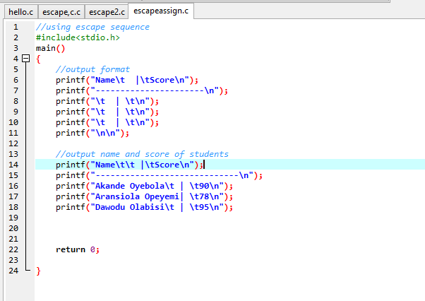
Identify the function called by main

Slide 30
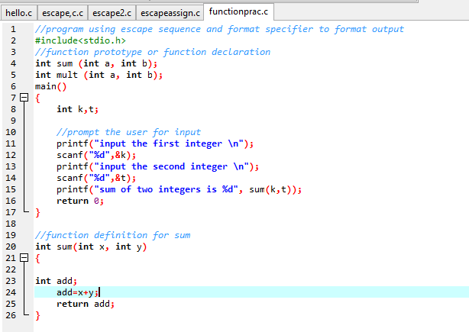
Identify the functions called by main and the point of call

Slide 31
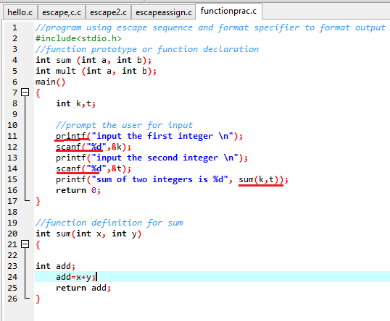
Solution

Slide 32
Note these:
Note that :
return 0; statement in the main function indicates the program ended successfully
The keyword return is one of several means we’ll use to exit a function
Every statement must end with a semicolon (also known as the statement terminator).
Each function including the main function must have its function body within the right and left braces i.e.{ function body}

Slide 33
Things to Note When Writing C Program
; (semicolon) indicates the end of a statement
<…> e.g. <stdio.h>..the compiler should look for the file in a library. In this case compiler should look for input and output files such as “printf” and “getchar”.
All C statements are defined in free format, i.e., with no specified layout or column assignment.

Slide 34
Lab work
Write a program without a return statement in the main function.

Slide 35
Function Definition
Definition refers to a place where the variable or function is created or assigned storage.
Syntax:
return-type function-name(argument or arguments list)

Slide 36
Difference Between Function definition and function declaration
Function definition Syntax:
return-type function-name(argument or arguments list)
Function declaration Syntax:
return-type function-name(argument or arguments list);
The major difference is that function declaration ends with a semicolon.
Another minor difference is that data type of the argument may not be indicated in function definition.
Another difference is that function definition is followed by a block of function body.

Slide 37
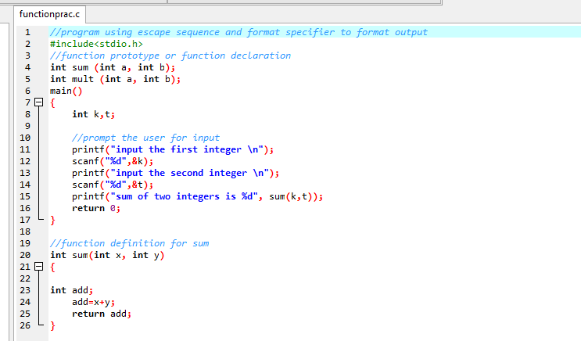
Example:

Slide 38
Reading Assignment
Textbook: Computer Science Problem Solving Methods In C and C++
Pages 92-110, 118-128

