Slide 1
DATA TYPE
BOLA AKANDE
COSC101

Slide 2
DATA TYPES
The data type of an object in memory determines the set of values it can have and what operations that can be performed on it. Examples of data types, int, float, char etc. Thus if a data type is an integer or float you can perform arithmetic operations on it.
It also signifies the way data is represented.
C is a strongly typed language because variables i.e. data must be declared before use.

Slide 3
DATATYPES
C has a small family of datatypes.
Numeric (int, float, double)
Character (char)
User defined (struct,union,array)

Slide 4
Numeric Data types
int: Data type int is used for whole numbers. int specifies integer. int occupies 4 bytes in the memory and it can be as low as 2 bytes.
float: it is used for specifying floating point numbers i.e. decimals, it specifies the fractional part of a number up to a single precision. It occupies 4 bytes memory space.

Slide 5
Numeric Data Types
double: it specifies a double-precision fractional number. Thus its used for large precision. It has the largest range in the computer. It occupies 8 to 16bytes

Slide 6
char
char: it’s a data type for specifying one character. It has the smallest range. It occupies 1 byte.
In ANSI C we have character constant, arrays of characters, and other character handling function.

Slide 7
NOTE THESE……….
float and double can also store whole numbers
Note that precision means number of digits used in expressing a value.
Also the space a data type occupies in the memory (i.e. its range) is machine dependent.
Real numbers is the same thing as float.

Slide 8
DERIVED DATA TYPES
There are other data types which are defined by users and called derived types.
There are infinite number of derived types, common examples are arrays, structures, and pointers.
They are constructed to meet user’s specific needs.

Slide 9
What are variables?
Variables
Named memory location
Their value can change during the execution of a program
In ANSI C programs, all variables must be declared prior to their use. This property makes C to be a strongly typed language.

Slide 10
VARIABLES
A variable is as named link/reference to a value stored in the system’s main memory or it is an expression that can be evaluated.
Consider: int x=0,y=0;
int y=x+2;.
x, y are variables
y = x +2 is an expression,+ is an operator.

Slide 11
SYNTAX FOR VARIABLE DECLARATION
Note that variables are declared by the association of a data type with a variable name.
Variable declaration syntax is as follows:
<data-type><identifier or variable name>;
For example
int x;
float area;
double temp;
char c;

Slide 12
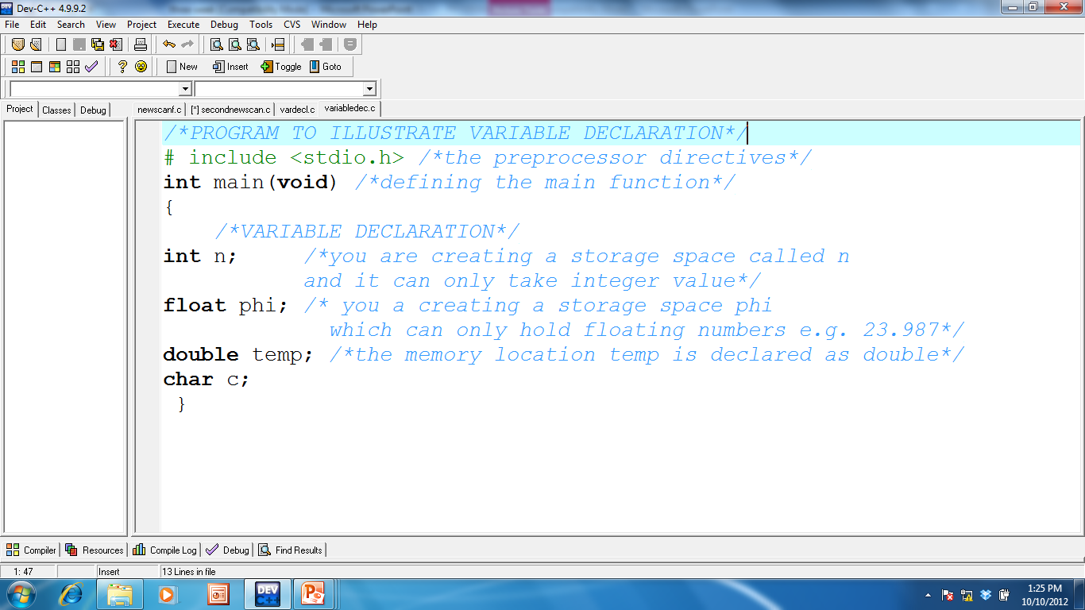

Slide 13
Initializing Variables
Intialization means declaring the first or starting value or constant value of a variable that has been previously declared or has just been declared.
By default a variable which is not intialize will take a 0 value, thus if you don’t want your variable to be 0 then you must initialized it.
Point of initialization:
at the point of declaration e.g.
int n=3;

Slide 14
Initializing variables
char x; /∗ uninitialized ∗/
char x=’A’; /∗ intialized to ’A’∗/
char x=’A’,y=’B’; /∗multiple variables initialized, meaning variable x will take character A while variable y will take character B∗/
char x=y=’Z’; /∗multiple initializations this means character Z is assigned to variables x and y∗/

Slide 15
HOW?
Variables is intialized through assignment operator i.e. =
Decalration and intialization can be done thus:
int a,b,c =0, d=4;
OR
int a=0;
=+

Slide 16
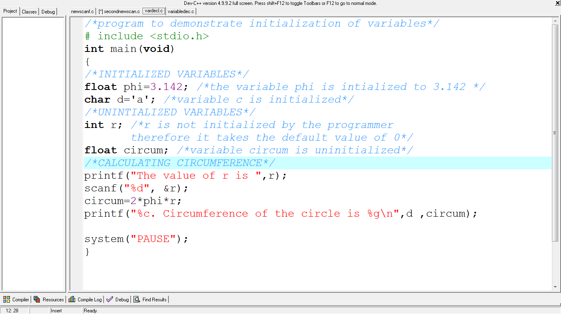

Slide 17
Memory Concepts
Variable names such as r, and area actually correspond to locations in the computer’s memory.
Every variable has a name, a type and a value.
when the statement
scanf( "%f", &r ); /* read a floating value */
is executed, the value typed by the user is placed into a memory location to which the name r has been assigned.
Suppose the user enters the number 2 as the value for r.
The computer will place 2 into location r
The statement
area = PI * r * r; /* assign value to area */
that performs the multiplications also replaces whatever value was stored in area.

Slide 18
Quiz
Pick out the errors
# include <stdio.h>
int main (void)
{
int h=10;
float y
float x
h*y=x
printf(“the product is ” +x);
}

Slide 19
External and Local Variables
Differences:
The scope of external variable is from the point of declaration to the end of the program.
Scope of local or automatic variable is only within the function where it is declared.
External variable remains in existence permanently i.e. they retain their values even if after the function that set them have returned.
Local variables are temporal; they only exists when the function that sets them exists.

Slide 20
Identifier
An identifier refers directly to the data stored in a particular memory location
Variable names are known as identifiers
Identifiers can contain letters, digits, underscore but it must not start with a digit.
In ANSI C the first 63 characters of an identifier is significant.
This is to increase portability and reduce errors.

Slide 21
Rules for Naming Identifiers
Rules govern the names that can be used as identifiers.
Do not use C keywords (reserved) as identifiers
Identifiers are case sensitive
Identifiers must not start with a numeric or digit character
Identifiers must not include punctuation, control, or special characters
It must not include space.
An identifier can start with an underscore e.g._age
For external variables, only the first 31 characters of identifiers are significant
Do not use an hyphen, the compiler treat it as minus.

Slide 22
Naming Identifier contd
Do not use C keywords(reserved) as identifiers
C has only 32 keywords
auto, double, int, struct, long, enum, register, typedef, char, extern, union, const, float, short, unsigned, signed, void, volatile, if, else while , for, do, double etc.
These keywords cannot be redefined for they already have an intended meaning or interpretation.
Identifiers are case sensitive
Case sensitivity means that an uppercase letter is not considered to be the same as its lowercase equivalent
For example, identifiers EMPL_NO and empl_no are different.

Slide 23
Naming Identifier contd
Identifiers must not start with a numeric character
5age is illegal X
Identifiers must not include punctuation, control, or special characters
?. @, ” are illegal X
Standard C practice is to use lowercase letters for variable names
n=0;
And you use uppercase for symbolic constants
PI = 3.142

Slide 24
Naming Identifiers
Names that begin with the underscore character are traditionally used in libraries for values or functions,
so it is better to avoid using names that begin with an underscore in simple application programs.
note also that library functions like printf() are not part of C keywords.
This is because they can be redefined though they have been predefined.

Slide 25
Exercise
Pop quiz (correct/incorrect):
int money$owed;
int total_count;
int score2;
int 2ndscore;
int long;

