Slide 1

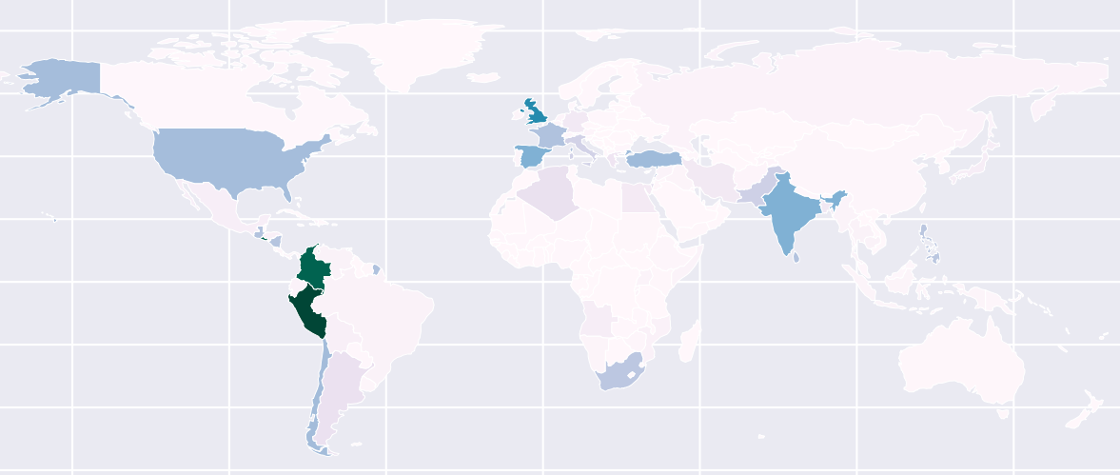
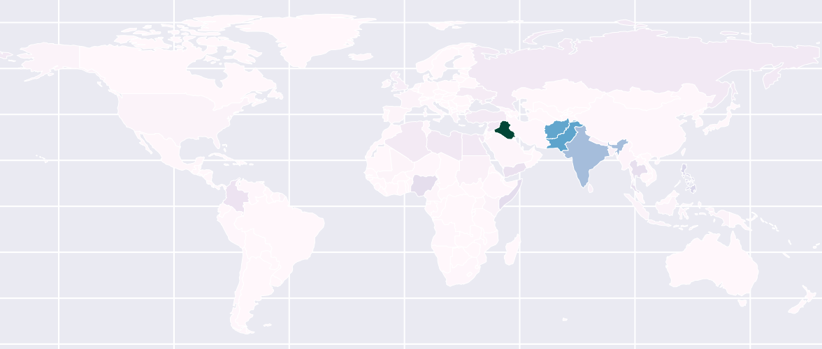


Global Terrorism 1970 - 2017
Anton Perepelenko, Mari Liis Velner
University of Tartu
Introduction
Thousands acts of terrorism happen every year causing enormous damage to economy and killing numerous people, bringing grief and pain to the world. Every developed country strives to eradicate this plague of modern times and spends millions of dollars on fighting terrorism. We believe that in order to fight something you should understand it. Therefore our project aims to discover different correlations and dependencies between various acts of terror and to show our fellow students the distribution and dynamics of terrorism.
Map 1. Distribution of terror attacks 1970 - 1996
Data
The Global Terrorism Dataset (GTD) was collected by the United States National Consortium for the Study of Terrorism and Responses to Terrorism (START) during several phases using public, non-classified high-quality source materials, including media articles and electronic news archives. The dataset is available at Kaggle.com as well as the official START webpage. It is a large database consisting of over 180,000 records with more than 120 features.
An impactful change in the methods of data collection happened in 1997 and as a result, the data starting from that year has many new values missing from the years before. In addition, more available information in the modern world combined with new data collection methods resulted in an increase in the number of recorded terrorism incidents. In order to avoid bias errors we decided to analyse data in two separate parts, namely before and after 1997.
Preprocessing
Map 2. Distribution of terror attacks 1997 - 2017
Did you know…
Methods
… anti-abortion extremists are a current domestic threat according to the United States Department of Justice? [1] 98% of abortion related terrorism incidents have occurred in USA.
… Shining Path is a communist party in Peru that is responsible for the most terror attacks worldwide during 1970-1997?
… during the El Salvador civil war in 1983, more than 35,000 people were kidnapped?
… during the Sandinista Revolution in Nicaragua in 1978 congress was taken hostage and the requested ransom was $10,000,000?
… the largest ransom ever paid is $275,000,000 paid by Qatar government in 2015 to release 26 Qatari hostages kidnapped in Iraq?
… 2500 persons participated in the confrontations with the police in Dhaka, Bangladesh on September 13th, 1994?
… incident with the largest number of casualties (1570 people killed) is the ISIL offensive in Northern Iraq in 2014?
We used Python as the main language for data processing.
Main used packages: pandas, geopandas, scipy, statscolletions.
Data preparation involved separating data in two parts, as stated in the Data section, removing typos, converting categories that represent missing values to NaN values, and encoding some numerical data into categorical.
The large size of the dataset as well as a large number of typos forced us to use the HPC provided by the University of Tartu in order to minimise the time of the computations.
Data analysis involved plotting data to the map, building graphs and performing Pearson Phi, Chi-squared, and ANOVA tests.
Some correlations and dependencies could not be found due to many missing values, especially in data before 1997.
Top facts
Top countries
Pre-1997: the most tumultuous area is South America
Post-1997: the Middle-East and South Asia
Most used attack type: bombing/explosion (~50%)
Citizens and private property are the top targets
2014 had the largest number of incidents (16,903)
ISIS is the most fatal terrorist group
1970 – 1997
Peru
Colombia
El Salvador
1997 - 2017
Iraq
Pakistan
Afghanistan
References
1. https://en.wikipedia.org/wiki/Anti-abortion_violence
https://github.com/Achaad/data-mining-terrorism

