Slide 1
MMO Game
LOBKE & ilias

Slide 2
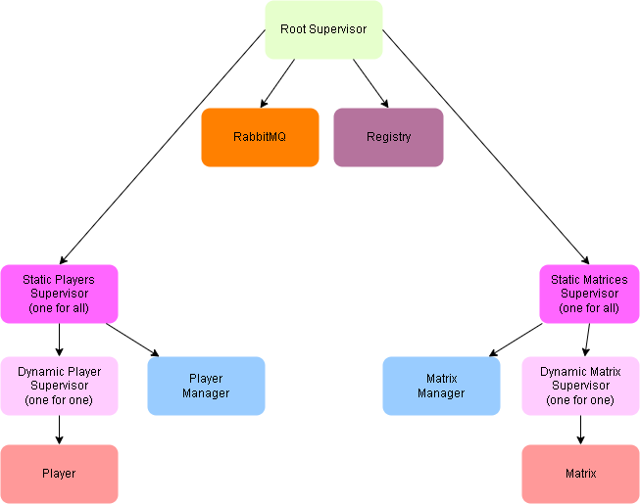
Schets OTP applicatie

Slide 3
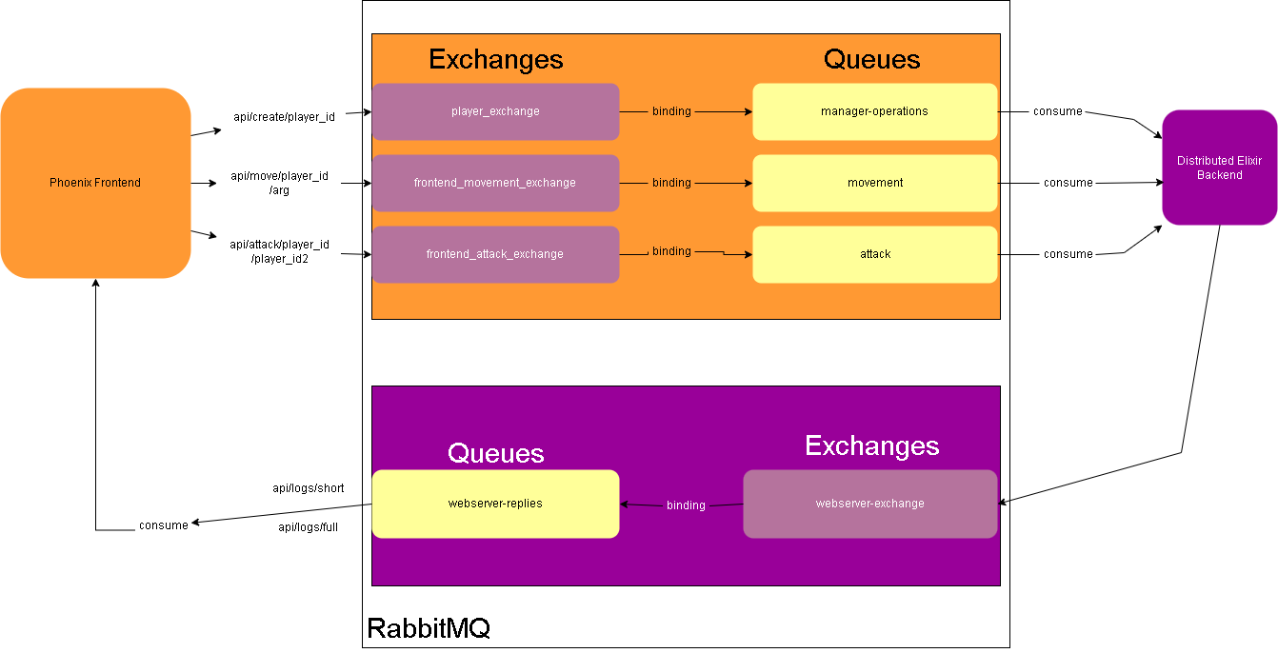
Schets distributed applicatie

Slide 4
Phoenix Frontend

Slide 5
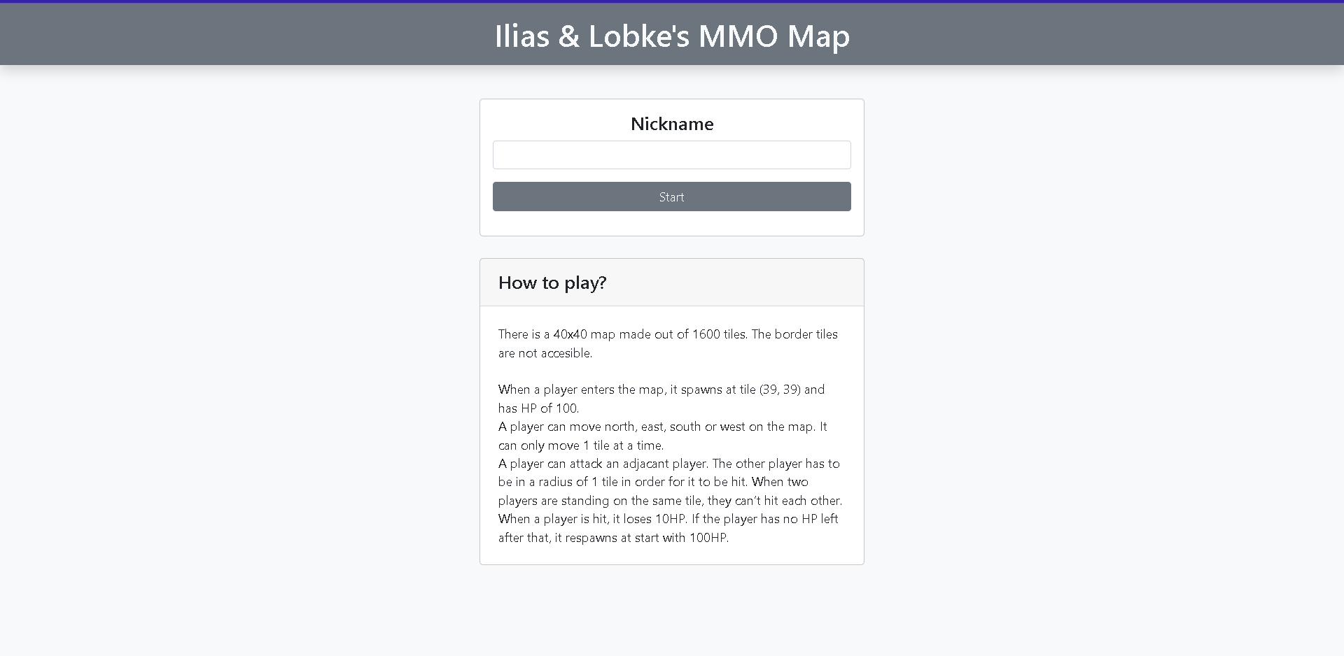
Creating a player
API call: localhost:4000/api/create/<username>

Slide 6
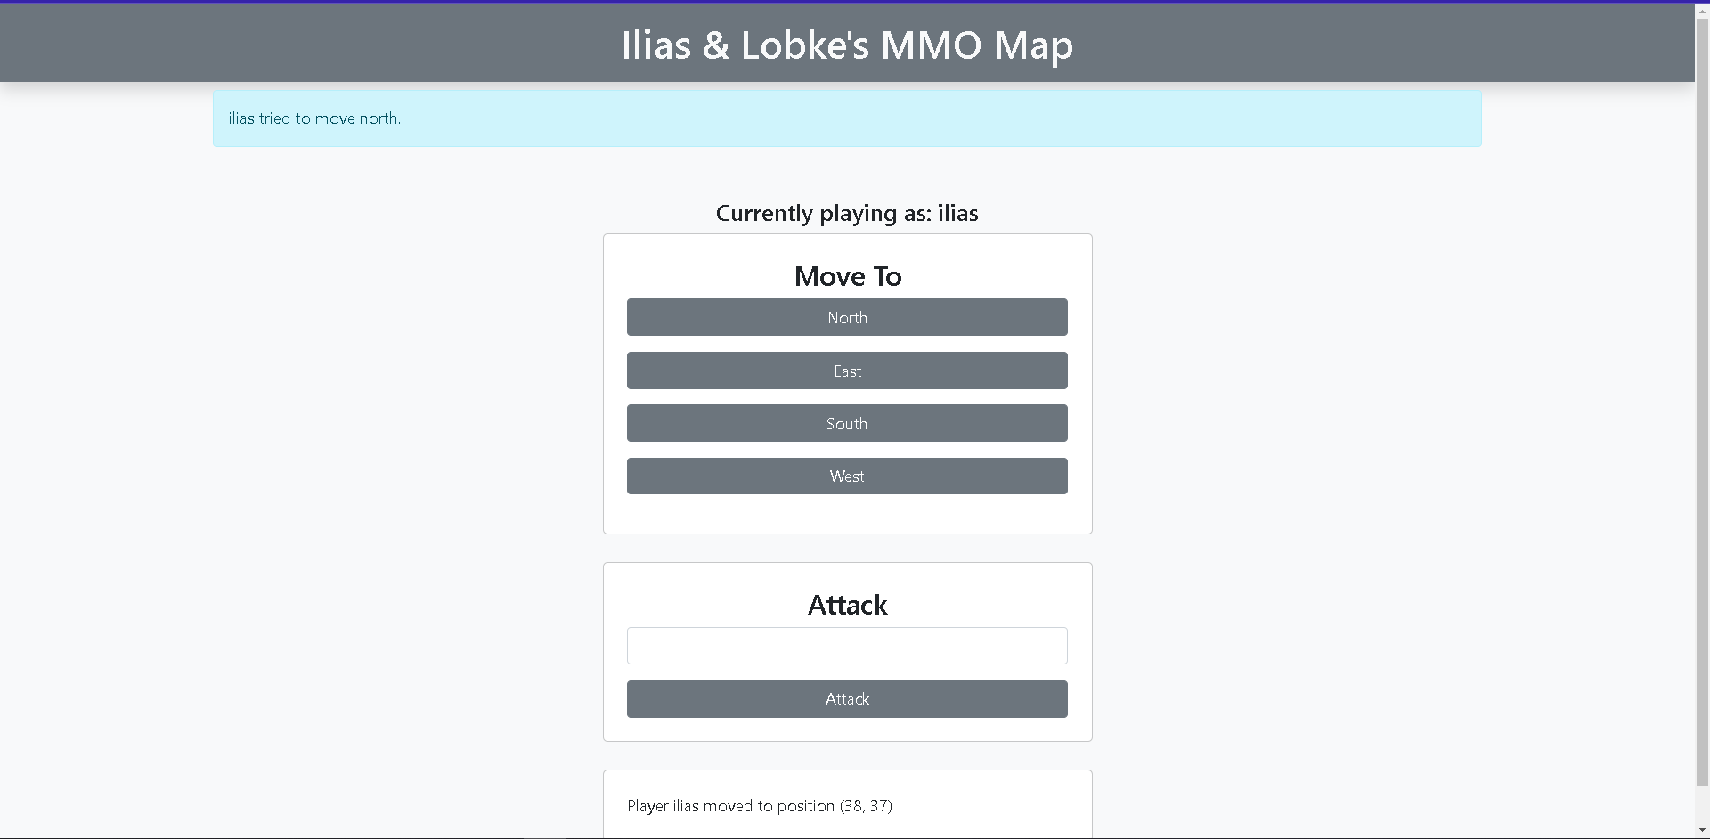
Moving a player
API call: localhost:4000/api/move/<username>/N

Slide 7
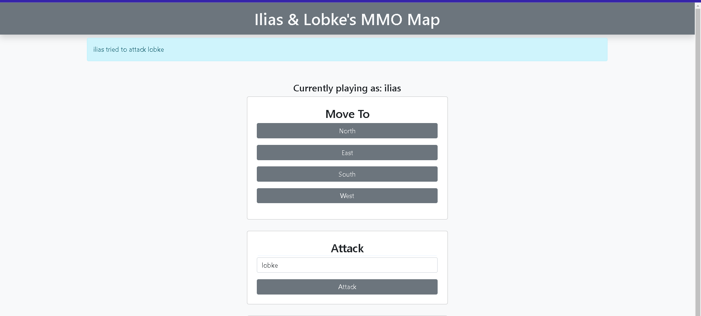
Attacking a player
API call:localhost:4000/api/attack/<username>/<username2>

Slide 8
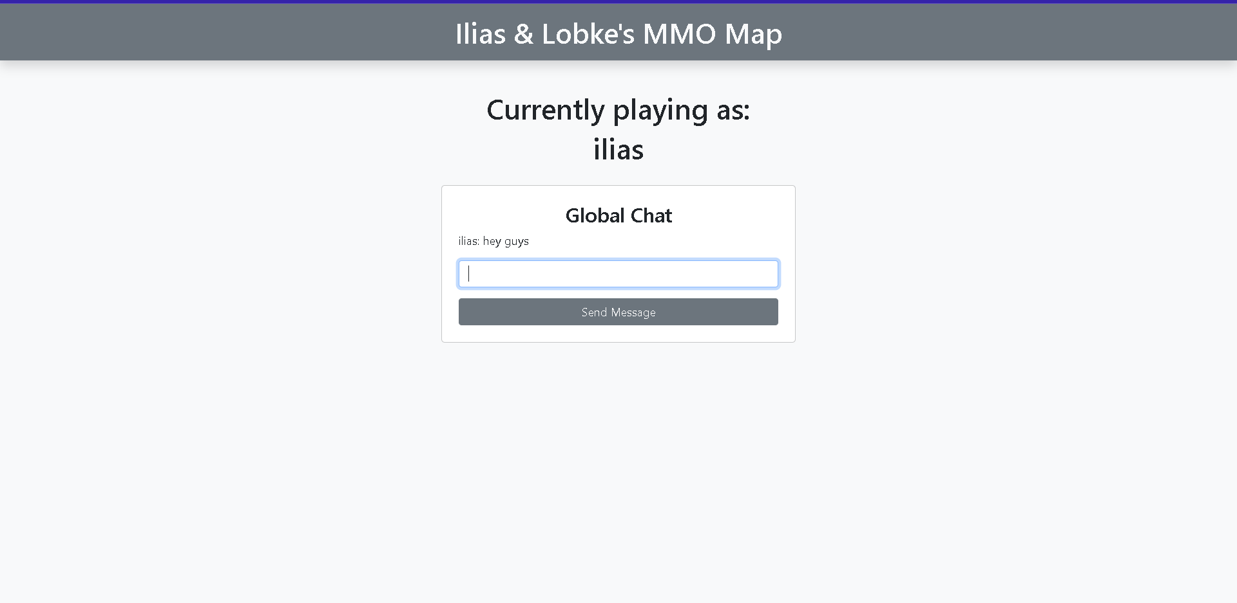
Entering Global Chat
localhost:4000/<your_username>/chat

Slide 9
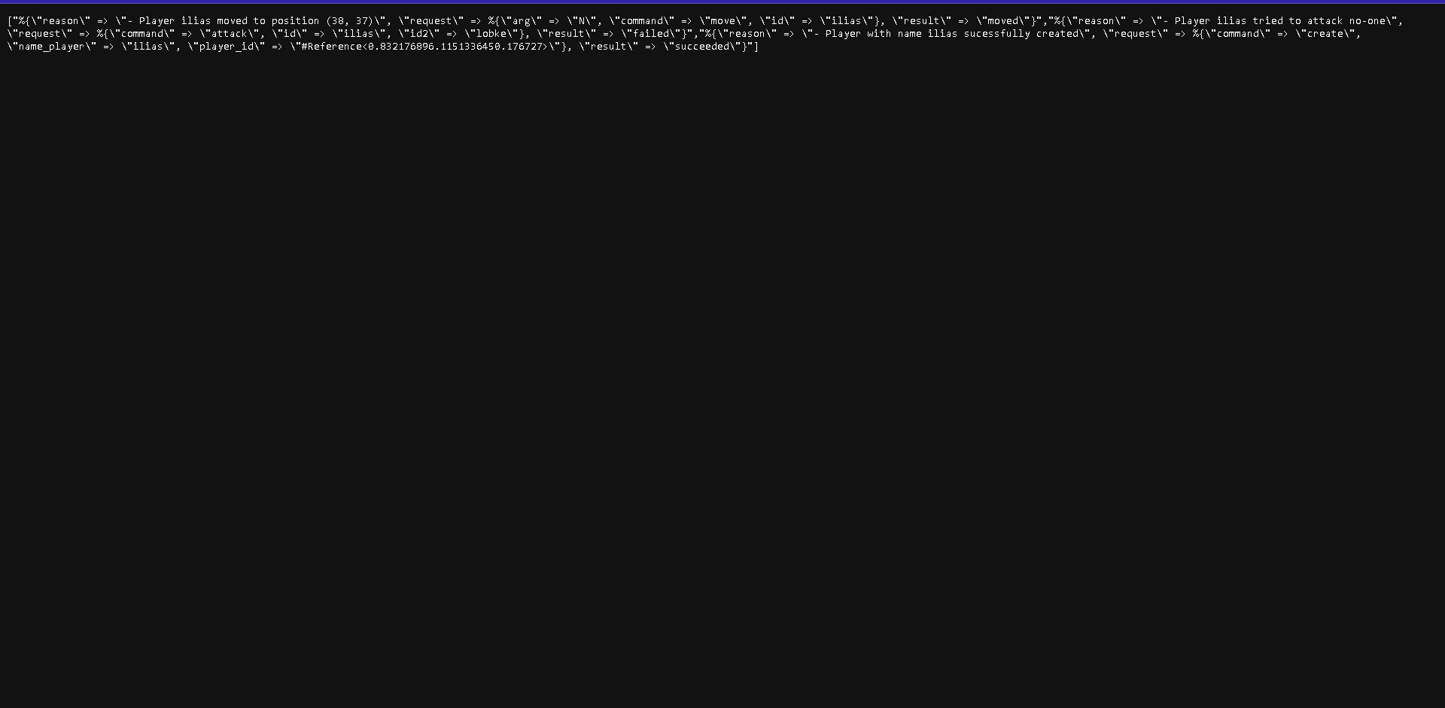
See Logs
API calls: localhost:4000/api/logs/full localhost:4000/api/logs/short

Slide 10
Elixir Backend

Slide 11
Moving a player
Mmo.Player.walk("player", :N)
Mmo.Player.walk("player", :E)
Mmo.Player.walk("player", :S)
Mmo.Player.walk("player", :W)

Slide 12
Attacking a player
Mmo.Player.attack("player", "attacked-player")

Slide 13
Get player data
Mmo.Player.get_position("player")
Mmo.Player.get("player”)

