Slide 1
Spelling Correction and the Noisy Channel
The Spelling Correction Task
Notes:
<number>

Slide 2
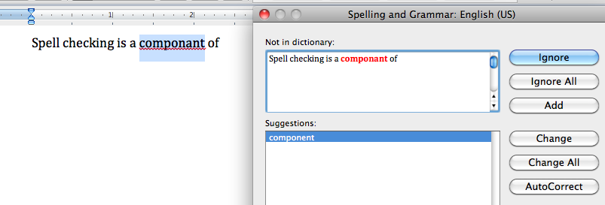
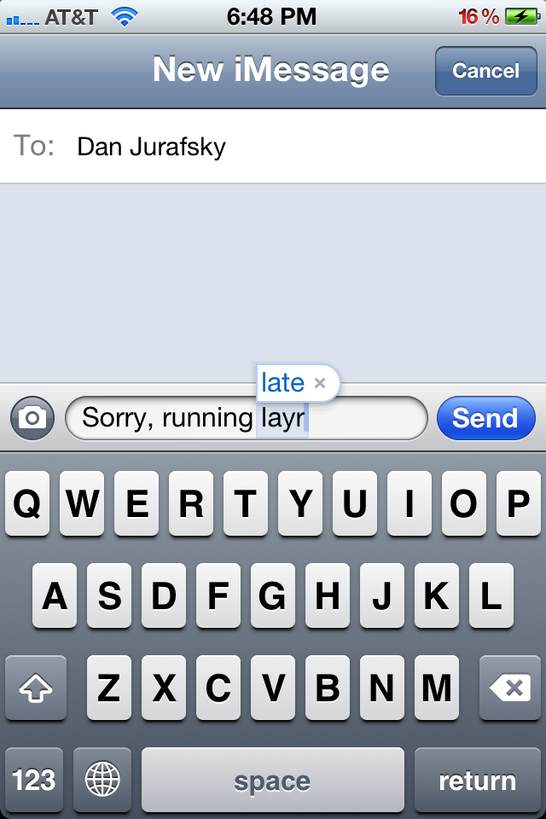
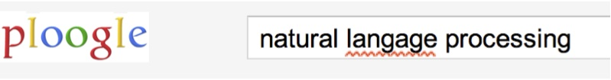
<number>
Applications for spelling correction
Word processing
Phones
Web search

Slide 3
<number>
Spelling Tasks
Spelling Error Detection
Spelling Error Correction:
Autocorrect
hte→the
Suggest a correction
Suggestion lists

Slide 4
<number>
Types of spelling errors
Non-word Errors
graffe →giraffe
Real-word Errors
Typographical errors
three →there
Cognitive Errors (homophones)
piece→peace,
too → two

Slide 5
<number>
Rates of spelling errors
26%: Web queries Wang et al. 2003
13%: Retyping, no backspace: Whitelaw et al. English&German
7%: Words corrected retyping on phone-sized organizer
2%: Words uncorrected on organizer Soukoreff &MacKenzie 2003
1-2%: Retyping: Kane and Wobbrock 2007, Gruden et al. 1983

Slide 6
<number>
Non-word spelling errors
Non-word spelling error detection:
Any word not in a dictionary is an error
The larger the dictionary the better
Non-word spelling error correction:
Generate candidates: real words that are similar to error
Choose the one which is best:
Shortest weighted edit distance
Highest noisy channel probability

Slide 7
<number>
Real word spelling errors
For each word w, generate candidate set:
Find candidate words with similar pronunciations
Find candidate words with similar spelling
Include w in candidate set
Choose best candidate
Noisy Channel
Classifier

Slide 8
Spelling Correction and the Noisy Channel
The Spelling Correction Task
Notes:
<number>

Slide 9
Spelling Correction and the Noisy Channel
The Noisy Channel Model of Spelling
Notes:
<number>

Slide 10
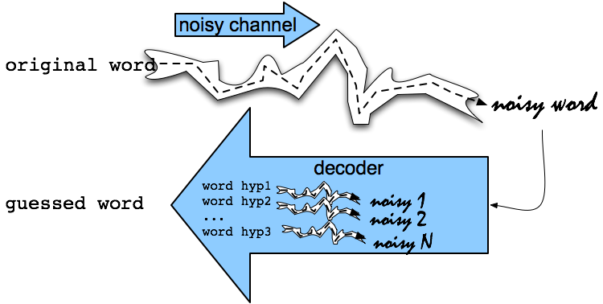
<number>
Noisy Channel Intuition

Slide 11
<number>
Noisy Channel
We see an observation x of a misspelled word
Find the correct word w
Notes:
Bayes Rule
<number>

Slide 12
History: Noisy channel for spelling proposed around 1990
IBM
Mays, Eric, Fred J. Damerau and Robert L. Mercer. 1991. Context based spelling correction. Information Processing and Management, 23(5), 517–522
AT&T Bell Labs
Kernighan, Mark D., Kenneth W. Church, and William A. Gale. 1990. A spelling correction program based on a noisy channel model. Proceedings of COLING 1990, 205-210

Slide 13
<number>
Non-word spelling error example
acress

Slide 14
<number>
Candidate generation
Words with similar spelling
Small edit distance to error
Words with similar pronunciation
Small edit distance of pronunciation to error

Slide 15
<number>
Damerau-Levenshtein edit distance
Minimal edit distance between two strings, where edits are:
Insertion
Deletion
Substitution
Transposition of two adjacent letters

Slide 16
<number>
Words within 1 of acress
Error | Candidate Correction | Correct Letter | Error Letter | Type
acress | actress | t | - | deletion
acress | cress | - | a | insertion
acress | caress | ca | ac | transposition
acress | access | c | r | substitution
acress | across | o | e | substitution
acress | acres | - | s | insertion
acress | acres | - | s | insertion

Slide 17
<number>
Candidate generation
80% of errors are within edit distance 1
Almost all errors within edit distance 2
Also allow insertion of space or hyphen
thisidea → this idea
inlaw → in-law

Slide 18
<number>
Language Model
Use any of the language modeling algorithms we’ve learned
Unigram, bigram, trigram
Web-scale spelling correction
Stupid backoff

Slide 19
<number>
Unigram Prior probability
Counts from 404,253,213 words in Corpus of Contemporary English (COCA)
word | Frequency of word | P(word)
actress | 9,321 | .0000230573
cress | 220 | .0000005442
caress | 686 | .0000016969
access | 37,038 | .0000916207
across | 120,844 | .0002989314
acres | 12,874 | .0000318463

Slide 20
<number>
Channel model probability
Error model probability, Edit probability
Kernighan, Church, Gale 1990
Misspelled word x = x1, x2, x3… xm
Correct word w = w1, w2, w3,…, wn
P(x|w) = probability of the edit
(deletion/insertion/substitution/transposition)

Slide 21
<number>
Computing error probability: confusion matrix
del[x,y]: count(xy typed as x)
ins[x,y]: count(x typed as xy)
sub[x,y]: count(x typed as y)
trans[x,y]: count(xy typed as yx)
Insertion and deletion conditioned on previous character

Slide 22
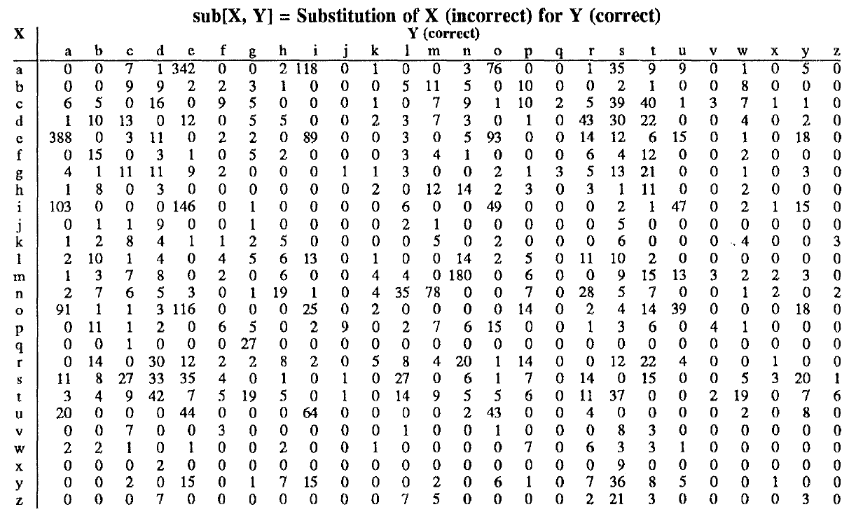
Confusion matrix for spelling errors

Slide 23
<number>
Generating the confusion matrix
Peter Norvig’s list of errors
Peter Norvig’s list of counts of single-edit errors

Slide 24
<number>
Channel model
Kernighan, Church, Gale 1990

Slide 25
<number>
Channel model for acress
Candidate Correction | Correct Letter | Error Letter | x|w | P(x|word)
actress | t | - | c|ct | .000117
cress | - | a | a|# | .00000144
caress | ca | ac | ac|ca | .00000164
access | c | r | r|c | .000000209
across | o | e | e|o | .0000093
acres | - | s | es|e | .0000321
acres | - | s | ss|s | .0000342

Slide 26
<number>
Noisy channel probability for acress
Candidate Correction | Correct Letter | Error Letter | x|w | P(x|word) | P(word) | 109 *P(x|w)P(w)
actress | t | - | c|ct | .000117 | .0000231 | 2.7
cress | - | a | a|# | .00000144 | .000000544 | .00078
caress | ca | ac | ac|ca | .00000164 | .00000170 | .0028
access | c | r | r|c | .000000209 | .0000916 | .019
across | o | e | e|o | .0000093 | .000299 | 2.8
acres | - | s | es|e | .0000321 | .0000318 | 1.0
acres | - | s | ss|s | .0000342 | .0000318 | 1.0

Slide 27
<number>
Noisy channel probability for acress
Candidate Correction | Correct Letter | Error Letter | x|w | P(x|word) | P(word) | 109 *P(x|w)P(w)
actress | t | - | c|ct | .000117 | .0000231 | 2.7
cress | - | a | a|# | .00000144 | .000000544 | .00078
caress | ca | ac | ac|ca | .00000164 | .00000170 | .0028
access | c | r | r|c | .000000209 | .0000916 | .019
across | o | e | e|o | .0000093 | .000299 | 2.8
acres | - | s | es|e | .0000321 | .0000318 | 1.0
acres | - | s | ss|s | .0000342 | .0000318 | 1.0

Slide 28
<number>
Using a bigram language model
“a stellar and versatile acress whose combination of sass and glamour…”
Counts from the Corpus of Contemporary American English with add-1 smoothing
P(actress|versatile)=.000021 P(whose|actress) = .0010
P(across|versatile) =.000021 P(whose|across) = .000006
P(“versatile actress whose”) = .000021*.0010 = 210 x10-10
P(“versatile across whose”) = .000021*.000006 = 1 x10-10

Slide 29
<number>
Using a bigram language model
“a stellar and versatile acress whose combination of sass and glamour…”
Counts from the Corpus of Contemporary American English with add-1 smoothing
P(actress|versatile)=.000021 P(whose|actress) = .0010
P(across|versatile) =.000021 P(whose|across) = .000006
P(“versatile actress whose”) = .000021*.0010 = 210 x10-10
P(“versatile across whose”) = .000021*.000006 = 1 x10-10

Slide 30
<number>
Evaluation
Some spelling error test sets
Wikipedia’s list of common English misspelling
Aspell filtered version of that list
Birkbeck spelling error corpus
Peter Norvig’s list of errors (includes Wikipedia and Birkbeck, for training or testing)

Slide 31
Spelling Correction and the Noisy Channel
The Noisy Channel Model of Spelling
Notes:
<number>

Slide 32
Spelling Correction and the Noisy Channel
Real-Word Spelling Correction
Notes:
<number>

Slide 33
<number>
Real-word spelling errors
…leaving in about fifteen minuets to go to her house.
The design an construction of the system…
Can they lave him my messages?
The study was conducted mainly be John Black.
25-40% of spelling errors are real words Kukich 1992

Slide 34
<number>
Solving real-world spelling errors
For each word in sentence
Generate candidate set
the word itself
all single-letter edits that are English words
words that are homophones
Choose best candidates
Noisy channel model
Task-specific classifier

Slide 35
Noisy channel for real-word spell correction
Given a sentence w1,w2,w3,…,wn
Generate a set of candidates for each word wi
Candidate(w1) = {w1, w’1 , w’’1 , w’’’1 ,…}
Candidate(w2) = {w2, w’2 , w’’2 , w’’’2 ,…}
Candidate(wn) = {wn, w’n , w’’n , w’’’n ,…}
Choose the sequence W that maximizes P(W)
Notes:
<number>

Slide 36
<number>
Noisy channel for real-word spell correction

Slide 37
<number>
Noisy channel for real-word spell correction

Slide 38
Simplification: One error per sentence
Out of all possible sentences with one word replaced
w1, w’’2,w3,w4 two off thew
w1,w2,w’3,w4 two of the
w’’’1,w2,w3,w4 too of thew
…
Choose the sequence W that maximizes P(W)
Notes:
<number>

Slide 39
<number>
Where to get the probabilities
Language model
Unigram
Bigram
Etc
Channel model
Same as for non-word spelling correction
Plus need probability for no error, P(w|w)

Slide 40
<number>
Probability of no error
What is the channel probability for a correctly typed word?
P(“the”|“the”)
Obviously this depends on the application
.90 (1 error in 10 words)
.95 (1 error in 20 words)
.99 (1 error in 100 words)
.995 (1 error in 200 words)

Slide 41
<number>
Peter Norvig’s “thew” example
x | w | x|w | P(x|w) | P(w) | 109 P(x|w)P(w)
thew | the | ew|e | 0.000007 | 0.02 | 144
thew | thew |  | 0.95 | 0.00000009 | 90
thew | thaw | e|a | 0.001 | 0.0000007 | 0.7
thew | threw | h|hr | 0.000008 | 0.000004 | 0.03
thew | thwe | ew|we | 0.000003 | 0.00000004 | 0.0001

Slide 42
Spelling Correction and the Noisy Channel
Real-Word Spelling Correction
Notes:
<number>

Slide 43
Spelling Correction and the Noisy Channel
State-of-the-art Systems
Notes:
<number>

Slide 44
<number>
HCI issues in spelling
If very confident in correction
Autocorrect
Less confident
Give the best correction
Less confident
Give a correction list
Unconfident
Just flag as an error

Slide 45
<number>
State of the art noisy channel
We never just multiply the prior and the error model
Independence assumptions→probabilities not commensurate
Instead: Weigh them
Learn λ from a development test set

Slide 46
<number>
Phonetic error model
Metaphone, used in GNU aspell
Convert misspelling to metaphone pronunciation
“Drop duplicate adjacent letters, except for C.”
“If the word begins with 'KN', 'GN', 'PN', 'AE', 'WR', drop the first letter.”
“Drop 'B' if after 'M' and if it is at the end of the word”
…
Find words whose pronunciation is 1-2 edit distance from misspelling’s
Score result list
Weighted edit distance of candidate to misspelling
Edit distance of candidate pronunciation to misspelling pronunciation

Slide 47
<number>
Improvements to channel model
Allow richer edits (Brill and Moore 2000)
ent→ant
ph→f
le→al
Incorporate pronunciation into channel (Toutanova and Moore 2002)

Slide 48
<number>
Channel model
Factors that could influence p(misspelling|word)
The source letter
The target letter
Surrounding letters
The position in the word
Nearby keys on the keyboard
Homology on the keyboard
Pronunciations
Likely morpheme transformations

Slide 49
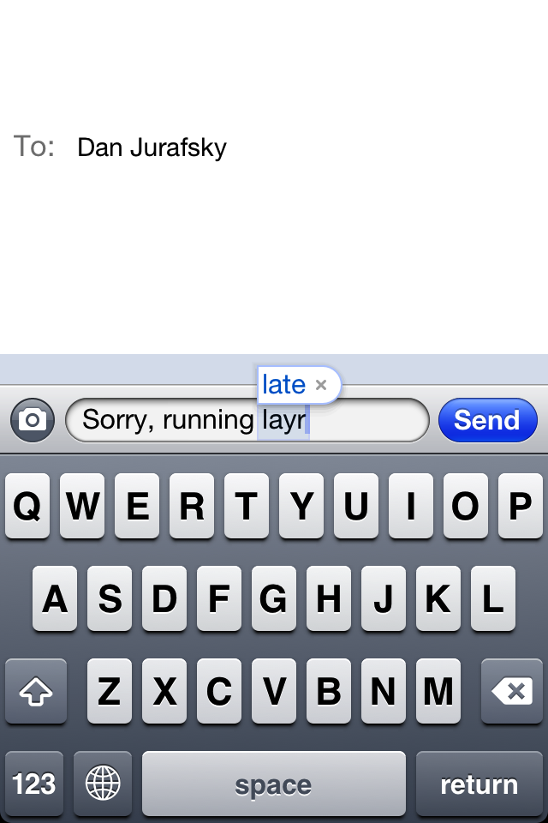
Nearby keys

Slide 50
<number>
Classifier-based methods for real-word spelling correction
Instead of just channel model and language model
Use many features in a classifier (next lecture).
Build a classifier for a specific pair like:
whether/weather
“cloudy” within +- 10 words
___ to VERB
___ or not

Slide 51
Spelling Correction and the Noisy Channel
Real-Word Spelling Correction
Notes:
<number>

