Slide 1
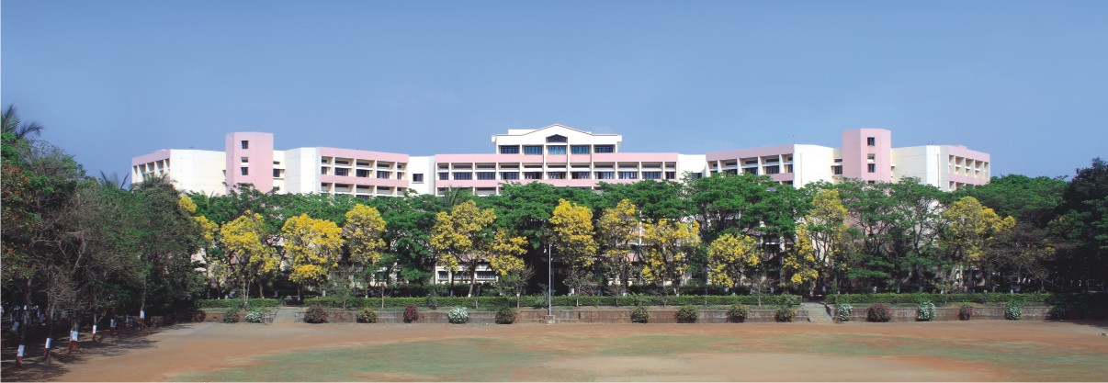

Medicine Reminder App
Submitted By: Achal Pravin Patil
Department of Computer Science and Design​
Academic Year: 2024–2025​
Under the Guidance of: Prof. Mrunali Pawar​
Notes:
NOTE:
To change the image on this slide, select the picture and delete it. Then click the Pictures icon in the placeholder to insert your own image.

Slide 2
Index
Abstract ​
Introduction​
Methodology​
Architecture​
Gantt Chart ​
References ​

Slide 3

Abstract
CarePlus is an Android-based healthcare management app developed using Java and integrated with Firebase to support real-time data storage and secure authentication. Designed for caretakers in old-age homes, the app helps manage resident information, schedule medications, track hospital visits, and maintain a personalized medicine catalog. Caregivers can receive timely reminders through notifications and SMS alerts, ensuring accurate and consistent medication administration.
With a user-friendly interface built on Material Design, CarePlus offers seamless navigation, guest profile management, and cloud-based access to vital health data. By combining intuitive design with powerful backend functionality, the app enhances caregiving efficiency and promotes better healthcare outcomes for elderly residents.

Slide 4
Introduction
Objective: To assist caretakers in efficiently managing health records and medication schedules for residents in old-age homes.
Enable users to add, view, update, and delete guest profiles, medications, hospitals, and hospitalization records.
Provide timely medication reminders through in-app notifications and SMS alerts.
Ensure secure user authentication and offer a seamless, user-friendly experience.
Technologies Used: Flutter :
Java: For native Android app development.
Android Studio: Primary IDE used for development and testing..

Slide 5
Introduction
Firebase: For authentication, real-time database storage, and image storage.
XML: For designing responsive and modern user interfaces.
Why This App?
Caregiving in old-age homes often involves manual, error-prone processes for managing health and medications.
Existing solutions are generic and lack focus on elderly care and medication adherence.
CarePlus offers a dedicated, streamlined solution tailored to caretakers' needs.
By integrating guest profiles, hospital records, medication schedules, and reminders in one platform, it simplifies and improves elderly care management.

Slide 6
Methodology
Requirement Analysis:Identified key features like user login, guest management, medication scheduling, and hospital tracking.
UI/UX Design: Created a clean and user-friendly interface using XML and Material Design components.
Development: Developed the app using Java and Android Studio; integrated Firebase for authentication, database, and image storage.
Navigation: Handled screen transitions using Intent and FragmentManager with a structured navigation drawer.
Testing: Tested UI flows, Firebase operations, and reminder features on emulators and real devices.
Deployment: Configured build settings and prepared the APK for release on Android platforms.

Slide 7
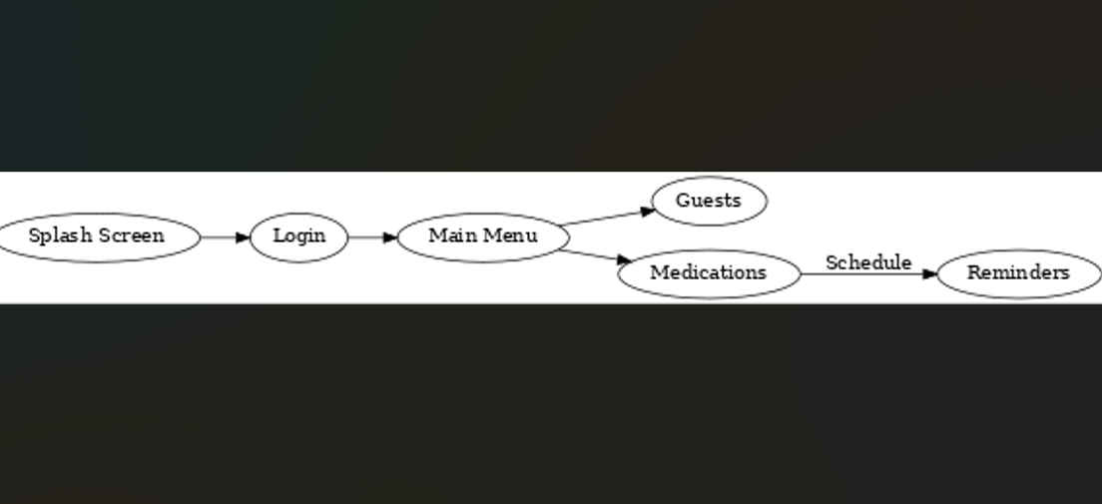
Architecture

Slide 8
Gantt Chart
Task | Week 1 | Week 2 | Week 3 | Week 4 | Week 5 | Week 6 | Week 7 | Week 8
Requirements Gathering | ✔️ | ✔️
UI/UX Design |  | ✔️ | ✔️
Project Setup (Flutter + Firebase) |  | ✔️ | ✔️
Authentication (Login/Signup) |  |  | ✔️ | ✔️
Home Page + Navigation Setup |  |  |  | ✔️
Blog Section + Details Pages |  |  |  | ✔️ | ✔️
Settings + Display Page |  |  |  |  | ✔️ | ✔️
Storage & Update/Delete Features |  |  |  |  |  | ✔️ | ✔️
Testing & Debugging |  |  |  |  |  |  | ✔️
Documentation & PPT |  |  |  |  |  |  |  | ✔️
Final Review + Submission |  |  |  |  |  |  |  | ✔️

Slide 9
References
Flutter Documentation – https://developer.android.com/docs
Firebase Documentation – https://firebase.google.com/docs
Java SE Documentation – https://docs.oracle.com/javase/8/docs/
Stack Overflow – For resolving development issues, debugging errors, and understanding community-accepted solutions.
Google Maps API – For future integration of map-based features
YouTube Tutorials – Various creators explaining Java + Firebase app development
W3Schools – https://www.w3schools.com (for general coding reference)
Gradle Documentation – https://docs.gradle.org

Slide 10
THANK YOU !!

