Slide 1
Graph Theory
Unit III

Slide 2
Simple Graph
A simple graph consists of
a nonempty set of vertices called V
a set of edges (unordered pairs of distinct elements of V) called E
Notation: G = (V,E)

Slide 3
An Introduction to Graph Theory
Definitions and Examples
Undirected graph
Directed graph
loop
G=(V,E)
isolated vertex
multiple
edges
adjacent
simple graph: an undirected graph without loop or multiple edges
degree of a vertex: number of edges connected
(indegree, outdegree)

Slide 4
Path/Trail/Walk/Circuit/Cycle
a
Starting node
Ending node
e
Walk(Path): no restriction (- represents the edge)
a-b-d-a-b-c
Simple path : no vertex can be repeated
abcde
trail: no edge can be repeated
abcdebd
b
d
c
length: number of edges in
this (path,trail,walk)
closed if starting node=ending node
closed trail: circuit (abcdbeda,
one draw without lifting pen)
closed path: cycle (abcda)

Slide 5
remove any cycle on the repeated
vertices
a
x
b
Definition: Let G=(V,E) be an undirected graph. We call G connected
if there is a path between any two distinct vertices of G.
a
e
a
e
b
b
disconnected with
two components
d
d
c
c

Slide 6
Vertex Degree: Euler Trails and Circuits
degree 1 vertex: pendant vertex
Corollary :The number of vertices of odd degree must be even.
Example: a regular graph: each vertex has the same degree
Is it possible to have a 4-regular graph with 10 edges?
2|E|=4|V|=20, |V|=5 possible (K₅)
with 15 edges?
2|E|=4|V|=30 not possible

Slide 7
Subgraphs, Complements, and Graph Isomorphism
a
a
e
a
b
e
b
e
b
d
d
c
c
d
d
induced subgraph
include all edges
of E in V₁
c
c
spanning subgraph
V₁=V

Slide 8
multigraph of multiplicity 3
multigraphs

Slide 9
Subgraphs, Complements, and Graph Isomorphism
a
complete graph: K_{n}
e
b
K₅
complement of a graph
G G
a
d
a
c
e
e
b
b
d
d
c
c

Slide 10
Subgraphs, Complements, and Graph Isomorphism
Graph Isomorphism
a
b
1
2
c
w x y z
3
4
d

Slide 11
Subgraphs, Complements, and Graph Isomorphism
Ex. 11.8
q
r
a
w
j
f
e
b
v
y
z
x
i
g
h
t
d
c
u
a-q c-u e-r g-x i-z b-v d-y f-w h-t j-s, isomorphic
Ex. 11.9
degree 2
vertices=3
degree 2 vertices=2

Slide 12
Vertex Degree: Euler Trails and Circuits
Ex. The Seven Bridge of Konigsberg
area a
area b
area d
area c
a
Find a way to walk about the city so as to cross
each bridge exactly once and then return to the
starting point.
b
d
c

Slide 13
Vertex Degree: Euler Trails and Circuits
Definition: Let G=(V,E) be an undirected graph or multigraph
with no isolated vertices. Then G is said to have an Euler circuit
if there is a circuit in G that traverses every edge of the graph
exactly once. If there is an open trail from a to b in G and this
trail traverses each edge in G exactly once, the trail is called an
Euler trail.
Theorem : Let G=(V,E) be an undirected graph or multigraph
with no isolated vertices. Then G has an Euler circuit if and only
if G is connected and every vertex in G has even degree.
a
All degrees are odd. Hence no Euler circuit
for the Konigsberg bridges problem.
b
d
c

Slide 14
Vertex Degree: Euler Trails and Circuits
Corollary : An Euler trail exists in G if and only if G is
connected and has exactly two vertices of odd degree.
Theorem:A directed Euler circuit exists in G if and only if
G is connected and in-degree(v)=out-degree(v) for all vertices v.
one in, one out

Slide 15
Bipartite Graphs
A simple graph is bipartite if V can be partitioned into V = V₁ ∪V₂ so that any two adjacent vertices are in different parts of the partition. Another way of expressing the same idea is bichromatic : vertices can be colored using two colors so that no two vertices of the same color are adjacent.

Slide 16
Bipartite Graphs
EG: C₄ is a bichromatic:
And so is bipartite, if we redraw it:

Slide 17
Bipartite Graphs
EG: C₄ is a bichromatic:
And so is bipartite, if we redraw it:

Slide 18
Bipartite Graphs
EG: C₄ is a bichromatic:
And so is bipartite, if we redraw it:

Slide 19
Bipartite Graphs
EG: C₄ is a bichromatic:
And so is bipartite, if we redraw it:

Slide 20
Bipartite Graphs
EG: C₄ is a bichromatic:
And so is bipartite, if we redraw it:

Slide 21
Bipartite Graphs
EG: C₄ is a bichromatic:
And so is bipartite, if we redraw it:

Slide 22
Bipartite Graphs
EG: C₄ is a bichromatic:
And so is bipartite, if we redraw it:

Slide 23
Bipartite Graphs
EG: C₄ is a bichromatic:
And so is bipartite, if we redraw it:

Slide 24
Bipartite Graphs
EG: C₄ is a bichromatic:
And so is bipartite, if we redraw it:

Slide 25
Bipartite Graphs
EG: C₄ is a bichromatic:
And so is bipartite, if we redraw it:

Slide 26
Bipartite Graphs
EG: C₄ is a bichromatic:
And so is bipartite, if we redraw it:

Slide 27
Bipartite Graphs
EG: C₄ is a bichromatic:
And so is bipartite, if we redraw it:
Q: For which n is C_{n} bipartite?

Slide 28
Bipartite Graphs
A: C_{n} is bipartite when n is even. For even n color all odd numbers red and all even numbers green so that vertices are only adjacent to opposite color.
If n is odd, C_{n} is not bipartite. If it were, color 0 red. So 1 must be green, and 2 must be red. This way, all even numbers must be red, including vertex n-1. But n-1 connects to 0 →←.

Slide 29
bipartite graph and complete bipartite graphs (K_{m,n})
K_{4,4}
K_{3,3} is not planar.
Therefore, any graph containing K₅
or K_{4,4} is nonplanar.

Slide 30
Planar Graphs
Def. A graph (or multigraph) G is called planar if G can be
drawn in the plane with its edges intersecting only at vertices of G.
Such a drawing of G is called an embedding of G in the plane.
Ex. K₁,K₂,K₃,K₄ are planar, K_{n} for n>4 are nonplanar.
K₄
K₅
applications: VLSI routing, plumbing,...

Slide 31
An Introduction to Graph Theory
Planar Graphs
Theorem 11.5 (Kuratowski's Theorem) A graph is planar if
and only if it contains a subgraph that is homeomorphic to
either K₅ or K_{3,3}.
Petersen graph
a subgraph homeomorphic to K_{3,3}
a
a
j
f
d
e
j
b
c
g
i
i
b
e
f
h
c
h
d
g
Petersen graph is nonplanar.

Slide 32
Planar Graphs
A planar graph divides the plane
into several regions (faces), one
of them is the infinite region.
R1
K₄
R4
R2
v=4,e=6,r=4, v-e+r=2
R3
(Euler's planar graph theorem)
For a connected planar graph or multigraph:
v-e+r=2
number
of vertices
number
of regions
number
of edges

Slide 33
Planar Graphs
proof: The proof is by induction on e.
e=0 or 1
v=1
r=1
e=0
v=1
r=2
e=1
v=2
r=1
e=1
v-e+r=2
Assume that the result is true for any connected planar graph or
multigraph with e edges, where
Now for G=(V,E) with |E|=k+1 edges, let H=G-(a,b) for a,b in V.
Since H has k edges,
And,
Now consider the situation about regions.

Slide 34
Planar Graphs
case 1: H is connected
b
b
a
a(=b)
a(=b)
a

Slide 35
Planar Graphs
case 2: H is disconnected
H₁
a
a
H₂
b
b
b
H₁
a
b
H₂
a

Slide 36
Planar Graphs
degree of a region (deg(R)): the number of edges traversed in
a shortest closed walk about the boundary of R.
two different embeddings
R₆
a
b
R₈
R₂
R₄
c
R₃
R₅
R₇
R₁
g
h
d
f
deg(R₁)=5,deg(R₂)=3
deg(R₃)=3,deg(R₄)=7
deg(R₅)=4,deg(R₆)=3
deg(R₇)=5,deg(R₈)=6
abghgfda

Slide 37
Planar Graphs
Only a necessary condition, not sufficient.

Slide 38
Planar Graphs
Ex. 11.18 For K₅, e=10,v=5, 3v-6=9<10=e. Therefore,
by Corollary 11.3, K₅ is nonplanar.
Ex. 11.19 For K_{3,3}, each region has at least 4 edges, hence
4r 2e. If K_{3,3} is planar, r=e-v+2=9-6+2=5. So 20=4r 2e=18,
a contradiction.

Slide 39
Dual Graph
Each map in a plane can be represented by a graph.
Each region is represented by a vertex.
Edges connect to vertices if the regions represented by these vertices have a common border.
Two regions that touch at only one point are not considered adjacent.
The resulting graph is called the dual graph of the map.

Slide 40
Dual Graph Examples
B
B
G
A
C
D
A
F
C
D
E
E
b
a d f g
e
b
a e
d
c
c

Slide 41
Trees: Definition & Applications
A tree is a connected graph with no cycles. A forest is a graph whose components are trees. An example appears below. Trees come up in many contexts: tournament brackets, family trees, organizational charts, and decision trees, being a few examples.

Slide 42
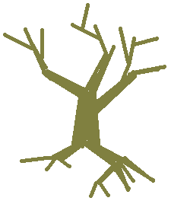
Trees
A very important type of graph in CS is called a tree:
Real
Tree

Slide 43
Trees
A very important type of graph in CS is called a tree:
Real
Tree
transformation

Slide 44
Trees
A very important type of graph in CS is called a tree:
Real
Tree
transformation

Slide 45
Trees
A very important type of graph in CS is called a tree:
Real Abstract
Tree Tree
transformation

Slide 46
Directed Trees
A directed tree is a digraph whose underlying graph is a tree and which has no loops and no pairs of vertices joined in both directions. These last two conditions mean that if we interpret a directed tree as a relation, it is irreflexive and asymmetric. Here is an example.

Slide 47
Trees: Leaves & Internal Vertices
In the following tree the red vertices are leaves. We now know every finite tree with an edge has a least two leaves. The other vertices are internal vertices.

Slide 48
Trees: Theorem on Leaves
Theorem: A tree T(V,E) with finite vertex set and at least one edge has at least two leaves (a leaf is a vertex with degree one). Proof: Fix a vertex a that is the endpoint of some edge. Move from a to the adjacent vertex along the edge. If that vertex has no adjacent vertices then it has degree one, so stop. If not, move along another edge to another vertex. Continue building a path in this fashion until you reach a vertex with no adjacent vertices besides the one you just came from. This is sure to happen because V is finite and you never use the same vertex twice in the path (since T is a tree). This produces one leaf. Now return to a. If it is a leaf, then you are done. If not, move along a different edge than the one at the first step above. Continue extending the path in that direction until you reach a leaf (which is sure to happen by the argument above).

Slide 49
Trees: Equivalent Condition on Paths
Theorem: Given vertices a and b in a tree T(V,E), there is a unique simple path from a to b. Proof: Trees are connected, so there is a simple path from a to b. The book gives a nice example of using the contrapositive to prove the rest of the theorem.
Theorem : Given a graph G(V,E) such that every pair of vertices is joined by a unique simple path, then G is a tree. This is the converse of the above theorem. Proof: Since a simple path joins every pair of points, the graph is connected. Now suppose G has a cycle abc…a. Then ba and bc…a are distinct simple paths from b to a. This contradicts uniqueness of simple paths, so G cannot possess such a cycle. This makes G a tree.

Slide 50
Rooted Trees
Sometimes it is useful to distinguish one vertex of a tree and call it the root of the tree. For instance we might, for whatever reasons, take the tree above and declare the red vertex to be its root. In that case we often redraw the tree to let it all “hang down” from the root (or invert this picture so that it all “grows up” from the root, which suits the metaphor better)

Slide 51
Rooted Directed Trees
It is sometimes useful to turn a rooted tree into a rooted directed tree T′ by directing every edge away from the root.

Slide 52
Rooted Trees: Terminology
Rooted trees and their derived rooted directed trees have some useful terminology, much of which is suggested by family trees. The level of a vertex is the length of the path from it to the root. The height of the tree is the length of the longest path from a leaf to the root. If there is a directed edge in T′ from a to b, then a is the parent of b and b is a child of a. If there are directed edges in T′ from a to b and c, then b and c are siblings. If there is a directed path from a to b, then a is an ancestor of b and b is a descendant of a.

Slide 53
(Rooted) Trees: Binary & m-ary
Our book describes a directed tree as binary if no vertex has outdegree over 2. It is more common to call a tree binary if no vertex has degree over 3. (In general a tree is m-ary if no vertex has degree over m+1. Our book calls a directed tree m-ary if no vertex has outdegree over m.) The directed rooted tree above is 4-ary (I think the word is quaternary) since it has a vertex with outdegree 4. In a rooted binary tree (hanging down or growing up) one can describe each child vertex as the left child or right child of its parent.

Slide 54
Trees: Edges in a Tree
Theorem (6.41): A tree on n vertices has n–1 edges. Proof: Let T be a tree with n vertices. Make it rooted. Then every edge establishes a parent-child relationship between two vertices. Every child has exactly one parent, and every vertex except the root is a child. Therefore there is exactly one edge for each vertex but one. This means there are n–1 edges.

Slide 55
Trees: Edges in a Tree
Theorem (6.42): If G(V,E) is a connected graph with n vertices and n–1 edges is a tree. This is the converse of theorem 6.41. Proof: Suppose G is as in the statement of the theorem, and suppose G has a cycle. Then we can remove an edge from the cycle without disconnecting G (see the next slide for why). If this makes G a tree, then stop. If not, there is still a cycle, so we can remove another edge without disconnecting G. Continue the process until the remaining graph is a tree. It still has n vertices, so it has n–1 edges by a prior theorem. This is a contradiction since G had n–1 vertices to start with. Therefore G has no cycle and is thus a tree.

Slide 56
Trees: Edges in a Tree (lemma)
(Why can we remove an edge from a cycle without disconnecting the graph? Let a and b be vertices. There is a simple path from a to b. If the path involves no edges in the cycle, then the path from a to be is unchanged. If it involves edges in the cycle, let x and y be the first and last vertices in the cycle that are part of the path from a to b. So there is a path from a to x and a path from y to b. Since x and y are part of a cycle, there are at least simple two paths from x to y. If we remove an edge from the cycle, at least one of the paths still remains. Thus there is still a simple path from a to b.)

Slide 57
Spanning Trees of a Graph
If G(V,E) is a graph and T(V,F) is a subgraph of G and is a tree, then T is a spanning tree of G. That is, T is a tree that includes every vertex of G and has only edges to be found in G. Using the procedure in the previous paragraph (remove edges from cycles until only a tree remains), we can easily prove that every connected graph has a spanning tree (theorem 6.43).

Slide 58
Planar Graphs
A dual graph of a planar graph
1
1
2
a
b
2
c
3
3
4
d
5
6
4
f
e
6
5
g
An edge in G corresponds with an edge in G^{d}.
It is possible to have isomorphic graphs with respective duals that
are not isomorphic.

Slide 59
Planar Graphs
Def. 11.20 cut-set: a subset of edges whose removal increase
the number of components
Ex. 11.21
b
e
cut-sets: {(a,b),(a,c)},
{(b,d),(c,d)},{(d,f)},...
d
f
a
h
c
g
a bridge
For planar graphs, cycles in one graph correspond to cut-sets
in a dual graphs and vice versa.

Slide 60
Hamilton Paths and Cycles
a path or cycle that contain every vertex
Unlike Euler circuit, there is no known
necessary and sufficient condition for a
graph to be Hamiltonian.
an NP-complete problem
Ex. 11.24
a
b
c
There is a Hamilton path, but no
Hamilton cycle.
d
e
f
g
h
i

Slide 61
Hamilton Paths and Cycles
Ex. 11.25
x
start labeling from here
4x's and 6y's, since x and y must
interleave in a Hamilton path (or cycle),
the graph is not Hamiltonian
y
y
y
x
y
y
x
x
y
The method works only for bipartite graphs.
The Hamilton path problem is still NP-complete when restricted
to bipartite graphs.

Slide 62
Hamilton Paths and Cycles
Ex. 11.26 17 students sit at a circular table, how many sittings are
there such that one has two different neighbors each time?
Consider K₁₇, a Hamilton cycle in K₁₇ corresponds to a seating
arrangements. Each cycle has 17 edges, so we can have
(1/17)17(17-1)/2=8 different sittings.
5
5
5
3
15
3
15
3
15
2
1
17
2
1
17
2
1
17
4
16
4
16
4
16
14
6
6
6
1,2,3,4,5,6,...,17,1
1,3,5,2,7,4,...,17,14,16,1
1,5,7,3,9,2,...,16,12,14,1

Slide 63
Hamilton Paths and Cycles
case 1.
v v₁ v₂ ...v_{m}
case 2. v₁ v₂ ...v_{k} v v_{k+1} ...v_{m}
case 3. v₁ v₂ ...v_{m} v

Slide 64
Hamilton Paths and Cycles
Ex. 11.27 In a round-robin tournament each player plays every
other player exactly once. We want to somehow rank the players
according to the result of the tournament.
not always possible to have a ranking where a player in a certain
position has beaten all of the opponents in later positions
a b c
but by Theorem 11.7, it is possible to list the players such that
each has beaten the next player on the list

Slide 65
Hamilton Paths and Cycles
Proof: First prove that G is connected. If not,
x
y
n₁ vertices
n₂ vertices
a contradiction

Slide 66
Hamilton Paths and Cycles
Assume a path p_{m} with m vertices
v₁ v₂ v₃ ... v_{m}
case 1. either v v₁ or v_{m} v
case 2. v₁,v₂,...,v_{m} construct a cycle
either v₁ v₂ v₃ ... v_{m}
or v₁ v₂ v₃ ...v_{t-1} v_{t} ... v_{m}
otherwise assume deg(v₁)=k, then deg(v_{m})<m-k.
deg(v₁)+deg(v_{m})<m<n-1, a contradiction
Therefore, v can be added to the cycle.
v

Slide 67
Hamilton Paths and Cycles
Proof: Assume G does not contain a Hamilton cycle. We add edges
to G until we arrive a subgraph H of K_{n} where H has no Hamilton
cycle, but for any edge e not in H, H+e has a Hamilton cycle.
For vertices a,b wher (a,b) is not an edge of H. H+(a,b) has a
Hamilton cycle and (a,b) is part of it.

Slide 68
Hamilton Paths and Cycles
a(=v₁) b(=v₂) v₃ ... v_{n}
If (b,v_{i}) is in H, then (a,v_{i-1}) cannot be in H. Otherwise,
b v_{i} v_{n} a v_{i-1} v_{i-2} v₃ is a Hamilton cycle in H.

Slide 69
Hamilton Paths and Cycles

Slide 70
Hamilton Paths and Cycles
A related problem: the traveling salesman problem
a
3
e
Find a Hamilton cycle of shortest total distance.
1
b
3
2
For example, a-b-e-c-d-a with total cost=
1+3+4+2+2=12.
4
3
d
5
4
2
c
graph problem vs. Euclidean plane problem
(computational geometry)
Certain geometry properties (for example, the triangle
inequality) sometimes (but not always) make it simpler.

Slide 71
Dijkstra's algorithm

Slide 72
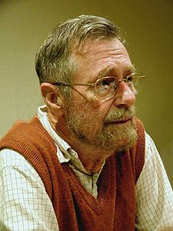
The author: Edsger Wybe Dijkstra
"Computer Science is no more about computers than astronomy is about telescopes."
http://www.cs.utexas.edu/~EWD/

Slide 73
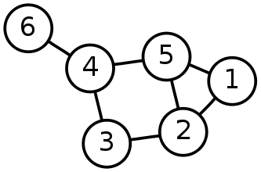
Single-Source Shortest Path Problem
Single-Source Shortest Path Problem - The problem of finding shortest paths from a source vertex v to all other vertices in the graph.

Slide 74
Dijkstra's algorithm
Dijkstra's algorithm - is a solution to the single-source shortest path problem in graph theory.
Works on both directed and undirected graphs. However, all edges must have nonnegative weights.
Approach: Greedy
Input: Weighted graph G={E,V} and source vertex v∈V, such that all edge weights are nonnegative
Output: Lengths of shortest paths (or the shortest paths themselves) from a given source vertex v∈V to all other vertices

Slide 75
Dijkstra's algorithm - Pseudocode
dist[s] ←0 (distance to source vertex is zero) for all v ∈ V–{s} do dist[v] ←∞ (set all other distances to infinity) S←∅ (S, the set of visited vertices is initially empty) Q←V (Q, the queue initially contains all vertices) while Q ≠∅ (while the queue is not empty) do u ← mindistance(Q,dist) (select the element of Q with the min. distance) S←S∪{u} (add u to list of visited vertices) for all v ∈ neighbors[u] do if dist[v] > dist[u] + w(u, v) (if new shortest path found) then d[v] ←d[u] + w(u, v) (set new value of shortest path)
(if desired, add traceback code)
return dist

Slide 76
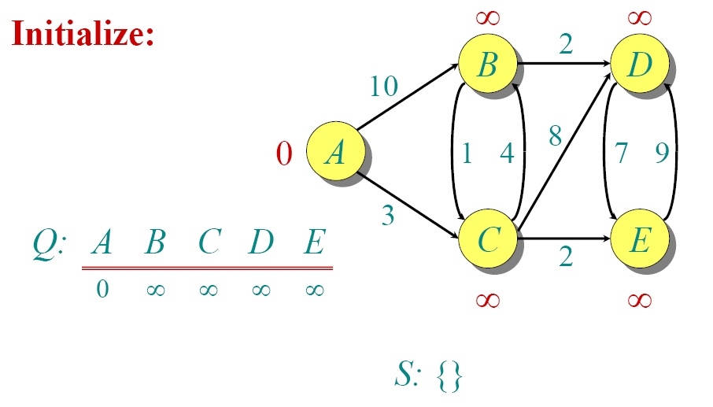
Dijkstra Animated Example

Slide 77
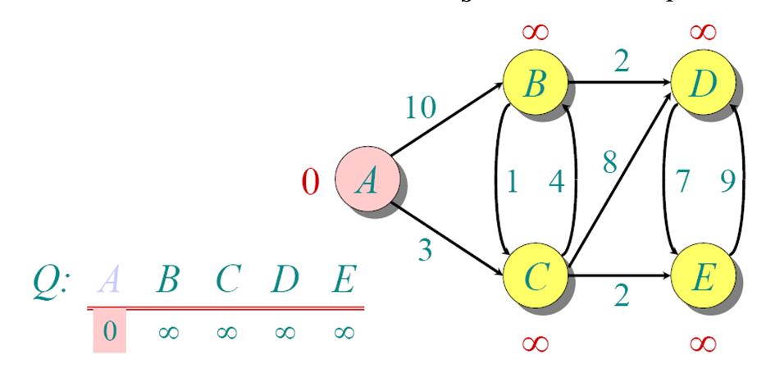
Dijkstra Animated Example

Slide 78
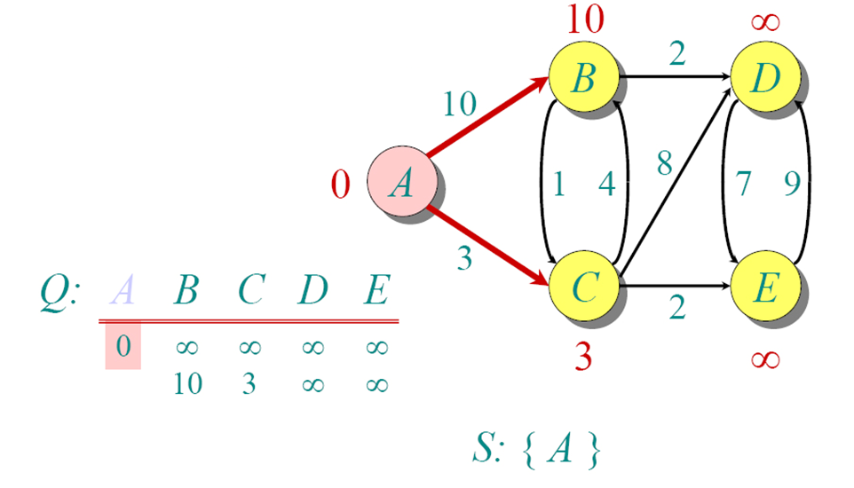
Dijkstra Animated Example

Slide 79
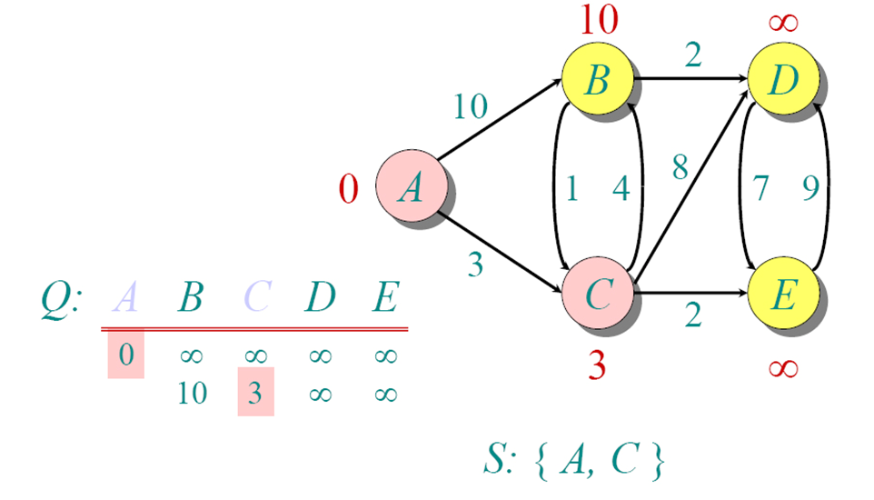
Dijkstra Animated Example

Slide 80
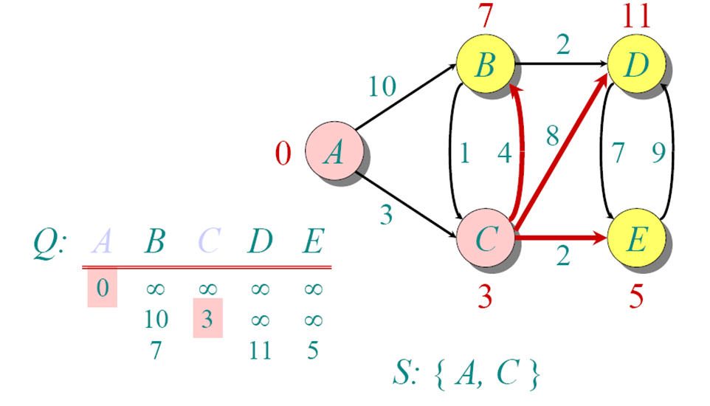
Dijkstra Animated Example

Slide 81
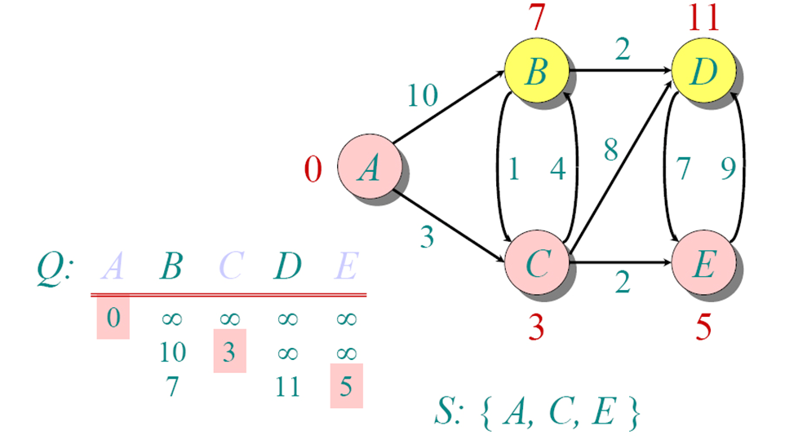
Dijkstra Animated Example

Slide 82
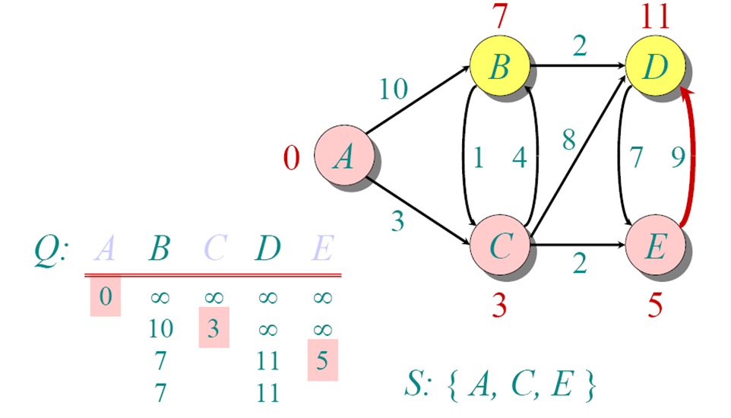
Dijkstra Animated Example

Slide 83
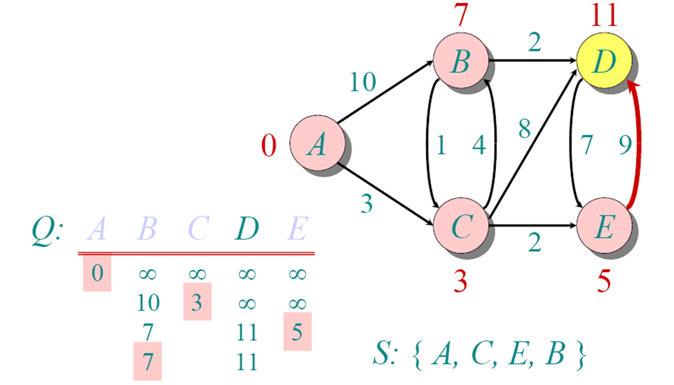
Dijkstra Animated Example

Slide 84
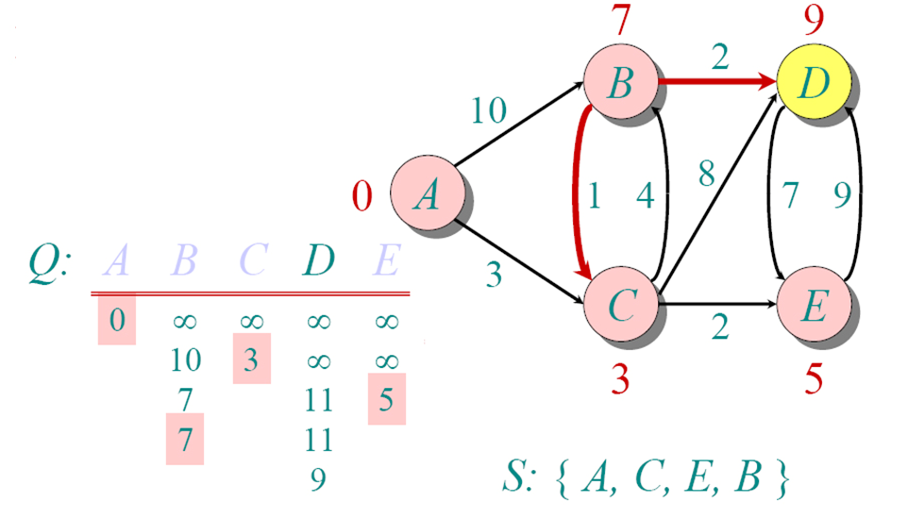
Dijkstra Animated Example

Slide 85
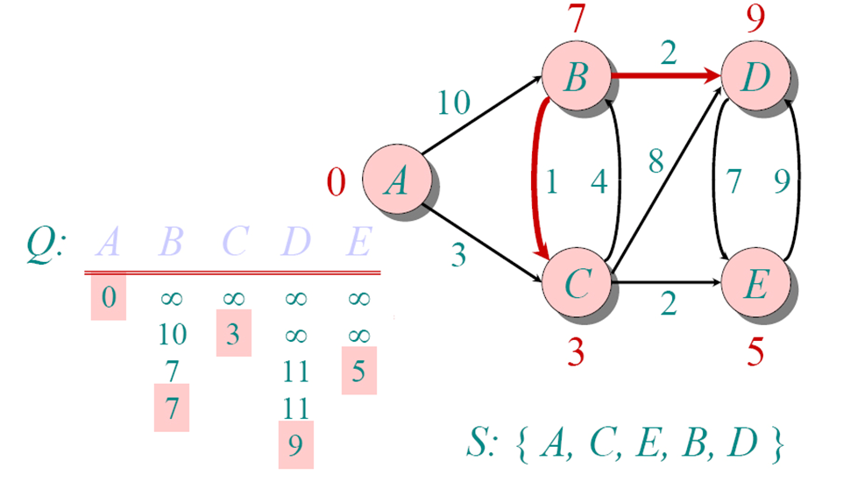
Dijkstra Animated Example

Slide 86
Implementations and Running Times
The simplest implementation is to store vertices in an array or linked list. This will produce a running time of
O(|V|^2 + |E|)
For sparse graphs, or graphs with very few edges and many nodes, it can be implemented more efficiently storing the graph in an adjacency list using a binary heap or priority queue. This will produce a running time of
O((|E|+|V|) log |V|)

Slide 87
Dijkstra's Algorithm - Why It Works
As with all greedy algorithms, we need to make sure that it is a correct algorithm (e.g., it always returns the right solution if it is given correct input).
A formal proof would take longer than this presentation, but we can understand how the argument works intuitively.
If you can’t sleep unless you see a proof, see the second reference or ask us where you can find it.

Slide 88
Dijkstra's Algorithm - Why It Works
To understand how it works, we’ll go over the previous example again. However, we need two mathematical results first:
Lemma 1: Triangle inequality If δ(u,v) is the shortest path length between u and v, δ(u,v) ≤ δ(u,x) + δ(x,v)
Lemma 2: The subpath of any shortest path is itself a shortest path.
The key is to understand why we can claim that anytime we put a new vertex in S, we can say that we already know the shortest path to it.
Now, back to the example…

Slide 89
Dijkstra's Algorithm - Why use it?
As mentioned, Dijkstra’s algorithm calculates the shortest path to every vertex.
However, it is about as computationally expensive to calculate the shortest path from vertex u to every vertex using Dijkstra’s as it is to calculate the shortest path to some particular vertex v.
Therefore, anytime we want to know the optimal path to some other vertex from a determined origin, we can use Dijkstra’s algorithm.

Slide 90
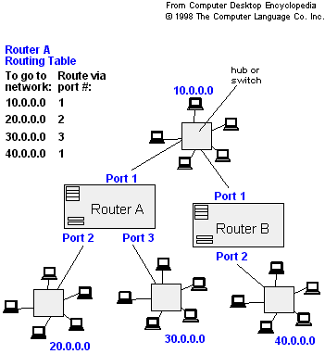
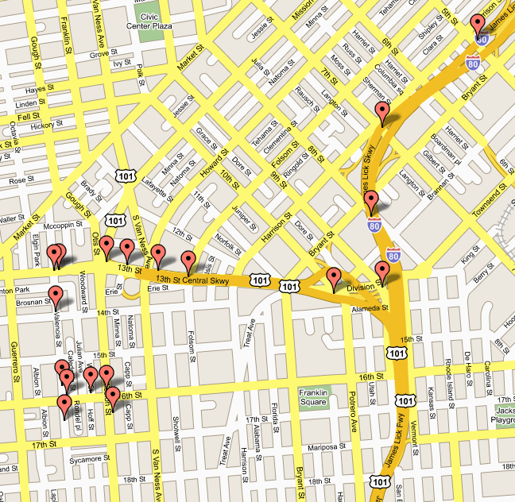
Applications of Dijkstra's Algorithm
- Traffic Information Systems are most prominent use
- Mapping (Map Quest, Google Maps)
- Routing Systems

Slide 91
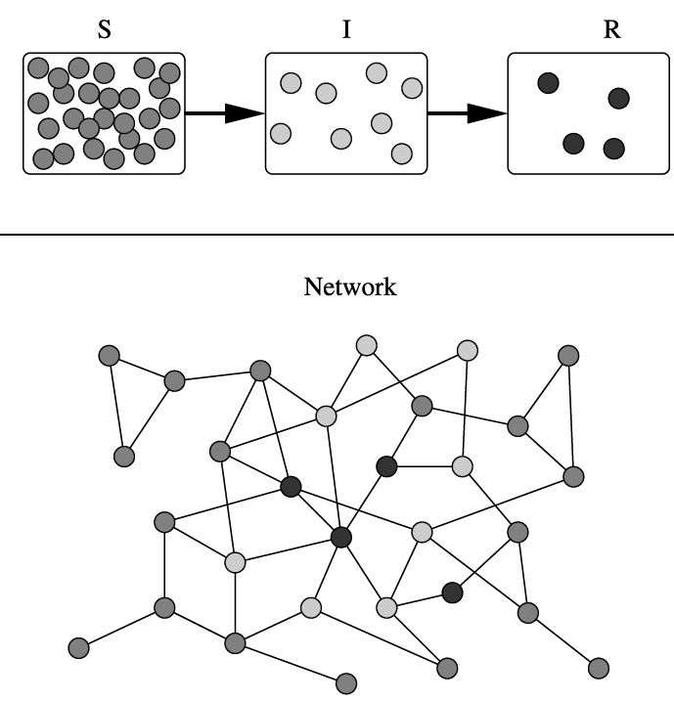
Applications of Dijkstra's Algorithm
One particularly relevant this week: epidemiology
Prof. Lauren Meyers (Biology Dept.) uses networks to model the spread of infectious diseases and design prevention and response strategies.
Vertices represent individuals, and edges their possible contacts. It is useful to calculate how a particular individual is connected to others.
Knowing the shortest path lengths to other individuals can be a relevant indicator of the potential of a particular individual to infect others.

Slide 92
Introduction
When a map is colored, two regions with a common border are customarily assigned different colors.
We want to use the smallest number of colors instead of just assigning every region its own color.

Slide 93
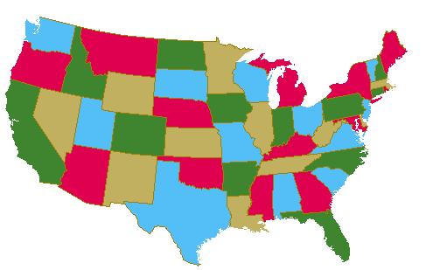
Map Coloring
Four colors are sufficient to color a map of the contiguous United States.
Source of map: http://www.math.gatech.edu/~thomas/FC/fourcolor.html

Slide 94
Graph Coloring
A coloring of a simple graph is the assignment of a color to each vertex of the graph so that no two adjacent vertices are assigned the same color.
The chromatic number of a graph is the least number of colors needed for a coloring of the graph.
The Four Color Theorem: The chromatic number of a planar graph is no greater than four.

Slide 95
Example
What is the chromatic number of the graph shown below?
The chromatic number must be at least 3 since a, b, and c must be assigned different colors. So Let’s try 3 colors first. 3 colors work, so the chromatic number of this graph is 3.
b e
a d g
c f

Slide 96
Example
What is the chromatic number for each of the following graphs?
White
White
Yellow
Green
Yellow
Yellow
White
White
Yellow
Yellow
White
Chromatic number: 2 Chromatic number: 3

Slide 97
Conclusion
In this chapter we have covered:
Introduction to Graphs
Graph Terminology
Representing Graphs and Graph Isomorphism
Graph Connectivity
Adjacency and Incident Matrix
Euler and Hamilton Paths
Planar Graphs
Trees
Dijkstra’s Algorithm
Graph Coloring

