Slide 1
Simplification of Switching Functions
(Boolean Functions)

Slide 2
Karnaugh Maps (K-Map)
A K-Map is a graphical representation of a logic function’s truth table

Slide 3
Quine-McKluskey Algorithm
Algorithm Based Simplification

Slide 4
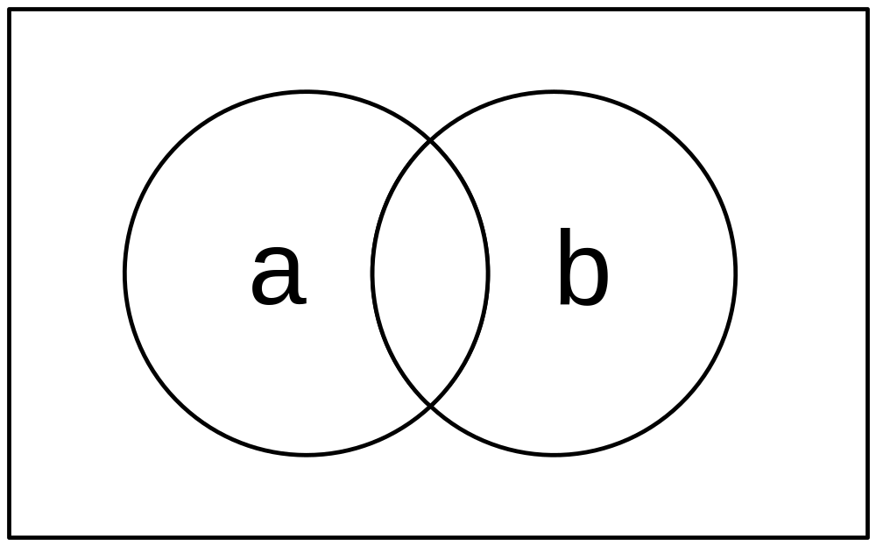
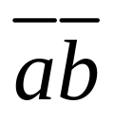
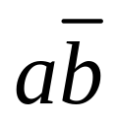
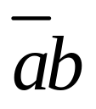
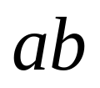
Relationship to Venn Diagrams

Slide 5

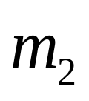
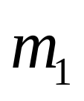
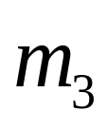
Relationship to Venn Diagrams

Slide 6

Relationship to Venn Diagrams
a
b

Slide 7




Relationship to Venn Diagrams
a
b

Slide 8
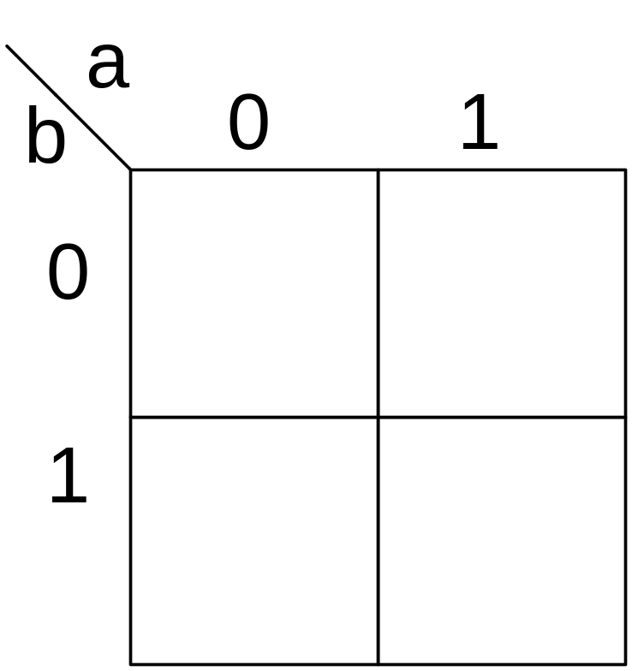
Relationship to Venn Diagrams

Slide 9
Two-Variable K-Map

Slide 10
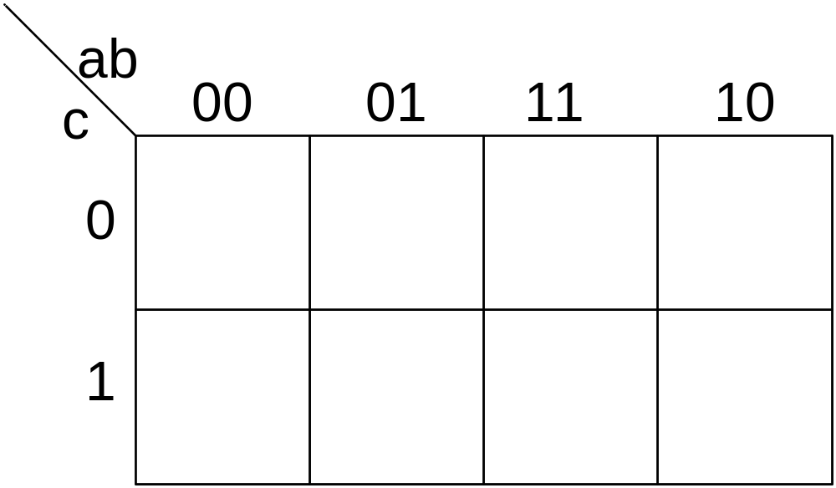
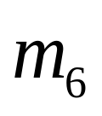
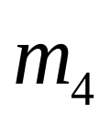
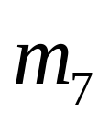
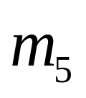
Three-Variable K-Map

Slide 11
Three-Variable K-Map

Slide 12
Three-Variable K-Map
Edges are adjacent

Slide 13
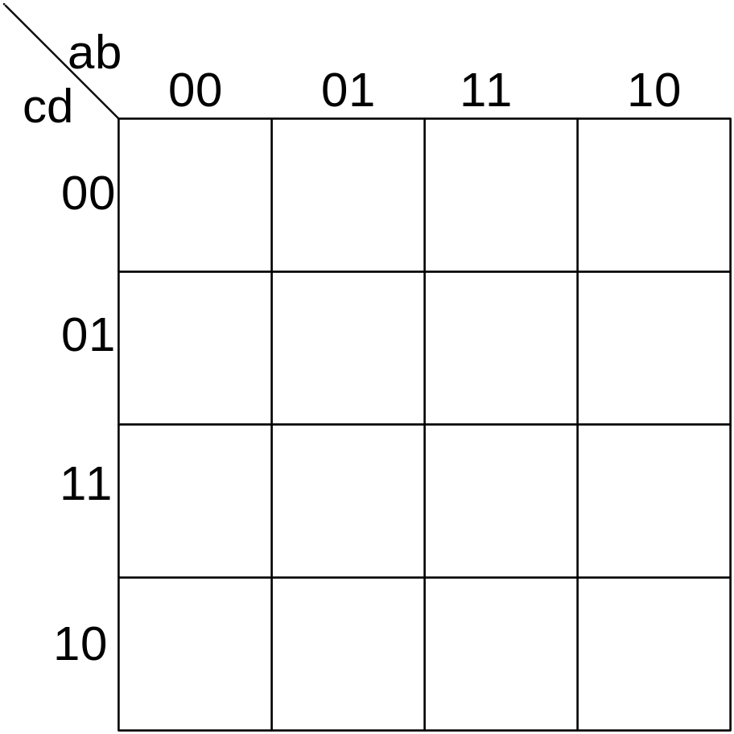
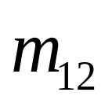
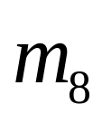
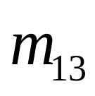
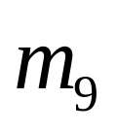
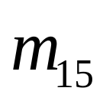
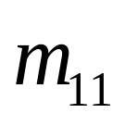
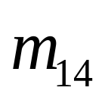
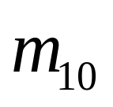
Four-variable K-Map

Slide 14
Four-variable K-Map

Slide 15
Four-variable K-Map
Edges are adjacent
Edges are adjacent

Slide 16
Plotting Functions on the
K-map
SOP Form

Slide 17
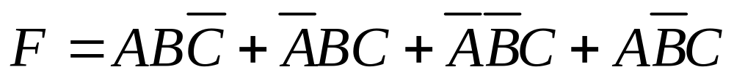
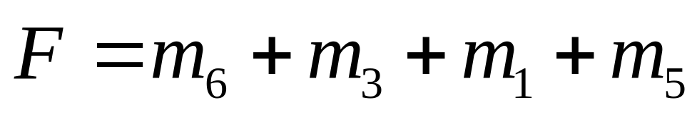
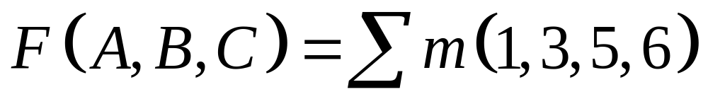
Canonical SOP Form
Three Variable Example
using shorthand notation

Slide 18
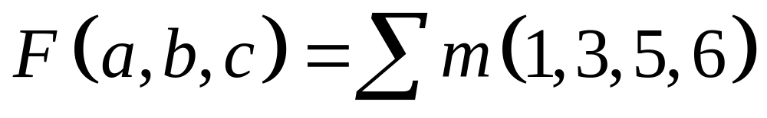
Three-Variable K-Map Example
Plot 1’s (minterms) of switching function
1
1
1
1

Slide 19
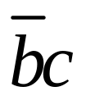
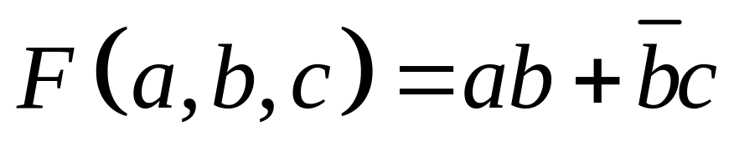
Three-Variable K-Map Example
Plot 1’s (minterms) of switching function
1
1
1
1

Slide 20
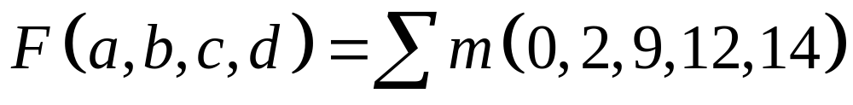
Four-variable K-Map Example
1
1
1
1
1

Slide 21
Karnaugh Maps (K-Map)
Simplification of Switching Functions
using K-MAPS

Slide 22
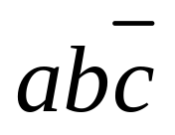
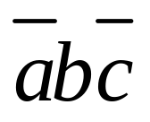
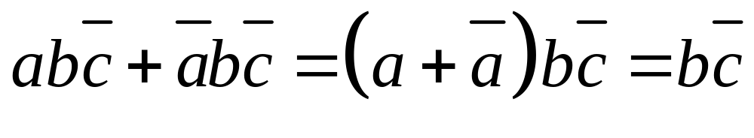
Terminology/Definition
Literal
  A variable or its complement
Logically adjacent terms
  Two minterms are logically adjacent if they differ in only one variable position
  Ex:
and
m6 and m2 are logically adjacent
Note:
Or, logically adjacent terms can be combined

Slide 23
Terminology/Definition
Implicant
  Product term that could be used to cover minterms of a function
Prime Implicant
  An implicant that is not part of another implicant
Essential Prime Implicant
  An implicant that covers at least one minterm that is not contained in another prime implicant
Cover
  A minterm that has been used in at least one group

Slide 24
Guidelines for Simplifying Functions
Each square on a K-map of n variables has n logically adjacent squares. (i.e. differing in exactly one variable)
When combing squares, always group in powers of 2^{m} , where m=0,1,2,….
In general, grouping 2^{m} variables eliminates m variables.

Slide 25
Guidelines for Simplifying Functions
Group as many squares as possible. This eliminates the most variables.
Make as few groups as possible. Each group represents a separate product term.
You must cover each minterm at least once. However, it may be covered more than once.

Slide 26
K-map Simplification Procedure
Plot the K-map
Circle all prime implicants on the K-map
Identify and select all essential prime implicants for the cover.
Select a minimum subset of the remaining prime implicants to complete the cover.
Read the K-map

Slide 27
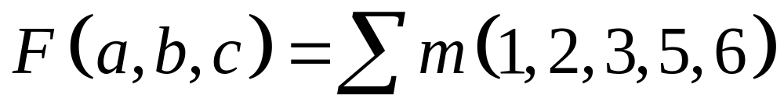
Example
Use a K-Map to simplify the following Boolean expression

Slide 28
Three-Variable K-Map Example
Step 1: Plot the K-map
1
1
1
1
1

Slide 29
Three-Variable K-Map Example
Step 2: Circle ALL Prime Implicants
1
1
1
1
1

Slide 30
Three-Variable K-Map Example
Step 3: Identify Essential Prime Implicants
PI
EPI
PI
1
1
1
1
EPI
1

Slide 31
Three-Variable K-Map Example
Step 4: Select minimum subset of remaining
Prime Implicants to complete the cover.
PI
EPI
1
1
1
1
EPI
1

Slide 32
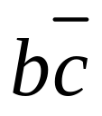
Three-Variable K-Map Example
Step 5: Read the map.
1
1
1
1
1

Slide 33
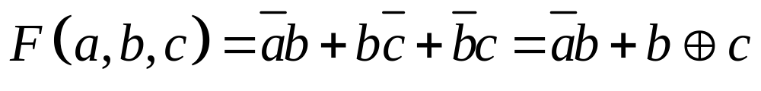
Solution

Slide 34
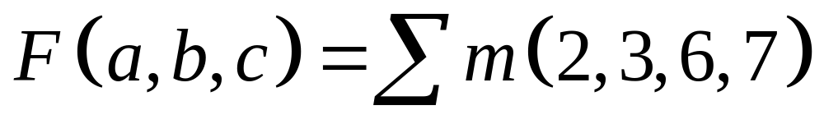
Example
Use a K-Map to simplify the following Boolean expression

Slide 35
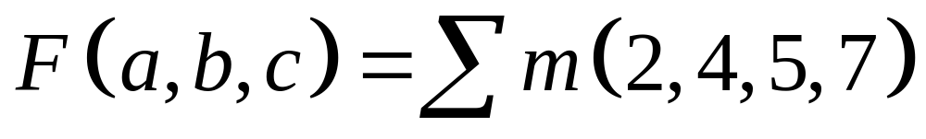
Three-Variable K-Map Example
Step 1: Plot the K-map
1
1
1
1

Slide 36
Three-Variable K-Map Example
Step 2: Circle Prime Implicants
Wrong!!
We really
should draw
A circle around
all four 1’s
1
1
1
1

Slide 37
Three-Variable K-Map Example
Step 3: Identify Essential Prime Implicants
EPI
EPI
Wrong!!
We really
should draw
A circle around
all four 1’s
1
1
1
1

Slide 38
Three-Variable K-Map Example
Step 4: Select Remaining Prime Implicants to
complete the cover.
EPI
EPI
1
1
1
1

Slide 39
Three-Variable K-Map Example
Step 5: Read the map.
1
1
1
1

Slide 40
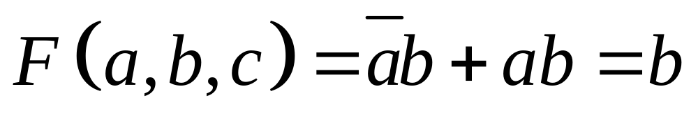
Solution
Since we can still simplify the function
this means we did not use the largest
possible groupings.

Slide 41
Three-Variable K-Map Example
Step 2: Circle Prime Implicants
Right!
1
1
1
1

Slide 42
Three-Variable K-Map Example
Step 3: Identify Essential Prime Implicants
EPI
1
1
1
1

Slide 43

Three-Variable K-Map Example
Step 5: Read the map.
1
1
1
1

Slide 44
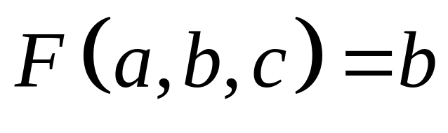
Solution

Slide 45
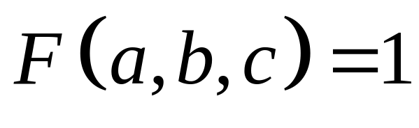
Three-Variable K-Map Example
1
1
1
1
1
1
1
1

Slide 46
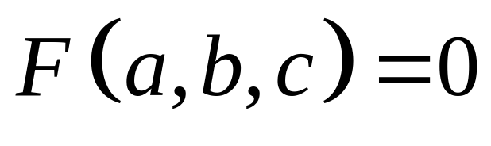
Three-Variable K-Map Example

Slide 47
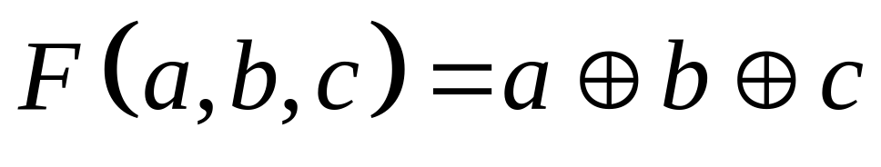
Three-Variable K-Map Example
1
1
1
1

Slide 48
Four Variable Examples

Slide 49
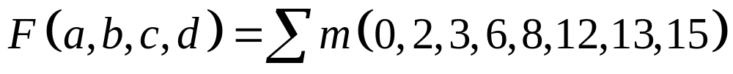
Example
Use a K-Map to simplify the following Boolean expression

Slide 50
Four-variable K-Map
1
1
1
1
1
1
1
1

Slide 51
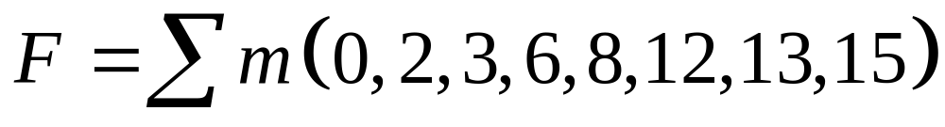
Four-variable K-Map
1
1
1
1
1
1
1
1

Slide 52
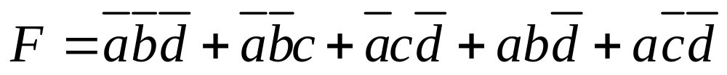
Four-variable K-Map
1
1
1
1
1
1
1
1

Slide 53
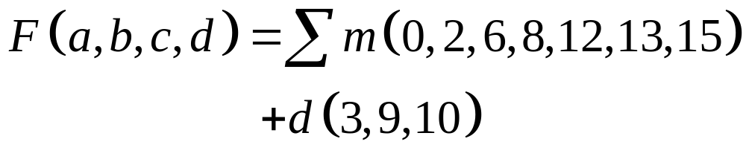
Example
Use a K-Map to simplify the following Boolean expression
D=Don’t care (i.e. either 1 or 0)

Slide 54
Four-variable K-Map
1
d
1
1
1
d
d
1
1
1

Slide 55
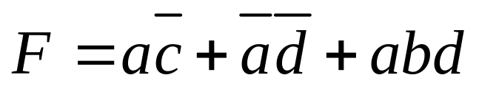
Four-variable K-Map
1
d
1
1
1
d
d
1
1
1

Slide 56
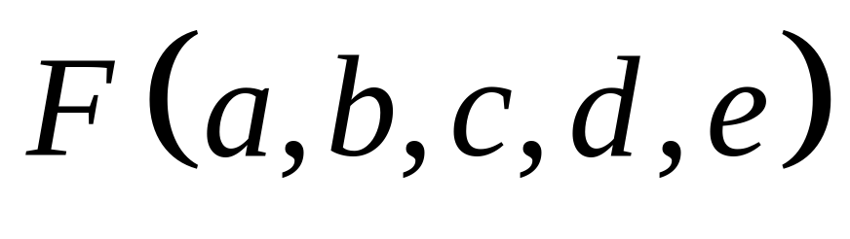
Five Variable K-Maps

Slide 57
Five variable K-map
Use two four variable K-maps
A=1
A=0

Slide 58
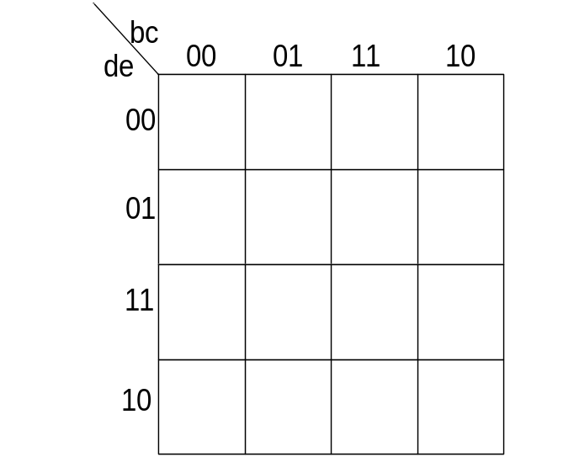
Use Two Four-variable K-Maps
A=0 map
A=1 map

Slide 59
Five variable example

Slide 60
Use Two Four-variable K-Maps
A=0 map
A=1 map
1
1
1
1
1
1
1
1

Slide 61


Use Two Four-variable K-Maps
A=0 map
A=1 map
1
1
1
1
1
1
1
1

Slide 62

Five variable example

Slide 63
Plotting POS Functions

Slide 64
K-map Simplification Procedure
Plot the K-map for the function F
Circle all prime implicants on the K-map
Identify and select all essential prime implicants for the cover.
Select a minimum subset of the remaining prime implicants to complete the cover.
Read the K-map
Use DeMorgan’s theorem to convert F to F in POS form

Slide 65

Example
Use a K-Map to simplify the following Boolean expression

Slide 66
Three-Variable K-Map Example
Step 1: Plot the K-map of F
1
1
1
1
1

Slide 67
Three-Variable K-Map Example
Step 2: Circle ALL Prime Implicants
1
1
1
1
1

Slide 68
Three-Variable K-Map Example
Step 3: Identify Essential Prime Implicants
PI
EPI
PI
1
1
1
1
EPI
1

Slide 69
Three-Variable K-Map Example
Step 4: Select minimum subset of remaining
Prime Implicants to complete the cover.
PI
EPI
1
1
1
1
EPI
1

Slide 70
Three-Variable K-Map Example
Step 5: Read the map.
1
1
1
1
1

Slide 71

Solution

Slide 72
Quine-McCluskey (Tabular) Minimization
Two step process utilizing tabular listings to:
  Identify prime implicants (implicant tables)
  Identify minimal PI set (cover tables)
All work is done in tabular form
  Number of variables is not a limitation
  Basis for many computer implementations
Proper organization and term identification
are key factors for correct results

Slide 73
Quine-McCluskey Minimization (cont.)
Terms are initially listed one per line in groups
  Each group contains terms with the same number of true and complemented variables
  Terms are listed in numerical order within group
Terms and implicants are identified using one of three common notations
  full variable form
  cellular form
  1,0,- form

Slide 74
Notation Forms
Full variable form - variables and complements in algebraic form
  hard to identify when adjacency applies
  very easy to make mistakes
Cellular form - terms are identified by their decimal index value
  Easy to tell when adjacency applies; indexes must differ by power of two (one bit)
  Implicants identified by term nos. separated by comma; differing bit pos. in () following terms

Slide 75
Notation Forms (cont.)
1,0,- form - terms are identified by their binary index value
  Easier to translate to/from full variable form
  Easy to identify when adjacency applies, one bit is different
  - shows variable(s) dropped when adjacency is used
Different forms may be mixed during the minimization

Slide 76
Example of Different Notations
F(A, B, C, D) = Σ m(4,5,6,8,10,13)
Full variable Cellular 1,0,-
1 ABCD 4 0100
ABCD 8 1000
2 ABCD 5 0101
ABCD 6 0110
ABCD 10 1010
3 ABCD 13 1101

Slide 77
Implication Table (1,0,-)
Quine-McCluskey Method
  Tabular method to systematically find all prime implicants
  ƒ(A,B,C,D) = Σ m(0,4,5,6,7,8,9, 10,13,15)
  Part 1: Find all prime implicants
  Step 1: Fill Column 1 with Group by number of true variables (# of 1’s).
Implication Table
Column I
0000
0100
1000
0101
0110
1001
1010
0111
1101
1111

Slide 78
Implication Table (cellular)
Quine-McCluskey Method
  Tabular method to systematically find all prime implicants
  ƒ(A,B,C,D) = Σ m(0,4,5,6,7,8,9, 10,13,15)
  Part 1: Find all prime implicants
  Step 1: Fill Column 1 with active-set and DC-set minterm indices. Group by number of true variables (# of 1’s).
Implication Table
Column I
0
4
8
5
6
9
10
7
13
15

Slide 79
Minimization - First Pass (1,0,-)
Quine-McCluskey Method
  Tabular method to systematically find all prime implicants
  ƒ(A,B,C,D) = Σ m(0,4,5,6,7,8,9,10,13,15)
  Part 1: Find all prime implicants
  Step 2: Apply Adjacency - Compare elements of group with N 1's against those with N+1 1's. One bit difference implies adjacent. Eliminate variable and place in next column.
  E.g., 0000 vs. 0100 yields 0-00
  0000 vs. 1000 yields -000
  When used in a combination, mark with a check. If cannot be combined, mark with a star. These are the prime implicants.
  Repeat until nothing left.
Implication Table
Column I
0000 ✓
0100 ✓
1000 ✓
0101 ✓
0110 ✓
1001 ✓
1010 ✓
0111 ✓
1101 ✓
1111 ✓
Column II
0-00
-000
010-
01-0
100-
10-0
01-1
-101
011-
1-01
-111
11-1

Slide 80
Minimization - First Pass (cellular)
Quine-McCluskey Method
  Tabular method to systematically find all prime implicants
  Part 1: Find all prime implicants
  Step 2: Apply Adjacency - Compare elements of group with N 1's against those with N+1 1's. 2^{n} difference implies adjacent. Next col is numbers with diff in parentheses.
  E.g., 0 vs. 4 yields 0,4(4)
  5 vs. 7 yields 5,7(2)
  When used in a combination, mark with a check. If cannot be combined, mark with a star. These are the prime implicants.
  Repeat until nothing left.
Implication Table
Column I
0 ✓
4 ✓
8 ✓
5 ✓
6 ✓
9 ✓
10 ✓
7 ✓
13 ✓
15 ✓
Column II
0,4(4)
0,8(8)
4,5(1)
4,6(2)
8,9(1)
8,10(2)
5,7(2)
5,13(8)
6,7(1)
9,13(4)
7,15(8)
13,15(2)

Slide 81
Minimization - Second Pass (1,0,-)
Implication Table
Column I
0000 ✓
0100 ✓
1000 ✓
0101 ✓
0110 ✓
1001 ✓
1010 ✓
0111 ✓
1101 ✓
1111 ✓
Column II
0-00 *
-000 *
010- ✓
01-0 ✓
100- *
10-0 *
01-1 ✓
-101 ✓
011- ✓
1-01 *
-111 ✓
11-1 ✓
Quine-McCluskey Method
  Step 2 cont.: Apply Adjacency - Compare elements of group with N 1's against those with N+1 1's. One bit difference implies adjacent. Eliminate variable and place in next column.
  E.g., 0000 vs. 0100 yields 0-00
  0000 vs. 1000 yields -000
  When used in a combination, mark with a check. If cannot be combined, mark with a star. These are the prime implicants.
  Repeat until nothing left.
Column III
01-- *
-1-1 *

Slide 82
Minimization - Second Pass (cellular)
Quine-McCluskey Method
  Step 2 cont.: Apply Adjacency - Compare elements of group with N 1's against those with N+1 1's. 2^{n} difference implies adjacent. Next col is numbers with differences in parentheses.
  E.g., 4,5(1) and 6,7(1) yields 4,5,6,7(3)
  When used in a combination, mark with a check. If cannot be combined, mark with a star. These are the prime implicants.
  Repeat until nothing left.
Implication Table
Column I
0 ✓
4 ✓
8 ✓
5 ✓
6 ✓
9 ✓
10 ✓
7 ✓
13 ✓
15 ✓
Column II
0,4(4) *
0,8(8) *
4,5(1) ✓
4,6(2) ✓
8,9(1) *
8,10(2) *
5,7(2) ✓
5,13(8) ✓
6,7(1) ✓
9,13(4) *
7,15(8) ✓
13,15(2) ✓
Column III
4,5,6,7(3) *
5,7,13,15 (10) *

Slide 83







Prime Implicants
Prime Implicants:
AB
A
CD
00
01
11
10
00
X
1
0
1
01
0
1
1
1
D
11
0
X
X
0
C
10
0
1
0
1
B

Slide 84
Prime Implicants (cont.)
Prime Implicants:
AB
A
CD
00
01
11
10
00
X
1
0
1
01
0
1
1
1
D
11
0
X
X
0
C
10
0
1
0
1
B
Stage 2: find smallest set of prime implicants that cover the active-set
recall that essential prime implicants must be in final expression

Slide 85
Coverage Table
Coverage Chart
4
X
X
5
X
X
6
X
8
X
X
X
9
X
X
10
X
13
X
X
0,4(0-00)
0,8(-000)
8,9(100-)
8,10(10-0)
9,13(1-01)
4,5,6,7(01--)
5,7,13,15(-1-1)
rows = prime implicants
columns = ON-set elements
place an "X" if ON-set element is
covered by the prime implicant

Slide 86
Coverage Table (cont.)
Coverage Chart
4
X
X
5
X
X
6
X
8
X
X
X
9
X
X
10
X
13
X
X
4
X
X
5
X
X
6
X
8
X
X
X
9
X
X
10
X
13
X
X
0,4(0-00)
0,8(-000)
8,9(100-)
8,10(10-0)
9,13(1-01)
4,5,6,7(01--)
5,7,13,15(-1-1)
0,4(0-00)
0,8(-000)
8,9(100-)
8,10(10-0)
9,13(1-01)
4,5,6,7(01--)
5,7,13,15(-1-1)
rows = prime implicants
columns = ON-set elements
place an "X" if ON-set element is
covered by the prime implicant
If column has a single X, than the
implicant associated with the row
is essential. It must appear in
minimum cover

Slide 87
Coverage Table (cont.)
4
X
X
5
X
X
6
X
8
X
X
X
9
X
X
10
X
13
X
X
0,4(0-00)
0,8(-000)
8,9(100-)
8,10(10-0)
9,13(1-01)
4,5,6,7(01--)
5,7,13,15(-1-1)
Eliminate all columns covered by
essential primes

Slide 88

Coverage Table (cont.)
4
X
X
5
X
X
6
X
8
X
X
X
9
X
X
10
X
13
X
X
4
X
X
5
X
X
6
X
8
X
X
X
9
X
X
10
X
13
X
X
0,4(0-00)
0,8(\000)
8,9(100-)
8,10(10-0)
9,13(1-01)
4,5,6,7(01--)
5,7,13,15(-1-1)
0,4(0-00)
0,8(\000)
8,9(100-)
8,10(10-0)
9,13(1-01)
4,5,6,7(01--)
5,7,13,15(-1-1)
Eliminate all columns covered by
essential primes
Find minimum set of rows that
cover the remaining columns

