Slide 1

Relations
Relations are a natural way to associate objects of various sets

Slide 2
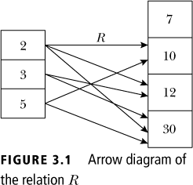
Relations

Slide 3
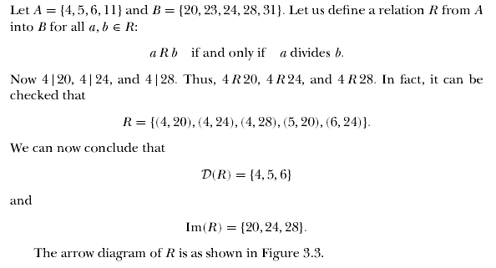
Relations

Slide 4
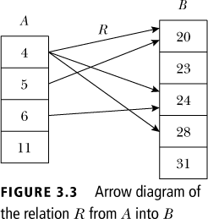
Relations

Slide 5

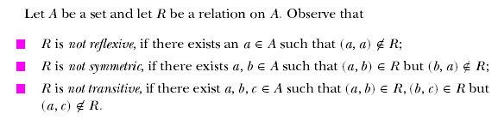
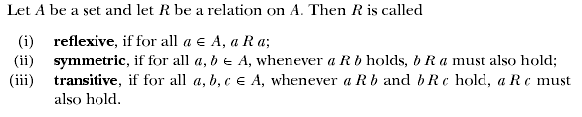
Relations

Slide 6

Relations

Slide 7
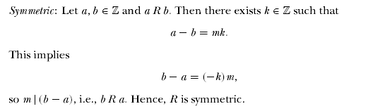
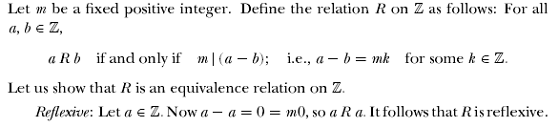
Relations

Slide 8
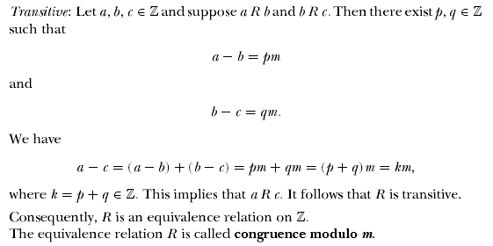
Relations
Example 3.1.32 continued

Slide 9
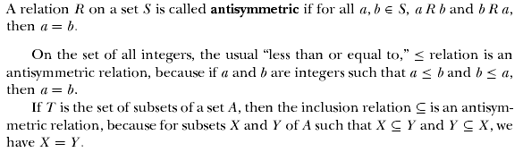
Partially Ordered Sets

Slide 10
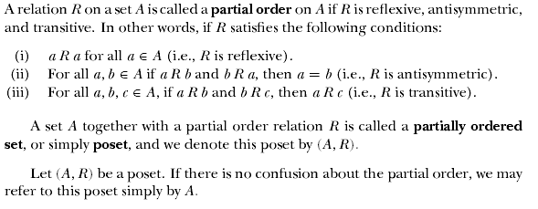
Partially Ordered Sets

Slide 11
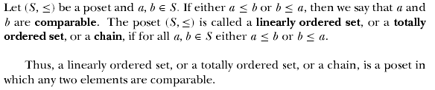
Partially Ordered Sets

Slide 12

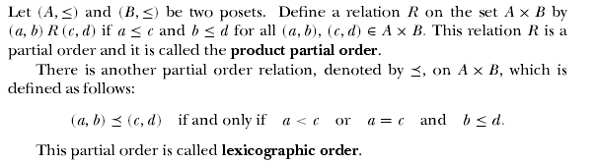
Partially Ordered Sets

Slide 13
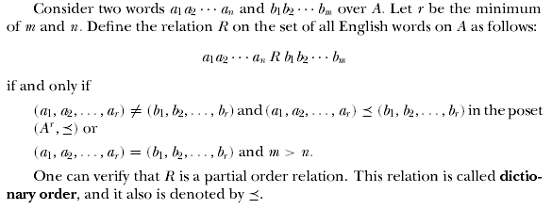
Partially Ordered Sets

Slide 14


Partially Ordered Sets

Slide 15
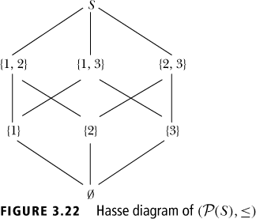
Partially Ordered Sets
Hasse Diagram
Let S = {1, 2, 3}. Then P(S) = {∅, {1}, {2}, {3}, {1, 2}, {2, 3}, {1, 3}, S}
Now (P(S),≤) is a poset, where ≤ denotes the set inclusion relation. The poset diagram of (P(S),≤) is shown in Figure 3.22

Slide 16

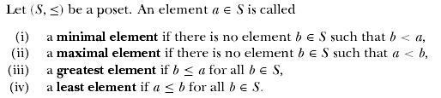
Partially Ordered Sets

Slide 17
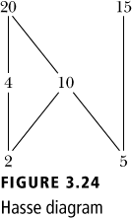
Partially Ordered Sets
Hasse Diagram
Consider the poset (S,≤), where S = {2, 4, 5, 10, 15, 20} and the partial order ≤ is the divisibility relation
In this poset, there is no element b ∈ S such that b ≠ 5 and b divides 5. (That is, 5 is not divisible by any other element of S except 5). Hence, 5 is a minimal element. Similarly, 2 is a minimal element

Slide 18
Partially Ordered Sets
Hasse Diagram
10 is not a minimal element because 2 ∈ S and 2 divides 10. That is, there exists an element b ∈ S such that b < 10. Similarly, 4, 15, and 20 are not minimal elements
2 and 5 are the only minimal elements of this poset. Notice that 2 does not divide 5. Therefore, it is not true that 2 ≤ b, for all b ∈ S, and so 2 is not a least element in (S,≤). Similarly, 5 is not a least element. This poset has no least element

Slide 19
Partially Ordered Sets
Hasse Diagram
There is no element b ∈ S such that b ≠15, b > 15, and 15 divides b. That is, there is no element b ∈ S such that 15 < b. Thus, 15 is a maximal element. Similarly, 20 is a maximal element.
10 is not a maximal element because 20 ∈ S and 10 divides 20. That is, there exists an element b ∈ S such that 10 < b. Similarly, 4 is not a maximal element.

Slide 20
Partially Ordered Sets
Hasse Diagram
20 and 15 are the only maximal elements of this poset
10 does not divide 15, hence it is not true that b ≤ 15, for all b ∈ S, and so 15 is not a greatest element in (S,≤)
This poset has no greatest element

Slide 21
Hasse Diagrams
Consider the graph for a finite poset ({1,2,3,4},≤)
When we KNOW it’s a poset, we can simplify the graph
4
3
2
1
4
3
2
1
4
3
2
1
4
3
2
1
Called the
Hasse
diagram

Slide 22
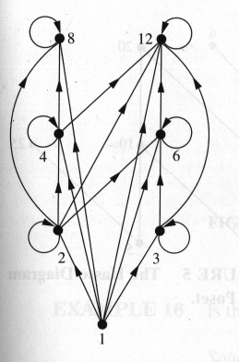
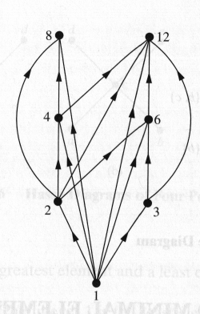
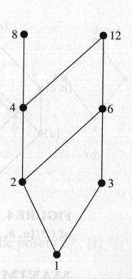
Hasse Diagram
For the poset ({1,2,3,4,6,8,12}, |)

Slide 23
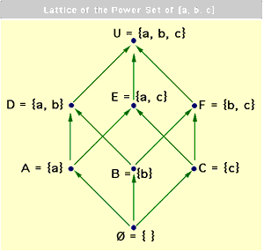
Order Relation on Power set¹.
A partially order set can be represented with using a POSET diagram. The POSET diagram on the right is based on the power set (all possible subsets) of the three element set {a, b, c}. These subsets form a special kind of partial order that is referred to as a lattice
Notes:
From last year:
From Charles F. Schmidt , Cognition - Section 1
http://www.rci.rutgers.edu/~cfs/305_html/Induction/SimpleLattice.html
Arrows are usually implicit and not required.
The above figure is the Hasse diagram for the poset ( ({a, b, c}), ⊆).
The supremum is given by the union and the infimum by the intersection of subsets (see later for definition of these terms).

Slide 24
An relation on binary digits.
Each source has one more ‘1’ digit than its target.

Slide 25
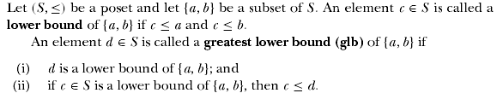

Lattices

Slide 26
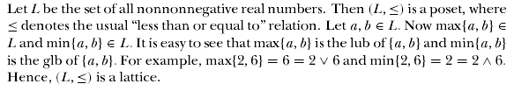
Lattices
Example:

Slide 27
Example
Which of the following partially ordered sets are lattices: I
c d
a b
0
A poset is a lattice iff for each pair x,y lub(x,y) and glb(x,y) both exist. On RHS {a,b} has three upper bounds c, d, and I and no one of them precedes the other two, i.e. none is least.
Notes:
The least upper bound and the greatest lower bound are called. supremum and infimum respectively

Slide 28
Power set¹(again)
The POSET Lattice on the right is based on the power set of {a, b, c}. The LUB is given by the union and the GLB by the intersection of subsets.
Notes:
http://www.rci.rutgers.edu/~cfs/305_html/Induction/SimpleLattice.html
A lattice is a special kind of partial order, it has a glb (infimum) and a lub (supremum).
If either the glb or the lub exist then they are unique.
The lub is given by the union and the glb by the intersection of subsets.
Consider first the operation of Union. Consider any pair of sets in the diagram. The Union of the pair will always yield a set which contains them both.
For example, D Union E equals U; A Union B equals D; and so on.
If one of the sets precedes the other in the partial order, then the union yields the set that occurs higher in the order. For example, A U D equals D.
The set obtained under union is referred to as the Least Upper Bound.
Next consider the set operation of intersection. Again consider any pair of sets in the diagram.
For example, D Intersection E equals A; A Intersection B equals ø; and so on. The set obtained under intersection is referred to as the Greatest Lower Bound for the pair.

Slide 29
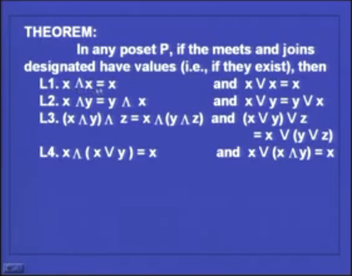
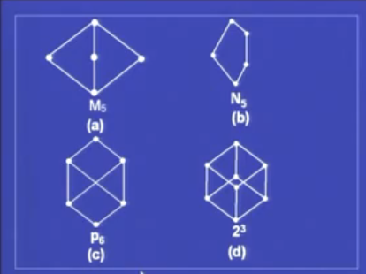
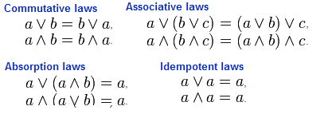
Axioms for Lattices (alternative notation)

Slide 30
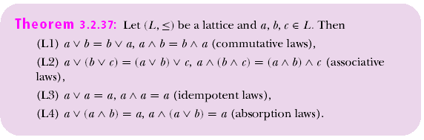
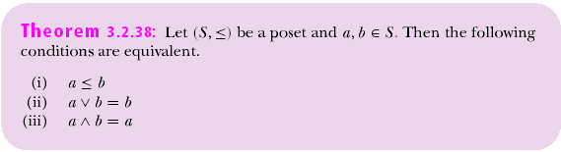
Lattices

Slide 31

Lattices

Slide 32
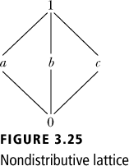
Non-distributive Lattice
Because
a ∧ (b ∨ c ) = a ∧ 1 = a
(a ∧ b) ∨ (a ∧ c ) = 0 ∨ 0 = 0, this is not a distributive lattice

Slide 33
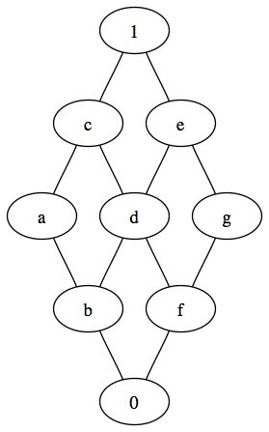
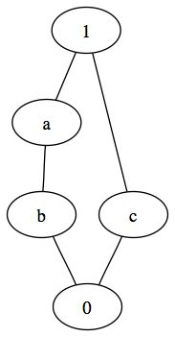
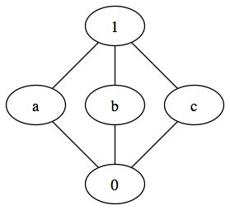

Examples
distributive
non-distributive

Slide 34
Complemented Lattice
Let a lattice ⟨A, ∨, ∧ ⟩ have a maximum element 1 and a minimum element 0. For any element a in A, if there exists an element b such that a ∨ b = 1 and a ∧ b = 0, then the lattice is a complemented lattice.
Find complements in the previous example

Slide 35
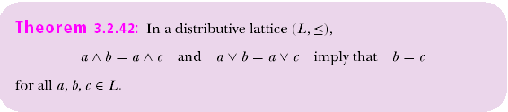
Lattices

Slide 36
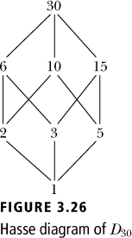
Lattices
Complement
Let D₃₀ denote the set of all positive divisors of 30. Then D₃₀ = {1, 2, 3, 5, 6, 10, 15, 30}.
(D₃₀,≤) is a poset where a ≤ b if and only if a divides b (≤ is the divisibility relation)
D₃₀,≤) is a poset where a ≤ b if and only if a divides b (≤ is the divisibility relation). Because 1 divides all elements of D₃₀, it follows that 1 ≤ m, for all m ∈ D₃₀. Therefore, 1 is the least element of this poset.

Slide 37
Lattices
Complement
Let a, b ∈ D₃₀. Let d = gcd{a, b} and m = lcm{a, b}. Now d | a and d | b. Hence, d ≤ a and d ≤ b.
This shows that d is a lower bound of {a, b}. Let c ∈ D₃₀ and c ≤ a, c ≤ b.
This shows that d is a lower bound of {a, b}. Let c ∈ D₃₀ and c ≤ a, c ≤ b. Then, c | a and c | b and because d = gcd{a, b}, it follows that c | d, so c ≤ d. Thus, d = glb{a, b}.

Slide 38
Lattices
Complement
Because all the positive divisors of a, b are also divisors of 30, d ∈ D₃₀, so d = a ∧ b
It can be shown that m ∈ D₃₀ and m = a ∨ b
Hence, (D₃₀,≤) is a lattice with the least element integer 1 and the greatest element 30

Slide 39
Lattices
Complement
For any element a ∈ D₃₀, (30/a) ∈ D₃₀
Using the properties of gcd and lcm, it can be shown that a ∧ (30/a) = 1 and a ∨ (30/a) = 30
10 ∧ (30/10) = gcd{10, 3} = 1 and 10 ∨ (30/10) = lcm{10, 3} = 30
Hence, 3 is a complement of 10 in this lattice

Slide 40

For any two integers a and b, their lcm and gcd are their lub and glb.
2 and 3 have no upper bounds here, therefore the first one is not a lattice.
Second one is a lattice

Slide 42

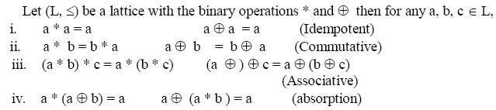

Slide 43

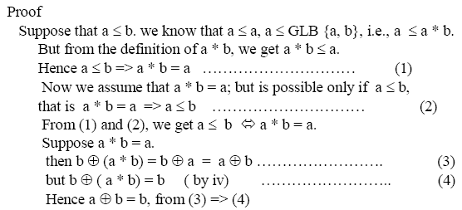

Slide 44
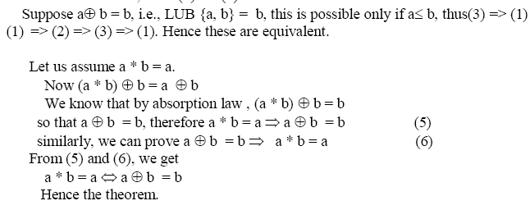

Slide 45


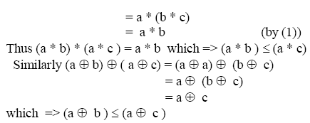

Slide 46
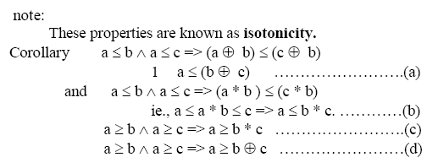

Slide 47

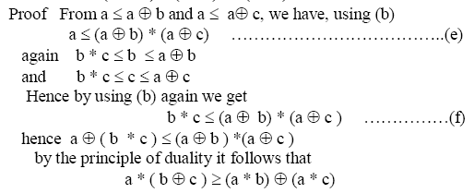

Slide 48

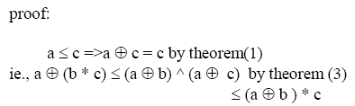




Slide 49


Slide 50

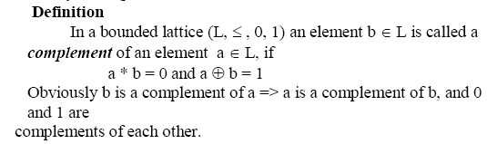

Slide 51

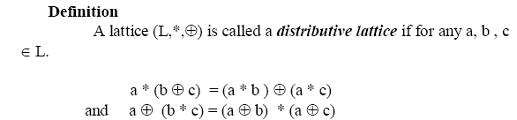

Slide 52

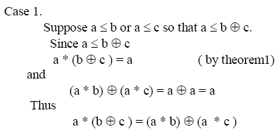

Slide 53
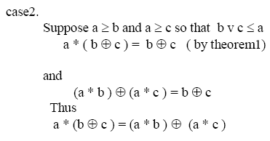
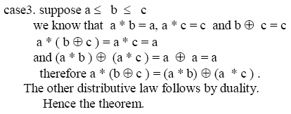

Slide 54


Lattices

Slide 55
Boolean Algebra
Let B be a set with at least two elements 0 and 1. Let two binary operations ∨ and ∧, and a unary operation ‾ are defined on B. The algebraic system ⟨B, ∨, ∧,‾ , 0,1⟩ is a Boolean algebra, if the following postulates are satisfied:
Idempotent laws: a ∨ a = a, a ∧ a = a;
Commutative laws: a ∨ b = b ∨ a, a ∧ b = b ∧ a
Associative laws: a ∨ (b ∨ c) = (a ∨ b) ∨ c, a ∧(b ∧ c) = (a ∧ b) ∧ c
Absorption laws: a ∨ (a ∧ b) = a, a ∧(a ∨ b) = a
Distributive laws: a ∨ (b ∧ c) = (a ∨ b) ∧(a ∨ c), a ∧ (b ∨ c) = (a ∧ b) ∨ (a ∧ c)

Slide 56
Boolean Algebra
Involution:
Complements: a ∨ = 1, a ∧ = 0;
Identities: a ∨ 0 = a, a ∧ 1 = a;
a ∨ 1 = 1, a ∧ 0 = 0;
De Morgan’s laws:

Slide 57



Slide 58

