Slide 1
Number Theory
Ref: Neal Koblitz: Introduction to Number Theory and Cryptography

Slide 2

Basics
What is the value of (11001001)₂ ?
Answer : 201
When base b=26 and use the letters A – Z for the digits 0 – 25, what is the value of (BAD)₂₆ ?
Answer : 679
When base b=26 and use the letters A – Z for the digits 0 – 25, what is the value of (B.AD)₂₆ ?
Answer:

Slide 3
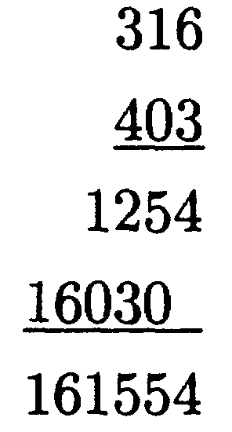
Basics
Find the multiplication of 160 and 199 in the base 7.
Divide 160 by 7: Quotient 22 Remainder 6
Divide 22 by 7: Quotient 3 Remainder 1
Divide 3 by 7: Quotient 0 Remainder 3.
(160) ₁₀ = (316) ₇
Divide 199 by 7: Quotient 28 Remainder 3
Divide 28 by 7: Quotient 4 Remainder 0
Divide 4 by 7: Quotient 0 Remainder 4
(199) ₁₀ = (403) ₇

Slide 4
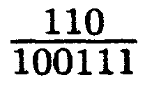



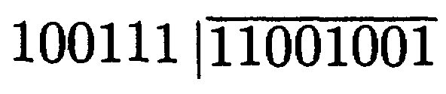



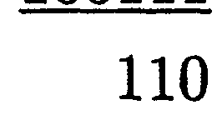

Slide 5
Divisors and Divisibility
Given integers a and b, we say that a divides b (or b is divisible by a) and write a|b if there exists an integer d such that b=ad.

Slide 6
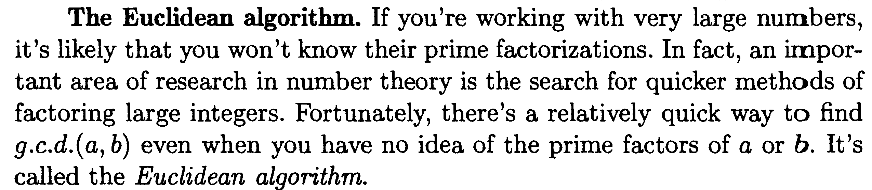

Slide 7
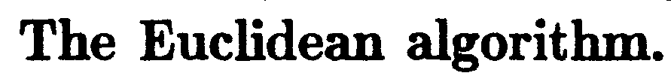
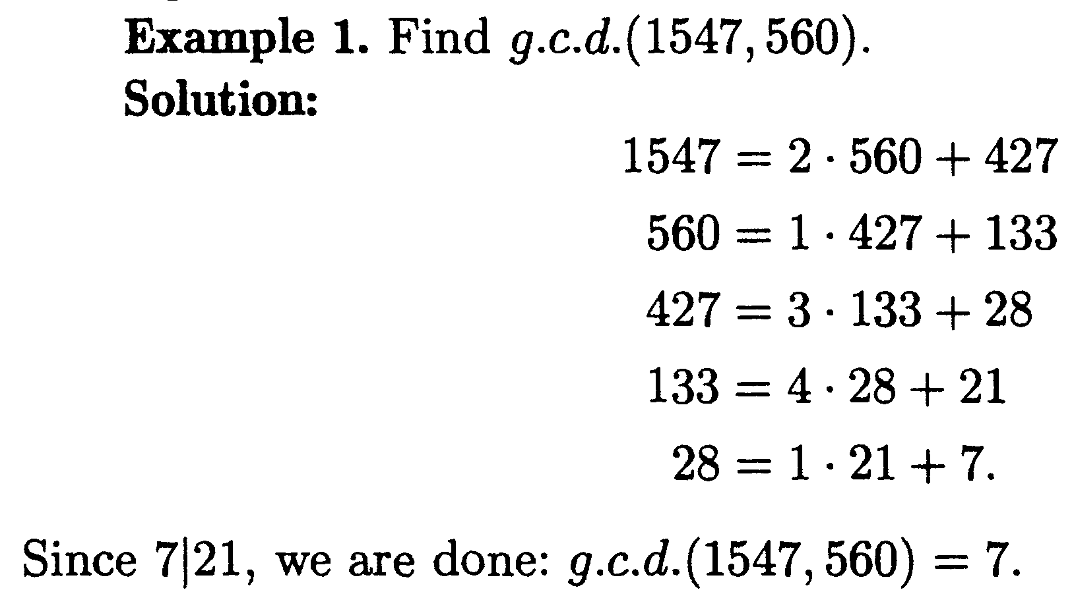

Slide 8
1.Divisors
Theorem 1.2. Let m and n be integers, not both zero. Then d = gcd(m, n) exists,and d = xm + yn for some integers x and y.
Proof. Let X = {sm + tn | s, t ∈ Z; sm + tn ≥1}. Then X is not empty since m² + n² is in X, so let d be the smallest member of X. Since d ∈ X we have d ≥ 1 and
d = xm + yn for integers x and y, proving conditions (i) and (iii) in the definition of the gcd.
Hence it remains to show that d|m and d|n.We show that d|n; the other is similar. By the division algorithm

Slide 9
1.Divisors
Two integers m and n are called relatively prime if gcd(m, n) = 1.
Hence 12 and 35 are relatively prime, but this is not true for 12 and 15
Because gcd(12, 15) = 3. Note that 1 is relatively prime to every
integer m. The following theorem collects three basic properties of
relatively prime integers.
Theorem 1.4. If m and n are integers, not both zero:
(i) m and n are relatively prime if and only if 1 = xm + yn for some integers x and y.
(ii) If d = gcd(m, n), then m/d and n/d are relatively prime.
(iii) Suppose that m and n are relatively prime.
(a) If m|k and n|k, where k ∈ Z, then mn|k.
(b) If m|kn for some k ∈ Z, then m|k

Slide 10
1.Divisors
Proof. (i) If 1 = xm + yn with x, y ∈ Z, then every divisor of both m and n divides 1, so must be 1 or −1. It follows that gcd(m, n) = 1. The converse is by the euclidean algorithm.
(ii). By Theorem 1.2, write d = xm + yn,
where x, y ∈ Z. Then
1 = x(m/d)+y(n/d) and (ii) follows from (i).
(iii). Write 1 = xm + yn, where x, y ∈ Z. If k = am and k = bn, a, b ∈ Z then k = kxm + kyn = (xb + ya)mn, and (a) follows. As to (b), suppose that
kn = qm, q ∈ Z. Then k = kxm + kyn = (kx + qn)m, so m|k.

Slide 11
2.Prime Factorization
Recall that an integer p is called a prime if:
(i) p ≥ 2.
(ii) The only positive divisors of p are 1 and p.
The reason for not regarding 1 as a prime is that
we want the factorization of every integer into
primes to be unique. The following result is needed.

Slide 12
2.Prime Factorization
Theorem 2. 1. Euclid’s Lemma. Let p denote a prime.
(i) If p|mn where m, n ∈ Z, then either p|m or p|n.
(ii) If p|m₁m₂ · · ·m_{r} where each m_{i} ∈ Z, then p|m_{i} for some i.
Proof. (i) Write d = gcd(m, p). Then d|p, so as p is a prime, either d = p or d = 1.
If d = p, then p|m; if d =1, then since p|mn, we have p|n by Theorem 1.4 .
(ii) This follows from (i) using induction on r.

Slide 13
2.Prime Factorization
Theorem 2.2. Every integer n >1 is a product of primes.
Proof. Let p_{n} denote the statement of the theorem. Then p₂ is clearly true.
If p₂, p₃, . . . , p_{k} are all true, consider the integer k + 1. If k + 1 is a prime, there is nothing to prove. Otherwise,
k + 1 = ab, where 2 ≤ a, b ≤ k. But then each of a and b are products of primes because p_{a} and p_{b} are both true by the
(strong) induction assumption. Hence ab = k + 1 is also a product of primes, as required.

Slide 14
2.Prime Factorization
Theorem 2.3. Prime Factorization Theorem. Every integer n ≥ 2 can be written as a product of (one or more) primes. Moreover, this factorization is unique except for the order of the factors. That is,
if n = p₁p₂ · · · p_{r} and n = q₁q₂ · · · q_{s} ,
where the p_{i} and q_{j} are primes, then r = s and the q_{j} can be relabeled so that p_{i} = q_{i} for each i.

Slide 15
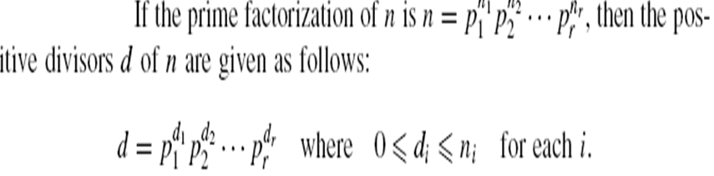
Prime Factorization
Collorary 2.4

Slide 16
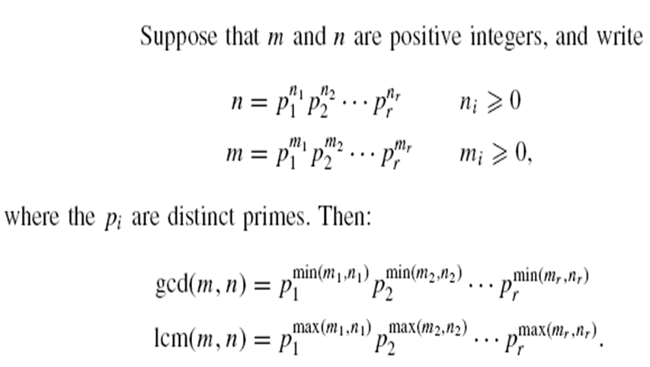
Prime Factorization
Theorem 2.5

Slide 17
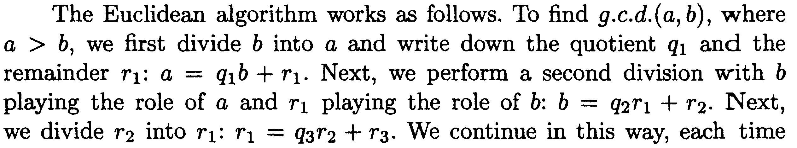
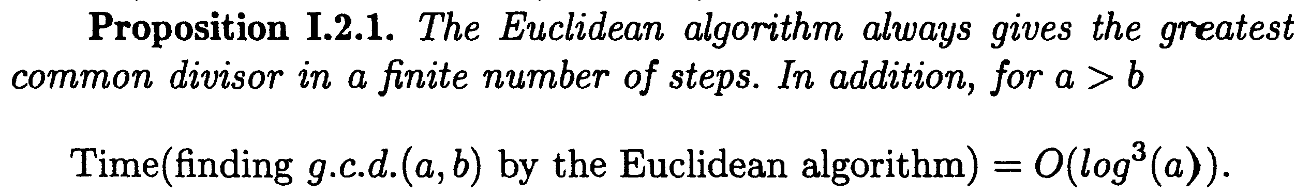

Slide 18
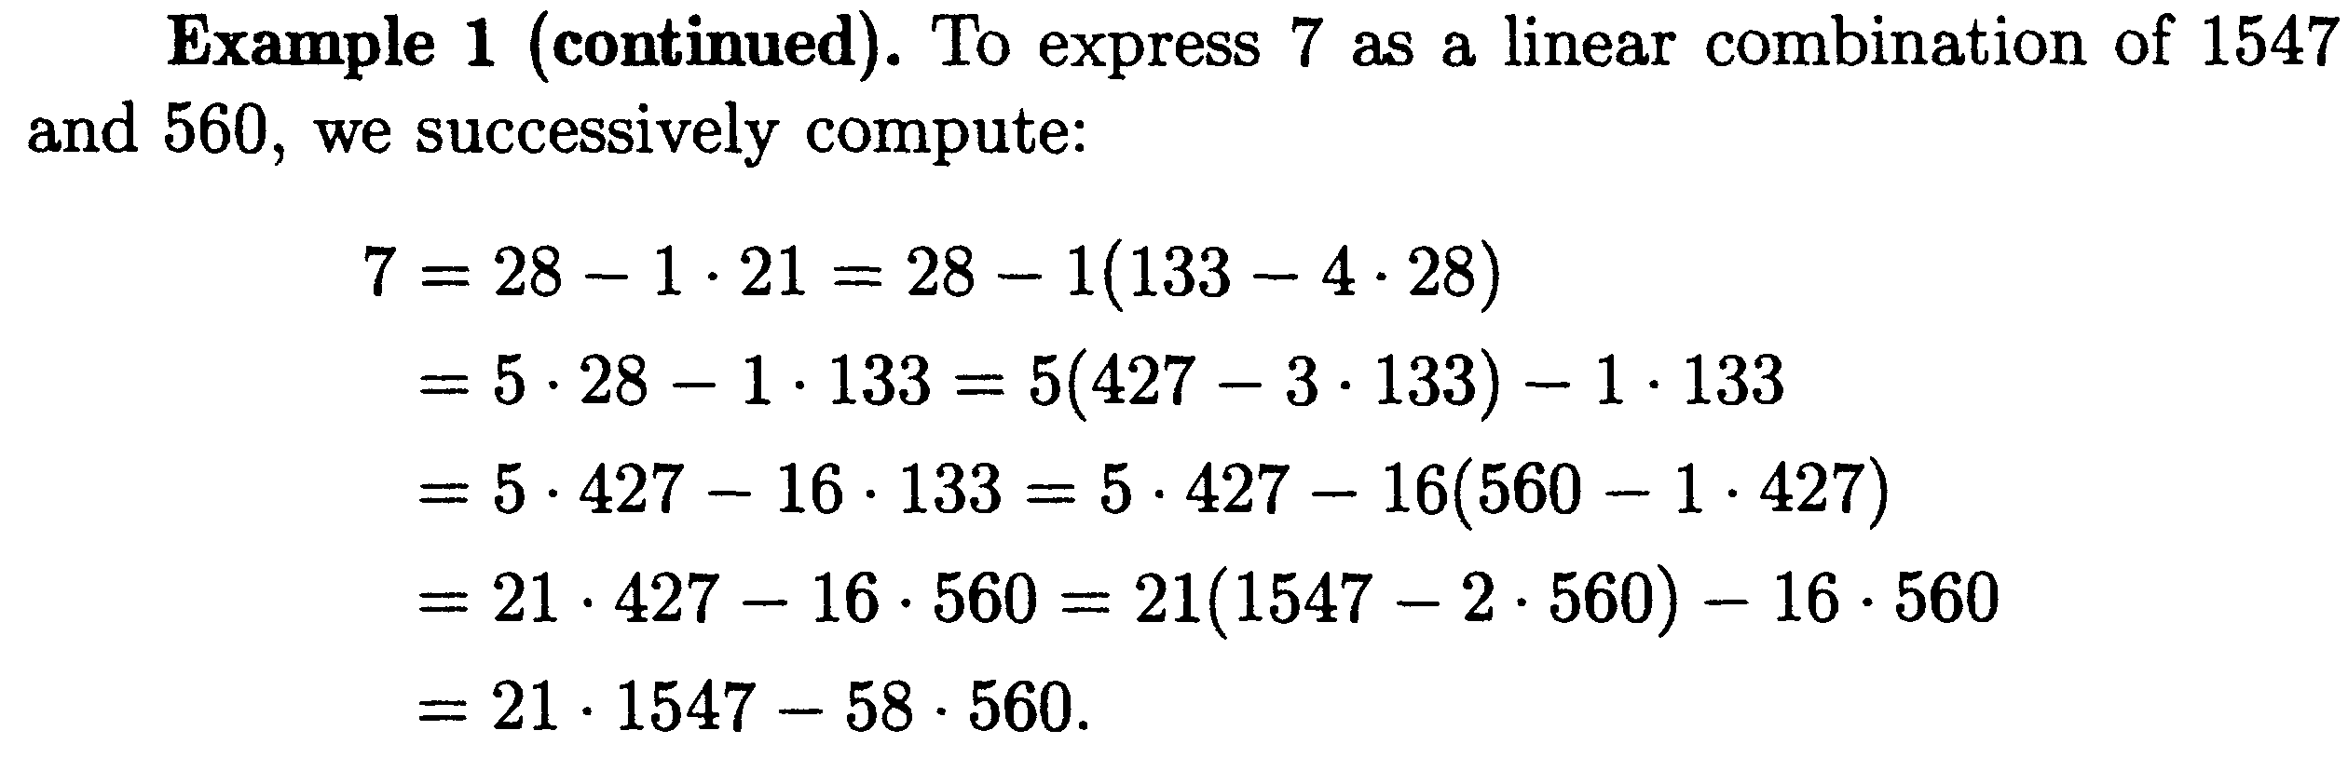
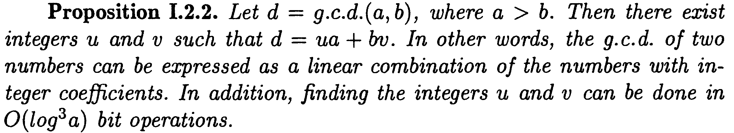

Slide 19
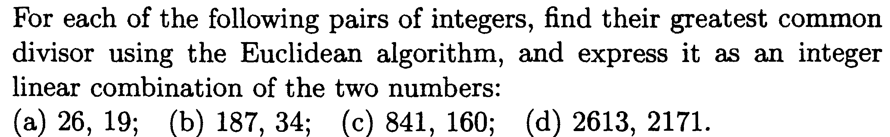

Slide 20
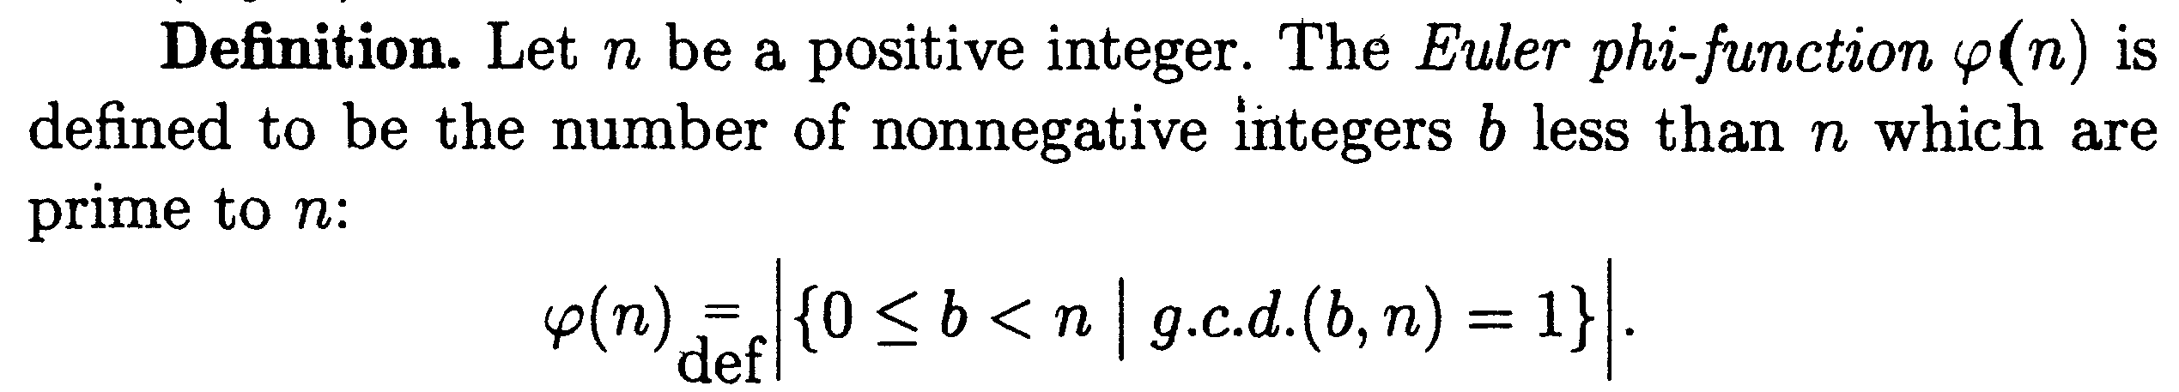
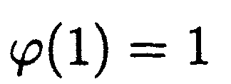
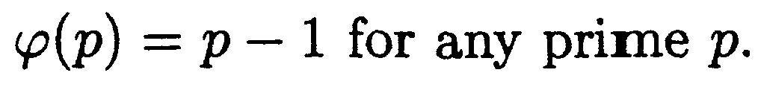

Slide 21
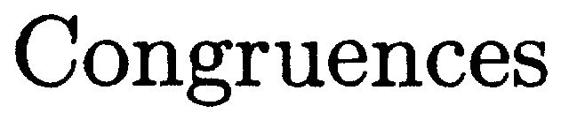
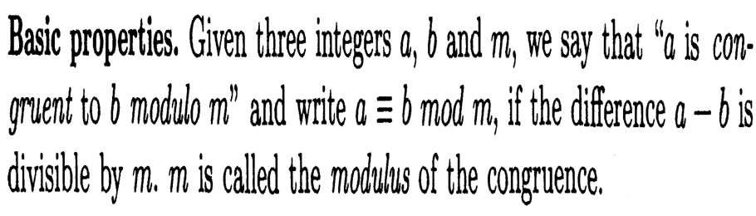

Slide 22
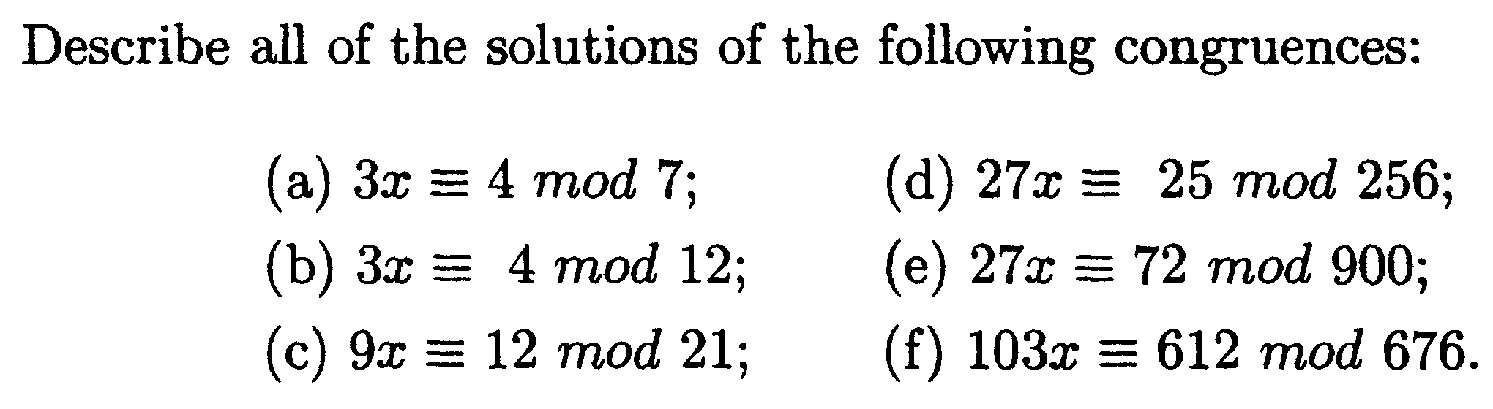

Slide 23
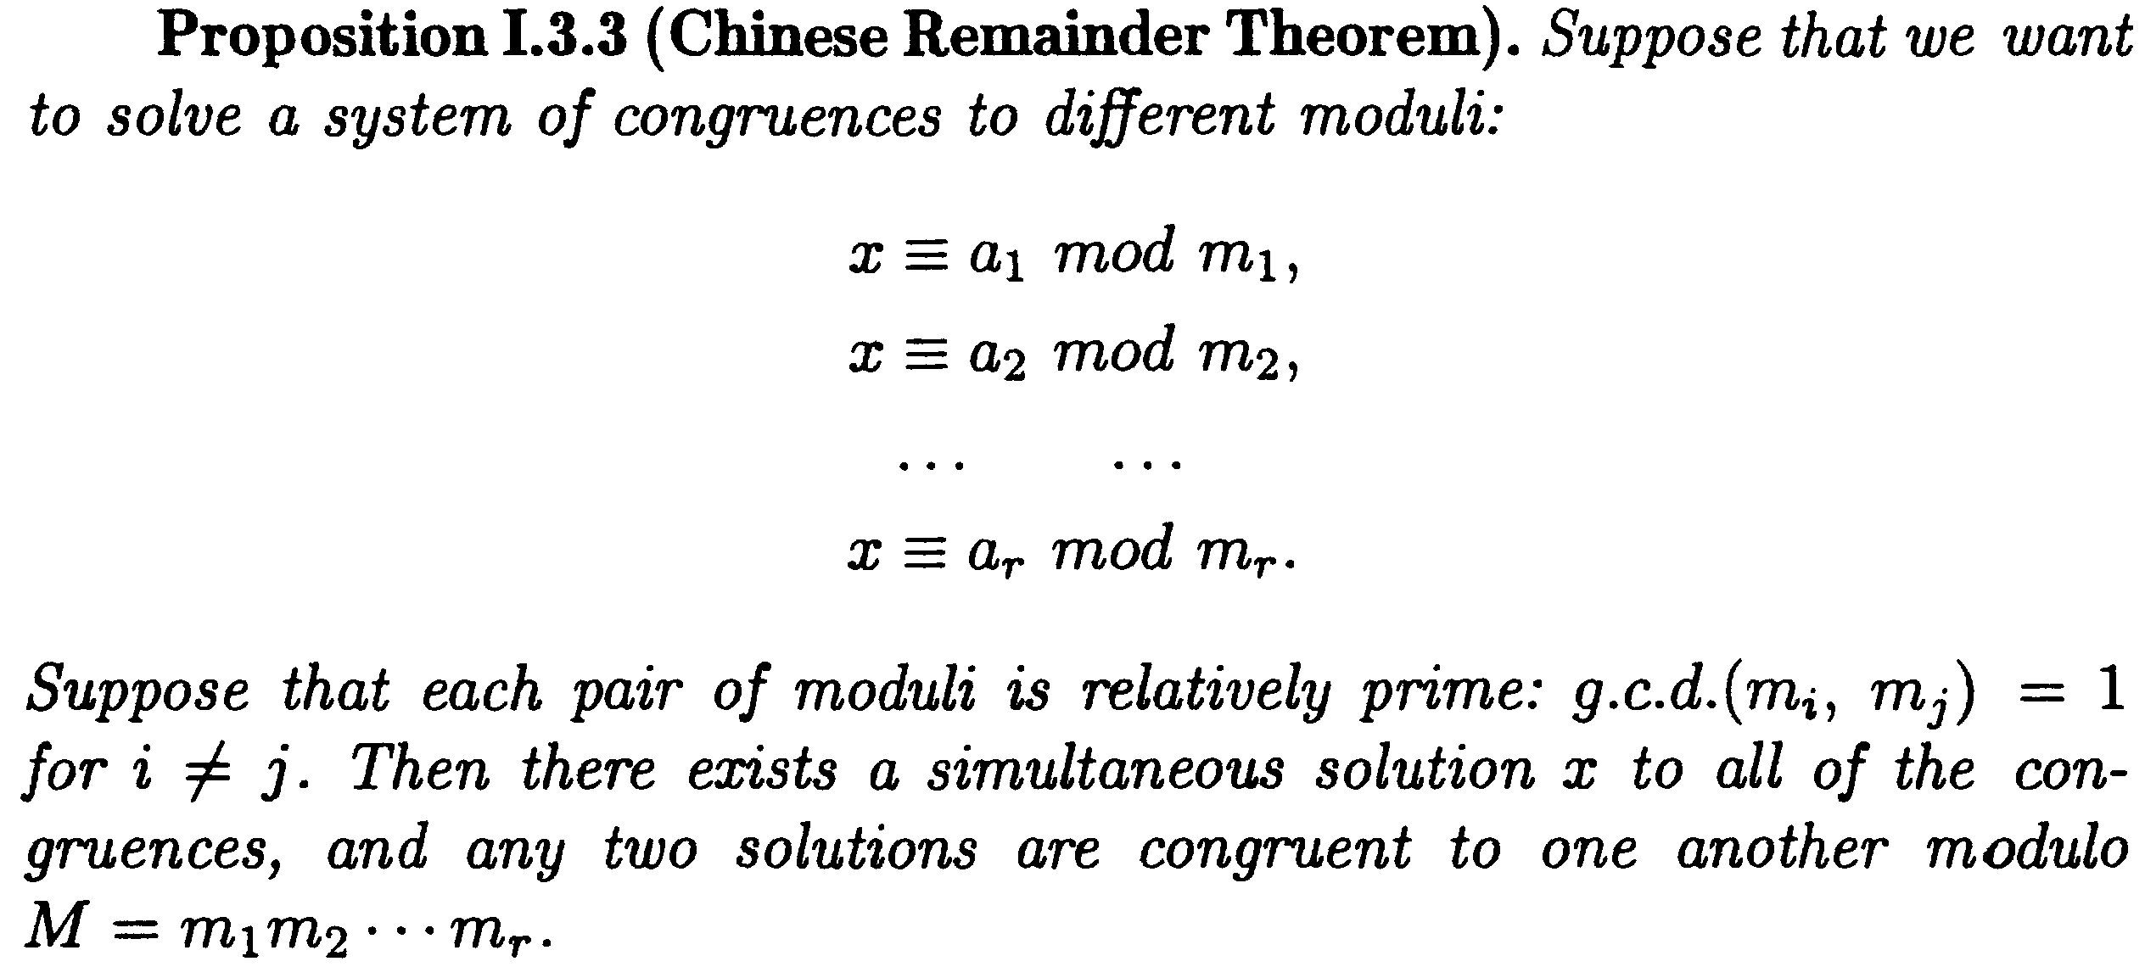

Slide 24
CHINESE REMAINDER THEOREM
The Chinese remainder theorem (CRT) is used to solve a set of congruent equations with one variable but different moduli, which are relatively prime, as shown
below:

Slide 25
CRT
Example
The following is an example of a set of equations with different moduli:
The solution to this set of equations is given in the next section; for the moment, note that the answer to this set of equations is x = 23. This value satisfies all equations: 23 ≡ 2 (mod 3), 23 ≡ 3 (mod 5), and 23 ≡ 2 (mod 7).

Slide 26
CRT
Solution To Chinese Remainder Theorem
1. Find M = m₁ × m₂ × … × m_{k}. This is the common modulus.
2. Find M₁ = M/m₁, M₂ = M/m₂, …, M_{k} = M/m_{k}.
3. Find the multiplicative inverse of M₁, M₂, …, M_{k} using the corresponding moduli (m₁, m₂, …, m_{k}). Call the inverses M₁⁻¹, M₂⁻¹, …, M_{k} ⁻¹.
4. The solution to the simultaneous equations is

Slide 27
CRT
Example
Find the solution to the simultaneous equations:
Solution We follow the four steps.
1. M = 3 × 5 × 7 = 105
2. M₁ = 105 / 3 = 35, M₂ = 105 / 5 = 21, M₃ = 105 / 7 = 15
3. The inverses are M₁⁻¹ = 2, M₂⁻¹ = 1, M₃ ⁻¹ = 1
4. x = (2 × 35 × 2 + 3 × 21 × 1 + 2 × 15 × 1) mod 105 = 23 mod 105

Slide 28
Suppose we are to find modular multiplicative inverse x of 35 modulo 3.
This is the same as finding x such that
35 x = 1 (mod 3)
Inverse of 35 modulo 3 is 2.
The inverse of 35 is –1 and its modulo 3 is 2
Inverse of 21 modulo 5
The inverse of 21 modulo 5 is 1.
Inverse of 15 modulo 7
The inverse of 15 modulo 7 is 1.

Slide 29
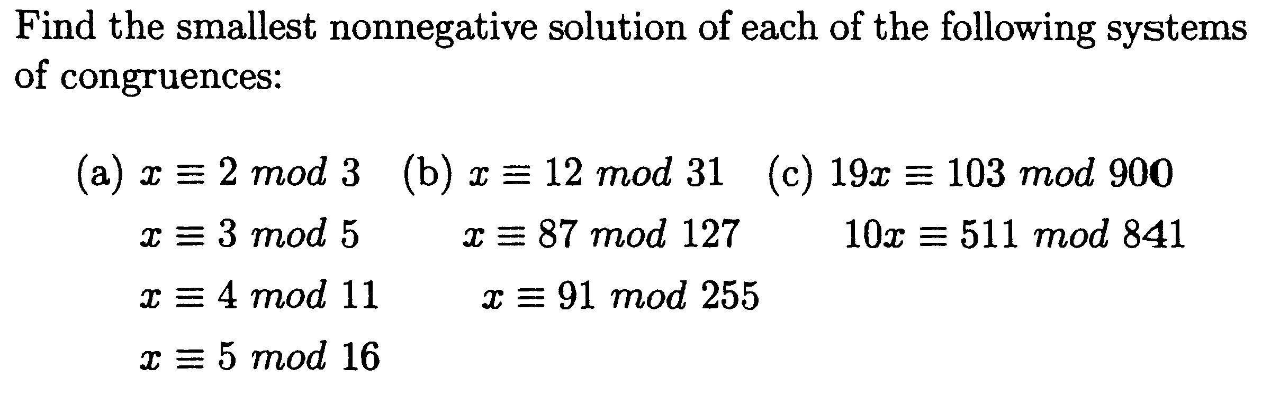

Slide 30
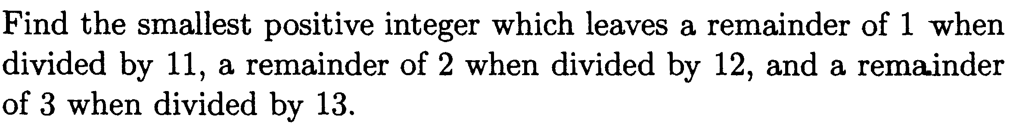

Slide 31
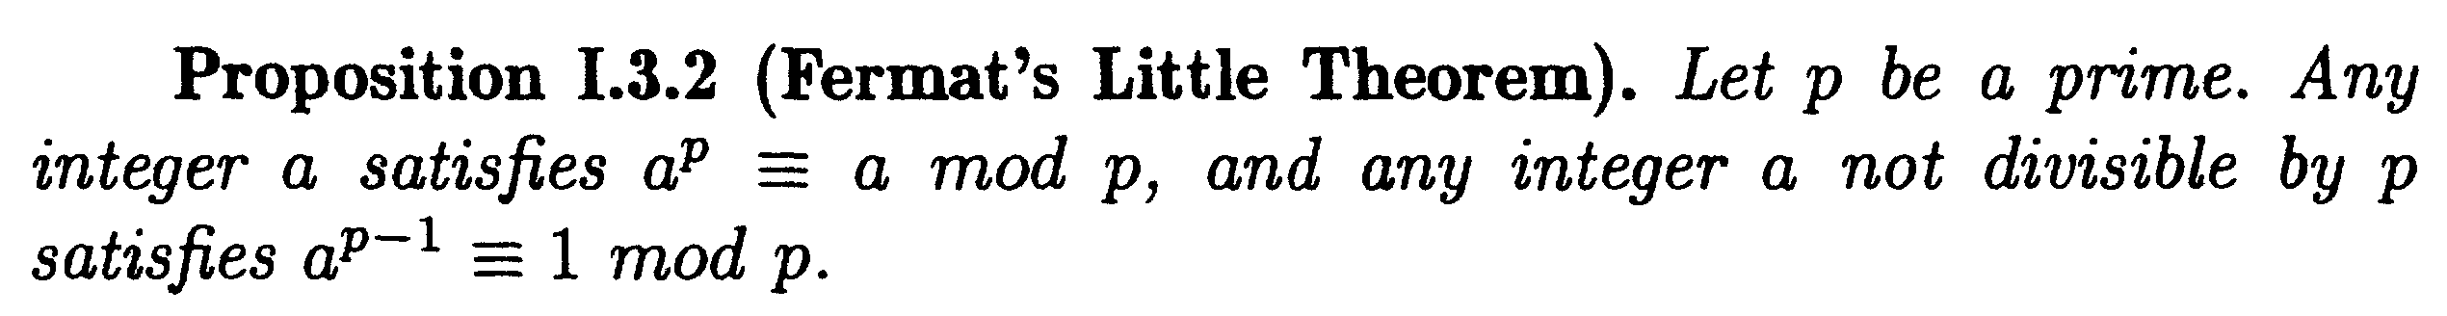


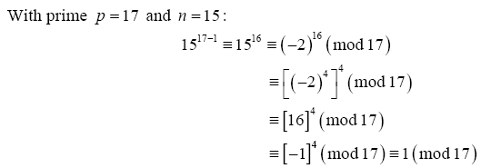

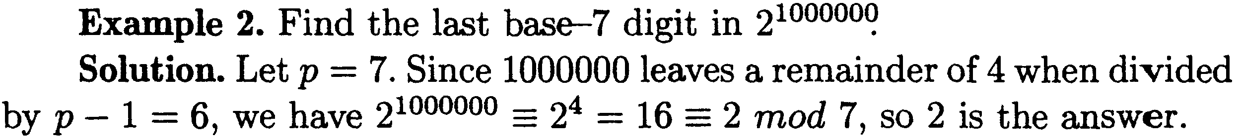

Slide 32
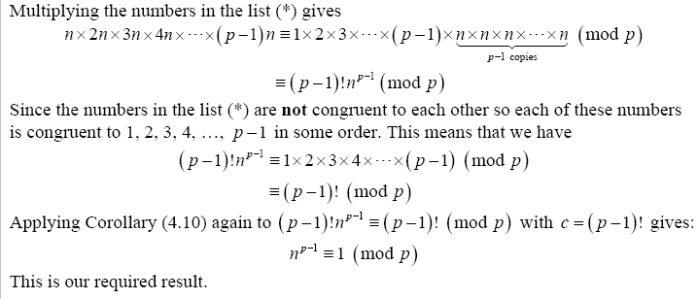

Slide 33
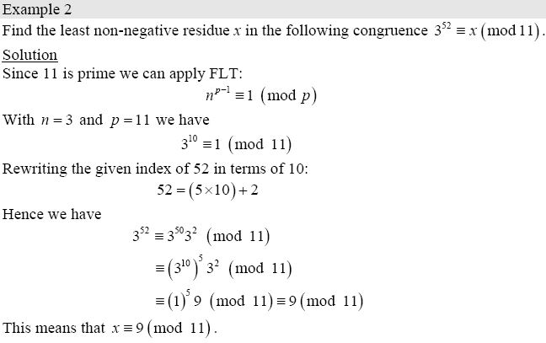

Slide 34
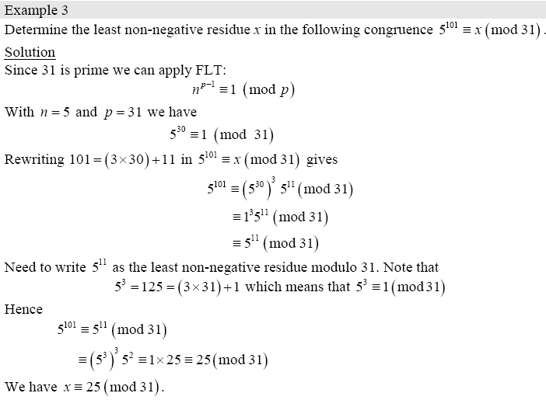

Slide 35
Prove that there is no perfect square a² which is congruent to 2 mod 4.
The remainders of a number a are 0,1,2 and 3. In the first case a² congruent to 0.
In the second case a² congruent to 1.
In the third case a² congruent to 0.
In the fourth case a² congruent to 1.

Slide 36
Prove that there is no perfect square a² whose last digit is 2.
each integer number is congruent to 0, 1, 2, . . . , 8 or 9 mod 10.
If a 0 mod 10, then a² 0 mod 10.
If a 1 mod 10, then a² 1 mod 10.
If a 2 mod 10, then a² 4 mod 10.
If a 3 mod 10, then a² 9 mod 10.
If a 4 mod 10, then a² 6 mod 10.
If a 5 mod 10, then a² 5 mod 10.
If a 6 mod 10, then a² 6 mod 10.
If a 7 mod 10, then a² 9 mod 10.
If a 8 mod 10, then a² 4 mod 10.
If a 9 mod 10, then a² 1 mod 10.
Therefore a² ≠ 2 mod 10, and the result follows.

Slide 38
Special Congruences
Wilson’s Theorem
If p is a prime then (p-1)! -1 (mod p).
The converse of this theorem is also true:
Theorem 6.2 If n is a positive integer
And n ≥ 2 and (n-1)! -1 (mod n) then n is a
prime.

Slide 39
Proof. It is easy to check the result when p is 2 or 3, so let us assume p > 3. If p is composite, then its positive divisors are among the integers 1, 2, 3, 4, ... , p-1
and it is clear that gcd((p-1)!,p) > 1, so we can not have (p-1)! = -1 (mod p). However if p is prime, then each of the above integers are relatively prime to p. So for each of these integers a there is another b such that ab = 1 (mod p). It is important to note that this b is unique modulo p, and that since p is prime, a = b if and only if a is 1 or p-1. Now if we omit 1 and p-1, then the others can be grouped into pairs whose product is one showing 2.3.4.....(p-2) = 1 (mod p)
(or more simply (p-2)! = 1 (mod p)). Finally, multiply this equality by p-1 to complete the proof.

Slide 40
Let us assume that a is positive and not divisible by p. The idea is that if we write down the sequence of numbers and reduce each one modulo p, the resulting sequence turns out to be a rearrangement of
Therefore, if we multiply together the numbers in each sequence, the results must be identical modulo p:
Collecting together the a terms yields
Finally, we may "cancel out" the numbers 1, 2, ..., p − 1 from both sides of this equation, obtaining
There are two steps in the above proof that we need to justify:
Why (A) is a rearrangement of (B), and
Why it is valid to "cancel" in the setting of modular arithmetic.
We will prove these things below; let us first see an example of this proof in action.

Slide 41
An example
If a = 3 and p = 7, then the sequence in question is
reducing modulo 7 gives
which is just a rearrangement of
Multiplying them together gives
that is,
Canceling out 1 × 2 × 3 × 4 × 5 × 6 yields
which is Fermat's little theorem for the case a = 3 and p = 7.

Slide 42
The rearrangement property
Finally, we must explain why the sequence
when reduced modulo p, becomes a rearrangement of the sequence
To start with, none of the terms a, 2a, ..., (p − 1)a can be congruent to zero modulo p, since if k is one of the numbers 1, 2, ..., p − 1, then k is relatively prime with p, and so is a, so Euclid's lemma tells us that ka shares no factor with p. Therefore, at least we know that the numbers a, 2a, ..., (p − 1)a, when reduced modulo p, must be found among the numbers 1, 2, 3, ..., p − 1.

Slide 43
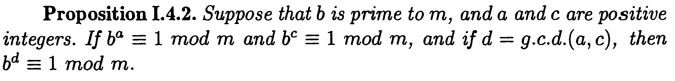

Slide 44
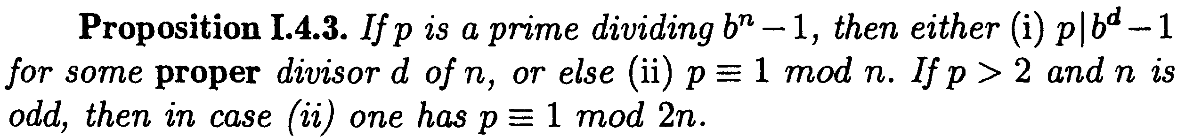

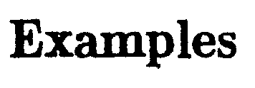
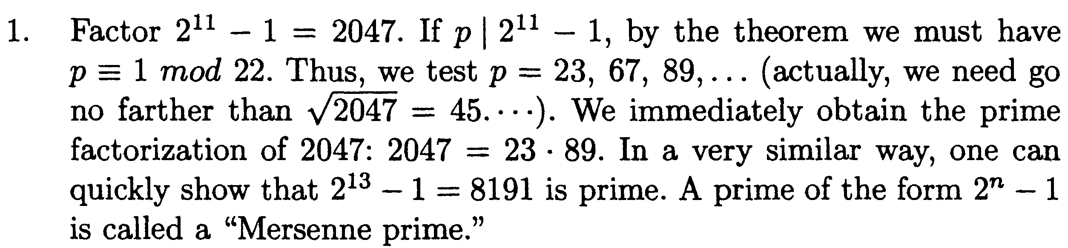

Slide 45
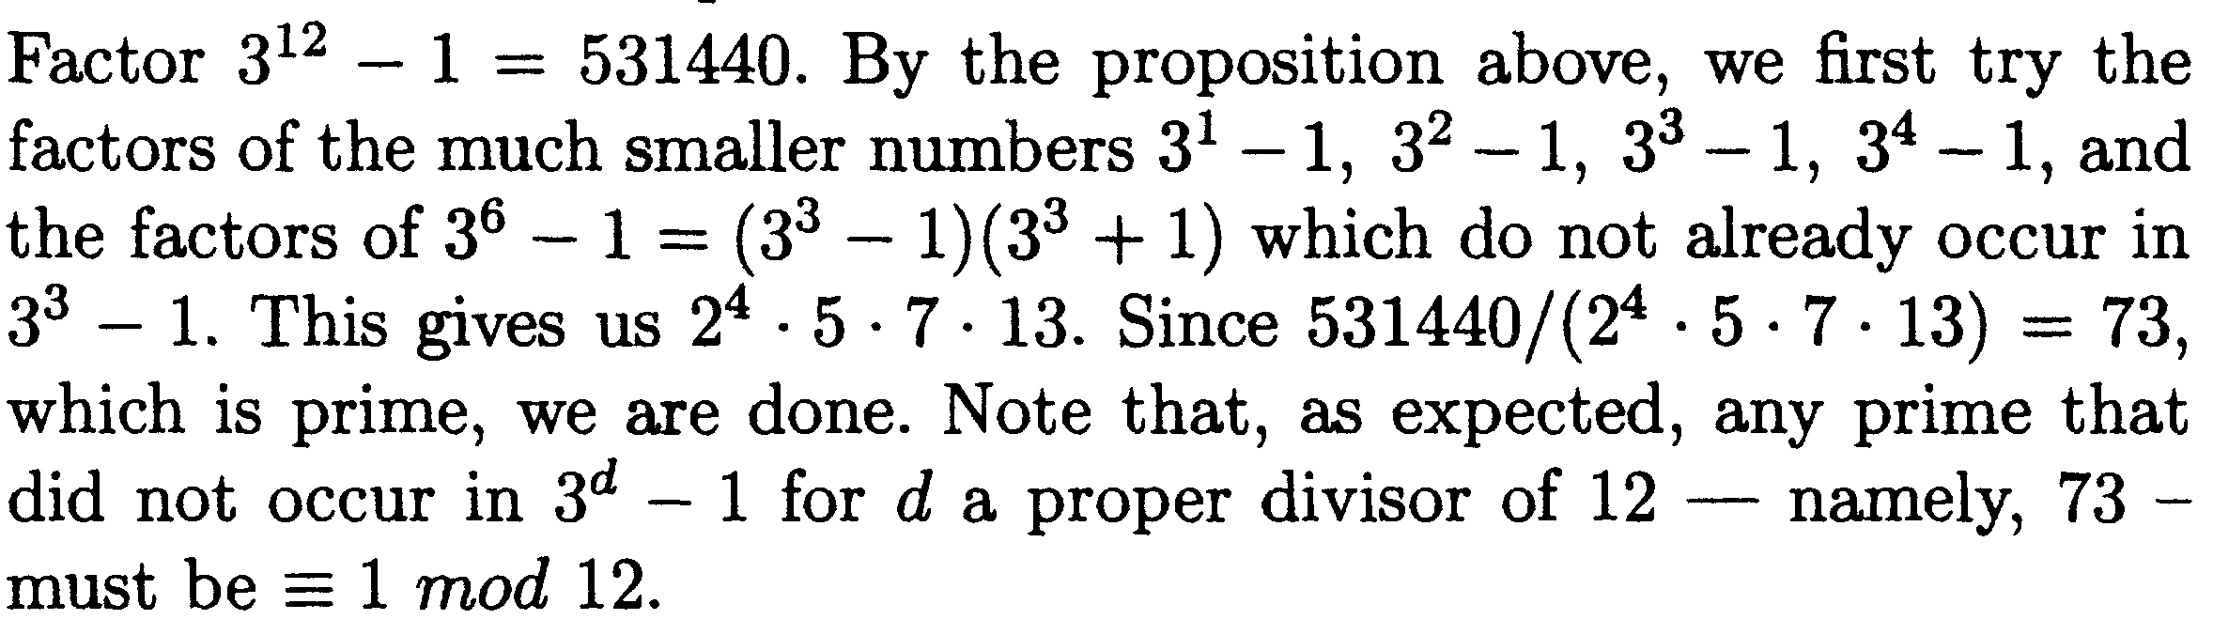

Slide 46
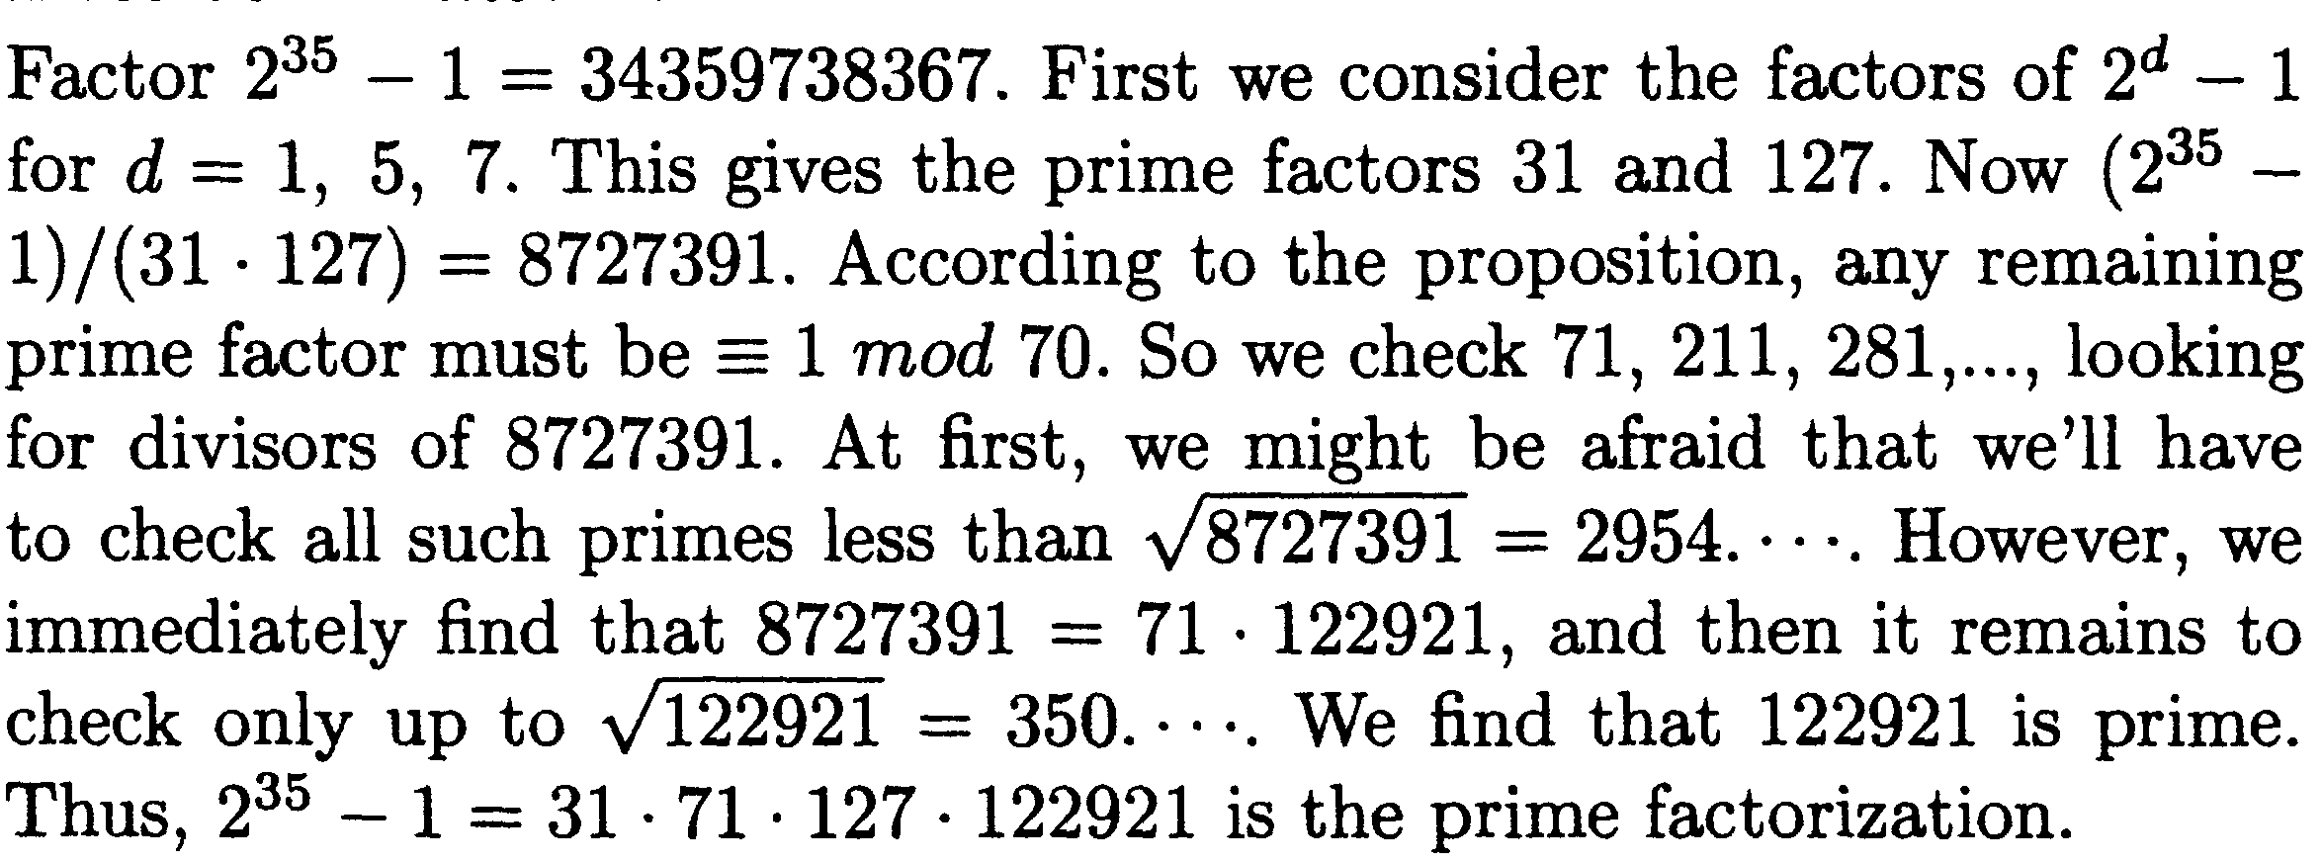

Slide 47
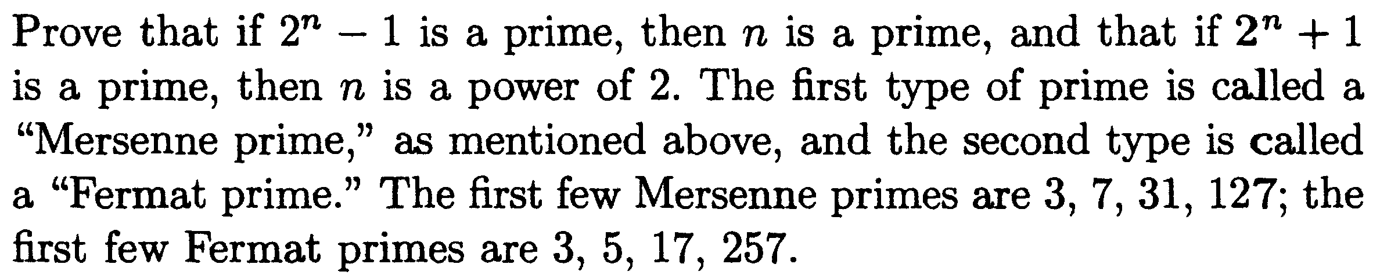


Slide 48
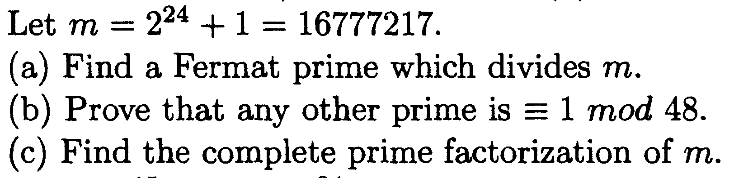

Slide 49
