Slide 1
Outline
Relations
Inverse Relation
Composition
Reflexive
Symmetric
Transitive
Antisymmetric
Equivalence
Poset [Partially ordered set]
Hasse Diagram

Slide 2
Learning Objectives
Learn about relations and their basic properties
Explore equivalence relations
Learn about posets
Explore how relations are used in the design of relational databases

Slide 3

Relations
Relations are a natural way to associate objects of various sets

Slide 4
Representing Relations
Set – ordered pairs
Set definition – membership values
Arrow Diagram

Slide 5
Relations
Arrow Diagram
  Write the elements of A in one column
  Write the elements B in another column
  Draw an arrow from an element, a, of A to an element, b, of B, if (a ,b) ∈ R
  Here, A = {2,3,5} and B = {7,10,12,30} and R from A into B is defined as follows: For all a ∈ A and b ∈ B, a R b if and only if a divides b
  The symbol → (called an arrow) represents the relation R

Slide 6
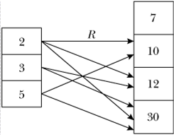
Relations

Slide 7
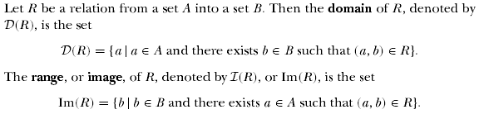
Relations

Slide 8
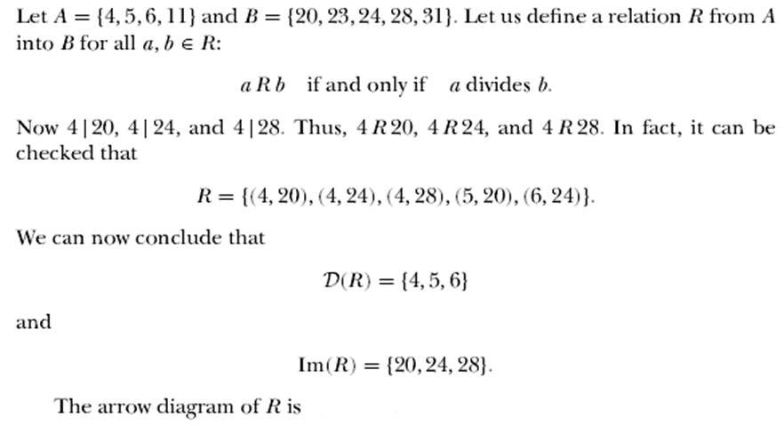
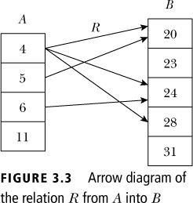
Relations

Slide 9

Inverse of Relations
  Let A = {1, 2, 3, 4} and B = {p, q, r}. Let R = {(1, q), (2, r ), (3, q), (4, p)}. Then R⁻¹ = {(q, 1), (r , 2), (q, 3), (p, 4)}
  To find R⁻¹, just reverse the directions of the arrows
  D(R) = {1, 2, 3, 4} = Im(R⁻¹), Im(R) = {p, q, r} = D(R⁻¹)

Slide 10
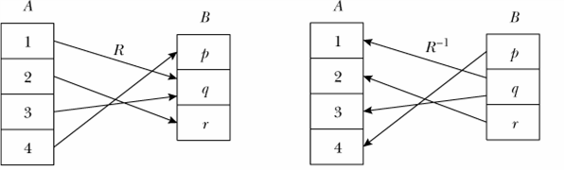
Inverse of Relations

Slide 11
Composition of Relations
Le R be a relations whose domain is A and whose image is B. Let S be a relation whose domain contains B and whose range is C. The composition of S and R is a subset of AXC. It is defined by:
Compositive is Associative

Slide 12
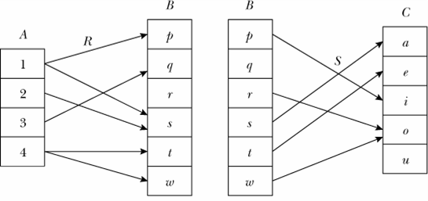
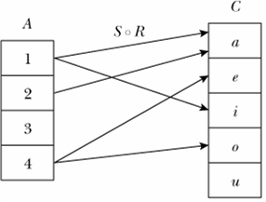
Composition of Relations
Example:
  Consider the relations R and S as given above
  The composition S ◦ R is shown on the right

Slide 13
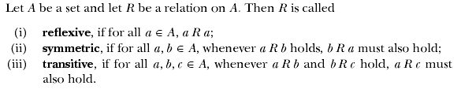
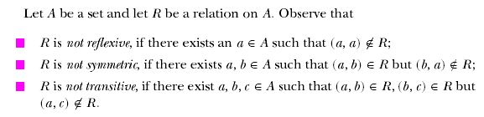
Properties of Relations

Slide 14






Example: R = {<x,y>| xRy = x is a friend of y}
Example: R = {<x,y>| xRy = x is the father of y}

Slide 15

Equivalence Relations

Slide 16
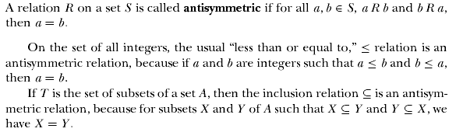
Partially Ordered Sets

Slide 17
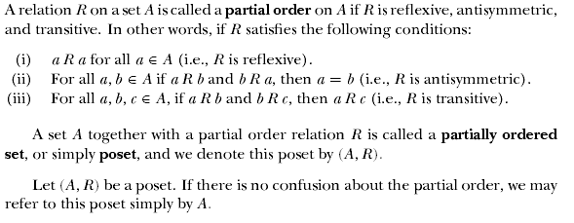

Partially Ordered Sets

Slide 18


Partially Ordered Sets

Slide 19
Hasse Diagrams
Let S={1,2,3,4}, consider the graph for a finite poset (S,≤)
When we KNOW it’s a poset, we can simplify the graph
4
3
2
1
4
3
2
1
4
3
2
1
4
3
2
1
Called the
Hasse
diagram

Slide 20
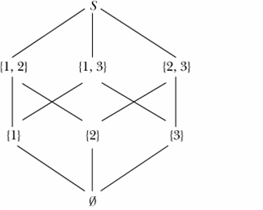
Partially Ordered Sets
Hasse Diagram
  Let S = {1, 2, 3}. Then P(S) = {∅, {1}, {2}, {3}, {1, 2}, {2, 3}, {1, 3}, S}
  Now (P(S),≤) is a poset, where ≤ denotes the set subset relation. The poset diagram of (P(S),≤) is shown

Slide 21
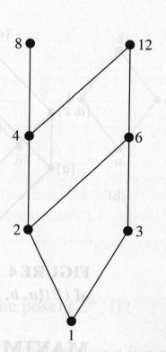
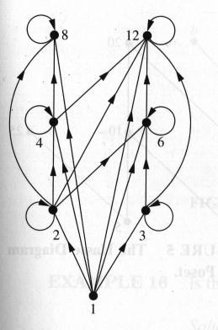
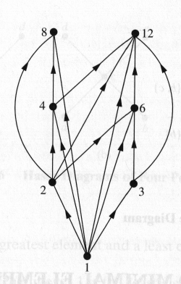
Hasse Diagram
Let S = {1,2,3,4,6,8,12},
≤ = | (Divisibility)
For the poset (S, ≤) Draw the Hasse Diagram

Slide 22

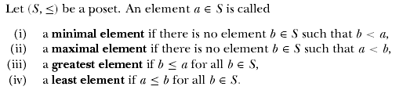
Partially Ordered Sets

Slide 23
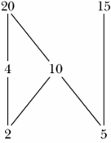
Partially Ordered Sets
Hasse Diagram
  Consider the poset (S,≤), where S = {2, 4, 5, 10, 15, 20} and the partial order ≤ is the divisibility relation.
  2 and 5 are the only minimal elements of this poset.
  This poset has no least element.
  20 and 15 are the only maximal elements of this poset.
  This poset has no greatest element.

Slide 24
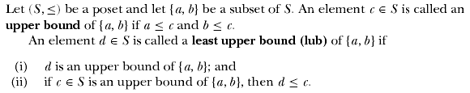
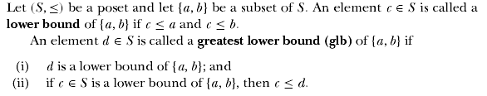
Partially Ordered Sets

Slide 25
Application: Relational Database
A database is a shared and integrated computer structure that stores
  End-user data; i.e., raw facts that are of interest to the end user;
  Metadata, i.e., data about data through which data are integrated
  A database can be thought of as a well-organized electronic file cabinet whose contents are managed by software known as a database management system; that is, a collection of programs to manage the data and control the accessibility of the data

Slide 26
Application: Relational Database
In a relational database system, tables are considered as relations
A table is an n-ary relation, where n is the number of columns in the tables
The headings of the columns of a table are called attributes, or fields, and each row is called a record
The domain of a field is the set of all (possible) elements in that column

Slide 27
Application: Relational Database
Each entry in the ID column uniquely identifies the row containing that ID
  Such a field is called a primary key
  Sometimes, a primary key may consist of more than one field

Slide 28
Application: Relational Database
Structured Query Language (SQL)
  Information from a database is retrieved via a query, which is a request to the database for some information
  A relational database management system provides a standard language, called structured query language (SQL)
  A relational database management system provides a standard language, called structured query language (SQL)

Slide 29
Application: Relational Database
Structured Query Language (SQL)
  An SQL contains commands to create tables, insert data into tables, update tables, delete tables, etc.
  Once the tables are created, commands can be used to manipulate data into those tables.
  The most commonly used command for this purpose is the select command. The select command allows the user to do the following:
    Specify what information is to be retrieved and from which tables.
    Specify conditions to retrieve the data in a specific form.
    Specify how the retrieved data are to be displayed.

Slide 30
Total order/linear order/simple order
If two objects/elements are always related in a poset (S,≤), then the partial order is called a total order, linear order or simple order. In this case (X,≤) is called a chain

Slide 31

Lattices

Slide 32


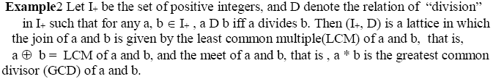

Slide 33
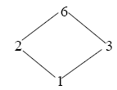

Slide 34
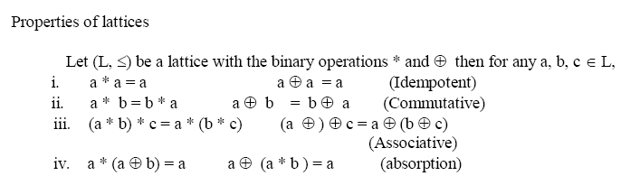

Slide 35
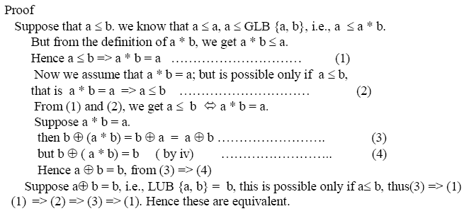


Slide 36
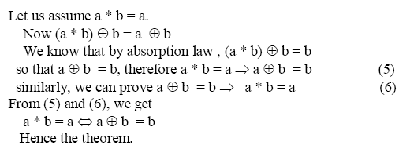

Slide 37



Slide 38
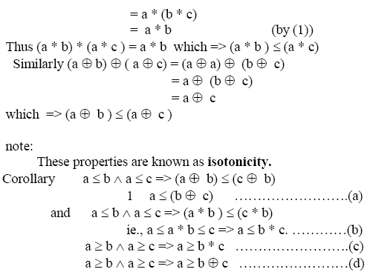

Slide 39
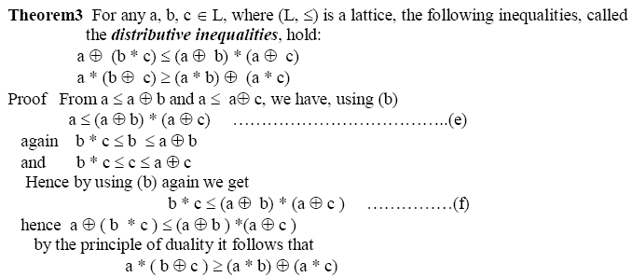

Slide 40
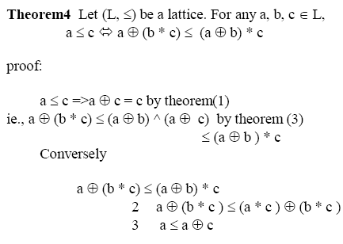



Slide 41

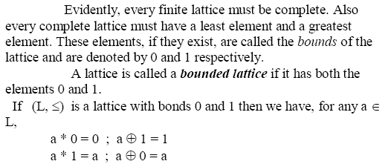

Slide 42
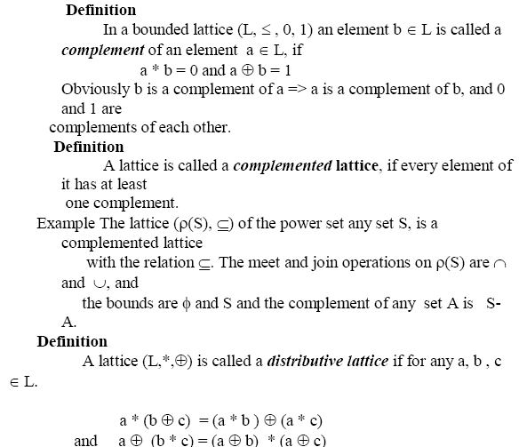

Slide 43
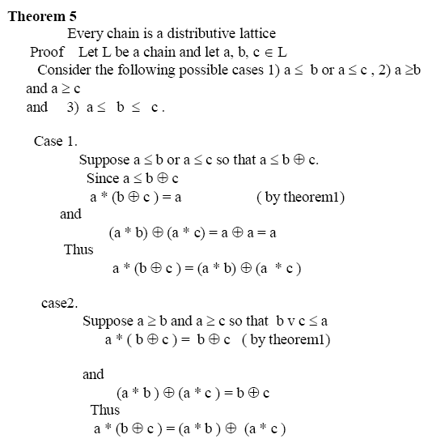

Slide 44
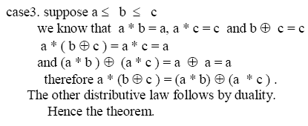
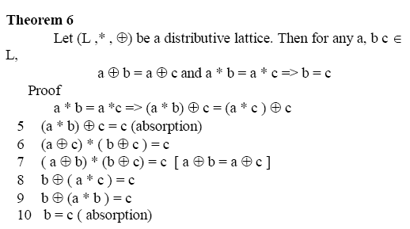

Slide 45
