Slide 1
Number Theory
Ref: Neal Koblitz: Introduction to Number Theory and Cryptography
Divisibility
Division Algorithm - Euclidean Algorithm
Congruence relation
Fermat's theorem
Euler-Phi function
Chinese Remainder Theorem
Wilson's theorem
Applications.

Slide 2
Divisors and Divisibility
Given integers a and b, we say that a divides b (or b is divisible by a) and write a|b if there exists an integer d such that b=ad.

Slide 3
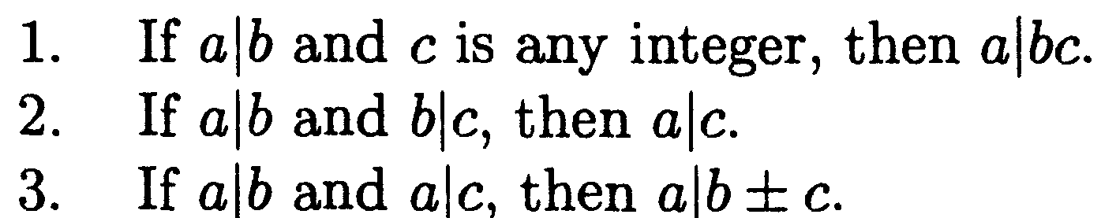
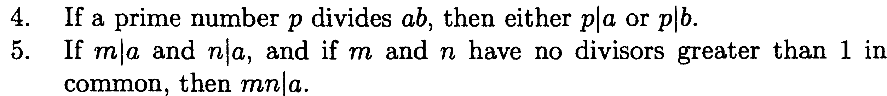

Slide 4
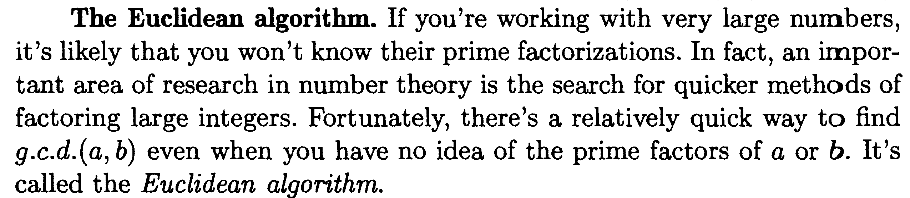

Slide 5

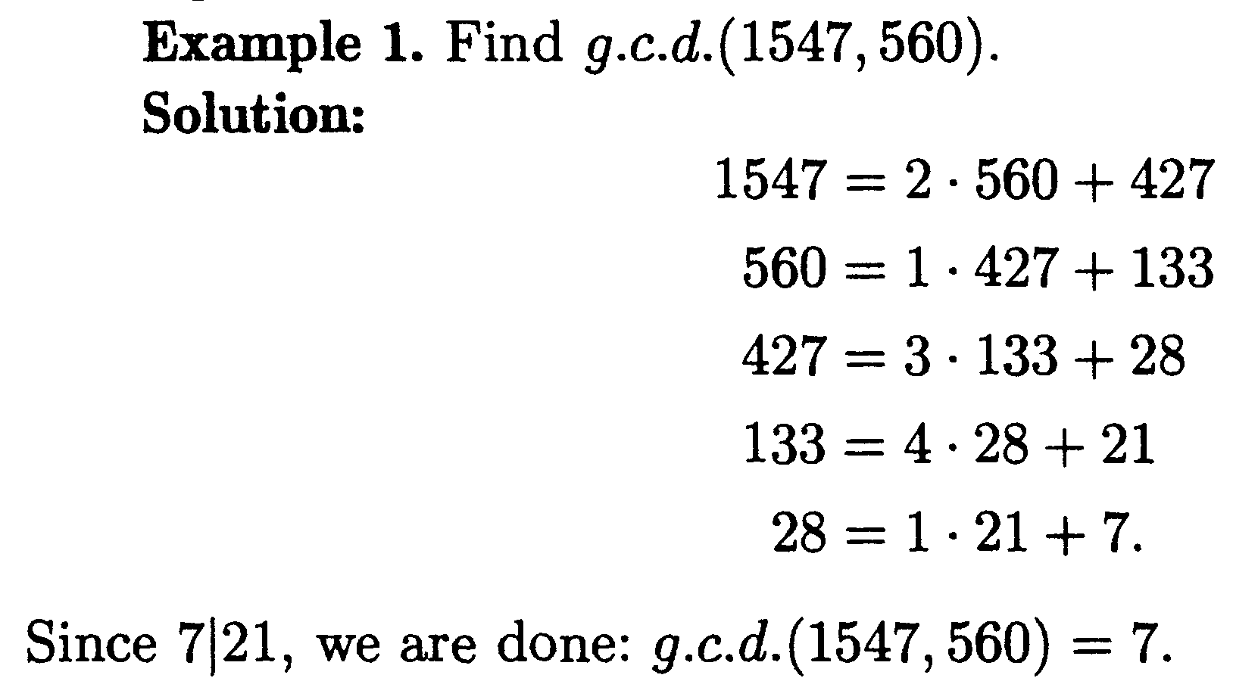

Slide 6
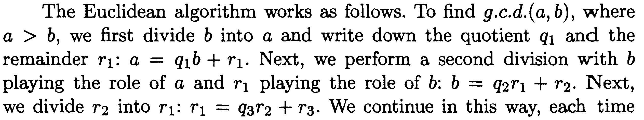
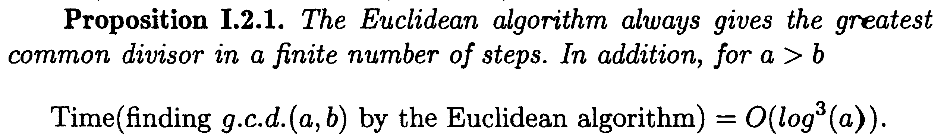

Slide 7
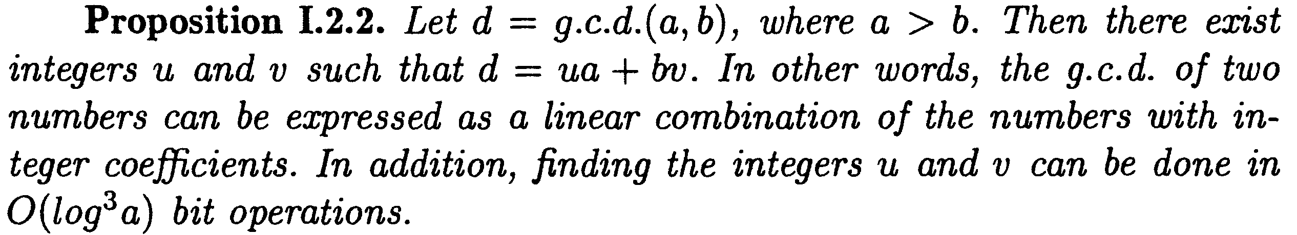
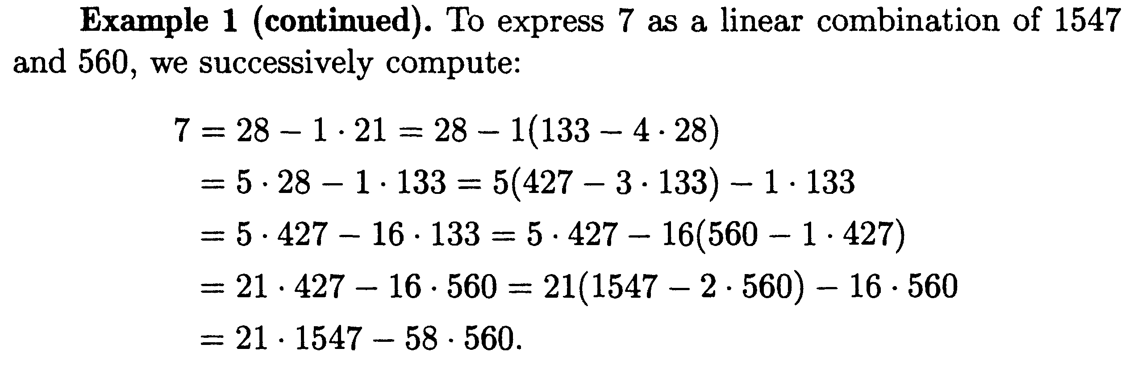
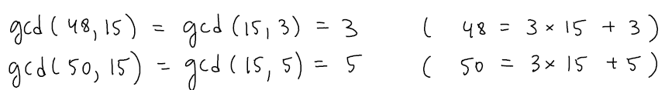
Bezout’s Identity

Slide 8
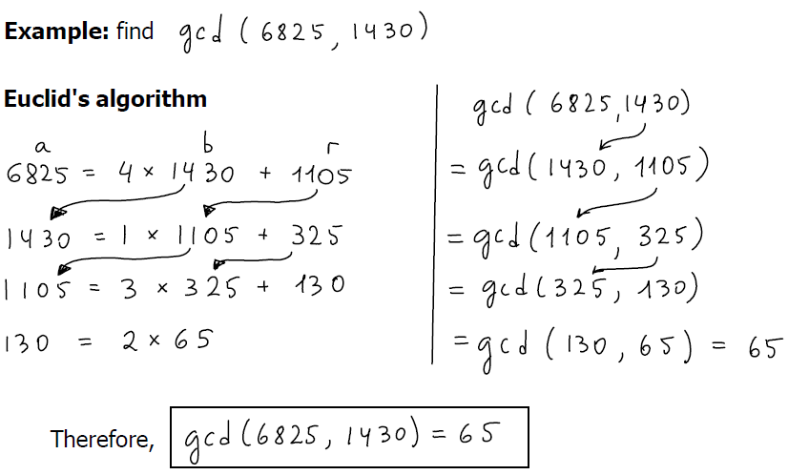

Slide 9
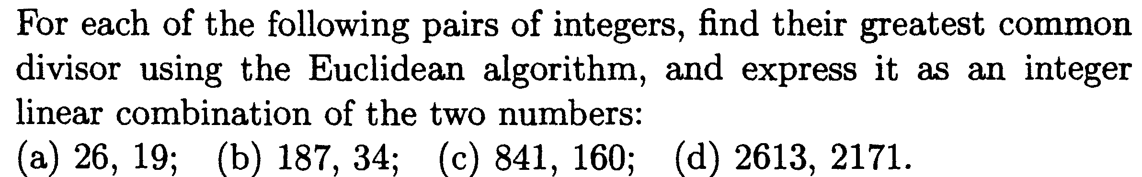

Slide 10

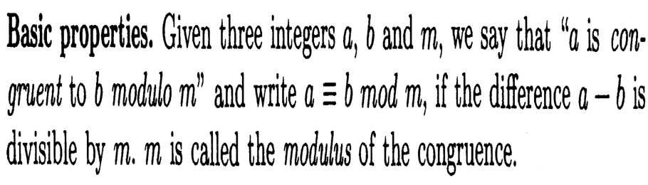

Slide 11
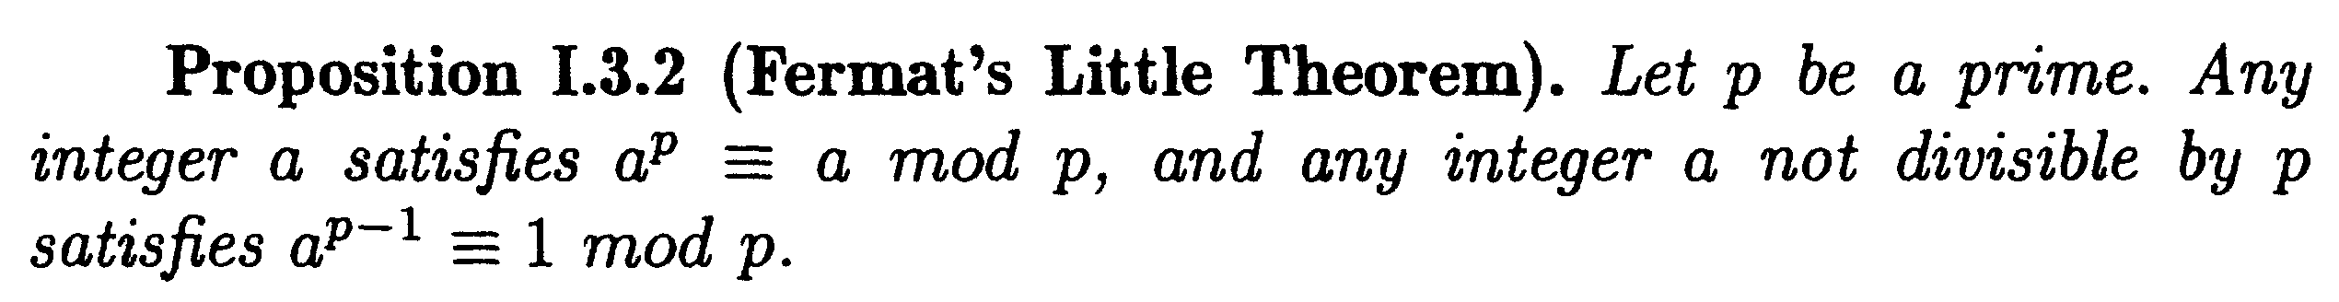


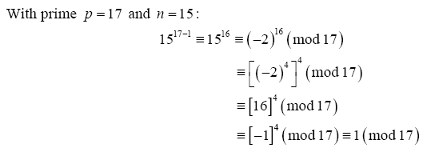

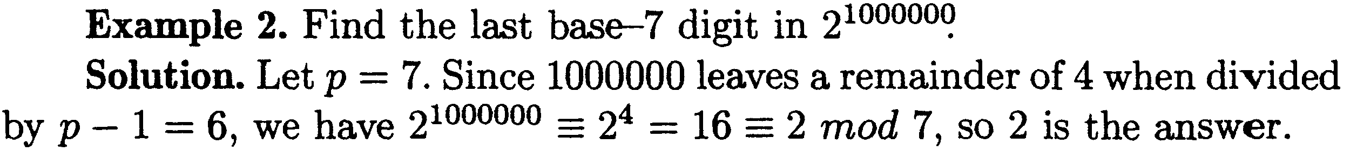

Slide 12
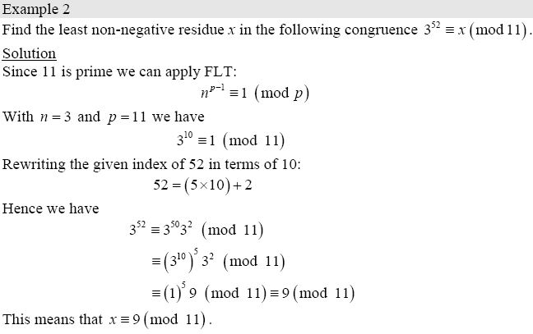

Slide 13
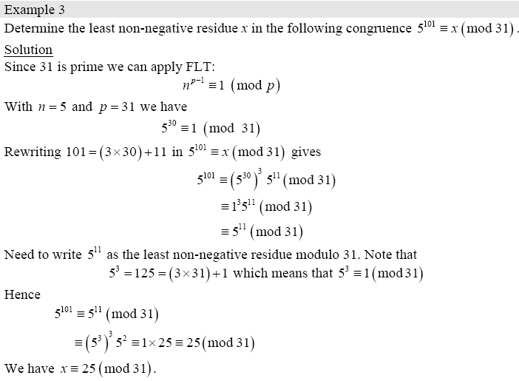

Slide 14
Prove that there is no perfect square a² which is congruent to 2 mod 4.
The remainders of a number a are 0,1,2 and 3. In the first case a² congruent to 0.
In the second case a² congruent to 1.
In the third case a² congruent to 0.
In the fourth case a² congruent to 1.

Slide 15
Prove that there is no perfect square a² whose last digit is 2.
each integer number is congruent to 0, 1, 2, . . . , 8 or 9 mod 10.
If a 0 mod 10, then a² 0 mod 10.
If a 1 mod 10, then a² 1 mod 10.
If a 2 mod 10, then a² 4 mod 10.
If a 3 mod 10, then a² 9 mod 10.
If a 4 mod 10, then a² 6 mod 10.
If a 5 mod 10, then a² 5 mod 10.
If a 6 mod 10, then a² 6 mod 10.
If a 7 mod 10, then a² 9 mod 10.
If a 8 mod 10, then a² 4 mod 10.
If a 9 mod 10, then a² 1 mod 10.
Therefore a² ≠ 2 mod 10, and the result follows.

Slide 16

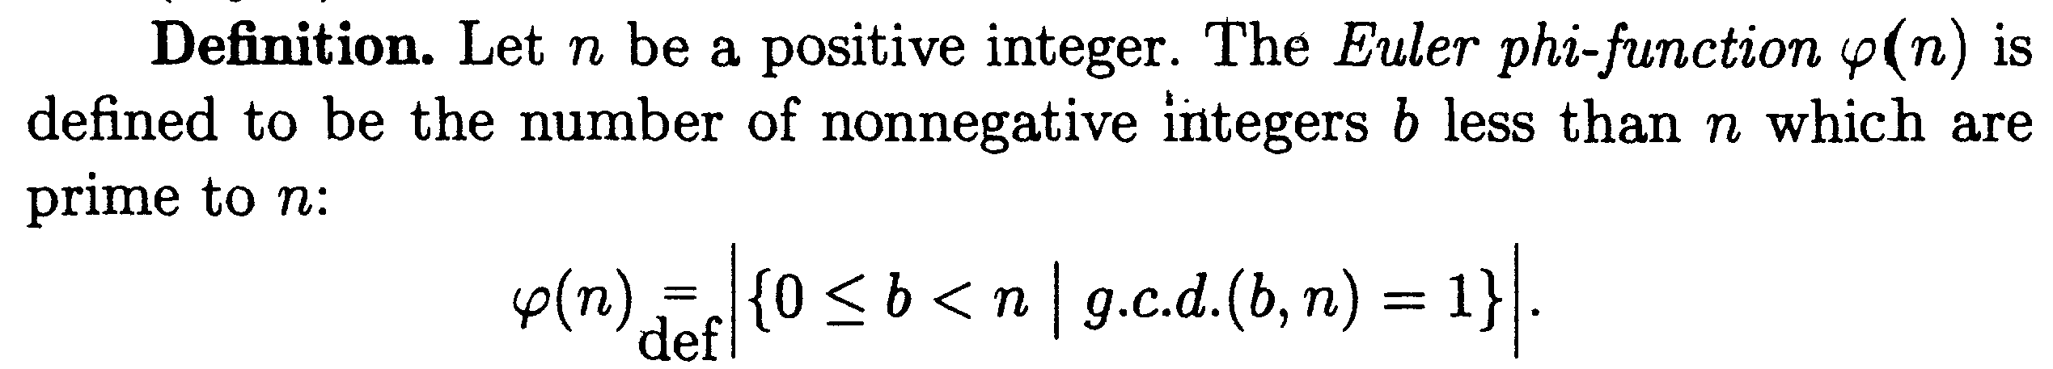
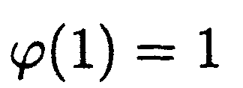
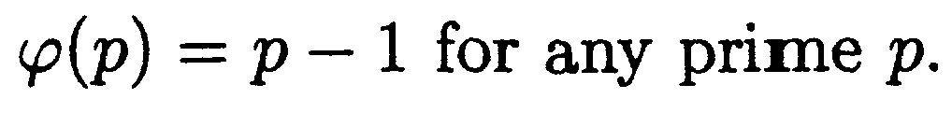

Slide 17
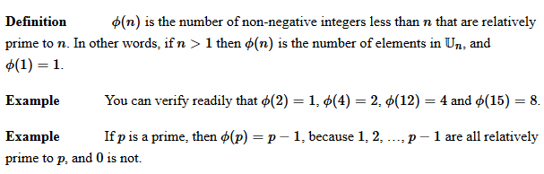

Slide 18
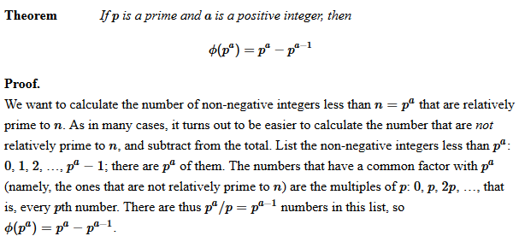

Slide 19



Slide 20
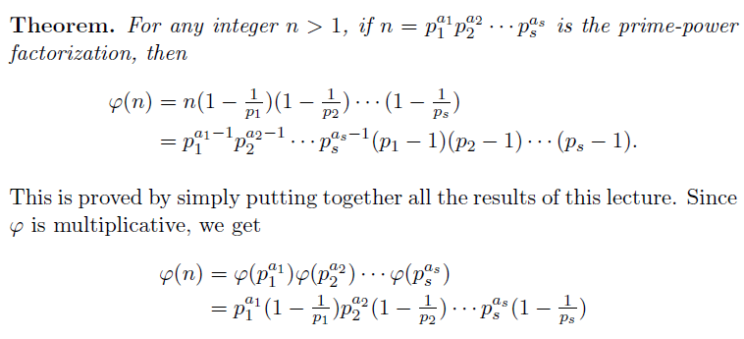


Slide 21
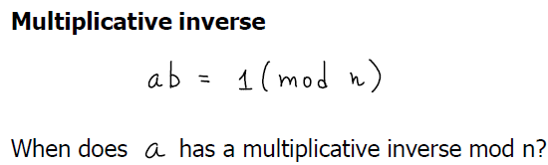
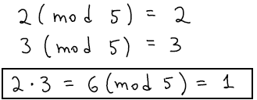
Multiplicative Moduli Inverse

Slide 22
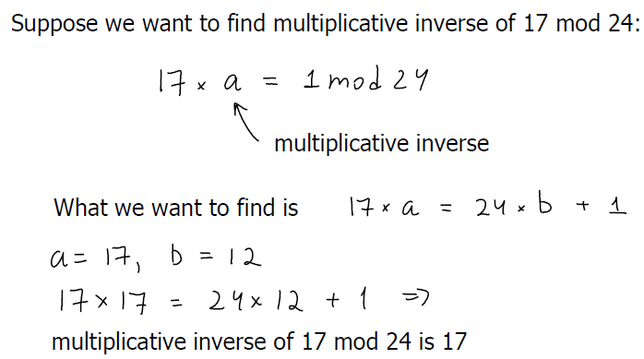

Slide 23
Examples contd…
Suppose we wish to find modular multiplicative inverse x of 3 modulo 11.
This is the same as finding x such that

Slide 24
Suppose we are to find modular multiplicative inverse x of 35 modulo 3.
This is the same as finding x such that
35 x = 1 (mod 3)
Inverse of 35 modulo 3 is 2.
35 – 11*3 = 2 ➔ 3 – 2 = 1
1 = 3 – 2 = 3 – (35 – 11*3) = 12*3 – 1*35
So the inverse of 35 is –1 and its modulo 3 is 2
Inverse of 21 modulo 5
1*21 – 4*5 = 1
So the inverse of 21 modulo 5 is 1.
Inverse of 15 modulo 7
1*15 – 2*7 = 1
So the inverse of 15 modulo 7 is 1.

Slide 25
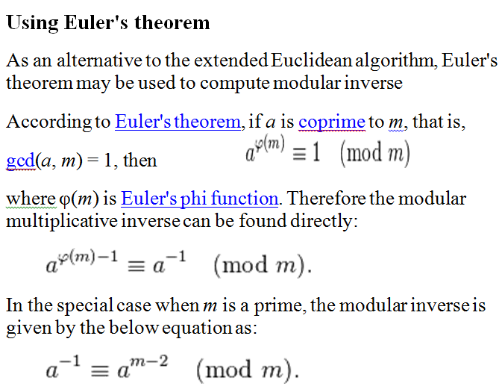

Slide 26
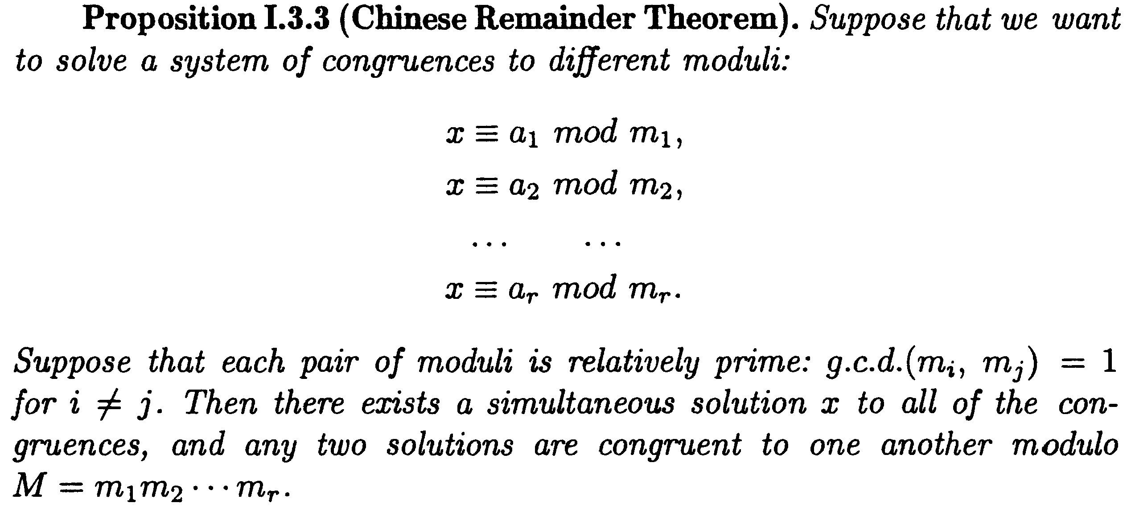

Slide 27
CHINESE REMAINDER THEOREM
The Chinese remainder theorem (CRT) is used to solve a set of congruent equations with one variable but different moduli, which are relatively prime, as shown
below:

Slide 28
CRT
Example
The following is an example of a set of equations with different moduli:
The solution to this set of equations is given in the next section; for the moment, note that the answer to this set of equations is x = 23. This value satisfies all equations: 23 ≡ 2 (mod 3), 23 ≡ 3 (mod 5), and 23 ≡ 2 (mod 7).

Slide 29
CRT
Solution To Chinese Remainder Theorem
1. Find M = m₁ × m₂ × … × m_{k}. This is the common modulus.
2. Find M₁ = M/m₁, M₂ = M/m₂, …, M_{k} = M/m_{k}.
3. Find the multiplicative inverse of M₁, M₂, …, M_{k} using the corresponding moduli (m₁, m₂, …, m_{k}). Call the inverses M₁⁻¹, M₂⁻¹, …, M_{k} ⁻¹.
4. The solution to the simultaneous equations is

Slide 30
CRT
Example
Find the solution to the simultaneous equations:
Solution We follow the four steps.
1. M = 3 × 5 × 7 = 105
2. M₁ = 105 / 3 = 35, M₂ = 105 / 5 = 21, M₃ = 105 / 7 = 15
3. The inverses are M₁⁻¹ = 2, M₂⁻¹ = 1, M₃ ⁻¹ = 1
4. x = (2 × 35 × 2 + 3 × 21 × 1 + 2 × 15 × 1) mod 105 = 23 mod 105

Slide 31
Inverse x of 19 modulo 43
43 - 2*19 = 5 19 - 3*5 = 4 5 - 4 = 1 5 - (19 - 3*5) = 1 4*5 - 19 = 1 4*(43 - 2*19) - 19 = 1 4*43 - 9*19 = 1 so the inverse of 19 is – 9 = 43 – 9 = 34.

Slide 32
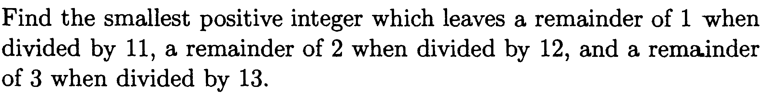

Slide 33
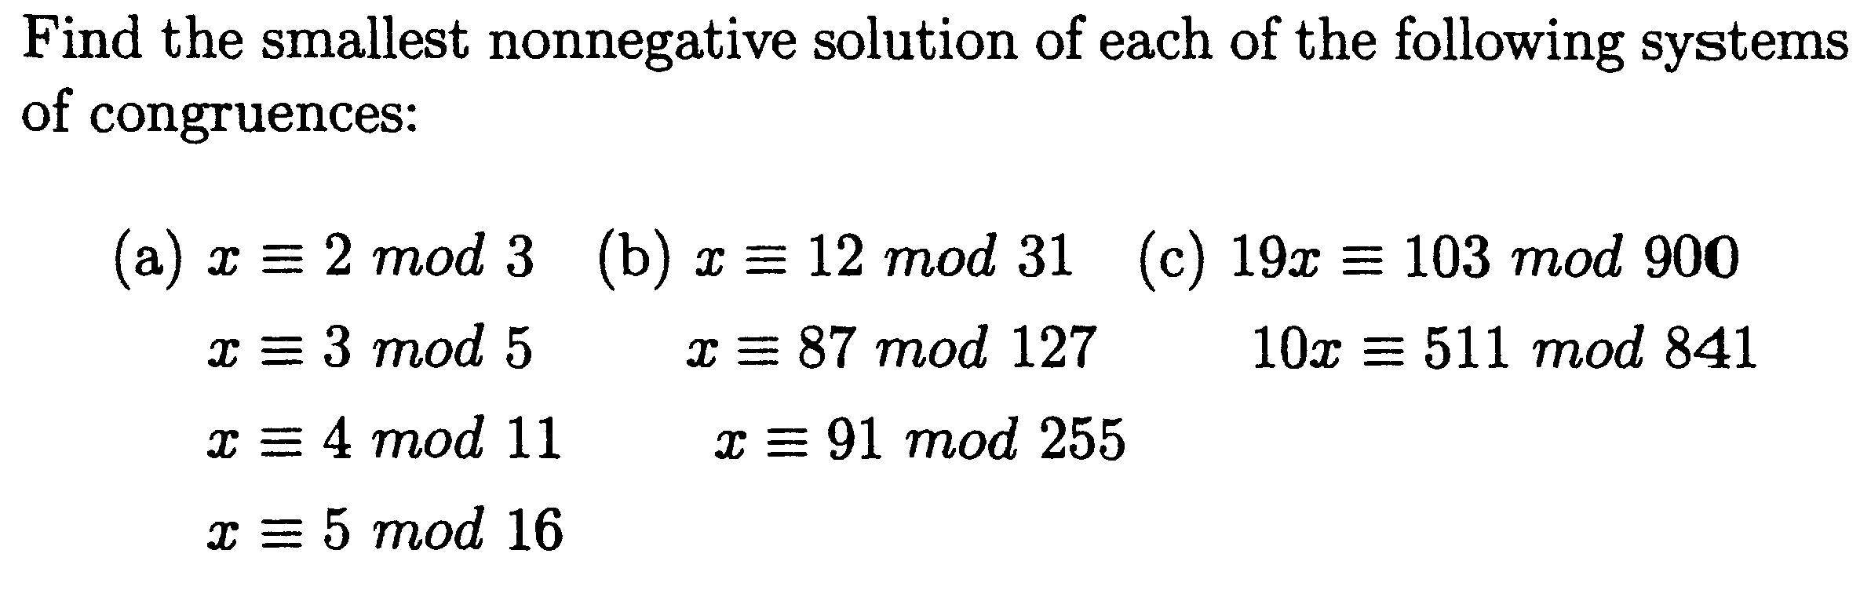

Slide 34
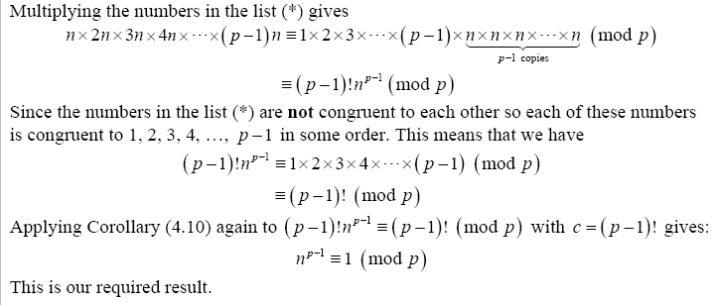

Slide 37
Prove that there is no perfect square a² which is congruent to 2 mod 4.
The remainders of a number a are 0,1,2 and 3. In the first case a² congruent to 0.
In the second case a² congruent to 1.
In the third case a² congruent to 0.
In the fourth case a² congruent to 1.

Slide 38
Prove that there is no perfect square a² whose last digit is 2.
each integer number is congruent to 0, 1, 2, . . . , 8 or 9 mod 10.
If a 0 mod 10, then a² 0 mod 10.
If a 1 mod 10, then a² 1 mod 10.
If a 2 mod 10, then a² 4 mod 10.
If a 3 mod 10, then a² 9 mod 10.
If a 4 mod 10, then a² 6 mod 10.
If a 5 mod 10, then a² 5 mod 10.
If a 6 mod 10, then a² 6 mod 10.
If a 7 mod 10, then a² 9 mod 10.
If a 8 mod 10, then a² 4 mod 10.
If a 9 mod 10, then a² 1 mod 10.
Therefore a² ≠ 2 mod 10, and the result follows.

Slide 39
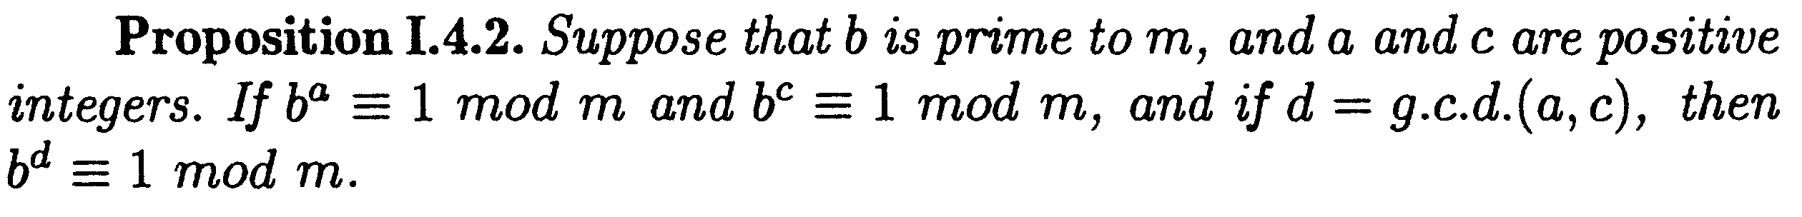

Slide 40
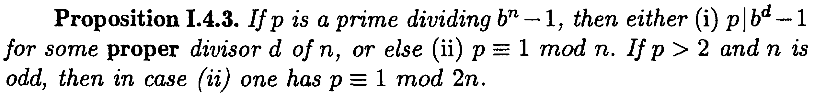


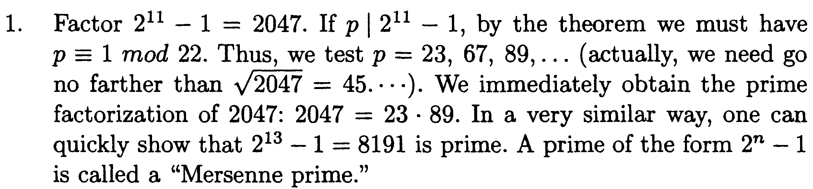

Slide 41
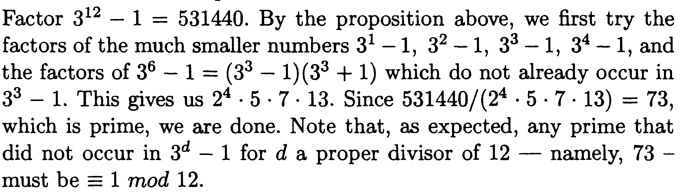

Slide 42
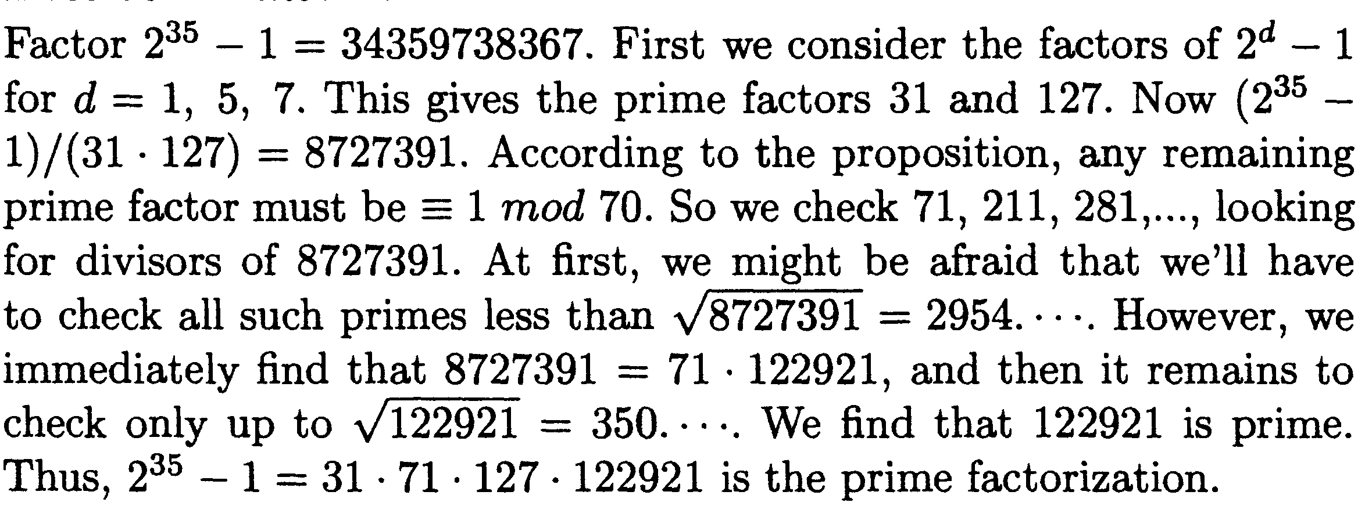

Slide 43
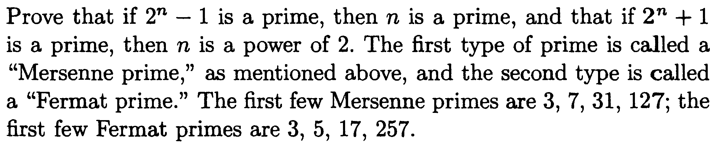


Slide 44
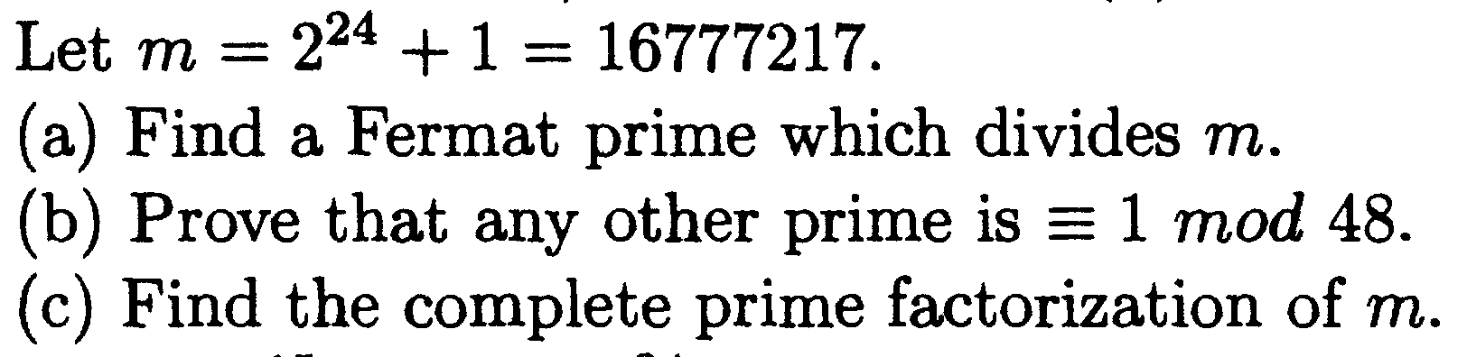

Slide 45
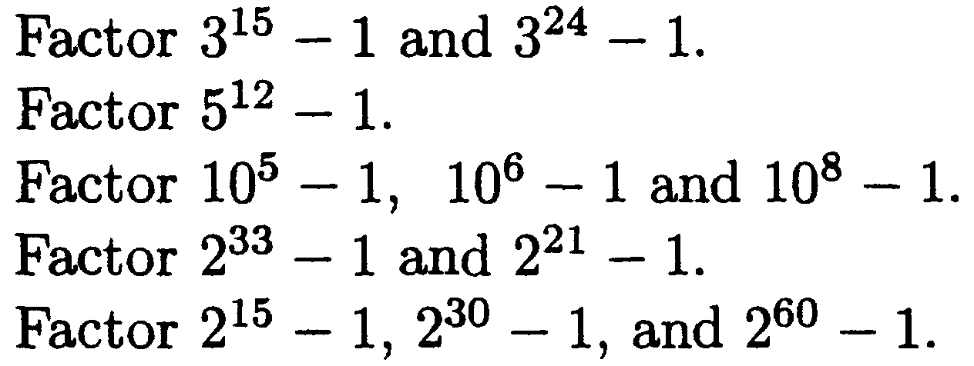

Slide 46
