Slide 1
Graphs
S.Dhanasekar
Department of Mathematics
VIT University

Slide 2
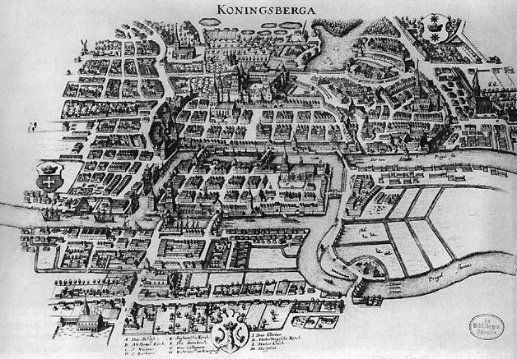

Slide 3
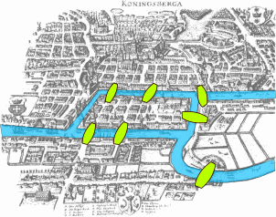

Slide 4
Königsberg bridge problem
The Königsberg bridge problem asks if the seven bridges of the city of Königsberg formerly in Germany but now known as Kaliningrad and part of western Russia, over the river Preger can all be traversed in a single trip without doubling back, with the additional requirement that the trip ends in the same place it began. `

Slide 5
Königsberg bridge problem
In 1735, Euler presented the solution to the problem before the Russian Academy. He explained why crossing all seven bridges without crossing a bridge twice was impossible. While solving this problem, he developed a new mathematics field called graph theory, which later served as the basis for another mathematical field called topology.

Slide 6
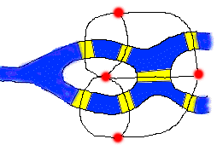
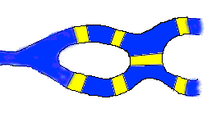
Modelling of Konisberg Problem
.

Slide 7
The Travelling Salesman Problem
A traveling salesman is to visit a number of cities; how to plan the trip so every city is visited once and just once and the whole trip is as short as possible ?

Slide 8
Four Colour Conjecture
In 1852 Francis Guthrie posed the “four color problem” which asks if it is possible to color, using only four colors, any map of countries in such a way as to prevent two bordering countries from having the same color.
This problem, which was only solved a century later in 1976 by Kenneth Appel and Wolfgang Haken, can be considered the birth of graph theory.

Slide 9
Definition
A graph G = (V ,E) consists of V , a nonempty set of vertices (or nodes) and E, a set of edges. Each edge has either one or two vertices associated with it, called its endpoints.
An edge is said to connect its endpoints.

Slide 10
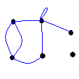
Definition
A graph G = (V, E) consists of V, a nonempty set of vertices, and E, a set of unordered pairs of distinct elements of V called edges.
For each e∈E, e = {u, v} where u, v ∈ V.
. An edge e is a loop if e = {u, u} for some u∈V.

Slide 11
Examples
How can we represent a network of (bi-directional) railways connecting a set of cities?
We should use a graph with an edge {a, b} indicating a direct train connection between cities a and b.

Slide 12
Bombay
Calcutta
Banglore
Delhi
Chennai
Punjab

Slide 13
Simple Graph
A graph in which each edge connects two different vertices and where no two edges connect the same pair of vertices is called a simple graph.

Slide 14
Multigraphs
Graphs that may have multiple edges connecting the same vertices are called multigraphs.When there are m different edges associated to the same unordered pair of vertices {u, v}, we also say that {u, v} is an edge of multiplicity m.
A graph with parallel edges and self loops is called Multigraph.

Slide 15
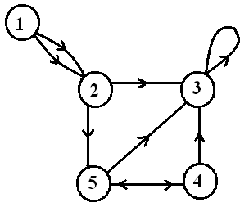
Directed graph
A directed graph (or digraph) (V ,E) consists of a nonempty set of vertices V and a set of directed edges (or arcs) E. Each directed edge is associated with an ordered pair of vertices.
The directed edge associated with the ordered pair (u, v) is said to start at u and end at v.

Slide 16
Basic definitions
Definition: Two vertices u and v in a graph G are called adjacent (or neighbors) in G if {u, v} is an edge in G.
If e = {u, v}, the edge e is called incident with the vertices u and v. The edge e is also said to connect u and v.
The vertices u and v are called endpoints of the edge {u, v}.

Slide 17
Basic definitions
Definition: The degree of a vertex in an undirected graph is the number of edges incident with it, except that a loop at a vertex contributes twice to the degree of that vertex.
In other words, you can determine the degree of a vertex in a displayed graph by counting the lines that touch it.
The degree of the vertex v is denoted by deg(v).

Slide 18
Basic definitions
A vertex of degree 0 is called isolated, since it is not adjacent to any vertex.
Note: A vertex with a loop at it has at least degree 2 and, by definition, is not isolated, even if it is not adjacent to any other vertex.
A vertex of degree 1 is called pendant. It is adjacent to exactly one other vertex.

Slide 19
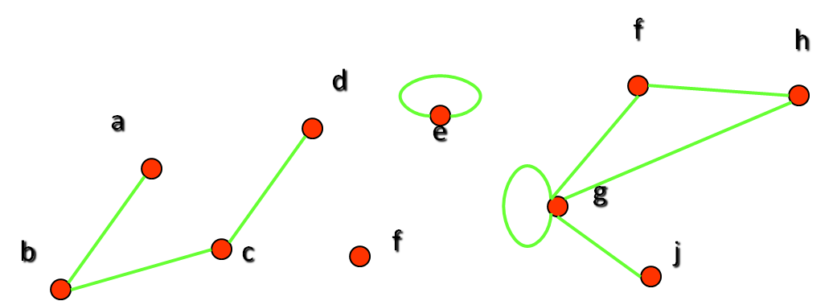
Examples
Which vertices in the following graph are isolated, which are pendant, and what is the maximum degree? What type of graph is it?

Slide 20
Examples
Let us look at the same graph again and determine the number of its edges and the sum of the degrees of all its vertices:
Result: There are 9 edges, and the sum of all degrees is 18. This is easy to explain: Each new edge increases the sum of degrees by exactly two.

Slide 21
Theorems
The Handshaking Theorem: Let G = (V, E) be an undirected graph with e edges. Then
2e = ∑_{v∈V} deg(v)
Example: How many edges are there in a graph with 10 vertices, each of degree 6?
Solution: The sum of the degrees of the vertices is 6⋅10 = 60. According to the Handshaking Theorem, it follows that 2e = 60, so there are 30 edges.

Slide 22
Theorems
Theorem: An undirected graph has an even number of vertices of odd degree.
Proof: Let V1 and V2 be the set of vertices of even and odd degrees, respectively (Thus V1 ∩ V2 = ∅, and V1 ∪V2 = V).
Then by Handshaking theorem
2|E| = ∑_{v∈V} deg(v) = ∑_{v∈V1} deg(v) + ∑_{v∈V2} deg(v)
Since both 2|E| and ∑_{v∈V1} deg(v) are even,
∑_{v∈V2} deg(v) must be even.
Since deg(v) if odd for all v∈V2, |V2| must be even.

Slide 23
Definition
Definition: In a graph with directed edges, the in-degree of a vertex v, denoted by deg⁻(v), is the number of edges with v as their terminal vertex.
The out-degree of v, denoted by deg⁺(v), is the number of edges with v as their initial vertex.
Question: How does adding a loop to a vertex change the in-degree and out-degree of that vertex?
Answer: It increases both the in-degree and the out-degree by one.

Slide 24
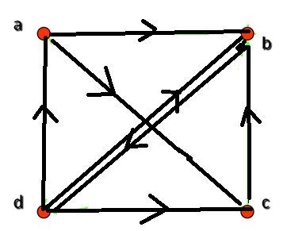
Examples
What are the in-degrees and out-degrees of the vertices a, b, c, d in this graph:
deg⁻(b) = 4
deg⁺(b) = 2
deg⁻(a) = 1
deg⁺(a) = 2

Slide 25
Theorem
Theorem: Let G = (V, E) be a graph with directed edges. Then:
∑_{v∈V} deg⁻(v) = ∑_{v∈V} deg⁺(v) = |E|
This is easy to see, because every new edge increases both the sum of in-degrees and the sum of out-degrees by one.

Slide 26
Example
∑_{v∈V} deg⁻(v)= 7
∑_{v∈V} deg⁺(v)= 7
The number of edges is 7
Hence theorem holds.

Slide 27
Definition
A subgraph of a graph G = (V, E) is a graph H = (W, F) where W⊆V and F⊆E.
Note: Of course, H is a valid graph, so we cannot remove any endpoints of remaining edges when creating H.

Slide 28
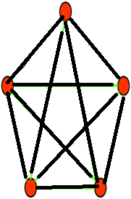
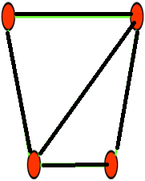
Example

Slide 29
Types of Subgraphs
Sub graph
Induced subgraph
Spanning subgraph
Components of a graph

Slide 30
a
c
c
b
c
b
induced subgraph
d
subgraph
e
a
a
c
b
b
e
d
e
d
spanning subgraph

Slide 31
Properties of Subgraph
Every graph is its own subgraph
A subgraph of H is a subgraph of G
A single vertex in a graph G is a subgraph of G
A single edge in G, together with its end verticies is a subgraph of G

Slide 32
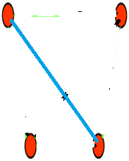
Definition
Complement of a graph: A graph G’is said to be complement of a graph G if for every pair of vertices u,v is adjacent in G’, whenever it’s not adjacent in G.

Slide 33
Matrix representation of graph
Definition: Let G = (V, E) be a simple graph with |V| = n. Suppose that the vertices of G are listed in arbitrary order as v₁, v₂, …, v_{n}.The adjacency matrix A (or A_{G}) of G, with respect to this listing of the vertices, is the n×n zero-one matrix with 1 as its (i, j)th entry when v_{i} and v_{j} are adjacent, and 0 otherwise.
In other words, for an adjacency matrix A = [a_{ij}],
a_{ij} = 1 if {v_{i}, v_{j}} is an edge of G, a_{ij} = 0 otherwise

Slide 34
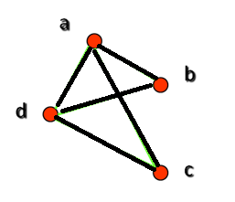
Example
What is the adjacency matrix A_{G} for the following graph G based on the order of vertices a, b, c, d ?
Note: Adjacency matrices of undirected graphs are always symmetric

Slide 35
Matrix representation of graph
Definition: Let G = (V, E) be an undirected graph with |V| = n. Suppose that the vertices and edges of G are listed in arbitrary order as v₁, v₂, …, v_{n} and e₁, e₂, …, e_{m}, respectively. The incidence matrix of G with respect to this listing of the vertices and edges is the n×m zero-one matrix with 1 as its (i, j)th entry when edge e_{j} is incident with v_{i}, and 0 otherwise.
In other words, for an incidence matrix M = [m_{ij}],
m_{ij} = 1 if edge e_{j} is incident with v_{i} m_{ij} = 0 otherwise.

Slide 36
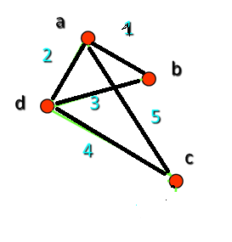
Example
What is the incidence matrix M for the following graph G based on the order of vertices a, b, c, d and edges 1, 2, 3, 4, 5, 6?
Note: Incidence matrices of directed graphs contain two 1s per column for edges connecting two vertices and one 1 per column for loops

Slide 37
Isomorphism of Graphs
Definition: The simple graphs G₁ = (V₁, E₁) and G₂ = (V₂, E₂) are isomorphic if there is a bijection (an one-to-one and onto function) f from V₁ to V₂ with the property that a and b are adjacent in G₁ if and only if f(a) and f(b) are adjacent in G₂, for all a and b in V₁.
Such a function f is called an isomorphism.
In other words, G₁ and G₂ are isomorphic if their vertices can be ordered in such a way that the adjacency matrices M_{G1} and M_{G2} are identical

Slide 38
Unfortunately, for two simple graphs, each with n vertices, there are n! possible isomorphisms that we have to check in order to show that these graphs are isomorphic.
From a visual standpoint, G₁ and G₂ are isomorphic if they can be arranged in such a way that their displays are identical (of course without changing adjacency).
However, showing that two graphs are not isomorphic can be easy.

Slide 39
For example, they must have
the same number of vertices,
the same number of edges, and
the same degrees of vertices.
For this purpose we can check invariants, that is, properties that two isomorphic simple graphs must both have.
Note that two graphs that differ in any of these invariants are not isomorphic, but two graphs that match in all of them are not necessarily isomorphic.

Slide 40
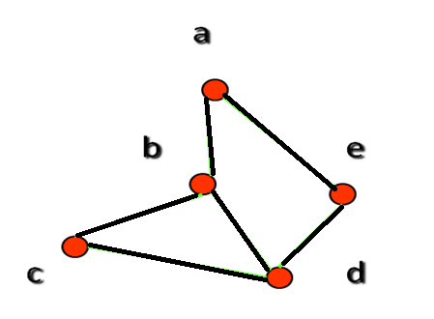
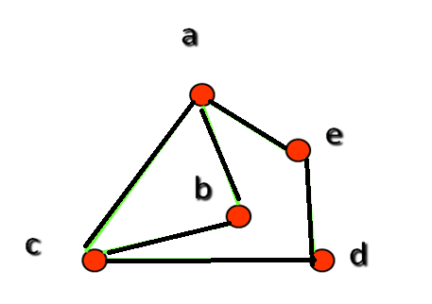
Example
: Are the following two graphs isomorphic?
Solution: Yes, they are isomorphic, because they can be arranged to look identical. You can see this if in the right graph you move vertex b to the left of the edge {a, c}. Then the isomorphism f from the left to the right graph is: f(a) = e, f(b) = a, f(c) = b, f(d) = c, f(e) = d.

Slide 41
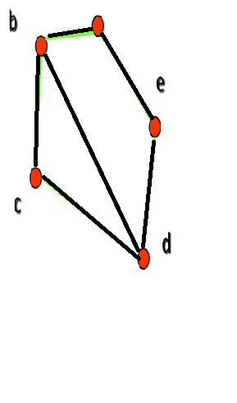
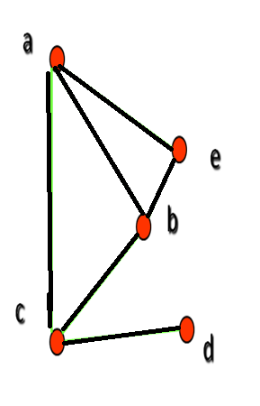
Example II: How about these two graphs?
Solution: No, they are not isomorphic, because they differ in the degrees of their vertices.
Vertex d in right graph is of degree one, but there is no such vertex in the left graph.

Slide 42
Theorem:1
Two graphs are isomorphic if and only if their vertices can be labeled in such a way that corresponding adjacency matrices are equal.

Slide 43
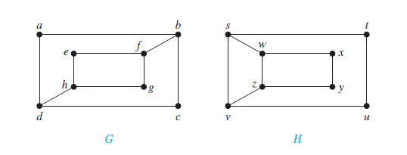
Determine whether the following graphs are isomorphic or not

Slide 44
The two graphs have same no of vertices and same no of edges. (8 vertices, 10 edges)
They also have 4 vertices of degree two, 4 vertices of degree 4.
Deg(a)=2 in G, must correspond to either one of t,u,x,or y in H.
But each of these four vertices in H is adjacent to another vertice of degree 2 which is not there in G.
Therefore they are not isomorphic.

Slide 45


Theorem:1
Two labeled graphs G and H are isomorphic with adjacency matrices A and B respectively if and only if there exists a permutation matrix P such that PA vertices can be labeled in such

Slide 46

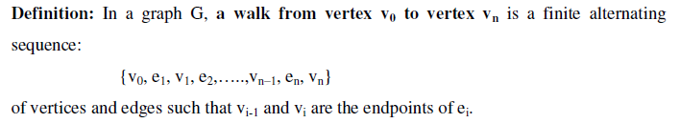

Slide 47
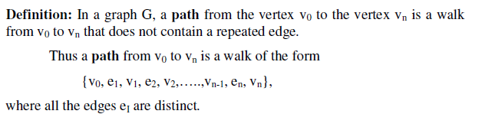
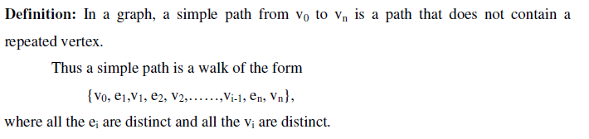

Slide 48
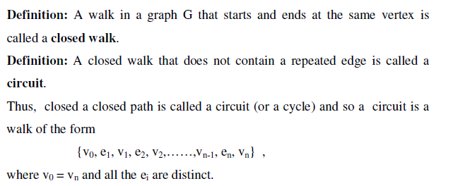

Slide 49
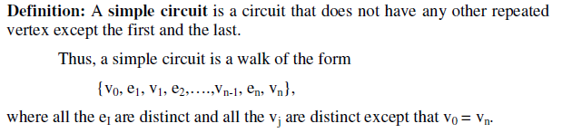

Slide 50
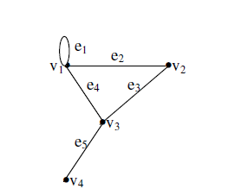
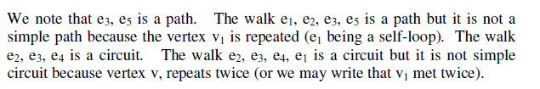
Example

Slide 51
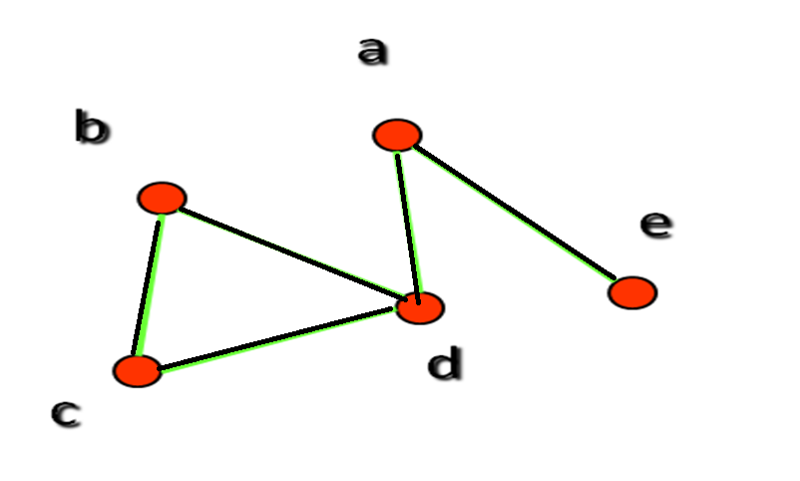
Connected Graphs
Any pair of vertices have path
Example:

Slide 52
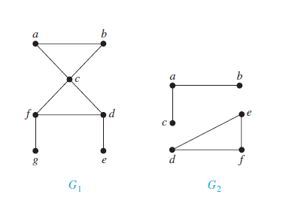
Not connected
connected

Slide 53
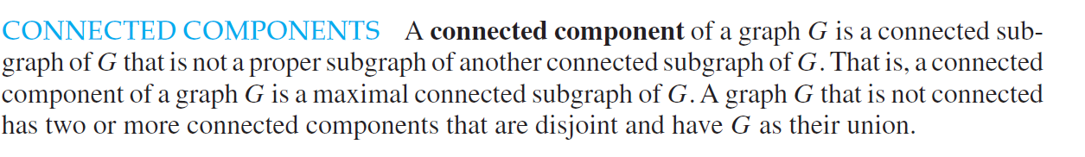

Slide 54
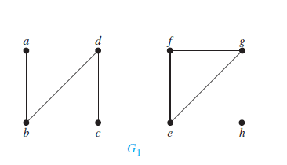
Cut vertices and Cut edges
Cut vertices:The removal of a vertex from a graph changes the connected graph into not connected.
Cut edges: The removal of an edge from a graph changes the connected graph into not connected
b,c,e are cut vertices ,(a,b) and (c,e) are cut edges

Slide 55
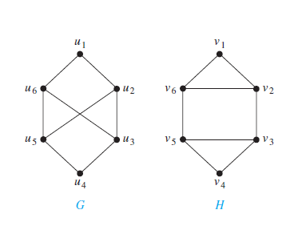
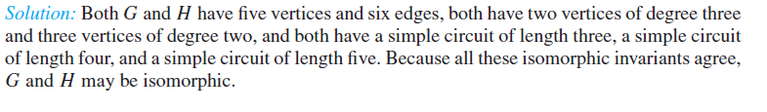
Determine the graphs G and H are Isomorphic

Slide 56
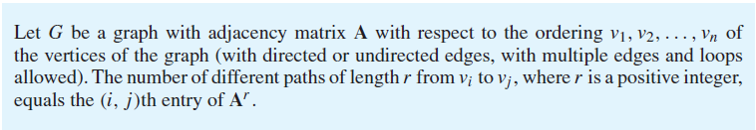
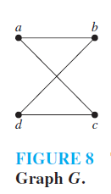
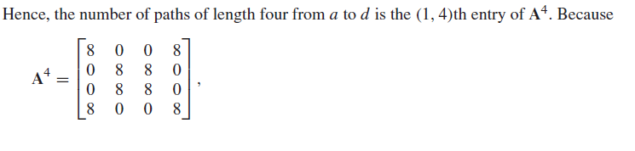

Slide 57
Euler Path and Circuit
A simple circuit contains all the edges is called Euler Circuit.
A simple path contains all the edged is called euler path.

Slide 58
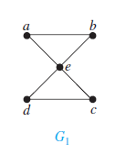
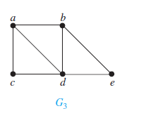

a,e,c,d,e,b,a. Eulur circuit
N0 Eulur circuit

Slide 59
Hamilton paths and circuits
A simple path which passes through all the vertices exactly once is called HAMILTON PATH
A simple circuit which passes through all the vertices exactly once is called Hamilton circuit.

Slide 60
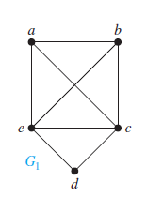
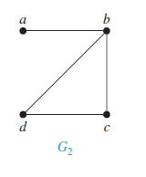
a,b,c,d,e,a, hamilton circuit
a,b,c,d. hamilton path

Slide 61
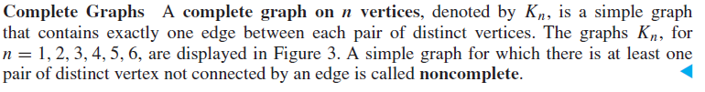
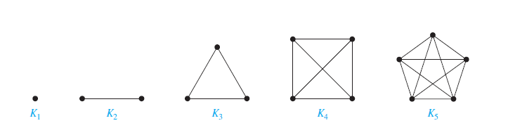

Slide 62
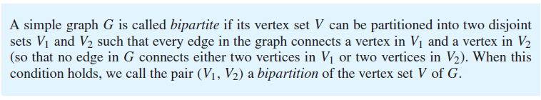

Slide 63
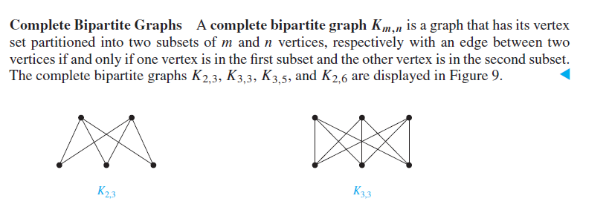

Slide 64
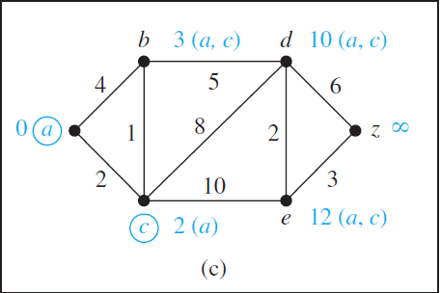
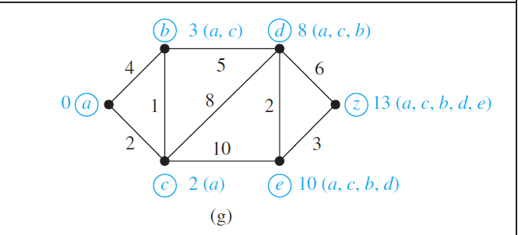
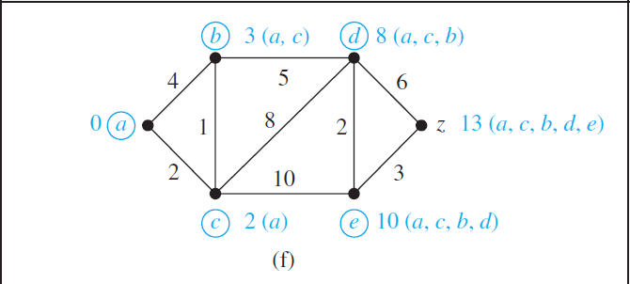
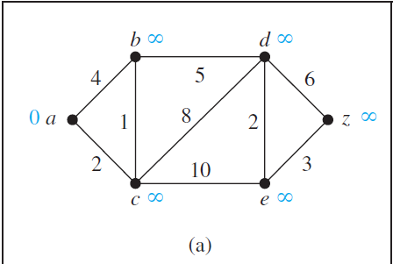
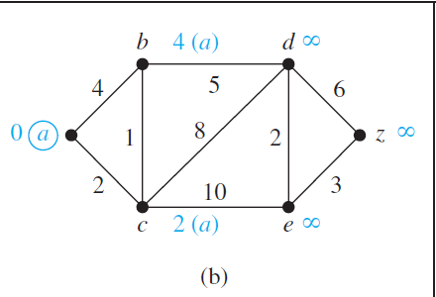
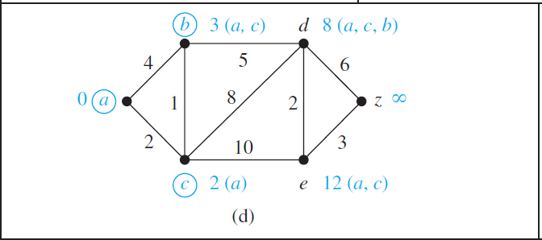
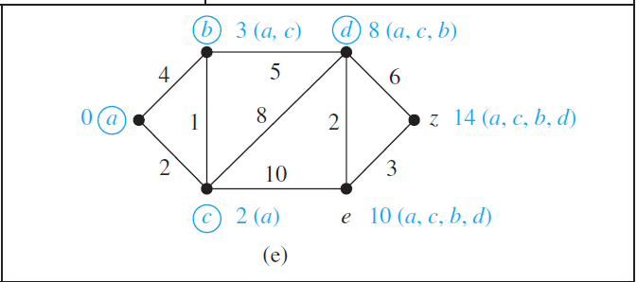
Shortest Path algorithm
Dijkstra’s Algorithm

Slide 65
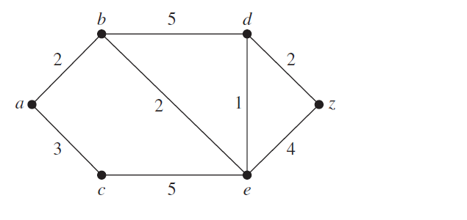
Shortest Path algorithm
Find theShortest path from a to z
Dijkstra’s Algorithm

Slide 66

Find the shortest path between a to z

Slide 67



Slide 68


Slide 69



Slide 70


Euler formula

Slide 71


Slide 72

Trees: Connected graph without cycles

Slide 73

Not trees

Slide 74

Rooted tree

Slide 75

Examples

Slide 76

Parent, Child,Siblings,Descendants

Slide 77


Example

Slide 78

Solution

Slide 79

M-ary Tree, Binary Tree

Slide 80

Examples
Binary tree, three -ary tree, 5-ary Tree

Slide 81
Ordered Rooted Tree
In a rooted tree all children are ordered.
First child is left child
Second child is right child

Slide 82

Example
f and g are left and right child of d respectively

Slide 83
Properties of Trees
A tree with n vertices have n-1 edges
A full m-ary tree with i internal vertices contains n=mi+1 vertices

Slide 84


Slide 85



Slide 86



Slide 87
Tree Traversal
Ordered rooted tree are used to store information
Procedures to visit each vertex to access the data
Used to represent the arithmetic expressions

Slide 88

Universal address system

Slide 89
Traversal Algorithms
Pre order traversal
In order traversal
Post order traversal

Slide 90

Preorder traversal

Slide 91

Preorder traversal

Slide 92

Preorder
NLR
ab,e,j,k,n,o,p,f,c,d,g,l.m.h,i

Slide 93

Post order

Slide 94

Post order
LRN
J,n,o,p,k.e,f,b,c,l.m.g.h,i,d,a

Slide 95

Inorder

Slide 96

Inorder
LNR
J,e,n,k,o.p,b,f,a,c,l,g,m,d,h,i

Slide 97

Infix, Postfix and Prefix Notations
Write the prefix form, postfix form of
+

Slide 98

Prefix, infix,postfix

Slide 99


Slide 100


Slide 101
Spanning Tree
A subgraph of G that is a tree which contains all the vertices
A simple graph is connected if and only if it has a spanning tree

Slide 102

Find the spanning trees for the graph

Slide 103


Slide 104

Minimum Spanning Tree

Slide 105
Algorithms
Kruskal’s Algorithm (edge based)
Prim’s Algorithm (vertex based)

Slide 106
Prim’s Algorithm (example)
V₂
3
V₃
V₁
V₂
V₃
1
2
Algorithm starts
V₆
3
V₁
3
V₂
1
1
4
1
1
4
V₁
3
V₄
V₅
V₁
After the 1st iteration
After the 2nd iteration
V₃
V₃
V₂
3
V₂
3
V₂
3
V₃
1
1
1
2
3
1
1
1
V₁
V₁
V₁
1
V₆
1
V₅
V₄
V₅
V₄
V₅
After the 3rd iteration
After the 4th iteration
After the 5th iteration

Slide 107
Kruskal’s Algorithm (example)
V₂
3
V₃
V₂
V₃
1
V₂
2
1
1
3
1
V₆
V₁
After the 1st iteration
V₁
V₁
1
4
1
4
V₄
V₄
V₅
V₂
V₃
1
1
V₅
V₁
1
After the 2nd iteration
After the 3rd iteration
V₅
V₂
V₃
V₂
3
V₃
1
2
1
2
1
1
V₁
V₁
V₆
V₆
1
1
V₄
V₅
V₄
V₅
After the 4th iteration
After the 5th iteration

Slide 108

Find the minimum spanning tree

Slide 109


Slide 110

Find the minimum spanning tree

