Slide 1
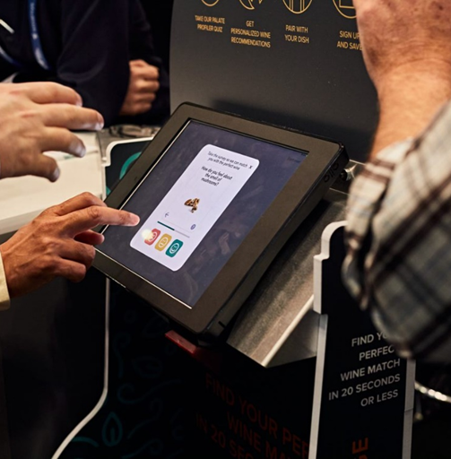
Digital Experience Report
Elevating Your Digital Experience Level

Slide 2

Introduction
COVID-19 has pushed companies over the technology tipping point - and transformed the way businesses interact with customers forever… Is your Digital landscape ready to take on the next-gen digital challenges?
In a short period, the COVID-19 pandemic has brought about years of change in the way companies across sectors and regions do business and connect to their customers. Most companies have leap-frogged the digitization of IT systems by three to four years and found new partners to simplify operations.
Our Digital Experience report captures key opportunities across your IT landscape that can help elevate your customer’s Digital Experience to what you stand for touching lives positively and relentlessly on innovation.

Slide 3








Digital Assurance Dimensions
Our report captures a Digital Organization's key facets that ensure all Needs of a Connected Consumer are fulfilled.
Multi-device and Multi-platform support : Provide seamless user experience across channels
Social Media Customer Feedback: Synthesize end user feedback for proactive mitigation
Content Quality: UST's digital assurance platform can help implement plug and play content validation capabilities to ensure globalization and localization
Performance of Applications: Our report simulates end user application performance across mobile and web environments from global user base
Accessible UX for Differently-abled: Ensures inclusivity of your digital assets to cater to everyone
Data Privacy and Regulatory Compliance: Automated compliance validations to comply with data privacy and regulations for digital success
Application Security: Early static security vulnerability assessments embeds confidence

Slide 4

What customers think of your digital assets ?
Our report covers multiple facets of your digital landscape and end-user interaction channels to identify and provide recommendations across asset hotspots. We ran accessibility and performance tests on your webpage to understand customer experiences. Customer feedback from social media was leveraged to analyse end user response and sentiments to the services offered to them.

Slide 5
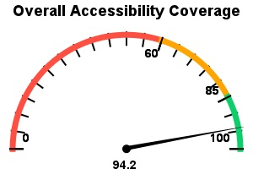
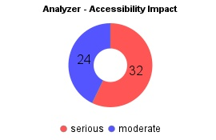
How inclusive are your digital assets to your consumer
Analyzed Page URL:
https://www.mclaren.com/
Reviewed On:
2024-07-31T12:00:00.000+05:30
Total Pages Accessed:
1
Analyzed Page URL:
https://www.ust.com/
Reviewed On:
2024-08-01T12:00:00.000+05:30
Total Pages Accessed:
0
Reviewed On:
2024-08-02T12:00:00.000+05:30
Total Pages Accessed:
2
Reviewed On:
2024-08-01T00:00:00.000+05:30
Total Pages Accessed:
0

Slide 6
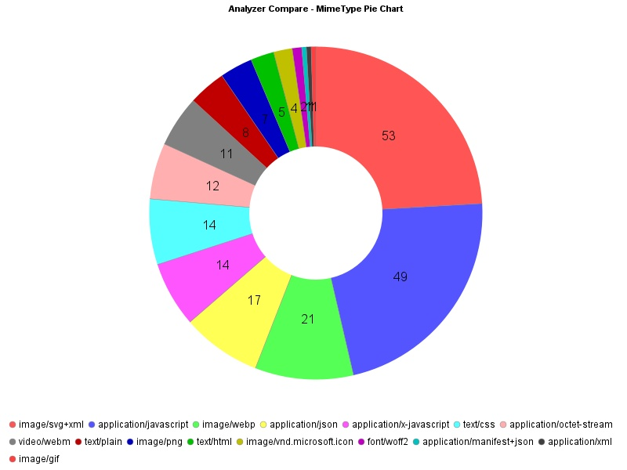
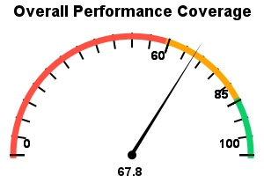
High Performance Assets: Are your end-users getting the performance and user experience they deserve?

Slide 7
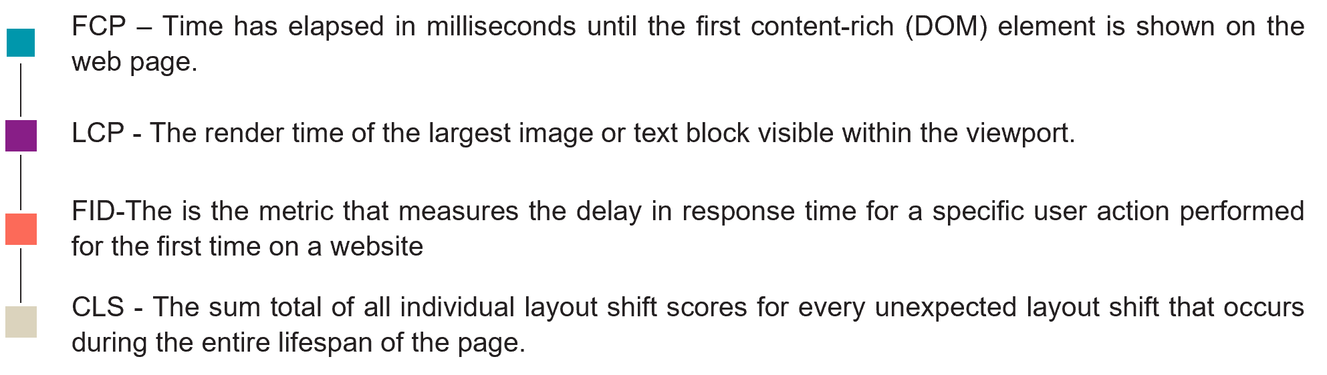
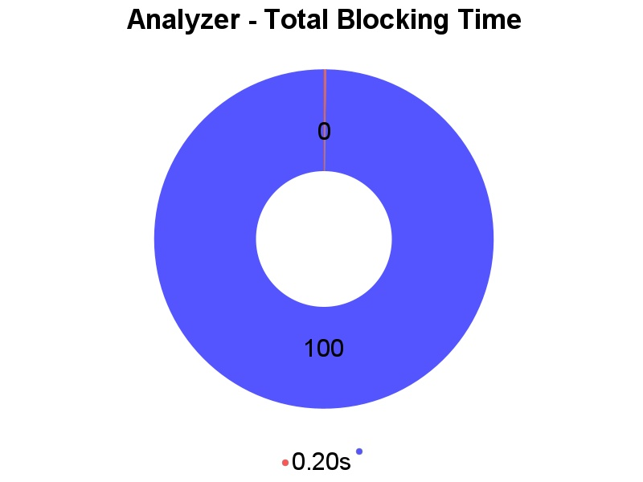
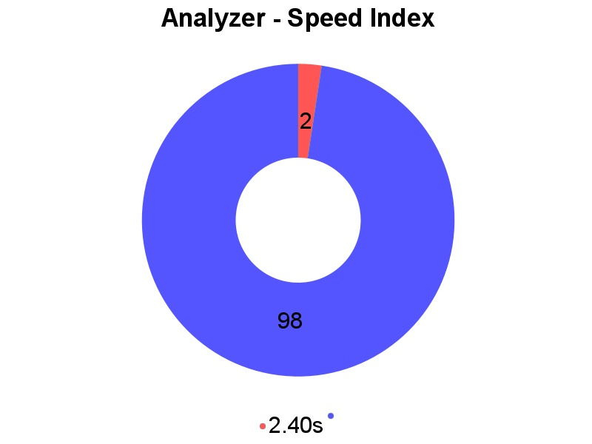
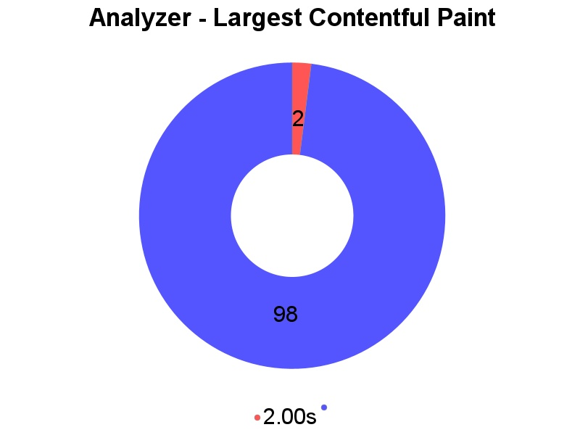
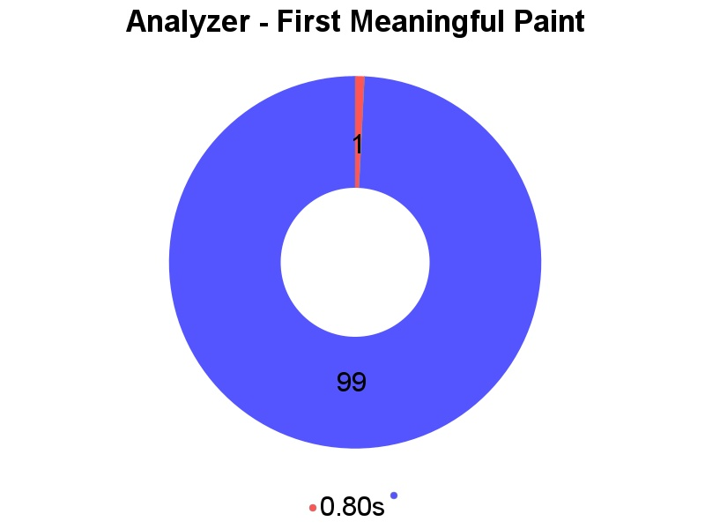


Slide 8
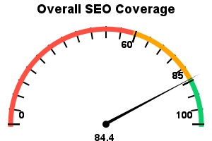
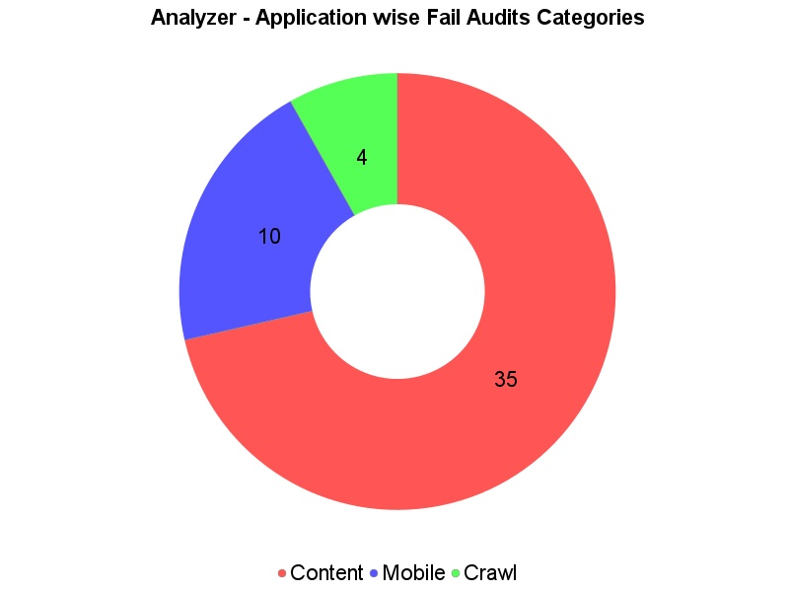
Optimizing Your Website: SEO

Slide 9
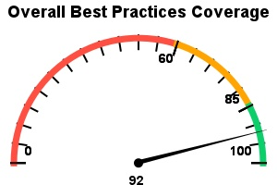
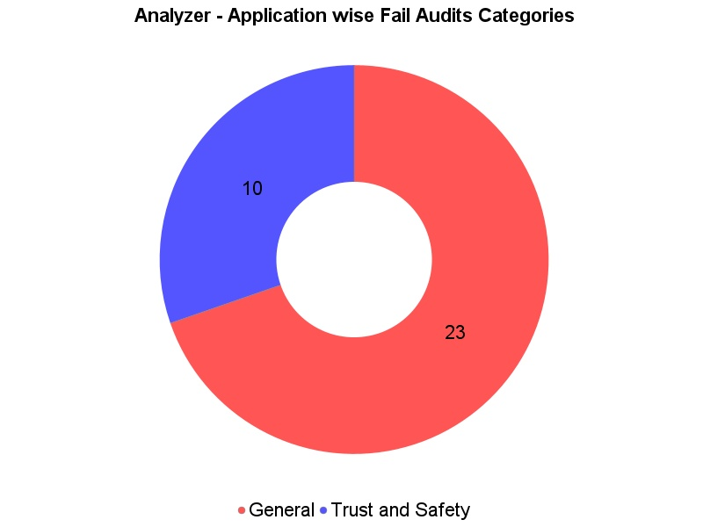
Optimizing Your Website: Best Practices

