Slide 1

Smart Healthcare System
Application Engineer And Development
INFO5100: Final Project
From: Achal Sancheti

Slide 2

Content:
Problem Domain
Proposed Solution
Object Model
Key Roles
Key Features
Extra Features
Screenshot

Slide 3
Problem Domain:
Many time it happens that the desired vaccine is not available in the hospital’s pharmacy or nearby drug store, that could cause an adverse effect.
Secondly, it is difficult for a patient to go and meet doctor, every time for check up.
In addition, there are most cases in which patient is in danger situation and everyone is unaware of patient’s situation.

Slide 4
Proposed Solution:
Patient can directly communicate with doctor and his relative using smart watch.
Vital sign of patient can be viewed by doctor on daily basis.
Emergency vaccine will be delivered to hospital using drone.
Doctor and patient’s relative can see the patient’s location at the time of emergency.
Patient can perform several task using his smart watch.

Slide 5
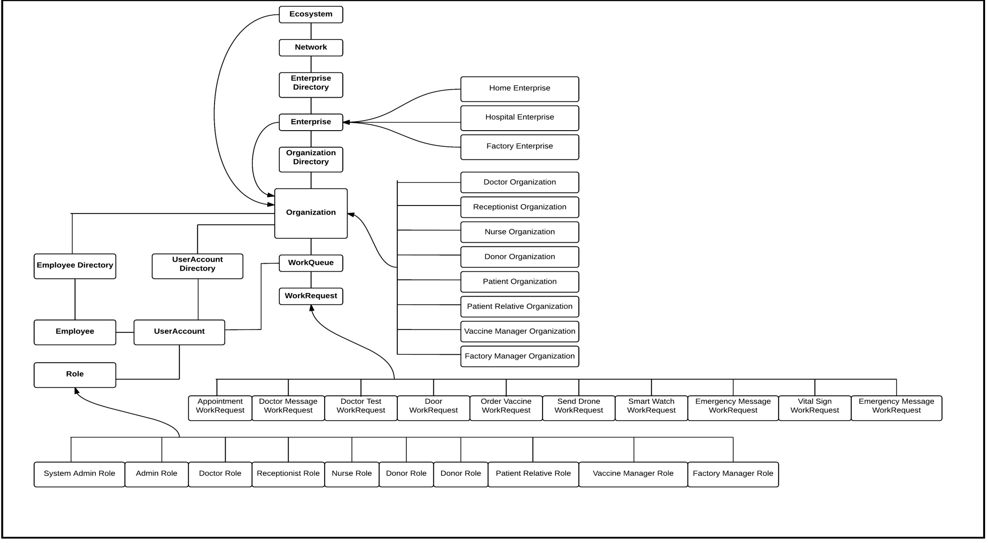
Object Model:

Slide 6
Key Roles:
System Admin Role
Admin Role
Doctor Role
Patient Role
Patient’s Relative Role
Nurse Role
Donor Role
Receptionist Role
Vaccine Manager Role
Factory Manager Role

Slide 7
Key Features:
Doctor will be able to see patient’s vital sign and can communicate with patient and his relative.
Patient will be able to communicate with doctor and relative using his smart watch.
Receptionist will manage the patient as well as the donor.
Donor will donate his blood and an e-certificate will be generated to him.
Nurse will take the donor’s blood, and send the information to receptionist for record.

Slide 8
Key Feature:
Doctor will be able to order vaccine from vaccine manager of hospital.
Vaccine manager will be able to send the vaccine to doctor, and in the emergency case if vaccine is not available, he can order vaccine from factory.
The factory manager will be able to send the vaccine from factory to hospital through drone.
The patient’s relative will be able to access all the doors of patient’s house and will be able to access the location of patient.

Slide 9
Extra Feature:
Patient’s smart watch and doctor’s device is connected with each other.
Doctor will be able to see the location of patient and can see and send video to patient.
Doctor will also be able to do a direct chat with patient.
Patient will be able to perform several task using his smart watch such as see or send video to doctor, see nearby drug store and hospital, send the vital sign to doctor, send email to any person, can lock and unlock doors of his house, can send a direct message to doctor and relative, can see the current climate etc.

Slide 10
Extra Feature:
The factory manager can send the vaccine through drone.
Vaccine manager and factory manager, both can see the location of the drone and can see how much distance is covered by the drone.
Patient can also book an appointment with doctor through his smart watch.
Patient’s relative can see the current location of the patient and can unlock the doors using his device.
An e-certificate will be generated for each donor.

Slide 11
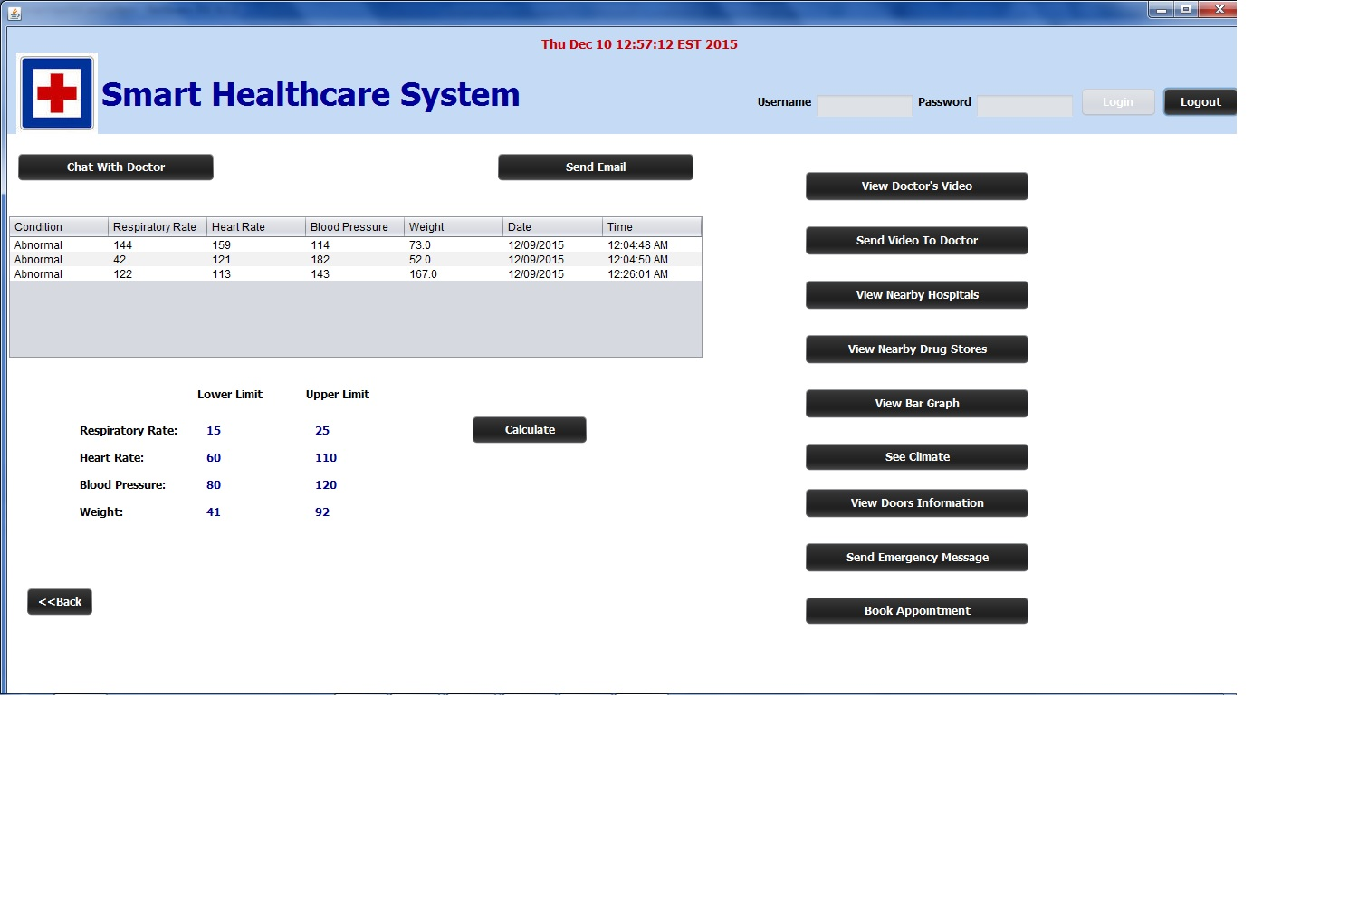
Screenshot:
Smart Watch Screenshot:

Slide 12


