Slide 1
An Optimized Security Protocol for D2D Communication in LTE-A Network
Submitted by
ACHARI SUMANTH-17BEC1190
AYAN NATH -17BEC1051
GALLA PRAVEEN -17BEC1105
Under the Guidance of
Dr. P. Vijayakumar
Associate Professor / SENSE
VIT Chennai

Slide 2
Content
Introduction
Related Works done previously
Proposed system and its Description
Block Diagram of Proposed System
Explanation
Algorithm
Typical Examples
Simulation Results
Conclusion
References

Slide 3
Introduction
Wireless Communication is basically transmitting / receiving voice and data using EM waves in open space, basically free from wires.
The information from the sender to the receiver is usually carried over a well defined frequency band. This frequency band also known as bandwidth allocated for wireless communication, is one of the most priced commodity.
The different channels can be formed because wireless communication today is not just between one person and the base station but it is a multiple access scenario, it is a multi user system.

Slide 4
Related Works done previously
Huge demand of broadband wireless communication data and various multimedia applications obligate to carry out fast improvement in the sector of wireless network.
Enormous users want to access the network from any place and at any time via their devices. LTE-A has been developed to fulfil the demand of wireless communication network and its user’s.
Device to device (D2D) communication in cellular network enables to establish direct communication between two mobile users or nearby mobiles without extending across the Base station (BS) or core network.

Slide 5
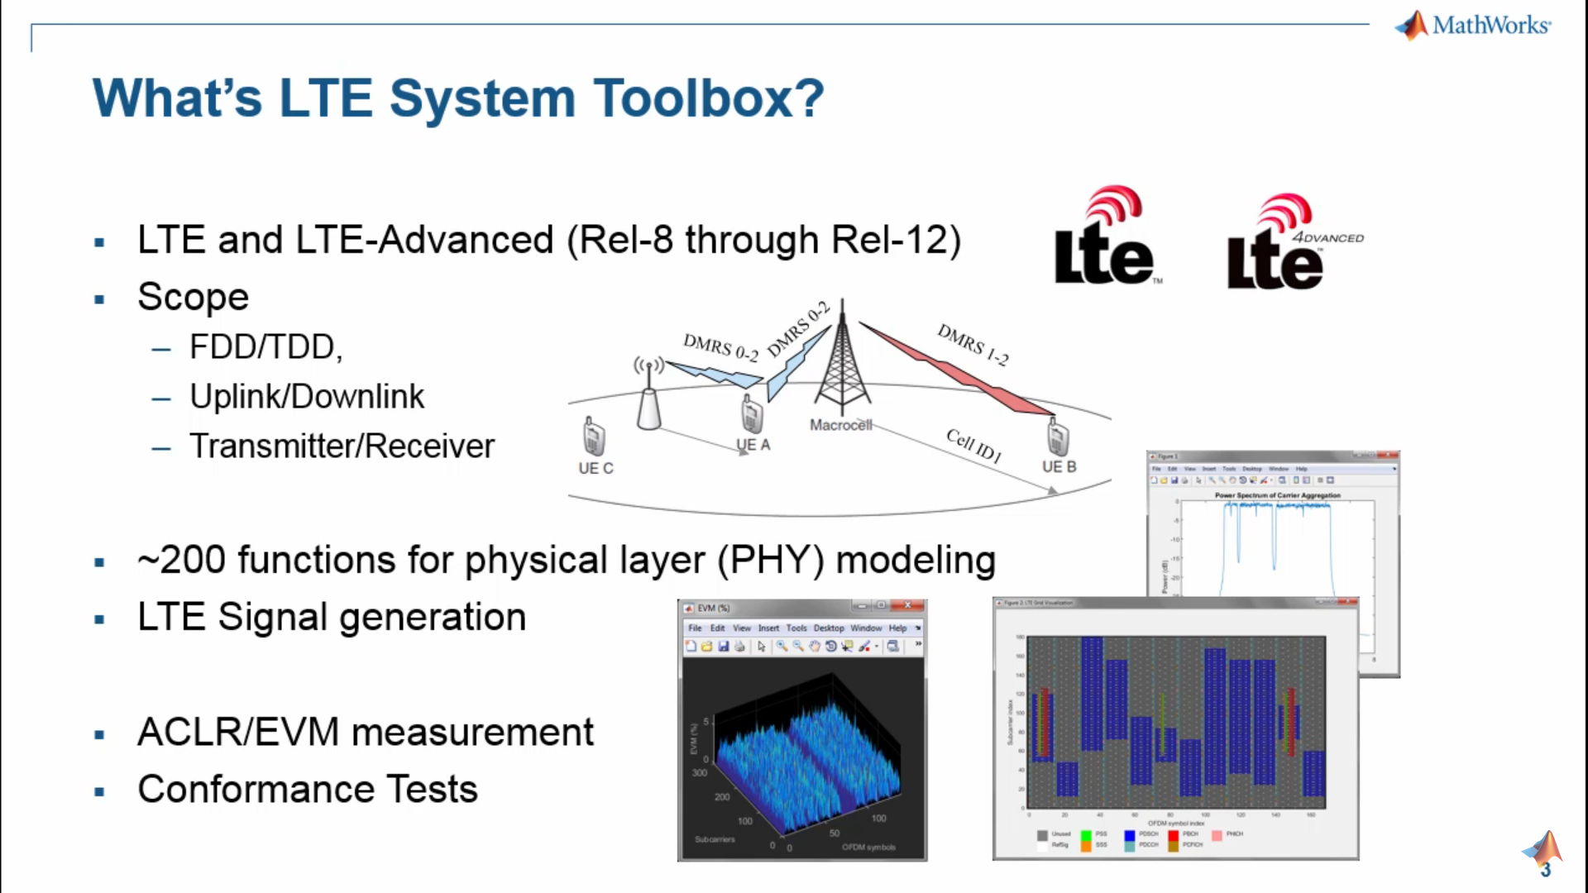
Proposed system and its Description

Slide 6
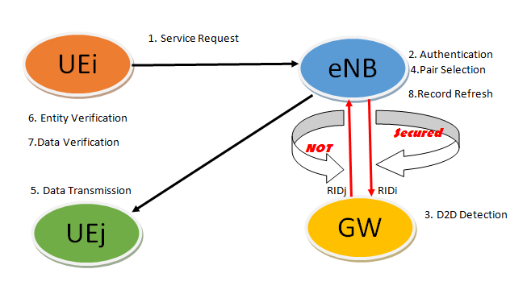
Block Diagram of Proposed System

Slide 7
Explanation
Huge demand of broadband wireless communication data and various multimedia applications obligate to carry out fast improvement in the sector of wireless network.
Enormous users want to access the network from any place and at any time via their devices. LTE-A has been developed to fulfil the demand of wireless communication network and its user’s.
Device to device (D2D) communication in cellular network enables to establish direct communication between two mobile users or nearby mobiles without extending across the Base station (BS) or core network.

Slide 8
Algorithm
Step 1: Once service request will be sent from UE_{i} to eNB, the authentication will be checked by eNB and RID_{i} will be sent to GW. Also, one random integer e ϵ [1,n-1] will be selected by eNB. (RID_{i}, e) will be sent to GW. Where n is the order chosen for ECC operations.
Step 2:Device to device detection will be performed by PSCF in GW. Let the real identity generated for the detected device is RID_{j}. Also, one random integer key K_{G} ϵ [1,n-1] will be selected by GW. Finally, R_{G}=K_{G}χG will be send to eNB. e and K_{G} for eNB and GW can be considered as temporary secret key so that it helps to hide their real identity.
Step 3:From the random integer selection, GW will calculate one S_{G} parameter. Where, S_{G}= K_{G} + e × d_{G}, + is used for scalar addition and d_{G} is the secret key of GW. From II and III step (S_{G}, RID_{j}) will be sent to eNB.

Slide 9
Algorithm
Step 4: From received data, eNB will check , R_{G} = S_{G}.G – e.Q_{G} where, Q_{G} public key of GW. If obtained R_{G} and calculated R_{G} is same, eNB will consider RID_{j} as the authenticated and in this way the secure communication can be established in between eNB and GW. [10] Once RID will be authenticated, further communication between two user equipments can be carried out using the steps of conventional protocol system.
The methodology that implemented here is the combination of symmetric cryptography, Public Key Infrastructure and ECC. The proposed idea can be implemented on Network Simulator 3 (NS3) software to verify the simulation results.

Slide 10
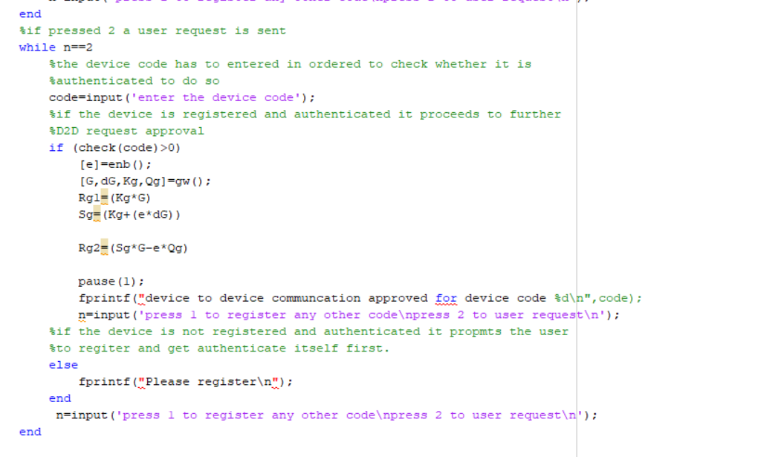
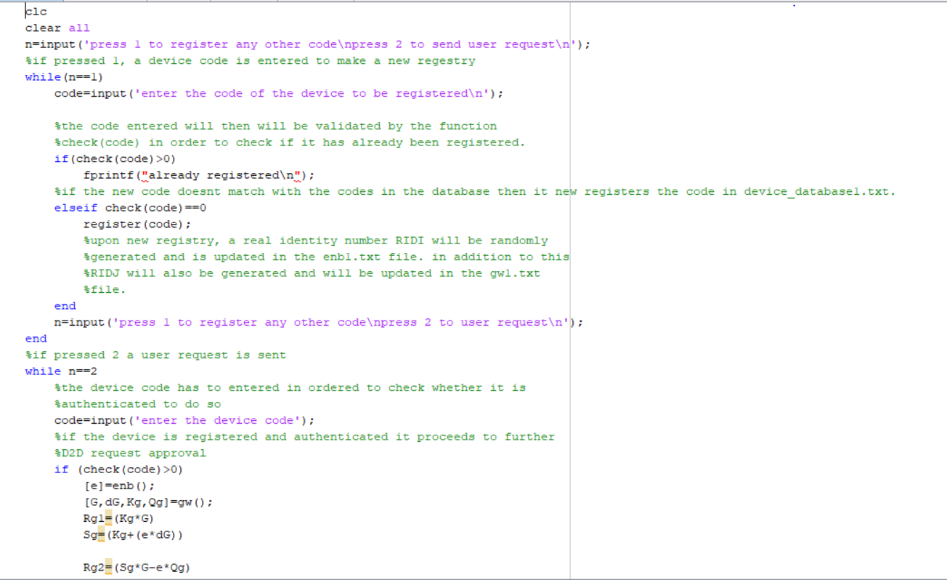
Typical Example

Slide 11
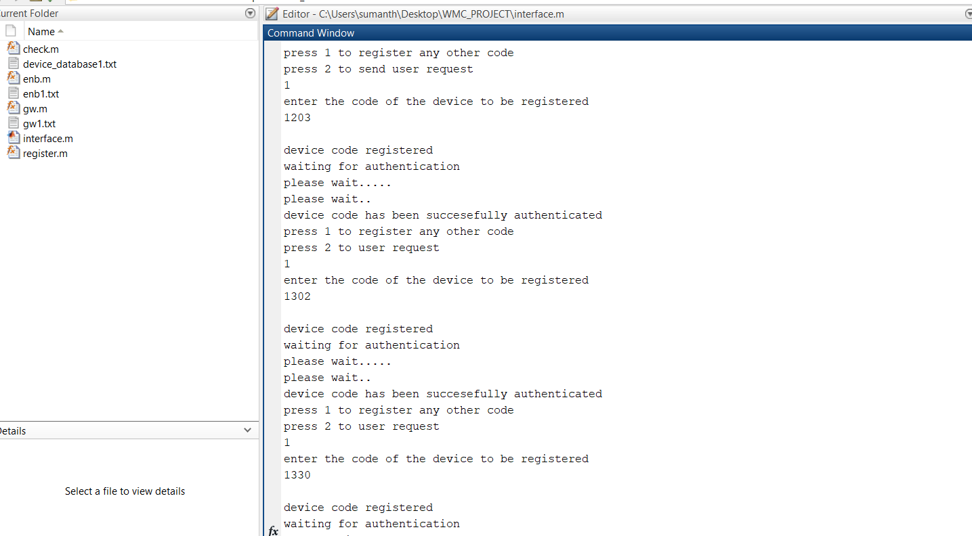
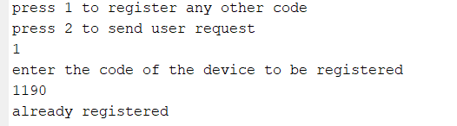
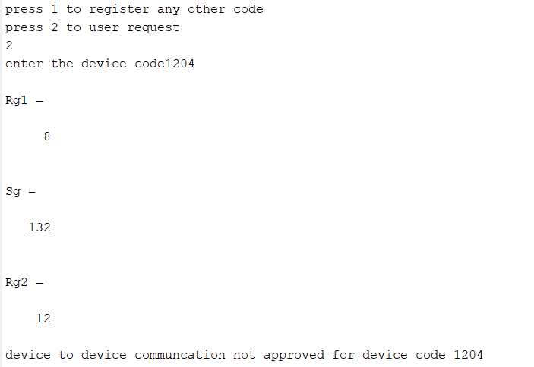
Simulation Results

Slide 12


Simulation Results

Slide 13
Conclusion
We have proposed an additional security system in SeDS protocol system to establish secure communication in between eNB and GW for D2D communication in LTE-A network. The system is explicitly design to achieve authenticity in the communication while detecting proper device by the GW. The conventional SeDS protocol was implemented using digital signature and symmetric encryption. Furthermore, we have included ECC so that even security between eNB and GW could not get compromised.
We have analyzed the D2D communication scenario and proposed above idea but its validity needs to be checked by implementing simulation on NS3 platform. The limitation to this paper is it needs to be checked whether the idea could get implemented when more than two user equipments are there.

Slide 14
References
[1] J. Chen, C. Yang and Y. Mai, "A novel smart forwarding scheme in LTE-Advanced networks", China Communications, vol. 12, no. 3, pp. 120-131, 2015.
[2] D. Choi and H. Choi, "An Group-based Security Protocol for Machine Type Communications in LTE-Advanced", Journal of the Korea Institute of Information Security and Cryptology, vol. 23, no. 5, pp. 885-896, 2013.
[3] L. Militano, M. Condoluci, G. Araniti, A. Molinaro and A. Iera, "When D2D communication improves group oriented services in beyond 4G networks", Wireless Netw, vol. 21, no. 4, pp. 1363-1377, 2014.
[4] S. Ramasubramanian, s. chung, S. Ryu and L. Ding, "Secure and Smart Media Sharing Based on a Novel Mobile Device-to-Device Communication Framework with Security and Procedures", ACM, pp. 35-49, 2015.
[5] Z. Aiqing, C. Jianxin, H. Rose and Q. Yi, “SeDS: Secure Data Sharing Strategy for D2D Communication in LTE-Advanced Networks”, IEEE Transaction on Vehicular Technology, Vol.65, No.4, pp. 2659-2672, 2016.
[6] A. Sharma, A. Trivedi and N. Roberts, "Efficient Load Balancing using D2D Communication and Biasing in LTE-Advance Het-Nets", ACM, 2015.
[7] H. Tang, Z. Ding and B. Levy, "Enabling D2D Communications Through Neighbor Discovery in LTE Cellular Networks", IEEE Transactions on Signal Processing, vol. 62, no. 19, pp. 5157-5170, 2014.

