Slide 1






DIABETIES PREDICTION USING MACHINE LEARNING AND EMBEDDED SYSTEM
Bangalore Institute of Technology
K.R. Road, V.V. Pura, Bengaluru.-560004.
Department of Computer Science & Engineering
FINAL YEAR-PROJECT PRESENTATION
Presented by 20P07
USN | NAME
1BI20CS070 | Harsh Adhikari
1BI20CS047 | Chinmay Lohomi
1BI20CS057 | Dheeraj Katoch
1BI20CS189 | Vivek Gupta
Under the guidance of:
Guide Name –Madhuri J
Designation - Assistant Professor
Dept. of CSE
BIT.

Slide 2
Bangalore Institute of Technology
K.R. Road, V.V. Pura, Bengaluru.-560004.
Department of Computer Science & Engineering
Agenda
Introduction
Literature Survey
Existing System
Problem Statement
Proposed System
Project Planning
Application
References

Slide 3
Bangalore Institute of Technology
K.R. Road, V.V. Pura, Bengaluru.-560004.
Department of Computer Science & Engineering
OVERVIEW
The project centres around the development of a foot health monitoring system
It is crucial for early detection and intervention, particularly in diabetic patients who are prone to foot-related complications.
By employing pressure sensors integrated with an Arduino microcontroller, the system captures real-time data reflecting variations in foot pressure distribution.
Leveraging machine learning techniques, the collected pressure data is analyzed to discern patterns indicative of abnormal foot pressure.

Slide 4
Bangalore Institute of Technology
K.R. Road, V.V. Pura, Bengaluru.-560004.
Department of Computer Science & Engineering
INTRODUCTION
By training a model on labelled pressure data, the system can learn patterns indicative of abnormal foot pressure.
Users can interact with the system to input sensor readings or view predictions, allowing for manual verification or intervention if necessary.
Additionally, the system may include logging capabilities to track historical data and trends, facilitating long-term monitoring and analysis of foot health status.

Slide 5
Bangalore Institute of Technology
K.R. Road, V.V. Pura, Bengaluru.-560004.
Department of Computer Science & Engineering
OBJECTIVES
To build a light weight, portable system for predicting Diabetes .
To analyze the foot pressure and mapping the pressure in the application .
To provide a cost-effective and user-centered podiatric device .
To build a Machine Learning model for Diabetes prediction
To implement a error free hardware-software prototype ready to be released to the market

Slide 6

Bangalore Institute of Technology
K.R. Road, V.V. Pura, Bengaluru.-560004.
Department of Computer Science & Engineering
LITERATURE SURVEY

Slide 7
Bangalore Institute of Technology
K.R. Road, V.V. Pura, Bengaluru.-560004.
Department of Computer Science & Engineering
Name of the paper | Authors | Publication | Content
[1]. “A Compact Wearable System for Detection of Plantar Pressure for Diabetic Foot Prevention” | Zihang You, Adnan Zahid, Hadi Heidari, Muhammad Ali Imran | October 2018 IEEE Asia Pacific Conference | This paper present a pair of wearable shoe-pads with shoes to detect the pressure of human body and provide the pressure map .
[2]. “A Wearable Gait Analysis System Used in Type 2 Diabetes Mellitus Patients: A Case–Control Study” | Wang C, Xu Y, Bai Y, Wang J, Long Z, Wang X, Zhou L | April 2021 Dove Medical Press | This study confirms that the wearable gait analysis system (Gaitboter) is an ideal system to identify abnormal gait in patients with type 2 diabetes

Slide 8
Bangalore Institute of Technology
K.R. Road, V.V. Pura, Bengaluru.-560004.
Department of Computer Science & Engineering
Name of the paper | Authors | Publication | Content
[3]. “Model-Based Feature Extraction for Gait Analysis and Recognition ” | Imed Bouchrika | 25 March 2007 IEEE International Conference | Gait knowledge is exploited via heel strike extraction to reduce the parameter space dimensionality and therefore reduce the computational load
[4]. “Foot Plantar Pressure Measurement System Based on Flexible Force-Sensitive Sensor and its Clinical Application.” | Bochen li,Yi liu,weih on,shengqiang xu. | 16 december 2018 IEEE international conference | a foot plantar pressure measurement system was developed based on resistive sensor. It consists of three self-developed flexible force-sensitive sensors, hardware circuit and software.

Slide 9
Bangalore Institute of Technology
K.R. Road, V.V. Pura, Bengaluru.-560004.
Department of Computer Science & Engineering
Name of the paper | Authors | Publication | Content
[5]. “Gait Analysis Methods: An Overview of Wearable and Non-Wearable Systems, Highlighting Clinical Applications” | Alvaro Muro-de-la-Herran, Begonya Garcia-Zapirain ,Amaia Mendez-Zorrilla | 19 February 2014 MDPI | This article presents a review of the methods used in recognition and analysis of the human gait from : image processing, floor sensors and sensors placed on the body
[6]. “Using Body-Worn Sensors for Preliminary Rehabilitation Assessment in Stroke Victims With Gait Impairment .” | Sen Qiu, Zhelong Wang, Hong-Yu Zhao, Long Liu | March 2018 IEEE international conference | The proposed gait analysis system can accurately quantify the patients’ gait without using lab restricted system. We can get foot angle, step length, step velocity and gait phase

Slide 10
Bangalore Institute of Technology
K.R. Road, V.V. Pura, Bengaluru.-560004.
Department of Computer Science & Engineering
Name of the paper | Authors | Publication | Content
[7]. “Smart insole: A wearable system for gait analysis ” | Wenyao Xu, Ming-Chun Huang, Navid Amini, Jason J. Liu | June 2012 International Conference on Pervasive Technologies Related to Assistive Environments | Smart Insole system can transfer the data from the patient side to the centralized servers in the medicals ,monitoring the user gait in real-time
[8]. “In-Shoe Plantar Pressure Measurement and Analysis System Based on Fabric Pressure Sensing Array .” | Lin Shu, Tao Hua, Yangyong Wang, Qiao Li | May 2010 IEEE transactions on information technology in biomedicine: a publication of the IEEE Engineering in Medicine and Biology Society | Textile-based in-shoe pressure measure and analysis system has been presented. It has pressure processing software ,which makes this system suitable for research laboratory and outdoor test

Slide 11
EXISTING SYSTEM
Bangalore Institute of Technology
K.R. Road, V.V. Pura, Bengaluru.-560004.
Department of Computer Science & Engineering
Blood Glucose Monitoring Systems: These systems involve measuring blood glucose levels using devices like glucometers. They often include strips for collecting a blood sample, a meter to analyze the sample, and sometimes connectivity to mobile apps or cloud services for data tracking and analysis.
Continuous Glucose Monitoring (CGM) Systems: CGM systems continuously monitor glucose levels throughout the day and night via a sensor inserted under the skin. These sensors transmit data to a receiver or Smartphone app, providing real-time glucose readings and trends, helping users manage their diabetes more effectively.
Haemoglobin A1c (HbA1c) Testing: This is a blood test that provides an average blood sugar level over the past 2-3 months. It measures the percentage of blood sugar attached to haemoglobin, the oxygen-carrying protein in red blood cells. High levels of HbA1c indicate poorly controlled diabetes.

Slide 12
PROBLEM STATEMENT
Bangalore Institute of Technology
K.R. Road, V.V. Pura, Bengaluru.-560004.
Department of Computer Science & Engineering
“To develop a foot pressure mapping system that is portable, lightweight for real-time monitoring and diabetes prediction using Machine Learning and FSR sensor,”
Input: Data collected from the Podiatric device built using IoT technology
Output: Prediction of diabetes due to foot pressures

Slide 13
PROPOSED STATEMENT
Bangalore Institute of Technology
K.R. Road, V.V. Pura, Bengaluru.-560004.
Department of Computer Science & Engineering
Pressure analysis system for diabetes prediction where the FSR Sensors are used to measure pressure
To develop our model we use embedded system development life cycle
Machine Learning Algorithms are employed to predict diabetes by analyzing foot pressure, based on preexisting dataset.

Slide 14
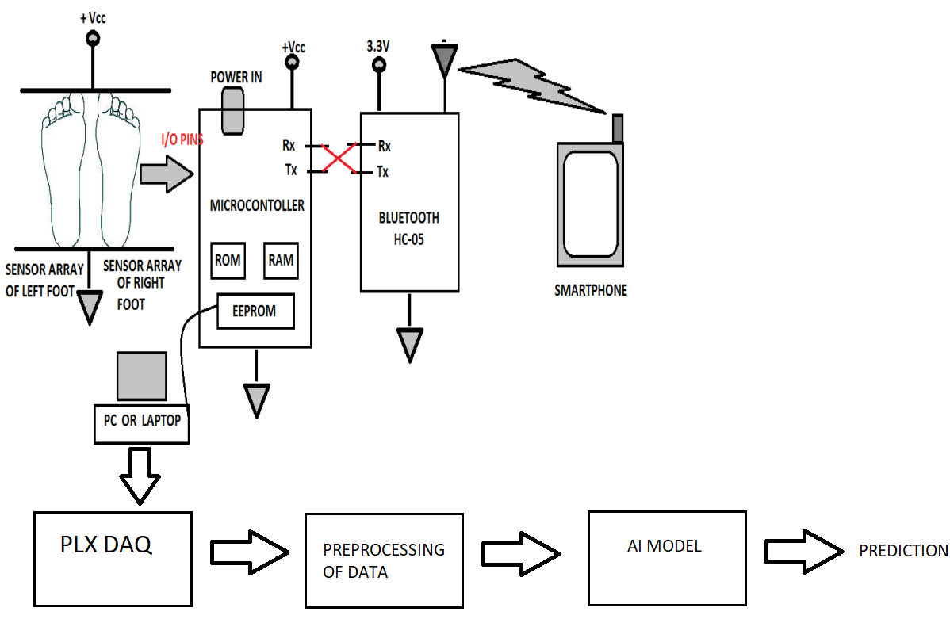
Bangalore Institute of Technology
K.R. Road, V.V. Pura, Bengaluru.-560004.
Department of Computer Science & Engineering
PROPOSED SYSTEM

Slide 15
SYSTEM REQUIRMENT
Bangalore Institute of Technology
K.R. Road, V.V. Pura, Bengaluru.-560004.
Department of Computer Science & Engineering
SOFTWARE AND HARDWARE REQUIREMENTS
SOFTWARE:
i. Coding Language : Python.
ii. Operating system : Windows 10 with MS EXCEL.
iii. Library : Matplotlib, numpy, Pandas, Sckit-learn.
iv. tool : Anaconda Navigator IDE 3.7.4 , jupyter Notebook, Arduino IDE
HARDWARE: ATMEGA 328 – 1 FSR Sensor – 4 Bluetooth module HC-05 – 1 Mobile phone Buzzer - 1 LED - 4 Resistors – 4 Jumper wires

Slide 16
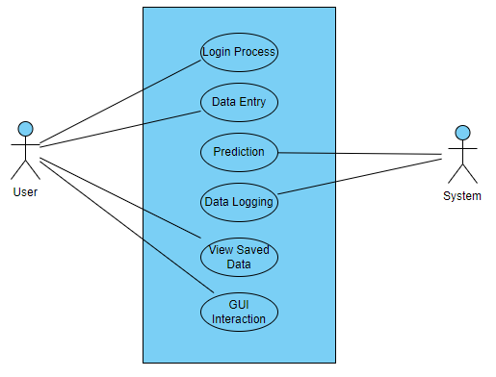
Bangalore Institute of Technology
K.R. Road, V.V. Pura, Bengaluru.-560004.
Department of Computer Science & Engineering
USE CASE DIAGRAM

Slide 17
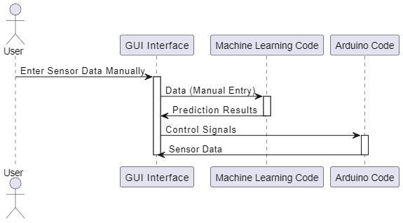
Bangalore Institute of Technology
K.R. Road, V.V. Pura, Bengaluru.-560004.
Department of Computer Science & Engineering
SEQUENCE DIAGRAM

Slide 18
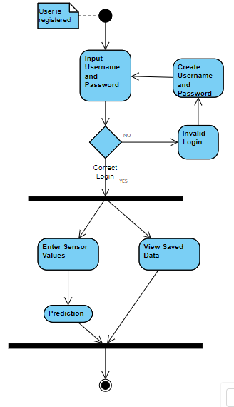
Bangalore Institute of Technology
K.R. Road, V.V. Pura, Bengaluru.-560004.
Department of Computer Science & Engineering
ACTIVITY DIAGRAM

Slide 19
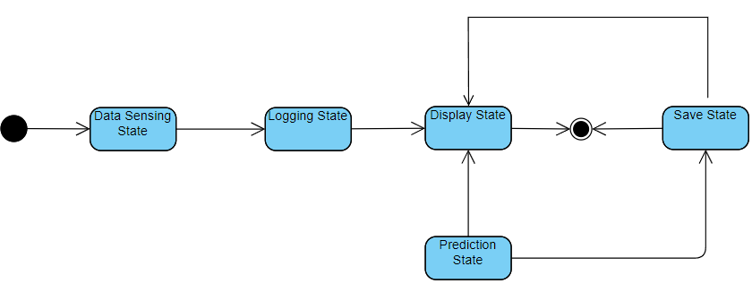
Bangalore Institute of Technology
K.R. Road, V.V. Pura, Bengaluru.-560004.
Department of Computer Science & Engineering
STATE CHART DIAGRAM

Slide 20
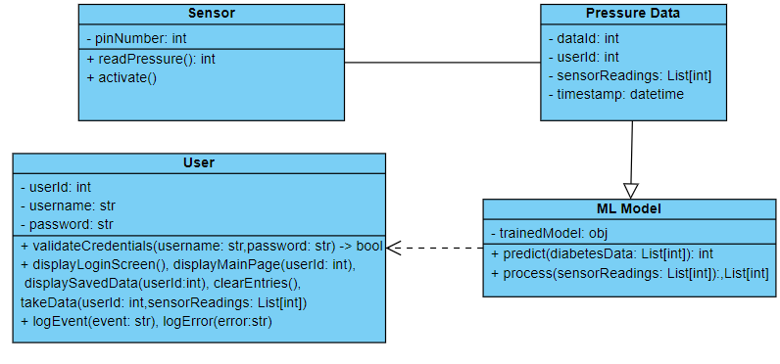
Bangalore Institute of Technology
K.R. Road, V.V. Pura, Bengaluru.-560004.
Department of Computer Science & Engineering
CLASS DIAGRAM

Slide 21
FUNCTIONAL REQUIRMENTS
Bangalore Institute of Technology
K.R. Road, V.V. Pura, Bengaluru.-560004.
Department of Computer Science & Engineering
Collect the input dataset and Preprocessing the dataset
Applying the SVM classifier algorithms for retrieval of best algorithm for prediction.
The system should be able to communicate with the user with appropriate responses.
The system should be able to analyze the parameters and predict whether a patient has a podiatric disease or not

Slide 22
NON-FUNCTIONAL REQUIRMENTS
Bangalore Institute of Technology
K.R. Road, V.V. Pura, Bengaluru.-560004.
Department of Computer Science & Engineering
Reliability: The progressions made by the Programmer ought to be obvious both to the Project pioneer and in addition the Test design.
Uniformity: The system must perform uniformly on all inputs.
Maintainability: The system watching and upkeep should be fundamental and focus in its approach
Security: Counting bug following the framework must give important security and must secure the entire procedure from slamming.
Efficiency: The system is made to perform at the best possible efficiency

Slide 23
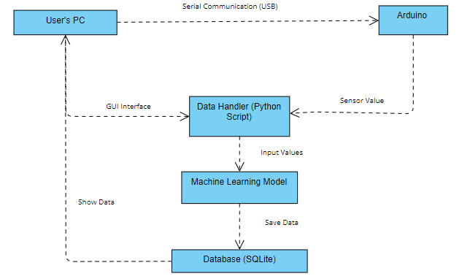
Bangalore Institute of Technology
K.R. Road, V.V. Pura, Bengaluru.-560004.
Department of Computer Science & Engineering
ARCHITECTURAL DESIGN

Slide 24
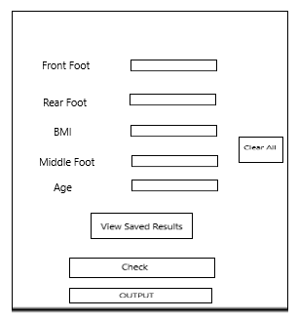
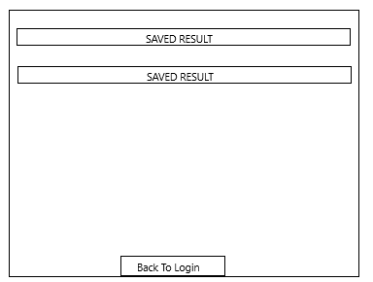
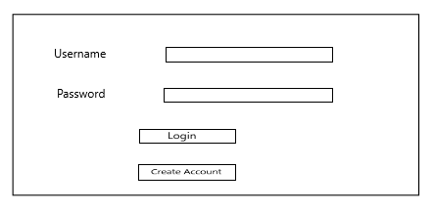
Bangalore Institute of Technology
K.R. Road, V.V. Pura, Bengaluru.-560004.
Department of Computer Science & Engineering
INTERFACE DESIGN

Slide 25
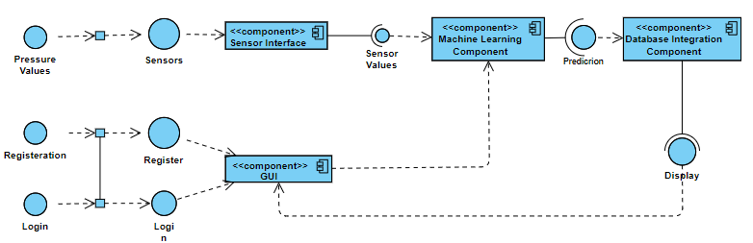
Bangalore Institute of Technology
K.R. Road, V.V. Pura, Bengaluru.-560004.
Department of Computer Science & Engineering
COMPONENT DESIGN

Slide 26
Bangalore Institute of Technology
K.R. Road, V.V. Pura, Bengaluru.-560004.
Department of Computer Science & Engineering
DATA STRUCTURE DESIGN
Arduino Data Structure: Each sensor reading from the Arduino can be represented as a tuple or list containing pressure values from individual sensors.
The Arduino should send this data over serial communication to the connected computer.
Machine Learning Model Input: The input to your machine learning model will be the sensor readings obtained from the Arduino. Ensure that the format of the input data matches the input requirements of your model (e.g., a NumPy array or a pandas DataFrame).

Slide 27
Bangalore Institute of Technology
K.R. Road, V.V. Pura, Bengaluru.-560004.
Department of Computer Science & Engineering
DATA STRUCTURE DESIGN
Machine Learning Model Output: The output of machine learning model will be a prediction indicating whether the patient has abnormal foot pressure or not. This prediction can be stored as a binary value (0 or 1) or as a descriptive label.
Database Structure: For storing data in a database, we need to design tables to store sensor readings, predictions, and timestamps.
User Authentication Data Structure: For User authentication for accessing the system, we need to store user credentials securely. This can be done using a separate table in the database or using a dedicated authentication service.

Slide 28
Bangalore Institute of Technology
K.R. Road, V.V. Pura, Bengaluru.-560004.
Department of Computer Science & Engineering
DATA STRUCTURE DESIGN
Logging Data Structure: If you're logging data for analysis or debugging purposes, we need to define the structure of log entries. Log entries may include timestamps, sensor readings, prediction results, and other relevant information.
GUI Interaction Data Structure: System includes a graphical user interface (GUI), we need to define data structures for handling user inputs and displaying results. This may involve defining data models for GUI components and managing their state.

Slide 29
Bangalore Institute of Technology
K.R. Road, V.V. Pura, Bengaluru.-560004.
Department of Computer Science & Engineering
ALGORITHM DESIGN
Arduino Code Algorithm Design:
1. Setup:
- Initialize serial communication with a baud rate of 9600.
- Define pin numbers for LEDs and the buzzer.
- Set pin modes for LEDs and the buzzer.
- Print initial messages to clear Excel sheet and label data for MS-Excel.
2. Loop:
- Read analog sensor values from four different analog pins (A0, A1, A2, A3).
- Invert the sensor readings (1023 - sensor reading) and store them in variables.
- Based on certain thresholds, turn on/off the buzzer and LEDs corresponding to each sensor reading.
- Print inverted sensor readings and current time to the serial monitor in a format suitable for Excel.
- Delay for a specified time.

Slide 30
Bangalore Institute of Technology
K.R. Road, V.V. Pura, Bengaluru.-560004.
Department of Computer Science & Engineering
ALGORITHM DESIGN
Machine Learning Code Algorithm Design:
1. Data Loading and Preprocessing:
- Load the diabetes dataset from a CSV file.
- Explore and preprocess the dataset if necessary, such as handling missing values or scaling features using StandardScaler.
2. Model Training:
- Split the dataset into training and testing sets using train_test_split.
- Train a Support Vector Machine (SVM) classifier using the training data.
- Evaluate the trained model's performance on the testing set.
3. GUI Construction:
- Use Tkinter to create a graphical user interface (GUI) for user interaction.
- Design the GUI layout with entry fields for users to manually input foot pressure data.
- Add buttons for clearing entries and making predictions.
- Use labels to display descriptive text and prediction results.

Slide 31
Bangalore Institute of Technology
K.R. Road, V.V. Pura, Bengaluru.-560004.
Department of Computer Science & Engineering
ALGORITHM DESIGN
4. Prediction Function:
- Define a function to gather input data from the GUI entry fields.
- Preprocess the input data using the same preprocessing steps applied during model training.
- Use the trained SVM model to predict the outcome (normal or abnormal foot pressure) based on the input data.
- Display the prediction result on the GUI.
5. User Interaction:
- Users manually enter foot pressure data into the GUI entry fields after observing the Arduino output.
- Click the "Check" button to initiate prediction based on the entered data.
- The GUI displays the prediction result as either "Patient has abnormal foot pressure" or "Patient is normal."
6. Integration:
- The Arduino code and the ML code are part of the same project but operate independently.
- Users manually transfer the observed sensor readings from the Arduino serial monitor to the ML GUI for prediction.

Slide 32
Bangalore Institute of Technology
K.R. Road, V.V. Pura, Bengaluru.-560004.
Department of Computer Science & Engineering
SVM Algorithm
Linear Binary Classifier: SVM is a mathematical and machine learning technique used to build a linear binary classifier.
It establishes a hyperplane in a high-dimensional space to separate a dataset into two segments, corresponding to the desired objective.
Hyperplane and Decision Boundary: The SVM classifier defines a hyperplane in the high-dimensional space that acts as the decision boundary between two classes.
Support Vectors: Support vectors are crucial data points that define the "gutters" or boundary conditions on either side of the hyperplane for each of the two classes.
Widest Street Approach : SVM adopts a "widest street" approach, aiming to create the hyperplane with the maximum margin between the two classes.

Slide 33
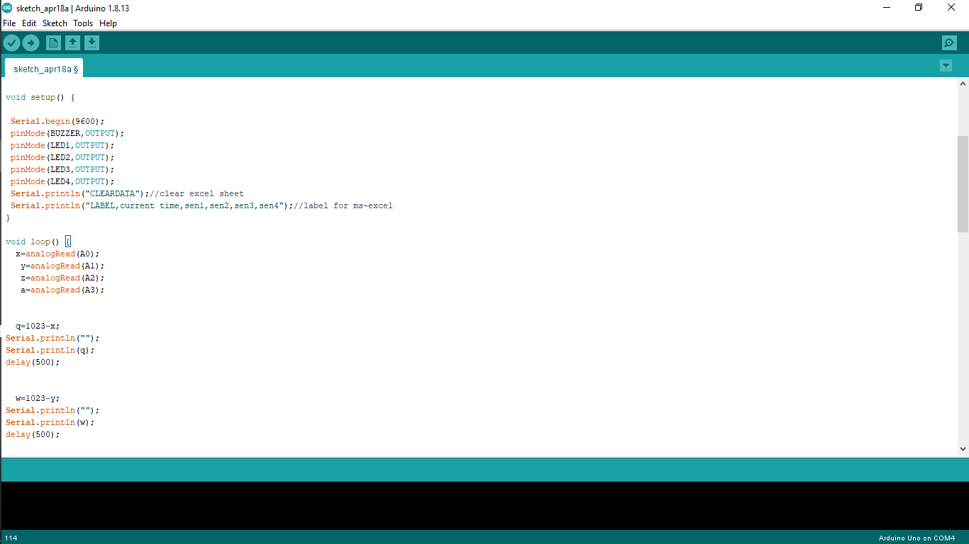
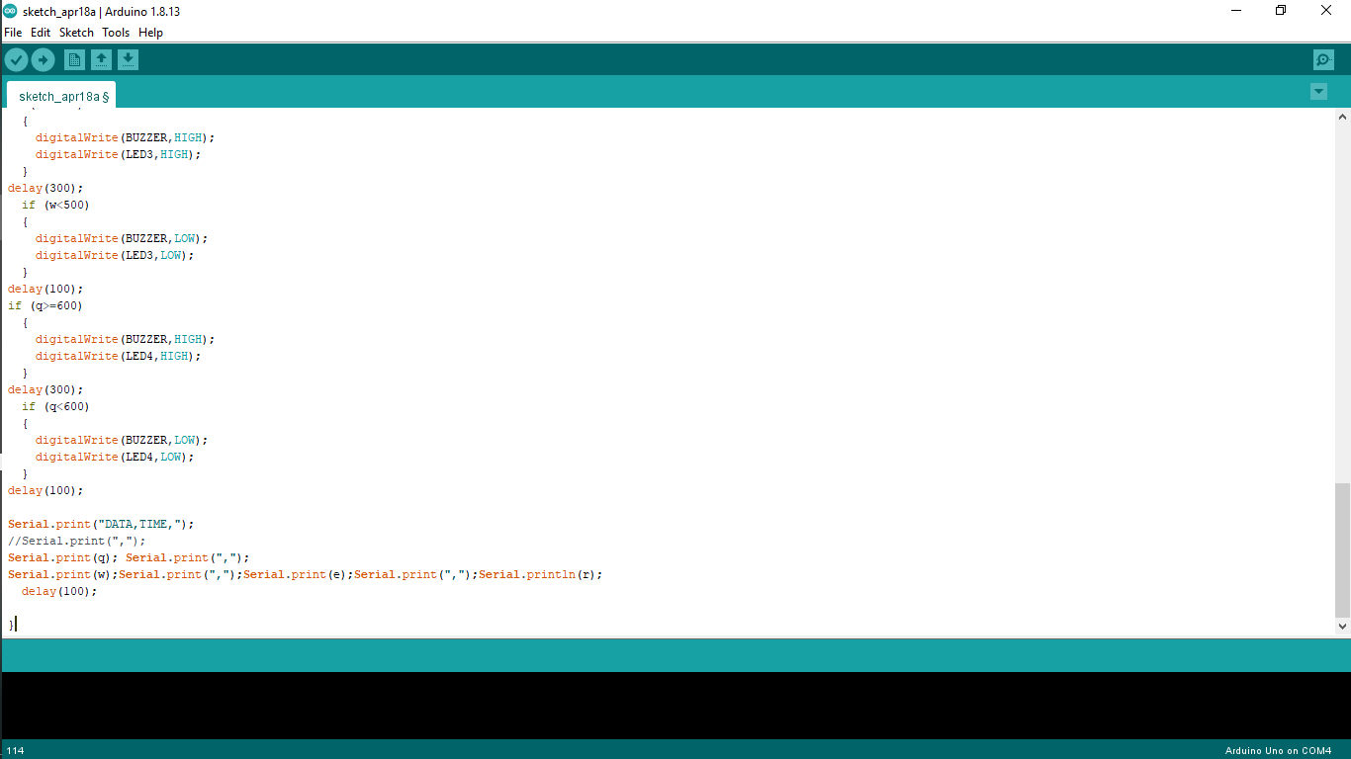
Bangalore Institute of Technology
K.R. Road, V.V. Pura, Bengaluru.-560004.
Department of Computer Science & Engineering
IMPLEMENTATION
Assigning the input sensors variables and ports to LEDs and buzzers
Printing the output on the Excel Sheet

Slide 34
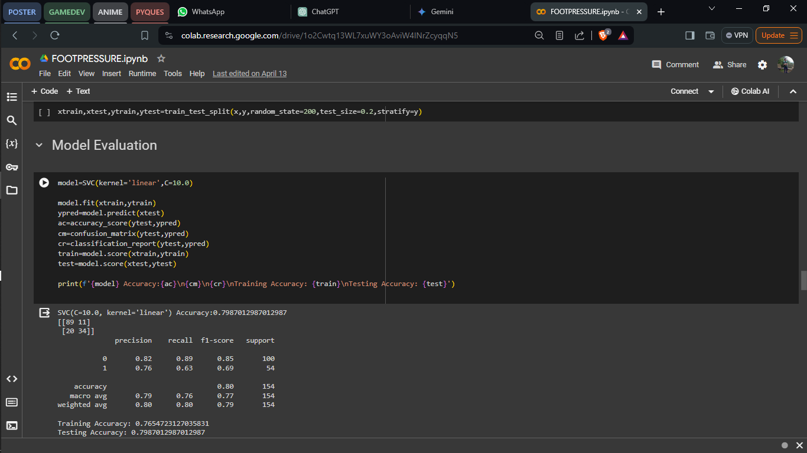
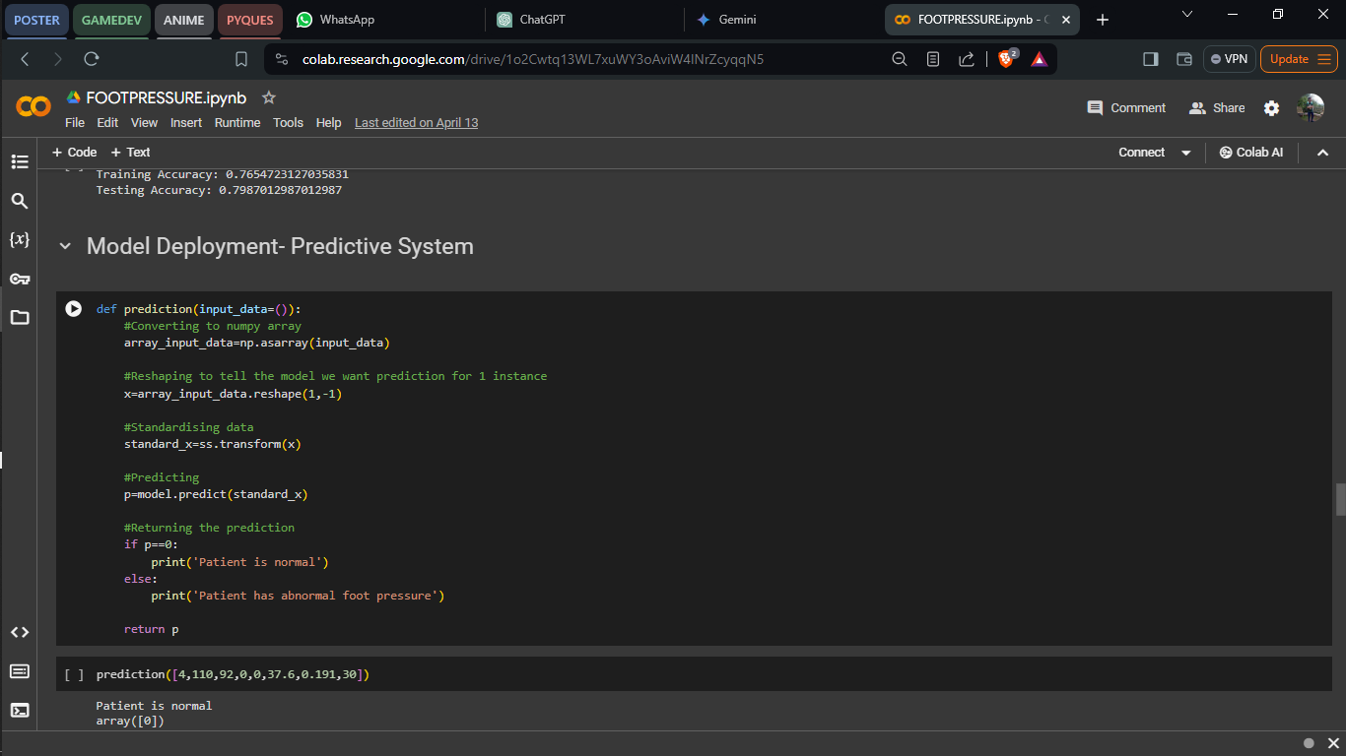
Bangalore Institute of Technology
K.R. Road, V.V. Pura, Bengaluru.-560004.
Department of Computer Science & Engineering
IMPLEMENTATION

Slide 35
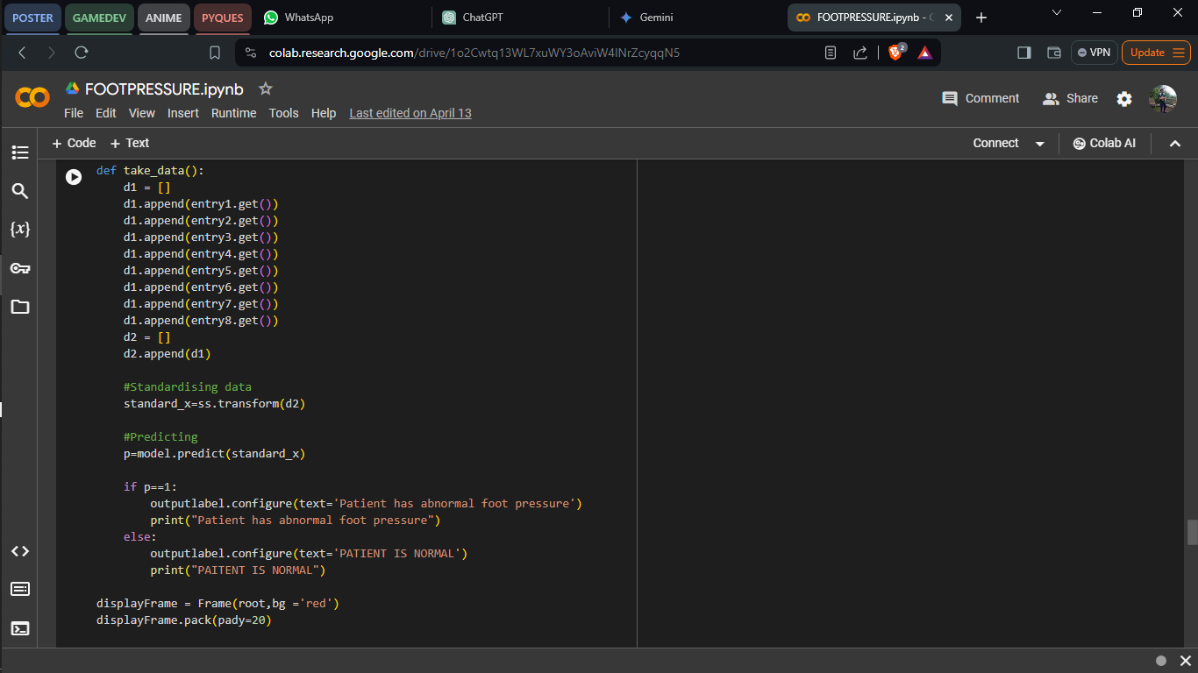
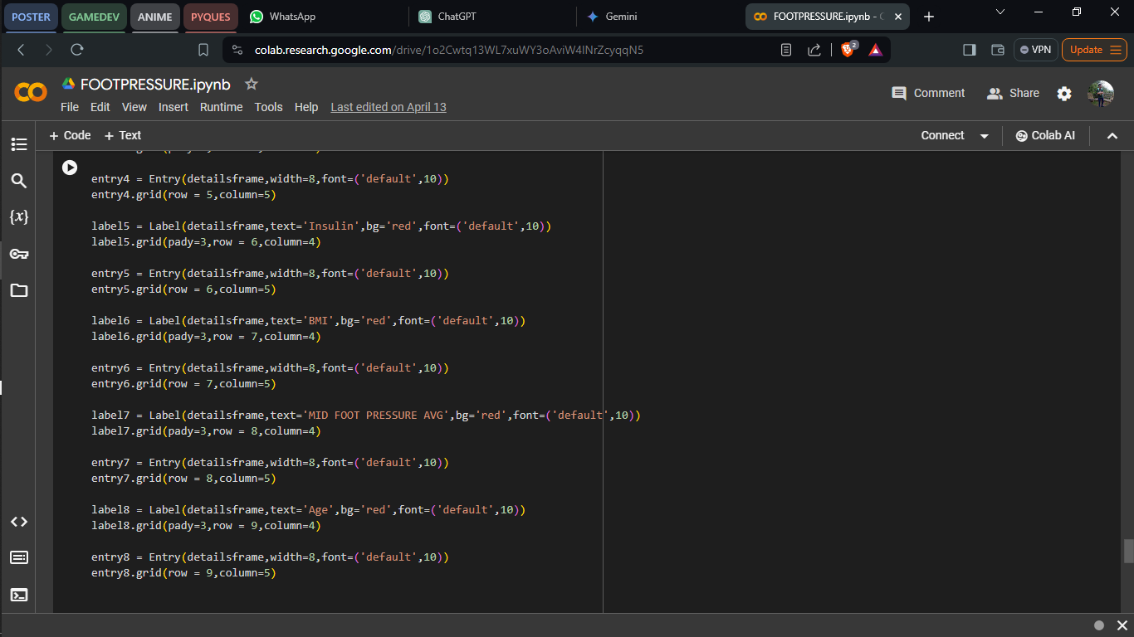
Bangalore Institute of Technology
K.R. Road, V.V. Pura, Bengaluru.-560004.
Department of Computer Science & Engineering
IMPLEMENTATION
Assigning the variables for each input
Creating the UI for adding space to enter input and a button

Slide 36
Bangalore Institute of Technology
K.R. Road, V.V. Pura, Bengaluru.-560004.
Department of Computer Science & Engineering
TESTING
Test # | Test Data(input) | Expected Result | Actual Result | Pass/Fail
1 | Overweight Person | Abnormal foot pressure predicted | Abnormal foot pressure predicted | Pass
2 | Young Person | Normal foot pressure predicted | Normal foot pressure predicted | Pass
3 | Normal Weight Person | Normal foot pressure predicted | Normal foot pressure predicted | Pass
4 | Elderly Person | Abnormal foot pressure predicted | Abnormal foot pressure predicted | Pass
5 | Person with High Glucose | Abnormal foot pressure predicted | Abnormal foot pressure predicted | Pass
6 | Person with High BMI | Abnormal foot pressure predicted | Abnormal foot pressure predicted | Pass

Slide 37
Bangalore Institute of Technology
K.R. Road, V.V. Pura, Bengaluru.-560004.
Department of Computer Science & Engineering
TESTING
Test Procedure:
Prepare Test Data:
For each test case, manually enter the relevant foot pressure data into the GUI.
Ensure that the test data covers various health conditions and age groups.
Execute Test Cases:
For each test case, observe the actual result displayed on the GUI after clicking the "Check" button.

Slide 38
Bangalore Institute of Technology
K.R. Road, V.V. Pura, Bengaluru.-560004.
Department of Computer Science & Engineering
TESTING
Compare Expected vs. Actual Result:
Compare the expected result for each test case with the actual result obtained from the ML prediction.
Determine Pass/Fail:
Determine whether each test case passes or fails based on the comparison of expected and actual results.
If the actual result matches the expected result, mark the test case as Pass. Otherwise, mark it as Fail.

Slide 39
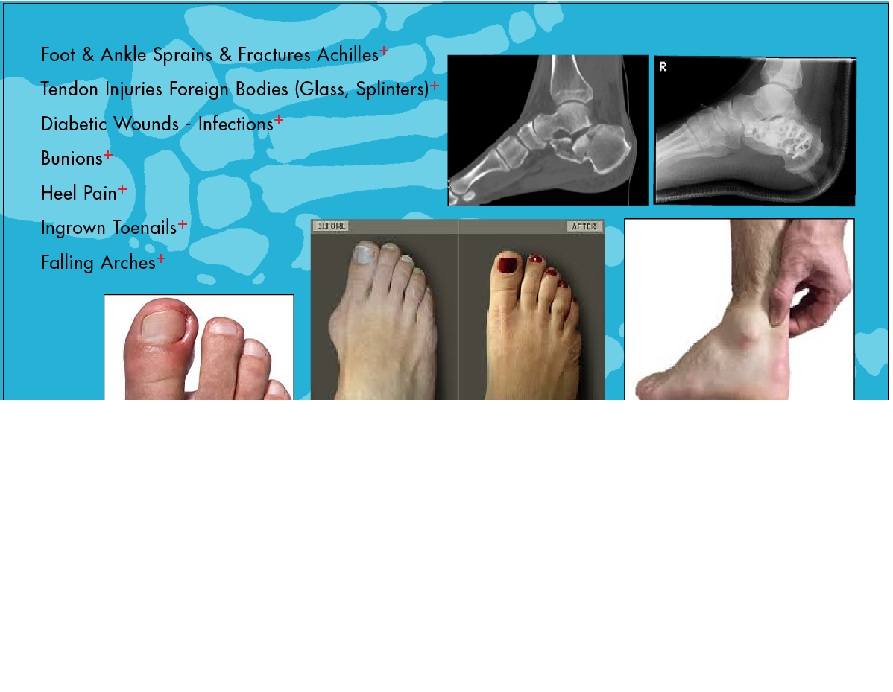
Pressure mapping of the feet is used for :- 1.Measuring degree of pronation. 2.Determining degree of ankle joint. 3.Determining patterns of weight bearing forces. 4.Back pain diagnosis. 5.Symmetry between feet. 6.Determining areas of highest pressure. 7.Identifying areas of potential ulceration in diabetics. 8.To evaluate surgical procedures. 9.Gait analysis of athletes for better performance.
Bangalore Institute of Technology
K.R. Road, V.V. Pura, Bengaluru.-560004.
Department of Computer Science & Engineering
APPLICATIONS

Slide 40
Bangalore Institute of Technology
K.R. Road, V.V. Pura, Bengaluru.-560004.
Department of Computer Science & Engineering
REFERENCES
[1] “A Compact Wearable System for Detection of Plantar Pressure for Diabetic Foot Prevention” Zihang You, Adnan Zahid, Hadi Heidari, Muhammad Ali Imran
[2]. “A Wearable Gait Analysis System Used in Type 2 Diabetes Mellitus Patients: A Case–Control Study” Wang C, Xu Y, Bai Y, Wang J, Long Z, Wang X, Zhou L
[3]. “Model-Based Feature Extraction for Gait Analysis and Recognition” Imed Bouchrika
[4]. “Foot Plantar Pressure Measurement System Based on Flexible Force-Sensitive Sensor and its Clinical Application.” Bochen li,Yi liu,weih on,shengqiang xu.
[5]. “Gait Analysis Methods: An Overview of Wearable and Non-Wearable Systems, Highlighting Clinical Applications” Alvaro Muro-de-la-Herran, Begonya Garcia-Zapirain ,Amaia Mendez-Zorrilla

Slide 41
Bangalore Institute of Technology
K.R. Road, V.V. Pura, Bengaluru.-560004.
Department of Computer Science & Engineering
REFERENCES
[6]. “Using Body-Worn Sensors for Preliminary Rehabilitation Assessment in Stroke Victims With Gait Impairment” Sen Qiu, Zhelong Wang, Hong-Yu Zhao, Long Liu
[7]. “Smart insole: A wearable system for gait analysis” Wenyao Xu, Ming-Chun Huang, Navid Amini, Jason J. Liu
[8]. “In-Shoe Plantar Pressure Measurement and Analysis System Based on Fabric Pressure Sensing Array ” Lin Shu, Tao Hua, Yangyong Wang, Qiao Li

Slide 42
Bangalore Institute of Technology
K.R. Road, V.V. Pura, Bengaluru.-560004.
Department of Computer Science & Engineering
THANK YOU

