Slide 1






FOOT PRESSURE MAPPING TECHNOLOGY
Bangalore Institute of Technology
K.R. Road, V.V. Pura, Bengaluru.-560004.
Department of Computer Science & Engineering
FINAL YEAR-PROJECT PRESENTATION
Presented by 20P07
USN | NAME
1BI20CS070 | Harsh Adhikari
1BI20CS047 | Chinmay Lohomi
1BI20CS057 | Dheeraj Katoch
1BI20CS189 | Vivek Gupta
Under the guidance of:
Guide Name –Madhuri J
Designation - Assistant Professor
Dept. of CSE
BIT.

Slide 2
Bangalore Institute of Technology
K.R. Road, V.V. Pura, Bengaluru.-560004.
Department of Computer Science & Engineering
Agenda
Introduction
Literature Survey
Existing System
Problem Statement
Proposed System
Project Planning
Application
References

Slide 3
Bangalore Institute of Technology
K.R. Road, V.V. Pura, Bengaluru.-560004.
Department of Computer Science & Engineering
OVERVIEW
An average person takes thousands of steps each day, resulting in the placement extreme high pressure on one’s feet.
This leads to various bio-mechanical problems with grievous effects. So, there is a need for monitoring foot pressure and treating these conditions effectively.
In this project, we present a versatile and discrete sensor which is capable of capturing data as you walk in real-time; vivid and easy to understand graphics obtained, will let the subject and the doctor see what happens while walking.

Slide 4
Bangalore Institute of Technology
K.R. Road, V.V. Pura, Bengaluru.-560004.
Department of Computer Science & Engineering
INTRODUCTION
Wireless Pressure Sensors: These sensors accurately measure the distribution of pressure exerted by the feet during walking, running, or standing.
Arduino Technology: The embedded system relies on Arduino technology to process the data from the pressure sensors in real-time.
Diagnosing Foot Conditions: By analyzing the pressure distribution and gait patterns, clinicians can make informed decisions about treatment and orthotic recommendations.
Custom Orthotics and Posture Correction: Based on the collected data, custom orthotics and posture correction strategies can be developed to address specific foot and lower limb issues.

Slide 5
Bangalore Institute of Technology
K.R. Road, V.V. Pura, Bengaluru.-560004.
Department of Computer Science & Engineering
OBJECTIVES
To build a light weight, protable, wireless system for monitoring of gait analysis .
To analyse the foot pressure and mapping the pressure in the application .
To provide a cost-effective and user-centered podiatric device .
To build a Machine Learning model for disease prediction
To implement a error free hardware-software prototype ready to be released to the market

Slide 6

Bangalore Institute of Technology
K.R. Road, V.V. Pura, Bengaluru.-560004.
Department of Computer Science & Engineering
LITERATURE SURVEY

Slide 7
[1] A Compact Wearable System for Detection of Plantar Pressure for Diabetic Foot Prevention
Bangalore Institute of Technology
K.R. Road, V.V. Pura, Bengaluru.-560004.
Department of Computer Science & Engineering
Authors : Zihang You, Adnan Zahid, Hadi Heidari, Muhammad Ali Imran
Publication : October 2018 IEEE Asia Pacific Conference
Proposed Idea : The proposed idea in this paper is to develop a pair of wearable shoe-pads with shoes that can detect and monitor the pressure and variations in plantar pressure on the human body. These shoe-pads are designed to provide a real-time pressure map and alarm to the patient or medical staff.

Slide 8
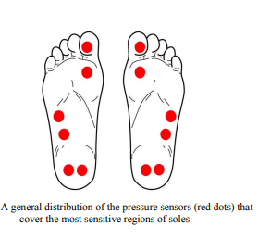
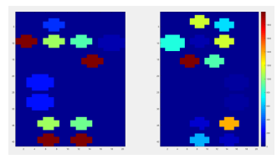
Architecture
Bangalore Institute of Technology
K.R. Road, V.V. Pura, Bengaluru.-560004.
Department of Computer Science & Engineering

Slide 9
[2] A Wearable Gait Analysis System Used in Type 2 Diabetes Mellitus Patients: A Case–Control Study
Bangalore Institute of Technology
K.R. Road, V.V. Pura, Bengaluru.-560004.
Department of Computer Science & Engineering
Authors : Wang C, Xu Y, Bai Y, Wang J, Long Z, Wang X, Zhou L
Publication : April 2021 Dove Medical Press
Proposed Idea : The proposed system in this study is the wearable gait analysis system called "Gaitboter." This system was used to investigate and analyze the gait of patients with type 2 diabetes, particularly those with peripheral neuropathy.

Slide 10
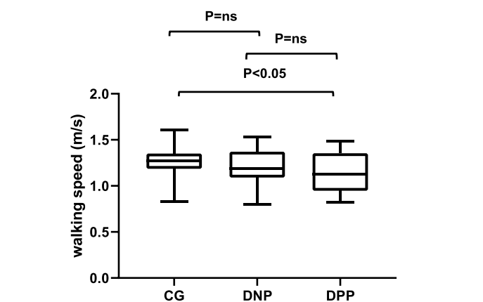
Architecture
Bangalore Institute of Technology
K.R. Road, V.V. Pura, Bengaluru.-560004.
Department of Computer Science & Engineering
Mean of walking speed (m/s) in different groups.
Abbreviations: DPP, diabetic patients with peripheral neuropathy; DNP, diabetic patients without peripheral neuropathy; CG, control group.

Slide 11
[3] Model-Based Feature Extraction for Gait Analysis and Recognition
Bangalore Institute of Technology
K.R. Road, V.V. Pura, Bengaluru.-560004.
Department of Computer Science & Engineering
Authors : Imed Bouchrika
Publication : 25 March 2016 IEEE International Conference
Proposed Idea : The proposed idea in the abstract is to use a model-based method for extracting human joint positions, specifically for gait analysis. This method employs elliptic Fourier descriptors to parametrize motion templates and leverages heel strike data to simplify the model. It successfully extracts ankle, knee, and hip joint positions with high accuracy for indoor and outdoor data, offering potential applications in recognition and markerless analysis.

Slide 12
Architecture
Bangalore Institute of Technology
K.R. Road, V.V. Pura, Bengaluru.-560004.
Department of Computer Science & Engineering
Elliptic Fourier Descriptors (EFD): The system utilizes Elliptic Fourier Descriptors to capture and model the complex motion patterns of the foot during gait. EFD is a mathematical technique that represents shapes by analyzing their contours, making it well-suited for modeling foot movement.
Integration of Heel Strike Data: To simplify the gait model, the system integrates data related to heel strikes. This information helps identify critical moments in the gait cycle and can be used to synchronize the gait analysis with the user's step pattern.
Real-Time Data Processing: The system employs real-time data processing to analyze the pressure distribution and gait patterns as the user walks or runs. This ensures that the analysis is conducted as the user moves, providing immediate feedback.
Wireless Data Transmission: The collected gait data and analysis results are wirelessly transmitted to the Android application for visualization and interpretation. This wireless data transmission allows for mobility and flexibility in using the system.
Custom Orthotic Generation: Based on the EFD-based motion model and the integrated heel strike data, the system can generate customized orthotic recommendations. These recommendations are tailored to the user's specific gait patterns and foot conditions, ensuring a personalized approach to posture correction and foot health improvement.

Slide 13
[4] Foot Plantar Pressure Measurement System Based on Flexible Force-Sensitive Sensor and its Clinical Application
Bangalore Institute of Technology
K.R. Road, V.V. Pura, Bengaluru.-560004.
Department of Computer Science & Engineering
Authors : Bochen li,Yi liu,weih on,shengqiang xu.
Publication : 16 december 2018 IEEE international conference
Proposed Idea : The study proposes a foot plantar pressure measurement system using a flexible force-sensitive sensor. This system features both hardware and software components and is designed for gait analysis. It demonstrates the system's accuracy and clinical value through a comparative experiment between patients with knee joint injuries and healthy subjects, showing significant differences in gait parameters and plantar pressure distributions..

Slide 14
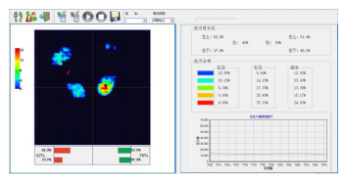
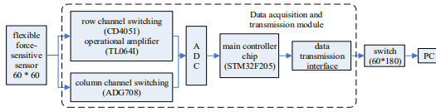
Architecture
Bangalore Institute of Technology
K.R. Road, V.V. Pura, Bengaluru.-560004.
Department of Computer Science & Engineering
The system software interface.
The flow chart of data acquisition and data transmission.

Slide 15
[5]. “Gait Analysis Methods: An Overview of Wearable and Non-Wearable Systems, Highlighting Clinical Applications”
Bangalore Institute of Technology
K.R. Road, V.V. Pura, Bengaluru.-560004.
Department of Computer Science & Engineering
Authors : Alvaro Muro-de-la-Herran, Begonya Garcia-Zapirain ,Amaia Mendez-Zorrilla
Publication : 19 February 2014 MDPI
Proposed Idea :This paper aims to provide a comprehensive overview of gait analysis systems, comparing Non-Wearable Systems (NWS) and Wearable Systems (WS), analyzing their advantages and disadvantages, and discussing their applications across various user groups, especially in clinical settings. The study also highlights the importance of developing future gait analysis technologies that address specific user needs and extend the measurement capacity of WS systems for long-term monitoring during daily activities.

Slide 16
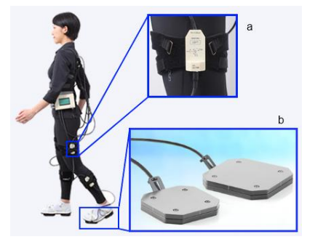
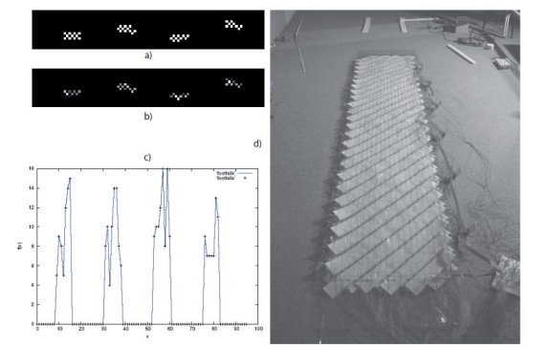
Architecture
Bangalore Institute of Technology
K.R. Road, V.V. Pura, Bengaluru.-560004.
Department of Computer Science & Engineering

Slide 17
[6]. “Using Body-Worn Sensors for Preliminary Rehabilitation Assessment in Stroke Victims With Gait Impairment”
Bangalore Institute of Technology
K.R. Road, V.V. Pura, Bengaluru.-560004.
Department of Computer Science & Engineering
Authors : Sen Qiu, Zhelong Wang, Hong-Yu Zhao, Long Liu
Publication : March 2018 IEEE international conference
Proposed Idea : The paper presents a wearable gait analysis system for assessing and rehabilitating stroke patients. The study emphasizes the significance of gait stability and quantifies various gait parameters, highlighting abnormalities in stroke patients' gait compared to healthy individuals. Individual patient analyses reveal specific gait issues, enabling tailored rehabilitation plans. The paper's central idea revolves around using wearable technology to assess and improve gait in stroke patients for enhanced rehabilitation outcomes.

Slide 18
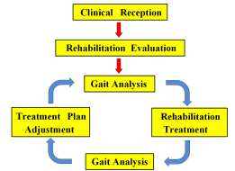
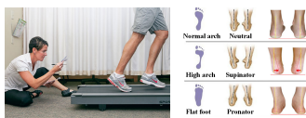
Architecture
Bangalore Institute of Technology
K.R. Road, V.V. Pura, Bengaluru.-560004.
Department of Computer Science & Engineering

Slide 19
[7]. “Smart insole: A wearable system for gait analysis”
Bangalore Institute of Technology
K.R. Road, V.V. Pura, Bengaluru.-560004.
Department of Computer Science & Engineering
Authors : Wenyao Xu, Ming-Chun Huang, Navid Amini, Jason J. Liu
Publication : June 2015 International Conference on Pervasive Technologies Related to Assistive Environments
Proposed Idea : The proposed idea is the development of a portable system called Smart Insole for gait analysis. Unlike traditional methods that require specialized gait labs and medical professionals, the Smart Insole integrates low-cost sensors within shoe insoles, enabling users to conduct gait analysis in their daily lives

Slide 20
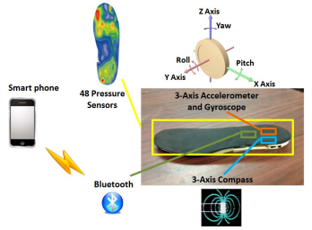
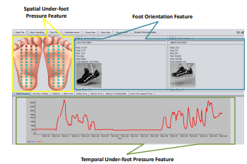
Architecture
Bangalore Institute of Technology
K.R. Road, V.V. Pura, Bengaluru.-560004.
Department of Computer Science & Engineering

Slide 21
[8]. “In-Shoe Plantar Pressure Measurement and Analysis System Based on Fabric Pressure Sensing Array”
Bangalore Institute of Technology
K.R. Road, V.V. Pura, Bengaluru.-560004.
Department of Computer Science & Engineering
Authors : Lin Shu, Tao Hua, Yangyong Wang, Qiao Li
Publication : May 2017 IEEE transactions on information technology in biomedicine: a publication of the IEEE Engineering in Medicine and Biology Society
Proposed Idea : The proposed idea is an in-shoe plantar pressure measurement and analysis system that utilizes a textile fabric sensor array integrated into an insole. This system offers a comfortable, lightweight, and cost-effective solution for evaluating footwear, athletic training, clinical gait analysis, and foot pathology diagnosis. It wirelessly transmits data to a remote receiver through Bluetooth, supporting multiple configuration modes.

Slide 22
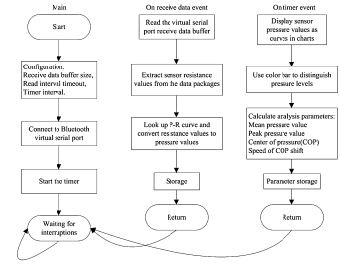
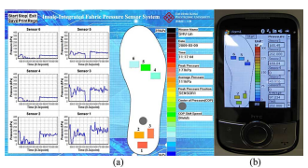
Architecture
Bangalore Institute of Technology
K.R. Road, V.V. Pura, Bengaluru.-560004.
Department of Computer Science & Engineering

Slide 23
EXISTING SYSTEM
Bangalore Institute of Technology
K.R. Road, V.V. Pura, Bengaluru.-560004.
Department of Computer Science & Engineering
The existing system of Gait analysis available in hospitals is a wired system with a simple vibrator
The foot pressures are measured based on vascular pressure and not force
The foot vascular pressure is monitored on PC
AI system is not included

Slide 24
PROBLEM STATEMENT
Bangalore Institute of Technology
K.R. Road, V.V. Pura, Bengaluru.-560004.
Department of Computer Science & Engineering
“The proposed wireless gait analysis system is portable, lightweight, and incorporates discrete sensors, making it suitable for various settings made using Arduino Uno and FSR sensor, for real-time monitoring and diverse applications including medical diagnosis and wellbeing assessments”
Input: Data collected from our Podiatric device built using IoT technology
Output: Prediction of disease due to foot pressures

Slide 25
PROPOSED STATEMENT
Bangalore Institute of Technology
K.R. Road, V.V. Pura, Bengaluru.-560004.
Department of Computer Science & Engineering
Gait analysis system for podiatric analysis where the FSR are used to measure pressure
Wireless data transmission eliminates the hindrance caused due to long wires
To develop our model we use EMBEDDED SYSTEM DEVELOPMENT LIFE CYCLE.
AI application is employed to predict the type of disease of the foot due to diabetes in patients using ML algorithms
ML algorithms like SVM, KNN, Logistic regression and Random Forest are used.

Slide 26
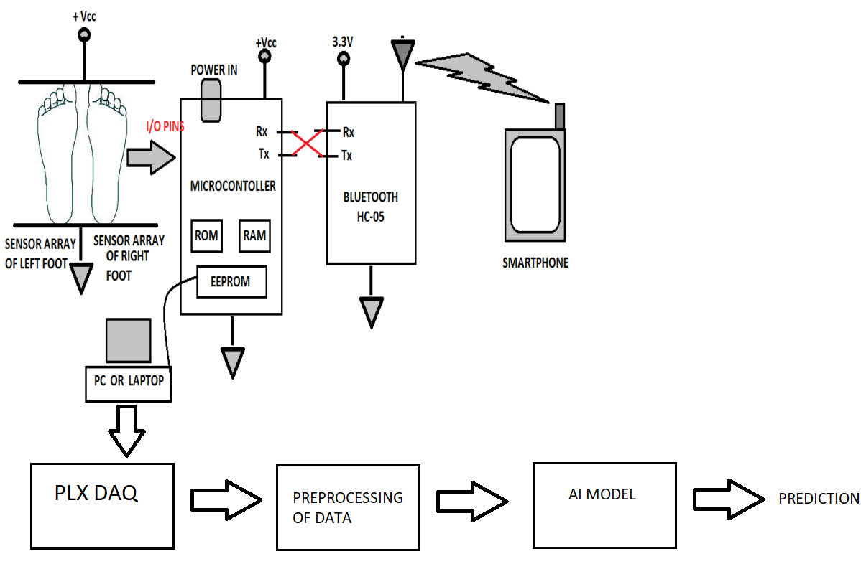
Bangalore Institute of Technology
K.R. Road, V.V. Pura, Bengaluru.-560004.
Department of Computer Science & Engineering
PROPOSED SYSTEM

Slide 27
SYSTEM REQUIRMENT
Bangalore Institute of Technology
K.R. Road, V.V. Pura, Bengaluru.-560004.
Department of Computer Science & Engineering
SOFTWARE AND HARDWARE REQUIREMENTS
SOFTWARE:
i. Coding Language : Python.
ii. Operating system : Windows 10 with MS EXCEL.
iii. Library : Matplotlib, numpy, Pandas, Sckit-learn.
iv. tool : Anaconda Navigator IDE 3.7.4 , jupyter Notebook, Arduino IDE
HARDWARE: ATMEGA 328 – 1 FSR Sensor – 4 Bluetooth module HC-05 – 1 Mobile phone Buzzer - 1 LED - 4 Resistors – 4 Jumper wires

Slide 28
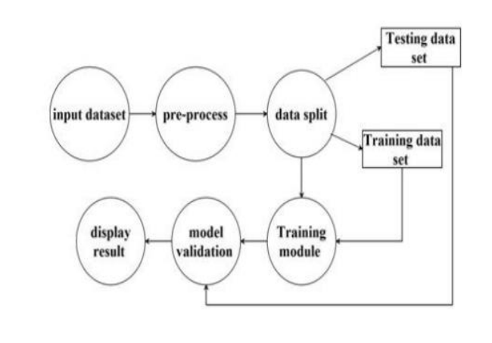
DATA FLOW DIAGRAM
Bangalore Institute of Technology
K.R. Road, V.V. Pura, Bengaluru.-560004.
Department of Computer Science & Engineering

Slide 29
FUNCTIONAL REQUIRMENTS
Bangalore Institute of Technology
K.R. Road, V.V. Pura, Bengaluru.-560004.
Department of Computer Science & Engineering
Collect the input dataset and Preprocessing the dataset
Applying the Logistic regression, KNN, SVM and Random forest classifier algorithms for retrieval of best algorithm for prediction.
The system should be able to communicate with the user with appropriate responses.
The system should be able to analyze the parameters and predict whether a patient has a heart disease or not

Slide 30
NON-FUNCTIONAL REQUIRMENTS
Bangalore Institute of Technology
K.R. Road, V.V. Pura, Bengaluru.-560004.
Department of Computer Science & Engineering
Usability The client acknowledge be typical nearly the buyer interfaces and committed to ask for ambush pressure in relocating to a unique framework with another condition.
Reliability The progressions made by the Programmer ought to be obvious both to the Project pioneer and in addition the Test design.
Uniformity The system must perform uniformly on all inputs.
Maintainability: The system watching and upkeep should be fundamental and focus in its approach
Security: Counting bug following the framework must give important security and must secure the entire procedure from slamming.
Efficiency: The system is made to perform at the best possible efficiency

Slide 31
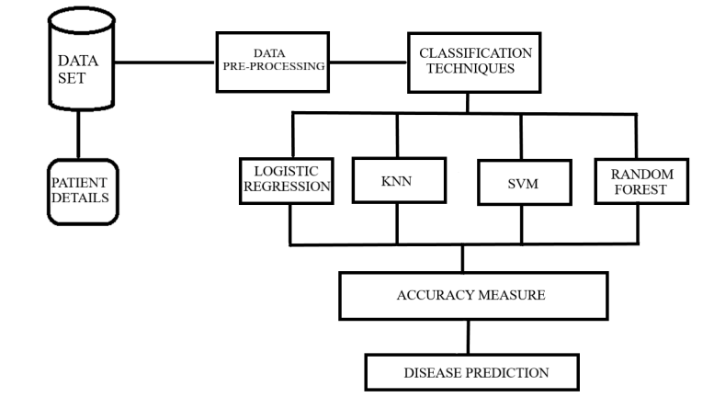
Bangalore Institute of Technology
K.R. Road, V.V. Pura, Bengaluru.-560004.
Department of Computer Science & Engineering
ARCHITECTURAL DESIGN

Slide 32
Bangalore Institute of Technology
K.R. Road, V.V. Pura, Bengaluru.-560004.
Department of Computer Science & Engineering
ALGORITHM DESIGN
Data Acquisition : The first stage of the proposed system is to acquire the data set
Data Pre-processing : It is the process of gathering, filtering and cleaning data before the data is put in an algorithm. To carry out this process we import the following libraries and data set i.e., Pandas, numpy, matpltlib.pyplot and seaborn modules from the Python Library. Pandas, Numpy and Seaborn Modules are used to convert the csv file to data frame (df) variable
Now different ML algorithms are used.

Slide 33
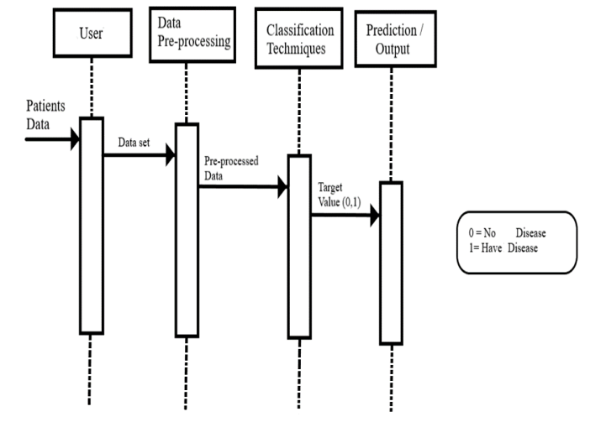
Bangalore Institute of Technology
K.R. Road, V.V. Pura, Bengaluru.-560004.
Department of Computer Science & Engineering
SEQUENCE DIAGRAM

Slide 34
Bangalore Institute of Technology
K.R. Road, V.V. Pura, Bengaluru.-560004.
Department of Computer Science & Engineering
Logistic Regression Algorithm
Modeling Binary Outcome : Logistic regression is employed when the dependent variable is binary, taking values like "0" and "1" (e.g., pass/fail).
The logistic function is utilized to model the relationship between the independent variables and the log-odds of the binary outcome.
Logistic Function and Odds : The logistic function converts log-odds (logarithm of odds) to probabilities, limiting the predicted probability between 0 and 1.
Parameter Estimation: Logistic regression involves estimating parameters for the logistic model.
The log-odds for the value labeled "1" is expressed as a linear combination of independent variables, each with its own parameter.

Slide 35
Bangalore Institute of Technology
K.R. Road, V.V. Pura, Bengaluru.-560004.
Department of Computer Science & Engineering
K-NN Algorithm
Overview of k-NN Algorithm: It is used for both classification and regression tasks , it relies on k closest training examples in the dataset.
k-NN Classification: In classification, the output is a class membership determined by a plurality vote of the k nearest neighbors.
The object is assigned to the class most common among its k nearest neighbors.
If k = 1, the object is assigned to the class of the single nearest neighbor.
k-NN Regression: In regression, the output is the average of the property values of the k nearest neighbors.
It predicts the property value for the object based on the average of its k nearest neighbors.

Slide 36
Bangalore Institute of Technology
K.R. Road, V.V. Pura, Bengaluru.-560004.
Department of Computer Science & Engineering
SVM Algorithm
Linear Binary Classifier: SVM is a mathematical and machine learning technique used to build a linear binary classifier.
It establishes a hyperplane in a high-dimensional space to separate a dataset into two segments, corresponding to the desired objective.
Hyperplane and Decision Boundary: The SVM classifier defines a hyperplane in the high-dimensional space that acts as the decision boundary between two classes.
This hyperplane is chosen to maximize the margin, which is the distance between the hyperplane and the nearest data points from each class.
Support Vectors: Support vectors are crucial data points that define the "gutters" or boundary conditions on either side of the hyperplane for each of the two classes.
Widest Street Approach:
SVM adopts a "widest street" approach, aiming to create the hyperplane with the maximum margin between the two classes.

Slide 37
Bangalore Institute of Technology
K.R. Road, V.V. Pura, Bengaluru.-560004.
Department of Computer Science & Engineering
Random Forest Algorithm
Ensemble Classifier: Random Forest is an ensemble classifier that combines multiple decision tree models to improve overall accuracy and robustness in both regression and classification tasks.
Collection of Random Trees: It consists of a collection of independently and identically distributed random trees, where each tree provides a unit of vote for the classification of input data.
Gini Index for Classification: Random Forest employs the Gini index as a criterion for classification, helping each individual tree determine the best split points and ultimately contributing to the final class assignment.
Voting Mechanism: The final class for a given input is determined by aggregating the results from each tree through a weighted voting mechanism.
Random Sampling with Weighted Votes: During training, a random seed is selected to draw a collection of samples from the training dataset, maintaining the class distribution.

Slide 38
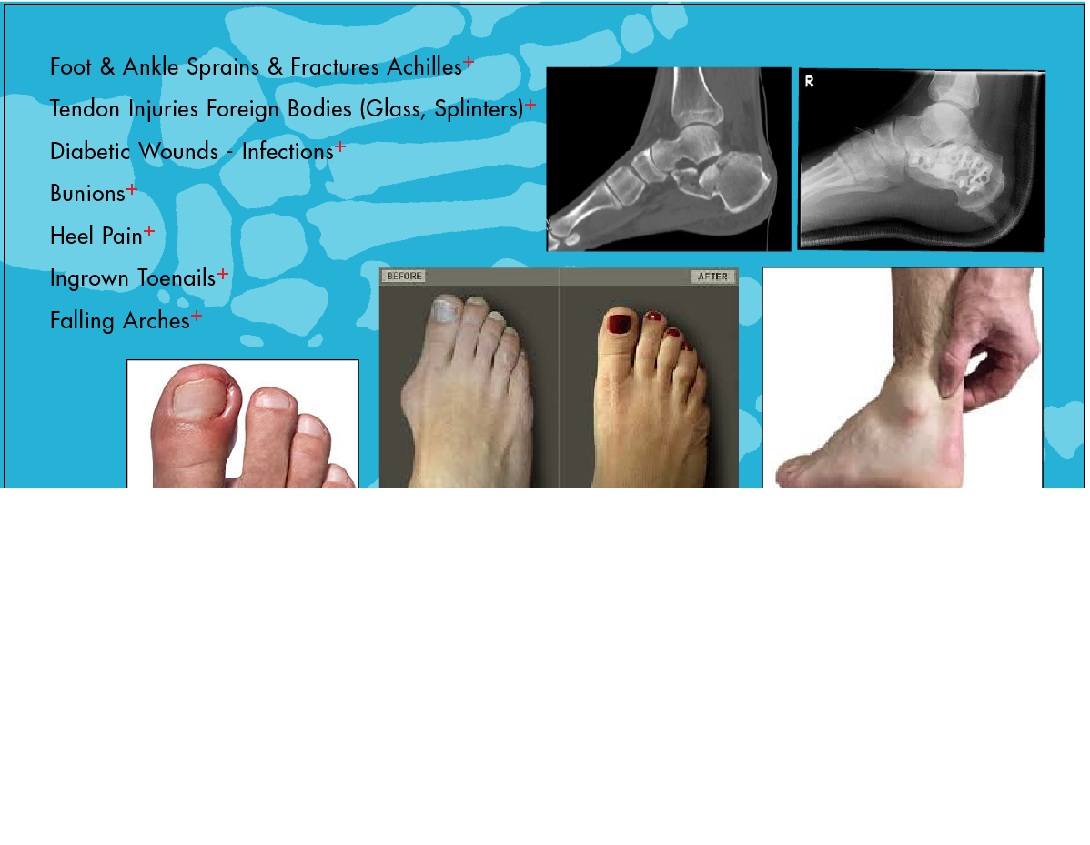
Pressure mapping of the feet is used for :- 1.Measuring degree of pronation. 2.Determining degree of ankle joint. 3.Determining patterns of weight bearing forces. 4.Back pain diagnosis. 5.Symmetry between feet. 6.Determining areas of highest pressure. 7.Identifying areas of potential ulceration in diabetics. 8.To evaluate surgical procedures. 9.Gait analysis of athletes for better performance.
Bangalore Institute of Technology
K.R. Road, V.V. Pura, Bengaluru.-560004.
Department of Computer Science & Engineering
APPLICATIONS

Slide 39
Bangalore Institute of Technology
K.R. Road, V.V. Pura, Bengaluru.-560004.
Department of Computer Science & Engineering
REFERENCES
[1] “A Compact Wearable System for Detection of Plantar Pressure for Diabetic Foot Prevention” Zihang You, Adnan Zahid, Hadi Heidari, Muhammad Ali Imran
[2]. “A Wearable Gait Analysis System Used in Type 2 Diabetes Mellitus Patients: A Case–Control Study” Wang C, Xu Y, Bai Y, Wang J, Long Z, Wang X, Zhou L
[3]. “Model-Based Feature Extraction for Gait Analysis and Recognition” Imed Bouchrika
[4]. “Foot Plantar Pressure Measurement System Based on Flexible Force-Sensitive Sensor and its Clinical Application.” Bochen li,Yi liu,weih on,shengqiang xu.
[5]. “Gait Analysis Methods: An Overview of Wearable and Non-Wearable Systems, Highlighting Clinical Applications” Alvaro Muro-de-la-Herran, Begonya Garcia-Zapirain ,Amaia Mendez-Zorrilla

Slide 40
Bangalore Institute of Technology
K.R. Road, V.V. Pura, Bengaluru.-560004.
Department of Computer Science & Engineering
REFERENCES
[6]. “Using Body-Worn Sensors for Preliminary Rehabilitation Assessment in Stroke Victims With Gait Impairment” Sen Qiu, Zhelong Wang, Hong-Yu Zhao, Long Liu
[7]. “Smart insole: A wearable system for gait analysis” Wenyao Xu, Ming-Chun Huang, Navid Amini, Jason J. Liu
[8]. “In-Shoe Plantar Pressure Measurement and Analysis System Based on Fabric Pressure Sensing Array ” Lin Shu, Tao Hua, Yangyong Wang, Qiao Li

Slide 41
Bangalore Institute of Technology
K.R. Road, V.V. Pura, Bengaluru.-560004.
Department of Computer Science & Engineering
THANK YOU

