Slide 1
Should we build agentic AI for offensive security?
Presented by Sudipta Acharya, PhD
RECOMMENDATION
Yes : a governed layer, proven in a 90-day pilot. Not another autonomous tool.
On the controlled test application, the AI adaptation ties tuned rule-based non-AI system.
On real-corpus curation the AI adaptation wins.
Fund a full product only once that advantage holds across diverse systems.
Based on controlled test app + Grafana evidence.
NUCLEIPILOT | TAKE-HOME SECURITY POC
01
Notes:
The decision the enterprise asked for is broad: should we build a product that applies agentic AI to offensive security - autonomous recon, red-teaming, triage? My recommendation is a scoped YES: enter as a GOVERNED layer on a proven open-source scanner (Nuclei) - the NucleiPilot approach - and prove it in a 90-day pilot, rather than building another autonomous red-teaming tool. The market already chases autonomy; for a regulated bank the defensible, differentiated entry is governance and evidence. The rest of the deck is that evidence: the market gap (slide 2), how the governed loop works (slide 3), what two demos actually showed (slide 4), and a reversible path with a kill-criterion (slide 5). Honest bottom line: on easy cases the agent only ties tuned rules; it clearly wins on hard, real-world curation - fund a full product only once that edge holds across diverse systems.

Slide 2
Market evidence leads to one focused experiment
What exists already
What our POC measures
Nuclei
1 Evidence-guided next check
Mature template-based security checks and filtering.
Does the planner choose a useful, approved validation after an initial signal?
Commercial agentic testing platforms
Products such as Terra and Hadrian already advertise validation, auditability, and scope controls.
2 Business-aware priority
Does it use the scan budget better than a simple severity rule or a tuned context-aware rule?
We do not claim these capabilities are missing from the market.
Narrow question: is the LLM worth its added cost and oversight?
NUCLEIPILOT | TAKE-HOME SECURITY POC
02
Notes:
Part 1 scanned the market, and two things are true. Mature scanners like Nuclei already do template-based detection and filtering well; and commercial agentic platforms - Terra, Hadrian and others - already advertise validation, auditability and scope controls, so I do NOT claim those capabilities are missing. The under-served corner for a bank is a transparent, governed decision layer on a trusted scanner, not another autonomous tool. That narrows the PoC to one honest question: does adding an LLM decision layer to Nuclei earn its extra cost and oversight? We measure two things - (1) evidence-guided next-check selection after an initial signal, and (2) business-aware prioritization under a limited scan budget, compared against BOTH a simple severity rule and a well-tuned context-aware rule. Beating a weak baseline proves nothing; the real bar is beating a well-tuned rule.

Slide 3
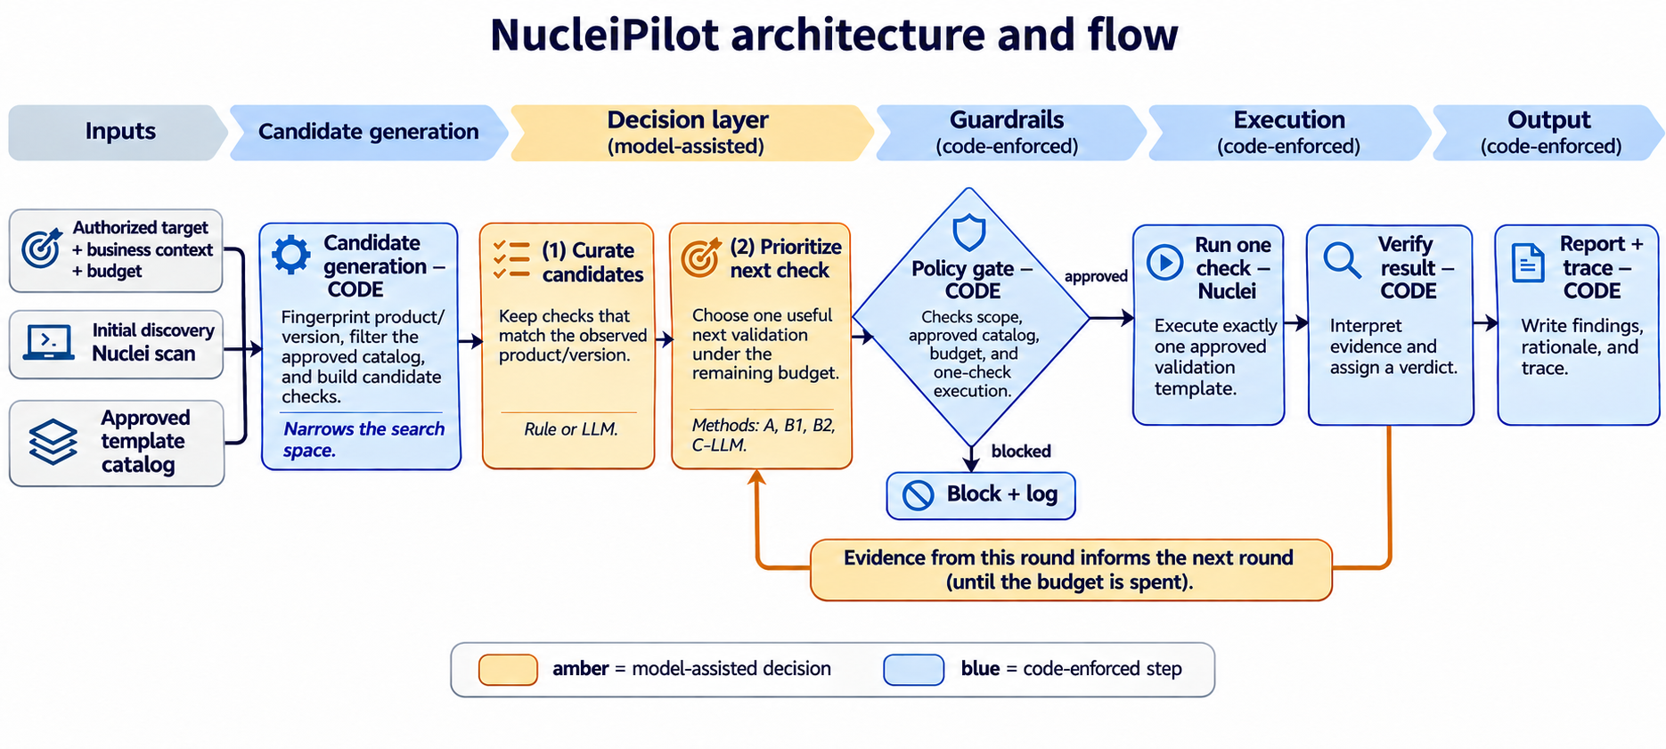
PoC
NucleiPilot = Nuclei (the proven scanner) + an AI agentic harness (decides what to test next) + code-enforced governance (keeps every action scoped, bounded and auditable).
NUCLEIPILOT | TAKE-HOME SECURITY POC
03
Notes:
This is the one governed loop - the same engine for both demos. Inputs: an authorized target with per-endpoint business context and a scan budget, an initial Nuclei discovery scan, and the approved template catalog. Code first narrows the candidates (fingerprint the product/version, filter the catalog). Then the model-assisted layer makes two kinds of decision - (1) CURATE: which candidate checks actually apply, and (2) PRIORITIZE: which one to run next under the remaining budget. Crucially the model only PROPOSES; a code policy gate then checks scope, the approved catalog, the budget and one-check execution before anything runs - out-of-scope or unapproved proposals are blocked and logged. Nuclei runs exactly one approved check, code interprets the evidence and assigns the verdict, and that evidence feeds the next round until the budget is spent. Amber = where the model assists; blue = enforced in code. The invariant - the model proposes, code authorizes - is the core safety property a regulated buyer asks for first.

Slide 4
What the evidence shows
Two demos on authorized localhost targets - a controlled test app, and a real Grafana server.
Demo 1 · Controlled test app - prioritization
Target: self-built 5-endpoint web app (localhost).
Templates: 7 custom “toy” templates (indicator → validation).
Under a 2-check budget: a severity rule chases the flashy high-severity page and misses the business-critical endpoints; a tuned context rule and the LLM both protect them.
Result: the LLM only TIES the tuned rule - honest, the agent is not needed on small, clean cases.
Also: a benign /health look-alike is marked NOT_CONFIRMED - a fired template is a hint, not a verdict.
Demo 2 · Live Grafana 8.3.0 - curation · REAL app & templates
Target: a real Grafana 8.3.0 server in Docker (localhost).
Templates: official ProjectDiscovery community templates from the real ~14k corpus - incl. the genuine CVE-2021-43798.
Task: from 12 Grafana-tagged CVEs, pick the one that applies to 8.3.0.
LLM picks CVE-2021-43798 → run live → CONFIRMED (reads /etc/passwd)
Governance throughout: model proposes, code authorizes (scope · allowlist · budget) · 4/4 safety tests fail safe. Bottom line: ties rules on easy cases; clearly wins on real-corpus curation - the pilot tests whether that edge holds broadly.
NUCLEIPILOT | TAKE-HOME SECURITY POC
04
Notes:
Two demos, one honest story - both on authorized localhost targets.
Demo 1, the controlled test app (prioritization): a self-built five-endpoint web app with seven custom ‘toy’ templates (indicator→validation pairs) and known ground truth. The business-critical endpoints (payments, account) deliberately carry only MEDIUM technical severity. Under a two-check budget, a severity-only rule chases the flashy high-severity page and misses the business-critical ones; both a tuned context-aware rule and the LLM protect payments and account. So the LLM only TIES a well-tuned rule here - and I report that honestly; the agent is not needed on small, clean cases. The app also plants a benign /health look-alike beside a real /docs issue; code validates both and marks /health NOT_CONFIRMED - a fired template is a hint, not a verdict.
Demo 2, live Grafana (curation) - a REAL application and REAL templates: a genuine Grafana 8.3.0 server in a local Docker container, scanned with the OFFICIAL ProjectDiscovery community templates from the real ~14,104-template corpus, including the genuine CVE-2021-43798 template. The task: from the 12 Grafana-tagged CVEs a tag filter gathers, pick the one that actually applies to 8.3.0. A tag rule cannot read versions (F1 0.15); a naive version parser trips on messy free-text ranges (0.29); the LLM reads the prose and selects exactly CVE-2021-43798 (F1 1.00, stable over three runs). Then the SAME governed engine runs that real community template live and the code verdict is CONFIRMED - it actually reads /etc/passwd via the plugin path traversal. A read-only safety gate refuses intrusive CVEs even if proposed.
Governance holds throughout both demos: model proposes, code authorizes (scope, allowlist, budget), and four of four deterministic safety tests fail safe. Bottom line: ties a tuned rule on easy cases, clearly wins on real-corpus curation - the condition that matters in the real world - and the pilot measures whether that edge holds across diverse, authorized targets.

Slide 5
From POC to a reversible investment decision
Days 1-30
Days 31-60
Days 61-90
Reproduce & compare
Add enterprise controls
Pilot & decide
Real approved targets; tuned rules vs. LLM; measure errors and cost.
Review permissions, data handling, logging and analyst approval.
Run on approved non-production assets; measure value vs. rules.
STOP the AI decision layer if it cannot beat tuned rules by enough to justify cost, delay and governance risk.
NUCLEIPILOT | TAKE-HOME SECURITY POC
05
Notes:
From PoC to a reversible investment decision, with gates so we never over-commit. Days 1-30: reproduce the PoC on real, approved targets and compare the LLM head-to-head against tuned rules, measuring errors and cost. Days 31-60: add the enterprise controls a bank requires - permissions/SSO, data-handling review, logging, and an analyst-approval step. Days 61-90: run a monitored pilot on approved non-production assets and measure value versus rules. The decision is reversible by design: expand the AI layer only with repeatable improvement over tuned rules, approved safeguards and acceptable cost; otherwise fall back to rules (an LLM can still help explain findings to analysts); and stop immediately if authorization, scope or sensitive-data controls ever fail. The one result that flips the yes-to-pilot into a no-to-building decision: no meaningful advantage over tuned rules on diverse real targets once accuracy, analyst time, reliability and cost are accounted for.

