Slide 1
Should AMEX build agentic AI for offensive security?
Presented by Sudipta Acharya, PhD
RECOMMENDATION
Yes — a governed layer, proven in a 90-day pilot. Not another autonomous tool.
On the controlled test app the LLM ties tuned rules; on real-corpus curation it already wins.
Fund a full product only once that advantage holds across diverse systems.
Based on saved controlled test app + Grafana evidence; not an independent enterprise benchmark.
NUCLEIPILOT | AMEX × ATOS TAKE-HOME
01
Notes:
The decision the exec asked for is broad: should AMEX build agentic AI for offensive security (autonomous recon, red-teaming, triage)? My answer is yes, but scoped: enter as a GOVERNED layer on a proven scanner (the NucleiPilot approach), proven first in a 90-day pilot -- not another autonomous tool. The market chases autonomy; for a bank the defensible move is governance and evidence. The PoC is the evidence: ties tuned rules on easy cases, clearly wins on real-corpus curation. Fund a full product only once that advantage holds across diverse systems.

Slide 2
Market evidence leads to one focused experiment
What exists already
What our POC measures
Nuclei
1 Evidence-guided next check
Mature template-based security checks and filtering.
Does the planner choose a useful, approved validation after an initial signal?
Commercial agentic testing platforms
Products such as Terra and Hadrian already advertise validation, auditability, and scope controls.
2 Business-aware priority
Does it use the scan budget better than a simple severity rule or a tuned context-aware rule?
We do not claim these capabilities are missing from the market.
Narrow question: is the LLM worth its added cost and oversight?
NUCLEIPILOT | AMEX × ATOS TAKE-HOME
02

Slide 3
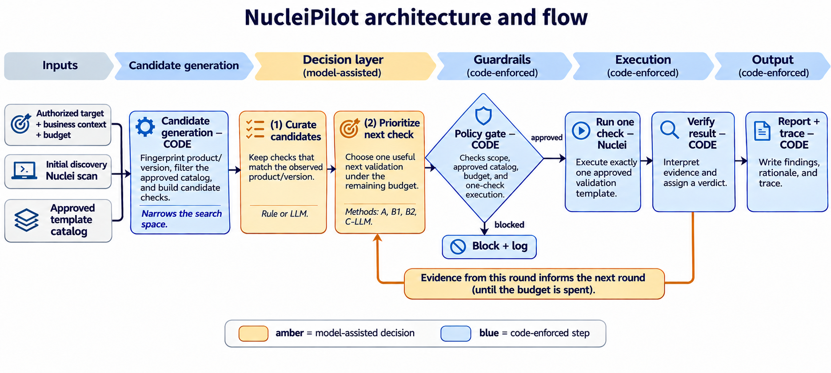
NUCLEIPILOT | AMEX × ATOS TAKE-HOME
03

Slide 4
What the evidence shows — honestly
Two decision tasks: prioritize under budget (easy, controlled app) and curate from the real ~14k-template corpus (hard, realistic).
Prioritization · controlled test app
LLM ties a tuned context rule under a 2-check budget. Honest: the agent is not needed on small, clean cases.
Curation · real 14k corpus — the win
From 12 Grafana-tagged CVEs the LLM reads messy free-text versions and picks CVE-2021-43798 for v8.3.0 → same engine runs it live → CONFIRMED (real file read).
Governance holds throughout
Benign /health look-alike rejected on evidence · 4 / 4 deterministic safety tests fail safe.
Bottom line: ties a tuned rule on easy cases; clearly wins where it counts — curation over a large, messy, real corpus. The pilot tests whether that edge holds across diverse targets.
NUCLEIPILOT | AMEX × ATOS TAKE-HOME
04
Notes:
Two experiments, one honest story. On the small, controlled test app the LLM only TIES a tuned context rule on prioritization (budget 2) — so it is not needed there, and I say so. The decisive result is CURATION on the real ~14k-template corpus: from 12 Grafana-tagged CVEs the LLM picks the one applicable to v8.3.0 at F1 1.00, versus 0.15 for a tag rule and 0.29 for a naive version parser, stable over 3 runs — because affected-version data is messy free-text, a reading task. It then runs CVE-2021-43798 live through the same governed engine and the code verdict is CONFIRMED. Governance holds throughout. This is why the recommendation is a scoped pilot: the agent's value scales with the size and messiness of the template space, and the pilot measures whether that holds across diverse targets.

Slide 5
From POC to a reversible investment decision
Days 1–30
Days 31–60
Days 61–90
Reproduce & compare
Add enterprise controls
Pilot & decide
Real approved targets; tuned rules vs. LLM; measure errors and cost.
Review permissions, data handling, logging and analyst approval.
Run on approved non-production assets; measure value vs. rules.
STOP the AI decision layer if it cannot beat tuned rules by enough to justify cost, delay and governance risk.
NUCLEIPILOT | AMEX × ATOS TAKE-HOME
05

