Slide 1
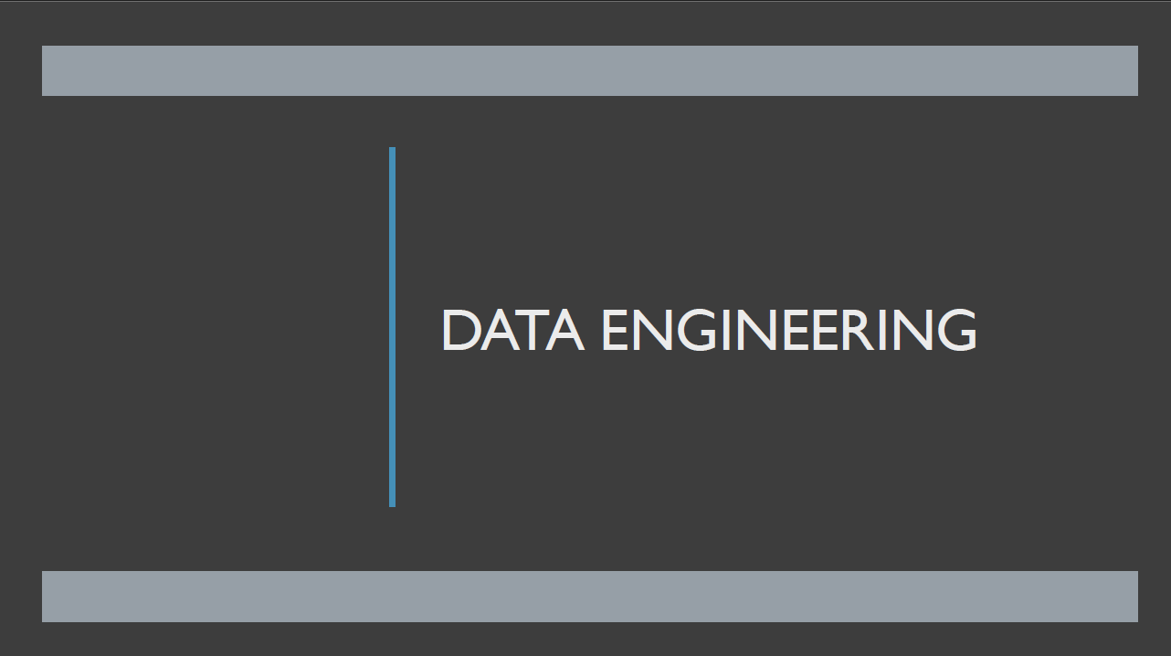

Slide 2
Frontend[React, Angular, etc.] (CRUD UI) [Create, Read, Update, Delete]
↓
Backend Services[Node.js, Django, Spring Boot, etc.]
↓
DBMS (e.g., MySQL, PostgresSQL, MongoDB, etc)
↓
[ETL Pipelines] — DE
↓
Data Lake / Warehouse / Big Data (Spark, Hadoop, Kafka)
↓
[DS/ML/DA] — Insights & Predictions
↓
Dashboards / Reports (Power BI, Tableau)

Slide 3
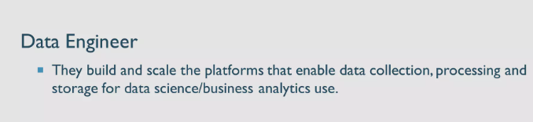

Slide 4
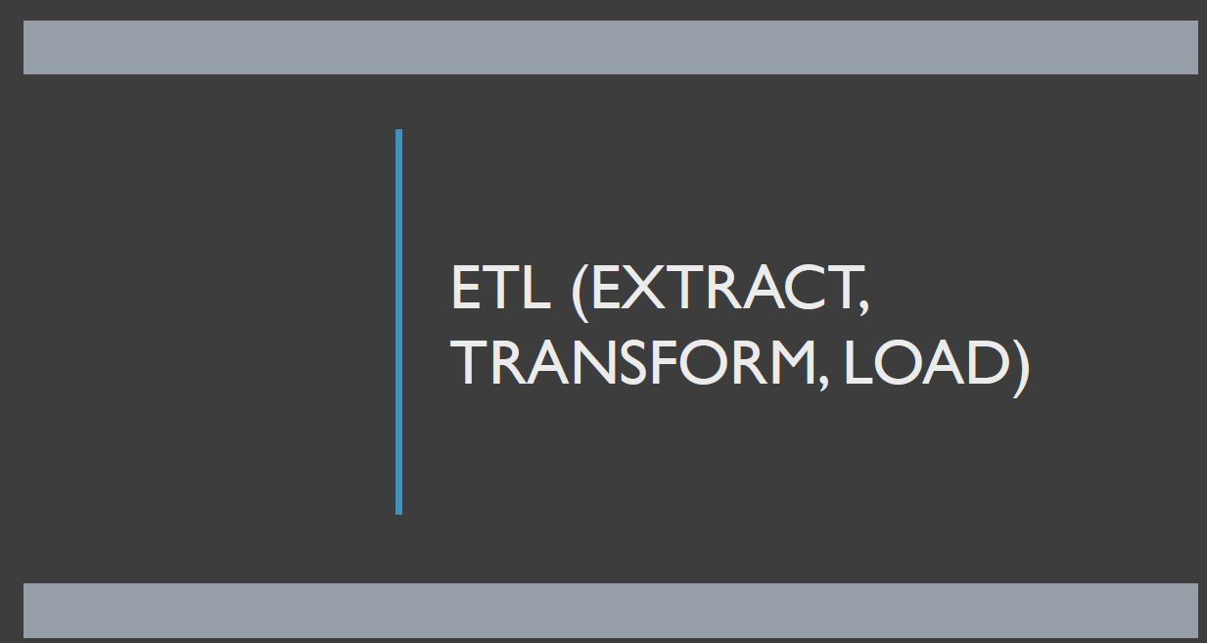

Slide 5
[Step 1: Extract] ← Upstream
─────────────────────
Pull RAW DATA from MySQL database
↓
[Step 2: Transform] ← Middle layer
─────────────────────
Clean and enrich data, e.g., format dates, remove duplicates
↓
[Step 3: Load] ← Downstream
─────────────────────
Load transformed data into a Data Warehouse (e.g., Snowflake) ##PROCESSED DATA
↓
[Step 4: Dashboard]
─────────────────────
BI tool (e.g., Power BI) reads from warehouse to show charts ##COOKED DATA

Slide 6
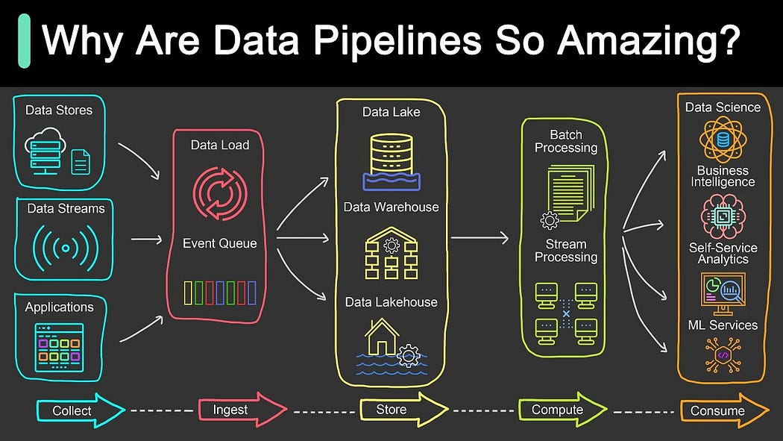
Step | Action | Purpose
Collect | Gather raw data | Capture from apps, APIs, devices
Ingest | Load into pipeline | Queue or stream data safely
Store | Save in lakes/warehouses | Keep data for access & analysis
Compute | Process/transform the data | Make it clean, structured, and useful
Consume | Use for BI, ML, or analytics | Create reports, predictions, insights

