Slide 1
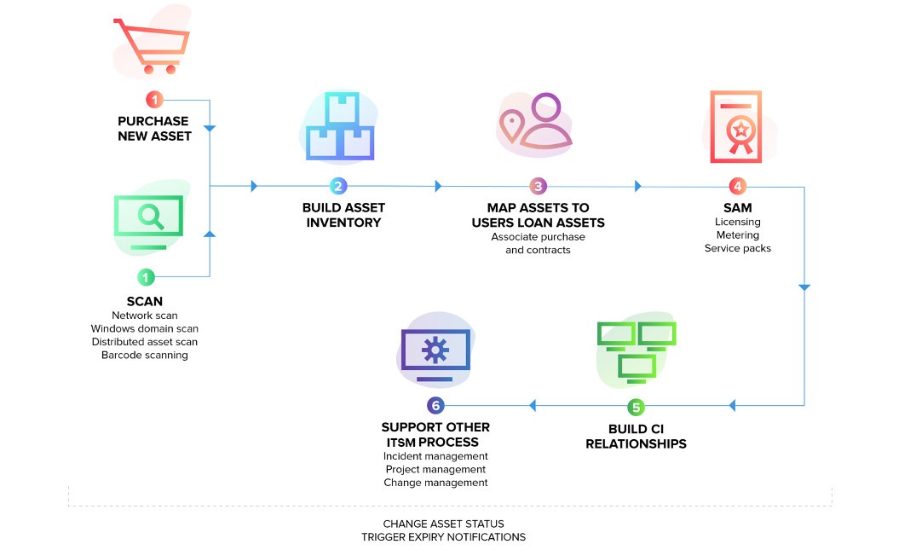

Slide 2









Slide 3
start
Login (admin)
HOME
ASSET
USERs
Assign Location
Move Asset
Release Asset
Audit Asset
Scan Asset (button)
Scan Asset (button)
Scan Asset (button)
Not Implemented
Scan Location (button)
Scan Location (button)
Scan Location (button)
Continue

Slide 4
Asset List
Download QR
Add Asset
Users List
New User
Edit , Delete (implemented) Give Permissions as per Role (Need to Implemented)
Create User
Asset QR
Location QR
Add Asset Manual
Download Template
Upload File
Generate by ID
Manual
Generate by ID
Manual
Add To Database

Slide 6
start
Login (admin1)
HOME
ASSET
Assign Location
Move Asset
Release Asset
Audit Asset
Scan Asset (button)
Scan Asset (button)
Scan Asset (button)
Create Audit
Audit Report
Scan Location (button)
Scan Location (button)
Scan Location (button)
Not implemented
Continue

Slide 7
Asset List
Download QR
Add Asset
Asset QR
Location QR
Add Asset Manual
Download Template
Upload File
Generate by ID
Manual
Generate by ID
Manual
Add To Database

Slide 8
start
Login (admin3)
HOME
Assign Location
Move Asset
Release Asset
Audit Asset
Scan Asset (button)
Scan Asset (button)
Scan Asset (button)
Not Implemented
Scan Location (button)
Scan Location (button)
Scan Location (button)

