Slide 1
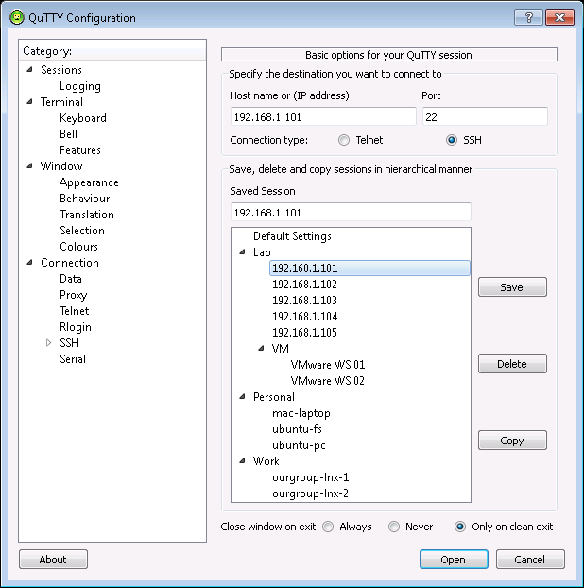
Hierarchical Sessions
Just drag-drop sessions to create sessions in tree hierarchy
Saves Session settings -
Use it to rename session
Delete current Session
Copy Sessions
Creates a copy of currently selected session. Use it to create new sessions

Slide 2
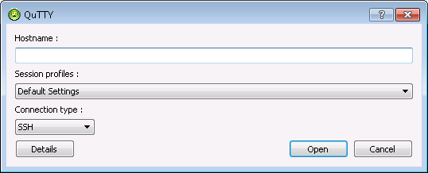
Auto completion allows entering Hostname/Session Profile easily with only a few keystrokes
Bring-up the classical detailed configuration window that allows to manage sessions and their configuration
Drop-down of hierarchical sessions allows selecting a profile to use quickly

