Slide 1

GEOPHYSICAL IMAGING
ELECTRICAL METHOD
Qixun Dan

Slide 2
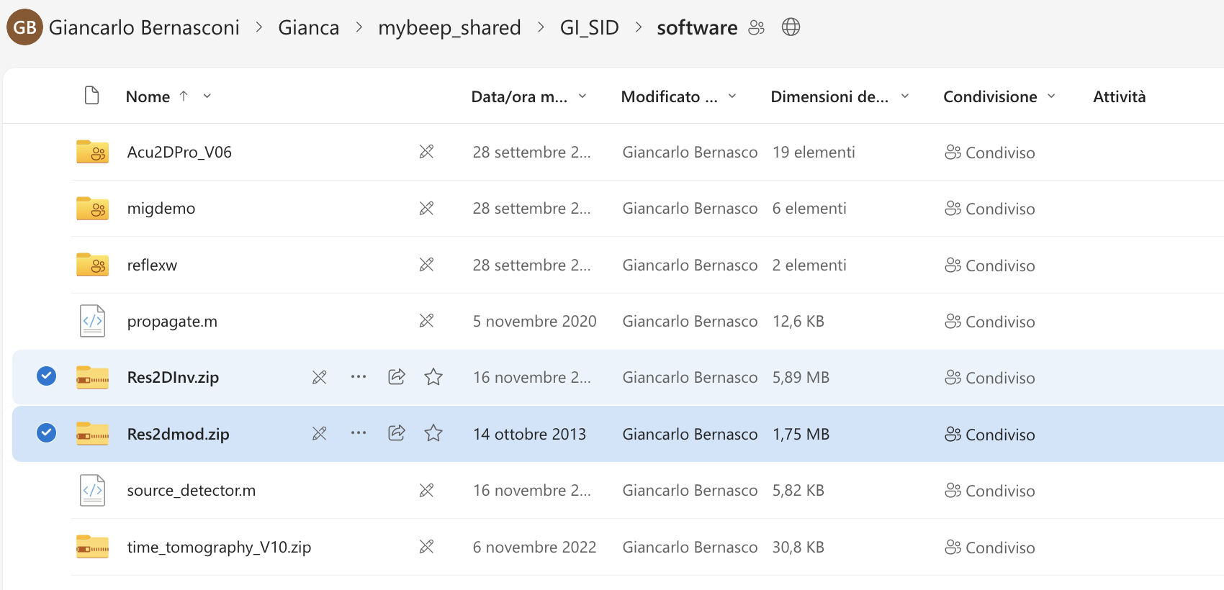
Step1
1.1. Download SW
Download RES2DMOD and RES2DINV from BEEP (SW folder)

Slide 3
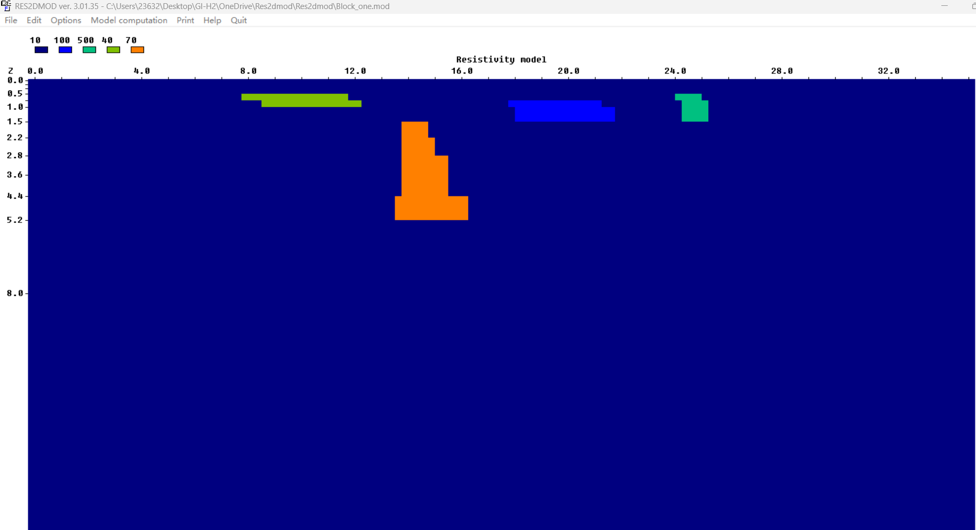
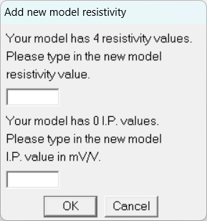
Step2
1.2. Simulation of an electrical acquisition
Use the SW RES2DMOD (RESistivity 2D MODeling) to compute a synthetic pseudosection for a given user model.
Enter the RES2DMOD folder, start the SW by running RES2DMOD.EXE, Load (FILE menu) a model: I suggest BLOCK_ONE.MOD.
Use EDIT to modify the model by deleting and assigning new resistivity values with the mouse, and to build a simulation scenario (e.g. a cavity, a layer, a localized anomaly, a specific shape anomaly, …).
Save the new model (res2dmod format) with another name.

Slide 4
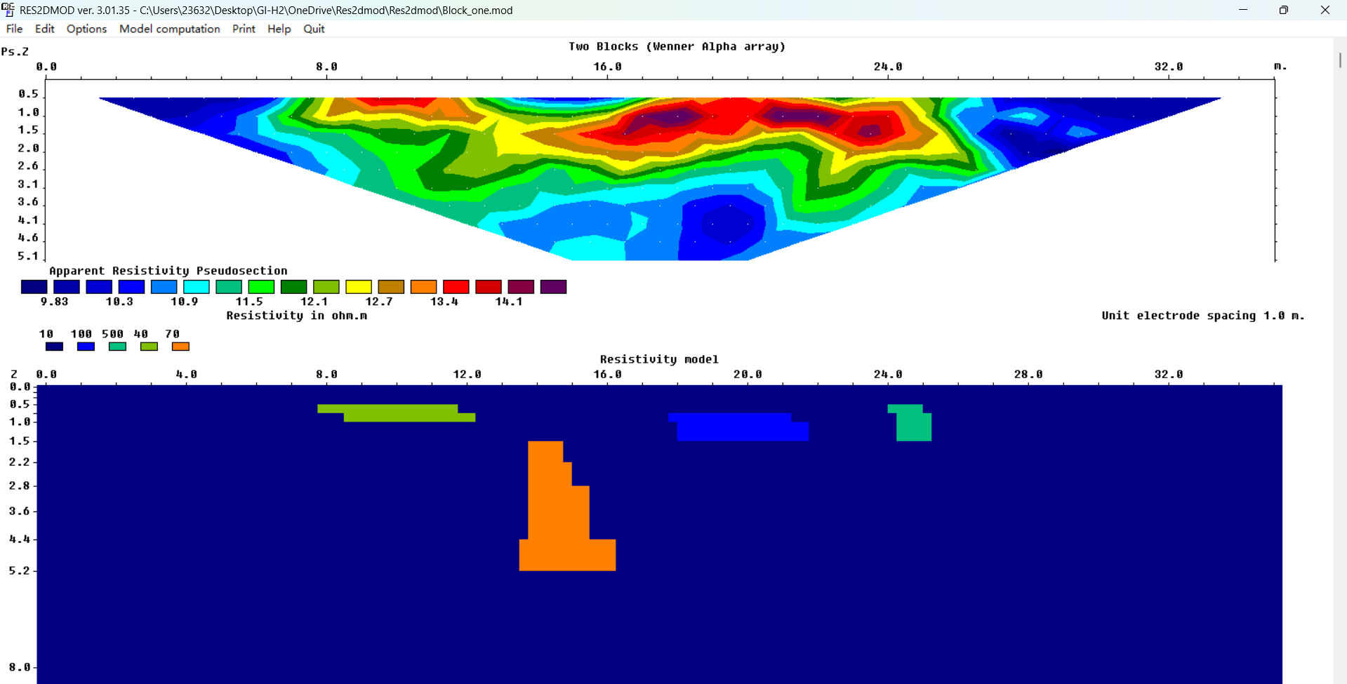
Step2
This plot shows the apparent resistivity pseudosection. Each color cell is one ρₐ measurement from a Wenner-α setup. The software calculates ρₐ using ρₐ = K·ΔV/I; for Wenner, K = 2πa. I exported the .DAT file from RES2DMOD (RES2DINV format) to get the numbers. In my figure the values are about 9.8–14.1 Ω·m. A pseudosection is only a data display; we need inversion to estimate the true resistivity.
1.2. Simulation of an electrical acquisition- Run an electrical acquisition simulation on the model. Check the result – we chose … Save a screen dump
Parameters: Apparent Resistivity Pseudosection / Werner Alpha Array / 36 electrodes on the Surface / Separation between electrodes: 1m / The values are about 9.8–14.1 Ω·m.

Slide 5
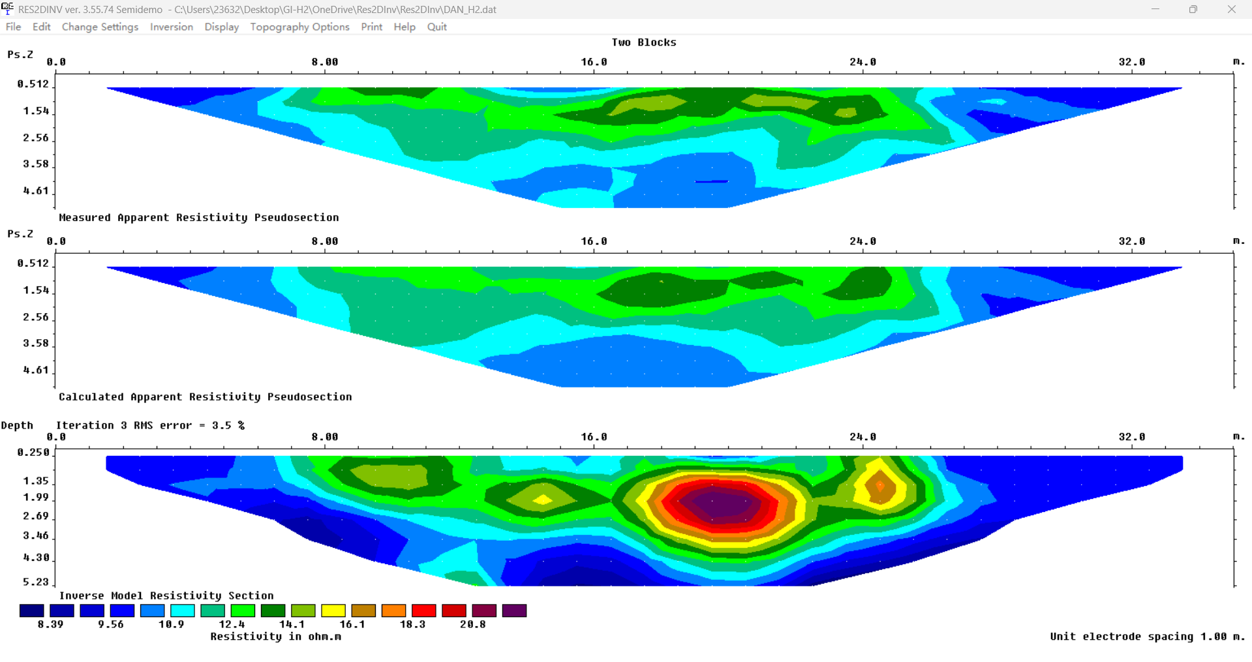
Step3
1.3. Resistivity inversion of an electrical acquisition
Use the SW RES2DINV (RESistivity 2D INVersion) to invert the true resistivity from the apparent resistivity in a pseudosection: we are using here our “simulated” acquisition. Enter the RES2DINV folder, start the SW by running RES2DINV.EXE. Load (FILE menu) the data generated in the previous section. Run the “standard” inversion. Check the result, save a dump screen in the POWERPOINT presentation, compare with the starting model, put comments in the presentation.
1. Measured apparent resistivity pseudosection from my data. It is only a data display, not the true subsurface.
2. Calculated apparent resistivity pseudosection. These are the predicted ρₐ values from the current inversion model at that iteration.
We compare it to the measured panel to see the misfit.
3. Inverse model resistivity section.
This is the recovered true-resistivity image after iterative inversion.
“Iteration 3 RMS error = 3.5%”. That is the data misfit after 3 iterations. Shows model with a small average error, close to the expected noise level.
Colorbar shows about 8.4 → 20.8 Ω·m; (an estimate of “true” resistivity after inversion).The central red area is the more resistive body, surrounded by lower-resistivity background.

Slide 6
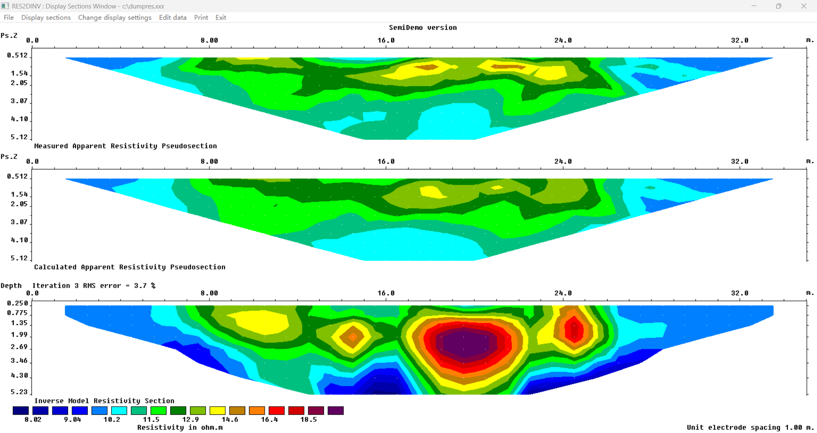
Step4
Perform other inversions by modifying the inversion settings.
Dump screen in presentation and comment. Suggestion: try to use same color scale for all graphics. In res2dinv, after running the inversion, you have to
enter the “DISPLAY” interface to set the colormap.
Vertical-to-horizontal flatness filter ratio: 3
I increased the vertical-to-horizontal flatness ratio to 3, which smooths the model more in the vertical direction; as a result the main anomaly looks taller with a deeper tail, while the data fit remains good at about 3.7% RMS.

Slide 7
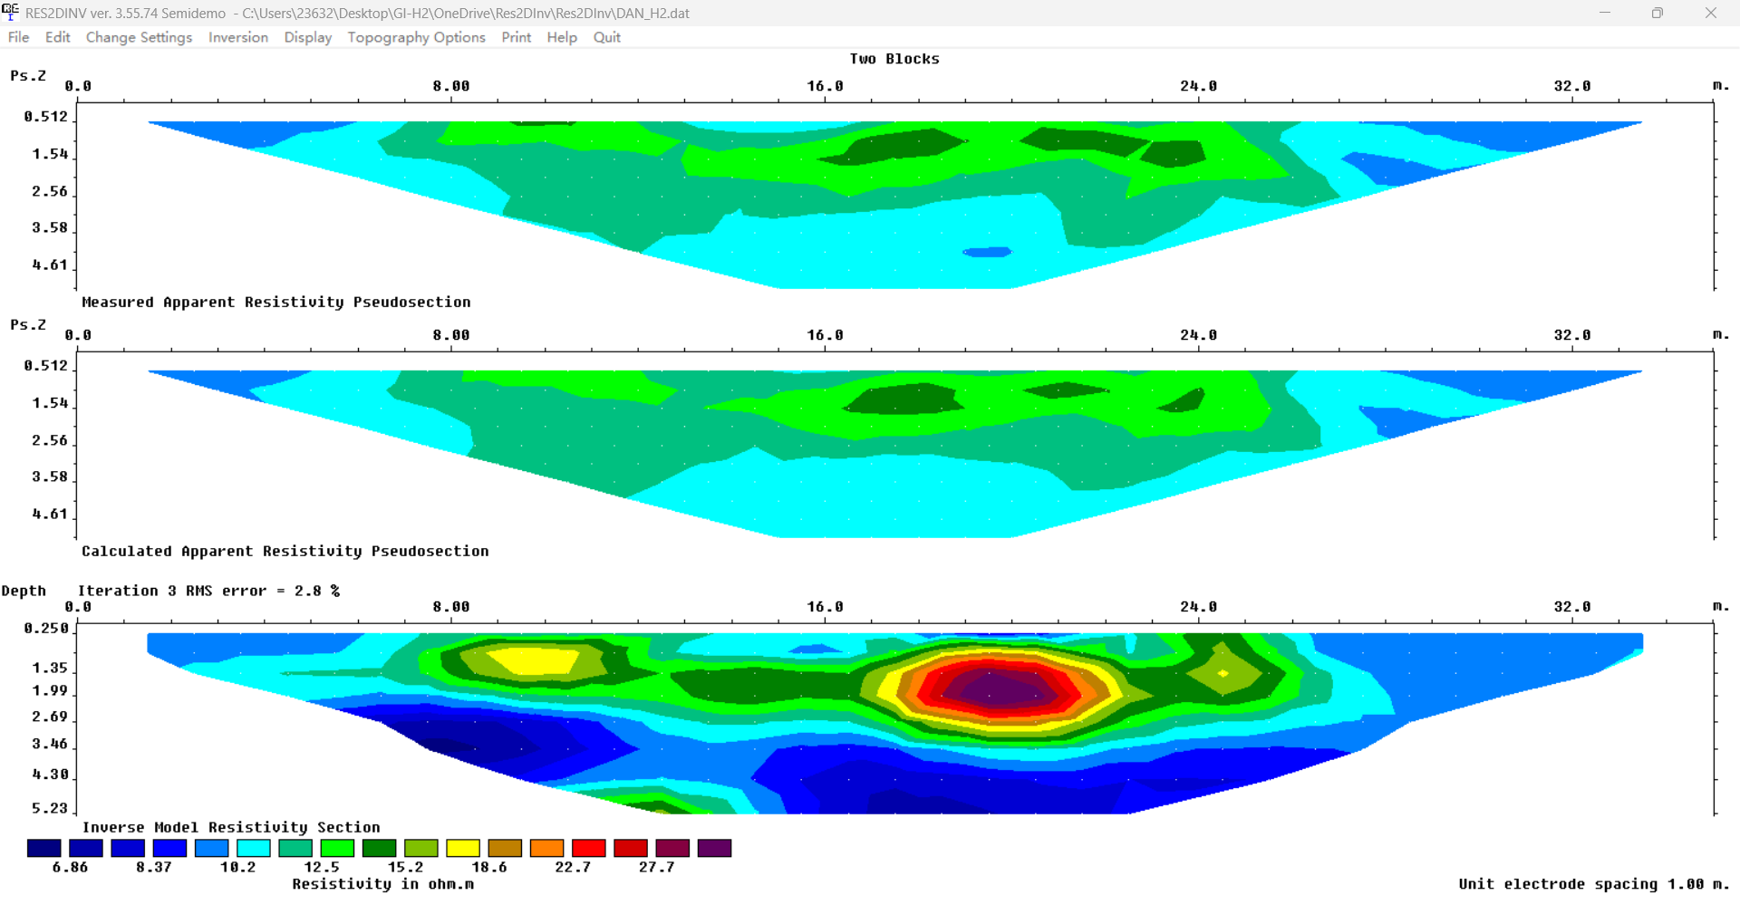
Step5
Perform other inversions by modifying the inversion settings.
Vertical-to-horizontal flatness filter Ratio
0.3
With V over H = 0.3 the inversion helps horizontal smoothing, so my resistive body spreads laterally and looks flatter; the fit is good at about 2.8% RMS.

Slide 8
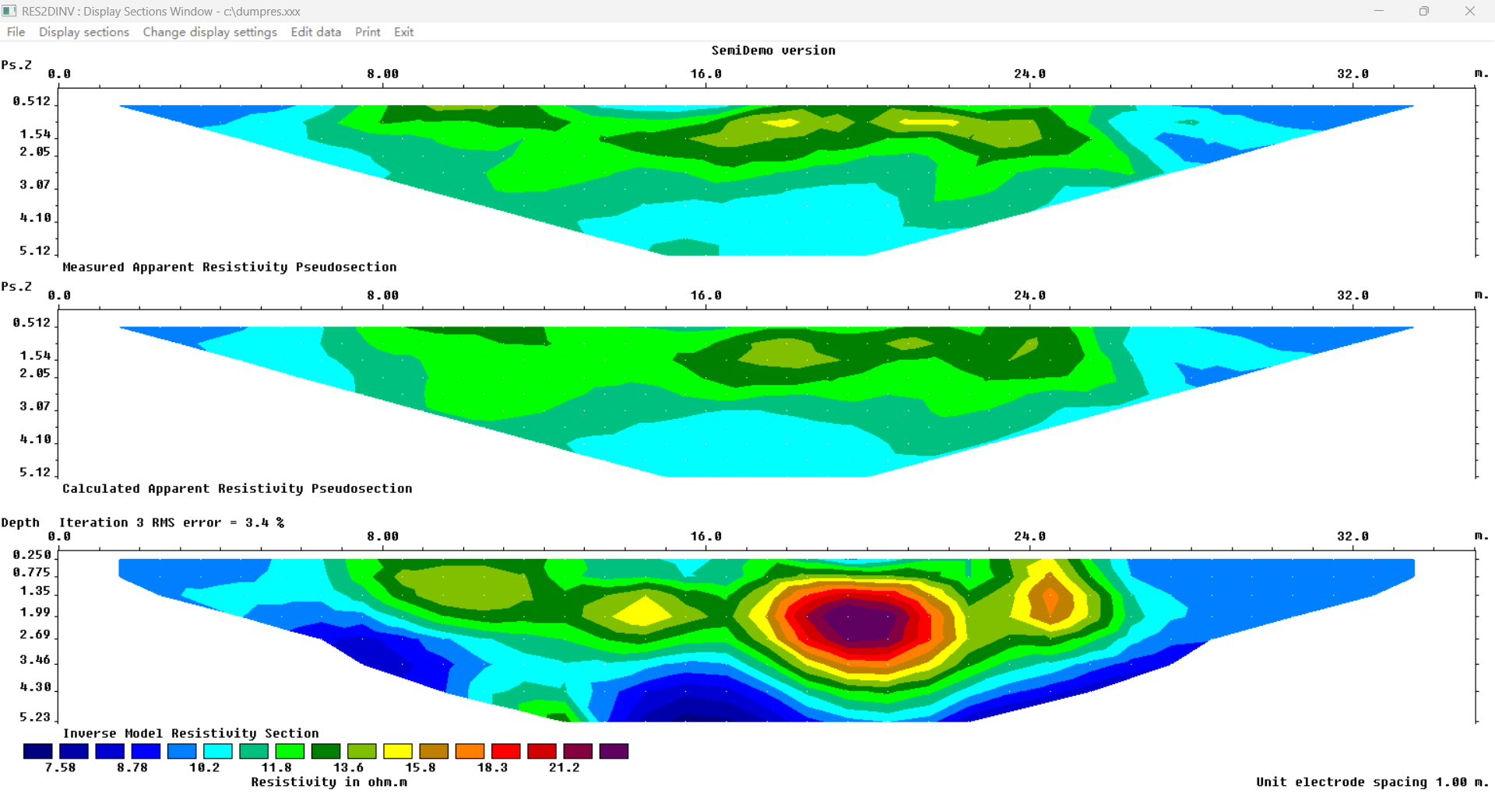
Step6
Damping factor with Depth: 0.04
Depth damping test (0.04). Adding a depth-dependent damping stabilizes the deep cells where sensitivity is low. The deep background becomes smoother, and the main resistive body appears slightly wider and shallower. The measured vs. calculated pseudosections still agree well (RMS ≈ 3.4%). Thus, this setting mainly improves deep stability while mildly spreading anomalies horizontally.

Slide 9
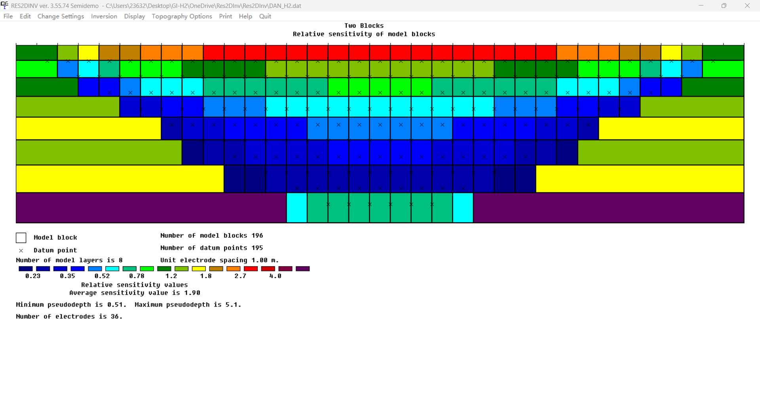
Step7
Relative Sensitivity of model blocks:
Relative sensitivity map (Wenner-α, 36 electrodes, a = 1 m). Sensitivity is highest under the line near the surface and decreases with depth (trapezoid). Avg. sensitivity = 1.90; pseudo-depth range = 0.51–5.1 m. This coverage justifies using depth damping to stabilize the deep model and shows where the inversion is well vs poorly constrained.

Slide 10
Comments
Survey & data： I used a Wenner-alpha array with 36 electrodes and 1 m spacing. The top panel is an apparent-resistivity pseudosection; each cell is one measurement computed by ρₐ = K·ΔV/I. A pseudosection is data display, not the true subsurface.
Inversion triplet： Top = Measured ρₐ, Middle = Calculated ρₐ from the current model, Bottom = Inverse model resistivity. I compare the first two to evaluate the RMS misfit.
Baseline fit： My inversions reach ~3.5% / 2.8% / 3.4% RMS in different tests, which indicates a good data fit (close to expected noise).
Physics of current flow： Current prefers low-resistivity paths; high-resistivity bodies deflect current. This is why the pseudosection shows higher ρₐ over resistive targets and lower ρₐ over conductive zones.
Result vs data： My measured pseudosection is around 10–14 Ω·m. The inverted model spans about 8–20.8 Ω·m, which is an estimate of true resistivity after regularization; values are not expected to match ρₐ directly.
Anisotropy test (V/H = 3)： Stronger vertical smoothing makes the main resistive body taller with a deeper root; misfit stays good (≈3.7% RMS).
Anisotropy test (V/H = 0.3)： Stronger horizontal smoothing spreads the anomaly laterally and makes it flatter; misfit improves (≈2.8% RMS).
Depth damping (0.04)： Adding damping with depth stabilizes deep cells where sensitivity is low; the deep background becomes smoother, and the main body appears slightly wider and shallower; fit remains ≈3.4% RMS.
Sensitivity map： Coverage forms a trapezoid: high sensitivity near the surface, low at depth and line ends. I trust features inside the high-sensitivity zone more than at the edges/depth, which supports using depth damping.

Slide 11
Thank you for your attention

