Slide 1
Fuzzer with
Coverage Metric Combinations
CS453 Team7
Hyunsik Yoon, Jiseok Kim,
Junyoung Choi, Jaeho Choi

Slide 2

What is Fuzzing?
A dynamic SW testing technique
Involves providing random, unexpected inputs to the SW
Aims to identify vulnerabilities, crashes, and bugs
https://www.freecodecamp.org/news/whats-fuzzing-fuzz-testing-explained/
Notes:
Fuzzing is a dynamic testing methodology that involves providing random, invalid, or unexpected inputs to the software. The primary goal of fuzzing is to identify vulnerabilities, crashes, and bugs that may have been overlooked during traditional testing processes.

Slide 3
Coverage-guided Fuzzing
Proposed to compensate for the shortcomings of black-box fuzzers
Maximize code coverage during fuzzing
Uses coverage metric for more efficient fuzzing
Proven effective in discovering vulnerabilities in real-world software
Notes:
Coverage-guided fuzzing is a technique aimed at maximizing code coverage during the fuzzing process. By utilizing coverage metrics, this approach enables more efficient fuzzing, leading to better vulnerability identification. Coverage-guided fuzzing has been proven effective in discovering vulnerabilities in real-world software, making it a valuable tool in the software testing landscape.

Slide 4
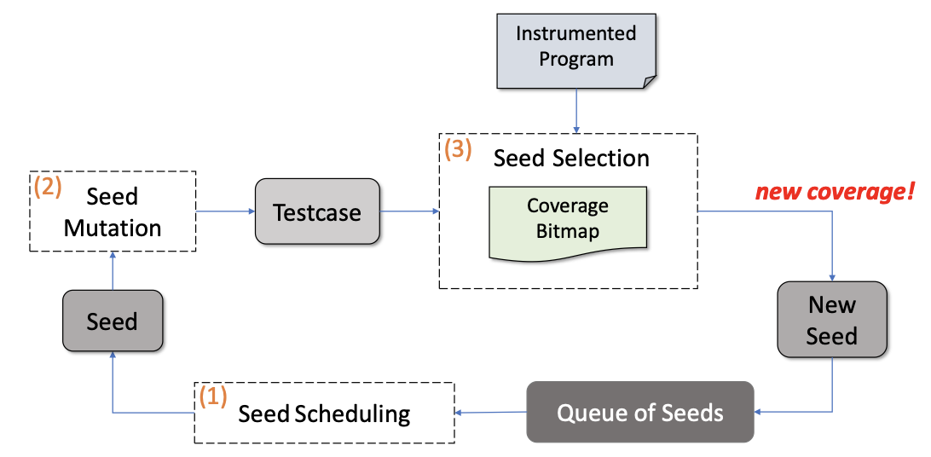
Major Stages of Coverage-guided Fuzzing
“Be Sensitive and Collaborative: Analyzing Impact of Coverage Metrics in Greybox Fuzzing (RAID’19)”
Notes:
Seed scheduling: prioritizes seeds based on factors like execution path diversity or coverage
Seed mutation: generates new test cases with techniques like bit flipping, arithmetic operations, or splicing
Seed selection: evaluates generated test cases using coverage metrics and retains high-quality seeds for further fuzzing
유전 알고리즘에서 새로운 cov를 달성한 흥미로운 인풋에 번식의 기회를 더 줌

Slide 5
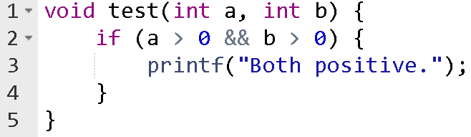
Sensitivity
Coverage metric’s ability to discern difference of paths
branch cov |  | cond cov
(0, 0) | (0, 1) | (0, 0) | (0, 1)
+50% | +0% | +50% | +25%
Metric with higher sensitivity is more likely to discover interesting input
But, Higher Sensitivity != Better Fuzzing
Notes:
Sensitivity in the context of a coverage metric,
refers to its capacity to discern differences between distinct execution paths.
If we consider a function like this with an initial input of (0,0) followed by a secondary input (0,1),
branch coverage will not register any changes.
But, condition coverage will detect a 25% increase in coverage.
Employing a guiding metric with enhanced sensitivity can aid a fuzzer in unearthing notable inputs.
However, it's important to note that a higher sensitivity does not always guarantee superior fuzzing results.

Slide 6
Motivation
Many coverage metrics have been proposed in existing coverage-guided fuzzing studies.
However, it is not known whether multiple coverage metrics can be used in combination.
Considering sensitivity, are there better strategies to guide the fuzzer?

Slide 7
Main Goal : Exploring Coverage Metric Combination
Sub Goals
1. Development of a Custom Fuzzing Tool
2. Experimenting with Various Coverage Metric Combinations
- Referencing Existing Implementations
- With Target Syntax Restrictions
- Comparing Coverage Metrics As Guide
- Exploring Effective Cov Combinations For Fuzzing

Slide 8

Target
Small language with simple grammars
Lua: embeddable scripting language especially for C/C++
Notes:
In order to achieve this task, we decided to write a fuzzer for languages with relatively small sizes and limited grammar. Currently, the strongest candidate is the LUA language, which is mainly used for small scripting and is used to develop games or support simple development environments for product users.

Slide 9
Evaluation method
Evaluation targets:
Part of open source programs
Google fuzzer test suite (https://github.com/google/fuzzer-test-suite)
Handmade programs with intentional bugs
Compare Random generation(Base) + Fuzzers with different policies
Metrics
Code coverage
Time taken for the first crash
Average distinct crash found per time
Notes:
As a basis for evaluating the Fuzzer produced in this way, we will use some of the code from the existing open source program or code that we have produced ourselves. Code coverage may be typically used as an evaluation metric, but since code coverage may not represent the performance of the fuzzer, we will evaluate the average time to detect the first error or the type of heuristic detected bug together to draw a conclusion.

