Slide 1
ByteNet
Rethinking Multimedia File Fragment Classification Through Visual Perspectives
A from-scratch PyTorch reproduction, trained end-to-end on real file fragments
Payaldurga Paila (202351103)
B.Tech Computer Science, IIIT Vadodara
Original paper: Liu et al., IEEE TMM 2025

Slide 2
THE PROBLEM
What is File Fragment Classification?
Storage & network systems break files into fixed-size sectors/packets — a “fragment”
When metadata is missing (damaged drive, stripped packet header), you only have raw bytes
Goal: predict the file type — jpg? pdf? exe? — from a 512-byte chunk alone
Matters for digital forensics (recovering deleted/damaged files) and network security (inspecting traffic)
A fragment looks like this:
FF D8 FF E0 00 10 4A 46
49 46 00 01 01 00 00 48
00 48 00 00 FF DB 00 43
00 08 06 06 07 06 05 08
...
No filename. No extension. No header guarantee
(a fragment may come from the middle of a file).
ByteNet Reproduction — Payaldurga Paila, IIIT Vadodara
2

Slide 3
KEY IDEA
Interbyte vs. Intrabyte Information
Prior work: only interbyte relations
Treats a fragment as a 1D sequence; only learns relationships BETWEEN separate bytes.
Misses bit-level structure inside a byte.
Byte 0xB4 = 10110100, shifted 7×:
x0 = 10110100
x1 = 01101001
x2 = 11010010
ByteNet: interbyte + intrabyte
x3 = 10100101
Bit-shifts each byte 7 times to expose the bits inside it too — critical for formats using variable-length codes (e.g. Huffman-coded JPEG DCT coefficients) whose patterns cross byte boundaries.
x4 = 01001011
x5 = 10010110
x6 = 00101101
x7 = 01011010
↑ each row = 1-bit shift of the row above (intrabyte)
↑ each column = 1-byte shift across the fragment (interbyte)
ByteNet Reproduction — Payaldurga Paila, IIIT Vadodara
3

Slide 4
METHOD — PART 1
Byte2Image: Bytes → Grayscale Image
1
2
3
Bit-shift
N-gram widen
Augment
Shift the Ns-byte fragment left 1 bit, 7 times → (Ns × 8) matrix
Group n consecutive rows, concatenate → (Ns−n+1) × 8n image (more square = CNN-friendly)
Flip / random-erase / mixup to diversify the fixed-size training set
Result: a fragment that used to be a flat byte string is now a 2D grayscale image that a CNN/Transformer can process — and both interbyte and intrabyte correlations survive the conversion.
ByteNet Reproduction — Payaldurga Paila, IIIT Vadodara
4

Slide 5
METHOD — PART 2
ByteNet: Dual-Branch Classifier
Byte Branch (BBFE)
Raw byte sequence
↓ single FC layer
memorizes “magic bytes”
(e.g. FFD8 → JPEG)
Feature
Fusion
FC + Softmax
Image Branch (IBFE)
concatenate
shallow + deep
features
predicted file type
(class probabilities)
Byte2Image output
↓ embedding layer
↓ 4 hierarchical stages
(ResNet OR PoolFormer
blocks + downsample)
↓ global average pool
Two IBFE variants: ByteResNet (ResNet blocks) and ByteFormer (attention-free PoolFormer blocks, fewer params)
ByteNet Reproduction — Payaldurga Paila, IIIT Vadodara
5

Slide 6
OUR REPRODUCTION
What We Actually Built
Re-implemented Byte2Image + ByteNet (both variants) in PyTorch, matching the paper's equations line-by-line
The paper's benchmarks (FFT-75, VFF-16) aren't downloadable offline — so we built our own REAL dataset
Carved 256-byte sectors from random offsets inside real files already on disk: .py, .json, .html, .png, .pdf, .gz, ELF binaries
2,240 real fragments, 7 classes, 80/20 train/test split — genuine classification signal, not synthetic noise
Trained + evaluated end-to-end on a single CPU core
ByteNet Reproduction — Payaldurga Paila, IIIT Vadodara
6

Slide 7
SCOPE
What We Scaled Down (and Why)
Setting | This reproduction | Paper
Sector size | 256 bytes | 512 / 4,096 bytes
Stage channels | [16, 32, 64, 128] | [64, 128, 256, 512]
Block depth / stage | 1 | 2 (ResNet) / 6–18 (PoolFormer)
Dataset | 2,240 real fragments, 7 classes | FFT-75 (75 × 102,400) / VFF-16
Epochs | 16–60 | 50
Compute | 1 CPU core | 2× NVIDIA RTX 3090
Architecture (branches, stages, fusion) is unchanged — only width/depth/data/compute are reduced so the pipeline trains in minutes on CPU.
ByteNet Reproduction — Payaldurga Paila, IIIT Vadodara
7

Slide 8
RESULTS
Main Result: 73.4% Test Accuracy
Configuration | Test Acc. | Params
ByteResNet (full, dual-branch) | 73.4% | 489K
ByteFormer (full, dual-branch) | 56.0% | 186K
ByteResNet — byte branch only | 30.8% | 489K
ByteResNet — image branch only | 75.4% | 489K
ByteResNet, n-gram = 2 / 8 / 16 | 73.2% / 72.5% / 72.1% | ~489K
7-class random-guess baseline: 14.3% → 73.4% is a >5× improvement.
ByteNet Reproduction — Payaldurga Paila, IIIT Vadodara
8

Slide 9
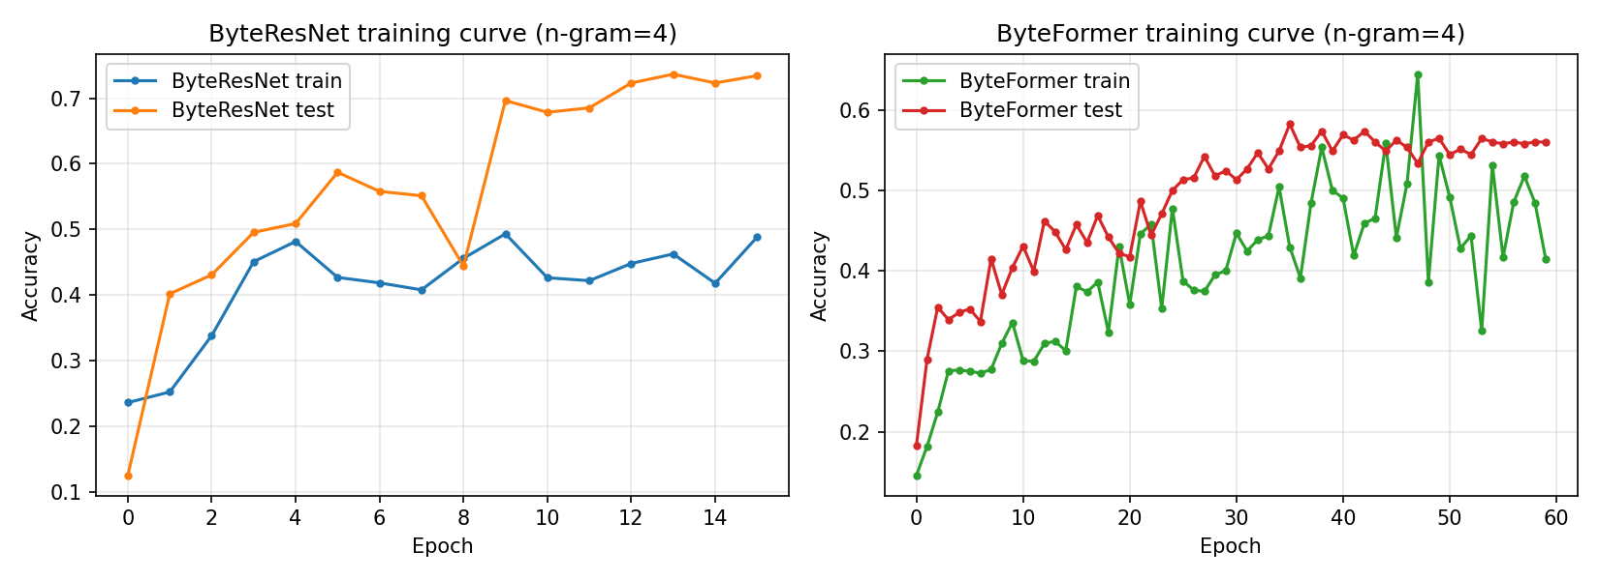
RESULTS
Training Curves
ByteResNet (left, 16 epochs) converges faster per-epoch; ByteFormer (right, 60 epochs) needed far more epochs to approach a similar trend but still plateaus lower.
ByteNet Reproduction — Payaldurga Paila, IIIT Vadodara
9

Slide 10
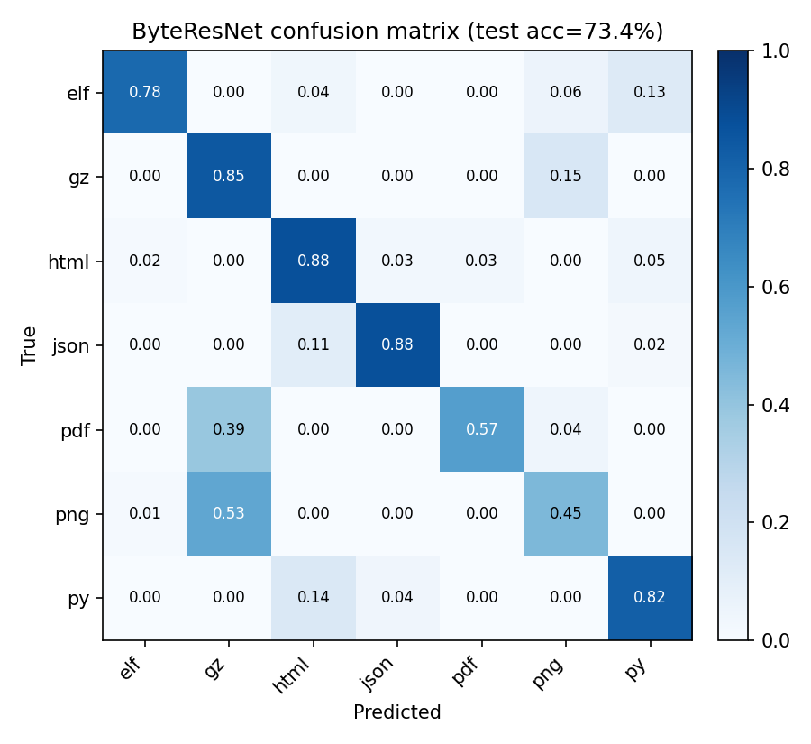
RESULTS
Confusion Matrix — Where Errors Happen
pdf ↔ png ↔ gz confusion is genuine, not a bug:
PDF embeds zlib/Flate-compressed streams
PNG uses zlib internally too
Their byte-level statistics genuinely overlap
Matches the paper's own Archive↔Published confusion (Fig. 7)
ByteNet Reproduction — Payaldurga Paila, IIIT Vadodara
10

Slide 11
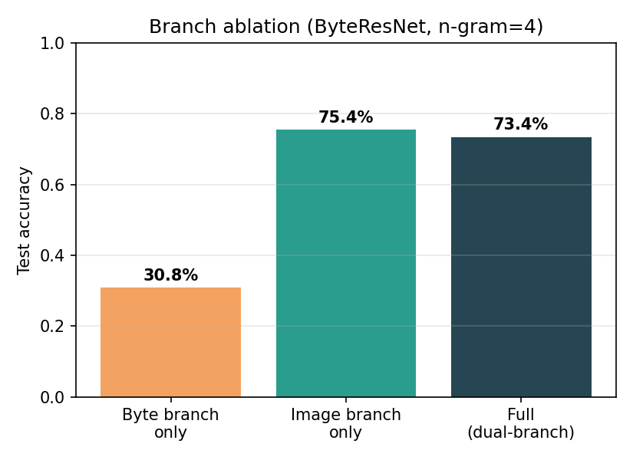
ABLATION
Which Branch Actually Matters?
Byte branch alone: 30.8% — barely better than guessing
Image branch alone: 75.4% — does almost all the work
Full dual-branch: 73.4% — comparable to image-only here
Matches the paper's own finding: image branch dominant, byte branch a smaller complementary signal
ByteNet Reproduction — Payaldurga Paila, IIIT Vadodara
11

Slide 12
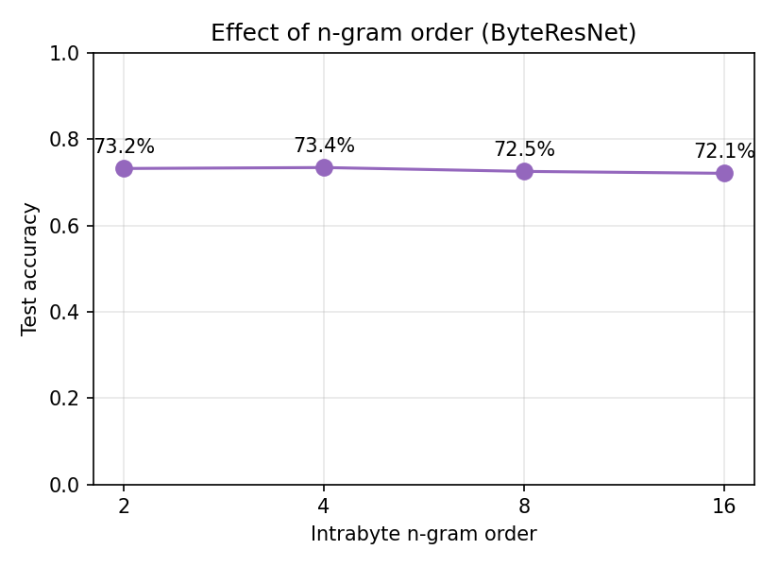
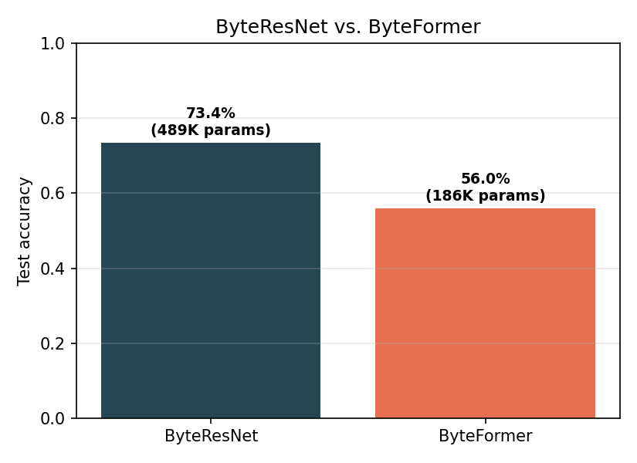
ABLATION
N-gram Order & ByteResNet vs. ByteFormer
ByteNet Reproduction — Payaldurga Paila, IIIT Vadodara
12

Slide 13
DISCUSSION
Where We Diverge From the Paper — Honestly
Image-only (75.4%) slightly beats full model (73.4%) — in the paper, full always wins. Likely cause: byte branch needs FFT-75-scale data (102K/class) to pay off; we have 320/class.
ByteFormer underperforms more sharply here (56% vs. 73%) even with 3.75× more epochs — patch tokenization plausibly needs more data than our 2,240-fragment corpus provides.
Absolute accuracy numbers aren't comparable to FFT-75/VFF-16 — different, much smaller dataset.
Root cause for all three: dataset scale, not an incorrect implementation — every qualitative claim we could test (image-branch dominance, n-gram robustness, genuine compression-format confusion) reproduced correctly.
ByteNet Reproduction — Payaldurga Paila, IIIT Vadodara
13

Slide 14
Conclusion
Byte2Image + dual-branch ByteNet reproduced faithfully from the paper's equations
Trained end-to-end on a REAL, non-synthetic fragment dataset built from local files
73.4% test accuracy (7-class, vs. 14.3% baseline) with an 489K-parameter model on 1 CPU core
Core qualitative claims of the paper reproduced: image-branch dominance, n-gram robustness
Divergences reported honestly and traced to dataset scale, not implementation error
Code: github.com/<your-username>/bytenet-implementation

