Slide 1
When Do Multiscale Features Help Small Defect Localization?
Accuracy and efficiency of PatchCore on MVTec AD
Yang Cao · Bernie Chen · Celine Li
Group 6 | Computer Vision Final Project | November 2026
Main question: Does feature fusion help when defects are small and memory is limited?
Group 6 | PatchCore small-defect localization
1

Slide 2
Problem and research question
Industrial training sets often contain normal images but few examples of future defects.
PatchCore compares each test patch with a memory bank of normal patch features.
For small defects, we ask whether combining layer2 and layer3 improves localization enough to justify its cost.
MVTec AD [1] · PatchCore [6]
2

Slide 3
Related work and our contribution
Approach | Key idea | Connection to our study
PaDiM [3] | Patch-feature distribution | Another normal-only baseline
PatchCore [6] | Coreset + nearest neighbor | Our fixed architecture
Reverse Distillation [7] | Multiscale teacher features | Alternative feature use
Heckler et al. [8] | Feature-layer selection matters | Motivates layer comparison
EfficientAD [9] | Low-latency anomaly detection | Efficiency context
We define small defects from original masks, compare feature layers at matched storage, and audit cropping and latency.
Papers [1]–[9] are listed in the English report
3

Slide 4
Hypotheses and design
Question | Comparison | What would support it?
H1 | layer2 vs layer3 | Higher small-defect AUPRO for layer2
H2 | fusion vs single layers | Consistent localization gain from fusion
H3 | equal 16 MiB banks | Fusion gain after matching vector storage
The PatchCore architecture is unchanged. Our study tests when each feature setting helps.
Protocol follows the final English report
4

Slide 5
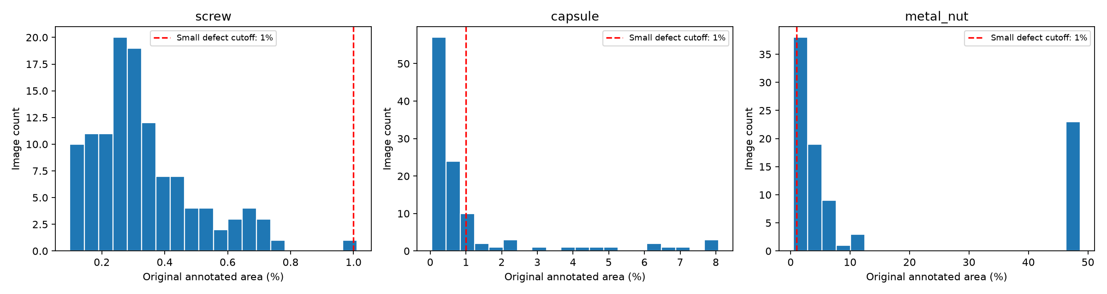
Dataset and original defect areas
Category | Normal train | Normal test | Small defects | Larger defects
screw | 320 | 41 | 118 | 1
capsule | 219 | 23 | 85 | 24
metal nut | 220 | 22 | 7 | 86
Small = original mask area ≤ 1% of original image. The groups are fixed before resizing or cropping.
MVTec AD [1] · results/audit/size224
5

Slide 6
Method: from normal images to anomaly maps
Normal train images
→
Frozen WRN50-2
layer2 / layer3 / fusion
→
Approximate greedy
coreset bank
→
CPU FAISS
1-nearest neighbor
→
Anomaly map
LAYERS = {'layer2': ['layer2'], 'layer3': ['layer3'],
'fusion': ['layer2', 'layer3']}
sampler = ApproximateGreedyCoresetSampler(config['coreset_ratio'], device)
Only normal training images enter the bank. CUDA runs feature extraction and coreset sampling; FAISS search runs on CPU.
PatchCore [6] · study/model.py
6

Slide 7
Experimental protocol
Condition | Values
Dataset | screw, capsule, metal_nut; official train/test split
Features | layer2, layer3, fusion
Seeds | 0, 1, 2 for the coreset
Input size | 224 and 320 pixels; resize + center crop
Main bank | 10% approximate greedy coreset: 54 runs
Matched bank | 4096 × 1024 float32 vectors = 16 MiB: 27 runs
54 main runs + 27 fixed-bank runs on a Windows RTX 5060 Laptop GPU
7

Slide 8
How results are evaluated
Primary metric: small-defect AUPRO@0.3, normalized over false-positive rates 0 to 0.3.
Secondary metrics: pixel AUROC and image AUROC.
We also measure bank vector storage and synchronized batch-1 latency.
Normal test images are included in subgroup metrics; test masks never select a model threshold.
def aupro(masks, maps, fpr_limit=.3):
study/metrics.py · final report Methodology
8

Slide 9
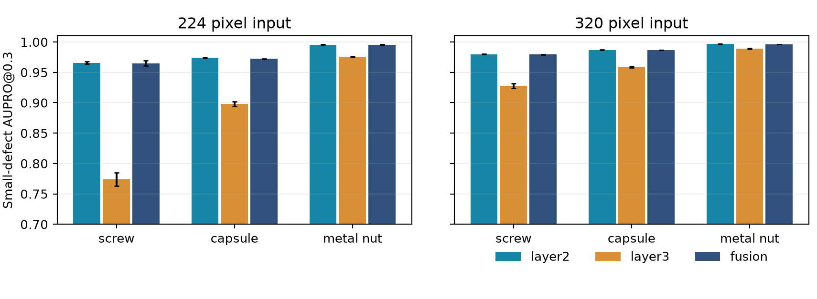
Main result: layer2 beats layer3
Layer2 scores higher in all six category × input-size comparisons. Fusion is close to layer2, without a consistent gain.
Mean ± sample SD across three coreset seeds · 10% bank
9

Slide 10
320-pixel input raises AUPRO and latency
Layer2 category | 224 AUPRO | 320 AUPRO | Gain | Latency ratio
screw | 0.9658 | 0.9797 | +0.0139 | 3.0×
capsule | 0.9741 | 0.9870 | +0.0130 | 3.0×
metal nut | 0.9956 | 0.9967 | +0.0011 | 3.2×
All nine category–feature combinations improve at 320 pixels.
Bank storage and inference time increase; resize and smoothing scales also change.
10% coreset · 224 vs 320 pixels
10

Slide 11
Equal 16 MiB banks: fusion still lacks a clear gain
Category | Layer2 AUPRO | Fusion AUPRO | Layer2 ms | Fusion ms
screw | 0.9593 | 0.9505 | 40.6 | 49.5
capsule | 0.9733 | 0.9719 | 39.4 | 49.5
metal nut | 0.9951 | 0.9953 | 41.4 | 51.3
Layer2 is faster in all three categories. The 0.0002 metal-nut fusion difference comes from a subgroup with seven anomaly images.
224 pixels · 4096 vectors per bank · three coreset seeds
11

Slide 12
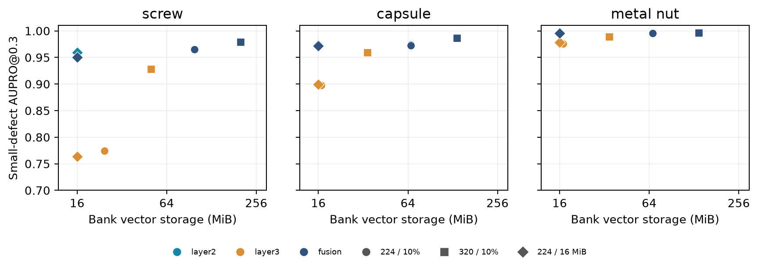
Localization versus bank vector storage
Equal stored vector bytes do not imply equal peak GPU memory, feature-extraction cost, or query-grid size.
Each point is a three-seed mean · bank vector storage only
12

Slide 13
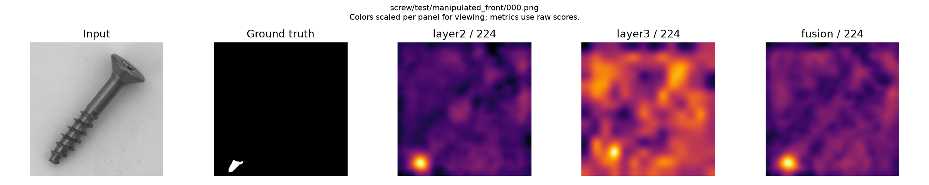
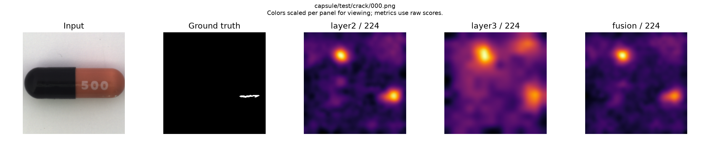
Qualitative results: screw and capsule
Input, transformed ground truth, layer2, layer3, and fusion maps. Heatmap panels have separate display color scales.
224-pixel input · seed 0 · results/figures
13

Slide 14
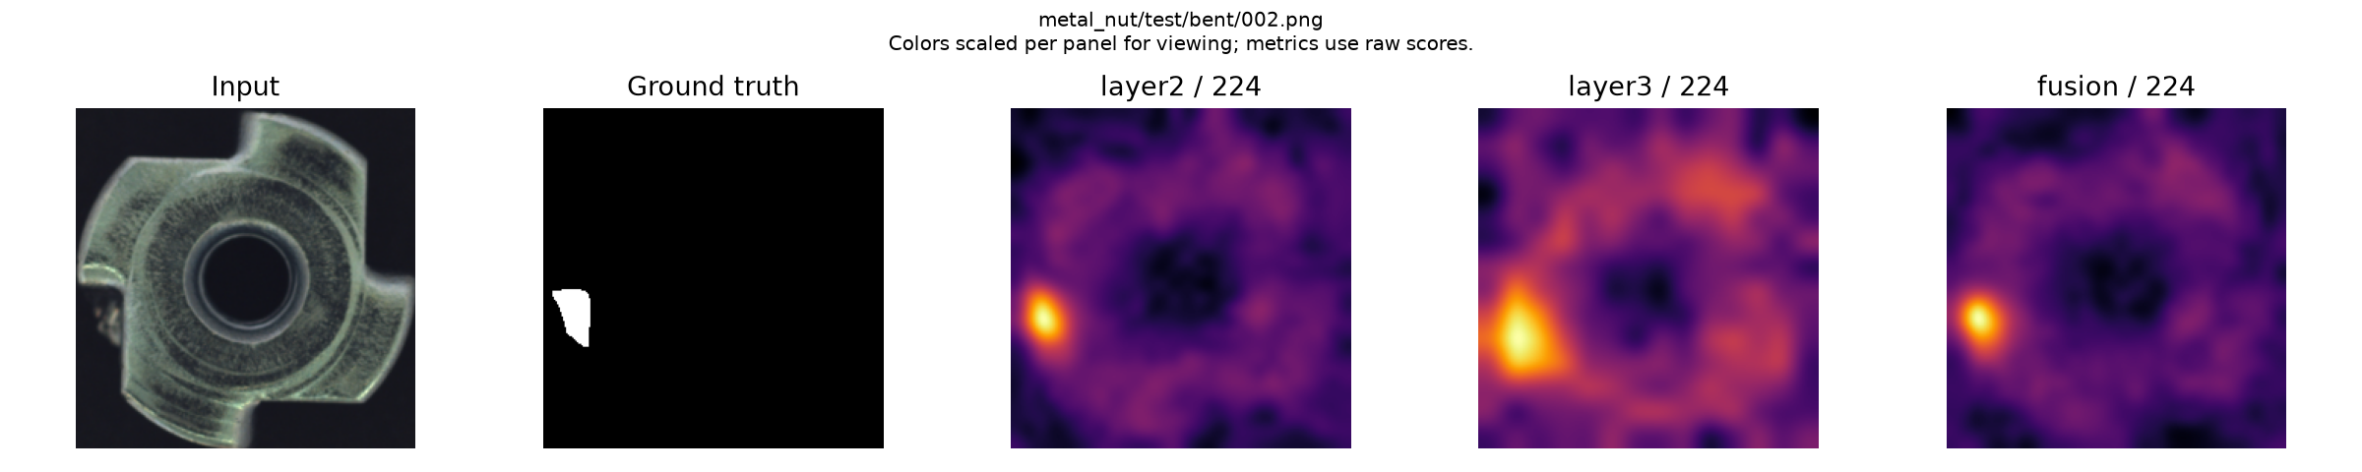
Qualitative result and uncertainty: metal nut
Only seven metal-nut anomaly images fall in the small-defect group.
The paired bootstrap compares one seed-0 fitted model pair per category and size.
Three-seed standard deviations describe coreset variation, not population-level certainty.
results/figures · paired image bootstrap in results/comparisons
14

Slide 15
Conclusion and limits
Layer2 gives the strongest overall small-defect localization in this study.
Fusion gives no consistent benefit, including with equal 16 MiB banks.
Layer3 is faster and stores fewer vectors in the 10% coreset condition.
320-pixel inputs improve localization while increasing latency and bank storage.
For inspection systems, layer2 is a practical starting point when localization matters most; layer3 trades accuracy for speed and storage.
Next: test more categories and backbones, and separate preprocessing effects from input-resolution gains.
Scope: three MVTec AD categories and one frozen backbone
15

Slide 16
References and reproducibility
[1] Bergmann et al. MVTec AD. CVPR 2019.
[2] Bergmann et al. Uninformed Students. CVPR 2020.
[3] Defard et al. PaDiM. ICPR Workshops and Challenges 2021.
[4] Li et al. CutPaste. CVPR 2021.
[5] Zavrtanik et al. DRAEM. ICCV 2021.
[6] Roth et al. Towards Total Recall in Industrial Anomaly Detection. CVPR 2022.
[7] Deng and Li. Reverse Distillation. CVPR 2022.
[8] Heckler et al. Pretrained Feature Extractors. CVPR Workshops 2023.
[9] Batzner et al. EfficientAD. WACV 2024.
Code, compact results, and English report: github.com/bernie90103/CV_final_project
Full bibliography and methods: output/pdf/group6_patchcore_final_report.pdf
16

