Slide 1

Homework 2
Emanuele Nardone PhD Student

Slide 2
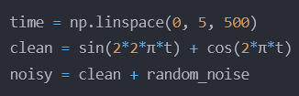
Homework 2
01
Exercise 1 – Signal Processing
Overview:
Signal Analysis and Filtering
Noise Reduction
Frequency Domain analysis
Input:
Time
Clean Signal
Noisy Signal
Goal:
Implement signal filtering
Calculate signal statistics
Visualize time and frequency domains

Slide 3
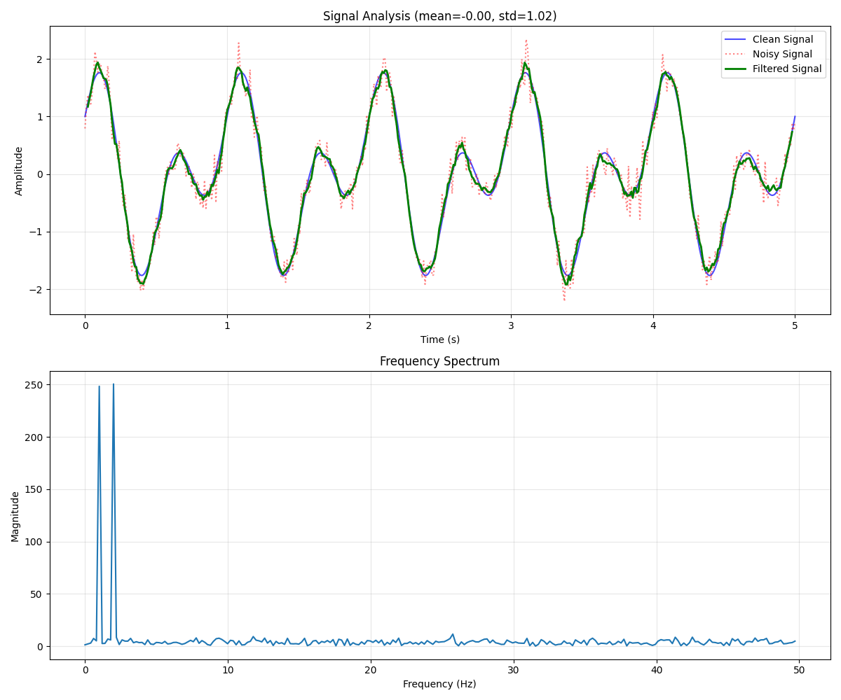
Homework 2
01
Exercise 1 – Signal Processing
Suggestions:
np.convolve
np.fft.fft
np.fft.fftfreq

Slide 4
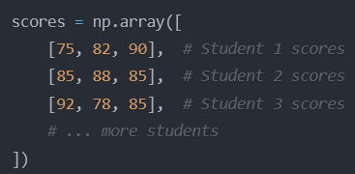
Homework 2
01
Exercise 2 – Score Analysis
Overview:
Multi-dimensional data analysis
Statistical measures
Performance assessment
Input:
Students Score
Goal:
Calculate students and subjects stats
Identify performance patterns
Create visualizations

Slide 5
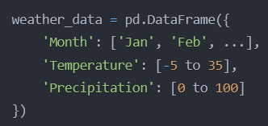
Homework 2
01
Exercise 3 – Weather Analysis
Overview:
Time series analysis
Seasonal patterns
Correlation studies
Input:
Wheater data
Goal:
Analyze seasonal trends
Study weather correlations
Create visualizations

Slide 6
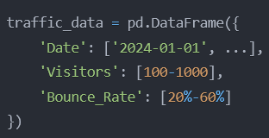
Homework 2
01
Exercise 4 – Website Traffic
Overview:
Time series analysis
Moving averages
Traffic pattern recognition
Input:
Traffic data
Goal:
Calculate traffic trends
Identify user patterns
Visualize key metrics

