Slide 1
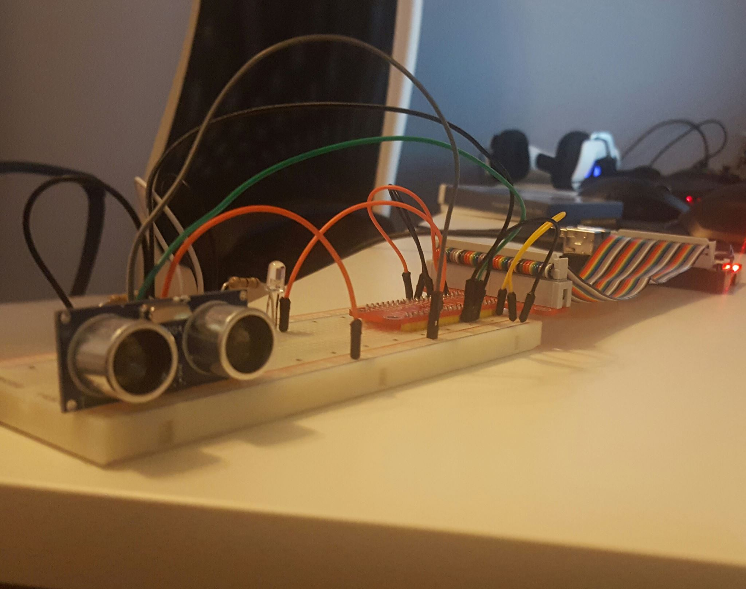
Smart Parking Lot
By: Achille Mattapullut

Slide 2
Content
Proposal
Budget
Schedule
Build Video
Course knowledge utilized from previous courses

Slide 3
Proposal
Finding parking is a major problem in Toronto
The current parking managing system is Time consuming
Solution:
Sensor to trigger Plate reader camera and open parking door
Plate number is registered to a database and link it to the customer mobile app
Pay on the go

Slide 4
Budget

Slide 5
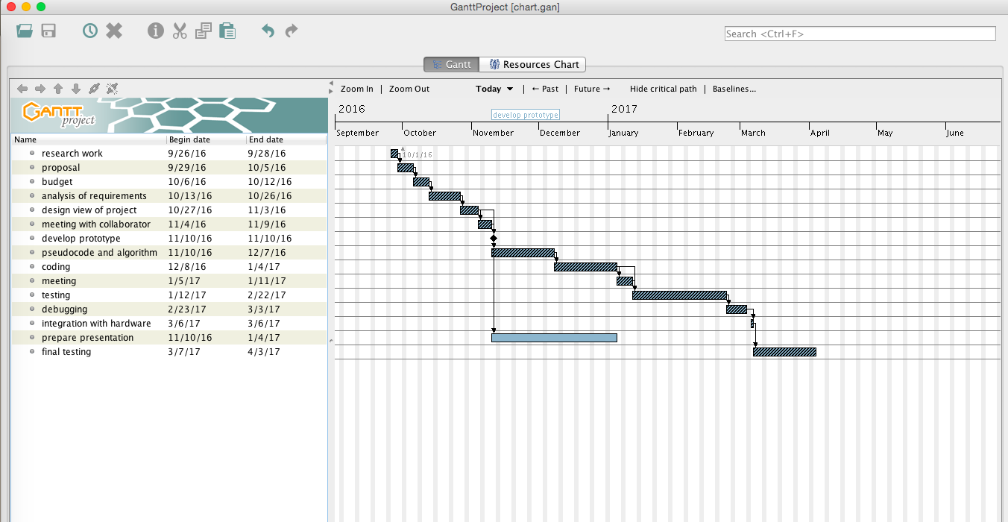
Schedule

Slide 6
Build Video
https://achille96.github.io/

Slide 7
Course Knowledge utilized from previous course
Technical C - TECH153
Programming Techniques in Java- CENG212
Internet Programming- CENG256
Unix Scripting- CENG200
Database with Java- CENG254
Electronic Devices and Circuits- TECH150

