Slide 1

Sales Transaction
Data Analysis

Slide 2
Data Overview
The following observation have been made based on the data provided in Sales.csv
The file consists of Sales data and transaction timestamp for each and every transaction.
It also had Country of transaction along with the Product id , product description , Unit price and the quantity sold.
The data was presented based on customer id.
For our ease we have calculated Total Amount and Day of Transaction and added to the current data.

Slide 3





Company's Performance

Slide 4
Performance Criteria
The Performance of the company based on the provided data has been classified into two parts:
1. Based on the "Quantity Sold".
2. Based on the Revenue Generated.

Slide 5
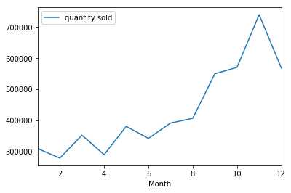
Performance Based on Quantity Sold
The graph shows the performance of the company over the period of months.
The graph shows that the number of quantity sold were on the rise but later after November saw a decline.

Slide 6
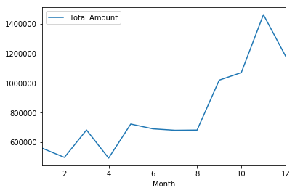
Performance Based on Revenue Generated
The graph depicts the performance based on company's performance in terms of Revenue Generation over the period of Months.
The trend is same the company's performance increased but seeing a decline since November.

Slide 7

Trends From the Data

Slide 8
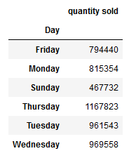
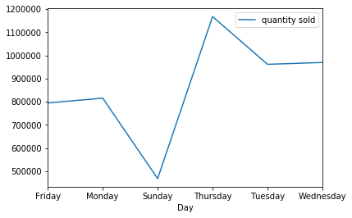
1. Shopping Day?
On Thursday we see max sale across all the countries.
While on Sunday's people don’t prefer to go out that much hence the least sale.

Slide 9
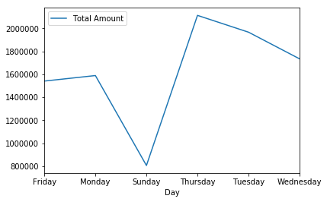
Shopping Day?
The Total Revenue generated over the week.
Maximum on Thursday.
Minimum on Sunday.

Slide 10
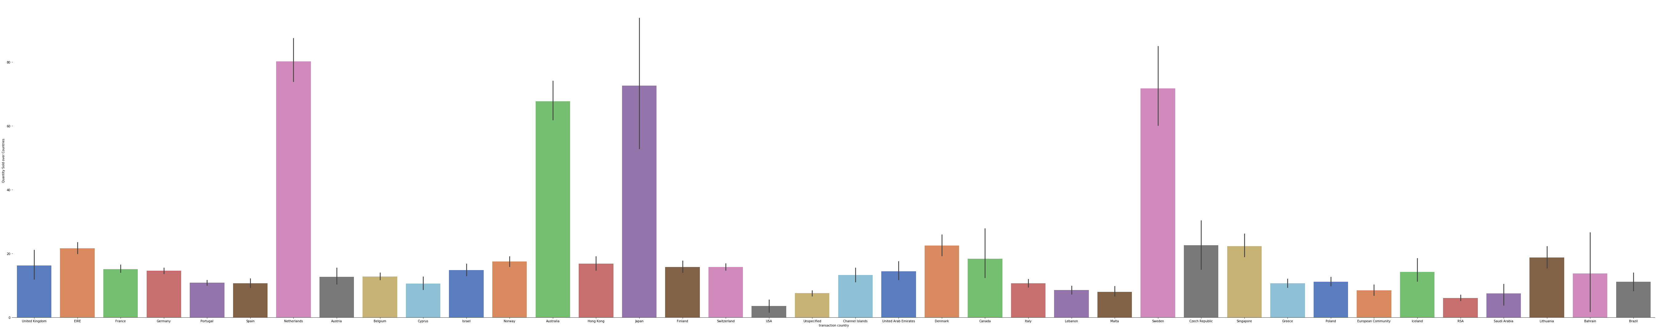
2. Countries With Most Quantities Sold.

Slide 11
From The Previous Graph we conclude that
1. Most of our product's quantity are sold in Netherlands on an Average.
2. While Quantity Wise USA is at the Bottom.
3. Top 3 Countries are:
I. NetherLands
II. Japan
III. Sweden

Slide 12
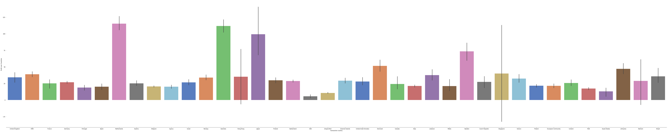
3. Countries With Highest Revenue Generated

Slide 13
1. Most of our Revenue is generated by Netherlands.
2. Least Revenue by USA.
3. Top 3 Revenue Generating Countries are:-
I. Netherlands
II. Australia
III. Japan

Slide 14
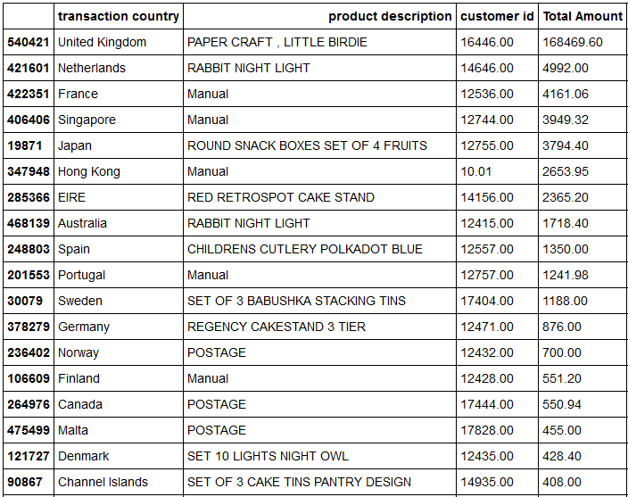
4. Products That Generated Most Revenue Across The Globe

Slide 15
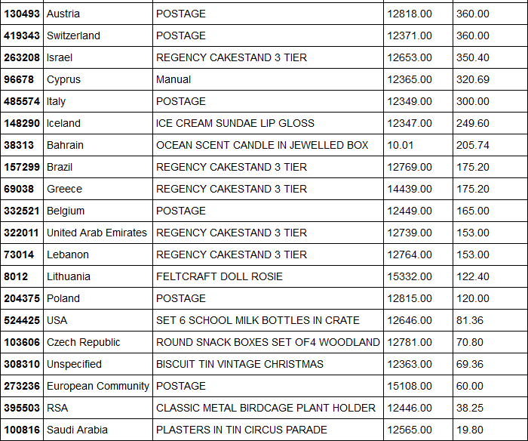
4. Products That Generated Most Revenue Across The Globe

Slide 16
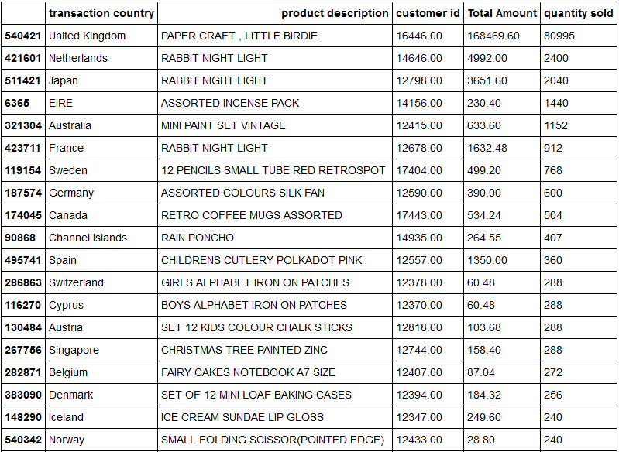
5. Products Being Sold The Most Across The Globe

Slide 17
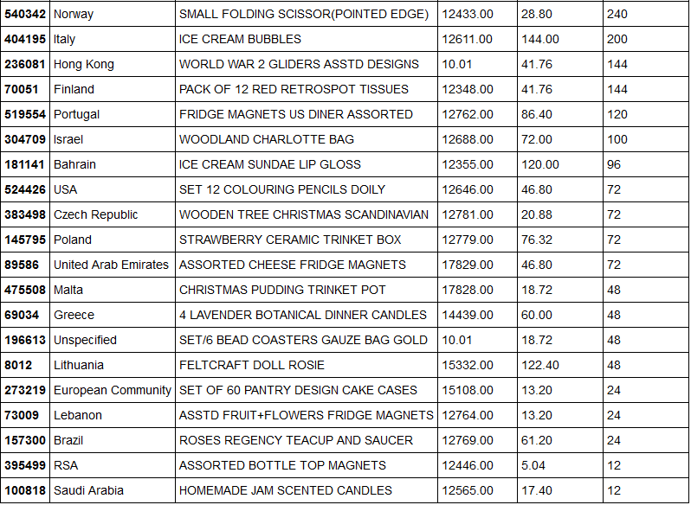
5. Products Being Sold The Most Across The Globe

Slide 18
6.Stock Options
Based on the data above we can do the following:-
1. We can have stock of products that are being sold the most categorized per country
2. We can have stock of products that generates the most revenue for the organisation categorized per country.
3. Having stocks of product that are not being sold much will not do good to the organisation

Slide 19
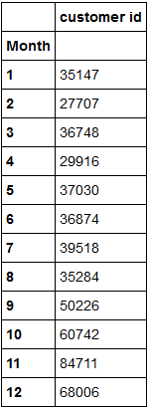
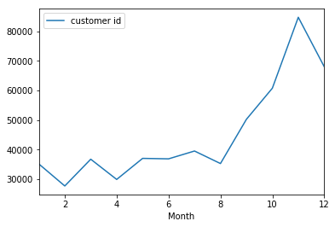
7. Customer Relations

Slide 20
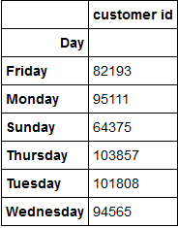
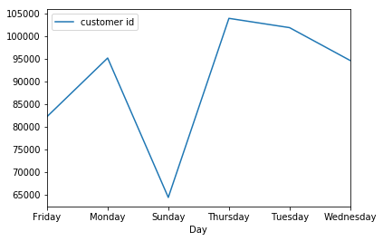
7. Customer Relations

Slide 21
7. Customer Relations
The last 2 graphs are about unique customers with unique customer id who have shopped with us categorized per month and per days.
We see an increasing trend in customer acquisition but after November a decline in number of customers.
We may include offers on Sunday to get our sales up as Sunday is Holiday and on Sunday we see a Major Dip in our sales as well as customer acquisition

Slide 22


