Slide 1

Predictive Marketing Analytics for Better Lead Conversion in EdTech
By Akhileshwar Pandey
Roll No- 21f3002866

Slide 2

Introduction
Blade Learner
EdTech company focused on humanities students
Key challenges
Inefficient lead prioritization.
Low conversion rate (about 7%).
Lack of data-driven decision making in telemarketing campaigns.

Slide 3
Objectives
Project Objectives:
Develop a predictive model for lead scoring.
Improve lead conversion rates.
Enhance telemarketing efficiency.
Establish data-driven decision-making culture.
By achieving these objectives, aim is to optimize resource allocation, increase revenue, and create a more targeted approach to student acquisition.

Slide 4
Methodology
Feature engineering
Created new features like time gaps between interactions, Parents intervention.
Encoded categorical variables for model input.
Model development
Trained and compared multiple models for lead scoring.
Used cross-validation to ensure model robustness.
Assessed model performance using various metrics like AUC-ROC, precision, recall, F1-score.
Data collection and preprocessing
Gathered lead data .
Cleaned and standardized data for analysis using excel and python.
Exploratory Data Analysis (EDA)
Identified trends in lead generation and conversion.
Analyzed patterns in successful conversions.

Slide 5
ML Model Development
Data preparation
Feature engineering: Created polynomial features to capture non-linear relationships.
Train-test split: Data divided into 80% training, 20% testing sets.
Model selection
Tested Logistic Regression, Decision Trees, and Random Forest.
Random Forest selected as best performing model.
Evaluation metrics
Accuracy: 96% on test set.
High AUC-ROC score: 0.99.
Precision, recall, and F1-score calculated.
Confusion matrix analyzed for false positives/negatives.
Challenges
Class imbalance addressed using SMOTE.
Lower recall for converted leads due to imbalance.
Engagement timing, lead source, and subject selection identified as key factors

Slide 6
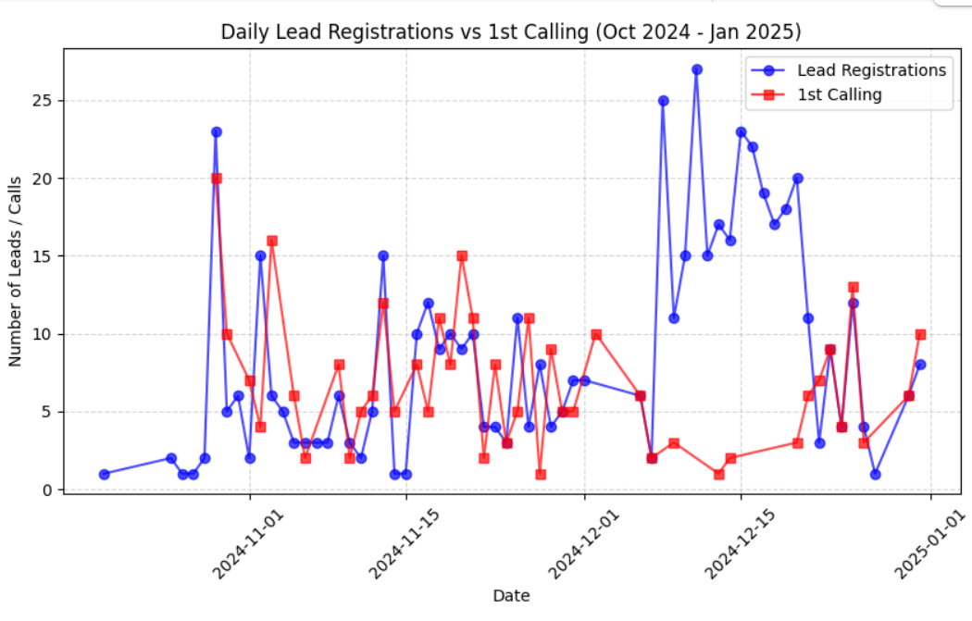
Key Findings
The graph illustrates daily lead registrations and the number of first calls made between October 2024 and January 2025.
multiple instances where lead registrations spike significantly, but the corresponding first calls do not increase proportionally.

Slide 7
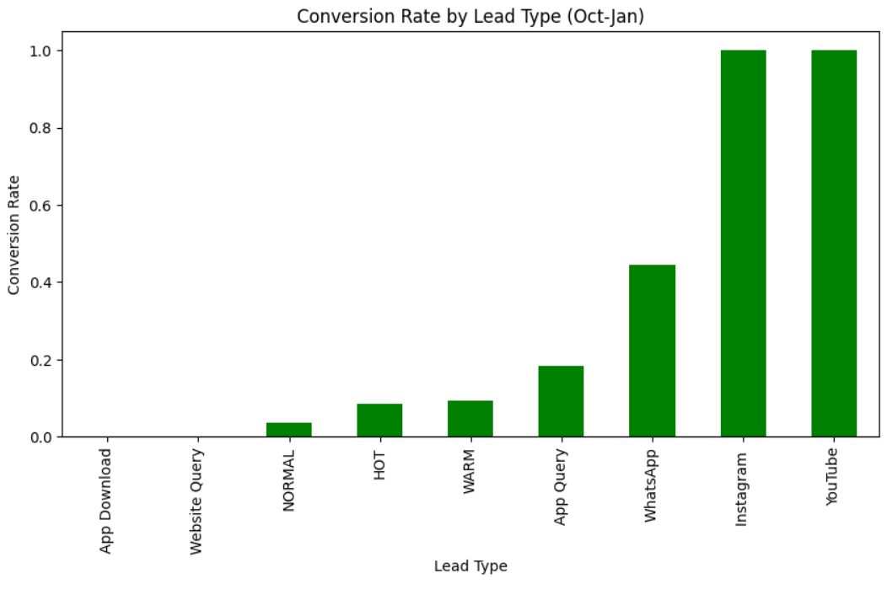
Key Findings
This graph evaluates the conversion rates across different lead sources and identify the most effective channels for acquiring customers.
Although leads from WhatsApp, Instagram and YouTube are less in volume but their conversion rate is much higher as compared to other leads.
‘NORMAL’ which happens to be the most frequent lead type is having very less conversion rate.

Slide 8
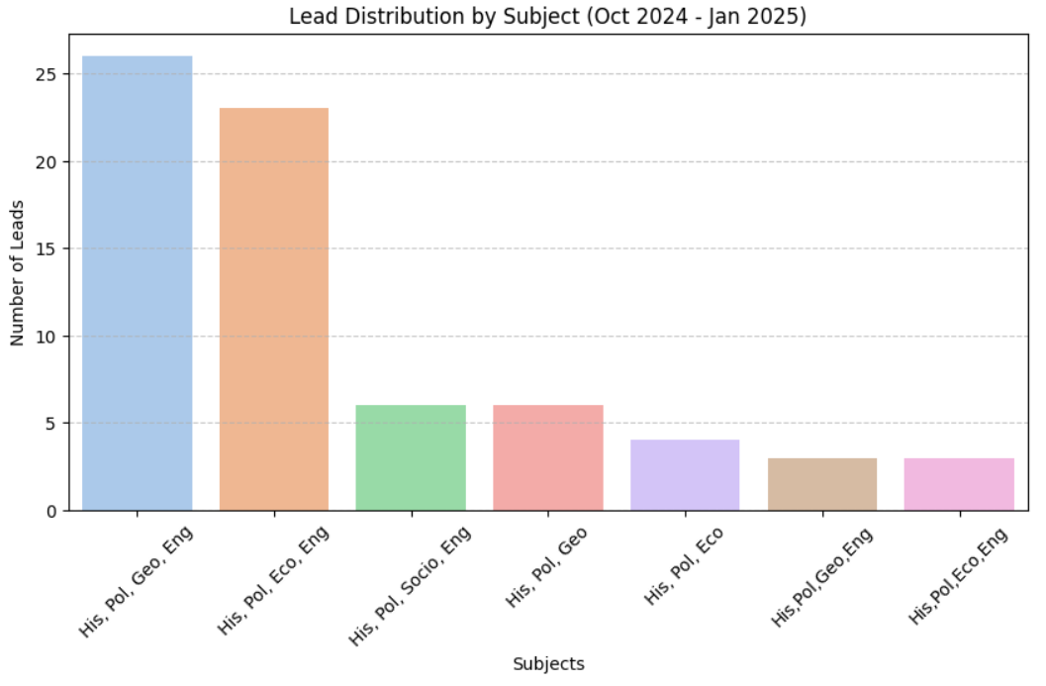
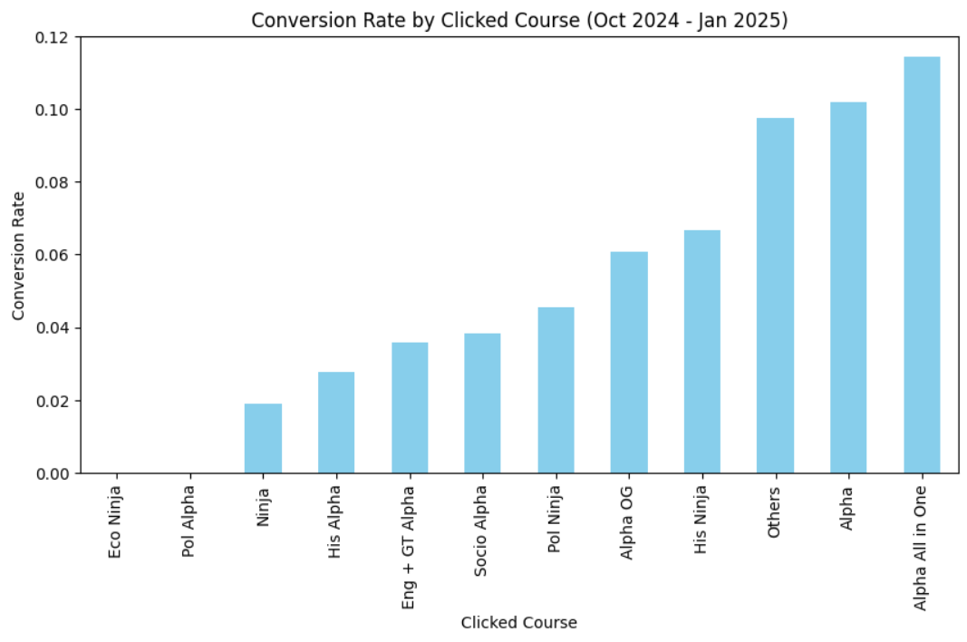
Key Findings
Most popular subject combinations: "His, Pol, Geo, Eng" and "His, Pol, Eco, Eng" have the highest number of leads, indicating strong interest in these subject combinations.
History Political English are the subject sought in every combinations.
The graph above shows that ‘Alpha All in One’ has highest Conversion rate. Although, Alpha OG has highest frequency but its conversion rate is lower than three courses.

Slide 9
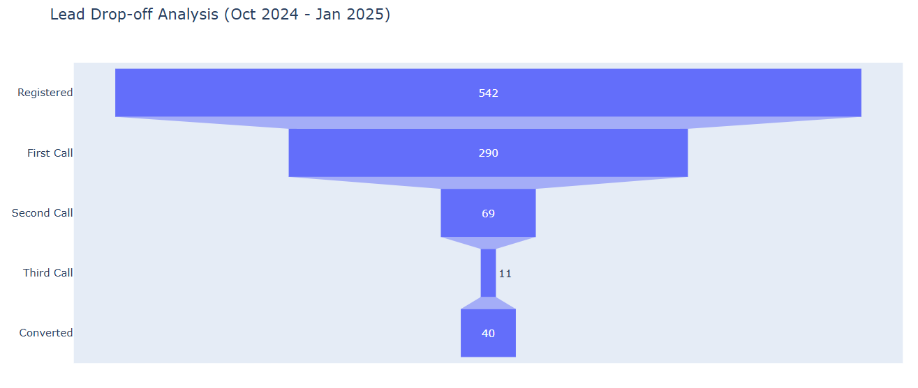
Key Findings
Significant drop-off after registration: Only about 53 percent of registered leads proceed to the first call.
Drastic decline after the second call: Only 11 out of 69 leads make it to the third call, indicating a major drop-off point.
Final conversion rate is low (7.27%): Only 40 leads out of 542 eventually convert.

Slide 10
Recommendations
Implement structured follow-up system within 24-48 hours of registration.
Increase marketing efforts on high-converting channels: Instagram, WhatsApp, YouTube.
Introduce time-sensitive discounts for high-potential leads.
Enhance data collection and management by capturing comprehensive lead information, including demographics (such as Board and State) and economic background of students.
Leads from Website Queries and App Downloads have lower conversion rates. Revamp landing pages, improve chatbot interactions, and offer incentives (discounts/free trials) for these leads.

Slide 11


