Slide 1

Unit Testing and E2E Testing in Angular
ASHIM KARKI

Slide 2
Why do we write tests?

Slide 3

Because my boss asked me to do so…

Slide 4

I want to make better applications to make users happy

Slide 5

I want to make myself happy

Slide 6
STORY

Slide 7


Slide 8


Slide 9
Different types of tests
Unit Tests and Integration Tests
Unit Test – test an element in isolation.
Integration Test - test an element with external resources.
Fast and easy to write
Low confidence
Angular – Testing component code with external template, services etc
End to End Tests
Test a certain scenario of an app (or the app as a whole).
Test the app functionality as a user; more confidence.

Slide 10
Agendas
Angular Testing Tools
Jasmine Introduction
Faking and Mocking Dependencies
Angular Testbed
Code Coverage
E2E testing

Slide 11




Angular Testing Tools

Slide 12
describe('Description of the test suite', () => {
it('should add numbers', () => {
expect(1 + 1).toEqual(2);
});
it('should add numbers', () => {
expect(1 + 2).toEqual(3);
});
it('should add numbers', () => {
expect(true).toEqual(true);
});
});

Slide 13
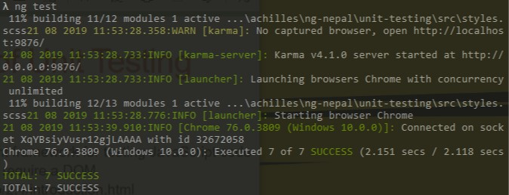

Slide 14
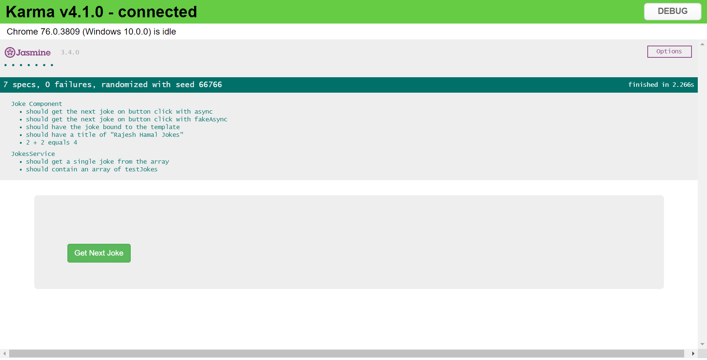

Slide 15
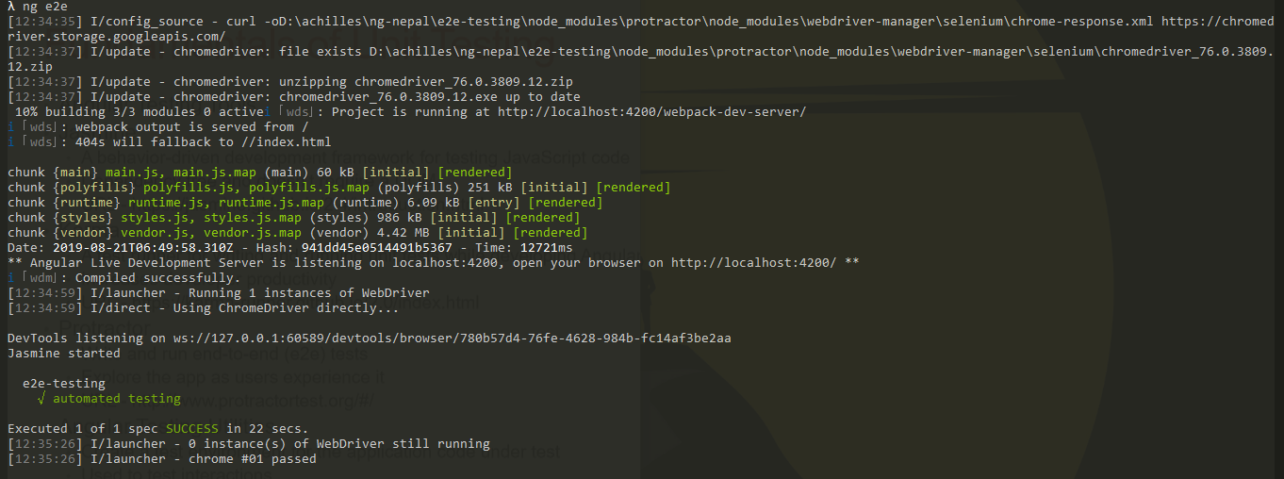

Slide 16
Jasmine Introduction

Slide 17
Structure of Testing
The AAA Structure
Arrange - initialize the system under test
Act - calling a method / function
Assert – assertion
beforeEach() and afterEach() run every time before and after the individual test
beforeAll() and afterAll() run once, before and after all the test suite

Slide 18
Fundamentals of Unit Testing
Tests are first-class citizens
Clean coding practices
Small functions and Proper naming
Single responsibility – test only one thing
Test files should have .spec.ts extension
Running tests using Angular CLI - ng test

Slide 19
DEMO

Slide 20
Faking Dependencies

Slide 21
Why fake the dependencies?
let jokesComponent = new JokesComponent(new JokesService());
How do I test with random values?
What if my service returns an error?

Slide 22
Using Fake Class
let jokesComponent = new JokesComponent(null);
class MockJokeService {
jokes;
getSingleJoke() {
return of('FAKE JOKE');
}
}
let jokesComponent = new JokesComponent(new MockJokeService());

Slide 23
Using Jasmine Spy Methods
const fakeJokeService = jasmine.createSpyObj('fakeJokeService', [‘getSingleJoke’]);
fakeJokeService.getSingleJoke.and.returnValue(of('FAKE JOKE'));
let jokesComponent = new JokesComponent(fakeJokeService);
expect(fakeJokeService.getSingleJoke).toHaveBeenCalled();
expect(fakeJokeService.getSingleJoke).toHaveBeenCalledTimes(1);

Slide 24
DEMO

Slide 25
Angular TestBed

Slide 26
Angular TestBed
One of most important tools among angular testing utilities
Configures and initializes environment for unit testing
Provides methods for creating components and services in unit tests

Slide 27
TestBed.configureTestingModule({
imports: [],
declarations: [JokesComponent],
providers: [JokesService]
});
fixture = TestBed.createComponent(JokesComponent);
jokesComponent = fixture.componentInstance;
const jokesTextDebug = fixture.debugElement.query(By.css('.joke’)).nativeElement;
fixture.detectChanges();

Slide 28
DEMO

Slide 29
Code Coverage

Slide 30
Code Coverage
ng test –code-coverage
How much of our code is covered with tests
Should always aim for higher coverage

Slide 31
E2E Testing

Slide 32
E2E Testing
A high-level testing of a feature or several interactions
Angular cli sets up a basic E2E testing environment while creating the project
Protractor is the testing framework used
Page Objects
A design pattern that is largely used in test automation
For enhancing test maintenance and reducing code duplication
Page Objects provide an API to the page under test

Slide 33
So, how did I get benefits from tests?
Analyze the code behavior (expected and unexpected changes)
It behaves as a safeguard against breaking changes
Makes developers feel guilty free and confident on their code
It saves time in the long run

Slide 34


Slide 36
ANY QUESTIONS?

Slide 37
Contact Me
GitHub: https://github.com/AchillesKarki
LinkedIn: https://www.linkedin.com/in/ashim-karki/
Facebook: https://www.facebook.com/iron.ashim.maiden
Gmail: aceem123@gmail.com

