Slide 1

Unit Testing and E2E Testing in Angular

Slide 2
What is Testing?
A test is code that throws an error when the actual result of something does not match the expected output.
Testing is executing that code.
It's simply some code which sets up some state, performs some action, and makes an assertion on the new state.

Slide 3
Why do we write tests?

Slide 4
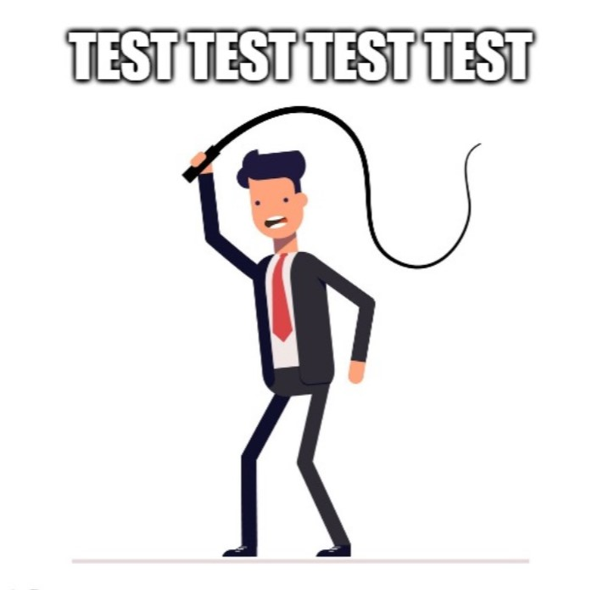
Because my boss asked me to do so…

Slide 5

I want to make better applications to make users happy

Slide 6

I want to make myself happy

Slide 7
Different types of tests
Unit Tests
Test an element in isolation, without external resources like database, file, etc.
Fast and easy to write.
Don’t test functionality of app, low confidence.
Angular – Testing component code in isolation (without template)
Integration Tests
Test an element with external resources.
Better confidence than unit tests.
Angular – Testing component code with external template, services etc.

Slide 8
Different types of tests
End to End Tests
Test a certain scenario of an app (or the app as a whole).
Test the app functionality as a user; more confidence.

Slide 9
Agendas
Angular Testing Tools
Jasmine Introduction
Faking and Mocking Dependencies
Angular Testbed
fakeAsync and async
Code Coverage
E2E testing

Slide 10




Angular Testing Tools

Slide 11
describe('Description of the test suite', () => {
it('should add numbers', () => {
expect(1 + 1).toEqual(2);
});
it('should add numbers', () => {
expect(1 + 2).toEqual(3);
});
it('should add numbers', () => {
expect(true).toEqual(true);
});
});

Slide 12
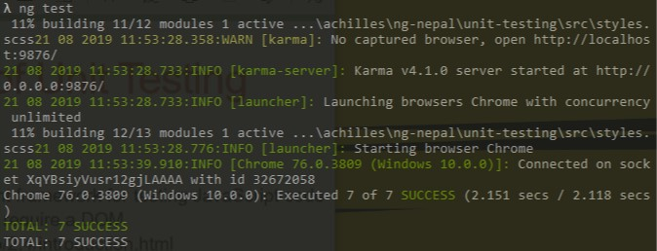

Slide 13
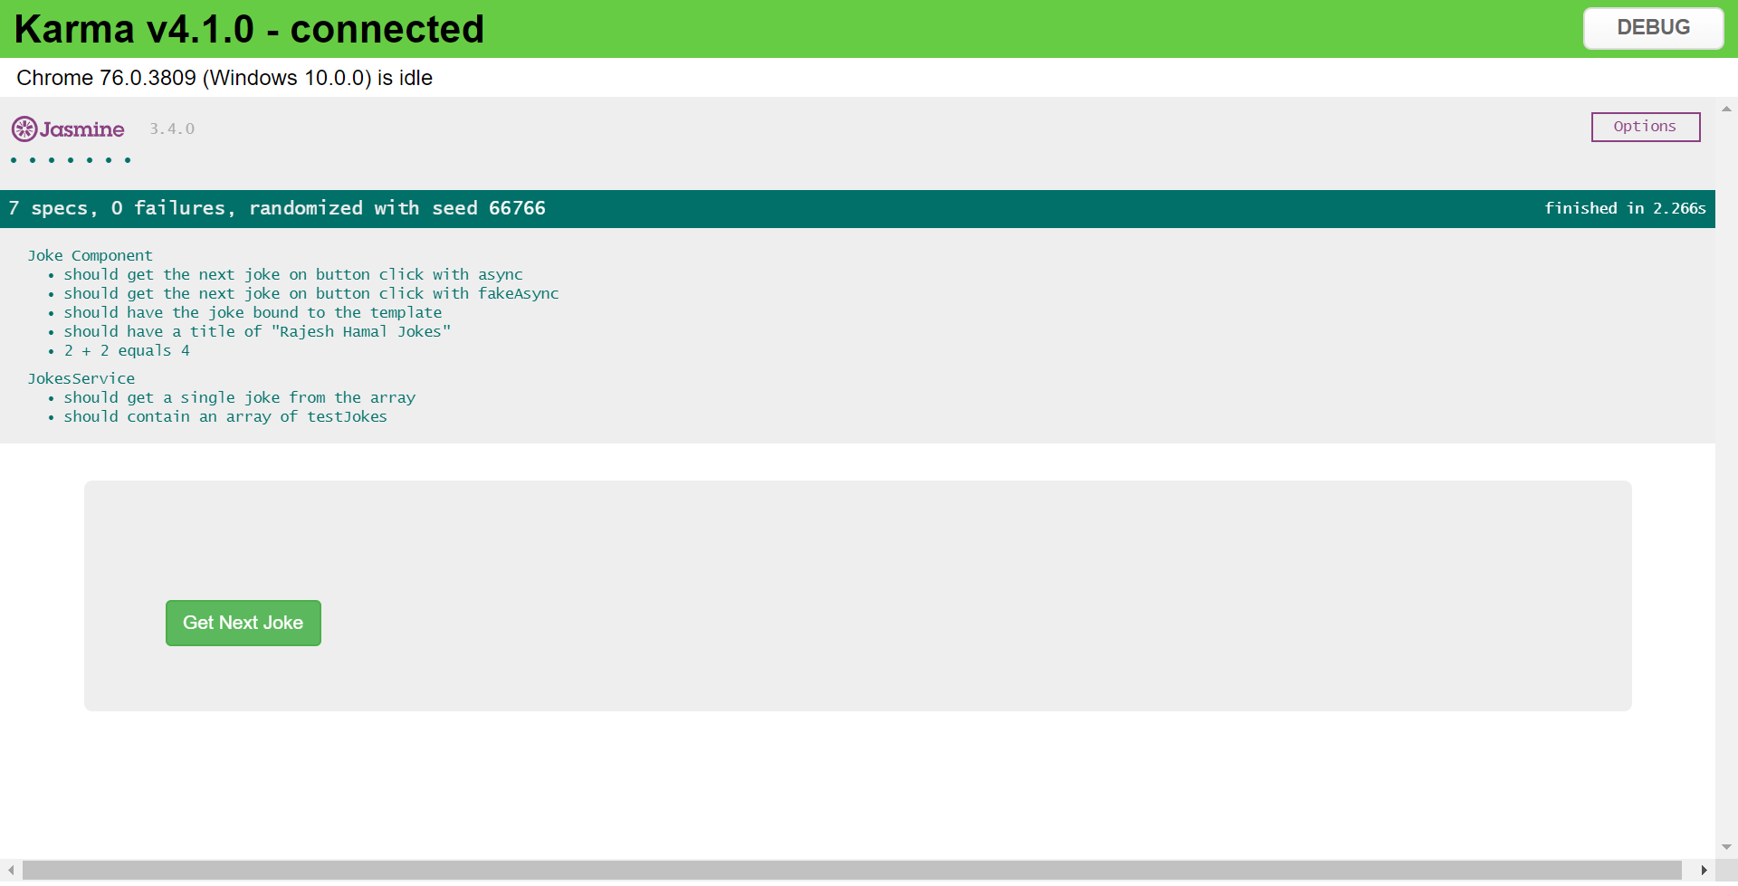

Slide 14
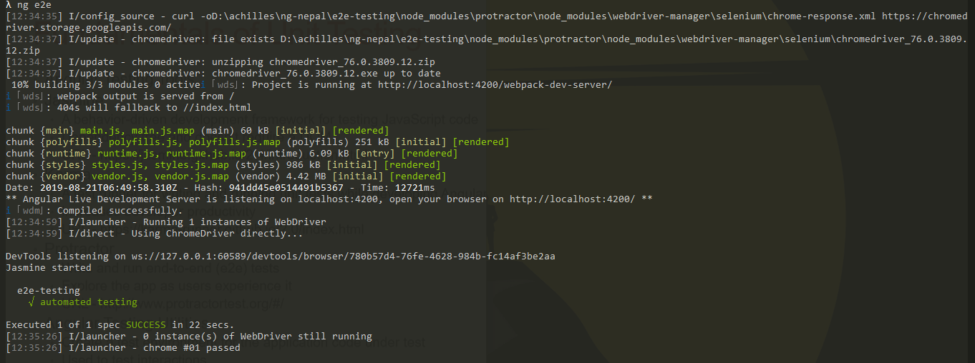

Slide 16
Jasmine Introduction

Slide 17
Fundamentals of Jasmine
describe() – define a suite – group of related tests
it() – define a spec or test
expect()
Takes actual value as the parameter chained with a Matcher function
The AAA Structure
Arrange - initialize the system under test
Act - calling a method / function
Assert – assertion

Slide 18
Fundamentals of Unit Testing
Tests are first-class citizens
Clean coding practices
Small functions and Proper naming
Single responsibility – test only one thing
Test files should have .spec.ts extension
Running tests using Angular CLI
• ng test

Slide 19
DEMO

Slide 20
Summary
Learned about Karma, Jasmine, Protractor
Angular CLI
Jasmine fundamentals and syntax
Tested the few properties of the class

Slide 21
Faking Dependencies

Slide 22
Why mocking and faking the dependencies?
Unit tests have to performed in isolation
The purpose of mocking is to isolate and focus on the code being tested and not on the behavior or state of external dependencies.

Slide 23
Using Fake Class
let jokeComponent = new JokesComponent(null);
class FakeJokeService {
fakeInitialization1;
fakeInitialization2;
getSingleJoke() {
return of(‘FAKE DATA’);
}
}
let jokeComponent = new JokesComponent(new FakeJokeService());

Slide 24
Using Jasmine Spy Methods
const fakeJokeService = jasmine.createSpyObj('fakeJokeService', [‘getSingleJoke’]);
fakeJokeService.getSingleJoke.and.returnValue(of('Fake Data’));
let jokeComponent = new JokesComponent(FakeJokeService);
expect(fakeService.getSomeData).toHaveBeenCalled();
expect(fakeService.getSomeData).toHaveBeenCalledTimes(1);

Slide 25
DEMO

Slide 26
Set Up and Tear Down
beforeEach()
Run some shared setup before each of the specs in the describe in which it is called
afterEach()
Run some shared teardown after each of the specs in the describe in which it is called
beforeAll()
Run some shared setup once before all the specs in the describe are run
afterAll()
Run some shared teardown once after all the specs in the describe are run

Slide 27
Summary
Faking and mocking
Isolation
Forget to update
Lots of duplicate code
Jasmine Spies
Spy functionality and assertions
Cleaner code

Slide 28
Angular TestBed

Slide 29
Angular TestBed
TestBed is one of most important tool among angular testing utilities
Configures and initializes environment for unit testing and provides methods for creating components and services in unit tests.

Slide 30
TestBed.configureTestingModule({
imports: [HttpClientModule],
declarations: [JokesComponent],
providers: [JokesService],
});
fixture = TestBed.createComponent(JokesComponent);
component = fixture.componentInstance;
jokeElementDebug = fixture.debugElement.query(By.css(‘p’));
jokeElementNative = jokeElementDebug.nativeElement;
fixture.detectChanges();

Slide 31
DEMO

Slide 32
Summary
Angular Testbed
Create a testing module as ngModule
Query the HTML template
Detect the changes

Slide 33
Async and fakeAsync

Slide 34
Async and fakeAsync
Testing asynchronous code has always been a challenge, but it’s now easier than ever, thanks to the async and fakeAsync utilities available for Angular
The async and fakeAsync utilities tell Angular to run the code in a dedicated test zone that helps us to deal with asynchronous code

Slide 35
Async
The async method with whenStable allows us to wait until all promises have been resolved to run our expectations.
it('should deal with asynchronous code', async( () => {
// arrange and act for asynchronous operations
fixture.whenStable().then(() => {
// perform the expectations
});
}));

Slide 36
DEMO

Slide 37
fakeAsync
The problem with async is that we still have to introduce real waiting in our tests, and this can make our tests very slow.
fakeAsync comes to the rescue and helps to test asynchronous code in a synchronous way.
it('should deal with asynchronous code’, fakeAsync( () => {
// arrange and act for asynchronous operations
tick();
// perform the expectations
}));

Slide 38
DEMO

Slide 39
Summary
How to test in asynchronous environment using fakeAsync and async
async
it generally simplifies the async tests (fixture.whenStable)
XHR calls can be made
fakeAsync
tick()
tests appear to be linear and synchronous
cannot call XHR requests

Slide 40
Code Coverage

Slide 41
Code Coverage
ng test –code-coverage
How much of our code is covered with tests?
Open ‘index.html’ within ‘coverage’ folder in the project
In most cases, we can’t cover 100% of the code
Should always aim for higher coverage

Slide 42
Unit Tests & Integration Tests
Unit testing Analyze the code behavior (expected and unexpected changes).
It behaves as a safeguard against breaking changes.
Makes developers feel guilty free on their code changes.
It also reveals the design mistakes.
It takes a lot time
Can be very complex and tiresome

Slide 43
E2E Testing

Slide 44
E2E Testing
Ensures that the integrated components function as expected
E2E test is a high-level test of a feature or several interactions
Angular cli sets up a basic E2E testing environment while creating the project
Protractor is the testing framework used

Slide 45
Page Objects
Page Object is a design pattern that is largely used in test automation for enhancing test maintenance and reducing code duplication.
Page Objects provide an API to the page under test and are responsible of abstracting away its implementation details from the tests themselves.

Slide 46
THE END

