Slide 1
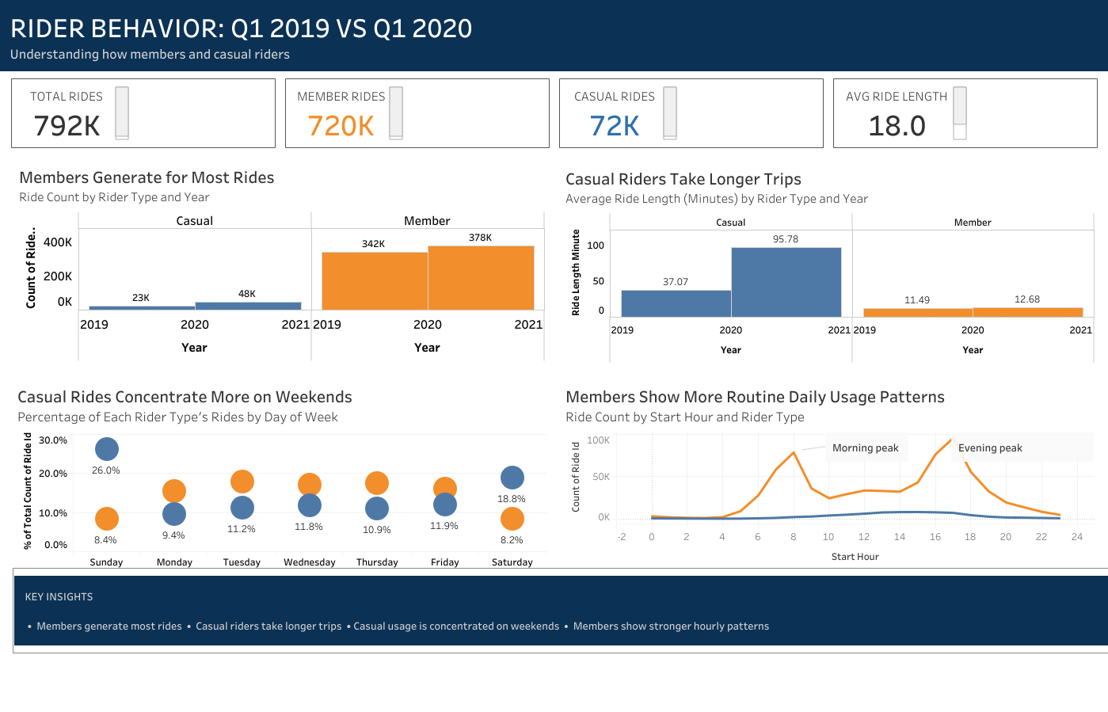
CYCLISTIC BIKE-SHARE ANALYSIS
Rider Behavior:
Q1 2019 vs Q1 2020
Understanding how members and casual riders use bike-share differently to support membership conversion strategy.
TOTAL RIDES
MEMBER RIDES
CASUAL RIDES
AVG RIDE LENGTH
792K
720K
72K
18.0
791,955 records
91.0% of rides
9.0% of rides
minutes
Prepared for Cyclistic executive review
Analysis dataset: Trip_Q1_2019_vs_Trip_Q1_2020.csv

Slide 2
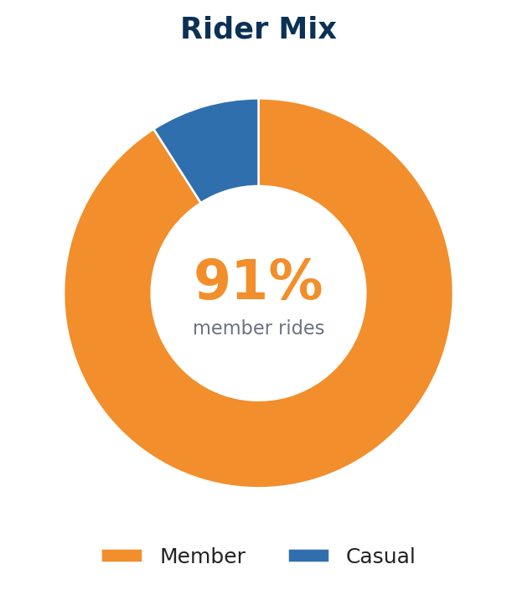
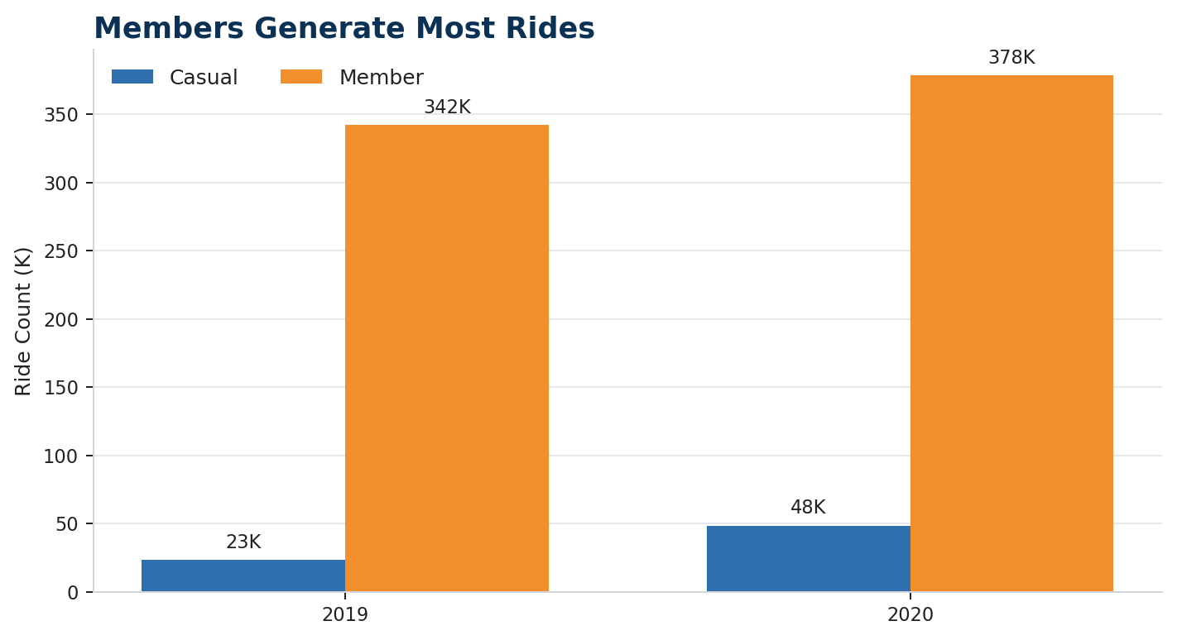
Executive summary
The deck uses the final CSV provided by the user; no additional filtering was applied after import.
Members drive volume; casual riders show longer, more leisure-oriented behavior
Business question: How do annual members and casual riders use bikes differently?
TOTAL RIDES
MEMBER RIDES
CASUAL RIDES
AVERAGE LENGTH
791,955
720K
72K
18.0 min
Final analysis file
91.0% of rides
9.0% of rides
Median: 9.0 min
Executive answer
Members dominate ride volume: 91.0% of all rides are from members.
Casual riders take longer rides: average duration is materially higher for casual riders.
Casual usage is weekend-skewed: Sunday and Saturday carry the highest casual ride share.
Members show routine hourly peaks: strongest activity occurs around 08:00 and 17:00.
Cyclistic Bike-Share Analysis • Q1 2019 vs Q1 2020 • Based on final CSV provided
Prepared for executive review

Slide 3
Ask
Clarify the problem and stakeholders before analysis.
Business task and decision context
Cyclistic wants to convert casual riders into annual members using data-backed marketing strategy.
Primary question assigned
Stakeholders
How do annual members and casual riders use Cyclistic bikes differently?
Lily Moreno: Director of Marketing; owns campaign strategy.
Marketing analytics team: prepares analysis and reporting.
This deck focuses on behavior differences that can inform membership conversion tactics.
Executive team: approves recommendations and investment.
Required case study deliverables
1
Business task
2
Data sources
3
Cleaning documentation
4
Analysis summary
5
Visual findings
6
Top 3 recommendations
Source: Case study brief assigns the first business question and requires six deliverables.
Cyclistic Bike-Share Analysis • Q1 2019 vs Q1 2020 • Based on final CSV provided
Prepared for executive review

Slide 4
Prepare
Define the data, scope, and toolchain used in the analysis.
Data source, scope, and analysis file
The analysis is based on the final CSV supplied for this case study and visualized in Tableau.
2019 RECORDS
2020 RECORDS
COMBINED RECORDS
RIDER TYPES
365,069
426,886
791,955
2
Divvy Trips Q1 2019
Divvy Trips Q1 2020
Appended dataset
member and casual
Fields used for the story
Scope boundaries
ride_id, started_at, ended_at
This is a Q1 2019 vs Q1 2020 comparison, not a full-year seasonality analysis.
member_casual, ride_length_minute
The deck uses the supplied final CSV as the analysis dataset.
day_of_week, day_name, start_hour
No additional filtering or recalculation is applied after import into this deck.
year and station names for context
Privacy note: no personally identifiable rider data is used.
Cyclistic Bike-Share Analysis • Q1 2019 vs Q1 2020 • Based on final CSV provided
Prepared for executive review

Slide 5
Process & Analyze
Prepare the data so member and casual behavior can be compared reliably.
Analysis workflow
Python/Colab was used to prepare the combined dataset; Tableau was used to create the dashboard.
1
2
3
4
5
Import CSV files
Standardize columns
Create time fields
Append datasets
Visualize & interpret
Load 2019 Q1 and 2020 Q1 trip data.
Align names and rider categories.
ride_length, day_name, start_hour.
Combine rows into one dataset.
Build Tableau dashboard and PPT.
Documentation statement
The final dataset contains 791,955 rows and 15 fields. It supports analysis of ride volume, ride duration, weekday distribution, and hourly usage patterns by rider type and year.
Cyclistic Bike-Share Analysis • Q1 2019 vs Q1 2020 • Based on final CSV provided
Prepared for executive review

Slide 6
Finding 1
Ride volume by rider type and year
Members generate the overwhelming majority of rides
In the final dataset, members account for 720K rides, while casual riders account for 72K rides.
What the chart shows
Member rides: 720,313 (91.0%).
Casual rides: 71,642 (9.0%).
Members make roughly 10× more trips than casual riders.
This confirms that member behavior is more frequent and routine by volume.
Implication
Growth does not require explaining the service from scratch: casual riders already use the system and can be targeted for conversion.
Cyclistic Bike-Share Analysis • Q1 2019 vs Q1 2020 • Based on final CSV provided
Prepared for executive review

Slide 7
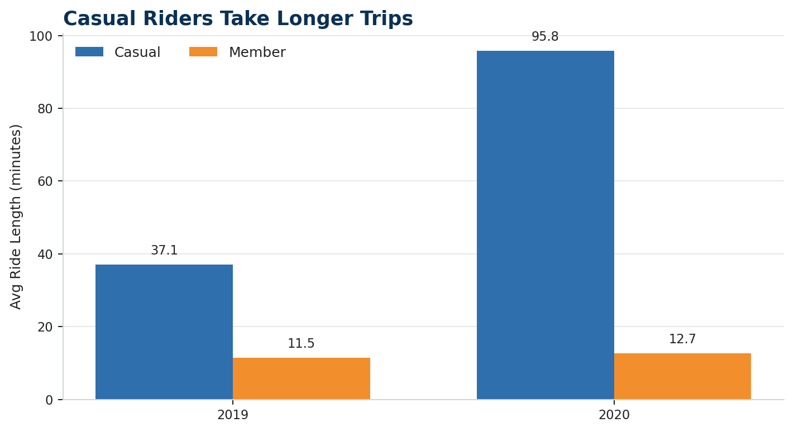
Finding 2
Average and median ride length by rider type
Casual riders take longer trips than members
The average ride length is higher for casual riders in both years; the median confirms the same directional pattern.
CASUAL AVG
MEMBER AVG
76.8 min
12.1 min
Median 22.0 min
Median 8.5 min
Specific values from the supplied CSV
2019 casual avg: 37.07 min; member avg: 11.49 min.
2020 casual avg: 95.78 min; member avg: 12.68 min.
This supports messaging that targets casual riders with long-trip value propositions.
Note: These figures use the final CSV exactly as provided. They match the Tableau dashboard values.
Cyclistic Bike-Share Analysis • Q1 2019 vs Q1 2020 • Based on final CSV provided
Prepared for executive review

Slide 8
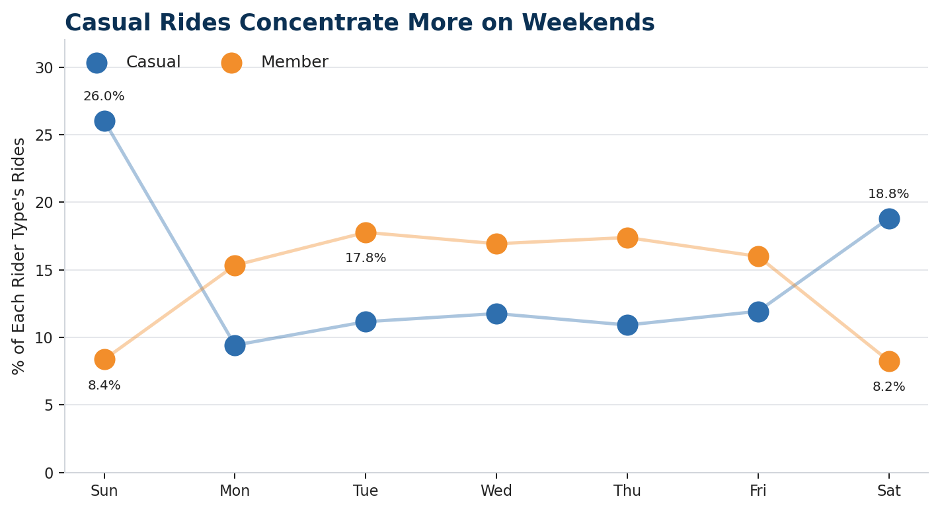
Finding 3
Weekday distribution by rider type
Casual riding is more concentrated on weekends
Casual riders over-index on Sunday and Saturday; members concentrate more on weekdays.
Weekend skew
CASUAL SUNDAY
CASUAL SATURDAY
26.0%
18.8%
highest share
second-highest
MEMBER TUESDAY
MEMBER WEEKEND
17.8%
16.6%
weekday peak
Sun + Sat
Implication
Weekend touchpoints are more relevant for casual conversion than broad, all-week messaging.
Cyclistic Bike-Share Analysis • Q1 2019 vs Q1 2020 • Based on final CSV provided
Prepared for executive review

Slide 9
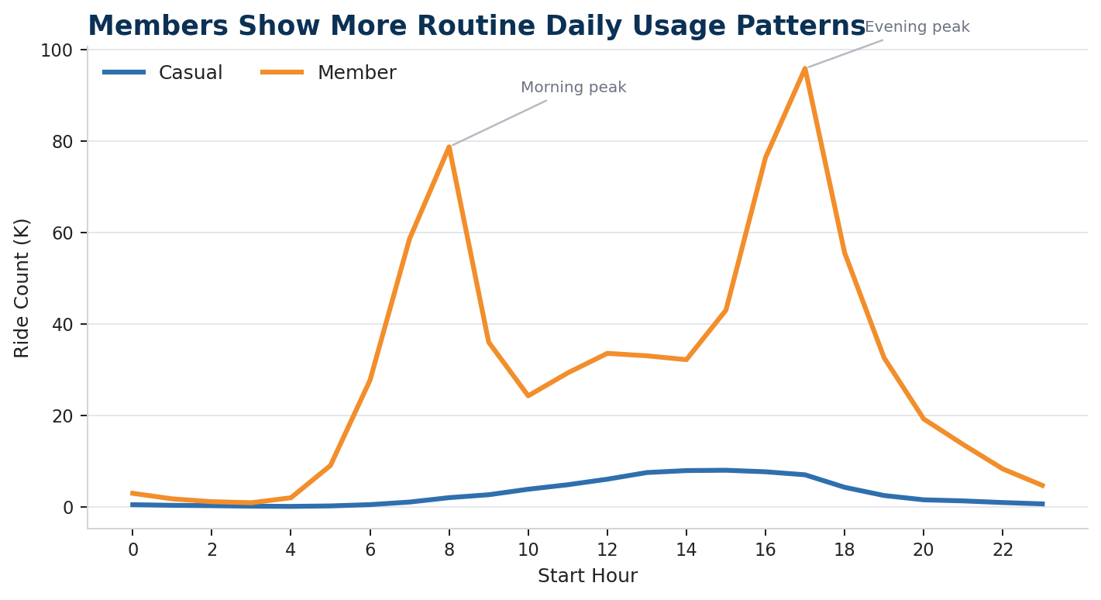
Finding 4
Hourly usage patterns by rider type
Members show stronger routine hourly usage patterns
Member activity has clear morning and evening peaks; casual activity peaks later in the day.
Peak usage from the CSV
MEMBER PEAK
CASUAL PEAK
17:00
15:00
95,865 rides
7,999 rides
Members display sharper 08:00 and 17:00 peaks.
Casual rides build through midday and afternoon.
Use “commute-related” as an inference, not a confirmed cause.
Cyclistic Bike-Share Analysis • Q1 2019 vs Q1 2020 • Based on final CSV provided
Prepared for executive review

Slide 10
Share
Final Tableau dashboard provided by the user
Dashboard view: rider behavior comparison
The dashboard combines KPIs, volume, duration, weekday share, and hourly usage in one executive view.
This screenshot is included as the supporting visualization deliverable. The presentation slides separate the dashboard into decisions and recommendations.
Cyclistic Bike-Share Analysis • Q1 2019 vs Q1 2020 • Based on final CSV provided
Prepared for executive review

Slide 11
Act
Translate the findings into marketing recommendations.
Top three recommendations
The recommendations focus on converting casual riders who already show high engagement.
1
Weekend conversion campaign
2
Long-trip value messaging
3
Segmented digital experiments
Target casual riders on Saturday and Sunday with membership trial offers and post-ride prompts.
Show savings or benefits of membership after longer casual rides and repeat long-duration sessions.
Run A/B tests by rider type, day, start hour, and high-casual stations; measure conversion rate.
Why: casual ride share is highest on Sunday and Saturday.
Why: casual rides are longer on average and median than member rides.
Why: usage patterns are different enough to justify targeted campaigns.
Measure: CTR, conversion rate, cost per conversion, repeat rides.
Measure: CTR, conversion rate, cost per conversion, repeat rides.
Measure: CTR, conversion rate, cost per conversion, repeat rides.
Cyclistic Bike-Share Analysis • Q1 2019 vs Q1 2020 • Based on final CSV provided
Prepared for executive review

Slide 12
Close
Limitations and next analysis steps
Use the findings, but avoid over-claiming causality
The data answers usage differences, not the exact reason casual riders would buy a membership.
Limitations
Next steps
Scope is Q1 2019 vs Q1 2020, not a full-year view.
Extend analysis to a full 12-month dataset for seasonality.
No rider-level identity: repeat behavior cannot be directly tracked.
Add weather and station-level factors to explain demand variation.
No pricing, revenue, or membership conversion data is included.
Create segments for repeat casual riders, if privacy-safe IDs exist.
Trip purpose is inferred from patterns, not observed directly.
Run controlled digital campaign tests against the identified segments.
Weather, events, and operational changes are not controlled.
Connect campaign exposure to membership conversion outcomes.
Final conclusion: Members use the service more frequently and routinely; casual riders use it less often but take longer and more weekend-oriented trips.
Cyclistic Bike-Share Analysis • Q1 2019 vs Q1 2020 • Based on final CSV provided
Prepared for executive review

Slide 13
Appendix
Source metrics computed directly from the supplied CSV
Metric reconciliation
These are the key values used in the deck and dashboard.
Metric
Value
Total rides
791,955
Member rides
720,313 (91.0%)
Casual rides
71,642 (9.0%)
Overall average ride length
18.0 minutes
Overall median ride length
9.0 minutes
2019: casual / member rides
23,163 / 341,906
2020: casual / member rides
48,479 / 378,407
2019: casual / member average duration
37.07 / 11.49 minutes
2020: casual / member average duration
95.78 / 12.68 minutes
Data source for metrics: /mnt/data/Trip_Q1_2019_vs_Trip_Q1_2020(1).csv. All calculations use the values in this file as supplied.
Cyclistic Bike-Share Analysis • Q1 2019 vs Q1 2020 • Based on final CSV provided
Prepared for executive review

