Slide 1
DATA ANALYTICS CASE STUDY
E-Commerce Customer Segmentation and Cohort Retention
Who comes back after the first order, and which customers are worth keeping
UCI Online Retail II · Dec 2009 to Dec 2011 · SQL, Python, Tableau · Novaldi Ramadhan Waluyo

Slide 2
OVERVIEW
Summary
£17.74M
805.5K
5,878
21%
Revenue, identified customers
Cleaned transactions
Customers
Return in month 1 (avg)
Most customers do not come back in the first month. Across the 24 cohorts with a month-1 value, on average only 21% of new customers bought again in the month after their first order. Retention stays near 20% for the next few months and is about 18% at month 6 and 18% at month 12. The largest loss happens right after the first order.
A small group of customers brings in most of the revenue. Champions and Loyal Customers are 43% of customers but 85% of revenue. Champions alone (1,324 customers) account for 69% of revenue.
At Risk customers are the clearest win-back target. 683 customers who used to buy often (5.3 orders on average) have not ordered for about a year (364 days on average). They spent £1.71M in total.
Revenue is seasonal. Monthly revenue rises from September and peaks in November in both 2010 and 2011, at roughly twice the level of early 2010. December 2011 looks low only because the data ends on 9 December.

Slide 3
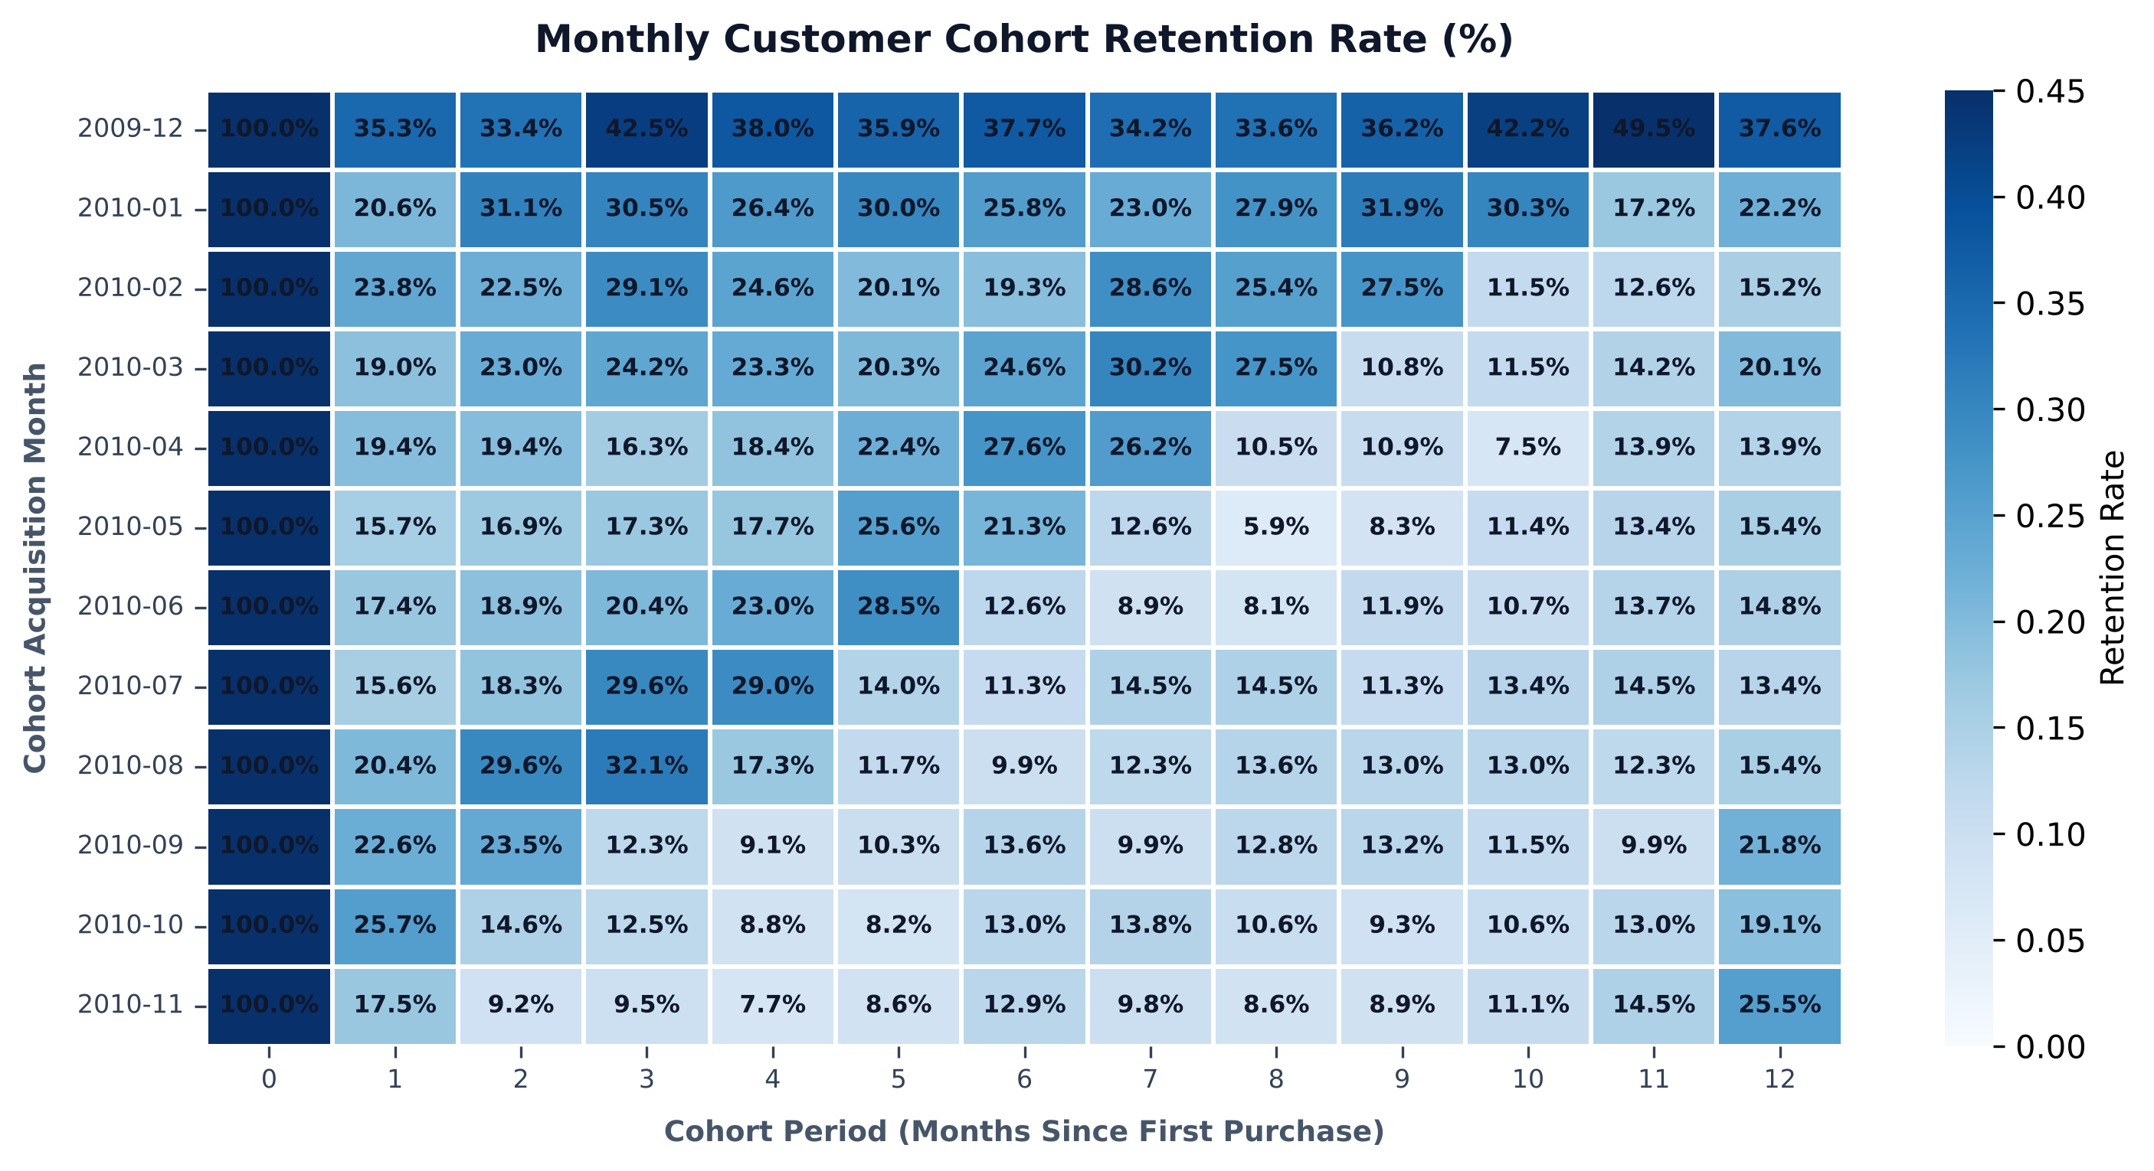
COHORT RETENTION
Only 21% of new customers buy again in month 1
Across the 24 cohorts with a month-1 value, on average only 21% of new customers bought again in the month after their first order. Retention stays near 20% for the next few months and is about 18% at month 6 and 18% at month 12. The largest loss happens right after the first order.
The December 2009 cohort retains much better than the rest (35% in month 1) because the data starts that month, so it includes customers who were already buying before.

Slide 4
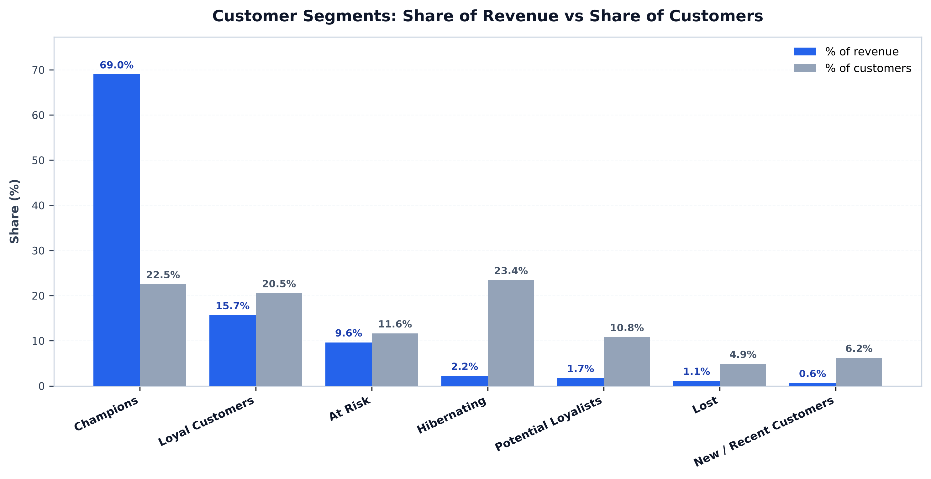
RFM SEGMENTATION
43% of customers bring in 85% of revenue
Champions and Loyal Customers are 43% of customers but 85% of revenue. Champions alone (1,324 customers) account for 69% of revenue.
683 customers who used to buy often (5.3 orders on average) have not ordered for about a year (364 days on average). They spent £1.71M in total.

Slide 5
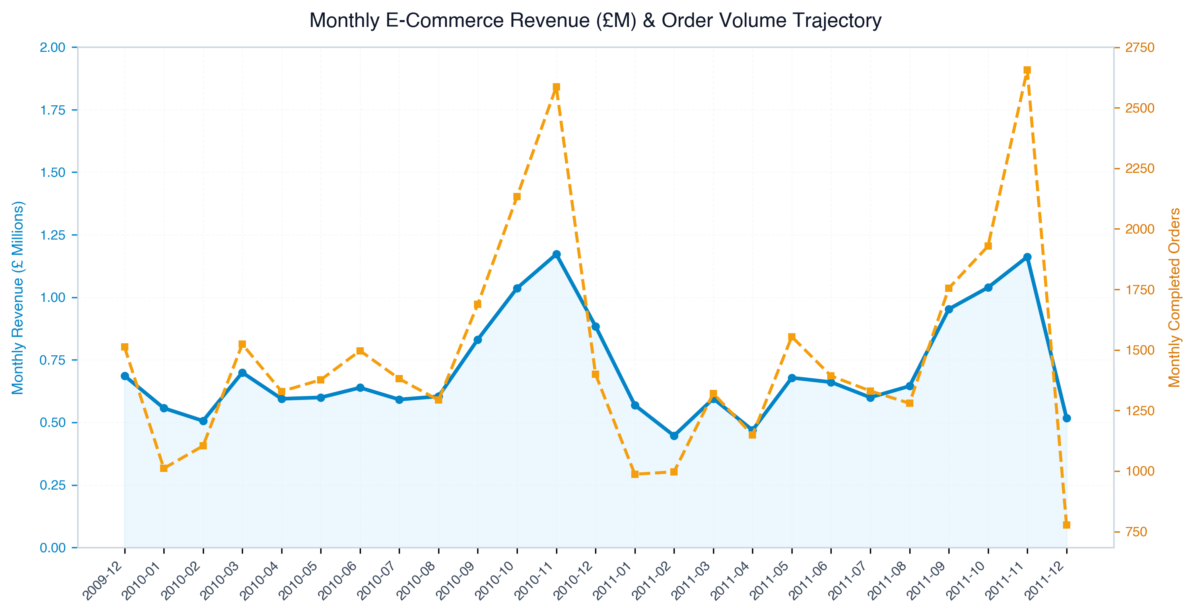
SEASONALITY
Revenue peaks every November
Monthly revenue rises from September and peaks in November in both 2010 and 2011, at roughly twice the level of early 2010. December 2011 looks low only because the data ends on 9 December.
Stock and campaigns should be planned around September to November.

Slide 6
WHAT TO DO
Recommendations
1. Focus on the second purchase
2. Run a win-back campaign for At Risk customers
The biggest drop is in the first month, so a follow-up offer or product recommendation a few weeks after the first order targets exactly that gap.
They have a proven buying history and £1.71M of past spend. Even a small reactivation rate is worth more than a campaign aimed at Hibernating customers (1,377 customers, 2.2% of revenue).
3. Keep Champions without heavy discounts
4. Plan stock and campaigns around September to November
They already buy often, so early access or service perks are a cheaper way to keep them than price cuts.
Demand is highest in these months in both years.
Directional only: the data has no marketing cost, channel or margin information.

Slide 7
HOW TO READ THESE RESULTS
Method and limitations
Data. 1,067,371 raw rows reduced to 805,549 after removing rows without a customer ID, cancelled invoices and non-positive quantities or prices.
Cohorts. Customers grouped by first-order month; retention is the share ordering again in each later month.
RFM. Recency, frequency and monetary value scored 1 to 5 by quintile, reference date 10 December 2011.
Tools. Python (pandas) for cleaning and scoring, SQLite for the SQL views, Tableau and matplotlib for charts.
The dataset has no marketing cost, acquisition channel or margin data, so recommendations cannot be costed. The 25% CAC increase comes from the project brief, not from the data.
Rows without a customer ID (about a quarter of the raw data) are excluded; revenue covers identified customers only.
The December 2009 cohort retains much better than the rest (35% in month 1) because the data starts that month, so it includes customers who were already buying before.
The data ends on 9 December 2011, so recent cohorts have only a few months of history.
RFM segments depend on the chosen score thresholds; different cut-offs would move some customers between segments.

