Slide 1
DATA ANALYTICS CASE STUDY
Fintech & PPOB Transaction Operations Analytics
Volume Concentration, Biller Failure Bottlenecks, Peak Load Patterns & Vendor Risk
Dataset: 316,376 masked transactions (1, 5 and 6 Aug 2026) | Tech Stack: SQL, Python (pandas/Seaborn), Power BI | Author: Novaldi Ramadhan Waluyo

Slide 2
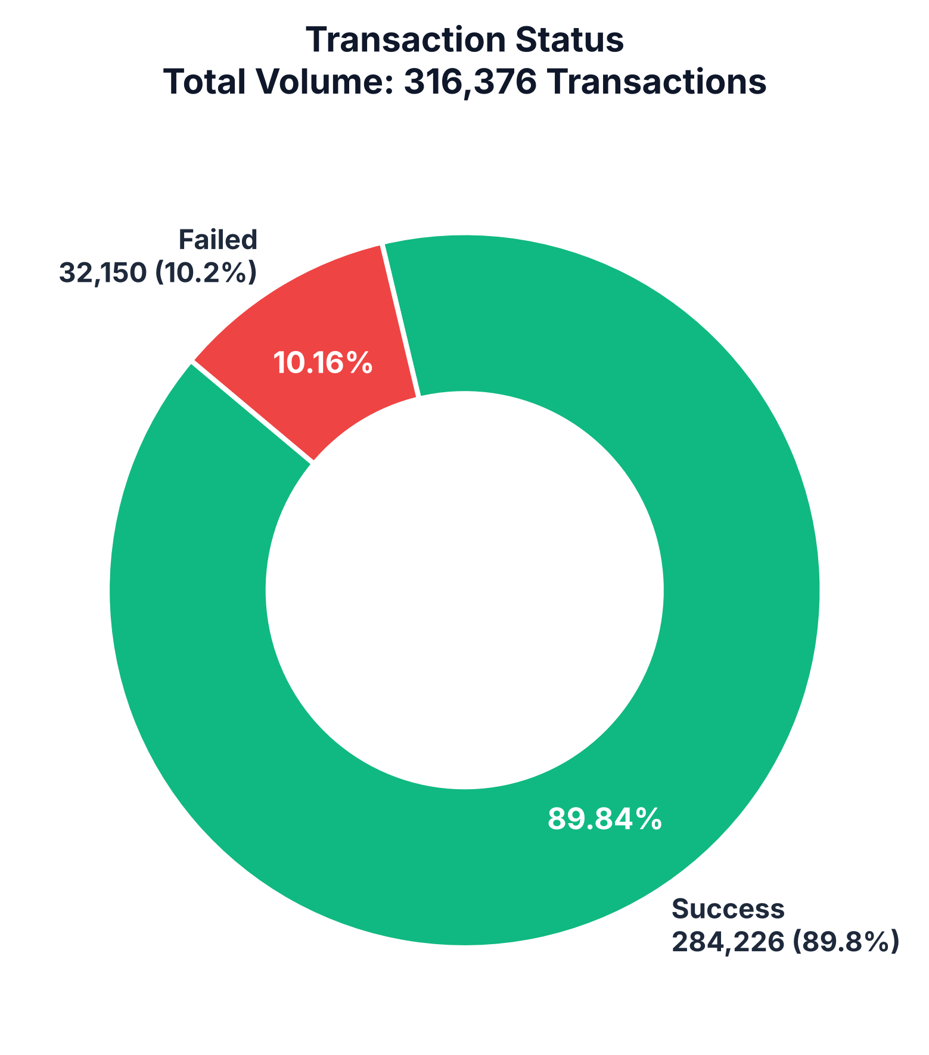
FINTECH OPERATIONS & DATA ANALYTICS
Executive Summary: Operational Performance
TOTAL VOLUME
316,376
Analyzed across 3 operational days
SUCCESS RATE
89.84%
284,226 settled transactions
FAILURE RATE
10.16%
32,150 failed transactions
FAILURE CONCENTRATION
60.9%
19,585 failures from 2 billers
Key Operational Highlights & Problem Statement
• Volume Baseline: 316.4k transactions over three days with an overall 89.84% success rate.
• Failure Concentration: 60.9% of all failures (19,585) come from two billers, Biller_29 and Biller_26, which handle only 19.6% of traffic.
• High-Volume Product Risk: TNP23, the #3 SKU by volume (22.3k tx), fails 22.75% of the time.
• Broken Denominations: XDF1000 (6.2k tx) fails 58.73% of the time, XDF2000 53.47% and XDF3000 48.28%, pointing to an upstream catalogue or denomination problem.
• Data Quality: 1,923 transactions (0.6%) used lower-case product codes such as xdg1. They failed 34.9% of the time vs 10.0% for standard codes. Codes were upper-cased before analysis.

Slide 3
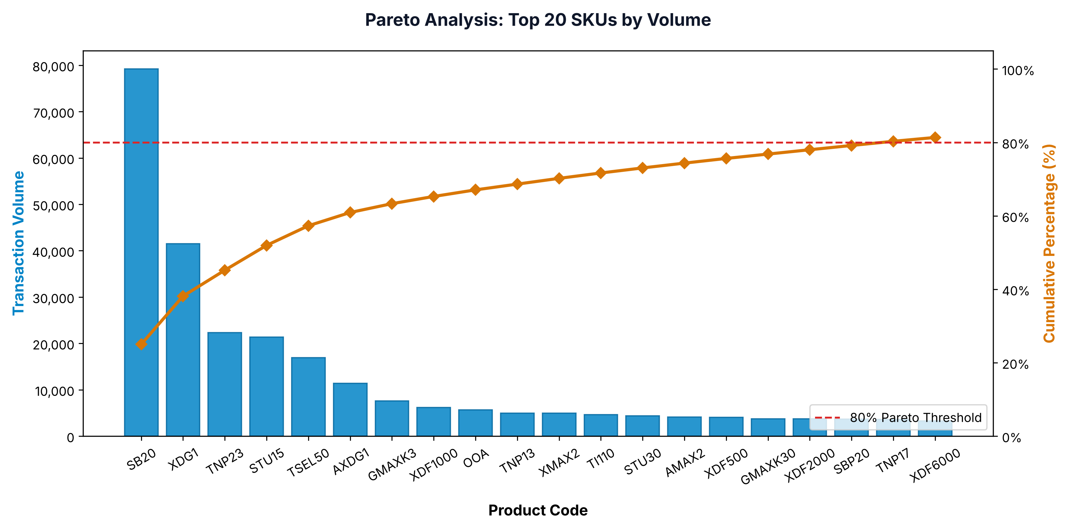
FINTECH OPERATIONS & DATA ANALYTICS
Product Volume Distribution: Pareto Concentration
Top Volume Drivers
• Heavy Pareto Skew: The top 5 SKUs carry 57.3% of volume (181.3k tx). It takes 20 SKUs to pass 80% (81.4%).
• Leading SKU (SB20): 79,184 transactions (25.0% of volume) with a 94.70% success rate.
• Runner-up (XDG1): 41,492 transactions (13.1% of volume) with a 96.47% success rate.
• Volume Vulnerability (TNP23): Ranked #3 in volume (22,334 tx) but plagued by a 22.75% failure rate (5,082 failed tx).
• Implication: The top 3 SKUs carry 45.2% of volume, so close monitoring of just three products protects almost half of all transactions.

Slide 4
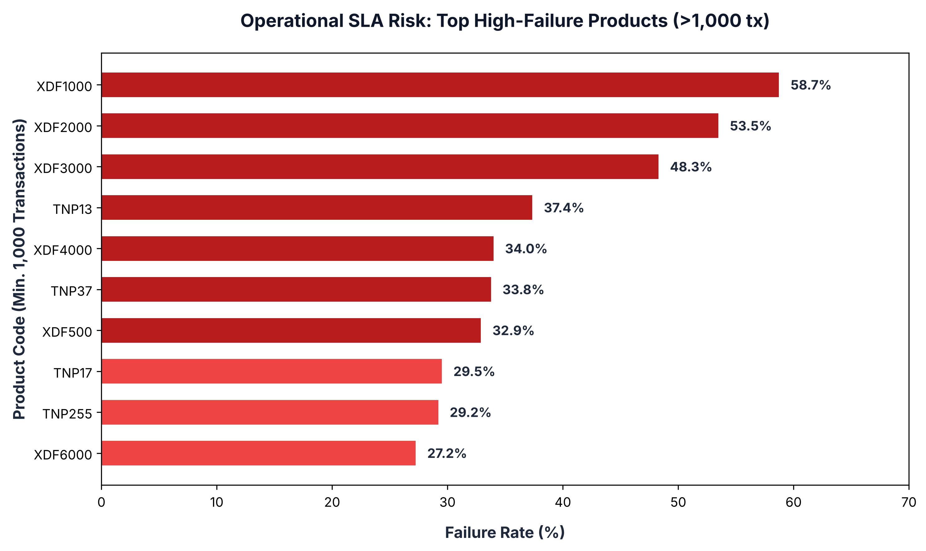
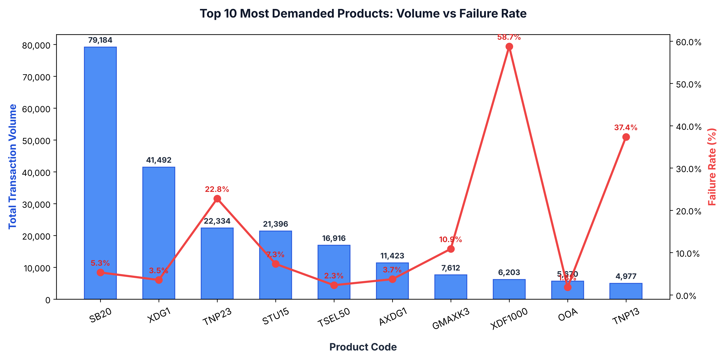
FINTECH OPERATIONS & DATA ANALYTICS
Operational Hotspots: Products with Critical Failure Rates
CRITICAL DIAGNOSTIC FINDINGS:
1. XDF series (Biller_29): XDF1000, XDF2000 and XDF3000 fail 58.73%, 53.47% and 48.28% of the time, which points to a denomination mismatch or a stock/balance problem upstream.
2. TNP series (Biller_26): TNP13 (37.35%) and TNP23 (22.75%) are high-demand products with high failure. No other biller carries them in this data, so a backup supplier is needed before any failover.

Slide 5
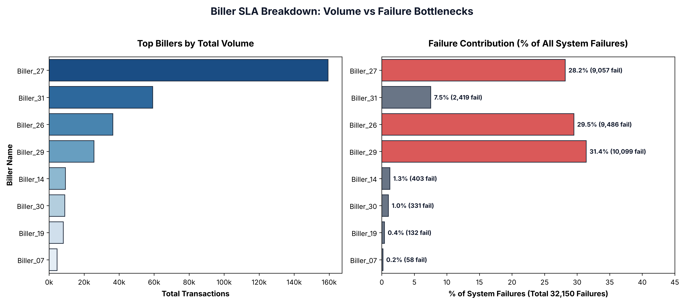
FINTECH OPERATIONS & DATA ANALYTICS
Biller Performance: Volume vs Failure Concentration
Biller Insights
• Biller_27 Backbone: Handles 50.4% of traffic (159.4k tx) at a 94.3% success rate.
• Biller_29 Alert: 60.6% success rate (39.38% failure rate); 31.4% of all failures.
• Biller_26 Bottleneck: 73.96% success rate (26.04% failure rate); 29.5% of all failures.
• Vendor Risk: Together they cause 60.9% of failures on only 19.6% of volume.
• No Backup Route: Their SKUs are not served by any other biller in the data (2 of 19,585 failures), so rerouting first needs a new supplier.

Slide 6
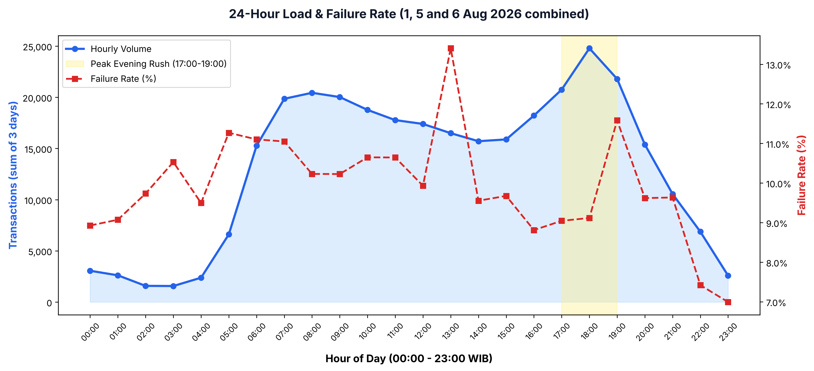
FINTECH OPERATIONS & DATA ANALYTICS
Temporal Load Analysis: 24-Hour Traffic Curve & Failure Patterns
Traffic & Load Patterns
• Evening Peak (17:00 - 19:00): 18:00 WIB is the busiest hour: 24,787 transactions over the three days (~8.3k per day). 17:00-19:00 carries 21.3% of volume.
• Morning Load (07:00 - 09:00): About 6.7k transactions per hour per day.
• Off-Peak (01:00 - 04:00): 02:00-03:00 WIB is the quietest window (~530 transactions per hour per day), suitable for batch reconciliation.
• Load vs Failure: Hourly failure rate ranges from 7.0% to 13.4% and does not rise with volume (18:00 is 9.1%), so failures are driven by billers and SKUs, not load.

Slide 7
FINTECH OPERATIONS & DATA ANALYTICS
B2B Partner Ecosystem & Customer Experience Risk
B2B Partner Exposure
• 46 Unique B2B Partners integrated into the gateway.
• Top 5 Partners account for 66.0% (208.9k tx) of total system volume.
• Partner_07 is the largest client (79,974 tx), followed by Partner_12 (55,304 tx).
• Risk: biller failures pass straight through to partners and can affect partner retention.
Customer Experience
• 291,662 unique customer MSISDNs analyzed.
• 32,150 failed transactions, each a failed purchase attempt for a customer.
• Repeated failures risk customers abandoning the purchase or switching apps.
• Clear status messages and safe retries reduce that friction.
Recovery Potential (illustrative)
• Every 10% of failures recovered is about 3,200 transactions per 3-day window.
• The two worst billers account for 19,585 failures, the largest single lever.
• Revenue impact cannot be estimated: the data has no transaction value.

Slide 8
FINTECH OPERATIONS & DATA ANALYTICS
Actionable Strategy: 4-Pillar Operational Optimization
1. Backup Biller & Health-Based Routing
Onboard a second supplier for the XDF and TNP product lines (none exists in this data). Then switch traffic automatically when a biller's failure rate passes 10% in a 5-minute window.
2. Automated Retry with Exponential Backoff
For transient errors on top SKUs (TNP23, STU15), retry up to 3 times with backoff before returning a final 'FAILED' status to the customer.
3. Biller Performance Targets
Agree a success-rate target (e.g. 95%) with Biller_29 and Biller_26, review it weekly, and add deposit-balance alerts.
4. Peak-Hour Monitoring
Watch failure rate and latency closely between 16:30 and 20:00 WIB. The data shows no capacity problem yet, so any scaling should follow latency data.

Slide 9
FINTECH OPERATIONS & DATA ANALYTICS
Technical Implementation & Portfolio Deliverables
SQL & Database Engineering
• Indexed SQLite schema (`idx_trans_date`, `idx_status`, `idx_biller_name`).
• Engineered analytical SQL views (`v_daily_biller_summary`, `v_hourly_traffic`).
• Advanced queries: CTEs, Window Functions (`RANK()`, `SUM() OVER`), and Pareto cumulative distributions.
• Product codes normalised to upper case (318 raw codes, 294 real SKUs).
Python Data Analytics Pipeline
• Pandas for high-volume data cleaning, type coercion & aggregation.
• Anonymized PII with deterministic hashing & mapping verification.
• Automated visualization generator (Seaborn & Matplotlib at 300 DPI).
• Automated PowerPoint reporting engine via `python-pptx`.
Business Impact & BI Modeling
• Pareto product volume concentration.
• Biller failure concentration analysis.
• 24-hour load and failure profile.
• Recommendations limited to what the data can support.

Slide 10
PORTFOLIO SUMMARY
Thank You / Q&A
This end-to-end project demonstrates business problem framing, SQL data modeling, exploratory data analysis, root-cause diagnostics, and executive presentation design.
Candidate: Novaldi Ramadhan Waluyo | Email: novaldiramadhan28@gmail.com | GitHub: github.com/Achimedes28

