Slide 1
DATA ANALYTICS CASE STUDY
Fintech & PPOB Transaction Operations Analytics
Volume Pareto, SLA Failure Bottlenecks, Peak Load Dynamics & Smart Routing Strategy
Dataset: 316,376 Live Operational Transactions | Tech Stack: SQL, Python (Pandas/Seaborn), Tableau | Author: Novaldi Ramadhan Waluyo

Slide 2
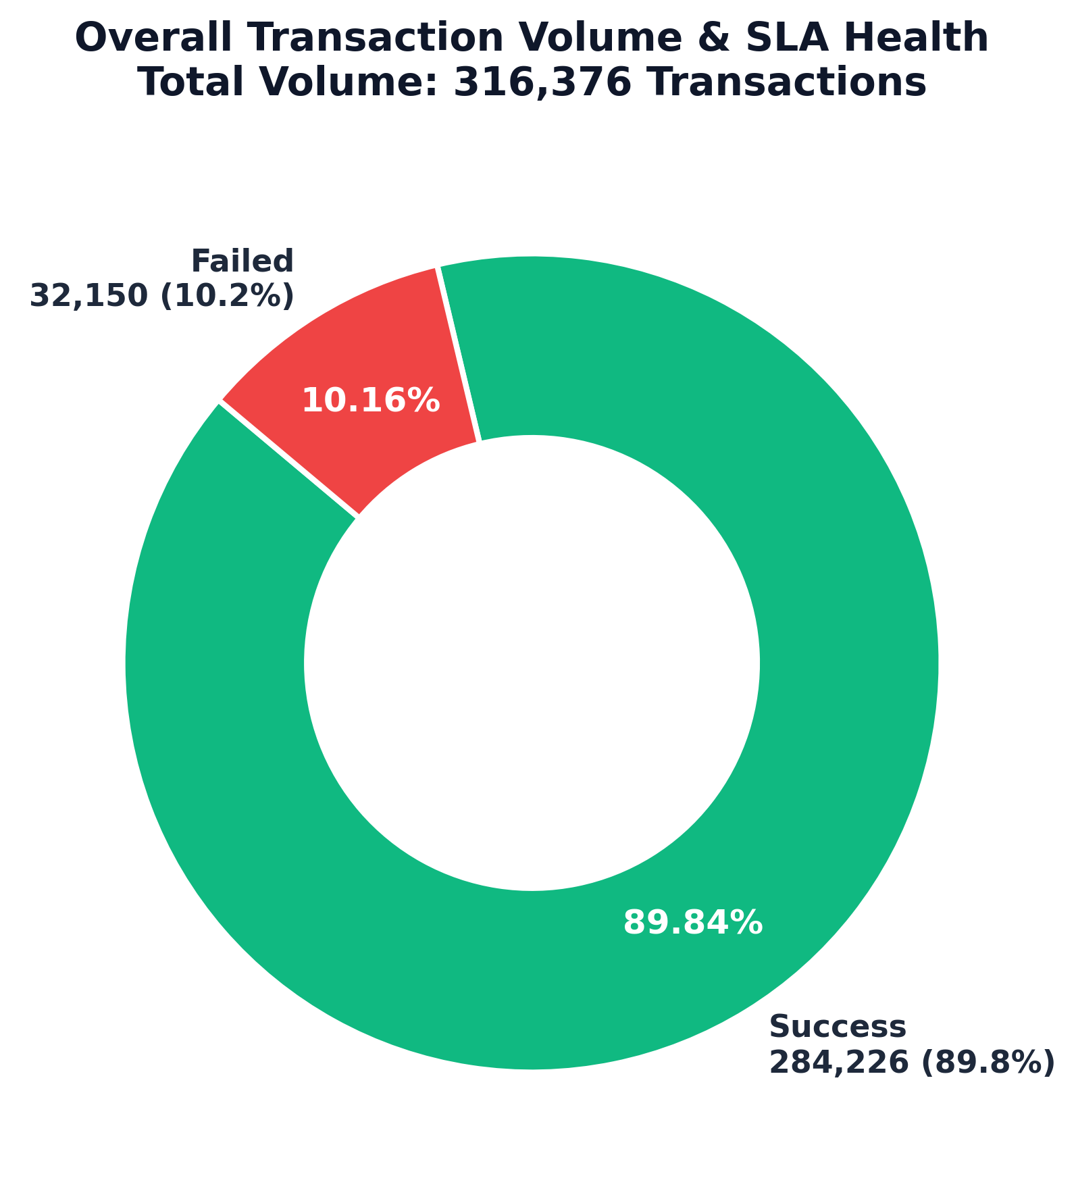
FINTECH OPERATIONS & DATA ANALYTICS
Executive Summary: Operational Performance & SLA Health
TOTAL VOLUME
316,376
Analyzed across 3 operational days
SUCCESS RATE
89.84%
284,226 settled transactions
FAILURE SLA RISK
10.16%
32,150 failed transactions
FAILURE CONCENTRATION
60.9%
19,585 failures from 2 billers
Key Operational Highlights & Problem Statement
• High Volume Baseline: System processed 316.3k transactions with an overall 89.84% success rate.
• Critical Failure Concentration: Over 60.9% of all system failures originate from just two vendors (Biller_29 & Biller_26), causing 19,585 failed user requests.
• High-Volume Product Risks: Key top-tier products like TNP23 (22.3k tx) suffer a 22.75% failure rate, severely hurting user trust and GMV conversion.
• Product Catalog Outliers: Certain micro-SKUs like XDF1000 face a catastrophic 58.73% failure rate, indicating severe API misconfiguration or upstream disconnection.
• Peak Evening Strain: Transactions peak between 17:00 - 19:00 WIB (up to 24,787 tx/hr), correlating with vendor timeout spikes.

Slide 3
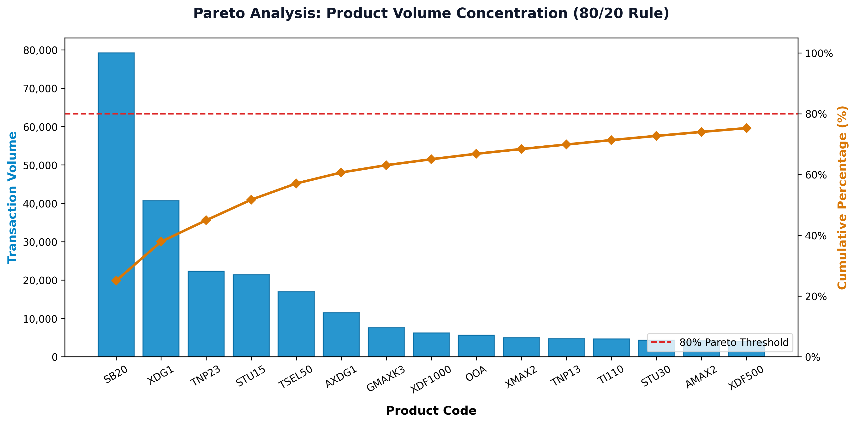
FINTECH OPERATIONS & DATA ANALYTICS
Product Volume Distribution: Pareto 80/20 Concentration
Top Revenue Drivers (Volume Analysis)
• Heavy Pareto Skew: Top 5 products generate 57.0% of total volume (180.4k tx). Top 15 products represent 82.4% of total traffic.
• Leading Star SKU (SB20): SB20 alone commands 79,184 transactions (25.03% market share) with a healthy 94.70% success rate.
• Runner Up (XDG1): XDG1 delivers 40,640 transactions (12.85% share) with a resilient 97.05% success rate.
• Volume Vulnerability (TNP23): Ranked #3 in volume (22,334 tx) but plagued by a 22.75% failure rate (5,082 failed tx).
• Operational Implication: Prioritizing reliability for just the top 3 SKUs safeguards ~45% of total business revenue.

Slide 4
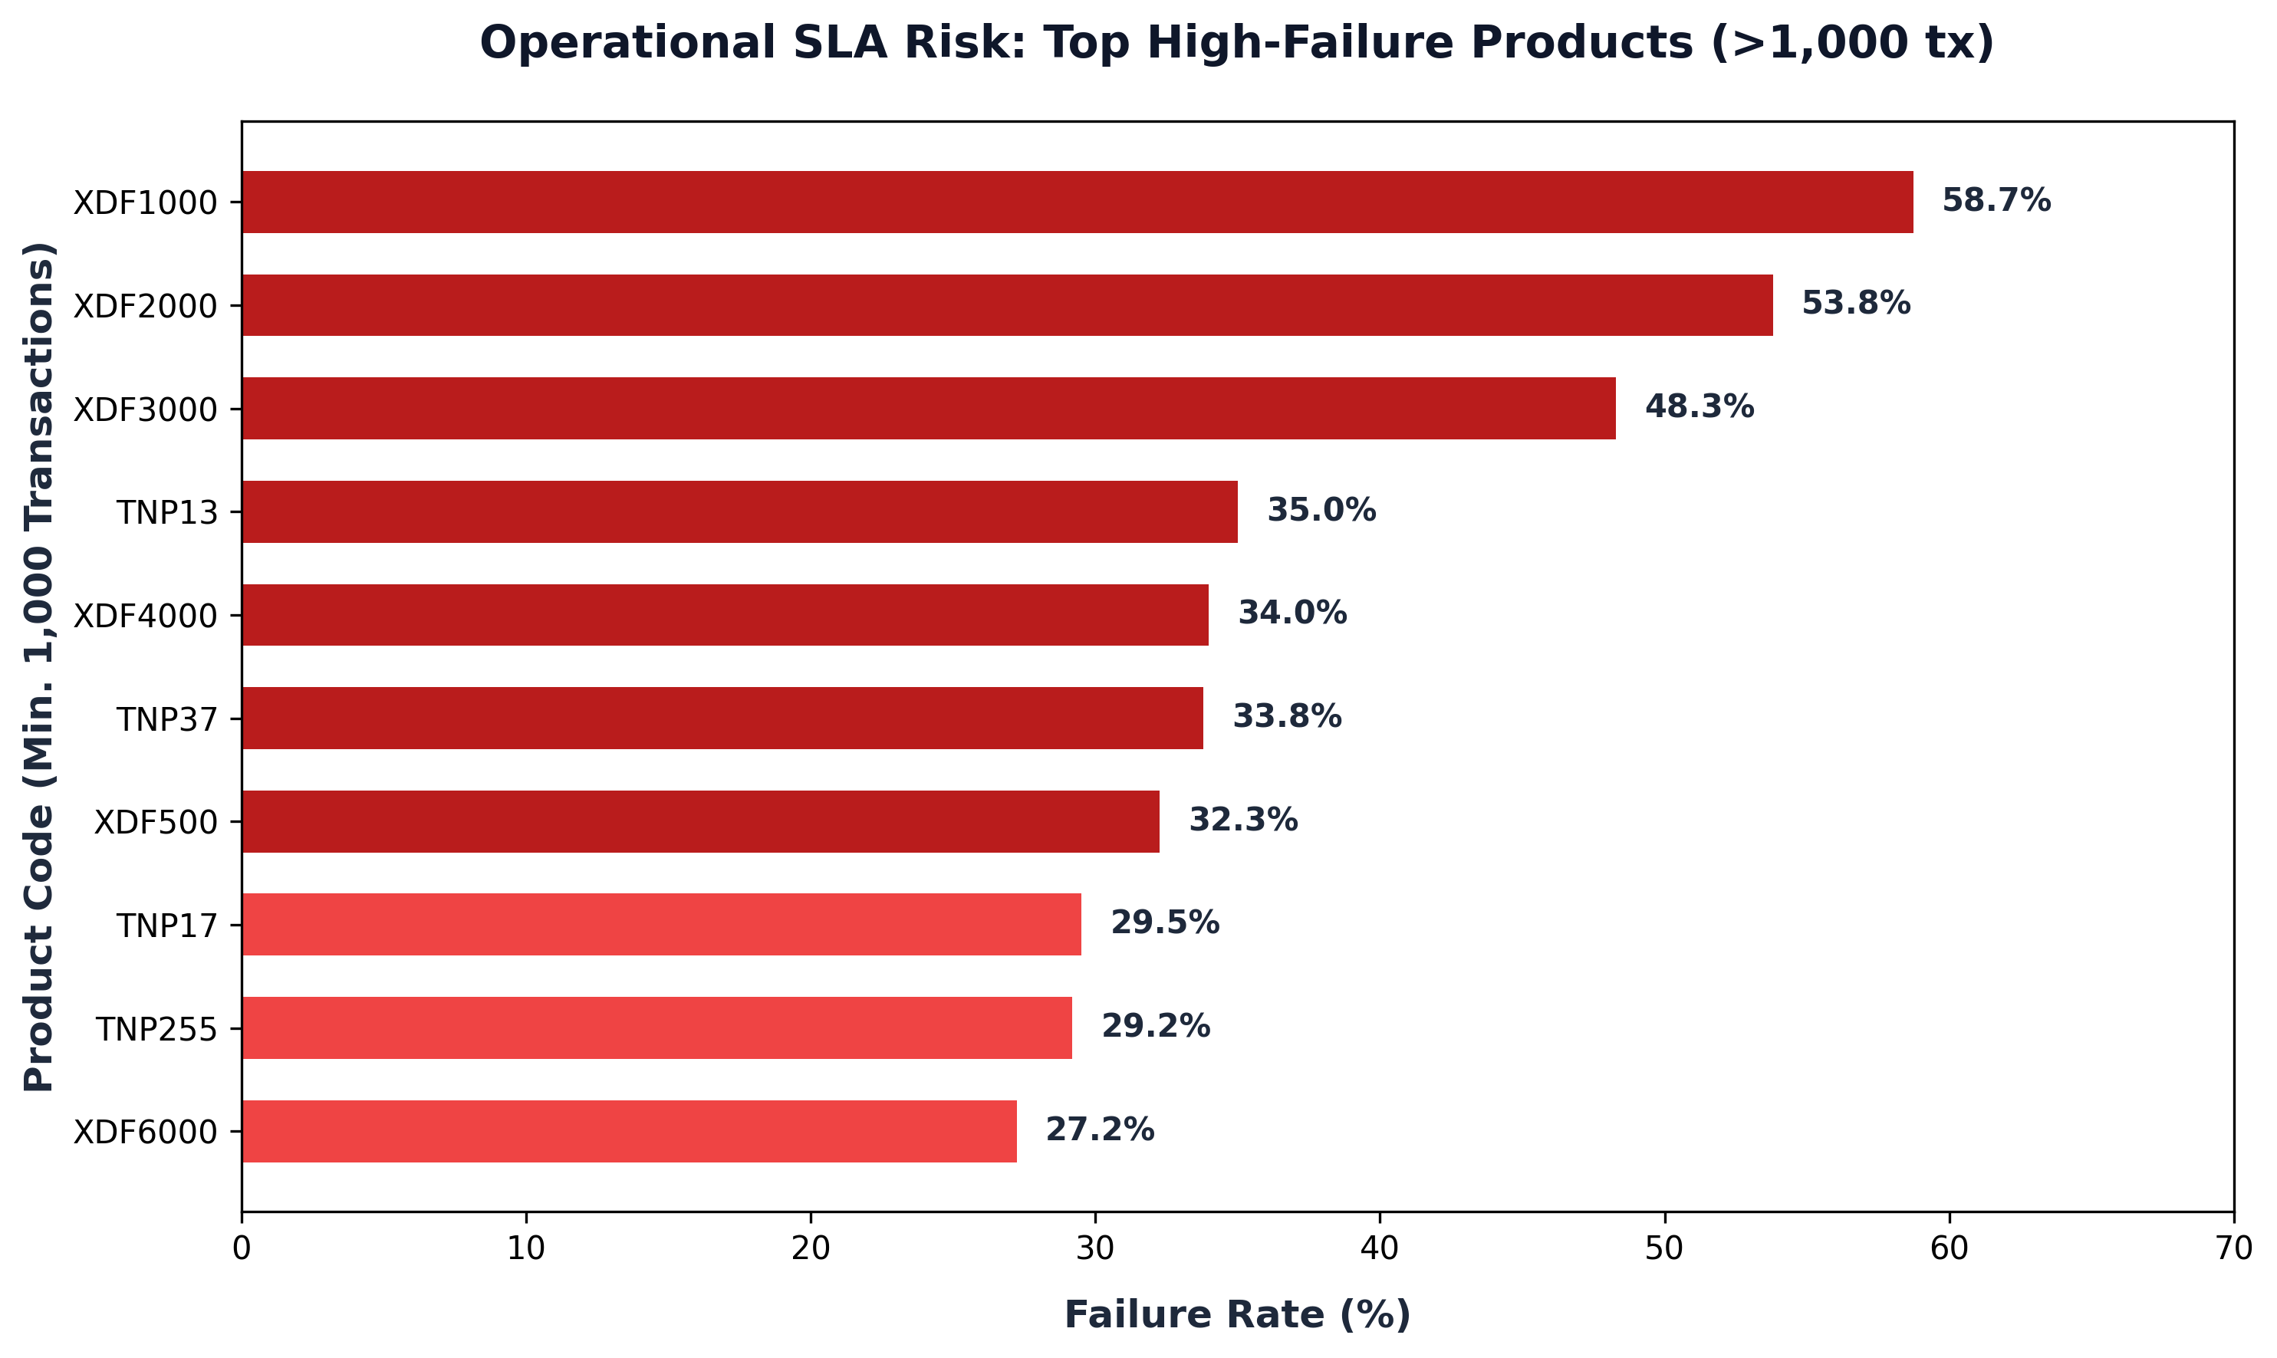
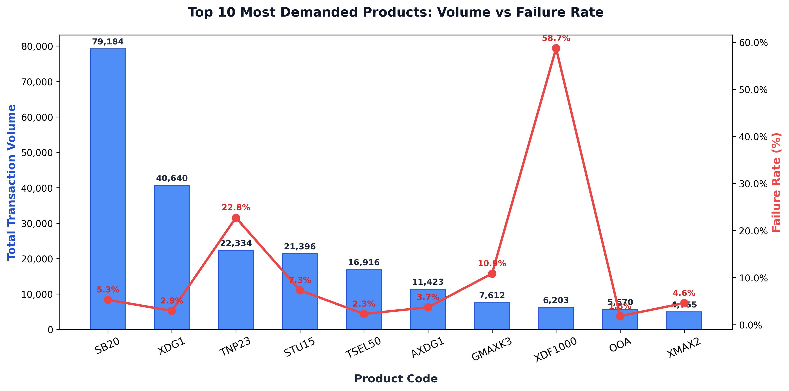
FINTECH OPERATIONS & DATA ANALYTICS
Operational Hotspots: Products with Critical Failure Rates
CRITICAL DIAGNOSTIC FINDINGS:
1. XDF1000 & XDF500: Extreme failure rates (58.73% and 32.26%) indicate upstream vendor denomination mismatch or depleted balance on partner switchboards.
2. TNP Series (TNP23 & TNP13): High demand products with 22.75% to 35.00% fail rates need immediate dynamic failover to alternative billers.

Slide 5
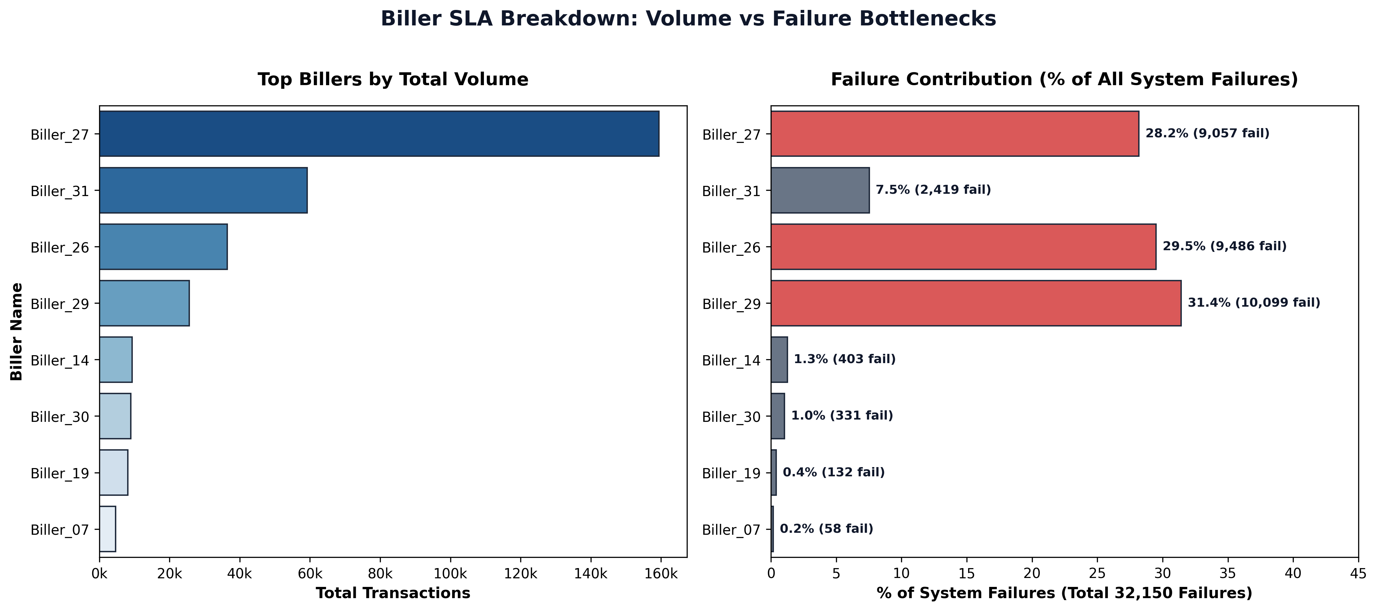
FINTECH OPERATIONS & DATA ANALYTICS
Vendor SLA Matrix: Biller Volume vs Failure Concentration
Vendor SLA Insights
• Biller_27 Dominance: Handles 50.4% (159.4k tx) with solid 94.3% SLA. Core backbone.
• Biller_29 Alert: 60.6% success rate (39.38% fail rate!). Contributes 31.4% of all system errors.
• Biller_26 Bottleneck: 73.96% success rate (26.04% fail). Contributes 29.5% of all errors.
• Vendor Risk: Together, Biller_29 & 26 generate 60.9% of system failures despite only 19.6% of volume!
• Action Required: Institute SLA penalty clauses and reroute traffic dynamically when vendor fail rate exceeds 10%.

Slide 6
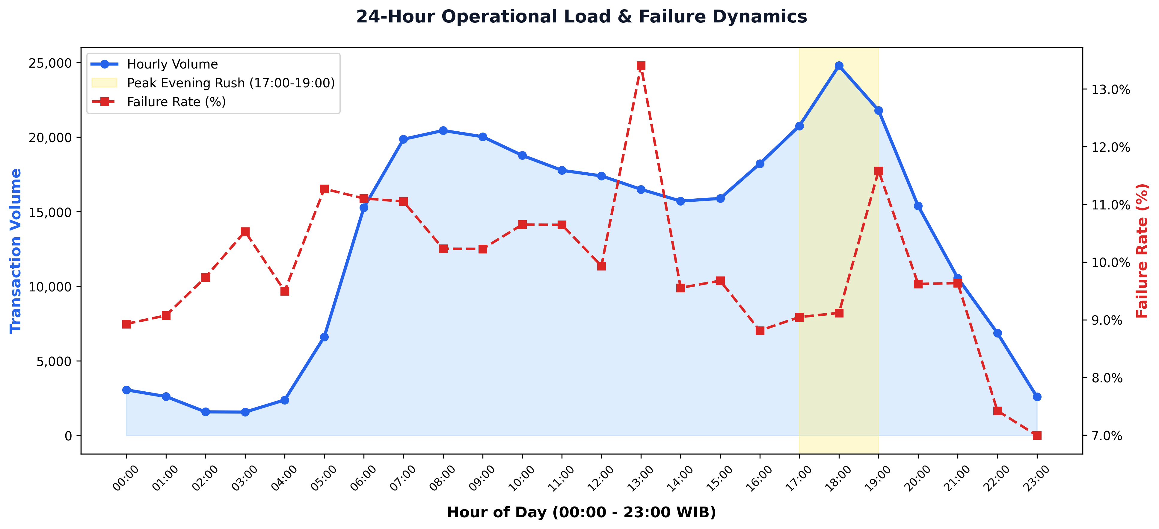
FINTECH OPERATIONS & DATA ANALYTICS
Temporal Load Analysis: 24-Hour Traffic Curve & Failure Patterns
Traffic & Load Patterns
• Evening Peak (17:00 - 19:00): Peak volume hits at 18:00 WIB (24,787 tx/hr), followed by 19:00 WIB (21,792 tx/hr). Represents 21.3% of daily traffic.
• Morning Rush (07:00 - 09:00): Sustained high load of ~20,000 tx/hr during morning commute and opening hours.
• Off-Peak Trough (01:00 - 04:00): Lowest traffic occurs between 02:00-03:00 WIB (<1,600 tx/hr). Ideal maintenance and batch reconciliation window.
• Load-Failure Correlation: Failure rates remain steady around 9.5% - 11.0% across all hours, indicating errors are vendor/SKU-systemic rather than pure server congestion.

Slide 7
FINTECH OPERATIONS & DATA ANALYTICS
B2B Partner Ecosystem & Customer Experience Risk
B2B Partner Exposure
• 46 Unique B2B Partners integrated into the gateway.
• Top 5 Partners account for 66.0% (208.9k tx) of total system volume.
• Partner_07 is the largest client (79,974 tx), followed by Partner_12 (55,304 tx).
• Risk: Systemic biller failures directly degrade partner SLA, risking B2B churn and SLA penalty clawbacks.
Customer Experience
• 291,662 unique customer MSISDNs analyzed.
• Over 32,150 failed transactions created customer friction and support tickets.
• Repeat failures cause users to abandon checkout or switch to competitor platforms.
• Preserving customer lifetime value requires immediate auto-retry and real-time status transparency.
Revenue Opportunity
• Recovering 70% of failed transactions via Smart Fallback Routing would salvage ~22,500 transactions per 3-day window.
• Annualized Potential: Recovers ~2.7M transactions and protects millions in GMV.
• Drastically cuts customer service ticket volume related to 'Pending/Failed' recharges.

Slide 8
FINTECH OPERATIONS & DATA ANALYTICS
Actionable Strategy: 4-Pillar Operational Optimization
1. Dynamic Smart Routing & Failover
Implement real-time health checks on upstream billers. If Biller_29 or Biller_26 failure rate exceeds 10% in a 5-minute rolling window, automatically route traffic to secondary backup billers (e.g. Biller_27 or Biller_19).
2. Automated Retry with Exponential Backoff
For transient errors on popular products (TNP23, STU15), implement a 3-attempt automated background retry queue before returning a hard 'FAILED' status to the end user.
3. Biller SLA Renegotiation & Vendor Penalties
Hold Biller_29 and Biller_26 accountable for breaching 95% SLA thresholds. Enforce contract penalty rebates and set minimum balance monitoring alerts.
4. Peak Load Capacity & Queue Provisioning
Scale gateway worker pods by 35% between 16:30 and 20:00 WIB daily to handle peak bursts of 24.7k+ tx/hr without queue timeouts.

Slide 9
FINTECH OPERATIONS & DATA ANALYTICS
Technical Implementation & Portfolio Deliverables
SQL & Database Engineering
• Indexed SQLite schema (`idx_date`, `idx_status`, `idx_biller`).
• Engineered analytical SQL views (`v_daily_biller_summary`, `v_hourly_traffic`).
• Advanced queries: CTEs, Window Functions (`RANK()`, `SUM() OVER`), and Pareto cumulative distributions.
• Instant query response on 316k+ records.
Python Data Analytics Pipeline
• Pandas for high-volume data cleaning, type coercion & aggregation.
• Anonymized PII with deterministic hashing & mapping verification.
• Automated visualization generator (Seaborn & Matplotlib at 300 DPI).
• Automated PowerPoint reporting engine via `python-pptx`.
Business Impact & BI Modeling
• Pareto 80/20 product revenue concentration.
• Vendor SLA gap analysis & failure concentration modeling.
• 24-Hour peak load capacity sizing.
• Strategic roadmap with estimated 2.7M annualized transaction recovery.

Slide 10
PORTFOLIO SUMMARY
Thank You / Q&A
This end-to-end project demonstrates business problem framing, SQL data modeling, exploratory data analysis, root-cause diagnostics, and executive presentation design.
Candidate: Novaldi Ramadhan Waluyo | Email: novaldiramadhan28@gmail.com | GitHub: github.com/Achimedes28

