Slide 1
Assembly Language for Intel-Based Computers, 5th Edition
Kip Irvine
Chapter 1: Basic Concepts
Slides prepared by the author
Revision date: June 3, 2006
(c) Pearson Education, 2006-2007. All rights reserved. You may modify and copy this slide show for your personal use, or for use in the classroom, as long as this copyright statement, the author's name, and the title are not changed.

Slide 2
Chapter Overview
Welcome to Assembly Language
Virtual Machine Concept
Data Representation
Boolean Operations
Irvine, Kip R. Assembly Language for Intel-Based Computers 5/e, 2007.
Notes:
This chapter insists of four sections.

Slide 3
Welcome to Assembly Language
Assembly language is the oldest programming language, and of all languages, bears the closest resemblance to native machine language.
  It provides direct access to computer hardware,
  requiring you to understand much about your computer’s architecture and operating system.
Irvine, Kip R. Assembly Language for Intel-Based Computers 5/e, 2007.

Slide 4
Welcome to Assembly Language
Some Good Questions to Ask
Assembly Language Applications
Irvine, Kip R. Assembly Language for Intel-Based Computers 5/e, 2007.

Slide 5
Questions to Ask
Why am I learning Assembly Language?
  be asked to write embedded programs
    embedded programs:
      short programs stored in a small amount of memory in single-purpose devices such as telephones, automobile fuel and ignition systems, air-conditioning control systems, security systems, data acquisition instruments, video cards, sound cards, hard drives, modems, and printers.
    Assembly language is an ideal tool for writing embedded programs because of its economical use of memory.
Irvine, Kip R. Assembly Language for Intel-Based Computers 5/e, 2007.
Notes:
If you study computer engineering, you may likely be asked to write embedded programs.
They are short programs stored in a small amount of memory in single-purpose devices such as telephones, automobile fuel and ignition systems, air-conditioning control systems, security systems, data acquisition instruments, video cards, sound cards, hard drives, modems, and printers.
Assembly language is an ideal tool for writing embedded programs because of its economical use of memory.

Slide 6
Questions to Ask
Why am I learning Assembly Language?
  Real-time applications dealing with simulation and hardware monitoring require precise timing and responses.
    High-level languages do not give programmers exact control over machine code generated by compilers.
    Assembly language permits you to precisely specify a
    program’s executable code.
Irvine, Kip R. Assembly Language for Intel-Based Computers 5/e, 2007.
Notes:
Real-time applications dealing with simulation and hardware monitoring require precise timing and responses.
High-level languages do not give programmers exact control over machine code generated by compilers.
Assembly language permits you to precisely specify a program’s executable code.

Slide 7
Questions to Ask
Why am I learning Assembly Language?
  Computer game consoles require their software to be highly optimized for small code size and fast execution.
  Game programmers are experts at writing code that takes full advantage of hardware features in a target system.
  They use assembly language as their tool of choice because it permits direct access to computer hardware, and code can be hand optimized for speed.
Irvine, Kip R. Assembly Language for Intel-Based Computers 5/e, 2007.
Notes:
Computer game consoles require their software to be highly optimized for small code size and fast execution.
Game programmers are experts at writing code that takes full advantage of hardware features in a target system.
They use assembly language as their tool of choice because it permits direct access to computer hardware, and code can be hand optimized for speed.

Slide 8
Questions to Ask
Why am I learning Assembly Language?
  helps you to gain an overall understanding of the interaction between computer hardware, operating systems, and application programs.
Irvine, Kip R. Assembly Language for Intel-Based Computers 5/e, 2007.
Notes:
Assembly language helps you to gain an overall understanding of the interaction between computer hardware, operating systems, and application programs. Using assembly language,
you can apply and test theoretical information you are given in computer architecture and operating systems courses.

Slide 9
Questions to Ask
Why am I learning Assembly Language?
  Hardware manufacturers create device drivers for the equipment they sell.
    Device drivers are programs that translate general operating system commands into specific references to hardware details.
      Printer manufacturers, for example, create a different MS-Windows device driver for each model they sell.
    The same is true for Mac OS, Linux, and other operating systems.
Irvine, Kip R. Assembly Language for Intel-Based Computers 5/e, 2007.
Notes:
Hardware manufacturers create device drivers for the equipment they sell.
Device drivers are programs that translate general operating system commands into specific references to hardware details.
Printer manufacturers, for example, create a different MS-Windows device driver for each model they sell.
The same is true for Mac OS, Linux, and other operating systems.

Slide 10
Questions to Ask
What background should I have?
  should have programmed in at least one structured high-level language, such as Java, C, Python, or C++.
  should know how to use IF statements, arrays, and functions to solve programming problems
Irvine, Kip R. Assembly Language for Intel-Based Computers 5/e, 2007.

Slide 11
Questions to Ask
What is an assembler, linker, and debugger?
  An assembler is a utility program that converts source code programs from assembly language into machine language.
  A linker is a utility program that combines individual files created by an assembler into a single executable program.
  A related utility, called a debugger, lets you to step through a program while it’s running and examine registers and memory.
Irvine, Kip R. Assembly Language for Intel-Based Computers 5/e, 2007.

Slide 12
Questions to Ask
What hardware/software do I need?
  You need a computer with an x86 processor.
  MASM is compatible with all versions of Microsoft Windows, beginning with Windows 95.
  Editor: Use a text editor or programmer’s editor to create assembly language source files.
    We recommend the latest version of Microsoft Visual Studio.
  32-Bit Debugger: The debugger supplied with Microsoft Visual Studio is excellent.
Irvine, Kip R. Assembly Language for Intel-Based Computers 5/e, 2007.

Slide 13
Questions to Ask
What types of programs will I create?
  two general classes of programs:
    16-Bit Real-Address Mode:
      run under MS-DOS and in the console window under MS-Windows.
    32-Bit Protected Mode:
      run under all 32-bit versions of Microsoft Windows.
Irvine, Kip R. Assembly Language for Intel-Based Computers 5/e, 2007.
Notes:
16-bit real-address mode programs run under MS-DOS and in the console window under MS-Windows.
Also known as real mode programs, they use a segmented memory model required of programs written for the Intel 8086 and 8088 processors.
32-bit protected mode programs run under all 32-bit versions of Microsoft Windows. They are usually easier to write and understand than real mode programs.

Slide 14
Questions to Ask
What will I learn?
  Basic principles of computer architecture as applied to x86 processors
  Basic boolean logic and how it applies to programming and computer hardware
  How x86 processors manage memory, using real mode, protected mode, and virtual mode
  How high-level language compilers (such as C++) translate statements from their language into assembly language and native machine code
  How high-level languages implement arithmetic expressions, loops, and logical structures at the machine level
Irvine, Kip R. Assembly Language for Intel-Based Computers 5/e, 2007.

Slide 15
Questions to Ask
What will I learn?
  Data representation, including signed and unsigned integers, real numbers, and character data
  How to debug programs at the machine level
  How application programs communicate with the computer’s operating system via interrupt handlers, system calls, and common memory areas
  How to interface assembly language code to C++ programs
  How to create assembly language application programs
Irvine, Kip R. Assembly Language for Intel-Based Computers 5/e, 2007.

Slide 16
Welcome to Assembly Language (cont)
How does assembly language (AL) relate to machine language?
  Machine language is a numeric language specifically understood by a computer’s processor (the CPU).
    All x86 processors understand a common machine language.
  Assembly language consists of statements written with short mnemonics such as ADD, MOV, SUB, and CALL.
  Assembly language has a one-to-one relationship with machine language:
    Each assembly language instruction corresponds to a single machine-language instruction.
Irvine, Kip R. Assembly Language for Intel-Based Computers 5/e, 2007.
Notes:
Machine language is a numeric language specifically understood by a computer’s processor (the CPU).
All x86 processors understand a common machine language.
Assembly language consists of statements written with short mnemonics such as ADD, MOV, SUB, and CALL.
Assembly language has a one-to-one relationship with machine language: Each assembly language instruction corresponds to a single machine-language instruction.

Slide 17
Welcome to Assembly Language (cont)
How do C++ and Java relate to AL?
  High-level languages such as C++ and Java have a one-to-many relationship with assembly language and machine language.
    A single statement in C++ expands into multiple assembly language or machine instructions.
int Y;
int X = (Y + 4) * 3;
mov eax,Y ; move Y to the EAX register
add eax,4 ; add 4 to the EAX register
mov ebx,3 ; move 3 to the EBX register
imul ebx ; multiply EAX by EBX
mov X,eax ; move EAX to X
Irvine, Kip R. Assembly Language for Intel-Based Computers 5/e, 2007.
Notes:
High-level languages such as C++ and Java have a one-to-many relationship with assembly language and machine language.
A single statement in C++ expands into multiple assembly language or machine instructions.
We can show how C++ statements expand into machine code.
Most people cannot read raw machine code, so we will use its closest relative, assembly language.
The following C++ code carries out two arithmetic operations and assigns the result to a variable.
Assume X and Y are integers: （on the left）
Following is the equivalent translation to assembly language.
The translation requires multiple statements because assembly language works at a detailed level: (on the right)

Slide 18
Welcome to Assembly Language (cont)
Is AL portable?
  A language whose source programs can be compiled and run on a wide variety of computer systems is said to be portable.
    A C++ program, for example, should compile and run on just about any computer, unless it makes specific references to library functions that exist under a single operating system.
  Assembly language is not portable because it is designed for a specific processor family.
Irvine, Kip R. Assembly Language for Intel-Based Computers 5/e, 2007.

Slide 19
Assembly Language Applications
Some representative types of applications:
  Business application for single platform
  Hardware device driver
  Business application for multiple platforms
  Embedded systems & computer games
(see next panel)
Irvine, Kip R. Assembly Language for Intel-Based Computers 5/e, 2007.
Notes:
Here are some representative types of applications.

Slide 20
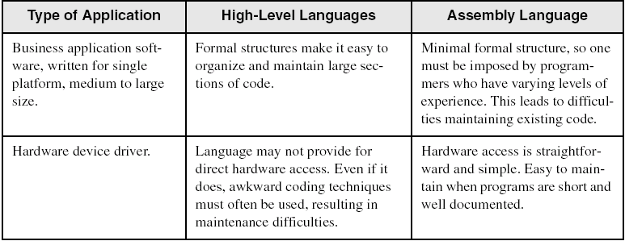
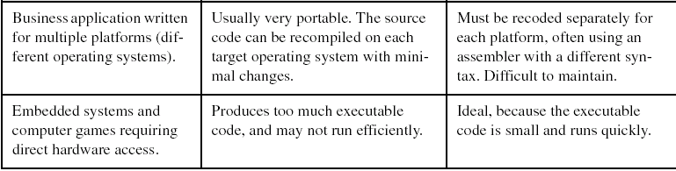
Comparing ASM to High-Level Languages
Irvine, Kip R. Assembly Language for Intel-Based Computers 5/e, 2007.

Slide 21
What's Next
Welcome to Assembly Language
Virtual Machine Concept
Data Representation
Boolean Operations
Irvine, Kip R. Assembly Language for Intel-Based Computers 5/e, 2007.

Slide 22
Virtual Machine Concept
Virtual Machines
Specific Machine Levels
Irvine, Kip R. Assembly Language for Intel-Based Computers 5/e, 2007.

Slide 23
Translating Languages
English: Display the sum of A times B plus C.
C++: cout << (A * B + C);
Assembly Language:
mov eax,A
mul B
add eax,C
call WriteInt
Intel Machine Language:
A1 00000000
F7 25 00000004
03 05 00000008
E8 00500000
Irvine, Kip R. Assembly Language for Intel-Based Computers 5/e, 2007.
Notes:
An effective way to explain how a computer’s hardware and software are related is called the virtual machine concept.
To explain this concept, let us begin with the most basic function of a computer, executing programs.
A computer can usually execute programs written in its native machine language.
Each instruction in this language is simple enough to be executed using a relatively small number of electronic circuits.

Slide 24
Specific Machine Levels
(descriptions of individual levels follow . . . )
Irvine, Kip R. Assembly Language for Intel-Based Computers 5/e, 2007.
Notes:
Instruction Set Architecture (Level 2) Computer chip manufacturers design into the processor an instruction set to carry out basic operations, such as move, add, or multiply. This set of instructions is also referred to as machine language. Each machine-language instruction is executed either directly by the computer’s hardware or by a program embedded in the microprocessor
chip called a microprogram.
Assembly Language (Level 3) Above the ISA level, programming languages provide translation layers to make large-scale software development practical. Assembly language, which appears at Level 3, uses short mnemonics such as ADD, SUB, and MOV, which are easily translated to the ISA level. Assembly language programs are translated (assembled) in their entirety
into machine language before they begin to execute.
High-Level Languages (Level 4) At Level 4 are high-level programming languages such as
C, C++, and Java. Programs in these languages contain powerful statements that translate into
multiple assembly language instructions. You can see such a translation, for example, by examining the listing file output created by a C++ compiler. The assembly language code is automatically assembled by the compiler into machine language.

Slide 25
High-Level Language
Level 5
Application-oriented languages
  C++, Java, Pascal, Visual Basic . . .
Programs compile into assembly language (Level 4)
Irvine, Kip R. Assembly Language for Intel-Based Computers 5/e, 2007.

Slide 26
Assembly Language
Level 4
Instruction mnemonics that have a one-to-one correspondence to machine language
Calls functions written at the operating system level (Level 3)
Programs are translated into machine language (Level 2)
Irvine, Kip R. Assembly Language for Intel-Based Computers 5/e, 2007.

Slide 27
Operating System
Level 3
Provides services to Level 4 programs
Translated and run at the instruction set architecture level (Level 2)
Irvine, Kip R. Assembly Language for Intel-Based Computers 5/e, 2007.

Slide 28
Instruction Set Architecture
Level 2
Also known as conventional machine language
Executed by Level 1 (microarchitecture) program
Irvine, Kip R. Assembly Language for Intel-Based Computers 5/e, 2007.

Slide 29
Microarchitecture
Level 1
Interprets conventional machine instructions (Level 2)
Executed by digital hardware (Level 0)
Irvine, Kip R. Assembly Language for Intel-Based Computers 5/e, 2007.

Slide 30
Digital Logic
Level 0
CPU, constructed from digital logic gates
System bus
Memory
Implemented using bipolar transistors
next: Data Representation
Irvine, Kip R. Assembly Language for Intel-Based Computers 5/e, 2007.

Slide 31
What's Next
Welcome to Assembly Language
Virtual Machine Concept
Data Representation
Boolean Operations
Irvine, Kip R. Assembly Language for Intel-Based Computers 5/e, 2007.

Slide 32
Data Representation
Binary Numbers
  Translating between binary and decimal
Binary Addition
Integer Storage Sizes
Hexadecimal Integers
  Translating between decimal and hexadecimal
  Hexadecimal subtraction
Signed Integers
  Binary subtraction
Character Storage
Irvine, Kip R. Assembly Language for Intel-Based Computers 5/e, 2007.

Slide 33
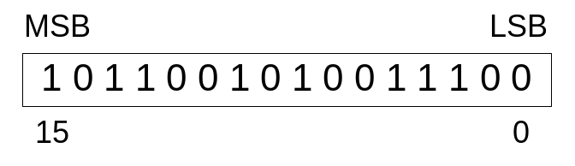
Binary Numbers
Digits are 1 and 0
  1 = true
  0 = false
MSB – most significant bit
LSB – least significant bit
Bit numbering:
Irvine, Kip R. Assembly Language for Intel-Based Computers 5/e, 2007.
Notes:
Binary numbers are base 2 numbers, in which each binary digit (called a bit) is either 0 or 1. Bits are numbered sequentially starting at zero on the right side and increasing toward the left.
The bit on the left is called the most significant bit (MSB), and the bit on the right is the least significant bit (LSB) 。

Slide 34

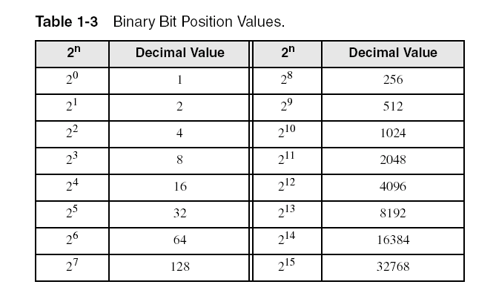
Binary Numbers
Each digit (bit) is either 1 or 0
Each bit represents a power of 2:
Every binary number is a sum of powers of 2
Irvine, Kip R. Assembly Language for Intel-Based Computers 5/e, 2007.

Slide 35
Translating Binary to Decimal
Weighted positional notation shows how to calculate the decimal value of each binary bit:
dec = (D_{n-1} × 2^{n-1}) + (D_{n-2} × 2^{n-2}) + ... + (D₁ × 2¹) + (D₀ × 2⁰)
D = binary digit
binary 00001001 = decimal 9:
(1 × 2³) + (1 × 2⁰) = 9
Irvine, Kip R. Assembly Language for Intel-Based Computers 5/e, 2007.

Slide 36
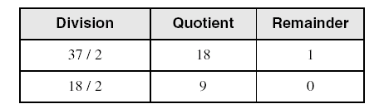
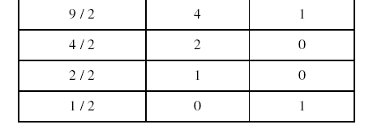
Translating Unsigned Decimal to Binary
Repeatedly divide the decimal integer by 2. Each remainder is a binary digit in the translated value:
37 = 100101
Irvine, Kip R. Assembly Language for Intel-Based Computers 5/e, 2007.

Slide 37
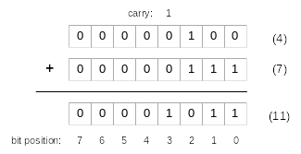
Binary Addition
Starting with the LSB, add each pair of digits, include the carry if present.
Irvine, Kip R. Assembly Language for Intel-Based Computers 5/e, 2007.

Slide 38

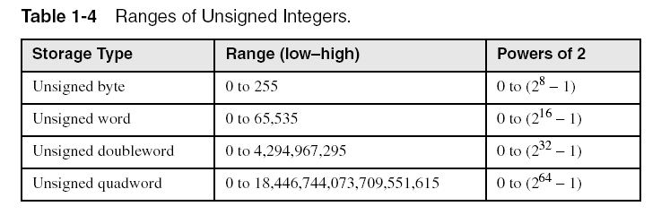
Integer Storage Sizes
Standard sizes:
What is the largest unsigned integer that may be stored in 20 bits?
Irvine, Kip R. Assembly Language for Intel-Based Computers 5/e, 2007.

Slide 39
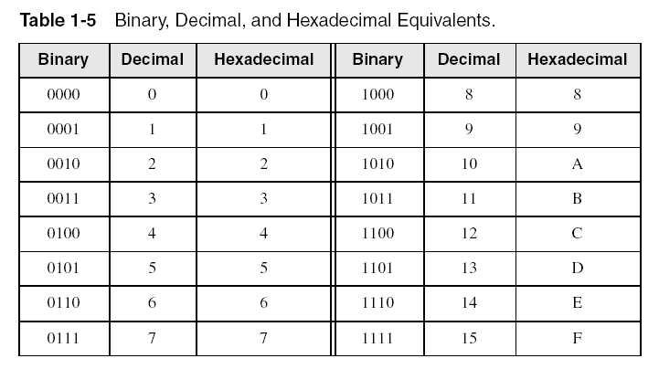
Hexadecimal Integers
Binary values are represented in hexadecimal.
Irvine, Kip R. Assembly Language for Intel-Based Computers 5/e, 2007.

Slide 40

Translating Binary to Hexadecimal
Each hexadecimal digit corresponds to 4 binary bits.
Example: Translate the binary integer 000101101010011110010100 to hexadecimal:
Irvine, Kip R. Assembly Language for Intel-Based Computers 5/e, 2007.

Slide 41
Converting Hexadecimal to Decimal
Multiply each digit by its corresponding power of 16:
  dec = (D₃ × 16³) + (D₂ × 16²) + (D₁ × 16¹) + (D₀ × 16⁰)
Hex 1234 equals (1 × 16³) + (2 × 16²) + (3 × 16¹) + (4 × 16⁰), or decimal 4,660.
Hex 3BA4 equals (3 × 16³) + (11 * 16²) + (10 × 16¹) + (4 × 16⁰), or decimal 15,268.
Irvine, Kip R. Assembly Language for Intel-Based Computers 5/e, 2007.

Slide 42
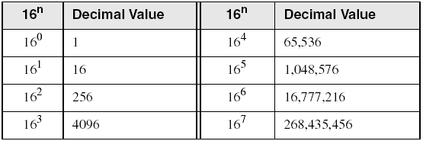
Powers of 16
Used when calculating hexadecimal values up to 8 digits long:
Irvine, Kip R. Assembly Language for Intel-Based Computers 5/e, 2007.

Slide 43
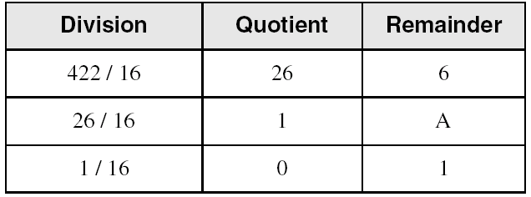
Converting Decimal to Hexadecimal
decimal 422 = 1A6 hexadecimal
Irvine, Kip R. Assembly Language for Intel-Based Computers 5/e, 2007.
Notes:
Repeatedly divide the decimal integer by 16. Each remainder is a hexadecimal digit in the translated value.

Slide 44
Hexadecimal Addition
Divide the sum of two digits by the number base (16). The quotient becomes the carry value, and the remainder is the sum digit.
1
1
36 28 28 6A
42 45 58 4B
78 6D 80 B5
21 / 16 = 1, rem 5
Important skill: Programmers frequently add and subtract the addresses of variables and instructions.
Irvine, Kip R. Assembly Language for Intel-Based Computers 5/e, 2007.

Slide 45
Hexadecimal Subtraction
When a borrow is required from the digit to the left, add 16 (decimal) to the current digit's value:
16 + 5 = 21
−1
C6 75
A2 47
24 2E
Practice: The address of var1 is 00400020. The address of the next variable after var1 is 0040006A. How many bytes are used by var1?
Irvine, Kip R. Assembly Language for Intel-Based Computers 5/e, 2007.

Slide 46
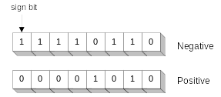
Signed Integers
The highest bit indicates the sign. 1 = negative,
0 = positive
If the highest digit of a hexadecimal integer is > 7, the value is negative. Examples: 8A, C5, A2, 9D
Irvine, Kip R. Assembly Language for Intel-Based Computers 5/e, 2007.

Slide 47
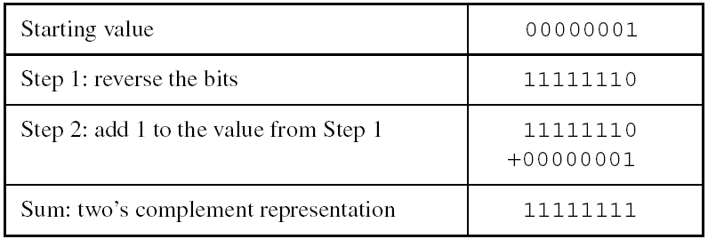
Forming the Two's Complement
Negative numbers are stored in two's complement notation
Represents the additive Inverse
Note that 00000001 + 11111111 = 00000000
Irvine, Kip R. Assembly Language for Intel-Based Computers 5/e, 2007.

Slide 48
Binary Subtraction
When subtracting A – B, convert B to its two's complement
Add A to (–B)
0 0 0 0 1 1 0 0 0 0 0 0 1 1 0 0
– 0 0 0 0 0 0 1 1 1 1 1 1 1 1 0 1
0 0 0 0 1 0 0 1
Practice: Subtract 0101 from 1001.
Irvine, Kip R. Assembly Language for Intel-Based Computers 5/e, 2007.

Slide 49
Learn How To Do the Following:
Form the two's complement of a hexadecimal integer
Convert signed binary to decimal
Convert signed decimal to binary
Convert signed decimal to hexadecimal
Convert signed hexadecimal to decimal
Irvine, Kip R. Assembly Language for Intel-Based Computers 5/e, 2007.

Slide 50
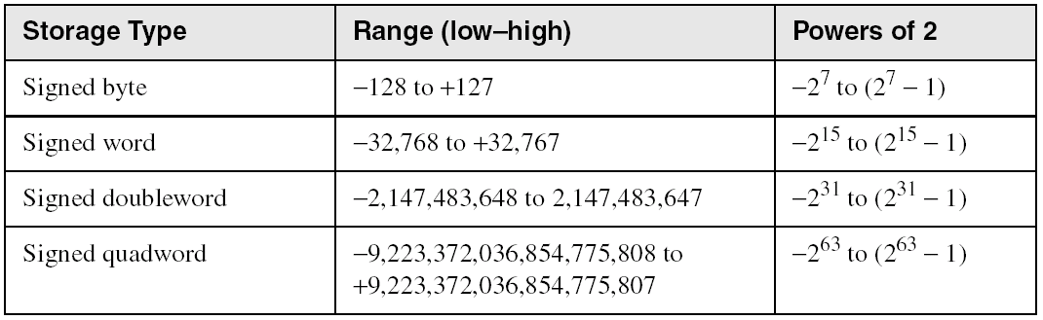
Ranges of Signed Integers
The highest bit is reserved for the sign. This limits the range:
Practice: What is the largest positive value that may be stored in 20 bits?
Irvine, Kip R. Assembly Language for Intel-Based Computers 5/e, 2007.

Slide 51
Character Storage
Character sets
  Standard ASCII (0 – 127)
  Extended ASCII (0 – 255)
  ANSI (0 – 255)
  Unicode (0 – 65,535)
Null-terminated String
  Array of characters followed by a null byte
Using the ASCII table
  back inside cover of book
Irvine, Kip R. Assembly Language for Intel-Based Computers 5/e, 2007.

Slide 52
Numeric Data Representation
pure binary
  can be calculated directly
ASCII binary
  string of digits: "01010101"
ASCII decimal
  string of digits: "65"
ASCII hexadecimal
  string of digits: "9C"
next: Boolean Operations
Irvine, Kip R. Assembly Language for Intel-Based Computers 5/e, 2007.

Slide 53
What's Next
Welcome to Assembly Language
Virtual Machine Concept
Data Representation
Boolean Operations
Irvine, Kip R. Assembly Language for Intel-Based Computers 5/e, 2007.

Slide 54
Boolean Operations
NOT
AND
OR
Operator Precedence
Truth Tables
Irvine, Kip R. Assembly Language for Intel-Based Computers 5/e, 2007.

Slide 55
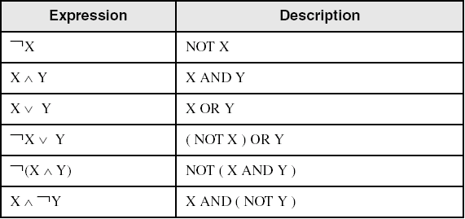
Boolean Algebra
Based on symbolic logic, designed by George Boole
Boolean expressions created from:
  NOT, AND, OR
Irvine, Kip R. Assembly Language for Intel-Based Computers 5/e, 2007.

Slide 56
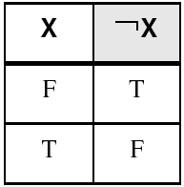
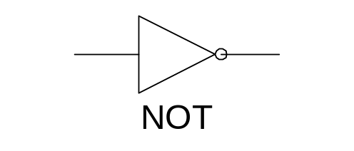
NOT
Inverts (reverses) a boolean value
Truth table for Boolean NOT operator:
Digital gate diagram for NOT:
Irvine, Kip R. Assembly Language for Intel-Based Computers 5/e, 2007.

Slide 57
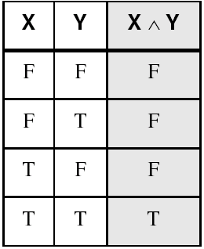
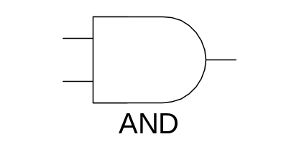
AND
Truth table for Boolean AND operator:
Digital gate diagram for AND:
Irvine, Kip R. Assembly Language for Intel-Based Computers 5/e, 2007.

Slide 58
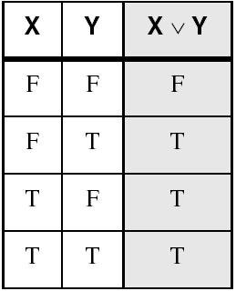
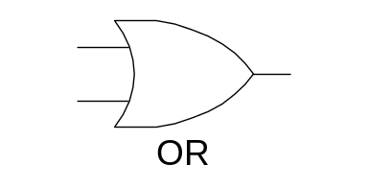
OR
Truth table for Boolean OR operator:
Digital gate diagram for OR:
Irvine, Kip R. Assembly Language for Intel-Based Computers 5/e, 2007.

Slide 59
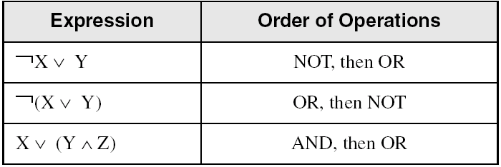
Operator Precedence
Examples showing the order of operations:
Irvine, Kip R. Assembly Language for Intel-Based Computers 5/e, 2007.

Slide 60
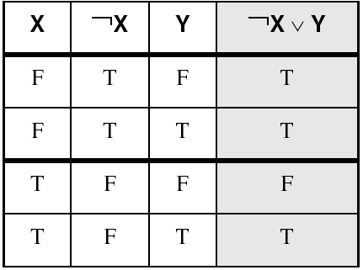
Truth Tables (1 of 3)
A Boolean function has one or more Boolean inputs, and returns a single Boolean output.
A truth table shows all the inputs and outputs of a Boolean function
Example: ¬X ∨ Y
Irvine, Kip R. Assembly Language for Intel-Based Computers 5/e, 2007.

Slide 61
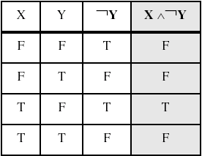
Truth Tables (2 of 3)
Example: X ∧ ¬Y
Irvine, Kip R. Assembly Language for Intel-Based Computers 5/e, 2007.

Slide 62
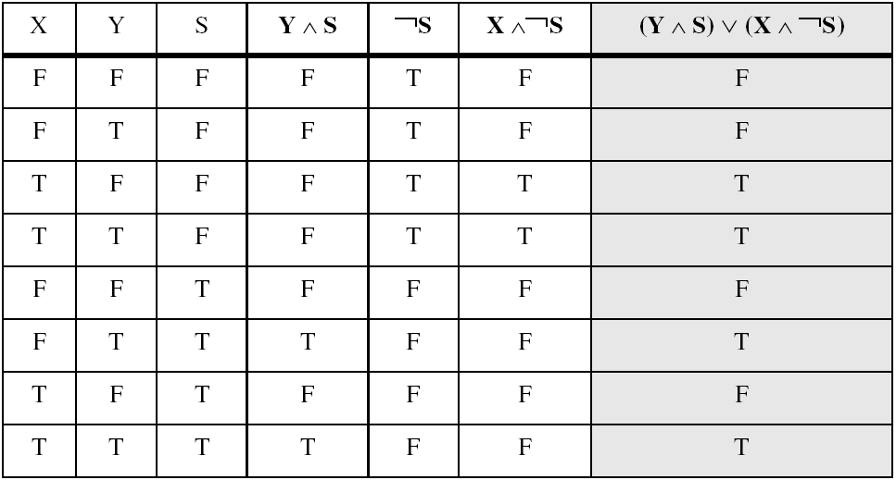
Truth Tables (3 of 3)
Example: (Y ∧ S) ∨ (X ∧ ¬S)
Two-input multiplexer
Irvine, Kip R. Assembly Language for Intel-Based Computers 5/e, 2007.

Slide 63
Summary
Assembly language helps you learn how software is constructed at the lowest levels
Assembly language has a one-to-one relationship with machine language
Each layer in a computer's architecture is an abstraction of a machine
  layers can be hardware or software
Boolean expressions are essential to the design of computer hardware and software
Irvine, Kip R. Assembly Language for Intel-Based Computers 5/e, 2007.

Slide 64

54 68 65 20 45 6E 64
What do these numbers represent?
Irvine, Kip R. Assembly Language for Intel-Based Computers 5/e, 2007.

