Slide 1
Assembly Language for Intel-Based Computers, 5th Edition
Kip R. Irvine
Chapter 5: Procedures
Slides prepared by the author
Revision date: June 4, 2006
(c) Pearson Education, 2002. All rights reserved. You may modify and copy this slide show for your personal use, or for use in the classroom, as long as this copyright statement, the author's name, and the title are not changed.

Slide 2
Chapter Overview
Linking to an External Library
The Book's Link Library
Stack Operations
Defining and Using Procedures
Program Design Using Procedures
Irvine, Kip R. Assembly Language for Intel-Based Computers 5/e, 2007.

Slide 3
The Book's Link Library
Link Library Overview
Calling a Library Procedure
Linking to a Library
Library Procedures – Overview
Six Examples
Irvine, Kip R. Assembly Language for Intel-Based Computers 5/e, 2007.

Slide 4
Link Library Overview
A file containing procedures that have been compiled into machine code
  constructed from one or more OBJ files
To build a library, . . .
  start with one or more ASM source files
  assemble each into an OBJ file
  create an empty library file (extension .LIB)
  add the OBJ file(s) to the library file, using the Microsoft LIB utility
Take a quick look at Irvine32.asm by clicking on Examples at the bottom of this screen.
Irvine, Kip R. Assembly Language for Intel-Based Computers 5/e, 2007.

Slide 5
Calling a Library Procedure
Call a library procedure using the CALL instruction. Some procedures require input arguments. The INCLUDE directive copies in the procedure prototypes (declarations).
The following example displays "1234" on the console:
INCLUDE Irvine32.inc
.code
mov eax,1234h ; input argument
call WriteHex ; show hex number
call Crlf ; end of line
Irvine, Kip R. Assembly Language for Intel-Based Computers 5/e, 2007.

Slide 6
Linking to a Library
Your programs link to Irvine32.lib using the linker command inside a batch file named make32.bat.
Notice the two LIB files: Irvine32.lib, and kernel32.lib
  the latter is part of the Microsoft Win32 Software Development Kit (SDK)
Irvine, Kip R. Assembly Language for Intel-Based Computers 5/e, 2007.

Slide 7
What's Next
Linking to an External Library
The Book's Link Library
Stack Operations
Defining and Using Procedures
Program Design Using Procedures
Irvine, Kip R. Assembly Language for Intel-Based Computers 5/e, 2007.

Slide 8
Library Procedures - Overview (1 of 4)
CloseFile – Closes an open disk file
Clrscr - Clears console, locates cursor at upper left corner
CreateOutputFile - Creates new disk file for writing in output mode
Crlf - Writes end of line sequence to standard output
Delay - Pauses program execution for n millisecond interval
DumpMem - Writes block of memory to standard output in hex
DumpRegs – Displays general-purpose registers and flags (hex)
GetCommandtail - Copies command-line args into array of bytes
GetMaxXY - Gets number of cols, rows in console window buffer
GetMseconds - Returns milliseconds elapsed since midnight
Irvine, Kip R. Assembly Language for Intel-Based Computers 5/e, 2007.

Slide 9
Library Procedures - Overview (2 of 4)
GetTextColor - Returns active foreground and background text colors in the console window
Gotoxy - Locates cursor at row and column on the console
IsDigit - Sets Zero flag if AL contains ASCII code for decimal digit (0–9)
MsgBox, MsgBoxAsk – Display popup message boxes
OpenInputFile – Opens existing file for input
ParseDecimal32 – Converts unsigned integer string to binary
ParseInteger32 - Converts signed integer string to binary
Random32 - Generates 32-bit pseudorandom integer in the range 0 to FFFFFFFFh
Randomize - Seeds the random number generator
RandomRange - Generates a pseudorandom integer within a specified range
ReadChar - Reads a single character from standard input
Irvine, Kip R. Assembly Language for Intel-Based Computers 5/e, 2007.

Slide 10
Library Procedures - Overview (3 of 4)
ReadFromFile – Reads input disk file into buffer
ReadDec - Reads 32-bit unsigned decimal integer from keyboard
ReadHex - Reads 32-bit hexadecimal integer from keyboard
ReadInt - Reads 32-bit signed decimal integer from keyboard
ReadKey – Reads character from keyboard input buffer
ReadString - Reads string from standard input, terminated by [Enter]
SetTextColor - Sets foreground and background colors of all subsequent console text output
StrLength – Returns length of a string
WaitMsg - Displays message, waits for Enter key to be pressed
WriteBin - Writes unsigned 32-bit integer in ASCII binary format.
WriteBinB – Writes binary integer in byte, word, or doubleword format
WriteChar - Writes a single character to standard output
Irvine, Kip R. Assembly Language for Intel-Based Computers 5/e, 2007.

Slide 11
Library Procedures - Overview (4 of 4)
WriteDec - Writes unsigned 32-bit integer in decimal format
WriteHex - Writes an unsigned 32-bit integer in hexadecimal format
WriteHexB – Writes byte, word, or doubleword in hexadecimal format
WriteInt - Writes signed 32-bit integer in decimal format
WriteString - Writes null-terminated string to console window
WriteToFile - Writes buffer to output file
WriteWindowsMsg - Displays most recent error message generated by MS-Windows
Irvine, Kip R. Assembly Language for Intel-Based Computers 5/e, 2007.

Slide 12
Example 1
Clear the screen, delay the program for 500 milliseconds, and dump the registers and flags.
.code
call Clrscr
mov eax,500
call Delay
call DumpRegs
Sample output:
EAX=00000613 EBX=00000000 ECX=000000FF EDX=00000000
ESI=00000000 EDI=00000100 EBP=0000091E ESP=000000F6
EIP=00401026 EFL=00000286 CF=0 SF=1 ZF=0 OF=0
Irvine, Kip R. Assembly Language for Intel-Based Computers 5/e, 2007.

Slide 13
Example 2
Display a null-terminated string and move the cursor to the beginning of the next screen line.
.data
str1 BYTE "Assembly language is easy!",0
.code
mov edx,OFFSET str1
call WriteString
call Crlf
Irvine, Kip R. Assembly Language for Intel-Based Computers 5/e, 2007.

Slide 14
Example 2a
Display a null-terminated string and move the cursor to the beginning of the next screen line (use embedded CR/LF)
.data
str1 BYTE "Assembly language is easy!",0Dh,0Ah,0
.code
mov edx,OFFSET str1
call WriteString
Irvine, Kip R. Assembly Language for Intel-Based Computers 5/e, 2007.

Slide 15
Example 3
Display an unsigned integer in binary, decimal, and hexadecimal, each on a separate line.
IntVal = 35
.code
mov eax,IntVal
call WriteBin ; display binary
call Crlf
call WriteDec ; display decimal
call Crlf
call WriteHex ; display hexadecimal
call Crlf
Sample output:
0000 0000 0000 0000 0000 0000 0010 0011
35
23
Irvine, Kip R. Assembly Language for Intel-Based Computers 5/e, 2007.

Slide 16
Example 4
Input a string from the user. EDX points to the string and ECX specifies the maximum number of characters the user is permitted to enter.
.data
fileName BYTE 80 DUP(0)
.code
mov edx,OFFSET fileName
mov ecx,SIZEOF fileName – 1
call ReadString
A null byte is automatically appended to the string.
Irvine, Kip R. Assembly Language for Intel-Based Computers 5/e, 2007.

Slide 17
Example 5
Generate and display ten pseudorandom signed integers in the range 0 – 99. Pass each integer to WriteInt in EAX and display it on a separate line.
.code
mov ecx,10 ; loop counter
L1: mov eax,100 ; ceiling value
call RandomRange ; generate random int
call WriteInt ; display signed int
call Crlf ; goto next display line
loop L1 ; repeat loop
Irvine, Kip R. Assembly Language for Intel-Based Computers 5/e, 2007.

Slide 18
Example 6
Display a null-terminated string with yellow characters on a blue background.
.data
str1 BYTE "Color output is easy!",0
.code
mov eax,yellow + (blue * 16)
call SetTextColor
mov edx,OFFSET str1
call WriteString
call Crlf
The background color is multiplied by 16 before being added to the foreground color.
Irvine, Kip R. Assembly Language for Intel-Based Computers 5/e, 2007.

Slide 19
What's Next
Linking to an External Library
The Book's Link Library
Stack Operations
Defining and Using Procedures
Program Design Using Procedures
Irvine, Kip R. Assembly Language for Intel-Based Computers 5/e, 2007.

Slide 20
Stack Operations
Runtime Stack
PUSH Operation
POP Operation
PUSH and POP Instructions
Using PUSH and POP
Example: Reversing a String
Related Instructions
Irvine, Kip R. Assembly Language for Intel-Based Computers 5/e, 2007.

Slide 21
Runtime Stack
Imagine a stack of plates . . .
  plates are only added to the top
  plates are only removed from the top
  LIFO structure
Irvine, Kip R. Assembly Language for Intel-Based Computers 5/e, 2007.

Slide 22
Runtime Stack
Managed by the CPU, using two registers
SS (stack segment):holds a pointer to stack segment descriptor tables
  ESP (stack pointer) *:holds a 32-bit offset into some location on the stack.
* SP in Real-address mode
Irvine, Kip R. Assembly Language for Intel-Based Computers 5/e, 2007.

Slide 23
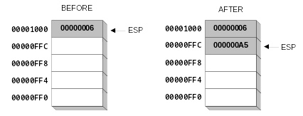
PUSH Operation (1 of 2)
A 32-bit push operation decrements the stack pointer by 4 and copies a value into the location pointed to by the stack pointer(ESP).
Irvine, Kip R. Assembly Language for Intel-Based Computers 5/e, 2007.

Slide 24
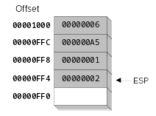
PUSH Operation (2 of 2)
Same stack after pushing two more integers:
The stack grows downward. The area below ESP is always available (unless the stack has overflowed).
Irvine, Kip R. Assembly Language for Intel-Based Computers 5/e, 2007.

Slide 25
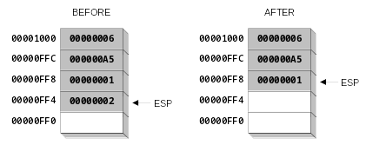
POP Operation
Copies value at stack[ESP] into a register or variable.
Adds n to ESP, where n is either 2 or 4.
  value of n depends on the attribute of the operand receiving the data
Irvine, Kip R. Assembly Language for Intel-Based Computers 5/e, 2007.

Slide 26
PUSH and POP Instructions
PUSH syntax:
  PUSH r/m16
  PUSH r/m32
  PUSH imm32
POP syntax:
  POP r/m16
  POP r/m32
Irvine, Kip R. Assembly Language for Intel-Based Computers 5/e, 2007.

Slide 27
Using PUSH and POP
Save and restore registers when they contain important values. PUSH and POP instructions occur in the opposite order.
push esi ; push registers
push ecx
push ebx
mov esi,OFFSET dwordVal ; display some memory
mov ecx,LENGTHOF dwordVal
mov ebx,TYPE dwordVal
call DumpMem
pop ebx ; restore registers
pop ecx
pop esi
Irvine, Kip R. Assembly Language for Intel-Based Computers 5/e, 2007.

Slide 28
Example: Nested Loop
When creating a nested loop, push the outer loop counter before entering the inner loop:
mov ecx,100 ; set outer loop count
L1: ; begin the outer loop
push ecx ; save outer loop count
mov ecx,20 ; set inner loop count
L2: ; begin the inner loop
;
;
loop L2 ; repeat the inner loop
pop ecx ; restore outer loop count
loop L1 ; repeat the outer loop
Irvine, Kip R. Assembly Language for Intel-Based Computers 5/e, 2007.

Slide 29
Example: Reversing a String
Use a loop with indexed addressing
Push each character on the stack
Start at the beginning of the string, pop the stack in reverse order, insert each character back into the string
Source code
Q: Why must each character be put in EAX before it is pushed?
Because only word (16-bit) or doubleword (32-bit) values can be pushed on the stack.
Irvine, Kip R. Assembly Language for Intel-Based Computers 5/e, 2007.

Slide 30
Your turn . . .
Using the String Reverse program as a starting point,
#1: Modify the program so the user can input a string containing between 1 and 50 characters.
#2: Modify the program so it inputs a list of 32-bit integers from the user, and then displays the integers in reverse order.
Irvine, Kip R. Assembly Language for Intel-Based Computers 5/e, 2007.

Slide 31
Related Instructions
PUSHFD and POPFD
  push and pop the EFLAGS register
PUSHAD pushes the 32-bit general-purpose registers on the stack
  order: EAX, ECX, EDX, EBX, ESP, EBP, ESI, EDI
POPAD pops the same registers off the stack in reverse order
  PUSHA and POPA do the same for 16-bit registers
Irvine, Kip R. Assembly Language for Intel-Based Computers 5/e, 2007.

Slide 32
Your Turn . . .
Write a program that does the following:
  Assigns integer values to EAX, EBX, ECX, EDX, ESI, and EDI
  Uses PUSHAD to push the general-purpose registers on the stack
  Using a loop, your program should pop each integer from the stack and display it on the screen
Irvine, Kip R. Assembly Language for Intel-Based Computers 5/e, 2007.

Slide 33
What's Next
Linking to an External Library
The Book's Link Library
Stack Operations
Defining and Using Procedures
Program Design Using Procedures
Irvine, Kip R. Assembly Language for Intel-Based Computers 5/e, 2007.

Slide 34
Defining and Using Procedures
Creating Procedures
Documenting Procedures
Example: SumOf Procedure
CALL and RET Instructions
Nested Procedure Calls
Local and Global Labels
Procedure Parameters
Flowchart Symbols
USES Operator
Irvine, Kip R. Assembly Language for Intel-Based Computers 5/e, 2007.

Slide 35
Creating Procedures
Large problems can be divided into smaller tasks to make them more manageable
A procedure is the ASM equivalent of a Java or C++ function
Following is an assembly language procedure named sample:
sample PROC
  .
  .
  ret
sample ENDP
Irvine, Kip R. Assembly Language for Intel-Based Computers 5/e, 2007.

Slide 36
Documenting Procedures
Suggested documentation for each procedure:
A description of all tasks accomplished by the procedure.
Receives: A list of input parameters; state their usage and requirements.
Returns: A description of values returned by the procedure.
Requires: Optional list of requirements called preconditions that must be satisfied before the procedure is called.
If a procedure is called without its preconditions satisfied, it will probably not produce the expected output.
Irvine, Kip R. Assembly Language for Intel-Based Computers 5/e, 2007.

Slide 37
Example: SumOf Procedure
;---------------------------------------------------------
SumOf PROC
;
; Calculates and returns the sum of three 32-bit integers.
; Receives: EAX, EBX, ECX, the three integers. May be
; signed or unsigned.
; Returns: EAX = sum, and the status flags (Carry,
; Overflow, etc.) are changed.
; Requires: nothing
;---------------------------------------------------------
  add eax,ebx
  add eax,ecx
  ret
SumOf ENDP
Irvine, Kip R. Assembly Language for Intel-Based Computers 5/e, 2007.

Slide 38
CALL and RET Instructions
The CALL instruction calls a procedure
  pushes offset of next instruction on the stack
  copies the address of the called procedure into EIP
The RET instruction returns from a procedure
  pops top of stack into EIP
Irvine, Kip R. Assembly Language for Intel-Based Computers 5/e, 2007.

Slide 39
CALL-RET Example (1 of 2)
main PROC
  00000020 call MySub
  00000025 mov eax,ebx
  .
  .
main ENDP
MySub PROC
  00000040 mov eax,edx
  .
  .
  ret
MySub ENDP
0000025 is the offset of the instruction immediately following the CALL instruction
00000040 is the offset of the first instruction inside MySub
Irvine, Kip R. Assembly Language for Intel-Based Computers 5/e, 2007.

Slide 40

CALL-RET Example (2 of 2)
The CALL instruction pushes 00000025 onto the stack, and loads 00000040 into EIP
The RET instruction pops 00000025 from the stack into EIP
(stack shown before RET executes)
Irvine, Kip R. Assembly Language for Intel-Based Computers 5/e, 2007.

Slide 41
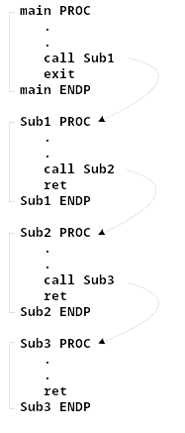
Nested Procedure Calls
By the time Sub3 is called, the stack contains all three return addresses:
Irvine, Kip R. Assembly Language for Intel-Based Computers 5/e, 2007.

Slide 42
Local and Global Labels
A local label is visible only to statements inside the same procedure. A global label is visible everywhere.
main PROC
jmp L2 ; error
L1:: ; global label
exit
main ENDP
sub2 PROC
L2: ; local label
jmp L1 ; ok
ret
sub2 ENDP
Irvine, Kip R. Assembly Language for Intel-Based Computers 5/e, 2007.

Slide 43
Procedure Parameters (1 of 3)
A good procedure might be usable in many different programs
  but not if it refers to specific variable names
Parameters help to make procedures flexible because parameter values can change at runtime
Irvine, Kip R. Assembly Language for Intel-Based Computers 5/e, 2007.

Slide 44
Procedure Parameters (2 of 3)
The ArraySum procedure calculates the sum of an array. It makes two references to specific variable names:
ArraySum PROC
  mov esi,0 ; array index
  mov eax,0 ; set the sum to zero
mov ecx,LENGTHOF myarray ; set number of elements
L1: add eax,myArray[esi] ; add each integer to sum
  add esi,4 ; point to next integer
  loop L1 ; repeat for array size
  mov theSum,eax ; store the sum
ret
ArraySum ENDP
What if you wanted to calculate the sum of two or three arrays within the same program?
Irvine, Kip R. Assembly Language for Intel-Based Computers 5/e, 2007.

Slide 45
Procedure Parameters (3 of 3)
This version of ArraySum returns the sum of any doubleword array whose address is in ESI. The sum is returned in EAX:
ArraySum PROC
; Receives: ESI points to an array of doublewords,
; ECX = number of array elements.
; Returns: EAX = sum
;-----------------------------------------------------
  mov eax,0 ; set the sum to zero
L1: add eax,[esi] ; add each integer to sum
  add esi,4 ; point to next integer
  loop L1 ; repeat for array size
ret
ArraySum ENDP
Irvine, Kip R. Assembly Language for Intel-Based Computers 5/e, 2007.

Slide 46
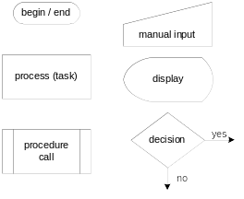
Flowchart Symbols
The following symbols are the basic building blocks of flowcharts:
(Includes two symbols not listed on page 166 of the book.)
Irvine, Kip R. Assembly Language for Intel-Based Computers 5/e, 2007.

Slide 47
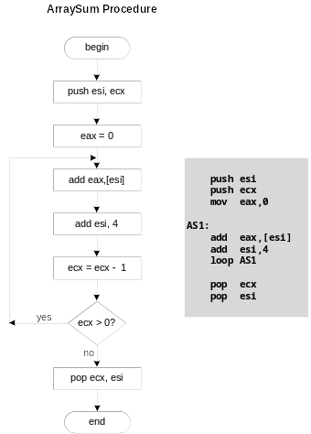
Flowchart for the ArraySum Procedure
Irvine, Kip R. Assembly Language for Intel-Based Computers 5/e, 2007.

Slide 48
Your turn . . .
Draw a flowchart that expresses the following pseudocode:
  input exam grade from the user
  if( grade > 70 )
  display "Pass"
  else
  display "Fail"
  endif
Irvine, Kip R. Assembly Language for Intel-Based Computers 5/e, 2007.

Slide 49
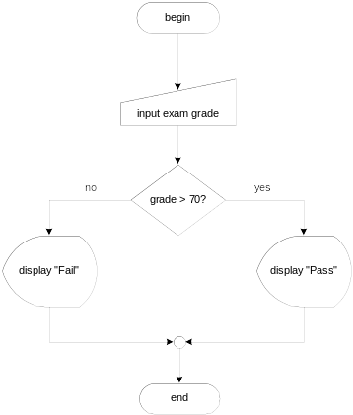
. . . (Solution)
Irvine, Kip R. Assembly Language for Intel-Based Computers 5/e, 2007.

Slide 50
Your turn . . .
Modify the flowchart in the previous slide to allow the user to continue to input exam scores until a value of –1 is entered
Irvine, Kip R. Assembly Language for Intel-Based Computers 5/e, 2007.

Slide 51
USES Operator
Lists the registers that will be preserved
ArraySum PROC USES esi ecx
mov eax,0 ; set the sum to zero
etc.
MASM generates the code shown in gold:
ArraySum PROC
push esi
push ecx
.
.
pop ecx
pop esi
ret
ArraySum ENDP
Irvine, Kip R. Assembly Language for Intel-Based Computers 5/e, 2007.

Slide 52
When not to push a register
The sum of the three registers is stored in EAX on line (3), but the POP instruction replaces it with the starting value of EAX on line (4):
SumOf PROC ; sum of three integers
  push eax ; 1
  add eax,ebx ; 2
  add eax,ecx ; 3
  pop eax ; 4
  ret
SumOf ENDP
Irvine, Kip R. Assembly Language for Intel-Based Computers 5/e, 2007.

Slide 53
What's Next
Linking to an External Library
The Book's Link Library
Stack Operations
Defining and Using Procedures
Program Design Using Procedures
Irvine, Kip R. Assembly Language for Intel-Based Computers 5/e, 2007.

Slide 54
Program Design Using Procedures
Top-Down Design (functional decomposition) involves the following:
  design your program before starting to code
  break large tasks into smaller ones
  use a hierarchical structure based on procedure calls
  test individual procedures separately
Irvine, Kip R. Assembly Language for Intel-Based Computers 5/e, 2007.

Slide 55
Integer Summation Program (1 of 4)
Description: Write a program that prompts the user for multiple 32-bit integers, stores them in an array, calculates the sum of the array, and displays the sum on the screen.
Main steps:
Prompt user for multiple integers
Calculate the sum of the array
Display the sum
Irvine, Kip R. Assembly Language for Intel-Based Computers 5/e, 2007.

Slide 56
Procedure Design (2 of 4)
Main
Clrscr ; clear screen
PromptForIntegers
WriteString ; display string
ReadInt ; input integer
ArraySum ; sum the integers
DisplaySum
WriteString ; display string
WriteInt ; display integer
Irvine, Kip R. Assembly Language for Intel-Based Computers 5/e, 2007.

Slide 57
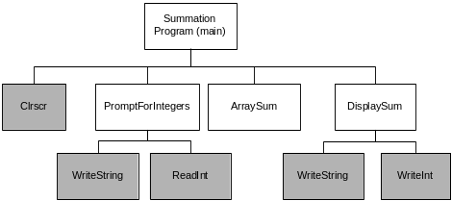
Structure Chart (3 of 4)
gray indicates library procedure
View the stub program
View the final program
Irvine, Kip R. Assembly Language for Intel-Based Computers 5/e, 2007.

Slide 58
Sample Output (4 of 4)
Enter a signed integer: 550
Enter a signed integer: -23
Enter a signed integer: -96
The sum of the integers is: +431
Irvine, Kip R. Assembly Language for Intel-Based Computers 5/e, 2007.

Slide 59
Summary
Procedure – named block of executable code
Runtime stack – LIFO structure
  holds return addresses, parameters, local variables
  PUSH – add value to stack
  POP – remove value from stack
Use the Irvine32 library for all standard I/O and data conversion
  Want to learn more? Study the library source code in the c:\Irvine\Examples\Lib32 folder
Irvine, Kip R. Assembly Language for Intel-Based Computers 5/e, 2007.

Slide 60

The End
Irvine, Kip R. Assembly Language for Intel-Based Computers 5/e, 2007.

